Slide 1

Literature Research
for
IMMD Ver.2 Design
Mesut Uğur
06/10/2018
mesut.ugur@metu.edu.tr

Slide 2
Content
Types of faults in a motor drive
Fault tolerant topologies (non-modular)
Fault tolerant topologies (modular)
Isolation requirements
Short circuit current and inductance
Stator winding configurations for a modular machine
Multi-phase modular machines
Fault detection
Applications
High speed machines - evaluation
Fractional Slot Concentrated Winding machines (Windings, Slots, Poles etc.)

Slide 3
Types of faults
Winding open-circuit faults
Winding short-circuit faults;
inter-turn short-circuit faults,
coil to coil faults,
line to line faults
line to ground faults
Transistor short-circuit faults
Transistor open circuit faults
DC bus capacitor faults.
Power supply failure or AC line fault in mains supplied rectifier
Sensor failure.
Control equipment failure
Bearing faults.
Static and dynamic eccentricity conditions (due to a bent shaft or a shaft misalignment).
Gearbox faults in non direct-driven machines.

Slide 4
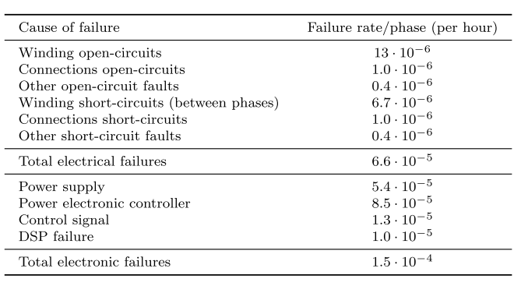
Failure Rates

Slide 5
Open circuit faults
Winding open-circuit faults:
among the most common faults.
caused as a consequence of:
the internal interruption of the motor windings
mechanical faults at the machine terminals
mechanical stresses on the connectors that link the motor and the inverter
by an electrical failure on an inverter phase leg
leads to the inability to produce a standard 3-phase constant magnitude rotating magnetic field
causes large torque pulsations, mainly at twice the frequency of the supply signal

Slide 6
Short circuit faults
Majority of stator winding faults begin as insulation breakdown failures that lead to a short-circuit between several turns of a phase winding.
causes a large circulating current that generates a high amount of heat to be locally released within a short time.
If undetected, inter-turn short-circuit faults rapidly propagate to neighboring turns, culminating in major faults such as coil to coil, phase to phase, phase to ground or open-circuit faults
Winding short-circuit faults involving the whole phase winding:
may happen as a consequence of
the closing of all the high side or low side switches of the inverter,
a DC bus short-circuit,
a short-circuit between machine terminals in the terminal box
physical damage on the cables connecting the motor and the inverter
FSCW’lerde, özellikle alternate teeth ise, phase-to-phase olması zor.
Slotta olan fault slotta kalır ☺
All-tooth ise, aynı slottaki sargıları iyi izole ederek sağlanabilir. End-winding’ler zaten değmeyecek.

Slide 7
Transistor open circuit
One of the most common inverter faults involves the permanent opening of a power semiconductor switch
due to damage to the transistor itself or the control logic commanding the gate signals.
current in the corresponding inverter leg is allowed to flow only during part of electrical cycle,
either through the other transistor or through the associated free-wheeling diode (bu GaN’da olmayacak mesela)
leading to a DC component in the phase currents and pulsations in the torque waveform
may remain undetected for a long time

Slide 8
Transistor short circuit
Transistor short-circuit faults usually occurs as a consequence of a single power semiconductor switch being permanently damaged.
The damage may be due to
a short-circuit fault in the associated free-wheeling diode
presence of impurities in the fabrication process may also trigger the short-circuiting of the power semiconductor switch.
erroneous control signals caused by driver malfunction
auxiliary power supply failure
electromagnetic disturbance
control software errors
serious fault condition that demands immediate remedial action
the other switch in the same leg has to be opened within a few µs
As a consequence of the fault, high magnitude DC current components that are mainly limited by the stator resistance appear in all the phases
poses a risk in terms of
current withstand capability of the remaining healthy transistors,
winding overheating
PM demagnetization
An extremely high and oscillating torque is produced

Slide 9
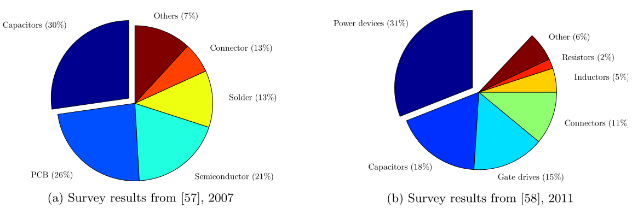
Fault Fun Facts
Among the stator related faults (37%), 23% were due to failures of the ground insulation and 4% due to turn insulation faults. (1982)
In slow speed motors (up to 720 rpm), the main cause of machine failure were failures in the stator windings. (1985)
Stator winding faults amounted to be around a 25% of all the machine faults. (1995)
Faults in the control circuit of the drive may account to 53% of the total faults; 38% and 7% of the faults corresponding to the power part and external auxiliaries, respectively. (1995)
Bu normal
Burda nasıl fault oluyor?
Much lower than expected

Slide 10
Fault Tolerance (PMSM)
The drive must be able to withstand a temporary fault (e.g. a short-circuit fault) without being damaged: «the different drive elements have a high degree of isolation between them»
The drive must be capable of operating in fault-conditions with a minimum level of performance: «having multiple independent phases or redundant drive elements»

Slide 11
Fault Tolerant Topologies (Standard motor)
Switch-redundant topologies.
An additional leg connected to the neutral point.
An additional redundant leg.
Full H-bridge/cascaded inverters.
Adoption of a delta connection
Use of direct AC/AC matrix converters
Employ current servo amplifiers
All methods require a reconfiguration of both the hardware and the software of the system once a fault has occurred.

Slide 12
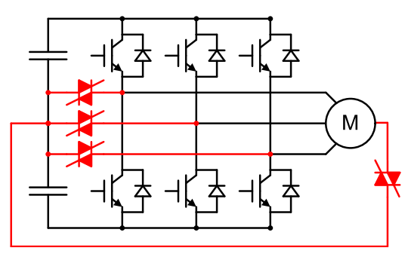
Switch Redundant Topology
TRIACs
SCRs
Power switch open-circuit
Power switch short-circuit
Winding open-circuit

Slide 13
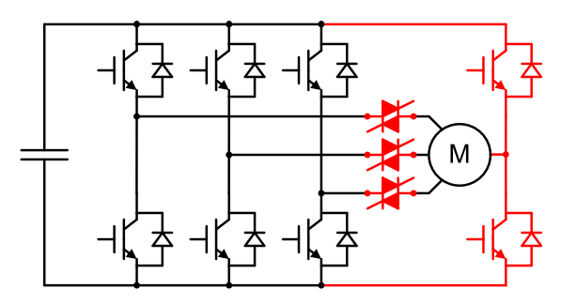
Additional leg (neutral)
Power switch open-circuit
Power switch short-circuit
Winding open-circuit

Slide 14
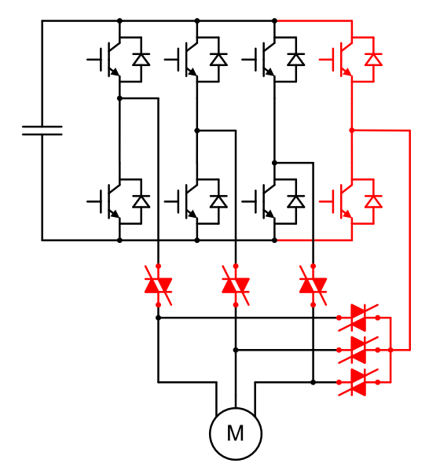
Additional leg (redundant)
Power switch open-circuit
Power switch short-circuit

Slide 15
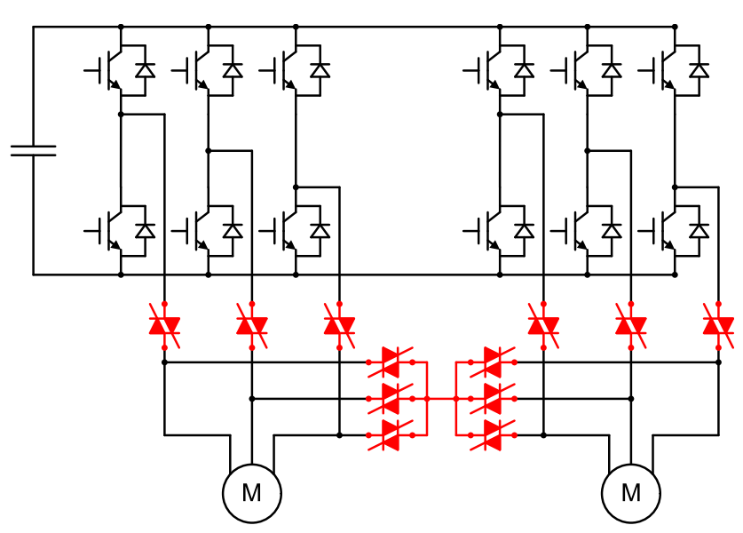
Redundant VSI
Configured to 5-leg
Power switch open-circuit
Power switch short-circuit

Slide 16
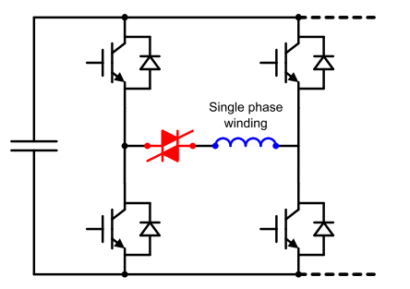
H-bridge Drive
Power switch open-circuit
Winding open-circuit
Due to the increased device count, inverter switching losses increase during normal operation.
Since the semiconductor devices must withstand the phase voltage rather than the line voltage, the power device voltage ratings are reduced and switching losses may even decrease; which, in turn, reduces the heat sink requirements.
For a 3-phase system, the volt-amperes rating of a full H-bridge inverter is 2/√3 times that of a half-bridge inverter, as the number of power switches doubles, but each switch must withstand only the phase voltage instead of the line voltage.

Slide 17
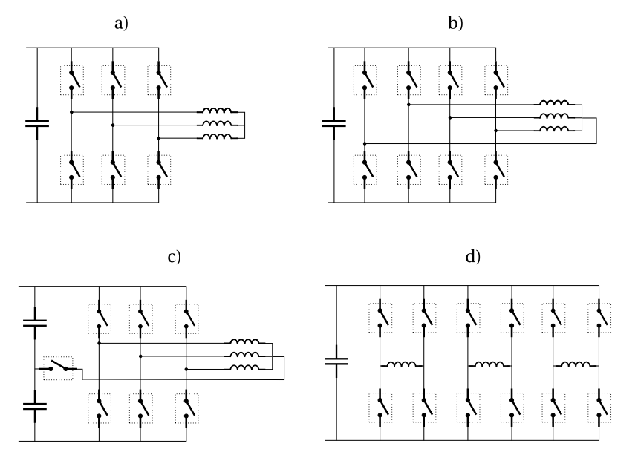
Fault Tolerant Topologies for 3-phase drives
Redundant bridge arm
The product of the number of switches and the rating of each switch (V·I) is increased by a factor 1.15 compared to conventional
Conventional
A phase can be completely short circuited to limit the short circuit current in case of a turn to turn short circuit fault, while it is still possible to control the two remaining phases.
Solution with less switch number

Slide 18
Fault Tolerant Topologies
Magnetic coupling between modules should be analyzed. «In any case, it must be noted that, unless the magnetic coupling between phases is eliminated, no truly independent operation of the individual phases is possible, which may result in an undesirable pulsating torque in the machine.» Buna gelicez.
Limit the short circuit current. Inductance calculation is necessary. Buna da gelicez.
Core loss and magnet loss calculation. Kanayan yara ?
Fault’ta DC bara nasıl davranıyor, incelemeye değer.
The power converter must be equipped with the necessary means to quickly detect and respond to several fault conditions; including, winding open-circuit faults, short-circuit faults, power transistor faults, etc. Fault’lar incelenmeye başlandı.
IMMD Ver.2’de protection devresi şart oğlu şart…

Slide 19
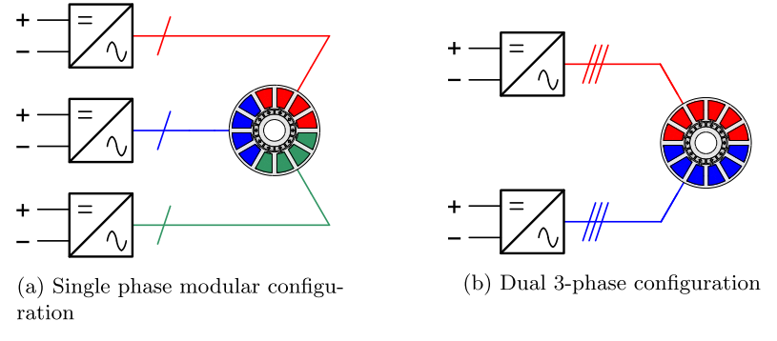
Fault Tolerant Topologies with Modular Motor
Two distinct approaches are usually considered:
Each machine phase is regarded as a single module and the drive is designed so that every phase operates independently. (a)
The second procedure is to have various sets of isolated 3-phase windings that are independently supplied. (b)

Slide 20
Fault Tolerant Topologies with Modular Motor
Single phase: It is required that it is magnetically, electrically, thermally and physically isolated from the rest of phases. These isolation requirements must be fulfilled both at the machine and at the power converter side.
Three phase: In case of a phase fault, the corresponding 3-phase winding is isolated and the drive continues to operate with a reduced power.
The multiple stator windings can be arranged as:
EMF phasor distribution of each 3-phase set is the same (bu bizim durum)
Currents are in-phase
Lower contact between modules
Less mutual coupling
There is an angular displacement between the EMF phasors belonging to different sets (bu uygulasak mı dediğimiz yapı)
Winding sets shifted by an electrical angle of π/3n
Supplied by currents with a delay of 1/6n of a period
Overlapped windings (nötrden?)
Can be supplied as a 3n-phase system: Increase in the winding factor and a reduction of the air-gap MMF harmonic content (torque ripple, rotor losses)

Slide 21
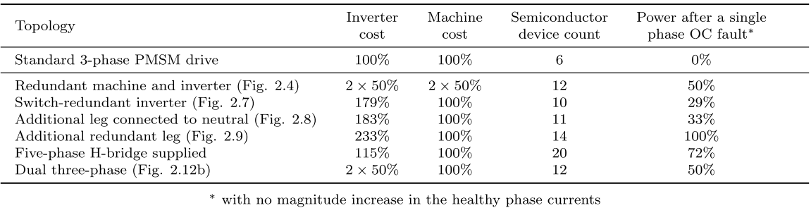
Fault Tolerant Topologies - Comparison
the only one able to sustain multiple electrical faults
Actual cost is higher
can also tolerate more than one electrical fault in different modules when the number of 3-phase winding sets is higher than two.
Bizim durum olabilirmiş, 2-seri, 2-paralel olmasa…

Slide 22
Gelelim winding short circuit mevzusuna (PMSM)
One common approach is to design the PM machine with a high enough phase inductance so as to limit the short-circuit currents to a given threshold.
As a consequence, the power factor at healthy conditions is low.
It must be ensured that the magnetic coupling between machine phases is reduced in order for the current in the faulted phase not to affect the flux linked by the remaining healthy phases.
The braking torque arising from a winding short-circuit fault is another aspect that must be taken into consideration; specially at low speeds.
Different approach: Machines with the magnets located in the stator and different kinds of actuators in order to reduce the PM flux linkage.

Slide 23
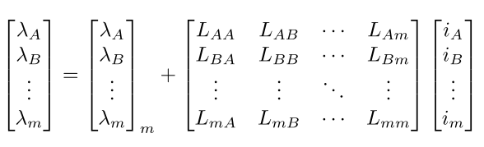
Nedir bu isolation mevzusu ?
Magnetic isolation: Bildiğimiz mutual inductance
Techniques to reduce the mutual inductance:
To employ certain winding configurations that inherently lead to a negligible coupling
In case of SM-PM machines, the air-gap component of the mutual inductance between phases can be reduced with deep magnets together with a nonmagnetic retaining sleeve
In order to reduce the slot leakage component of the mutual inductance, each slot must contain only coils belonging to a single phase. (Bu alternate teeth heralde)
Kendime not: Bizim tasarım ne derece magnetically isolated, Maxwell’de deneyebiliriz. Şöyle ki, sırayla sadece belli fazlara akım versek, diğer fazların (veya modüllerin) endüklenen gerilimlerinde ne kadar değişim olduğuna bakılabilir.
Kendime not: Bizim tasarımı (24 slot) bi de alternate teeth ile denesek mi? Hem performansı vs. nasıl değişiyor hem de yukardakiyle aynı yöntemle mutual coupling ne kadar değişiyor bakılabilir.

Slide 24
Nedir bu isolation mevzusu ?
Electrical isolation: a power switch or winding short-circuit fault may cause the neutral point of the star connection to rise to the DC link voltage, so that the ability to deliver a net torque is lost.
By employing a full H-bridge inverter, each machine phase becomes electrically independent and an additional degree of freedom for machine supply is gained
Although the use of a full H-bridge inverter doubles the number of power semiconductor switches, it only slightly increases the volt-amperes rating of the inverter, as each power switch needs to withstand only the phase voltage instead of the line voltage in a star-connected system.
A 5-phase machine supplied from a half-bridge inverter is capable of delivering a significant amount of torque with a low torque ripple, even after the loss of one phase.
Multi 3-phase’lerde bir faz gittiğinde tüm 3-faz’ı uçurmak gerekiyor. Dolayısıyla örneğin 2 modül varsa 1 faz gittiğinde güç %50’ye düşüyor.

Slide 25
Nedir bu isolation mevzusu ?
Thermal isolation: If no proper thermal isolation between phases exists, the locally generated heat will propagate to neighboring phases, jeopardizing the integrity of the healthy phase windings isolation.
In order to attain an effective thermal isolation between phases, it is necessary that
the phase windings are physically separated
a good thermal path to the cooling surface (most usually the stator outer surface) is provided
Bu konuda bir çalışma yapmak gerekir mi?
Beyin kasırgası:
Loss’un büyük kısmı copper loss olarak statorda çıkıyor. Soğumak için de en iyi yol radial olarak kasadan havaya doğru ısı transferi (diye biliyorum). Aslında back core heigh ile motorun soğuması arasında bir bağ var.
**Additionally, FSCWs are most commonly employed in high pole number machine designs, for which the multi-pole magnetic circuit with small stator yokes can lead to a significant reduction in the machine’s weight and volume. The high slot fill factor and the small stator yoke also provide for a good thermal path between the coils and the machine’s outer surface.

Slide 26
Self-inductance
In case of a terminal short-circuit fault, the short-circuit current in a PMSM is mainly limited by the d-axis inductance; specially at high speeds, when the winding reactance largely dominates over the phase resistance. (low speed’de bu iyice sıkıntı).
This requirement is usually achieved by designing the slot geometry so that a high slot leakage inductance is obtained.
 | Our Design | Required
Ephm | 81 V | 81 V
Iphm | 8.5 A | 8.5 A
Isc | 35 A | 8.5 A (1.0 pu)
Llk | 2.87 mH | Geometri
La | 0.78 mH | Arttırılabilir mi?
Ls | 3.66 mH | 15.16 mH
Power factor | 0.972 | 0.707
Angle | 13.5⁰ | 45⁰
Kabuller:
No saliency
Iphm and Ephm are in-phase
Not a coincidence !
kVA rating %40 arttı.

Slide 27
Self-inductance
Having a high phase inductance results in an increased stator iron flux, if compared to a machine with negligible inductance. This demands that the stator yoke is increased by a factor of √2. Why?
Bir önceki analizde çıkmıştı bu √2. Aslında 1.0 pu değil de arada bir değer yapılsa? Ne şiş yansın ne kebap…
Gözlem: Power factor düştükçe akım artmıyor muydu normalde? Inverter size büyüyordu falan. Önceki analizde bi gariplik var sanki. Gerilim (Vt) 83 V’tan 114 V’a çıktı. DC bara gerilimi yetmiyorsa akımı arttırmak gerekecek. Eph düşük, Iph yüksek yeni bir tasarım mı yapılacak?
H-bridge 3-phase inverter ve inductance üzerine bir analiz:
For a 3-phase system, the kVA rating of a full H-bridge inverter is 2/√3 times that of a half-bridge inverter. (15 %)
Power factor with 1.0 pu inductance is 1/√2 (41 %).
Total kVA rating increases by 2√2/√3 (63%).
The current angle with respect to the back-EMF can be advanced by ψ = 30◦.
This increases the current necessary to deliver the rated torque by a 15%, but reduces the required voltage by a 29%. kVA reduction => 18%.
In total, kVA rating is increased by 34%.

Slide 28
Self-inductance
Remarks:
Fractional-slot concentrated-windings inherently lead to high slot leakage inductances and high air-gap harmonic leakage components due to the rich harmonic content of the armature MMF distribution.
In case of single-layer FSCWs, the increased MMF harmonic content compared to double-layer windings and the higher number of conductors belonging to the same phase in each slot leads to the highest phase self-inductance values.

Slide 29
On stator configurations
3-phase (mostly), 12 slot m/c
Stator-1: All-teeth, physically modular

Slide 30
On stator configurations
3-phase (mostly), 12 slot m/c
Stator-2: All-teeth, physically modular
Nasıl bir fark var?

Slide 31
On stator configurations
3-phase (mostly), 12 slot m/c
Stator-3: All-teeth, shifted modular

Slide 32
On stator configurations
3-phase (mostly), 12 slot m/c
Stator-4: All-teeth, shifted modular

Slide 33
On stator configurations
3-phase (mostly), 12 slot m/c
Stator-5: Alternate-teeth, physically modular

Slide 34
On stator configurations
3-phase (mostly), 12 slot m/c
Stator-6: Alternate-teeth, shifted modular

Slide 35
On stator configurations
Alternate teeth (Single layer)
Higher winding factors
Higher slot fill factor (additional insulation)
Higher phase self-inductance
Lower mutual inductance
Higher physical and thermal isolation (improved fault-tolerant capability)
Easier manufacturing
All-teeth (Double layer)
The end-windings are shorter
The induced back-EMF waveform are more sinusoidal.
Lower air-gap MMF harmonic and subharmonic content (rotor losses, unbalanced radial forces, torque ripple, vibration etc.)

Slide 36
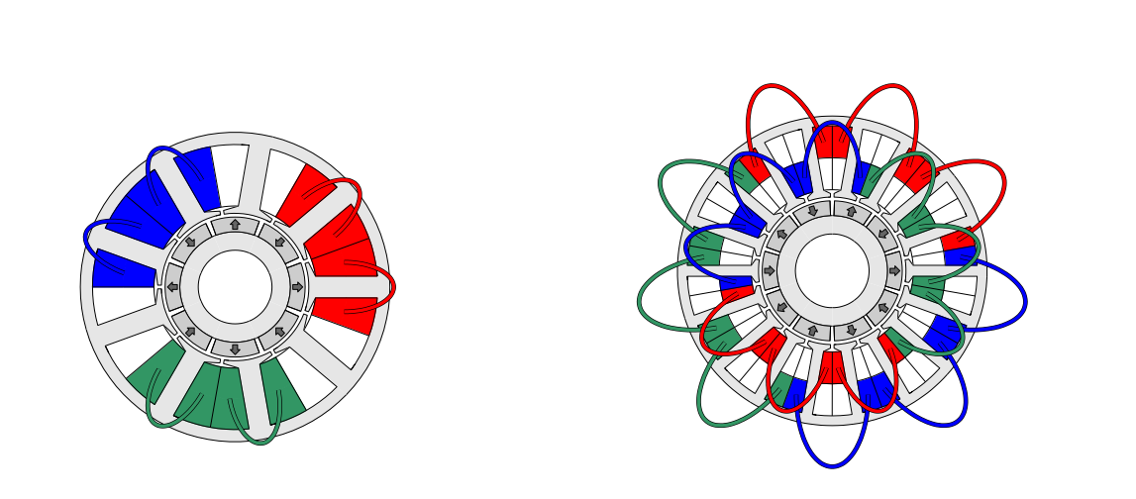
On stator configurations
Four-layer FSCW machine with yq = 2
Mixed single/double-layer

Slide 37
On stator configurations
3-phase (mostly), 12 slot m/c
Stator-7: Alternate teeth, Double stator
Mümkün mü?
Veya bunun all-teeth olanı…

Slide 38
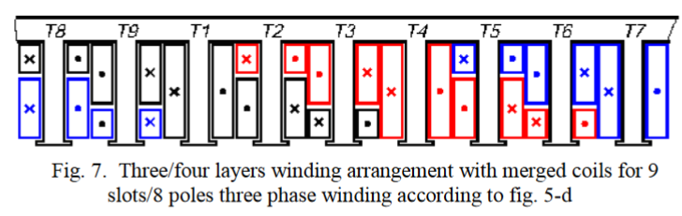
On stator configurations
Şöyle bir şey var:
M. Cistelecan, F. Ferreira, and M. Popescu, Three phase tooth-concentrated multiple-layer fractional windings with low space harmonic content," in Energy Conversion Congress and Exposition (ECCE), 2010 IEEE , Atlanta, GA, USA, September 2010, pp. 1399-1405.
Adopting a higher number of layers helps reduce:
the harmonic content of the armature MMF
the torque ripple
the rotor losses

Slide 39
On stator configurations
3-phase (mostly), 12 slot m/c
Stator-8 (proposed): All teeth, 4-phase, 3-module
Çifte modülerlik:
1-faz gittiğinde bütün modülü kapatman gerekmeyebilir.

Slide 40
On stator configurations
Stator-8 (proposed)
3-phase
4-module
4x6 = 24 transistors
1TF: 75% redundancy
2TF: 50% redundancy
3-phase
4-module
4x12 = 48 transistors
1TF: 92% redundancy
2TF: 83% redundancy
4-phase
3-module
4x6 = 24 transistors
1TF: 92% redundancy
2TF*: 83% redundancy
2TF**: 75% redundancy
* If the second phase is from another module
** If the second phase is from the same module
kVA hesaplama işi anlaşılmadı !
Redundancy hesabında dengesizlik nasıl gözetilecek?

Slide 41
On stator configurations
6-fazlı olsa mesela?
6-phase
2-module
2x12 = 24 transistors
1TF: 92% redundancy
2TF: 83% redundancy
Question:
What is the likelihood of a complete module fault? Control circuit mesela.
Bu soru aslında ‘Faz sayısını neden maksimum yapmıyoruz?’un cevabını verecek.

Slide 42
On stator configurations
Şöyle bir şey varmış:
24-slot alternate-teeth asymmetric six-phase PMSM
24-slot all-teeth asymmetric six-phase PMSM

Slide 43
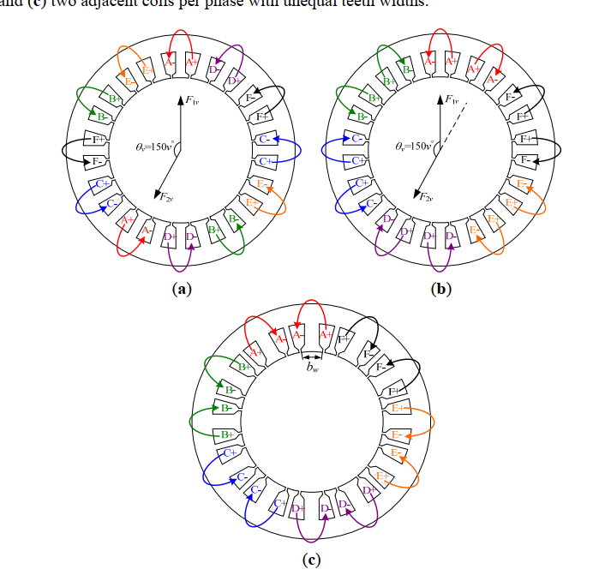
On stator configurations
two adjacent coils per phase
two coils of same phase shifting by 150 degree;
two adjacent coils per phase with unequal teeth widths

Slide 44
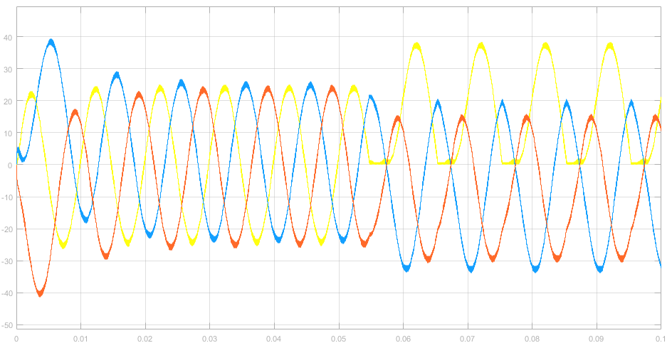
Fault Detection
Transistor open-circuit:
S1’de motor akımı varken (iletimde), S1’i kapatmaya çalıştığımızda kapanmayacaktır ?
S1’e yük binecektir (conduction loss).
Motor faz akımındaki DC’den tespit edilebilir mi?
S1

Slide 45
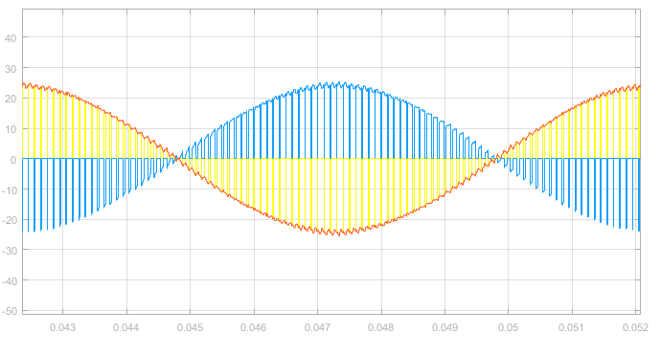
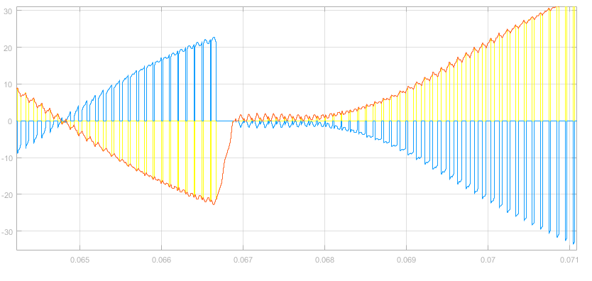
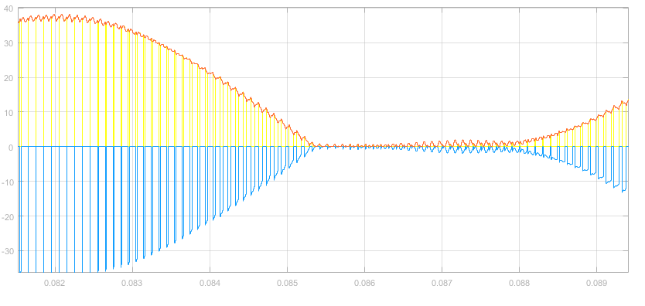
Fault Detection
Transistor open-circuit:
S1
S2
Iphase
IS1
IS2

Slide 46
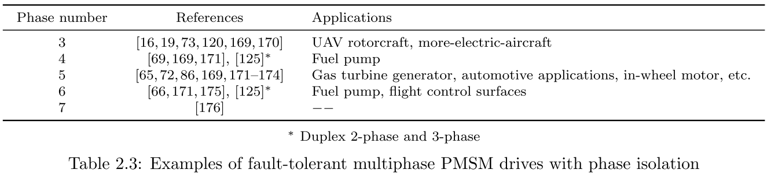
Application
This becomes of the utmost importance in safety critical applications, in which the failure of the system cannot be tolerated.
For non safety critical systems, such as those found in production industry, fault-tolerance can also bring benefits regarding increased running times and longer maintenance cycles.
Aerospace: fuel pump [62,66–69], flap and slat actuators [70–73], cabin pressure control servo-drive actuator [12], drives more-electric-aircraft in general [74–81].
Automotive: traction [82–87], X-by-wire systems (braking, steering, etc.) [65, 88, 89].
Generation: Wind turbine [90–93].
Marine: Propulsion [27, 61, 94, 95].
The use of dual-stator machine designs and redundant drive structures is common in ship propulsion applications

Slide 47
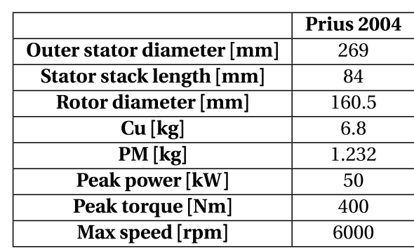
Traction ?
Pirius
Machine Volume: 4.774 l
Power density: 10.47 kW/l (peak power)
Speed: 6000 rpm
Our design
Machine Volume: 7.729 l
Power density: 1.04 kW/l (peak power)
Speed: 600 rpm
Coincidence ?
What are the limations for us for designing a high speed machine ?
Water cooling (high power)
Test setup
Mechanical parts
Tip speed
Core loss
Winding extra losses, litz wire?

Slide 48
High speed design
We are here !

Slide 49
High speed design
As the speed increases (same power):
Torque ↓
Dimensions ↓
Pole area ↓
Flux ↓ (13 kat)
Frequency ↑ (50 kat)
Coil voltage ↓ (3.5 kat)
Number of turns ↓ (3.5 kat)
Bu tasarımda aynı DC Link voltajı ve aynı modül sayısı var. Bu durumda faz gerilimi sabit. Tork çok düşmesine rağmen aynı akım var drive’da. Haliyle verimi hep aynı gidiyor.
Question: Böyle mi olmalı ?
Bu analizlerde core loss yok, yani aslında var da frekanstan etkilenmiyor.

Slide 50
High speed design
Derken GaN’ları içeren şöyle bir analiz yaptım:
60A GaN bölgesi
30A GaN bölgesi
60A GaN bölgesi
30A GaN bölgesi
En düşük 24A, en yüksek 10A faz akımı var.
Hesap: Tepe akımı x 1.5 kat marjin
Question: 60 Amperlik GaN kullansam hep, ne olur? Apart from cost…

Slide 51
High speed design
Farklı transistör seçimleri:
Margin: 2
Margin: 1.2
60A GaN bölgesi
30A GaN bölgesi
60A GaN bölgesi
30A GaN bölgesi

Slide 52
High speed design
Loss dağılımları:
Core loss’u hesaplayabilmeliyiz !

Slide 53
High speed design
Volume and Power Density:
PCB’ye tüm komponentlerin sığdığı varsayılıyor !
Reduction in motor volume is obvious.
There is no change in the capacitor volume.
Drive volume reduces since the outer stator diameter reduces.
Heat sink required thermal impedance does not change.
Heat sink length increases since area is reduced.
In total, heat sink volume is decreased. Bu yanlış olabilir ! Bunu incelemek lazım.

Slide 54
High speed design
Volume and Power Density:
Bu da böyle bir anımdır.
Tabi burada da yine aynı assumption var (PCB komponentleri sığıyor).

Slide 55
Fractional Slot Concentrated Winding Machines
The usual criteria for the choice of the number of phases, poles and slots:
Winding feasibility.
Non-overlapped coil windings
Modularity.
Winding factor.
Radial forces.
Cogging torque and torque ripple.
Rotor losses.
MMF subharmonics.
Peak armature reaction (MMF sub-harmonic ile alakalı bu da)
Self-inductance.
Mutual inductance between phases.
Number of phases.

Slide 56
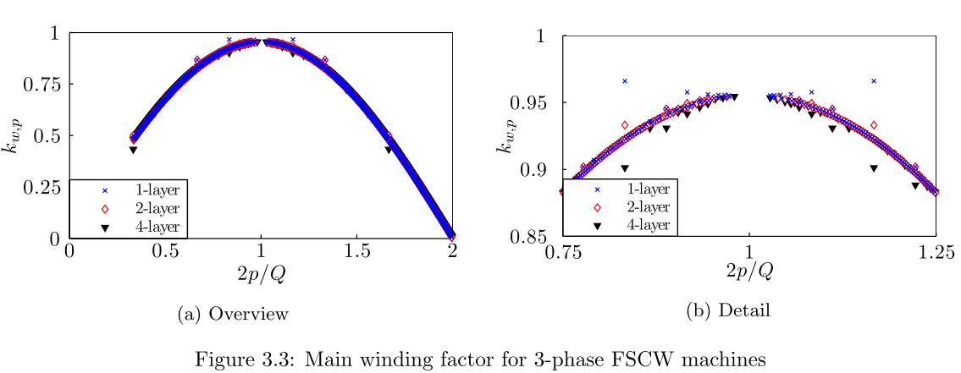
Fractional Slot Concentrated Winding Machines
Winding factor
Biz burdayız
Anladığım kadarıyla, kutup sayısı stator oluk saysına ne kadar yakın olursa o kadar yüksek kw elde ediyoruz, zaten flux linkage’ı düşününce çok mantıklı. Ama eşit yapamıyoruz çünkü cogging torque var. Bu yüzden ‘’as close as possible’’.
Biz 24/22 yapabilirmişiz aslında.
Alternate teeth yapmak da arttırıyor. Tabi modül sayısı 2 olacaktı.
30/26 motorda (1-layer), 3 fazda kw = 0.936, 5 fazda kw = 0.964.

Slide 57
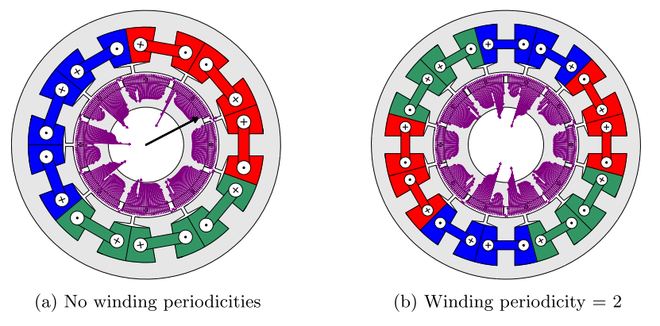
Fractional Slot Concentrated Winding Machines
Radial forces
gcd(2p,Q) > 1: Periodicity
It is 4 in our case.
1-layer, 3-phase machines.
9/8
12/10
An adequate rule to design FSCW machines with respect to the magnetic forces is that the number of winding periodicities is an even number and sufficiently high.

Slide 58
Fractional Slot Concentrated Winding Machines
Cogging torque
Np = 2p/gcd (2p,Q)
It is 5 in our case.
Having a high value of Np leads to a high frequency and low amplitude cogging torque.
!!! The requirement of having a low number of periodicities to reduce the cogging torque is detrimental to reduce the radial forces in the air-gap, so a compromise between both criteria must be met.

Slide 59
Fractional Slot Concentrated Winding Machines
Rotor losses
Rotor losses in PM machines are caused by;
the existence of flux pulsations due to the stator slots
the presence of air-gap MMF harmonics
!!! When the machine is designed with open slots and 1-layer FSCWs, the flux pulsations may be very high; specially when 2p ≈ Q and the pole-pitch is close to the slot-pitch, leading to high rotor losses.
Techniques to reduce rotor losses:
Laminated rotor
Axial and/or circumferential segmentation of the permanent-magnets ???
Use of a higher resistivity PM material (e.g. bonded vs sintered)
Shielding by copper cladding ???

Slide 60
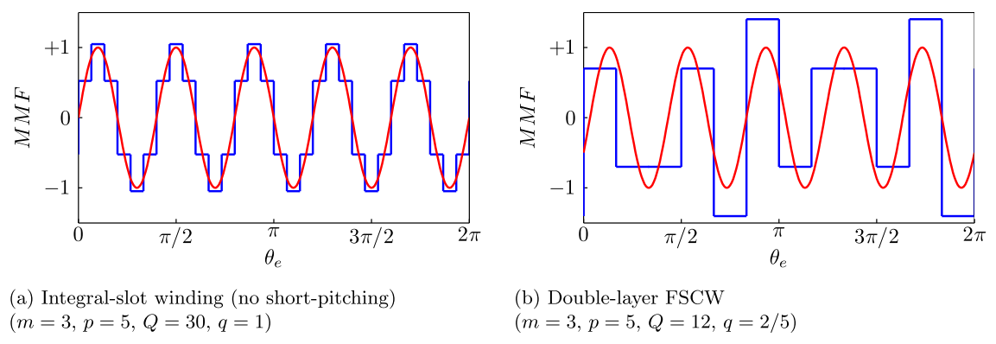
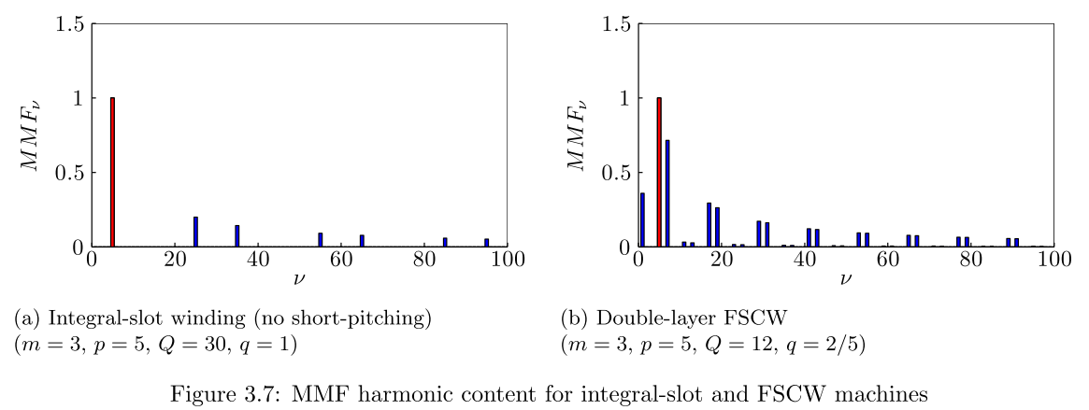
Fractional Slot Concentrated Winding Machines
Rotor losses: MMF harmonics
Integral slot vs fractional slot (bu ildiğimiz ve boyun eğdiğimiz bir şey)

Slide 61
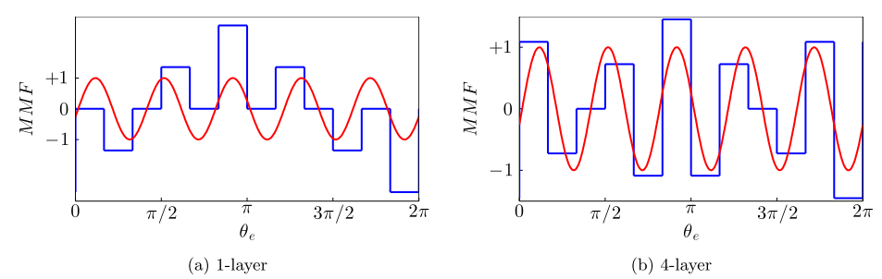
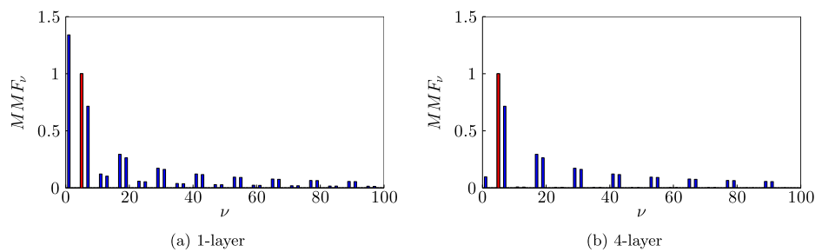
Fractional Slot Concentrated Winding Machines
Rotor losses: MMF harmonics
Layer sayısı karşılaştırması
Buradaki trade-off: isolation vs MMF harmonic content
In general terms, rotor losses tend to decrease when the number of poles and slots increase, while keeping the same 2p/Q ratio. => Qs ve p arttıkça, yüksek katman sayısının yarattığı avantaj azalıyor.

Slide 62
Fractional Slot Concentrated Winding Machines
MMF sub-harmonics
MMF subharmonics are those with harmonic order ν < p.
Almost all FSCWs, except those with q = 1/2, lead to armature MMF subharmonics
The lower the number of layers for a particular combination, the higher the MMF subharmonic content.
Sub-harmonic:
Baya farkediyor
p = 5
Have more adverse effect on rotor losses due to being low order
Another consequence of MMF subharmonics is an unbalanced saturation of the iron parts among the rotor poles.
MMF subharmonics lead to low order radial forces between the rotor and the stator of the machine.

Slide 63
Fractional Slot Concentrated Winding Machines
MMF sub-harmonics
MMF subharmonics are those with harmonic order ν < p.
Almost all FSCWs, except those with q = 1/2, lead to armature MMF subharmonics
The lower the number of layers for a particular combination, the higher the MMF subharmonic content.
Sub-harmonic:
Baya farkediyor
p = 5
Have more adverse effect on rotor losses due to being low order
Another consequence of MMF subharmonics is an unbalanced saturation of the iron parts among the rotor poles.
MMF subharmonics lead to low order radial forces between the rotor and the stator of the machine.

Slide 64
Fractional Slot Concentrated Winding Machines
MMF distribution – Our machine

Slide 65
Fractional Slot Concentrated Winding Machines
MMF distribution – Our machine
Fundamental
14
Sub-harmonic
(2)

Slide 66
Fractional Slot Concentrated Winding Machines
MMF distribution – Our machine

