Slide 1


Middle East Technical University
Department of Electrical and Electronics Engineering
Development of an Integrated Modular Motor Drive (IMMD) System
Mesut Uğur
31.05.2017

Slide 2

Research Group
Research Fields
Renewable Energy
Power Quality
Smart Grids
Power Electronics
Electrical Machines
Events
Weekly seminars
Journal Club
Research League
Multi-disciplinary
Undergraduate students
http://power.eee.metu.edu.tr

Slide 3
Outline
What is IMMD?
Why IMMD?
Challenges
DC Link Capacitor Optimization
IMMD Design
Future Work

Slide 4
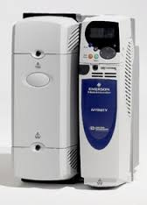
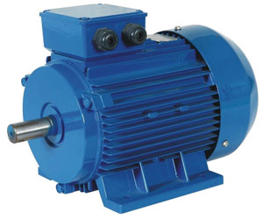
Conventional motor drives
Drives are placed in a separate cabinet
Increased volume, weight and cost
Connection with long cables
Long cable effect, EMI problems

Slide 5
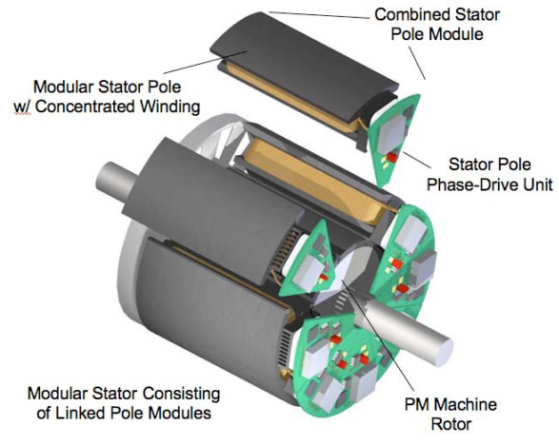
Integrated Modular Motor Drives (IMMDs)
The motor drive is integrated to the motor back-end
Both the motor and the drive are modularised

Slide 6
Motivation
Integration
Power density of the overall system is enhanced.
Voltage overshoots due to cabling effect is eliminated.
Modularization
Fault tolerance is increased.
Voltage stress on modules is reduced.
Heat dissipation is distributed to a wider area.

Slide 7
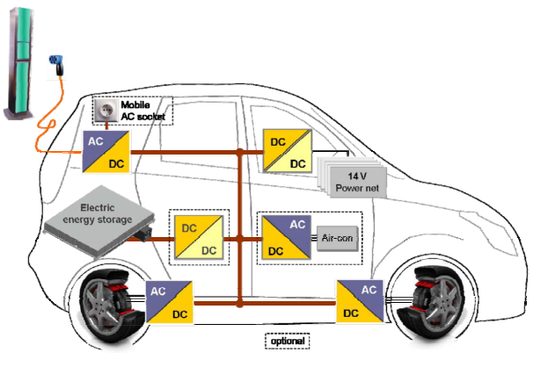
Critical Applications
Electric traction: electric vehicles, trains
Aerospace: aircrafts, space crafts

Slide 8
Challenges
Fitting into a small volume requires size reduction and optimum placement of components.
Cooling of both units should be achieved simultaneously.
Power and control electronics components are subjected to high temperature and vibration

