Slide 1


Middle East Technical University
Department of Electrical and Electronics Engineering
Development of an Integrated Modular Motor Drive (IMMD) System
Mesut Uğur
31.05.2017

Slide 2

Research Group
Research Fields
Renewable Energy
Power Quality
Smart Grids
Power Electronics
Electrical Machines
Events
Weekly seminars
Journal blub
Research League
Multi-disciplinary project
Undergraduate students
http://power.eee.metu.edu.tr

Slide 3
Outline
What is IMMD?
Why IMMD?
Challenges
DC Link Capacitor Optimization
IMMD Design
Future Work

Slide 4
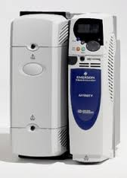
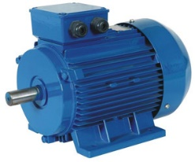
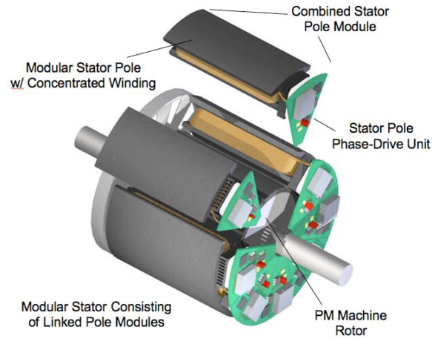
Conventional Motor Drives vs IMMD
Drives are placed in a separate cabinet
Increased volume, weight and cost
Connection with long cables
Long cable effect, EMI problems

Slide 5
Integrated Modular Motor Drives (IMMDs)
The motor drive is integrated to the motor back-end
Both the motor and the drive are modularized

Slide 6
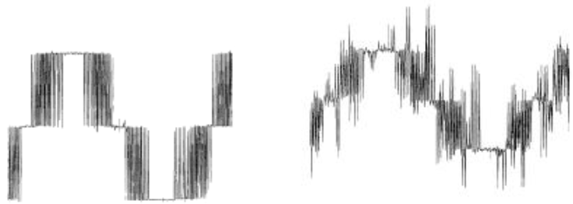
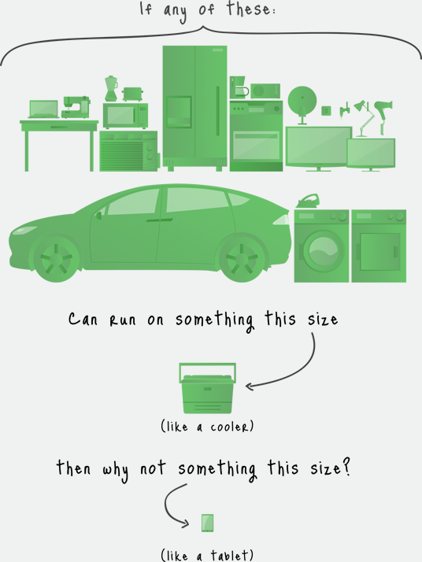
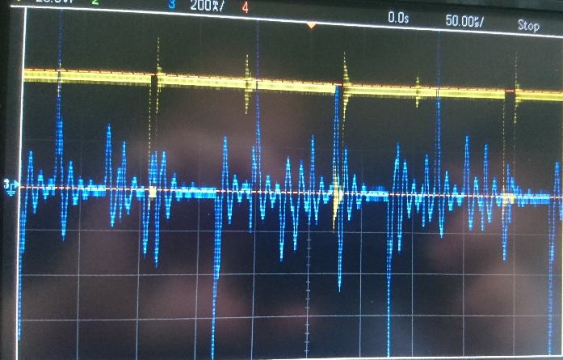
Motivation - Integration
Power density
Voltage overshoots
Motor lifetime

Slide 7
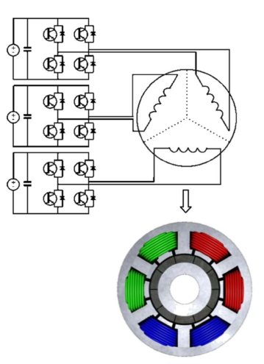
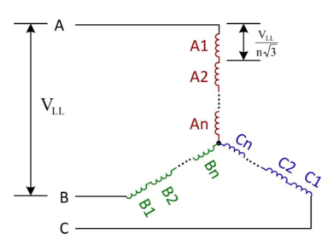
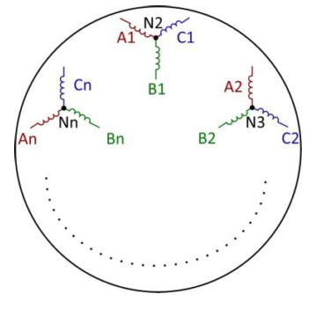
Motivation - Modularization
Increased fault tolerance
Distributed heat dissipation
Reduced voltage stress

Slide 8
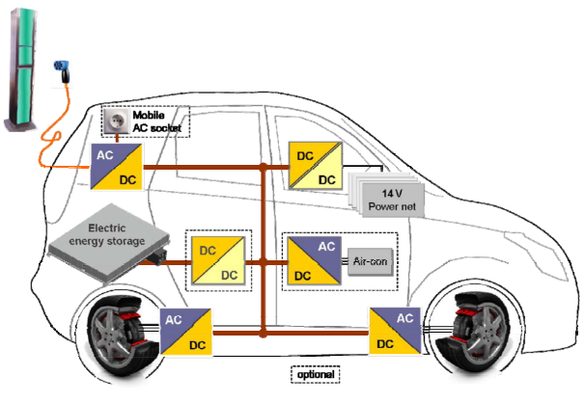
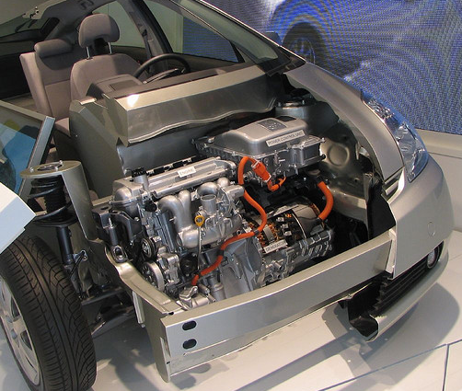
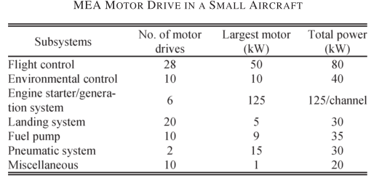
Critical Applications
Electric traction: EVs, HEVs, Trains
Aerospace: Aircrafts, Space crafts

Slide 9
Challenges
Fitting into a small volume requires size reduction and optimum placement of components.
Passive component size reduction
Heat sink size reduction
Cooling of both units should be achieved simultaneously.
Achieve superior drive efficiency
Heat distribution
Power and control electronics components are subjected to high temperature and vibration.

Slide 10
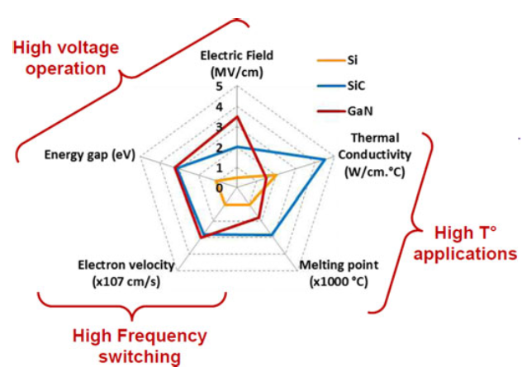
Gallium Nitride (GaN) Power Semiconductors
Wide band-gap (WBG) power semiconductor devices
Low semiconductor loss: heat sink size is reduced
High operation frequency: passive component size is reduced
High speed device
Low R_{ds_on}
Low E_{on} & E_{off}
High junction temperature
Low C_{in} and C_{out}

Slide 11
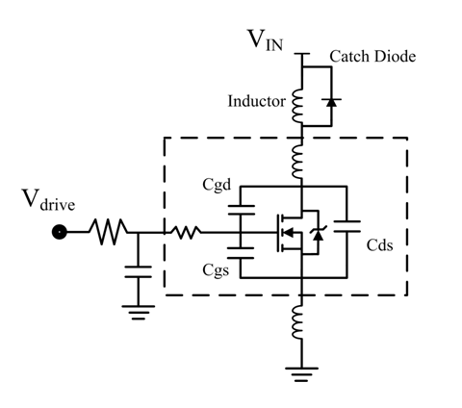
Gallium Nitride (GaN) Power Semiconductors
Parasitic components become significant
Careful layout design is required
Commercial availability
Low ratings
Reliability

Slide 12
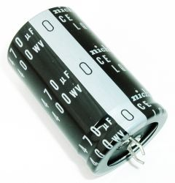
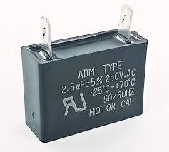
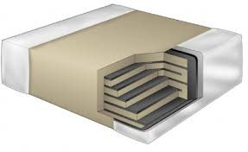
DC Link Capacitor Optimization
DC link capacitors constitute
20% of cost and weight
30% of volume
DC Link capacitor types
Electrolytic
Metal Film
Critical parameters
Capacitance per volume
RMS current per volume
Cost
ESL & ESR
Reliability & lifetime
Mechanical durability
Multi-layer ceramic (MLCC)

Slide 13
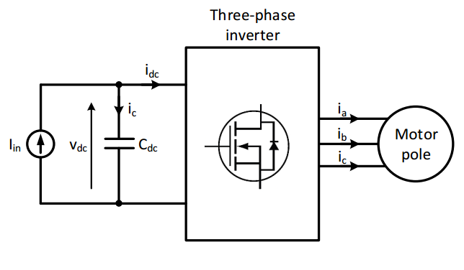
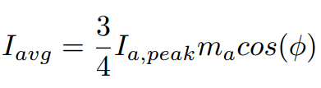

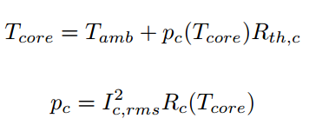
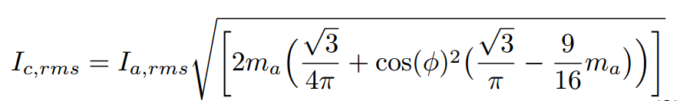
DC Link Capacitor Optimization
DC Link model
DC Link average current
DC Link ripple voltage
Capacitor heating
DC Link RMS current

Slide 14
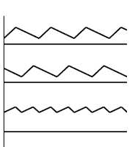
DC Link Capacitor Optimization
Effect of interleaving

Slide 15
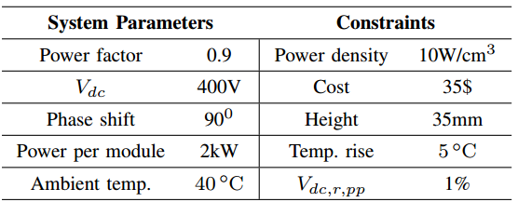
DC Link Capacitor Optimization

Slide 16
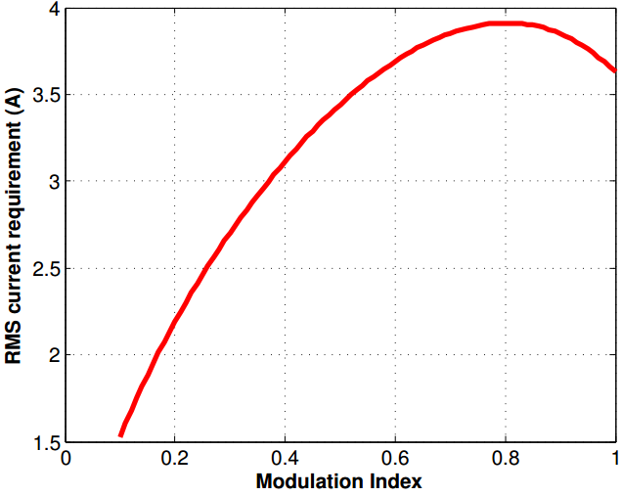
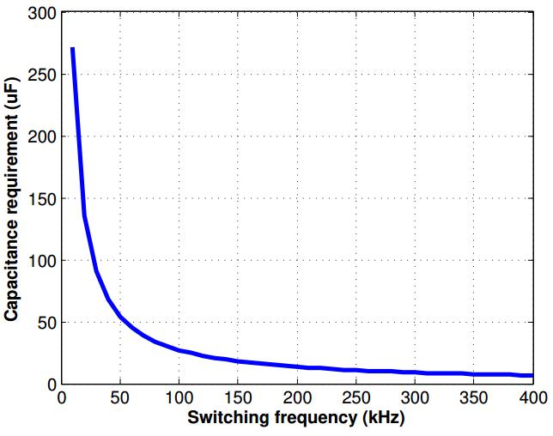
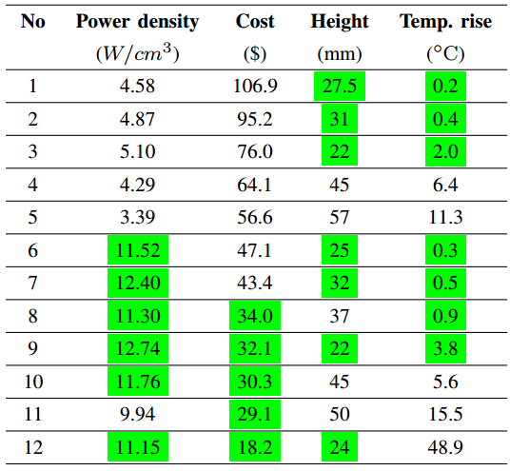
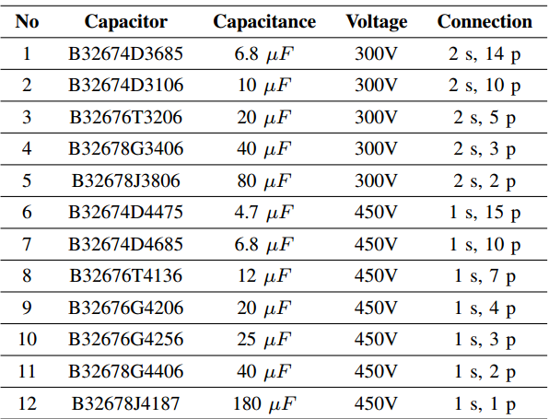
DC Link Capacitor Optimization
RMS current vs m_{a}
Capacitance vs f_{sw}

Slide 17
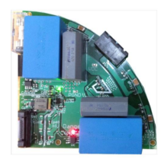
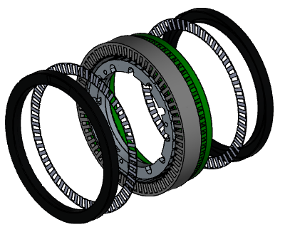
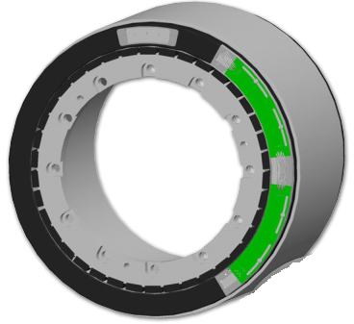
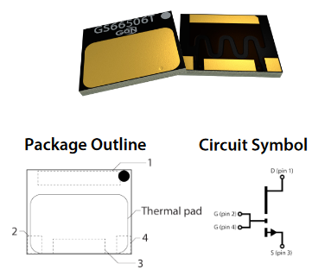
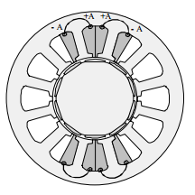
IMMD Design
Four three-phase inverter modules
Power stage with cascode GaN FETs
Permanent Magnet Brushless DC motor
Fractional Slot Concentrated Winding

Slide 18
IMMD Design
Buraya bir çizim koyalım
Devre ve motor
Specifications
Four three-phase modules
6 kW total output power
24 slot double layer stator
20 pole PM rotor
600V – 20A GaN FETs
Four 20μF, 450V capacitors

Slide 19
How efficient?
Loss Characterization
Hangi güçte akımda/voltajda elde edildiğini yazalım
Device’ları koyalım
Hangi rengin hangi loss olduğunu yazalım
Vektörel koyalım

Slide 20
So, what now?
Near future:
Build a 6 kW laboratory prototype with the specifications
Proof of concept
Drive efficiency: 98.5%
Drive power density: 15 W/cm³
Fault tolerance tests
Motor housing for cooling (no heatsink)
Ultimately:
IMMD design for an actual application
Fully modular and complete design
Reliability tests

Slide 21
References
G. Lo Calzo et al., “Integrated motor drives: state of the art and future trends,” IET Electr. Power Appl., vol. 10, no. 8, pp. 757–771, Sep. 2016.
J. Wang, Y. Li, and Y. Han, “Integrated Modular Motor Drive Design With GaN Power FETs,” IEEE Trans. Ind. Appl., vol. 51, no. c, pp. 3198–3207, 2015.
J. J. Wolmarans, M. B. Gerber, H. Polinder, S. W. H. De Haan, J. A. Ferreira, and D. Clarenbach, “A 50kW integrated fault tolerant permanent magnet machine and motor drive,” PESC Rec. - IEEE Annu. Power Electron. Spec. Conf., pp. 345–351, 2008.
N. R. Brown, T. M. Jahns, and R. D. Lorenz, “Power Converter Design for an Integrated Modular Motor Drive,” Ind. Appl. Conf. 2007. 42nd IAS Annu. Meet. Conf. Rec. 2007 IEEE, pp. 1322–1328, 2007.
S. M. Lambert, B. C. Mecrow, R. Abebe, G. Vakil, and C. M. Johnson, “Integrated Drives for Transport - A Review of the Enabling Electronics Technology,” IEEE Veh. Power Propuls. Conf., pp. 1–6, 2015.
A. Shea and T. M. Jahns, “Hardware integration for an integrated modular motor drive including distributed control,” in 2014 IEEE Energy Conversion Congress and Exposition (ECCE), 2014, pp. 4881–4887.

Slide 22

Questions, opinions and suggestions
Thank you !

