Slide 1


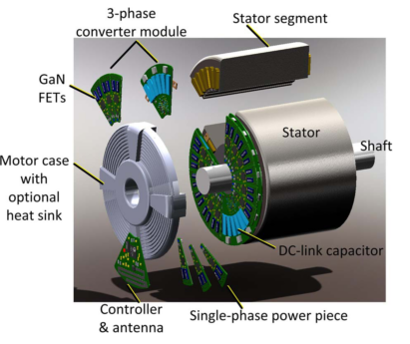
Development of an Integrated Modular Motor Drive (IMMD) System
Mesut Uğur Ozan Keysan
Department of Electrical and Electronics Engineering
Middle East Technical University
Introduction
DC link capacitor optimization
Conventional motor drive systems vs.
* increased volume and weight
electric traction and aerospace where power density is critical
Electromagnetic interference (EMI) problems
integrated directly to the motor back-end
Modularization divided into several parts
Large volume/cost
Model
Algorithm
Effect of Interleaving
Results
Motivation
Motivation behind integration
Motivation behind modularization
Advantages of IMMDs
Critical applications
power density of the overall system can be enhanced
fault tolerance
voltage stress
heat dissipation
IMMD Design
Fractional slot machines
Frameless motor
Modular PCB
GaN
Master/slave
Challenges
Fitting into a small volume
Subject to vibration & temperature
WBG devices: address
Parasitic problems
Careful layout design
Conclusion
Here are my conclusions
References
Fitting into a small volume
Subject to vibration & temperature
EEE Graduate Research Workshop 2017

