Slide 1


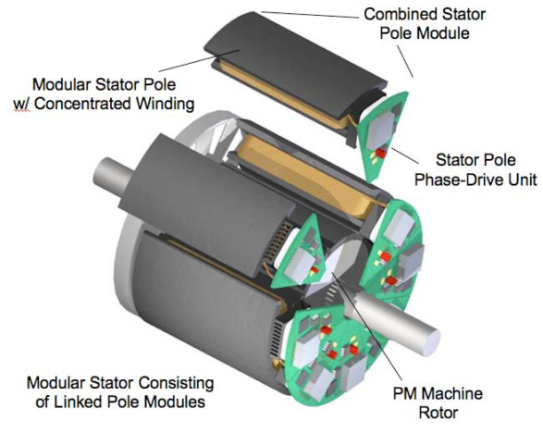
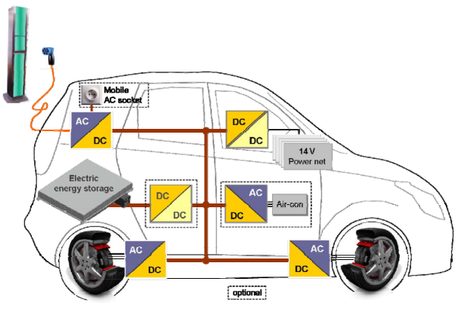
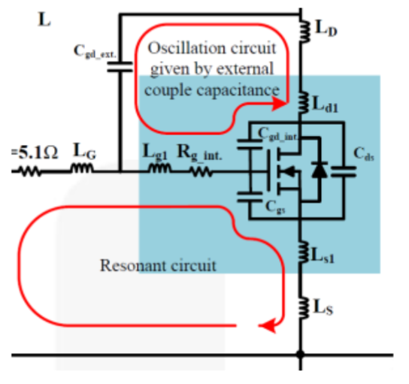
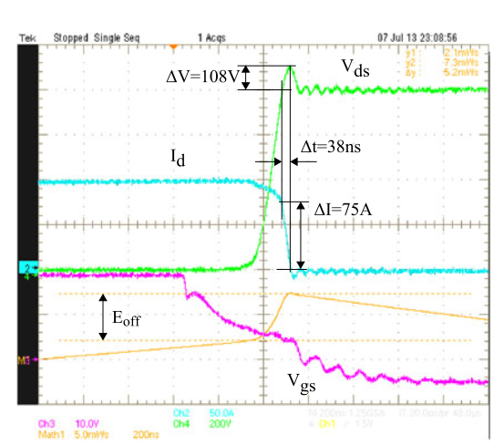
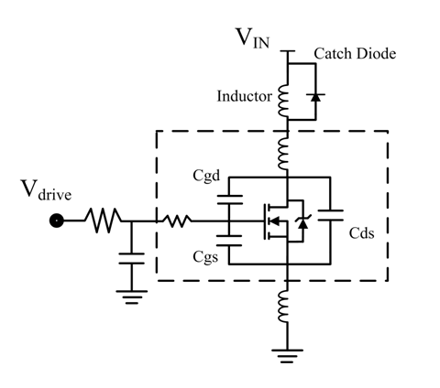
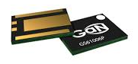
Development of an Integrated Modular Motor Drive (IMMD) System
Mesut Uğur Ozan Keysan
ugurm@metu.edu.tr keysan@metu.edu.tr
Department of Electrical and Electronics Engineering
Middle East Technical University
Introduction
DC link capacitor optimization
In conventional motor drive systems, drive units are placed in a separate cabinet, and they are connected to the motor via long cables. This brings increased volume and weight as well as increased voltage overshoot and electromagnetic interference (EMI) problems.
In integrated modular motor drives (IMMD), the motor drive is integrated directly to the motor back-end and the system is modularized by dividing into several parts [1].
DC link capacitors constitute:
20% of cost and weight,
30% of volume [1].
DC link capacitor selection algorithm
Effect of interleaving
Motivation
Optimum phase-shift angle selection
Integration
Power density of the overall system is enhanced significantly [2].
Voltage overshoots due to cabling effect is eliminated.
Modularization
Fault tolerance is increased.
Voltage stress on modules is reduced.
Heat dissipation is distributed to a wider area.
A set of film capacitors are considered. Optimization is achieved based on:
Power density
Cost
Height
Temperature rise
Applications
Electric traction: electric vehicles, trains
Aerospace: aircrafts, space crafts
IMMD Design
Series and parallel connected three-phase inverter modules
Fractional Slot Concentrated Winding (FSCW) stator
Permanent Magnet Brushless DC (PM-BLDC) motor
Challenges
Specifications
Loss Characterization
Fitting into a small volume requires size reduction and optimum placement of components.
Cooling of both units should be achieved simultaneously.
Power and control electronics components are subjected to high temperature and vibration [3].
Four three-phase modules
6kW total output power
24 slot double layer stator
20 pole rotor
600V – 20A GaN FETs
Four 20uF, 450V capacitors
These challenges can be addressed by using wide band-gap (WBG) power semiconductor devices such as Gallium Nitride (GaN).
Low semiconductor loss: heat sink size is reduced
High operation frequency: passive component size is reduced
Additional challenges due to GaN
Parasitic components become significant
Careful layout design is required
Turn-off characteristics of a power device
Conclusions & Planned Work
A laboratory prototype is being developed
Results
Drive efficiency: 98.5%
Drive power density: 15 W/cm³
What else ???
References
G. Lo Calzo et al., “Integrated motor drives: state of the art and future trends,” IET Electr. Power Appl., vol. 10, no. 8, pp. 757–771, Sep. 2016.
J. Wang, Y. Li, and Y. Han, “Integrated Modular Motor Drive Design With GaN Power FETs,” IEEE Trans. Ind. Appl., vol. 51, no. c, pp. 3198–3207, 2015.
J. J. Wolmarans, M. B. Gerber, H. Polinder, S. W. H. De Haan, J. A. Ferreira, and D. Clarenbach, “A 50kW integrated fault tolerant permanent magnet machine and motor drive,” PESC Rec. - IEEE Annu. Power Electron. Spec. Conf., pp. 345–351, 2008.
EEE Graduate Research Workshop 2017

