Slide 1

Literature Survey
for
Integrated Modular Motor Drives
Mesut Uğur
26/02/2018
mugur@earsis.com

Slide 2

The idea of IMMD
The first idea of an Integrated Modular Motor Drive as we know of was brought forward in 2002.

Slide 3
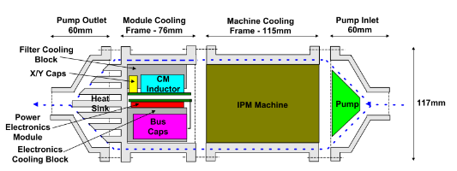
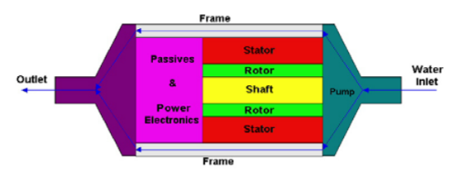
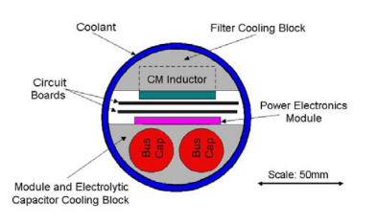
University of Wisconsion-Madison
Nathan C. Harris, Thomas M. Jahns, Surong Huang (with Lipo)
2002, Integrated Motor/Controller Drive for Automotive Water Pump Application
No hardware, No modularization.
500W, 42VDC, 5000rpm.
5 brushless machine topologies are discussed. Interior PM synchronous m/c is selected.
Six-switch PWM voltage-source inverter, power MOSFETs, integrated power electronics module (IPEM)
On Power Electronics side, physical layout, thermal management and EMI filter design are discussed

Slide 4
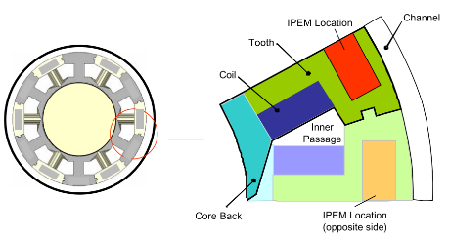
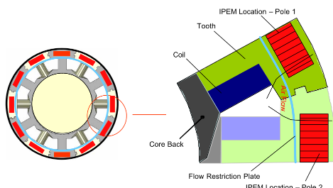
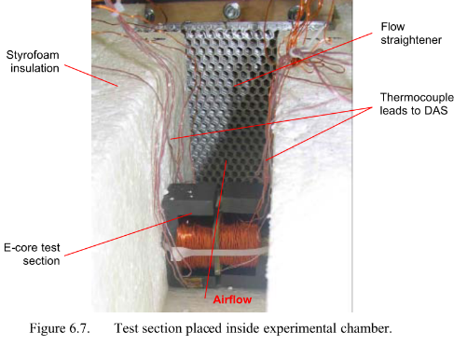
University of Wisconsion-Madison
Stephanie I. Mueller (MSc Thesis) with Professor Greg F. Nellis
2005, Model and Design of an Air-Cooled Thermal Management System for An Integrated Motor/Controller
Modular permanent magnet machine
Integrated power electronics module (IPEM)
Experimental verification with E cores?

Slide 5
University of Wisconsion-Madison
Suman Dwari, Leila Parsa, and Thomas A. Lipo
2005, Model and Design of an Air-Cooled Thermal Management System for An Integrated Motor/Controller
Modular permanent magnet machine
Integrated power electronics module (IPEM)
Experimental verification with E cores?

Slide 6
http://power.eee.metu.edu.tr/
Mesut Uğur
mugur@earsis.com
https://blog.metu.edu.tr/ugurm/

