Slide 1

Literature Research
for
IMMD Ver.2 Design
Mesut Uğur
06/10/2018
mesut.ugur@metu.edu.tr

Slide 2
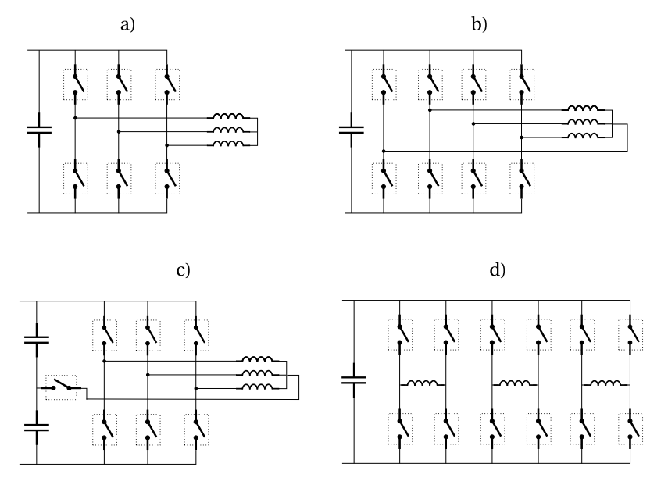
Fault Tolerant topologies for 3-phase drives
Redundant bridge arm
The product of the number of switches and the rating of each switch (V·I) is increased by a factor 1.15 compared to conventional
Conventional
A phase can be completely short circuited to limit the short circuit current in case of a turn to turn short circuit fault, while it is still possible to control the two remaining phases.
Solution with less switch number

Slide 3
Fault Tolerant topologies
Magnetic coupling between modules should be analyzed.
Limit the short circuit current. Inductance calculation is necessary.
https://ieeexplore.ieee.org/document/6918483
Core loss and magnet loss calculation
https://ieeexplore.ieee.org/document/1597318

Slide 4
Types of faults
Winding open-circuit faults
Winding short-circuit faults;
inter-turn short-circuit faults,
coil to coil faults,
line to line faults
line to ground faults
Transistor short-circuit faults
Transistor open circuit faults
DC bus capacitor faults.
Power supply failure or AC line fault in mains supplied rectifier
Sensor failure.
Control equipment failure
Bearing faults.
Static and dynamic eccentricity conditions (due to a bent shaft or a shaft misalignment).
Gearbox faults in non direct-driven machines.

Slide 5
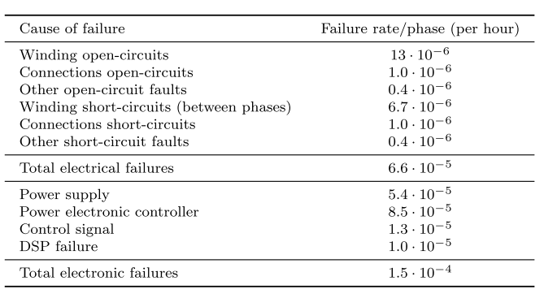
Types of faults

Slide 6
Types of faults
Winding open-circuit faults:
among the most common faults
caused as a consequence of the internal interruption of the motor windings, mechanical faults at the machine terminals, mechanical stresses on the connectors that link the motor and the inverter or by an electrical failure on an inverter phase leg
leads to the inability to produce a standard 3-phase constant magnitude rotating magnetic field which
causes large torque pulsations, mainly at twice the frequency of the supply signal
Majority of stator winding faults begin as insulation breakdown failures that lead to a short-circuit between several turns of a phase winding.
causes a large circulating current that generates a high amount of heat to be locally released within a short time.
If undetected, inter-turn short-circuit faults rapidly propagate to neighboring turns, culminating in major faults such as coil to coil, phase to phase, phase to ground or open-circuit faults

Slide 7
Types of faults
Winding short-circuit faults involving the whole phase winding.
may happen as a consequence of
the closing of all the high side or low side switches of the inverter,
a DC bus short-circuit,
a short-circuit between machine terminals in the terminal box
physical damage on the cables connecting the motor and the inverter
One of the most common inverter faults involves the permanent opening of a power semiconductor switch
due to damage to the transistor itself
or the control logic commanding the gate signals.
current in the corresponding inverter leg is allowed to flow only during part of electrical cycle,
either through the other transistor or through the associated free-wheeling diode,
leading to a DC component in the phase currents and pulsations in the torque waveform
may remain undetected for a long time

Slide 8
Types of faults
Transistor short-circuit faults usually occurs as a consequence of a single power semiconductor switch being permanently damaged.
The damage may be due to
a short-circuit fault in the associated free-wheeling diode
presence of impurities in the fabrication process may also trigger the short-circuiting of the power semiconductor switch.
erroneous control signals caused by driver malfunction
auxiliary power supply failure
electromagnetic disturbance
control software errors
serious fault condition that demands immediate remedial action
the other switch in the same leg has to be opened within a few µs
As a consequence of the fault, high magnitude DC current components that are mainly limited by the stator resistance appear in all the phases
poses a risk in terms of
current withstand capability of the remaining healthy transistors,
winding overheating
PM demagnetization
An extremely high and oscillating torque is produced

Slide 9
Types of faults

Slide 10
Application
This becomes of the utmost importance in safety critical applications, in which the failure of the system cannot be tolerated.
For non safety critical systems, such as those found in production industry, fault-tolerance can also bring benefits regarding increased running times and longer maintenance cycles.

Slide 11
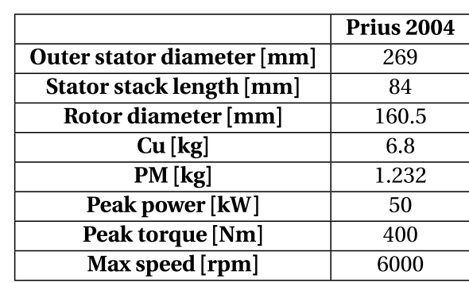
Traction ?
Pirius
Machine Volume: 4.774 l
Power density: 10.47 kW/l (peak power)
Speed: 6000 rpm
Our design
Machine Volume: 7.729 l
Power density: 1.04 kW/l (peak power)
Speed: 600 rpm
Coincidence ?
What are the limations for us for designing a high speed machine ?
Water cooling (high power)
Test setup
Mechanical parts
Tip speed
Core loss
Winding extra losses, litz wire?

Slide 12
High speed design
We are here !

Slide 13
High speed design
As the speed increases (same power):
Torque ↓
Dimensions ↓
Pole area ↓
Flux ↓ (13 kat)
Frequency ↑ (50 kat)
Coil voltage ↓ (3.5 kat)
Number of turns ↓ (3.5 kat)
Bu tasarımda aynı DC Link voltajı ve aynı modül sayısı var. Bu durumda faz gerilimi sabit. Tork çok düşmesine rağmen aynı akım var drive’da. Haliyle verimi hep aynı gidiyor.
Question: Böyle mi olmalı ?
Bu analizlerde core loss yok, yani aslında var da frekanstan etkilenmiyor.

Slide 14
High speed design
Derken GaN’ları içeren şöyle bir analiz yaptım:
60A GaN bölgesi
30A GaN bölgesi
60A GaN bölgesi
30A GaN bölgesi
En düşük 24A, en yüksek 10A faz akımı var.
Hesap: Tepe akımı x 1.5 kat marjin
Question: 60 Amperlik GaN kullansam hep, ne olur?

Slide 15
High speed design
Farklı transistör seçimleri:
Margin: 2
Margin: 1.2
60A GaN bölgesi
30A GaN bölgesi
60A GaN bölgesi
30A GaN bölgesi

Slide 16
High speed design
Loss dağılımları:
Core loss’u hesaplayabilmeliyiz !

Slide 17
High speed design
Volume and Power Density:
Reduction in motor volume is obvious.
There is no change in the capacitor volume.
Drive volume reduces since the outer stator diameter reduces.
Heat sink required thermal impedance does not change.
Heat sink length increases since area is reduced.
In total, heat sink volume is decreased.
PCB’ye tüm komponentlerin sığdığı varsayılıyor !

