Slide 1
Front View
AC
DC +
DC -
Power Module
Capacitor
Cold Plate
13.2mm
106.4mm
140mm
85mm

Slide 2
Top View

Slide 3
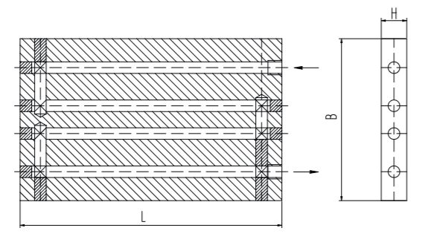
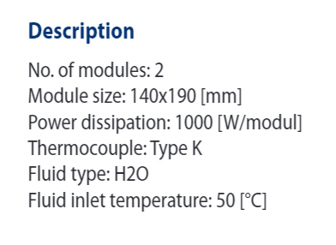
Heatsink
https://www.dau-heatsinks.com/fileadmin/user_upload/DAU/Datenblaetter_Juni_2024/Miba_Product_Flyer_Liquid_Cooling_Series_KS.pdf?utm_source=pocket_saves

Slide 4
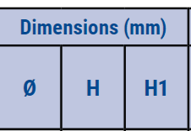
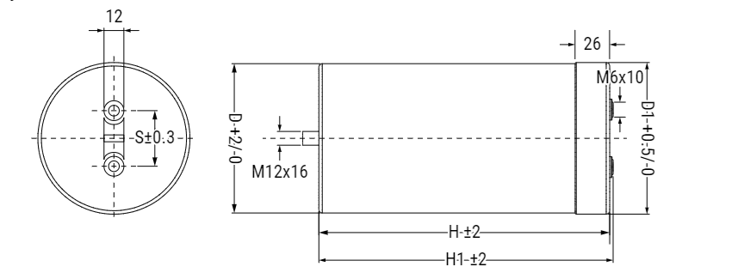
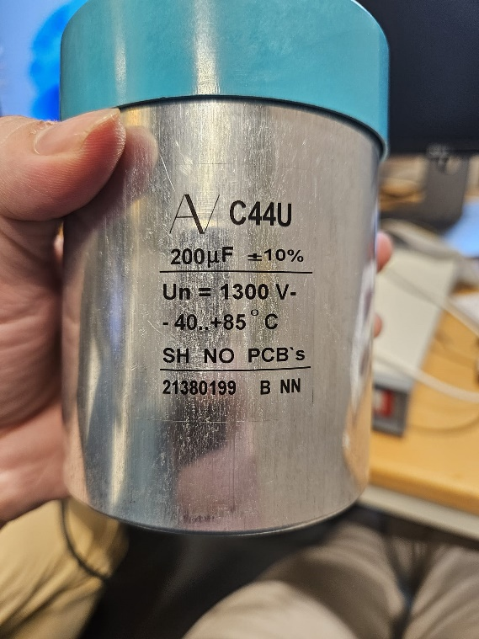
Capacitor
https://content.kemet.com/datasheets/KEM_F3119_C44U_M.pdf

Slide 5
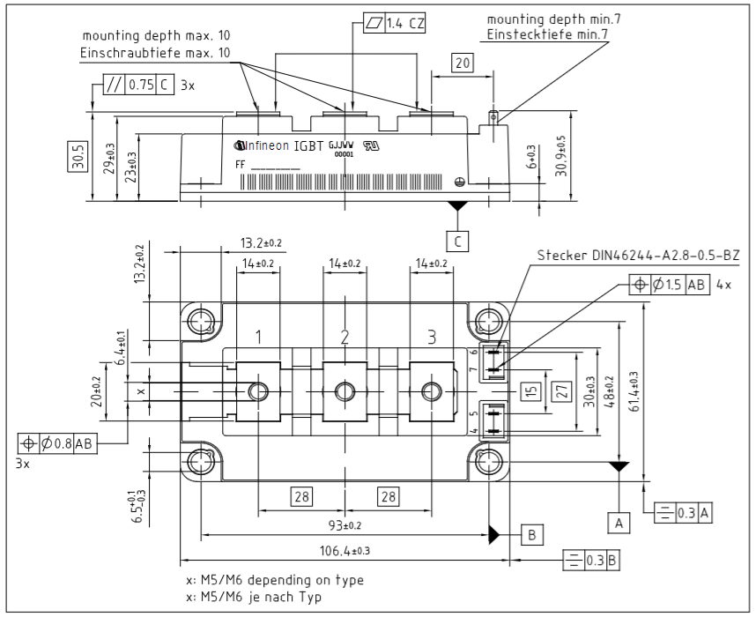
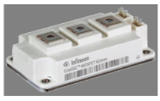
Power Module
https://www.infineon.com/dgdl/Infineon-FF3MR20KM1H-DataSheet-v01_00-EN.pdf?fileId=8ac78c8c8afe5bd0018b18a8bcde381a&_gl=1*d4az8w*_up*MQ..&gclid=CjwKCAjwodC2BhAHEiwAE67hJH0tvJHgZ57l5CyZLWo7A3vgT-FzpCPN5dYoo1eviVThRGPVYWDNCxoCv08QAvD_BwE&gclsrc=aw.ds

Slide 6
Mersen- Laminated BusBar
https://www.mersen.com/products/solutions-power-management/bus-bars/laminated-bus-bar
https://www.mersen.com/sites/default/files/publications-media/5-spm-bus-bar-solutions-guide-mersen.pdf

Slide 7
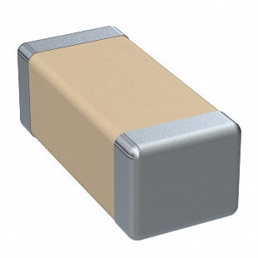
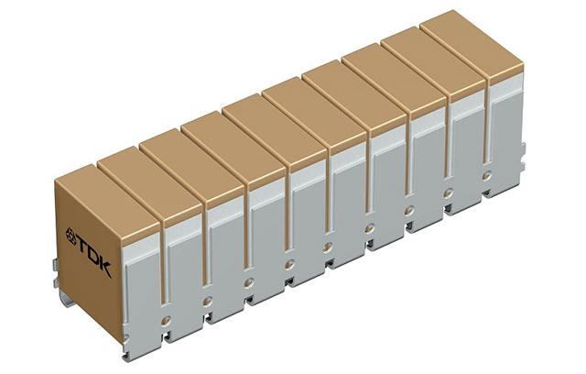
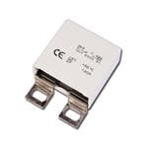
Ceramic Capacitors
https://www.digikey.se/en/products/detail/kemet/C1206C103KFRAC7800/4172876
https://www.digikey.se/sv/products/detail/epcos---tdk-electronics/B58035U5106M001/7100511?utm_adgroup=&utm_source=google&utm_medium=cpc&utm_campaign=PMAX%20Shopping_Product_High%20Performers&utm_term=&productid=7100511&utm_content=&utm_id=go_cmp-19549529751_adg-_ad-__dev-c_ext-_prd-7100511_sig-Cj0KCQjwiuC2BhDSARIsALOVfBK3gnNyJD4gNDtxFLe2PbrxTl23Ee5nHfKNWer-tUhf3DXTEcDGmY8aAhlIEALw_wcB&gad_source=1&gclid=Cj0KCQjwiuC2BhDSARIsALOVfBK3gnNyJD4gNDtxFLe2PbrxTl23Ee5nHfKNWer-tUhf3DXTEcDGmY8aAhlIEALw_wcB
https://www.mouser.se/ProductDetail/KEMET/C4BSWBX3100ZBFJ?qs=pqRVuuzkf6aXSxIQ488d%252BA%3D%3D&mgh=1&utm_id=20705987001&gad_source=1&gclid=CjwKCAjwreW2BhBhEiwAavLwfJsji_u-DcaDpKUsbHfvasufdkQoWE9aNXyBKvdaYv2aoY4nhIw_gBoCv_4QAvD_BwE

Slide 8
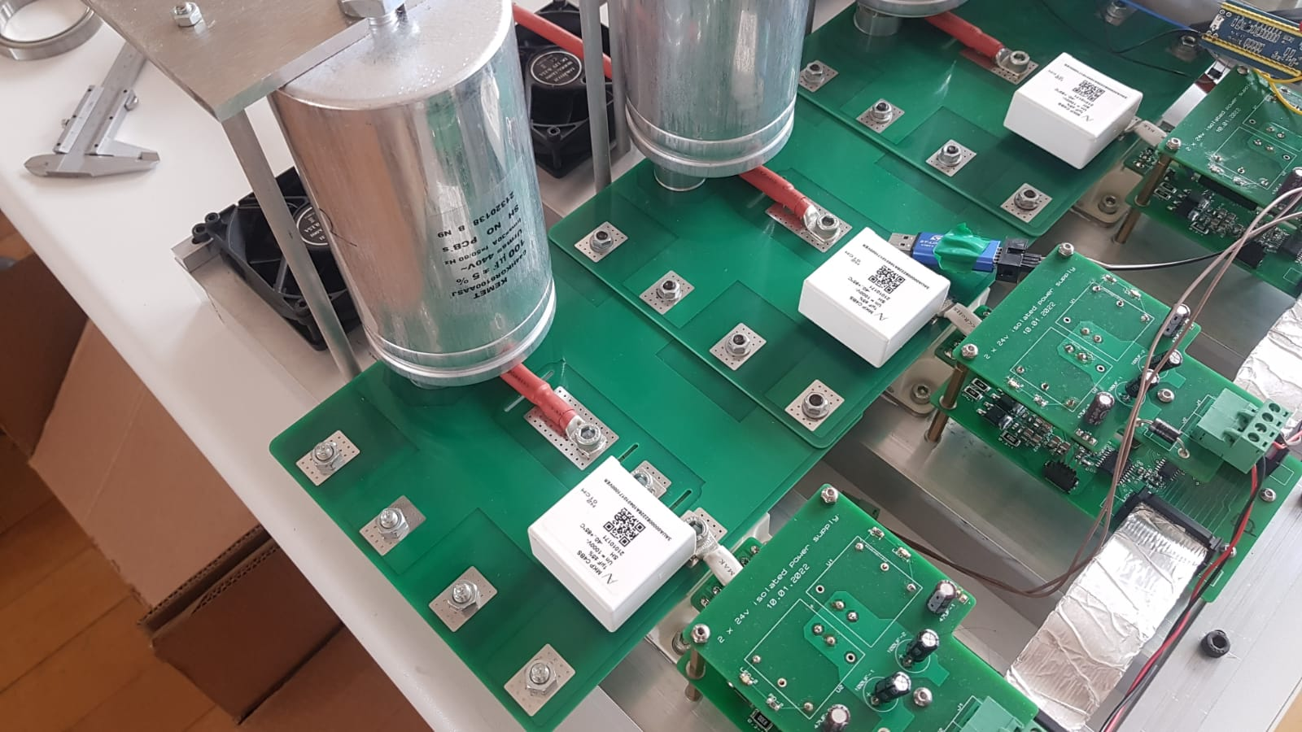
Or PCB?

