Slide 1
SPB Optimization
1200 V DC-link, 300 kW three-phase inverter

Slide 2
Optimizing SPB Level Number with Available GaN Devices
Core question:
How many stacked two-level cells are worth adding before device count and control overload dominate?
Method:
Off-the-shelf GaN database
D-FOM screening
first-order loss model
More cells
lower Vcell
better device FOM
more switches

Slide 3
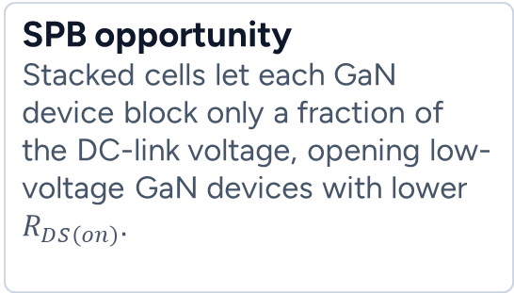
Why this optimization matters
System target
1200 V DC-link
• 300 kW output power
• ≈ 291 A rms phase current
• high-frequency GaN switching
SPB opportunity
Stacked cells let each GaN device block only a fraction of the DC-link voltage, opening low-voltage GaN devices with lower $R_{DS\left(on\right)}.$
SPB penalty
Each added cell brings six more switch positions, gate drivers, sensing, balancing, layout effort, and reliability questions.
Voltage stress
Device FOM
Loss & thermal
Complexity
The optimum is not simply the lowest-voltage device: it is the best balance of device FOM, conduction loss, switching loss, and implementation complexity.

Slide 4
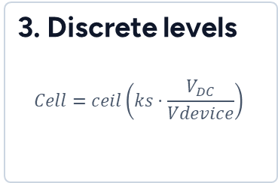
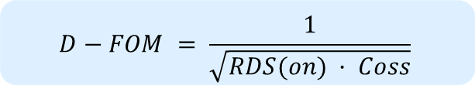

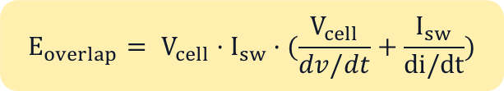
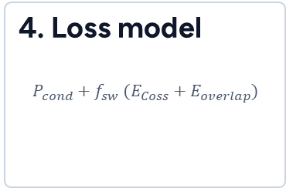
Screening workflow implemented in MATLAB
1. Inputs
VDC, Pout, pf, modulation, fsw, dv/dt, di/dt, safety factor
2. Database
RDS(on), Coss, voltage rating, current rating, vendor/device
3. Discrete levels
$$Cell=ceil\left(ks·\frac{V_{DC}}{Vdevice}\right)$$
4. Loss model
$$P_{cond}+f_{sw} (E_{Coss}+E_{overlap})$$
$$D−FOM = \frac{1}{\sqrt{RDS(on) · Coss}}$$
$$E_{overlap}= V_{cell}·I_{sw}·(\frac{V_{cell}}{dv/dt}+\frac{I_{sw}}{di/dt})$$
$$E_{Coss} = C_{oss.eq} · V_{cell}^{2}$$
Only realizable x-axis points are used: 650 V, 200 V, 150 V, 120 V, 100 V devices create different discrete SPB level counts.

Slide 5
Preliminary Results
Top-left
Device database: lower-left is attractive, but voltage rating must be feasible.
Top-middle
D-FOM ranks devices by RDS(on)–Coss trade-off.
Top-right
Discrete level count chooses the feasible best-FOM devices.
Bottom row
Separates conduction, switching energy, and switching-loss components.

Slide 6
Preliminary Results
Low voltage GaN often has excellent RDS(on), but its Coss can be large.
The optimum depends on current, voltage per cell, and switching frequency.
D-FOM alone does not decide the design.
It only decides which devices deserve closer evaluation.
Interpretation
100–200 V devices look attractive, but only become feasible when enough cells are stacked.

Slide 7
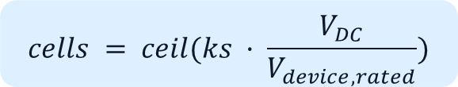
Discrete levels: the x-axis is constrained by available device classes
650 V GaN
cells ≈ 3
simple, mature
200 V GaN
cells ≈ 8
Low voltage
100 V GaN
cells ≈ 15
Aggressive low-voltage
$$cells = ceil(ks · \frac{V_{DC}}{V_{device,rated}})$$
3
6
8
9
12
15
18
650V
200V
100V
If we force 14 cells with 100 V GaN, the voltage margin is only about 100 / (1200/15) = 1.25×.

Slide 8

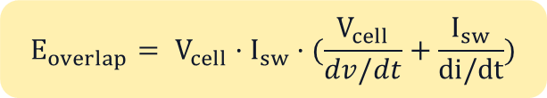
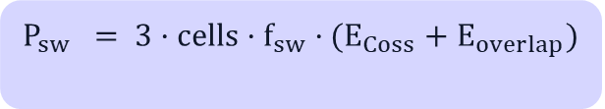
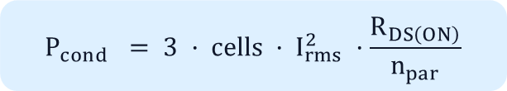
Loss model
What it captures
• higher cell count reduces Vcell
• lower-voltage devices reduce RDS(on)
• higher fsw amplifies switching energy
• dv/dt and di/dt affect VI overlap
$$P_{cond} = 3 · cells · I_{rms}^{2} ·\frac{R_{DS\left(ON\right)}}{n_{par}}$$
$$E_{overlap}= V_{cell}·I_{sw}·(\frac{V_{cell}}{dv/dt}+\frac{I_{sw}}{di/dt})$$
$$E_{Coss} = C_{oss.eq} · V_{cell}^{2}$$
What it still misses
• measured Eon/Eoff per device
• dynamic RDS(on)
• thermal impedance
• layout inductance and overshoot
• DC-link capacitor ripple
$$P_{sw} = 3·cells·f_{sw}·(E_{Coss}+E_{overlap})$$
Next step: replace the generic overlap model with measured or datasheet-based Eon/Eoff for each candidate voltage class.

Slide 9
Suggested comparative study for the project
Case A: simple high-voltage SPB
650 V GaN
3 cells
Mature devices, low cell count
Lower sensing and gate-drive overhead
Case B: aggressive low-voltage SPB
100 V GaN
15 cells
Case C: low-voltage SPB
200 V GaN
8 cells
Middle-ground baseline
Compare each case using the same current, fsw, thermal boundary, and modulation strategy.
Evaluation metrics
Semiconductor loss
conduction + Coss + measured/estimated Eon/Eoff
Cost / Failure rate *Normalized?
switch positions, gate drivers, isolated supplies, sensors
Thermal feasibility
junction rise at nominal and overload current
DC-link / module capacitor
ripple current, energy storage, balancing control
Motor friendliness
voltage steps, CM voltage, winding stress, filtering need

Slide 10
References
J. A. Anderson, G. Zulauf, J. W. Kolar, and G. Deboy, “New Figure-of-Merit Combining Semiconductor and Multi-Level Converter Properties,” IEEE Open Journal of Power Electronics, 2020.
G. Rohner, J. W. Kolar, D. Bortis, and M. Schweizer, “Optimal Level Number and Performance Evaluation of Si/GaN Multi-Level Flying Capacitor Inverter for Variable Speed Drive Systems,” ICEMS, 2022.
G. Rohner et al., “Comparative Evaluation of Three-Phase Three-Level GaN and Seven-Level Si Flying Capacitor Inverters for Integrated Motor Drives Considering Overload Operation,” IEEE Access, 2024.
G. Rohner, J. Huber, S. Mirić, and J. W. Kolar, “Comparative Evaluation of Three-Phase Three-Level Flying Capacitor and Stacked Polyphase Bridge GaN Inverter Systems for Integrated Motor Drives,” Electronics, 2024.
“Literature Survey for Integrated Modular Motor Drives,” presentation.

