Slide 1
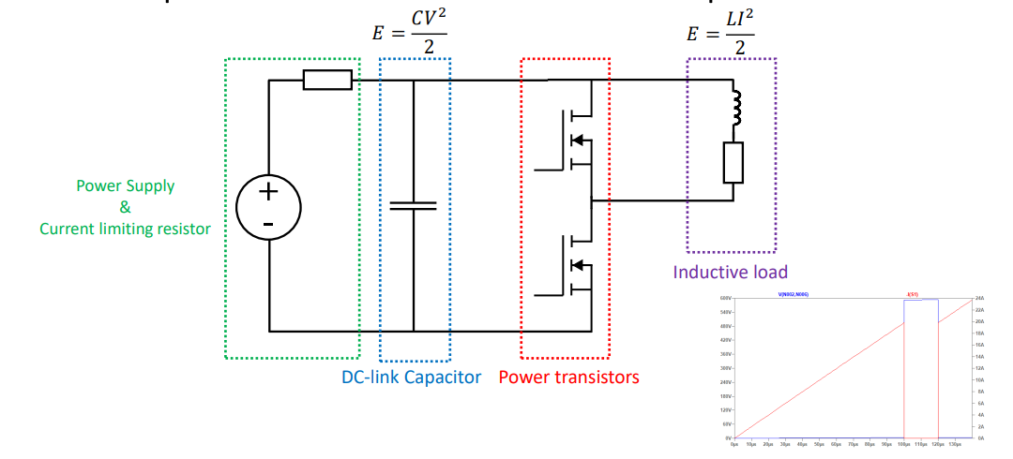
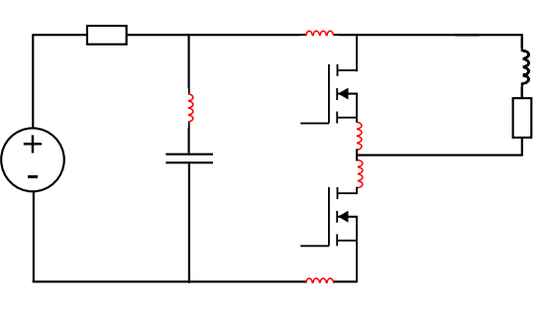
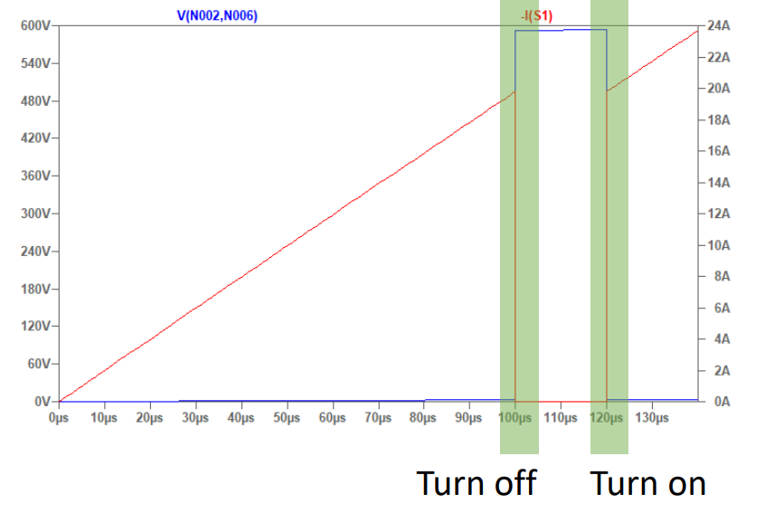
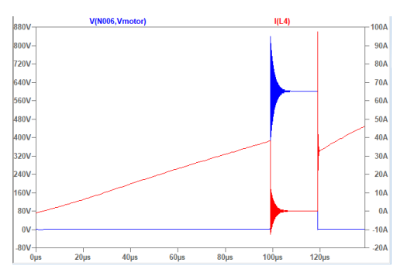
Double Pulse Test
Ideal parts and waveforms
Parasitics and affects

Slide 2
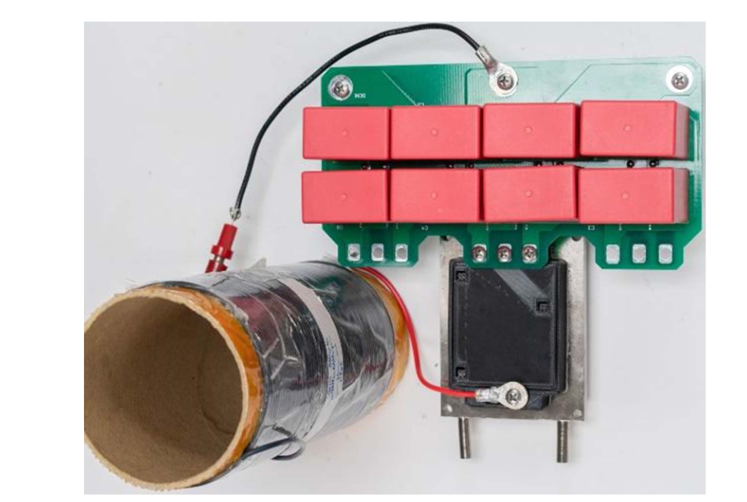
Inductor Selection
The key considerations for the selection of this inductor include:
It should not saturate at the peak test currents. (Air core inductors)
It should limit the di/dt so that the switching times (T1, T2 and T3) are not less than 10 μs, to ensure the devices have fully turned on or off.
The di/dt should not be so low that the switching times are longer than 200 μS so as not to cause the DC bus voltage to dip by more than ≈5 percent, and so change the switching performance. In addition, if the current pulse is long, then the chip temperature can increase by more than a few °C, again affecting the switching performance.
The inductor should be mounted well away from the test setup to prevent EMI interference or magnetic field coupling into any gate drive circuits or instrumentation

Slide 3
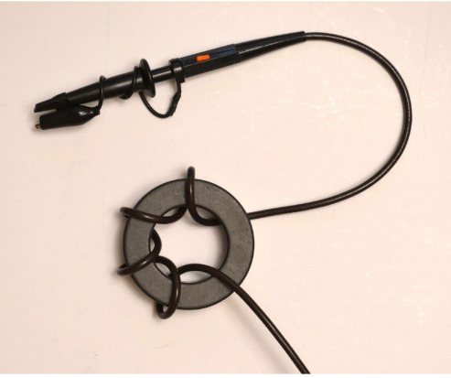
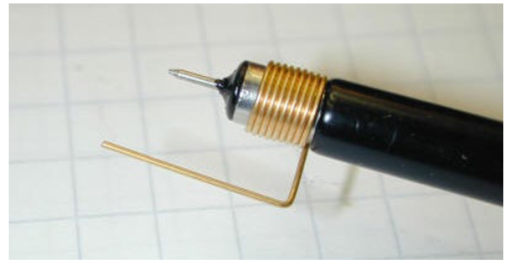
Instrumentation
We need some techniques to reduce loop inductance and coupling in the measurement path and how some turns around a ferrite core can add common mode impedance to the measurement signal.
To measure voltages at nonground reference potentials, differential probes are required and should be selected with a high common mode rejection ratio, as the DUT can be moving at very high dv/dt levels with respect to the scope ground.
Voltage probe tip to reduce inductance in measurement loop
Voltage probe with some added common mode impedance

Slide 4
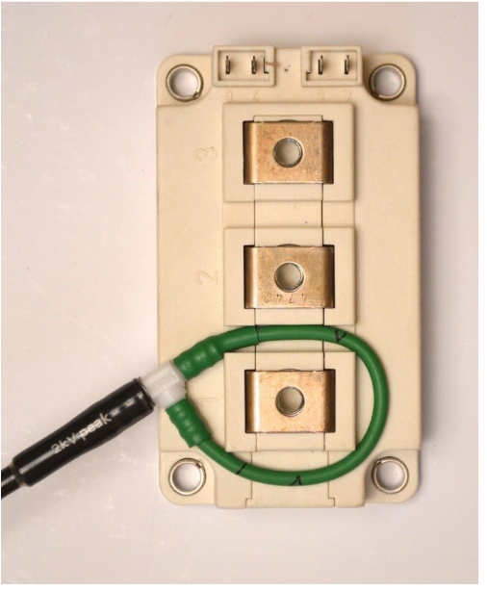
Instrumentation
To measure the actual device switching current, a current sensor must be inserted into the source/drain of the DUT.
Rogowski coils: These have a bandwidth of between 15-30 Mhz which is enough for many applications and any delay skew can be compensated for with an oscilloscope.

Slide 5
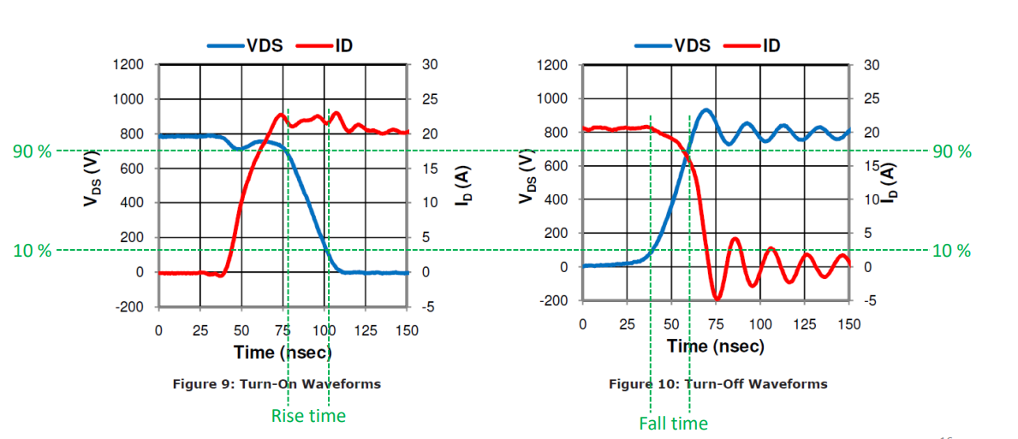
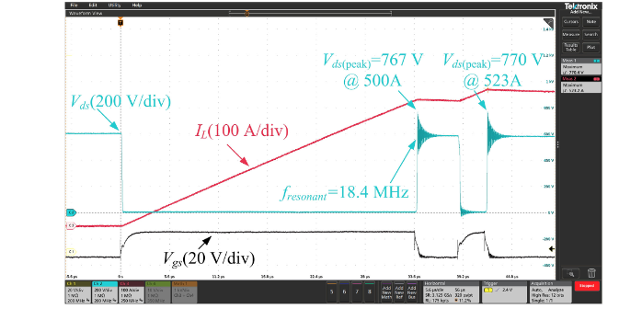
What testing should be included in a DPT and expected results
DUT can be switched at different voltages.
  We can change the DC link voltage.
DUT can be switched at different currents.
  We can change the pulse widths or inductor values.
DUT can be switched at different temperatures.
  This can be adjusted by mounting the DUT on a heatsink, which can be heated or cooled

Slide 6
References
A Low Inductance, High Power Density 3L-TNPC Power Module for More-Electric Aircraft Applications, in IEEE Transactions on Transportation Electrification
Design and Evaluation of a 1200-V/200-A SiC Three-Level NPC Power Module," in IEEE Transactions on Industry Applications
Double Pulse Testing: The How, What and Why by David Levett, Ziqing Zheng and Tim Frank, Infineon Technologies
Double pulse testing by Philip Abrahamssont

