Slide 1
Holistic Life Cycle Cost Optimization of the Traction Inverter
Enes Ayaz, KTH
2023.06.19

Slide 2
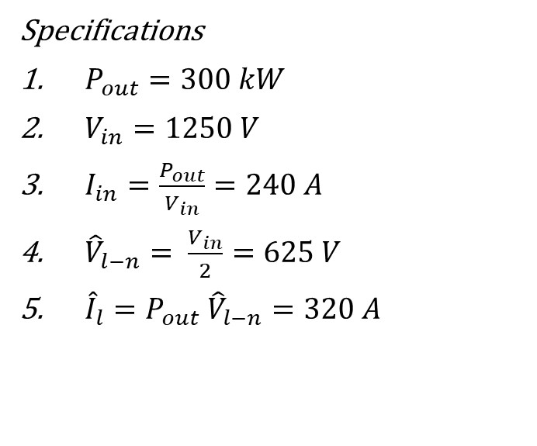
Key parameter indicators(KPI) and Design Chapters [1]
Heat sink and cooling types
  Cold plate and liquid cooling
  Air cooling and heat-sink design
Selection of topology and power modules
  2-level : Half-bridge modules
  3-level NPC, TTC : Half-bridge modules, common-collector modules
  Segmented/multi module/phase structures
Capacitor bank for DC-link
  Maximum voltage ripple
  RMS current of the capacitor bank (thermal issues)
Bus bar design
  Low inductance laminated connection
    To decrease switching noise
    To decrease switching losses
Auxiliary circuits:
  Gate drives and sensors
  Power supplies
Connectors and Filters :
  Input, output ; common mode, differential mode
Volume (50kW/L)
Losses/Efficiency (99.5%)
Additionally, life cycle cost optimization (LCCA) is required to select the design that is both economically and energy-wise favorable.
Cost
Reliability
Specifications
$P_{out}=300 kW$
$V_{in}=1250 V$
$I_{in}=\frac{P_{out}}{V_{in}}=240 A$
${\hat{V}}_{l−n}= \frac{V_{in}}{2}=625 V$
${\hat{I}}_{l}={P_{out} \hat{V}}_{l−n}=320 A$

Slide 3

Loss and Volume Breakdowns \ Considered Topologies [2,3]
Losses
Power semiconductors (90 %) (eff 99.5%)
  Conduction Losses
  Switching Losses
  Driving losses
  Leakage Losses
Additional Losses ( 10%)
  Filters losses
Volume
Power Module (12%)
Gate Drives (3%)
Capacitor (24 %)
Cooling (32 %)
  Cold plate
  Heatsink
Others (29%)
Cooling
Losses
Volume
Three-level
T-Type (3L-TT)
Inverter
Three-level
Neutral Point Clamped (3L-NPC)
Inverter
Three-level
Active Neutral Point Clamped
(3L-ANPC)
Inverter
Two-level (2L)
Inverter
Modular multilevel converters
(MMC)

Slide 4
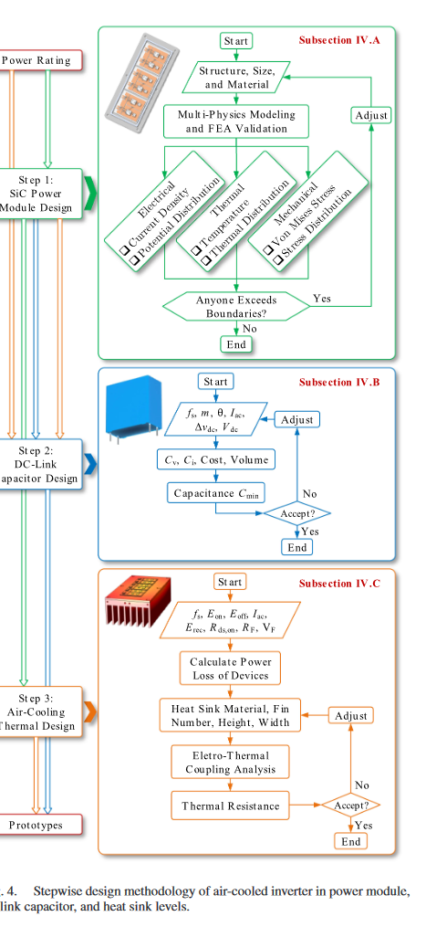
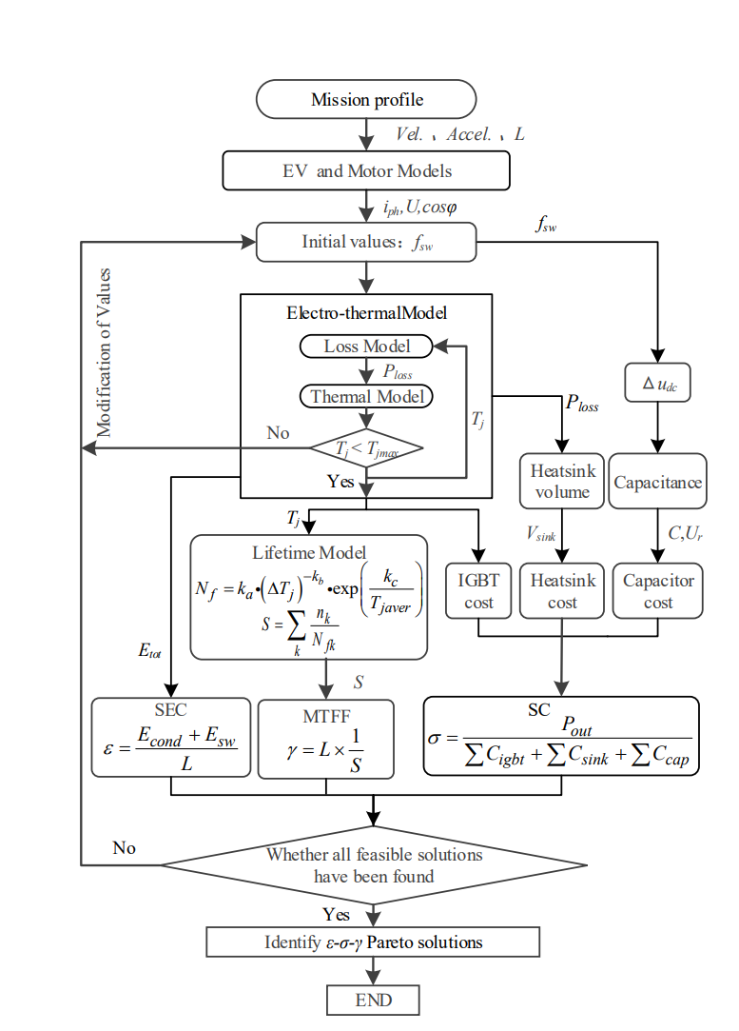
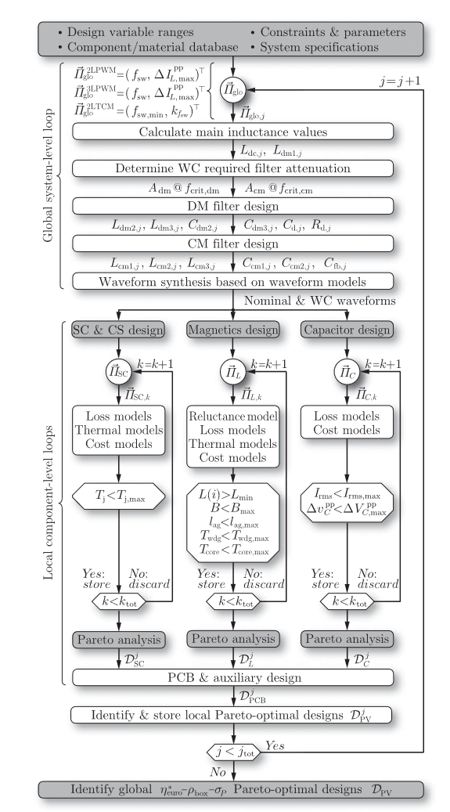
Stepwise Design Methodology and Multi-objective Optimization [4,5]
Key performance indicators:
  Higher efficiency
  Smaller volume
  Higher reliability
  Lower cost
  Life cycle cost
Optimization :
  Stochastic optimizations like Genetic Algorithm
  Direct search
  Pareto frontier
Inputs:
  Mission profiles
  Power ratings (Voltage, Current)

Slide 5
References
[1] A Compact 250 kW Silicon Carbide MOSFET based Three-Level Traction Inverter for Heavy Equipment Applications
[2] Stepwise Design Methodology and Heterogeneous Integration Routine of Air-Cooled SiC Inverter for Electric Vehicle
[3]Potentials and Comparison of Inverter Topologies for Future All-Electric Aircraft Propulsion
[4] Multi-objective optimization design of electric vehicle converters based on ε-γ-σ
[5] Comparative Life Cycle Cost Analysis of Si and SiC PV Converter Systems Based on Advanced η-ρ-σ Multiobjective Optimization Techniques

