Slide 1
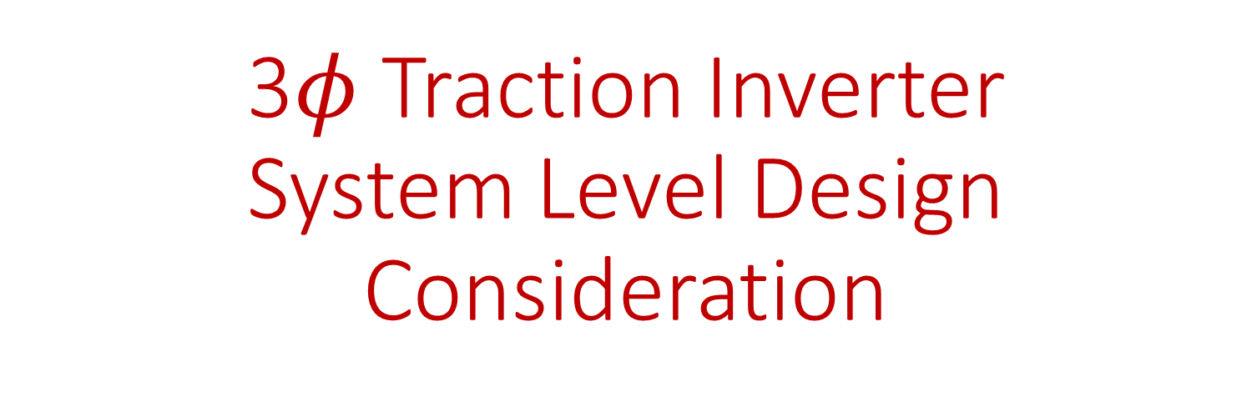
3$φ$ Traction Inverter
System Level Design Consideration
Enes Ayaz
First Draft : 2023.06.01
It will be expanded with details. Also, analytical calculations and simulations will be created to compare several options considering both the system and subsystem level.

Slide 2
System Level Design Considerations [1]
Heat sink and cooling types
  Cold plate, liquid cooling
  Air cooling and heat-sink design
Selection of topology and power modules
  2-level : Half-bridge modules
  3-level NPC : Half-bridge modules
  3-level TTC : Half-bridge modules, Common-collector modules
  Segmented/multi module/phase structures
Capacitor bank for DC-link or decoupling
  Motor phase-module requirements
Busbar design
  Low inductance laminated connection to decrease switching noise
Auxliary circuits:
  Gate drives
  Sensors
  Power supplies
Connectors and Filters :
  Input, output ; common mode, differential mode
Additionally, the life-time modelling and common mode voltage and EMI issues should be consireded.

Slide 3
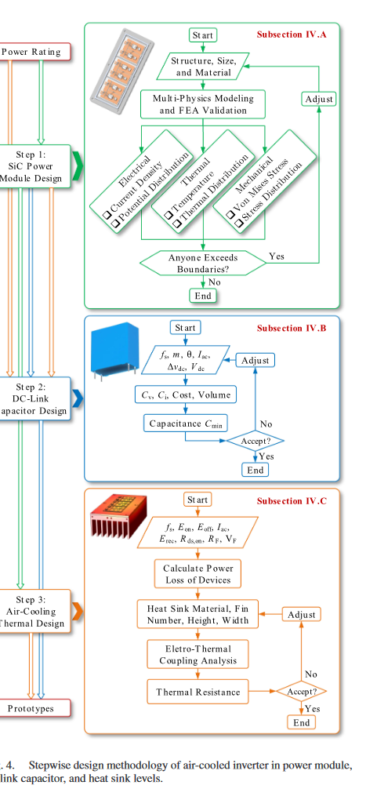
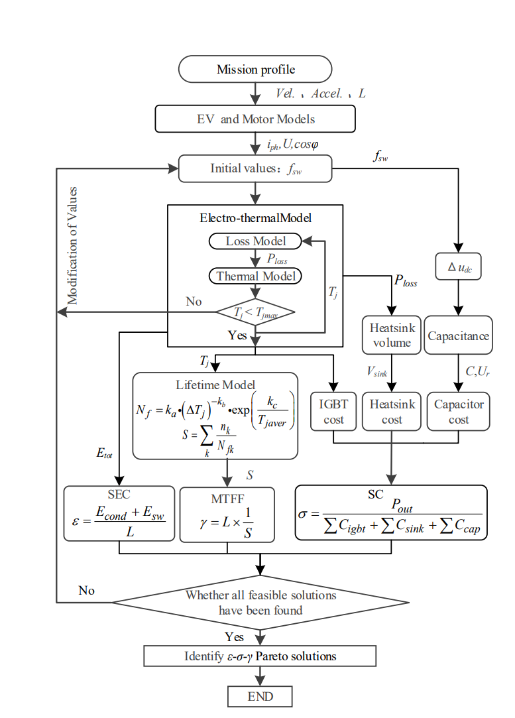
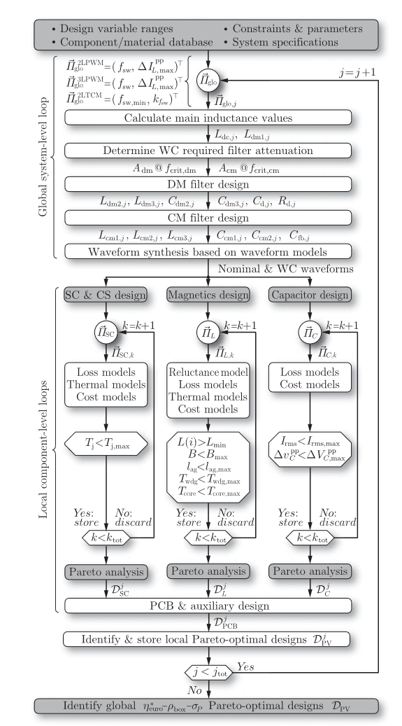
Stepwise Design Methodology and Multi-objective Optimization [6,9,10]
Multi-performance indicators :
  Higher reliability
  Higher efficiency
  Lower cost
  Smaller package
Optimization :
  Stochastic optimizations like Genetic Algorithm (but it has local optima problem)
  Direct search
  Pareto frontiers

Slide 4
Conceptual Topology Level Design [2,5]
The potential solutions to enable high-density and high-efficiency traction inverters:
  Utilize WBG devices (all-SiC), with off-the-shelf modules, discrete or an optimized DBC???//
  Still medium frequency range 10-25kHz up to 80kHz ????
  Passing to multi level (especially 3L) inverters since 2L inverters have
      Higher output voltage harmonics
      Lower efficiency at higher switching frequency, which is vital to decrease the volume
      Higher dv/dt and EMI, which causes common mode problems at the motor side
      Higher voltage ratings for switches
  But 3L inverters (NPC, ANPC, T-type) have
      increased number of switches
      increased isolated gate drives
      Increased cost and complexity
  NPC and ANPC have
      Higher conduction losses due to the series connection of two devices
  T-type
      Higher voltage ratings for some of the switches
      Higher switching losses because of higher voltage stress on single-switches

Slide 5
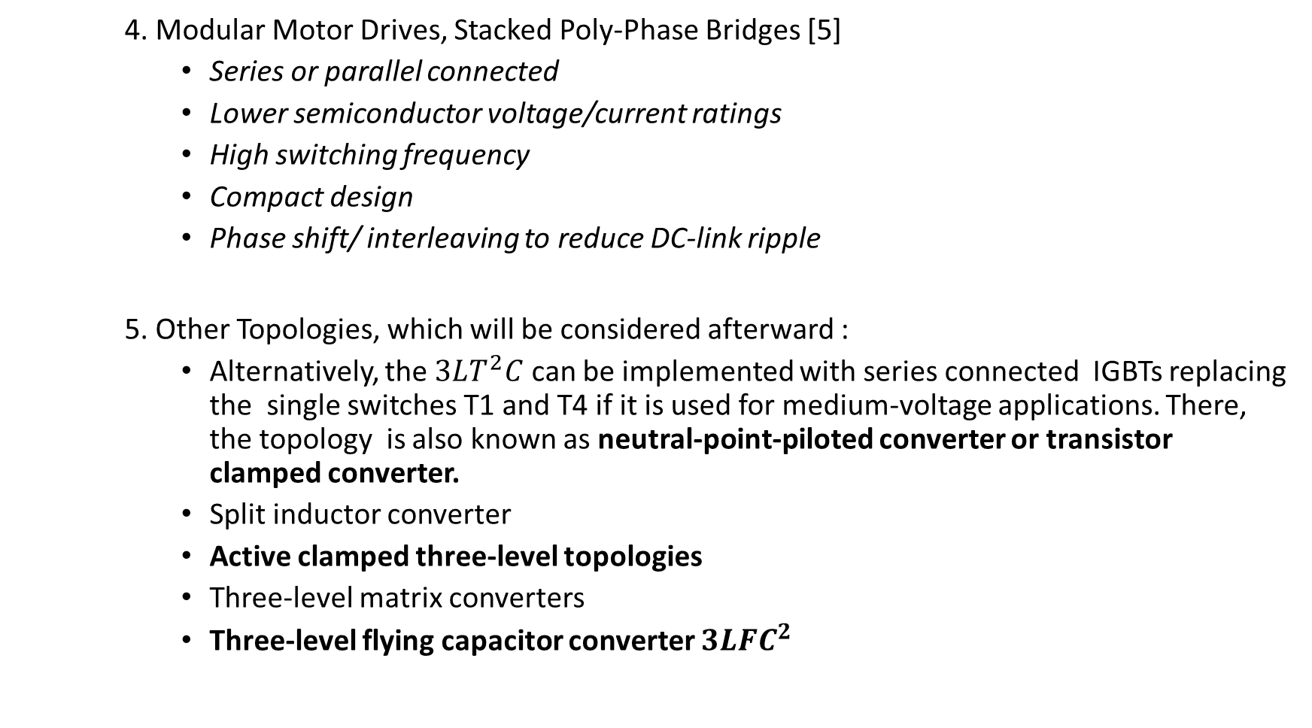
  4. Modular Motor Drives, Stacked Poly-Phase Bridges [5]
      Series or parallel connected
      Lower semiconductor voltage/current ratings
      High switching frequency
      Compact design
      Phase shift/ interleaving to reduce DC-link ripple
5. Other Topologies, which will be considered afterward :
      Alternatively, the $3LT^{2}C$ can be implemented with series connected IGBTs replacing the single switches T1 and T4 if it is used for medium-voltage applications. There, the topology is also known as neutral-point-piloted converter or transistor clamped converter.
      Split inductor converter
      Active clamped three-level topologies
      Three-level matrix converters
      Three-level flying capacitor converter $3LFC^{2}$

Slide 6
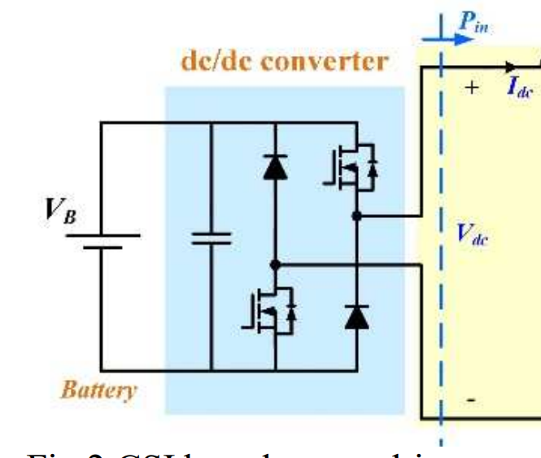
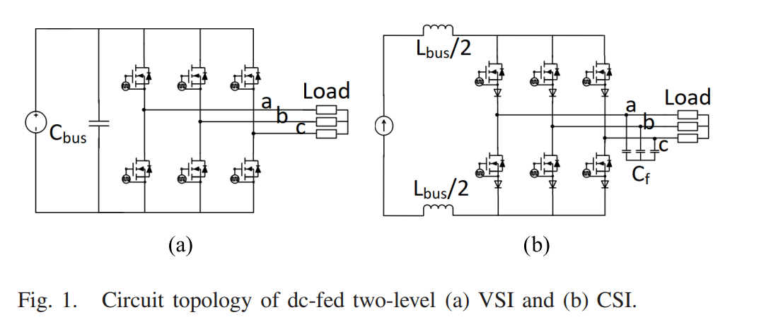
Voltage source inverters (VSIs) or current source inverters (CSIs) [3,4]
CSIs provide
  Higher efficiency
  Lower THD in the current
  Lower conducted EMI (both differential mode and common mode)
But, CSIs
  Have higher number of switches
  Require additional DC/DC converter to energize via battery

Slide 7


$$2LC$$
Suitable for low voltage applications.
Simple
Inexpensive
Bad efficiency for higher switching frequency
Cause higher overvoltage due to long cables
Cause higher machine isolation stress

Slide 8
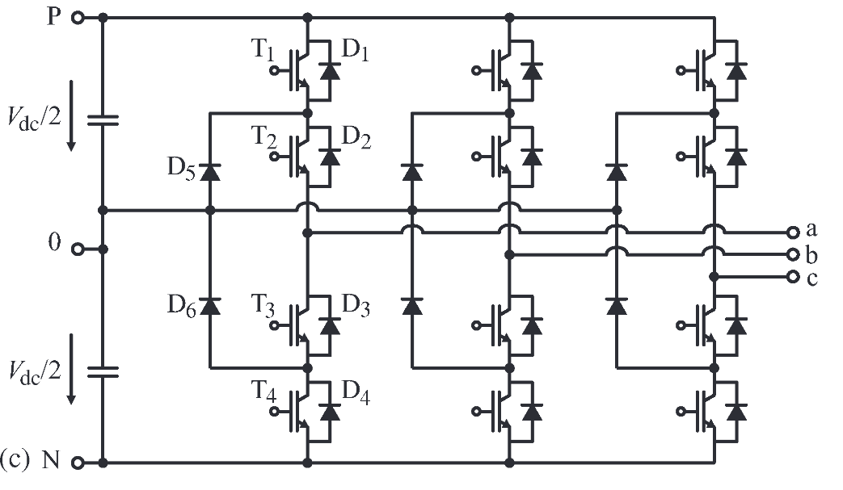

$3LNPC^{2}$
Medium voltage applications.
Reduced switching losses.
Split blocking voltage
The conduction losses can increase for bipolar devices if two devices with half of the blocking voltage are connected in series compared to one device providing the full blocking voltage.
Increased amount of semiconductors (2 diodes and four MOSFETs per bridge leg)
Increased amount of isolated gate drive voltage supplies (6 addition ones per inverter )

Slide 9
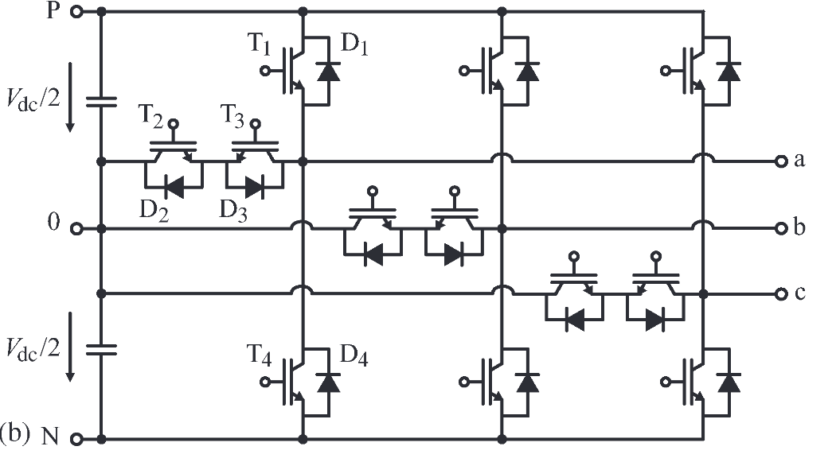
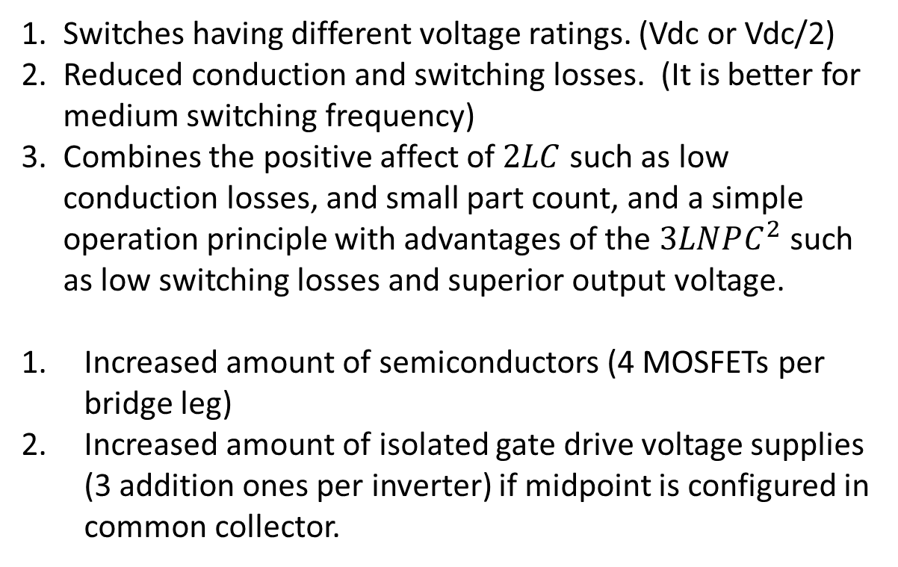

$$3LT^{2}C$$
Switches having different voltage ratings. (Vdc or Vdc/2)
Reduced conduction and switching losses. (It is better for medium switching frequency)
Combines the positive affect of $2LC$ such as low conduction losses, and small part count, and a simple operation principle with advantages of the $3LNPC^{2}$ such as low switching losses and superior output voltage.
Increased amount of semiconductors (4 MOSFETs per bridge leg)
Increased amount of isolated gate drive voltage supplies (3 addition ones per inverter) if midpoint is configured in common collector.

Slide 10
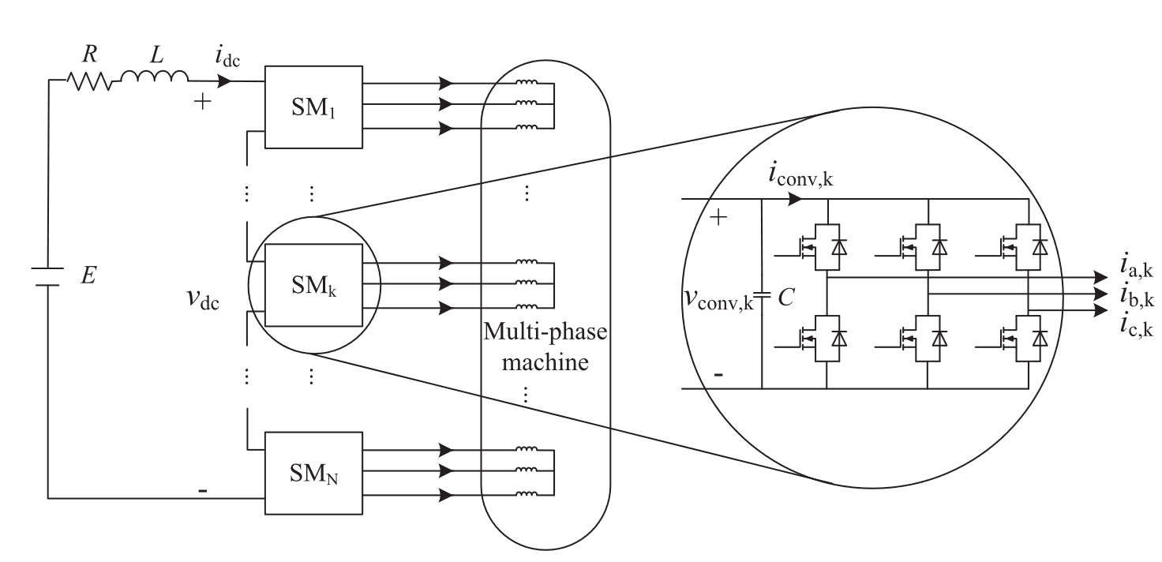
SPB [5]
The voltage ratings of the switches depends on the number of series connected submodules.
Can drive multi-phase or multi-3-phase machines
Reduces capacitor size in submodules, allowing for high switching frequencies.
Possesses an inherent fault-tolerant capability.
Integration and scalability
Since the series connected submodules are sharing the dc voltage, submodule capacitor voltage balance should be maintained under both normal and fault conditions.

Slide 11
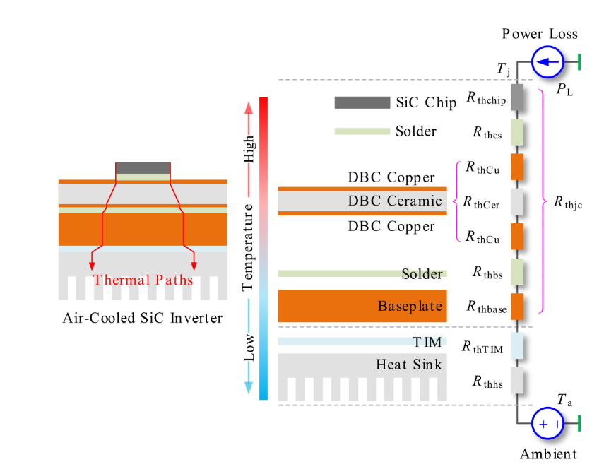
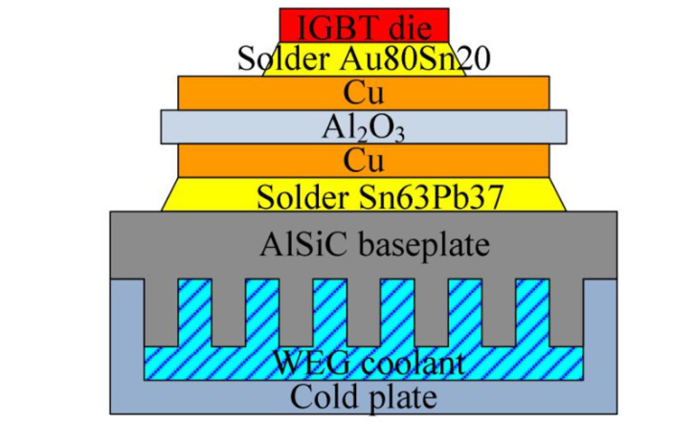
Thermal Management [6,7]
The size of the SiC device is smaller than the Si counterpart, and its power loss caused by high switching frequency makes it a high-heat-flux scenario.
Overheating is typically a main cause that can lead to device failure, system malfunction, or even the vehicle break down.
Especially when modern automotive industry continuously drives for higher system performance and smaller packing size, proper thermal management is critically required to achieve better heat dissipation, avoid local heat concentration, improve reliability, and reduce packaging size.

Slide 12
Thermal Management [7]
Different cooling technologies for power electronics are based on
  The heat transfer mechanism
  Coolant agent
  Heat sink (Aluminum is the cheapest and simplest)
  Advanced thermal interface materials (TIM) such as silicone based greases, aluminum-filled polyesters, and epoxy adhesives with silver particles
1. Air cooling technologies
  convection heat transfer mechanism
  Natural air convection
    the the simplest one
    Increasing the surface area of heat transfer with added fins
    Heat spreaders
  Forced air-cooling systems
    piezoelectric fans
    synthetic jet diaphragm

Slide 13
Thermal Management [7]
2. Liquid cooling technologies
  higher device power density
  microchannel heat sink can achieve around 1000 W/cm2 heat flux (State-of-the-art)
  Electro-wetting, jet impingement; Immersion; Two-phase spray cooling
  However, liquid cooling also brings in extra weight, complexity, and cost to the system.
  Acoustic noise, coolant leakage, corrosion, toxicity are also other factors
  Cutting-edge cooling: magnetic cooling, thermoelectric cooling, thermo-tunneling and thermo-ionic cooling, phase change materials
DBC direct bond copper:
This type of substrate contains a ceramic layer sandwiched in between two copper layers.
In order to spread better the heat and to increase the mechanical strength of the module, the substrate is bonded to a base plate.
DSC double sided cooling:

Slide 14
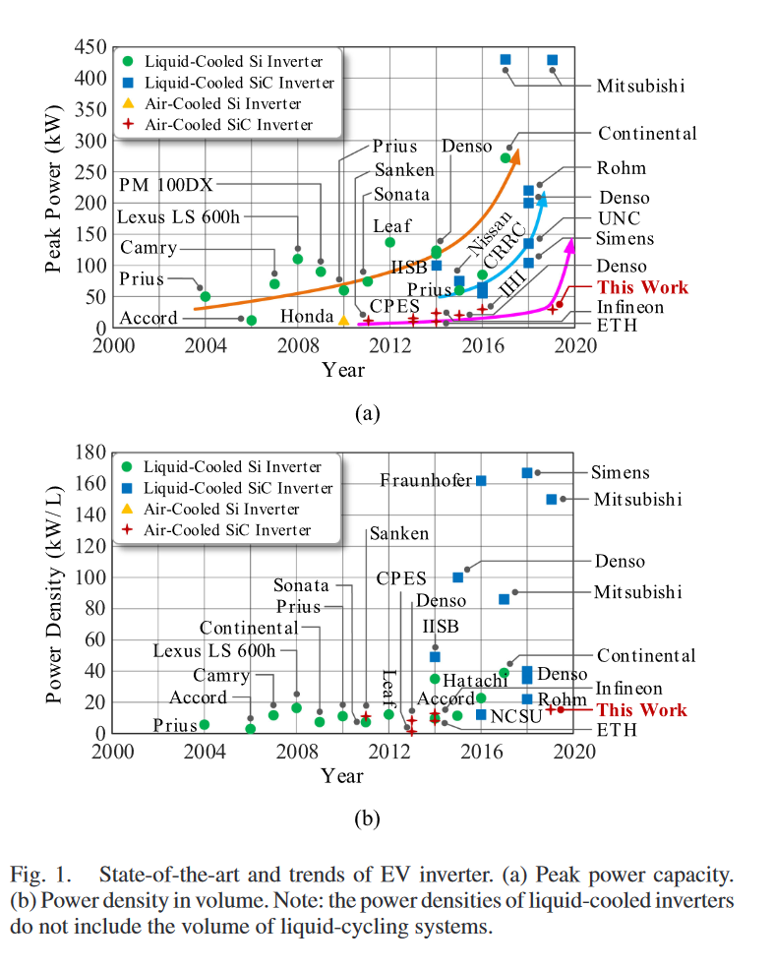
STATE-OF-THE-ART [6]
However, the volume of the liquid-cycling system (pumps, radiator, compressor, and chiller) will remarkably reduce the overall power density of the PCU.

Slide 15
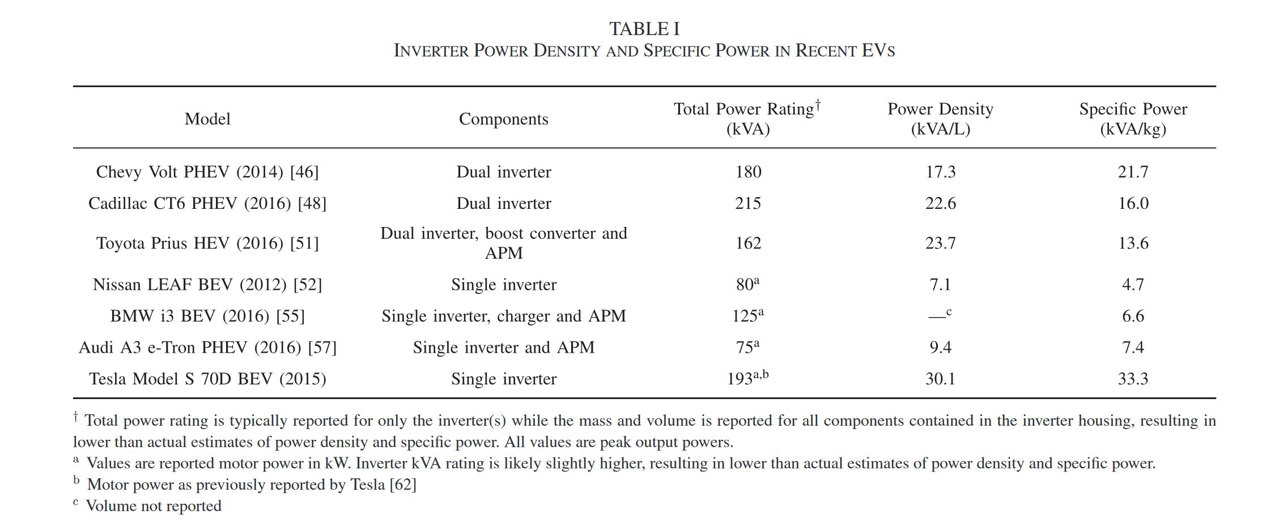
STATE-OF-THE-ART [8]

Slide 16
Trend [6,8]
The liquid-cooled Si inverters dominate the market, nowadays.
However, the liquid-cooled SiC inverters have been replacing the liquid-cooled Si inverter.
Direct cooling has been demonstrated in the Cadillac CT6 inverter in which the module package is fully immersed in the coolant, rather than bolted to a cold plate.
Passive 2-phase immersion cooling has been successfully applied to large scale traction inverters. (immersing them in a non-conductive cooling fluid.)
Moreover, the undergoing air-cooled SiC inverters are expected to be the next-generation PCU of EV powertrain toward the continuously increasing light and compact requirements of the EV.
If the air-cooled SiC inverter is desired, it
  Requires innovative to enhance the power dissipation and reduce the thermal resistance, including
    optimized heat sink structure
    integrated baseplate with pin-fin
    power-shower technologies
    3-D printed heat sink
    nano-scale thermal interface material (TIM)
    cold spray low temperature soldering
  Requires on-line regulation of power losses; including
    adaptive switching frequency
    adjustable dc-link voltage

Slide 17
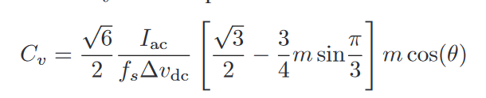

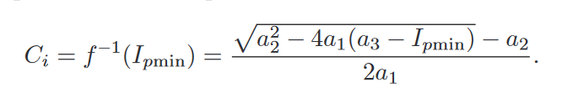
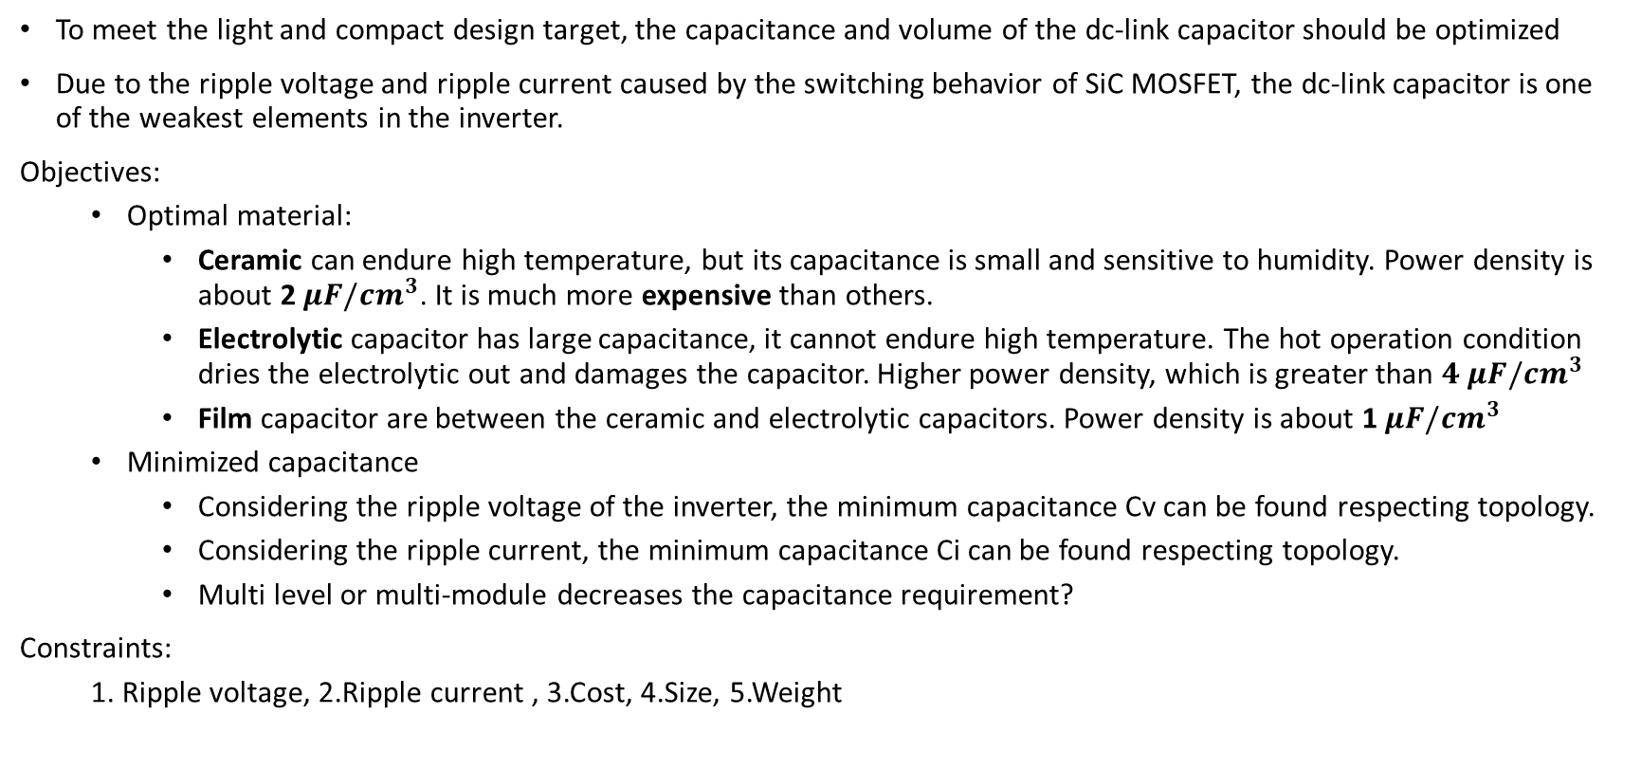
DC-link Capacitor Selection [6]
To meet the light and compact design target, the capacitance and volume of the dc-link capacitor should be optimized
Due to the ripple voltage and ripple current caused by the switching behavior of SiC MOSFET, the dc-link capacitor is one of the weakest elements in the inverter.
Objectives:
  Optimal material:
    Ceramic can endure high temperature, but its capacitance is small and sensitive to humidity. Power density is about 2$μF/cm^{3}$. It is much more expensive than others.
    Electrolytic capacitor has large capacitance, it cannot endure high temperature. The hot operation condition dries the electrolytic out and damages the capacitor. Higher power density, which is greater than $4 μF/cm^{3}$
    Film capacitor are between the ceramic and electrolytic capacitors. Power density is about 1$μF/cm^{3}$
  Minimized capacitance
    Considering the ripple voltage of the inverter, the minimum capacitance Cv can be found respecting topology.
    Considering the ripple current, the minimum capacitance Ci can be found respecting topology.
    Multi level or multi-module decreases the capacitance requirement?
Constraints:
  1. Ripple voltage, 2.Ripple current , 3.Cost, 4.Size, 5.Weight

Slide 18
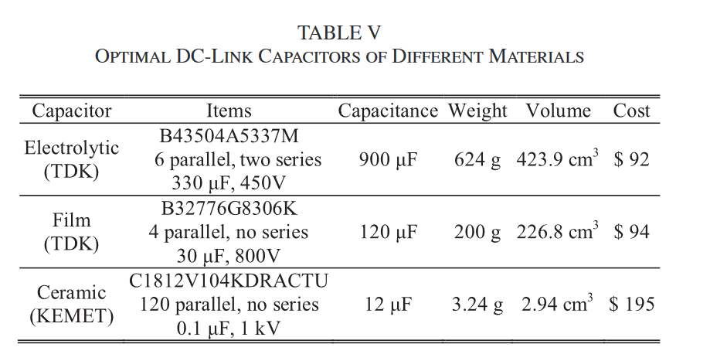
DC-link Capacitor Selection- Example Weight/Volume/Cost[6]

Slide 19
Busbar Design [11]
High switching speed of SiC may potentially cause:
  Excessive voltage overshoot
  Ringing
The overshoot voltage during turn-OFF transient is a common issue. It stems from:
  high di/dt (5-10 times higher than Si)
  the total stray inductance in the current commutation loops (CCLs)
    the parasitic inductance of the dc-link capacitors
    the stray inductance of the semiconductor devices or power modules
    the stray inductance on the bus bars connecting the capacitors and the power devices.
The laminated bus bar structure, which consists of multiple copper sheets, separated from each other by a dielectric material, is commonly used since it can effectively reduce the stray inductance. A proper busbar decrease:
  voltage overshoot
  electromagnetic interference (EMI) emission
  switching losses
  thermal stress

Slide 20
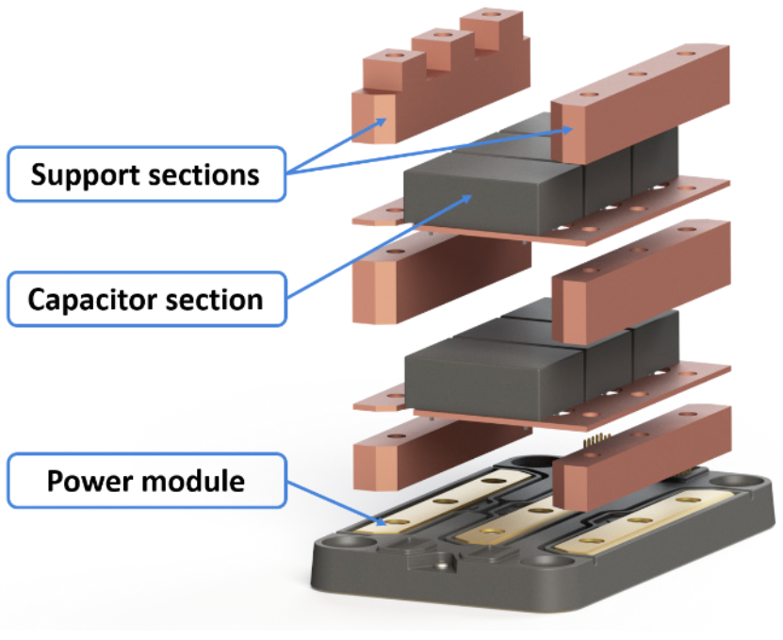
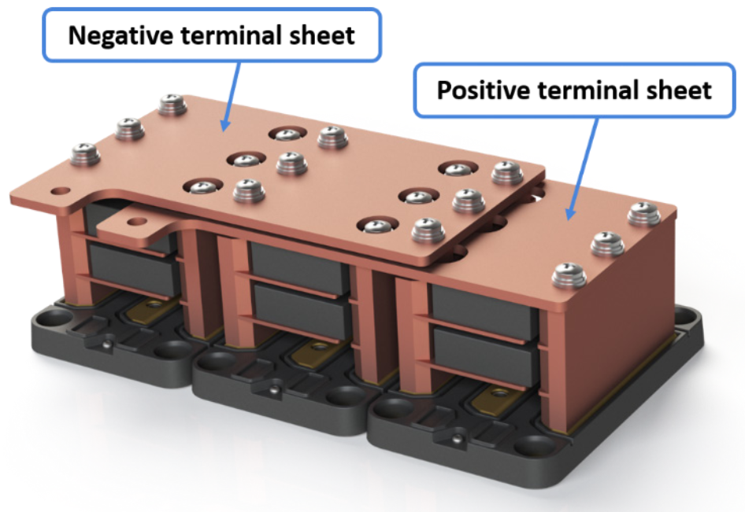
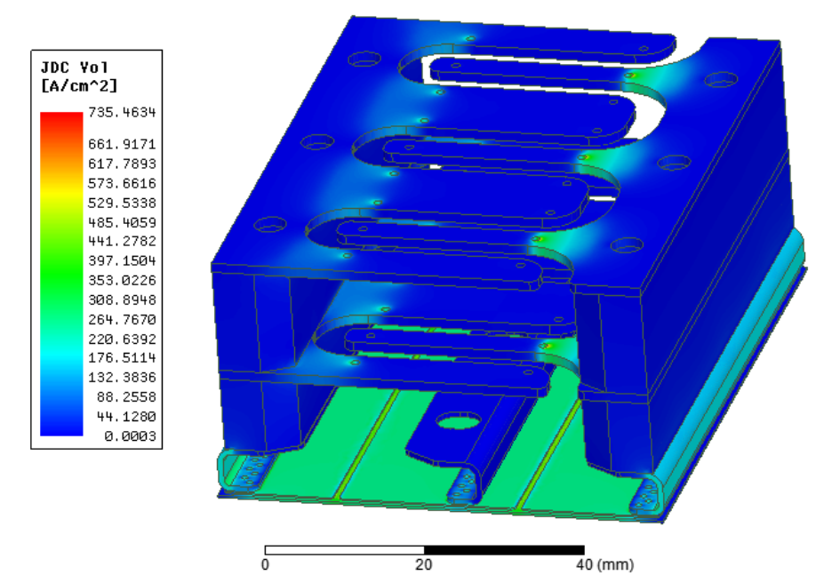
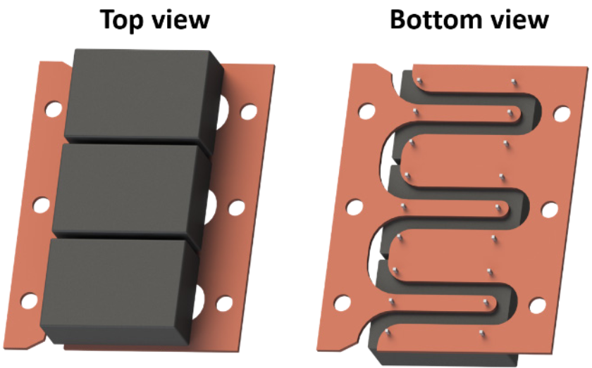
Busbar Design Example[12]
High-frequency current flow paths should be considered.
The layout of the busbar should be symmetric.
Current distribution should be homogenized.
Analytical calculations or FEA can be used to calculate stray inductances.
The stray inductances in current commutation loops should be minimized. (Typically order of 10nH)

Slide 21
References
[1] A Compact 250 kW Silicon Carbide MOSFET based Three-Level Traction Inverter for Heavy Equipment Applications
[2] Design and Validation of A 250-kW All-Silicon Carbide High-Density Three-Level T-Type Inverter
[3] Comparative Study of Conducted Common-Mode EMI in WBG-Enabled DC-Fed Three-Phase Current-Source Inverter
[4] Design of High Power Density 100 kW Surface Permanent Magnet Machine with No Heavy Rare Earth Material Using Current Source Inverter for Traction Application
[5] Modulation and Power Losses of a Stacked Polyphase Bridge Converter
[6] Stepwise Design Methodology and Heterogeneous Integration Routine of Air-Cooled SiC Inverter for Electric Vehicle
[7] Recent Developments in Thermal Management of Electrified Powertrains

Slide 22
References
[8] Automotive Traction Inverters: Current Status and Future Trends
[9] Multi-objective optimization design of electric vehicle converters based on ε-γ-σ
[10] Comparative Life Cycle Cost Analysis of Si and SiC PV Converter Systems Based on Advanced η-ρ-σ Multiobjective Optimization Techniques
[11] Busbar Design and Optimization for Voltage Overshoot Mitigation of a Silicon Carbide High-Power Three-Phase T-Type Inverter
[12] A low-inductance Sectional Busbar for Snuberless Operation of SiC-based EV Traction Inverters

