Slide 1
Gate Driver

Slide 2
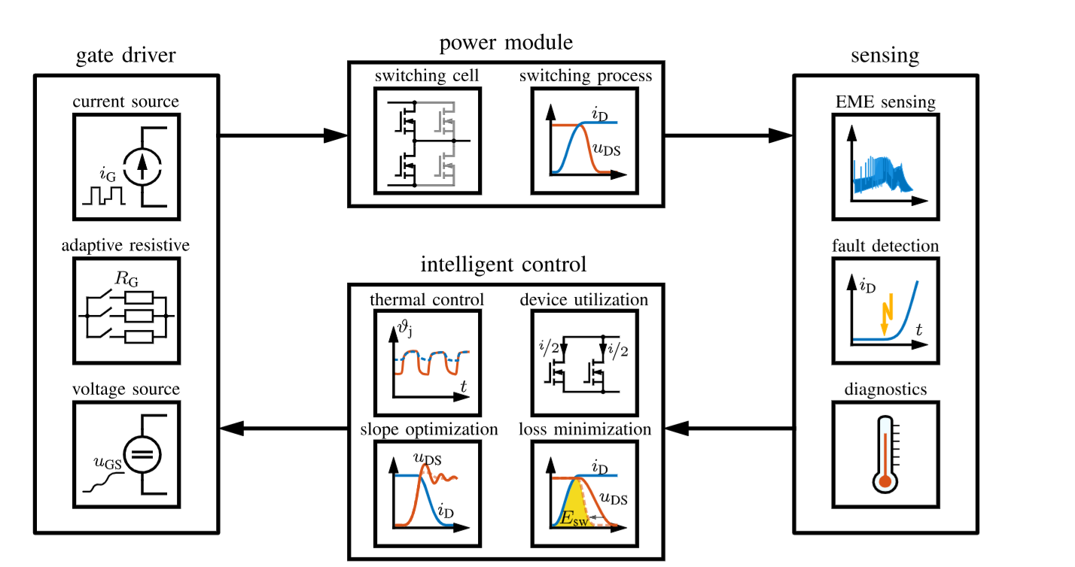
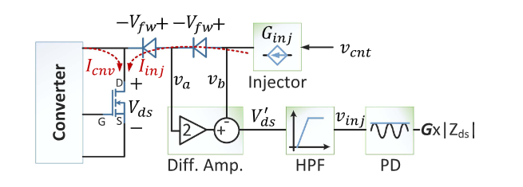
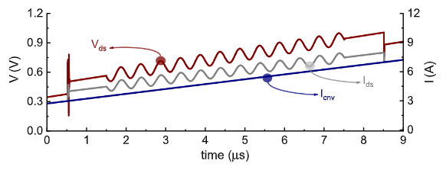
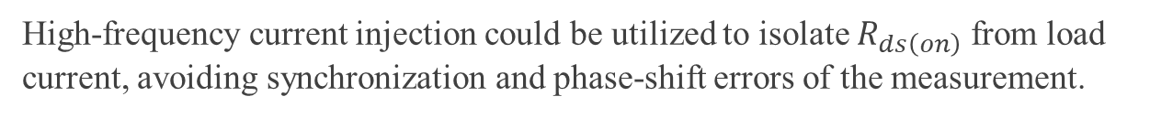
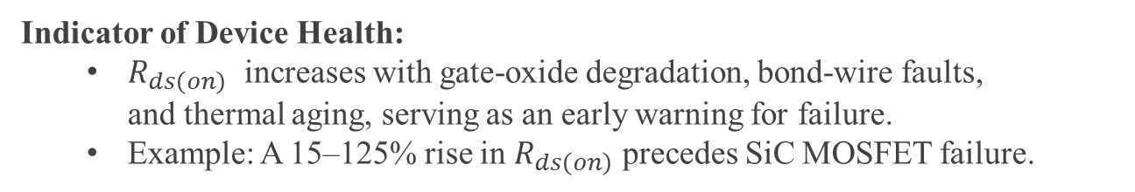
Intelligent Gate Drivers: Online $R_{ds}$ Measurement
Indicator of Device Health:
  $R_{ds\left(on\right)}$​ increases with gate-oxide degradation, bond-wire faults, and thermal aging, serving as an early warning for failure.
  Example: A 15–125% rise in $R_{ds\left(on\right)}$​ precedes SiC MOSFET failure.
Fault Prevention:
  Detects chip- and package-level defects (e.g., solder cracks, oxide traps) before catastrophic failure.
High-frequency current injection could be utilized to isolate $R_{ds\left(on\right)}$​​ from load current, avoiding synchronization and phase-shift errors of the measurement.
Fig: Intelligent Gate Drivers:
Sensing,control, gate drivers
F. Karakaya, "An Approach for Online Estimation of On-State Resistance in SiC MOSFETs Without Current Measurement,
Jochen Henn, ”Intelligent Gate Drivers for Future Power Converters”

