Slide 1

Topology Selection of 3$φ$ Traction Motor Drives
Enes Ayaz
2023.05.19-2023.05.28

Slide 2
Aims
  Reducing power losses
  Better thermal design
  Integration of the drive system (also called e-axle)
  Which in turn enables using larger battery pack, providing longer mileage
Higher voltage level
  Enable faster charging
  Decreased power losses and demands for conductor material (by decreasing current requirements for the same power level)
  New standard : Megawatt Charging System (MCS) (up to 1250 V and 3000 A)
  But it should be consider reliability and physical stress, such chip cracks, bond-wires failures
Semiconductors SiC MOSFETs
  Higher temperature
  Better efficiency
  But, new kind of failure mechanism
  Should perform lifetime analysis, considering economic lifetime of the inverter

Slide 3
HemizeroD-Objectives
precisely define the specifications, requirements and possibilities for the design of BEHDV powertrains with a nominal battery voltage of 1250 V compatible with the new MCS charging standard
to develop and build a power electronic converter optimized for 1250V with min 99.5% efficiency in the best point and understand the challenges.
to develop and build an electric machine optimized for 1250V with at least 98% efficiency in best working point and understand the challenges
to investigate and understand aging phenomena on constituent components of converters and electric machine that occurs at an elevated voltage level
to develop methods for diagnostics and prognostics with the aim of reducing maintenance costs.
To achieve a total efficiency in the drive system in the best operating point of 97.5%

Slide 4
HemizeroD-
The holistic life cycle cost optimization at the system level provides the opportunity to achieve cost reduction in balance with climate benefit that enables implementation.
Scania has, for example, launched the concept of TOE (Total Operating Economy) to better understand how the vehicle system's costs and performance affect hauliers' finances.
The project will develop methods and software to be able to optimize the life cycle cost of drive systems in electrified cargo vehicles. The optimization concerns design parameters as well as those in the control software, such as e.g. the switching frequency.
The project is coming thus contributing to hardware and software optimization and electrical architecture in vehicles and charging and tank infrastructure
This applies to the possibility of holistically optimizing drive systems across subsystem boundaries. The possibility of using time simulations and FEM simulations as part of calculating constraint conditions and objective function will be tested.

Slide 5
HemizeroD- State-of-Art Traction inverters:
  2L topology:
    Simple
    Reliable
    Not suitable for battery packs having a nominal voltage above 800V
    Not suitable for MCS Standard
  Multi-level modular topologies:
    Reliable
    Lower Cost
    Fault tolerant
  3L topologies:
    Better dv/dt, affecting the motor winding insulations and stress on the bearings
    Better efficiency for higher switching frequency
    Splitting the blocking voltage

Slide 6
HemizeroD- State-of-Art Semiconductors:
  Efficiency, temperature, compactness, and cost
  Silicon carbide (SiC):
    Higher temperature
    Better efficiency
    High blocking voltage
    But, new kind of failure mechanism
  Gallium Nitride (GaN)
    Better efficiency
    Lower blocking voltage
    Higher switching frequency

Slide 7
HemizeroD- State-of-Art :
Especially considering that the project aims at a high voltage system, modularity at the component, phase, converter or motor level can be used to achieve high efficiency, high compactness, low cost and high reliability.
To achieve this, a holistic optimization of the entire drive system including motor, inverter, control, and individual components such as intermediate link capacitors is required. In doing so, it is also important to consider methods for cooling the motor, inverter, and components such as intermediate link capacitors

Slide 8
PowerizeD :
Page 513, Page 537, Page 542, Page 554, Page 639
Holistic approach, combining mission profiles, power modules and converter advanced models, and digital twins, to provide optimized traction systems in terms of efficiency, size and reliability.
A shift to SiC metal-oxide semiconductor field-effect transistors (MOSFETs) would enable significant loss reductions, particularly at part load operation, and enable higher switching frequencies, whereby smaller dc-link capacitors can be used. This could result in significant cost and size reductions along with efficiency improvements.
Condition-monitoring-based operation concept will prevent over-dimensioned design, unnecessary material use, replacement of components before end of life, reduced volume and weight, and reduced costs. The concept, however, comes with a challenge to develop lifetime models based of physics of failure and machine learning methods, using data from a multitude of vehicles operating daily and being connected to a cloud-based data collection centre.

Slide 9
PowerizeD-Objectives
To accurately define the specifications, requirements, and opportunities for the design of BEHDV drivetrains with a 1250 V nominal battery voltage compatible with the new MCS charging standard
To identify suitable circuit topologies and other basic design choices to meet the requirements
To design (through holistic design optimization) a competitive and highly efficient 1250 V SiC-based BEHDV traction inverter for e-axle integration
To design a gate drive unit with condition monitoring of the SiC MOSFETs
To verify the designed traction inverter design through realistic laboratory tests
To drive reliability improvements, prediction of reliability, and investigate methods for condition monitoring in the entire drive system.

Slide 10
PowerizeD
  A multi-physics optimization of the traction inverter is performed such that the specified target function is minimized.
    Lifetime models of all critical components are developed through a combination of review of existing literature, analytical considerations, numerical simulations, and experiments.
Nominal power losses of the traction inverter of 0.6% (compared to state-of-the-art 1.0%)
Losses over the VECTO long-haul drive cycle of 0.7% (compared to state-of-the-art 1.2%)
Nominal input voltage of the designed converters of 1250 V (state-of-the-art 800 V)
Power density of the traction inverter of 50 kW/l (compared to state-of-the-art 30 kW/l)

Slide 11
Key Technologies
1) power converter topology—The arrangement of the semiconductor devices and passive components;
2) power semiconductor material (commonly silicon or silicon carbide);
3) passive component requirements;
4) modulation and control techniques that are optimized for the application requirements;
5) packaging, housing, and integration, including thermal interfaces and EMI shielding.

Slide 12
Parameters
1) weight/volume implications at the system level;
2) thermal design and cooling requirements;
3) power converter efficiency and power quality;
4) packing, reliability, and availability.

Slide 13
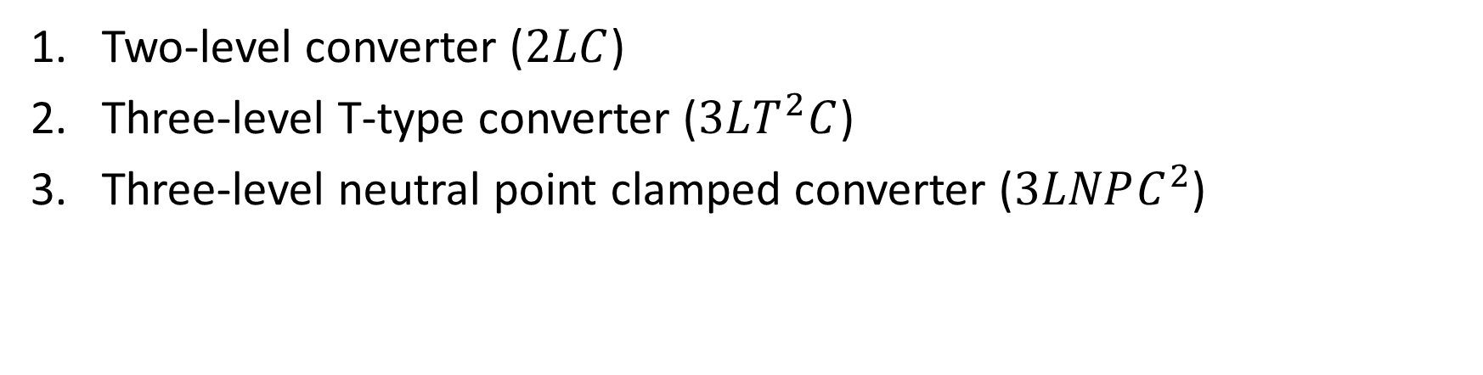
Common Topologies
Two-level converter ($2LC$)
Three-level T-type converter ($3LT^{2}C$)
Three-level neutral point clamped converter ($3LNPC^{2}$)

Slide 14
Comparison of 2LC and Corresponding 3L Competitors
3LCs offer an increased efficiency at higher switching frequencies.
3LCs decrease the electromagnetic interference (EMI).
3LCs decreases the output harmonics, so output load losses.
However,
3LCs increases the complexity of both integration and control.
3LCs have higher initial costs.

Slide 15
Trade-offs
Shifting toward lower switching frequency
+
Usage larger conductor diameters
+
Paralleling switching device
=
Higher efficiency
=
But bulky system
Shifting toward higher switching frequency
=
Fulfilling control performance
+
Reducing acoustic noise
+
Reducing the volume and weight of passive components
+
High power density
+
But lower efficiency

Slide 16


$$2LC$$
Suitable for low voltage applications.
Simple
Inexpensive
Bad efficiency for higher switching frequency
Cause higher overvoltage due to long cables
Cause higher machine isolation stress

Slide 17
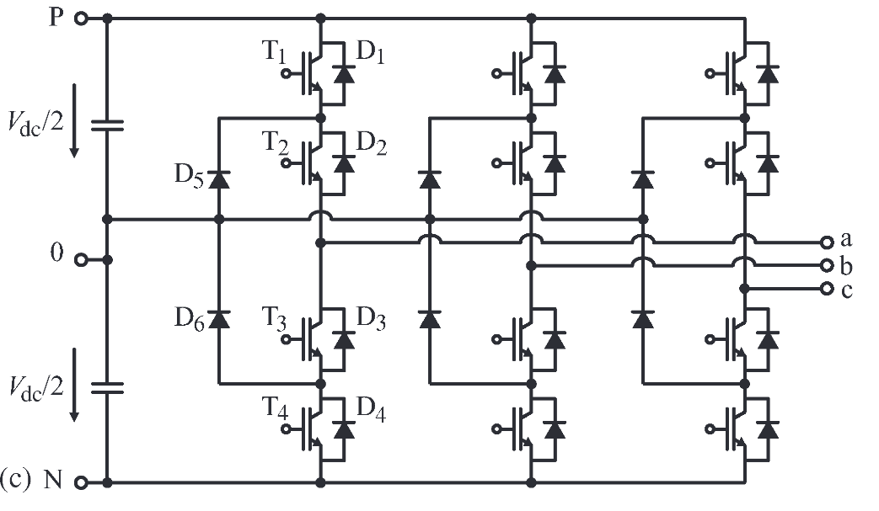

$3LNPC^{2}$
Medium voltage applications.
Reduced switching losses.
Split blocking voltage
The conduction losses can increase for bipolar devices if two devices with half of the blocking voltage are connected in series compared to one device providing the full blocking voltage.
Increased amount of semiconductors (2 diodes and four MOSFETs per bridge leg)
Increased amount of isolated gate drive voltage supplies (6 addition ones per inverter )

Slide 18
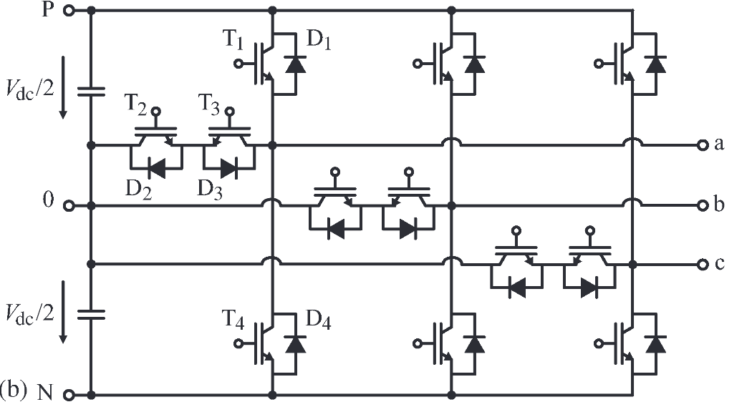
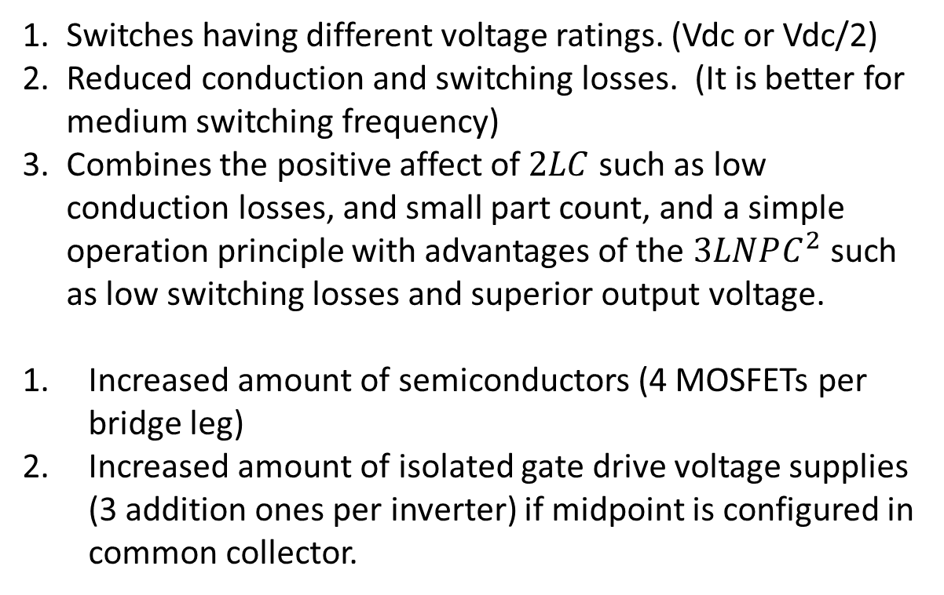

$$3LT^{2}C$$
Switches having different voltage ratings. (Vdc or Vdc/2)
Reduced conduction and switching losses. (It is better for medium switching frequency)
Combines the positive affect of $2LC$ such as low conduction losses, and small part count, and a simple operation principle with advantages of the $3LNPC^{2}$ such as low switching losses and superior output voltage.
Increased amount of semiconductors (4 MOSFETs per bridge leg)
Increased amount of isolated gate drive voltage supplies (3 addition ones per inverter) if midpoint is configured in common collector.

Slide 19
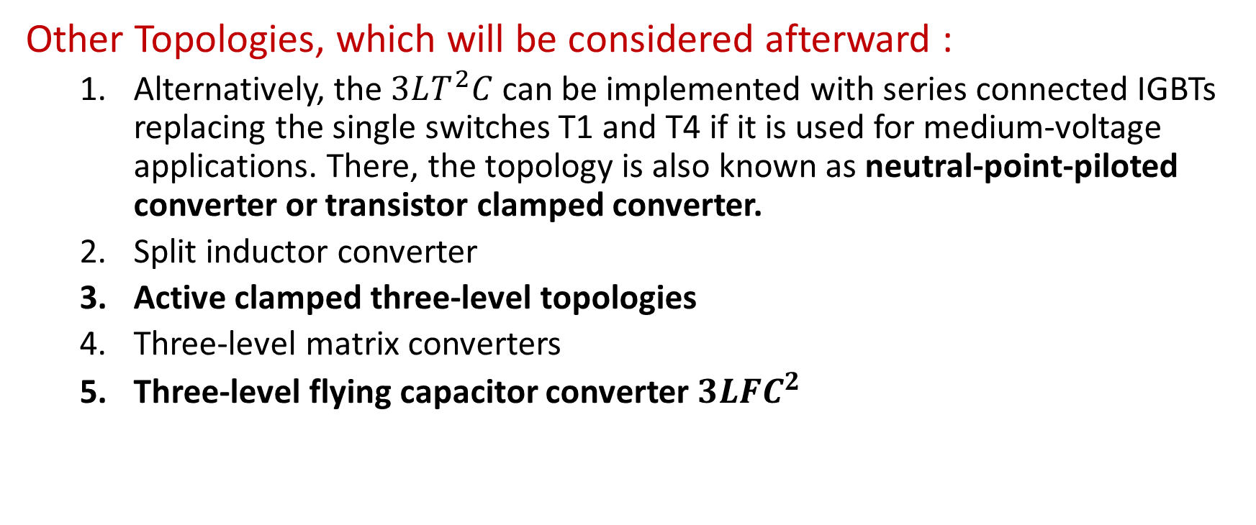
Other Topologies, which will be considered afterward :
  Alternatively, the $3LT^{2}C$ can be implemented with series connected IGBTs replacing the single switches T1 and T4 if it is used for medium-voltage applications. There, the topology is also known as neutral-point-piloted converter or transistor clamped converter.
  Split inductor converter
  Active clamped three-level topologies
  Three-level matrix converters
  Three-level flying capacitor converter $3LFC^{2}$

Slide 20
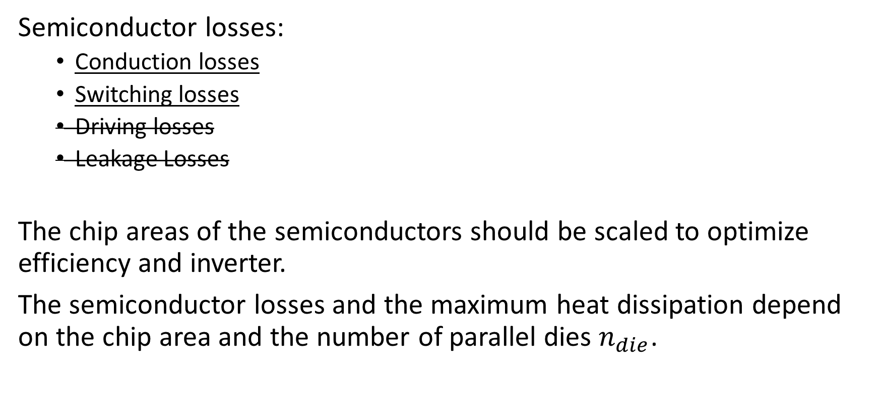
Semiconductor Losses and Chip Area Optimization
Semiconductor losses:
  Conduction losses
  Switching losses
  Driving losses
  Leakage Losses
The chip areas of the semiconductors should be scaled to optimize efficiency and inverter.
The semiconductor losses and the maximum heat dissipation depend on the chip area and the number of parallel dies $n_{die}$.

Slide 21
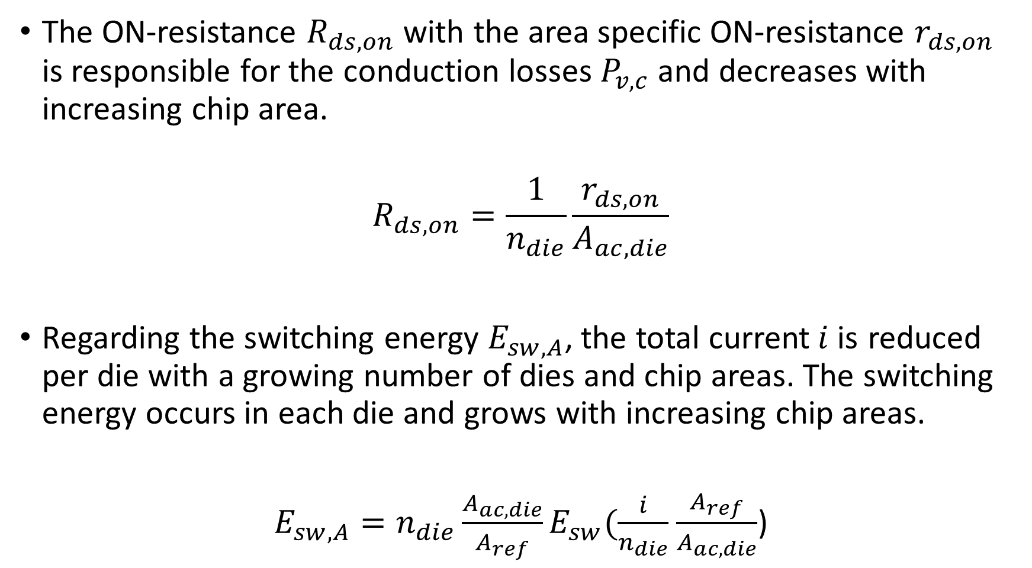
The ON-resistance $R_{ds,on}$ with the area specific ON-resistance $r_{ds,on}$ is responsible for the conduction losses $P_{v,c}$and decreases with increasing chip area.
$$R_{ds,on}=\frac{1}{n_{die}}\frac{r_{ds,on}}{A_{ac,die}}$$
Regarding the switching energy $E_{sw,A}$, the total current$i$is reduced per die with a growing number of dies and chip areas. The switching energy occurs in each die and grows with increasing chip areas.
$E_{sw,A}=n_{die}\frac{A_{ac,die}}{A_{ref}}E_{sw}(\frac{i}{n_{die}}$ $\frac{A_{ref}}{A_{ac,die}}$)

Slide 22
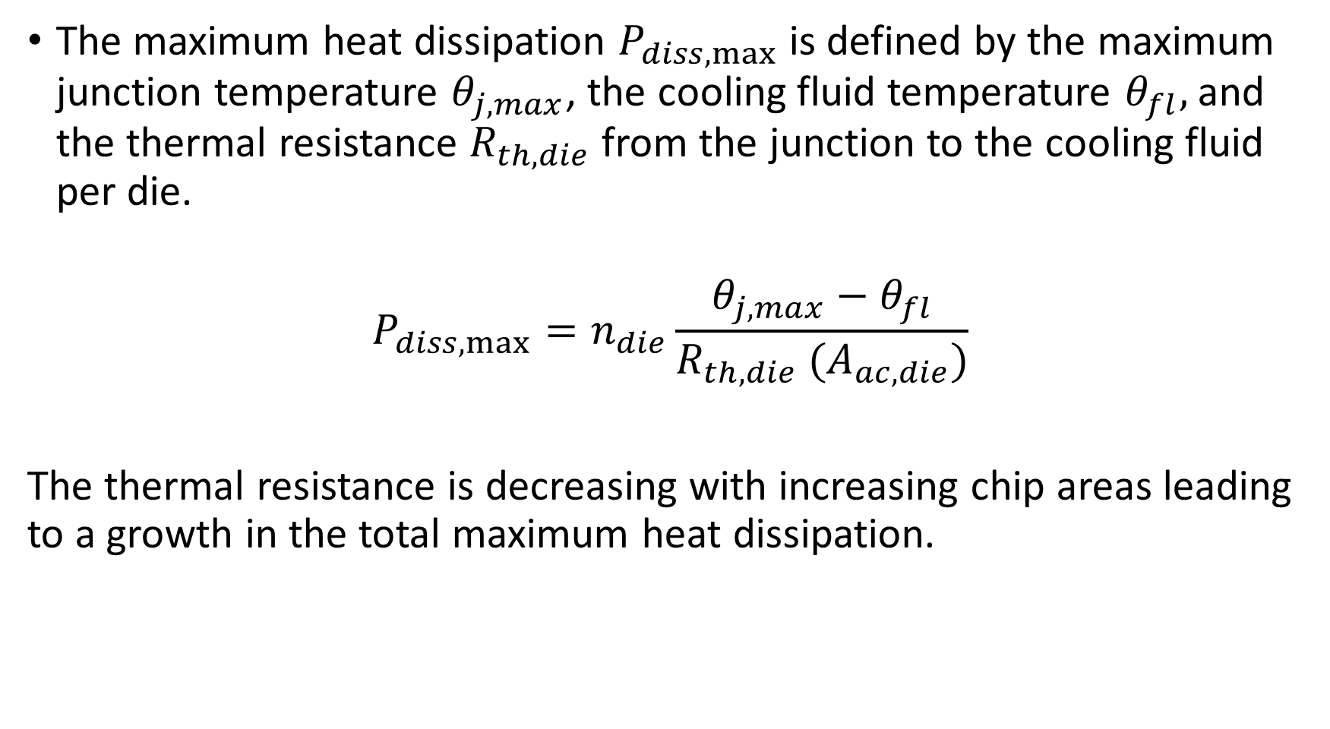
The maximum heat dissipation $P_{diss,max}$ is defined by the maximum junction temperature $θ_{j,max}$, the cooling fluid temperature $θ_{fl},$and the thermal resistance $R_{th,die}$ from the junction to the cooling fluid per die.
$$P_{diss,max}=n_{die}\frac{θ_{j,max}−θ_{fl}}{R_{th,die} (A_{ac,die})}$$
The thermal resistance is decreasing with increasing chip areas leading to a growth in the total maximum heat dissipation.

Slide 23
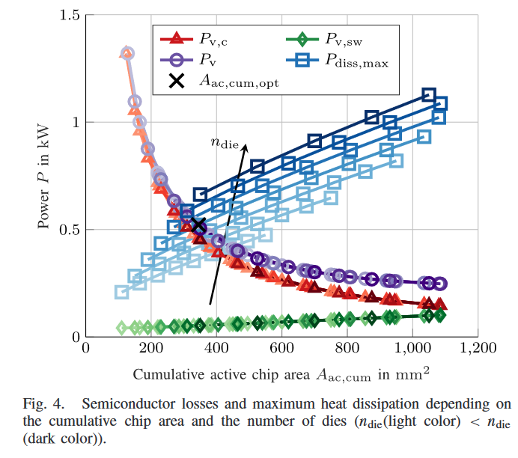

Slide 24
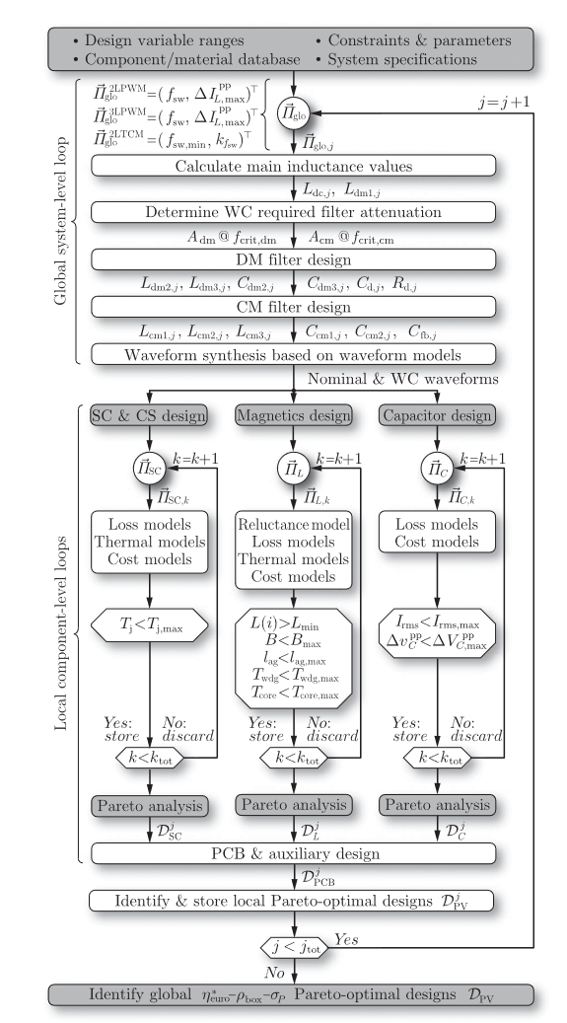
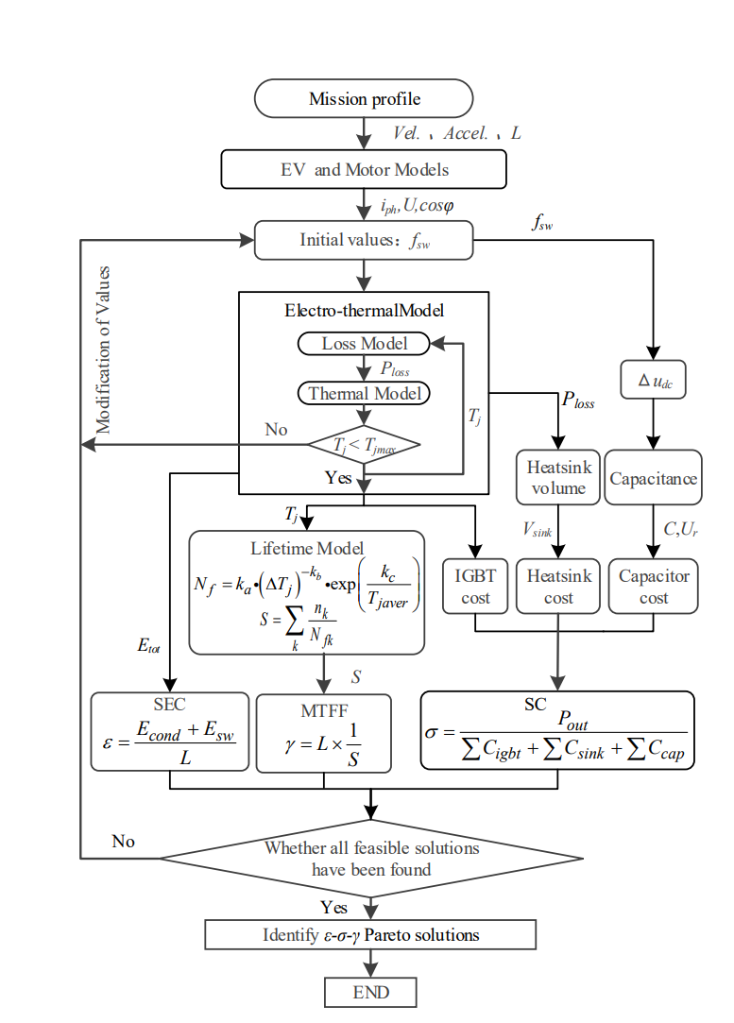

Slide 25
References
[1] Comparative Evaluation of Advanced Three-Phase Three-Level Inverter/Converter Topologies Against Two-Level Systems
[2] Potentials and Comparison of Inverter Topologies for Future All-Electric Aircraft Propulsion
[3] Electric/Hybrid-Electric Aircraft Propulsion Systems
[4] Multi-objective optimization design of electric vehicle converters based on ε-γ-σ
[5] Comparative Life Cycle Cost Analysis of Si and SiC PV Converter Systems Based on Advanced η-ρ-σ Multiobjective Optimization Techniques

