Slide 1
Preliminary Investigation on
Bearing Currents In EV Drives:
Sources, Modelling and Mitigations
Enes Ayaz

Slide 2
Sources and Consequences of Bearing Current [1] [2]
Sources
Low frequency bearing currents:
  Magnetic field asymmetry, generating `shaft voltage`
    Inability to manufacture a motor to perfect accuracy.
    Unbalanced voltage signal generated by the inverter. [2]
  Anisotropy of magnet`s remanence and permeability of iron core material
High frequency bearing current:
  High frequency common mode voltage (CMV), resulting `shaft voltage` in variable frequency drives (VFDs)
    capacitive path
    inductive path
  SiC and GaN (WBG) has given rise to dramatic increases in dv/dt.
Consequences
Once the bearing current density exceeds a particular threshold, the metallic structure and lubricants of the bearings could be progressively damaged, hence significantly curtailing bearing life [1].
2.Nine percent of all bearing failures are caused by bearing currents [2].

Slide 3
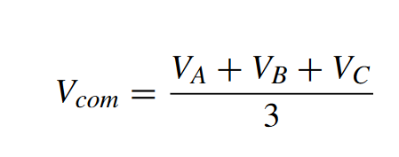
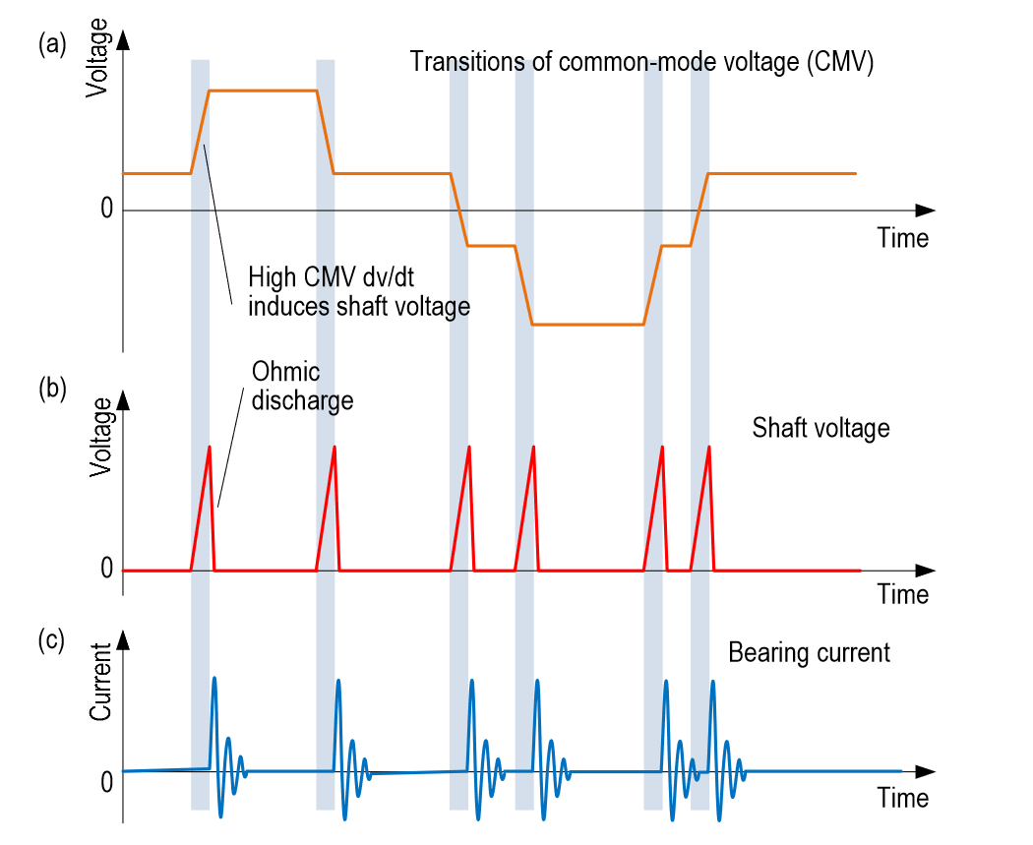
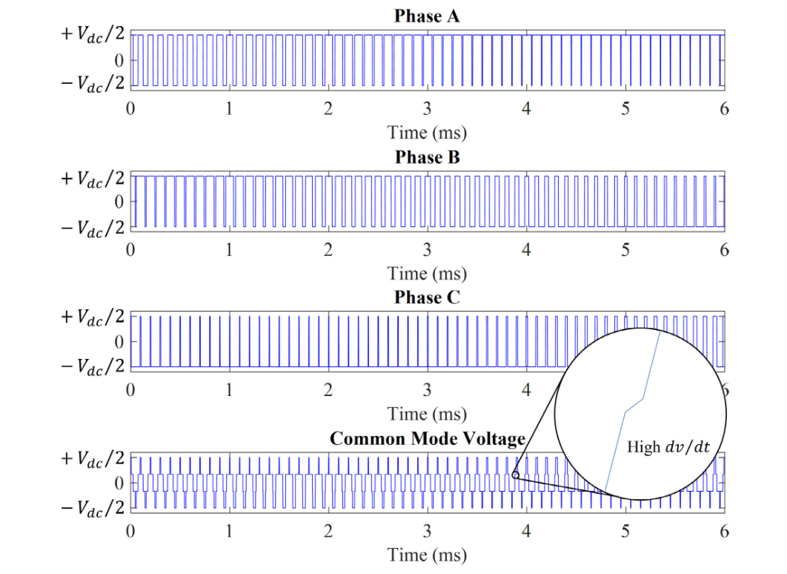
PHYSICS OF BEARING CURRENTS [1]
COMMON MODE VOLTAGE
The neutral to ground voltage is the zero-sequence voltage, expressed below
The frequency of the common mode voltage is 3 times the switching frequency and the switching action produces very high dv/dt.
The RMS value of common mode voltage increases with an increase of switching frequency and a decrease of motor speed. the peak magnitude is affected by switching frequency only.

Slide 4
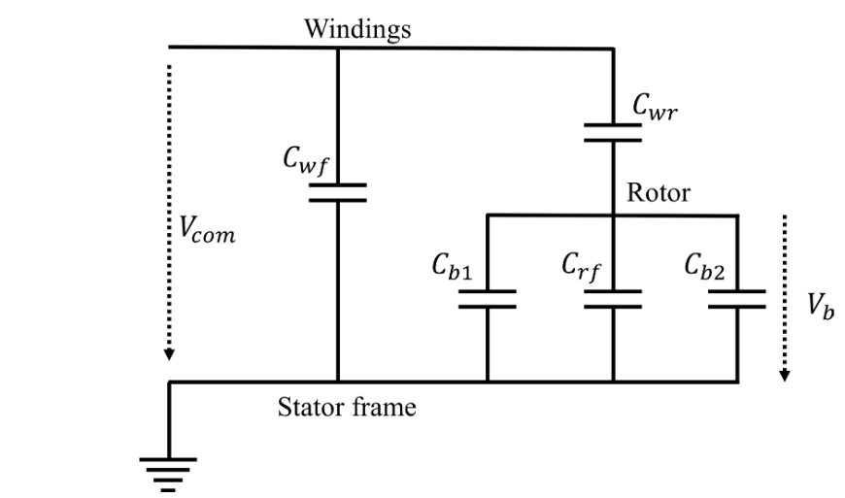
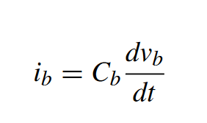
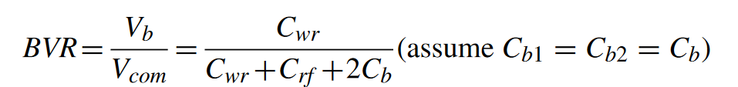
PHYSICS OF BEARING CURRENTS
FOUR TYPES OF BEARING CURRENT MECHANISMS
The stray capacitances or parasitic capacitances in the machine provide a path for the bearing current.
1. CAPACITIVE BEARING CURRENTS
The main parasitic capacitances in the machine have been identified as :
  Winding-stator frame capacitor Cwf.
  Winding-rotor capacitor Cwr.
  Stator-rotor capacitor Crf.
  The bearings act as capacitors, Cb1 and Cb2.
If the speed is low (< 100rpm), the bearing ball may contact the races
and hence the bearing is equivalent to a resistor.
The amplitude of this bearing current is typically ≤ 200mA.

Slide 5
PHYSICS OF BEARING CURRENTS
2. ELECTRIC DISCHARGE MACHINING (EDM) CURRENTS-iEDM
Causes:
  If the `Vb` is high enough to cause electrical breakdown of the lubricant film, the energy stored in the rotor-frame capacitance discharges and generates an impulse current.
  The dielectric lubricant can flow into the channel and form a new insulation film, and thus the bearing capacitance charges again.
  This breakdown-recovery-breakdown process repeatedly continues.
Consequences:
  The so called EDM current damages the bearing with each impulse as the discharged energy damages the metal surface.
  This process progressively increases the presence of metallic particles in the lubricant, which exacerbates on-going electrical breakdown.
  The vicious circle accelerates bearing failure.

Slide 6
PHYSICS OF BEARING CURRENTS
3. CIRCULATING BEARING CURRENTS-iCB
Causes:
  The common mode voltage generates a high frequency common mode current which flows in the winding→stator→ground path.
  This high frequency current induces a common mode flux which further generates a high frequency voltage along the shaft.
  The shaft voltage causes the circulating bearing currents in the loop: shaft → driving end bearing→stator frame→non driving end bearing→shaft.
4. ROTOR GROUND CURRENTS-iRG
Causes:
  The rotor can be grounded via load in some cases.
  If the impedance of rotor to ground is much lower than the stator to ground impedance, a proportion of the ground current will flow from the rotor through the bearing, since the current flows predominantly in the path with the lowest impedance.

Slide 7
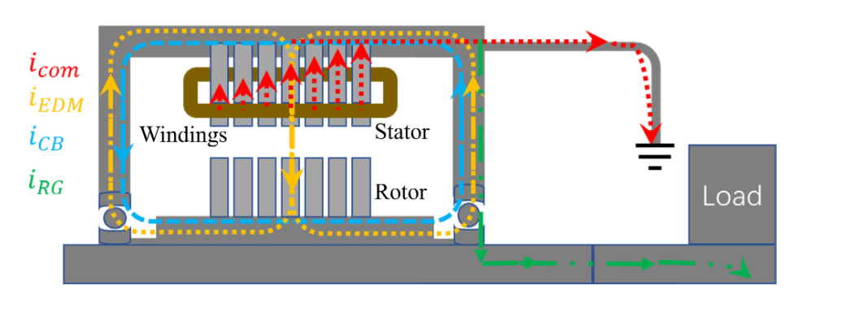
PHYSICS OF BEARING CURRENTS
Since the capacitive bearing currents are usually too small to be harmful to the bearings, in some literature only the last 3 types of bearing currents are recognized.
The rotor ground current should be investigated on a caseby-case basis as it is only present if the rotor is grounded, meaning it depends on the configuration of the load.
Hence, the main interest in published studies has been on the modelling and prediction of the EDM and circulating currents.

Slide 8
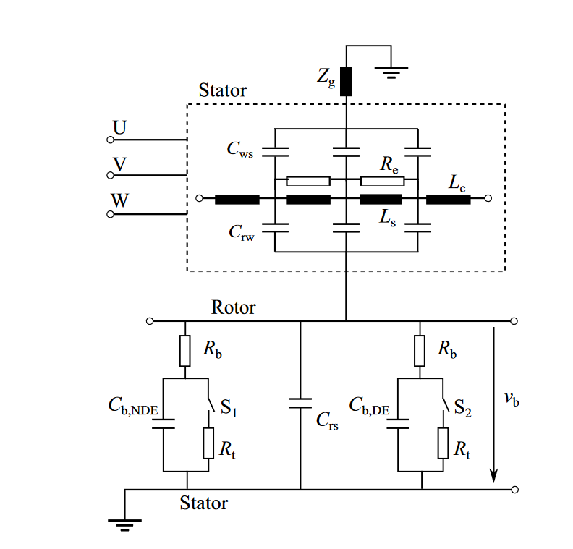
CAPACITIVE EDM BEARING CURRENT MODEL [3,4]
  Capacitive bearing current model including phase model.
  Parameters can be measured by impedance analyzer and fitting afterward [4].
  They can be analytically calculated by simplifying the machine for the capacitive configuration.
  2D-FEM can be used to calculate the capacitance values. (Turn-to-turn and turn-to-core capacitances)
  3D-FEM can be used to account the end-winding effect. (Rotor-to-plate capacitance)

Slide 9
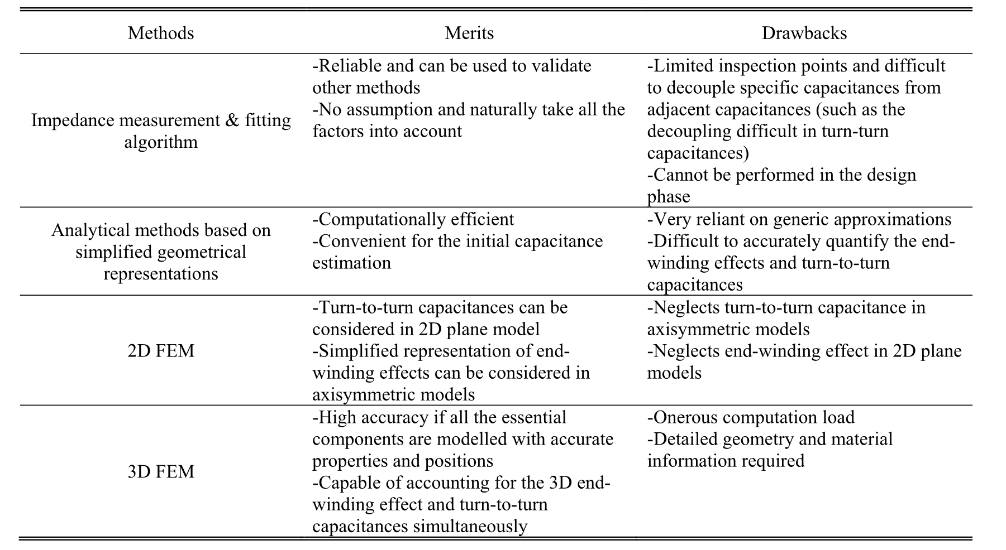

Slide 10
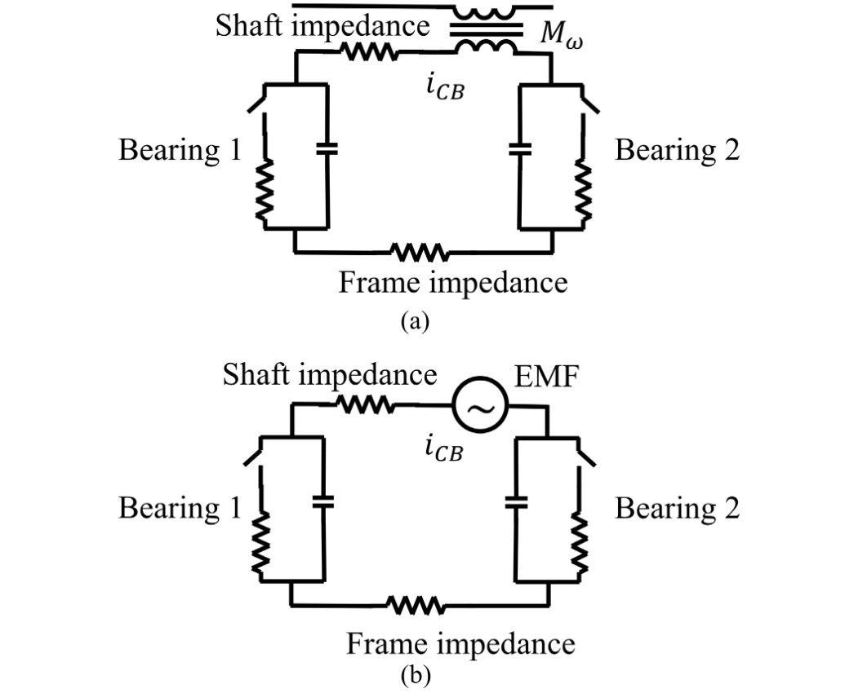
INDUCTIVE CIRCULATING BEARING CURRENT[3,4]
Equivalent circuit of circulating bearing current
(a) with mutual inductance; (b) with EMF source.
The current is generated by the induced shaft voltage which results from the common mode current icom.
The circulating bearing current and the common mode current are coupled via the common mode flux.
The mechanism can be considered as a transformer with the primary side having common mode current and the secondary side with circulating bearing current.

Slide 11
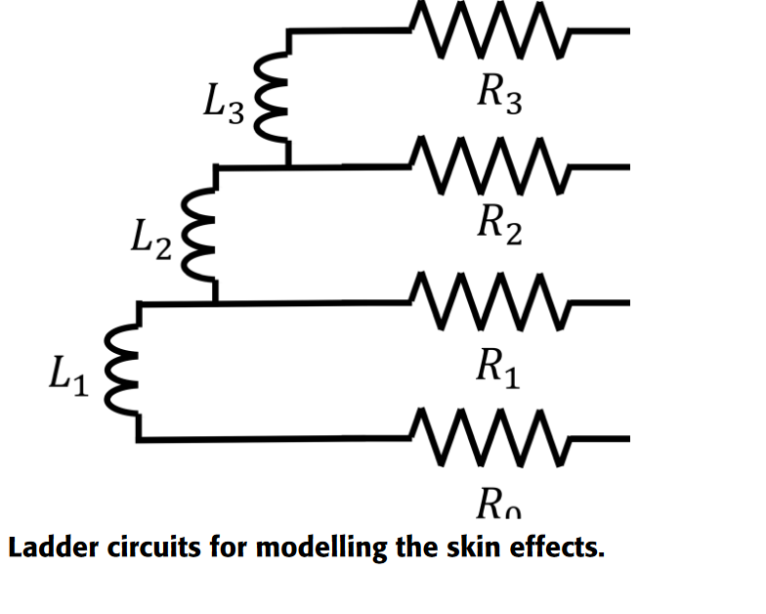
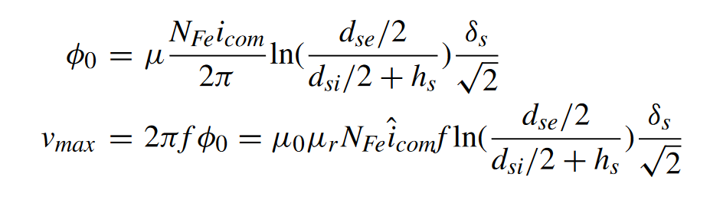
INDUCTIVE CIRCULATING BEARING CURRENT[3,4]
The common mode voltage generates the common mode current which flows via the winding-to-stator capacitor into the stator laminations.
The impedance of the stator core is strongly frequency-dependent due to the skin effect. The skin and proximity effects are taken into account by modeling the resistances and inductances by ladder circuits
The common mode circumferential flux, an analytical calculation of the mutual inductance and the resulting circulating current path impedance can be found analytically.
NFe is the number of sheets of stator core, dse is the outer diameters of stator lamination, dsi is the inner diameters of stator lamination, hs is the height of stator slot, δs is the skin depth and f is the frequency of common mode current.

Slide 12
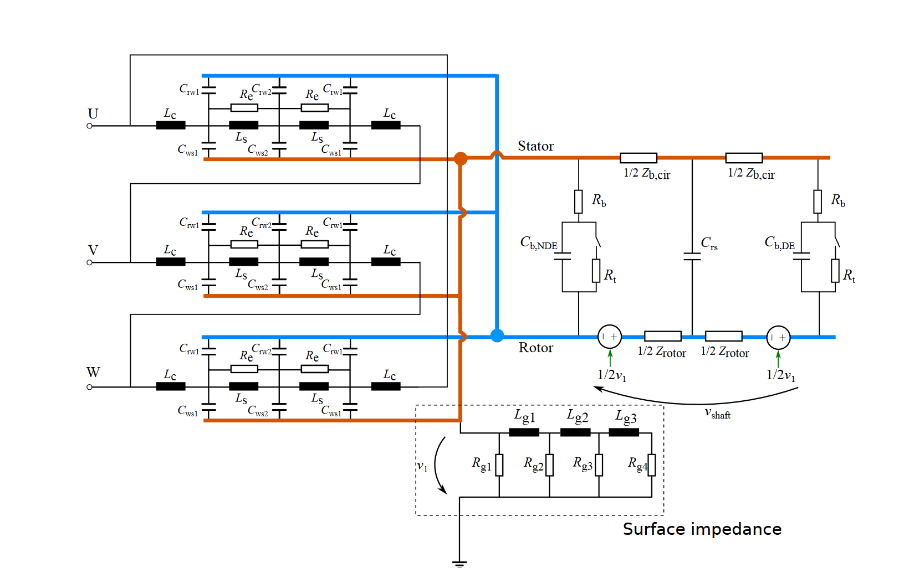
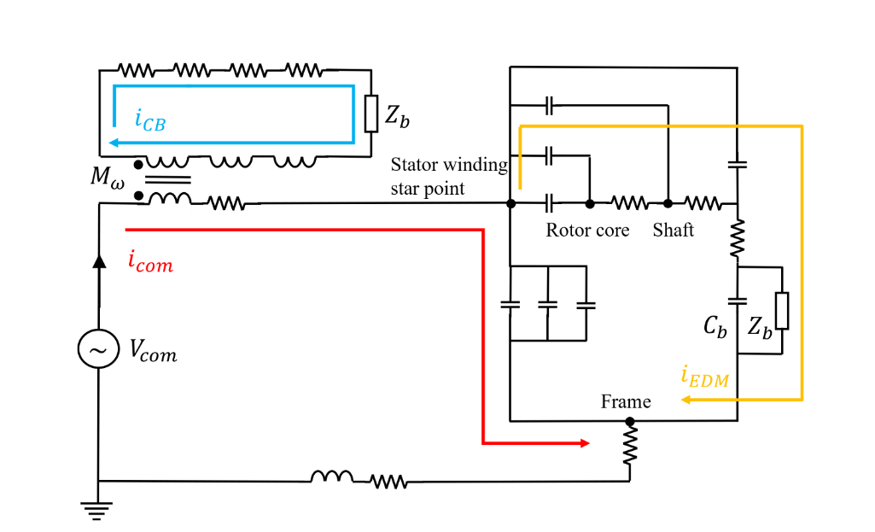
COMBINED EDM AND CIRCULATING CURRENT MODELING [3,4,5]
Complete model for capacitive
and inductive bearing current.
Equivalent lumped parameter model [6].

Slide 13
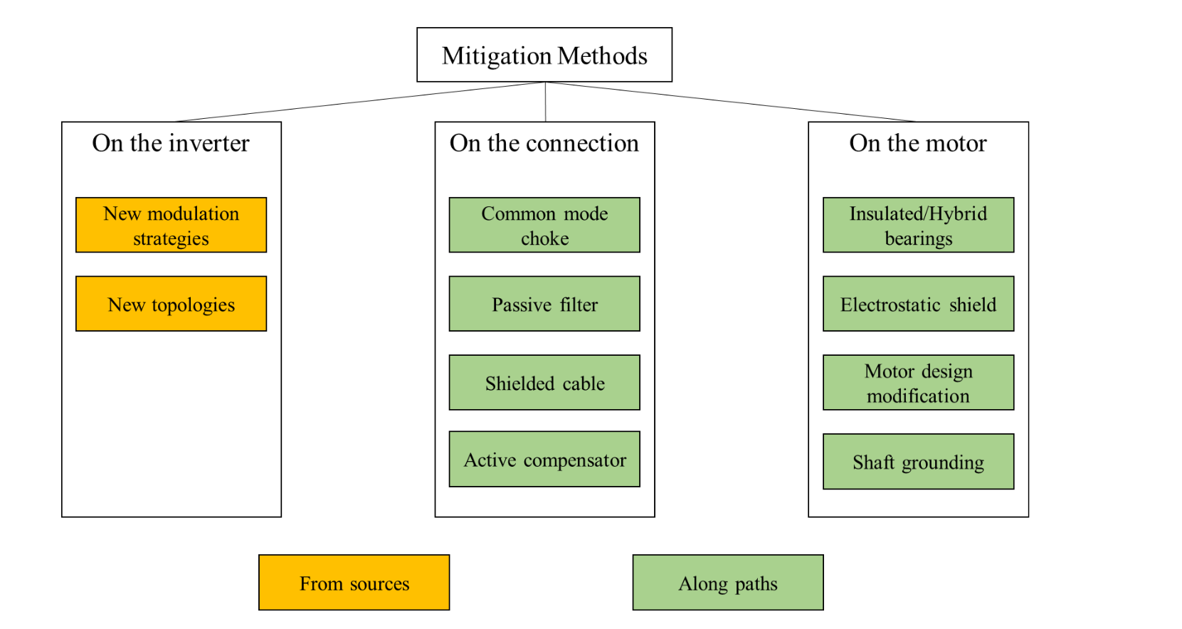
MITIGATION METHODS- Inverter Side
Inverter side mitigation methods act directly on the source so that they are effective for all four bearing current mechanisms.
New modulations
  Selective harmonic eliminations
  Space vector modulation
  Utilizing degree of freedom
New topologies
  Additional 4th leg with LC filter
  Cascaded inverters
  Dual bridge inverter
  3-level is better than 2-level
  Multi-level is better than 3-level
  Achieving high degree of freedom

Slide 14
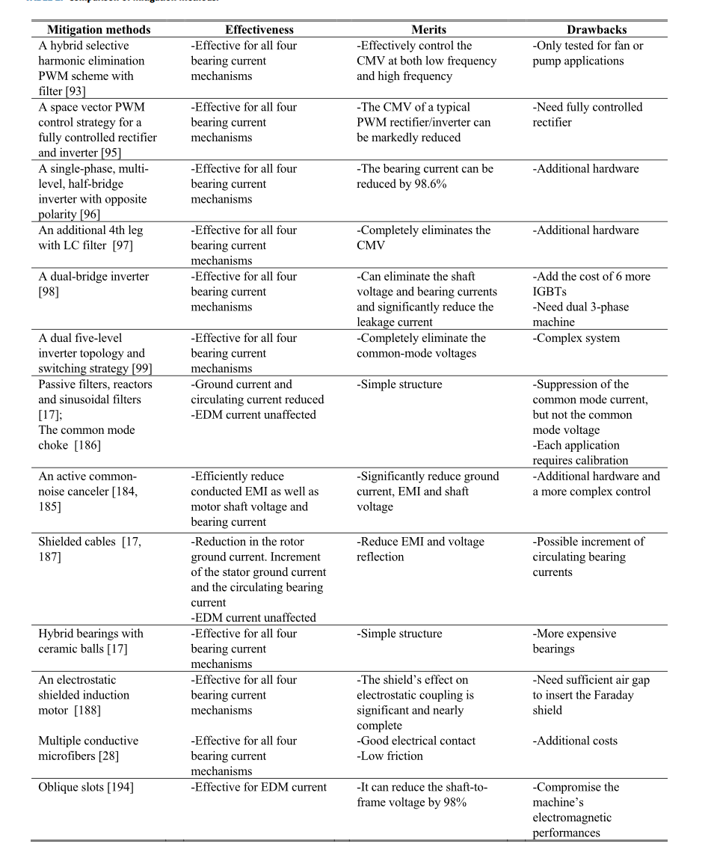
[1]

Slide 15
References
[1] A Review of Modeling and Mitigation Techniques for Bearing Currents in Electrical Machines With Variable-Frequency Drives
[2] A Review of Shaft Voltages and Bearing Currents in EV and HEV Motors
[3] Modeling and Measurement of Capacitive and Inductive Bearing Current in Electrical Machines
[4] A Universal High-Frequency Three-Phase Electric-Motor Model Suitable for the Delta and Star-Winding Connections\
[5] Induction Motor Model for the Analysis of Capacitive and Induced Shaft Voltages
[6] An Improved Model for Circulating Bearing Currents in Inverter-Fed AC Machines

