Slide 1



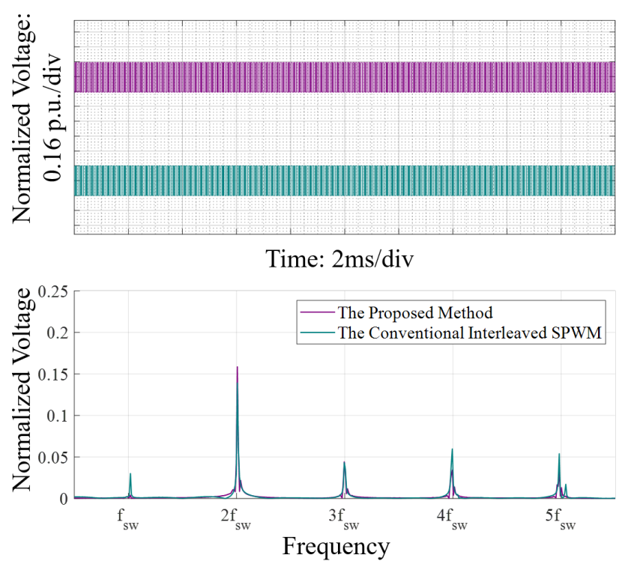
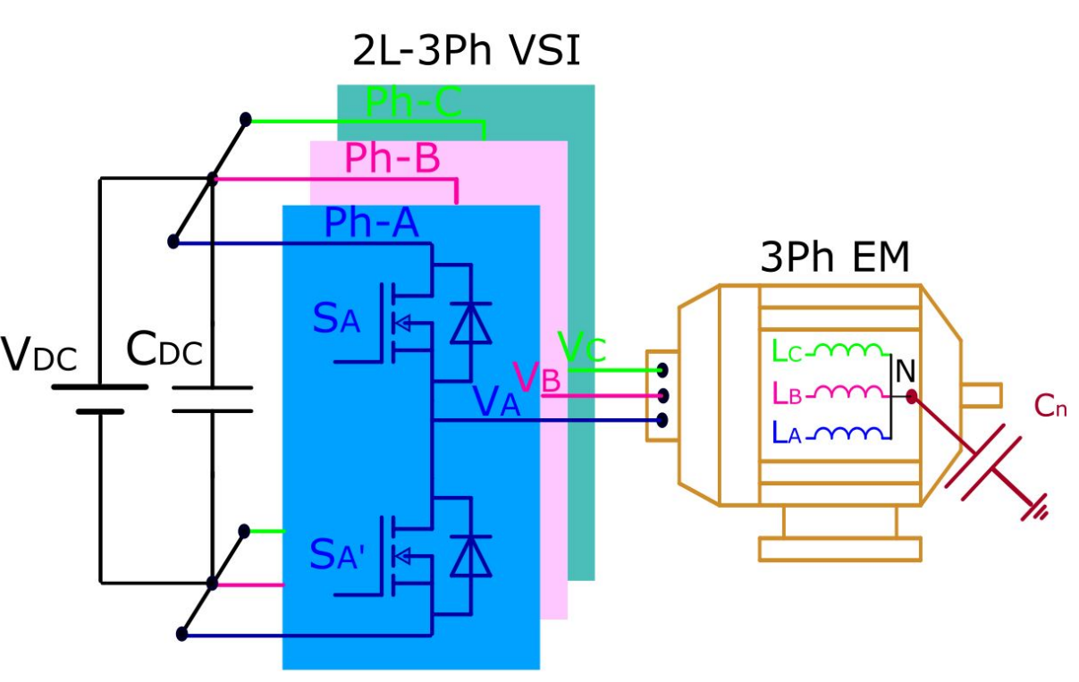
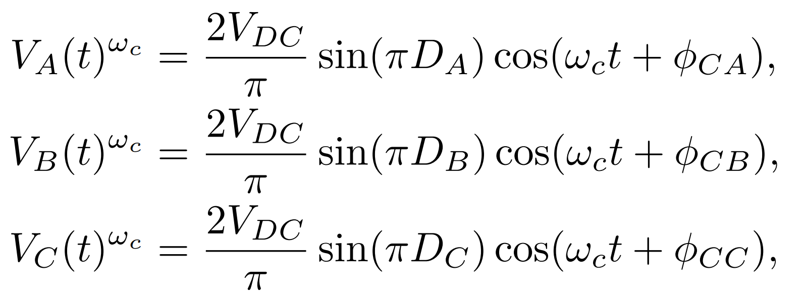
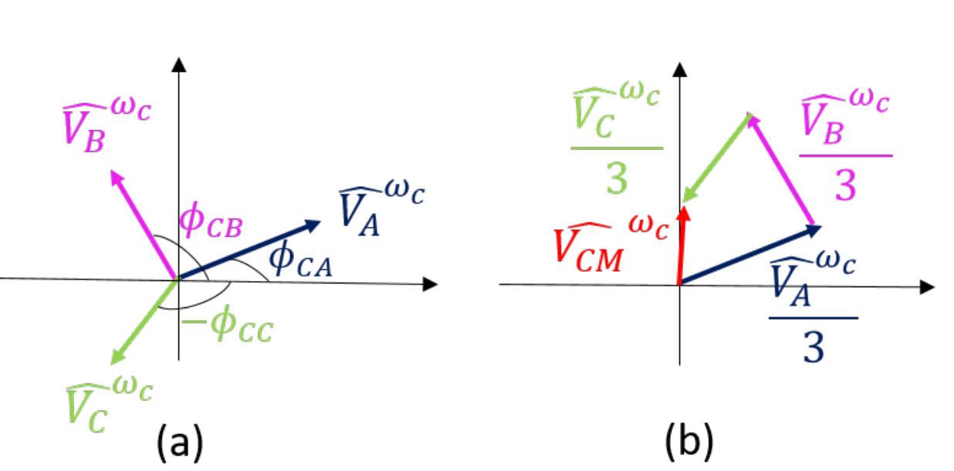
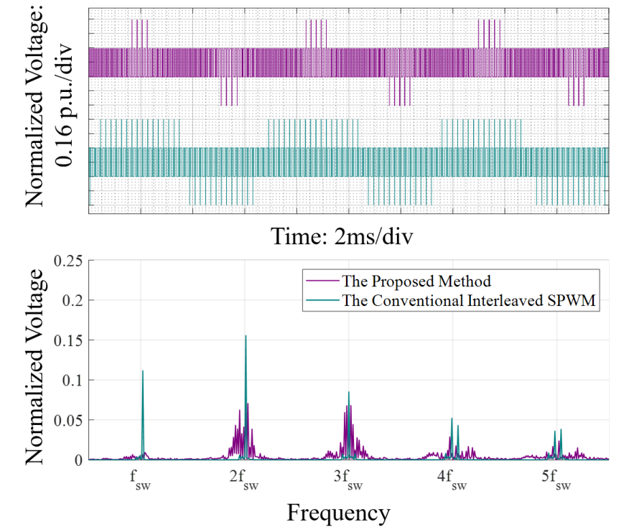
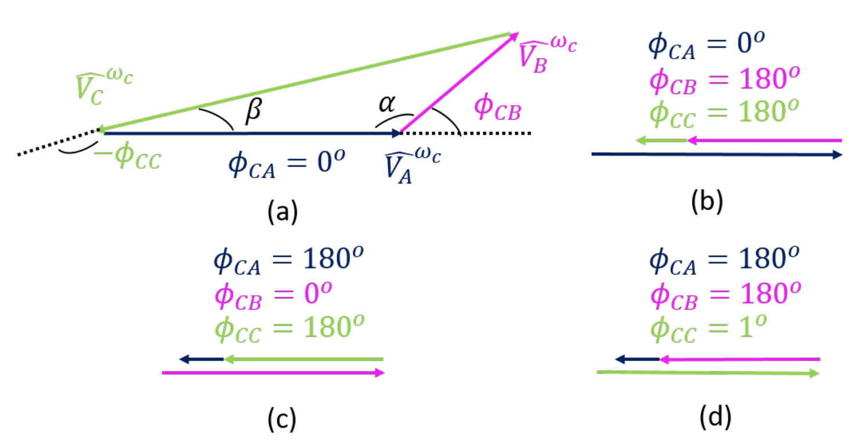
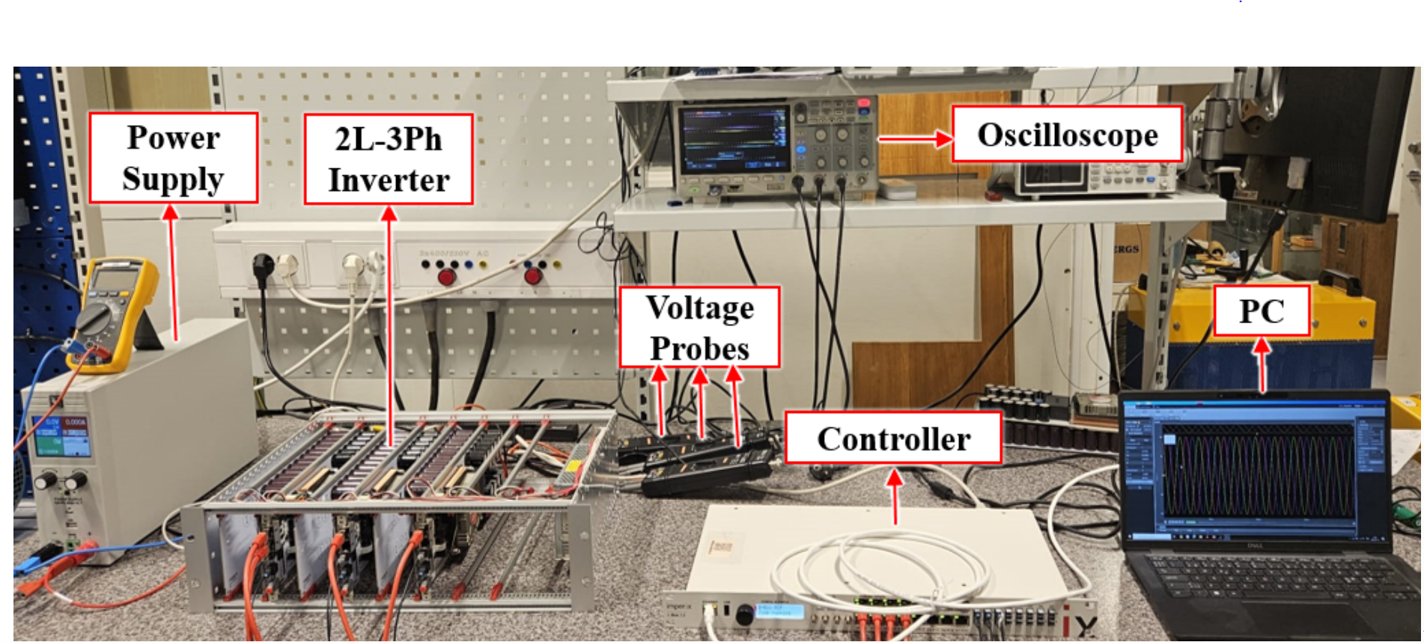
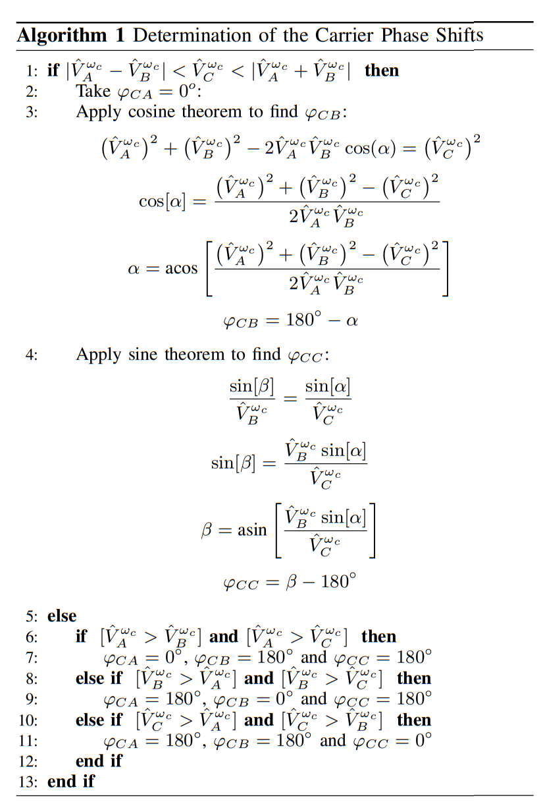
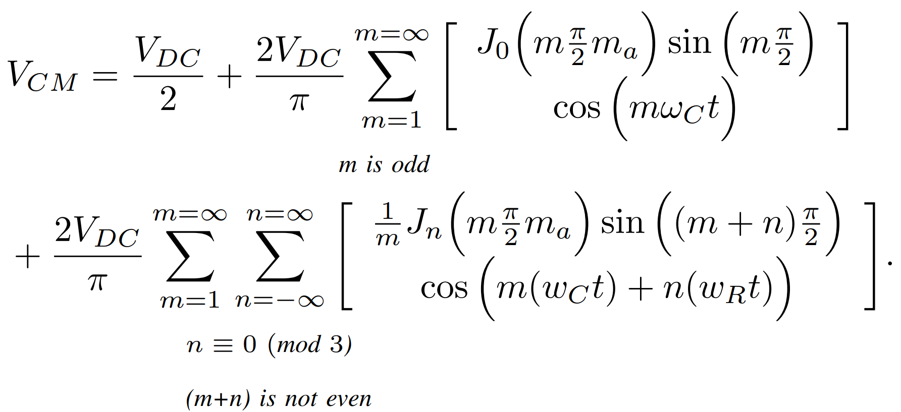
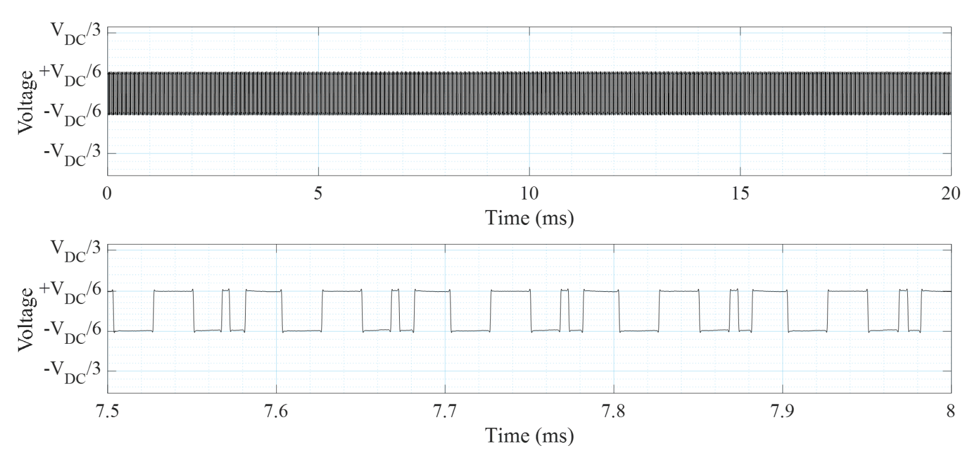
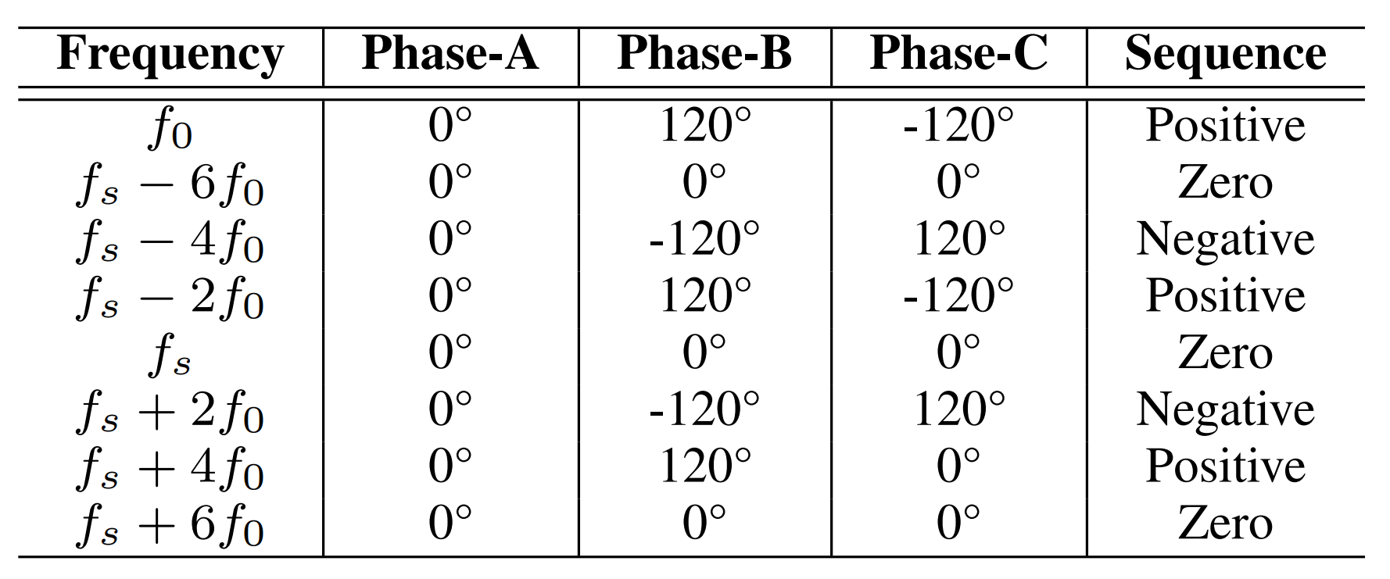
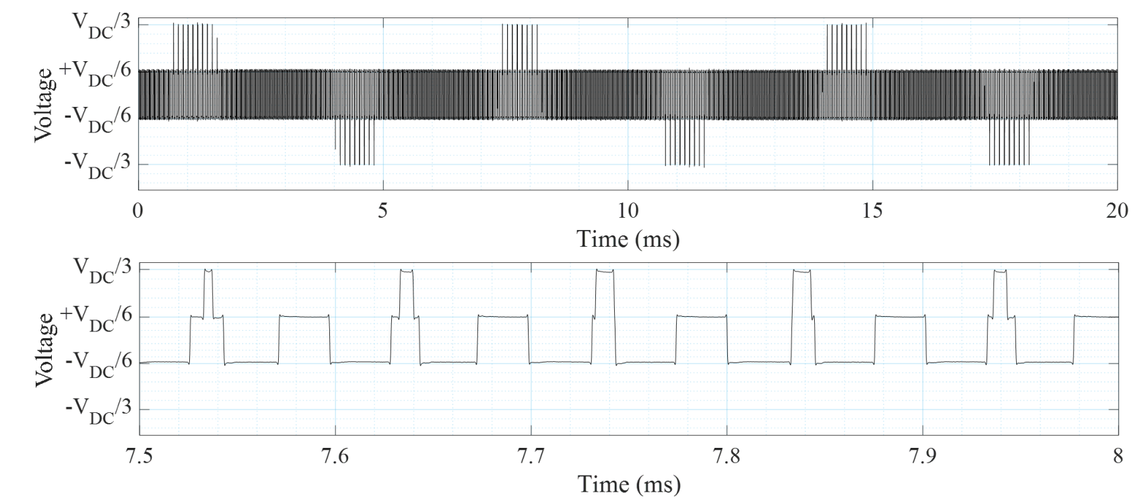
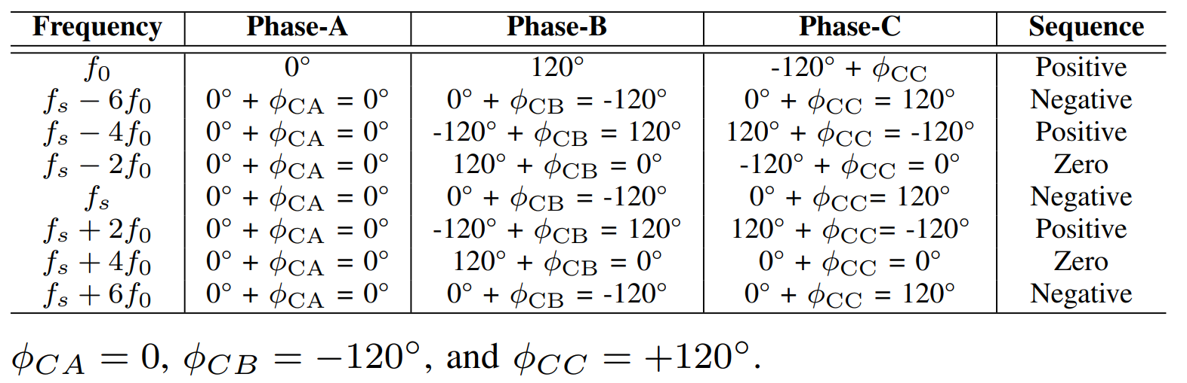
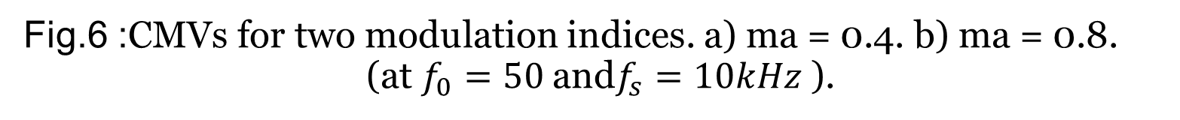
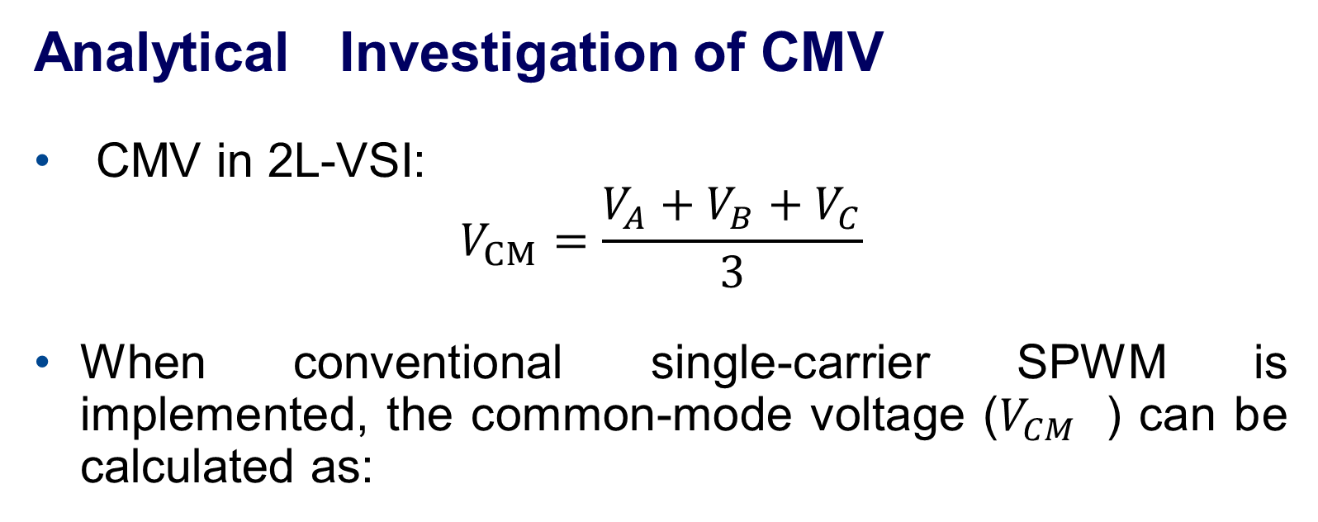
Common-Mode Voltage Reduction in Two-Level Inverters by Introducing Adaptive Carrier-Phase-Shift Method
Funded by EU CHIPS JU (PowerizeD) & Swedish Energy Agency (HEMIZERO)
Enes Ayaz, Shahriar Sarmast Ghahfarokhi, Staffan Norrga, Hans-Peter Nee – KTH Royal Institute of Technology
Introduction & Motivation
Two-Level Voltage Source Inverters dominate industrial motor drives due to simplicity, low cost, and reliability.
Proposed Method
Represent 1st carrier harmonics of each phase in phasor domain.
Simulation Results
(a)
Adjust phase shifts to either:
  Form a triangle → cancel CMV completely.
  Align small vectors opposite to the largest vector (triangle inequality not met).
Fig.1 :The system structure of a 2L-3Ph motor drive system.
Problem: PWM outputs → Common-Mode Voltage → leads to:
Electromagnetic Interference (EMI).
Bearing currents → insulation damage → reduced lifespan.
Existing Mitigation Approaches:
New inverter topologies / CM filters → ↑ cost & complexity.
Constant carrier-phase-shift PWM → partial CMV reduction only.
Key Idea:
Dynamically adjusts carrier phase shifts every switching interval.
Minimizes CMV harmonics at the instantaneous level.
No hardware changes → scalable & low-cost.
Fig.2 :Phasor domain analysis of the CMV in the first switching harmonic. a) The phase voltages. b) The CMV.
(b)
Fig.3 :Determination of the carrier phase shifts in phasor domain analysis. a) Triangle formation. b) Phase-A voltage vector is bigger than other vectors. c) Phase-B voltage vector is bigger than other vectors. d) Phase-C voltage vector is bigger than other vectors.
Fig.4 : The CMVs and their FFTs for two modulation indices.
a) ma = 0.4. b) ma = 0.8.
Analytical Investigation of CMV
CMV in 2L-VSI:
$$V_{CM}=\frac{{V_{A}+V_{B}+V}_{C}}{3}$$
When conventional single-carrier SPWM is implemented, the common-mode voltage ($V_{CM}$ ) can be calculated as:
Algorithm
Experimental Results
Fig.5 : Experimental setup of 2-level 3-phase inverter system.
Harmonic decomposition → Zero-sequence components create CM currents.
(a)
Table. 1 : Frequency Components and Their Sequences Around First Carrier Harmonic.
(b)
Conventional Interleaving
Shifts carriers by 0°, 120°, 240° → redistributes harmonics.
Discussion
  Bearing current mechanisms: capacitive, electric discharge machining (EDM), and circulating bearing currents.
    Capacitive bearing currents: strongly influenced by high-frequency CMV components; higher dv/dt → larger currents.
    EDM currents: triggered when CMV exceeds lubricant breakdown voltage → electrical discharge across bearings.
  Switching pattern impact: less critical for capacitive currents but important for EDM current suppression.
Fig.6 :CMVs for two modulation indices. a) ma = 0.4. b) ma = 0.8.
(at $f_{0}=50$and$f_{s}=10kHz$).
Table. 2 : Frequency Components and Their Phases Around First Carrier Harmonic for Multi-Carrier Signals.
Conclusion
Adaptive Carrier-Phase-Shift SPWM:
Reduces instantaneous CMV more effectively than constant carrier phase-shift PWMs.
Maintains simplicity of 2L-VSIs.
No additional hardware required.
Future Work:
Extend to multi-phase & multi-level inverters.

