Slide 1



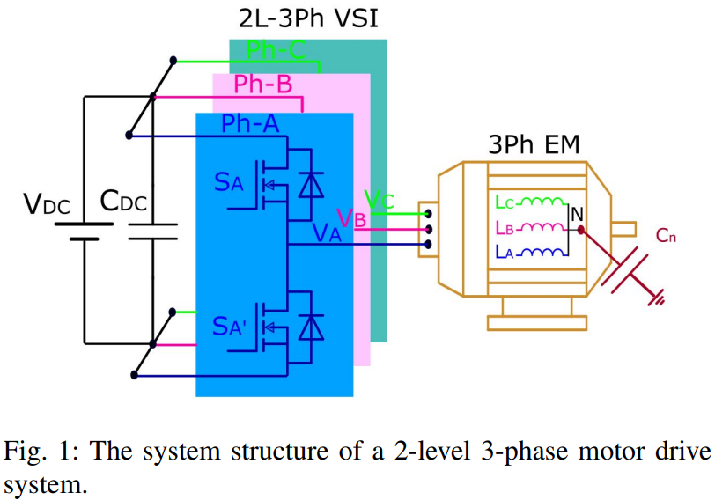
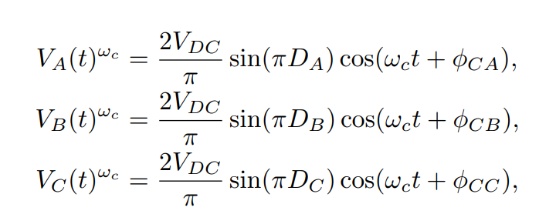
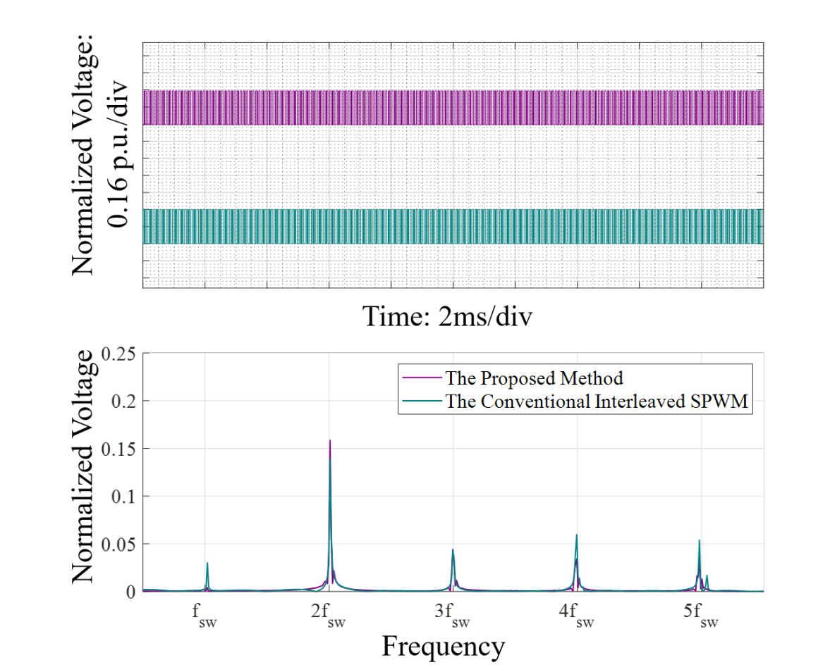
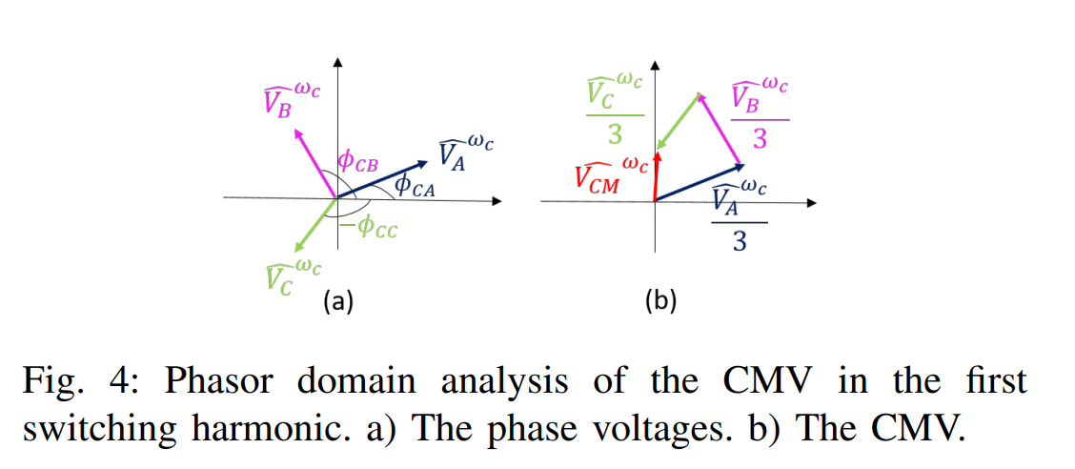
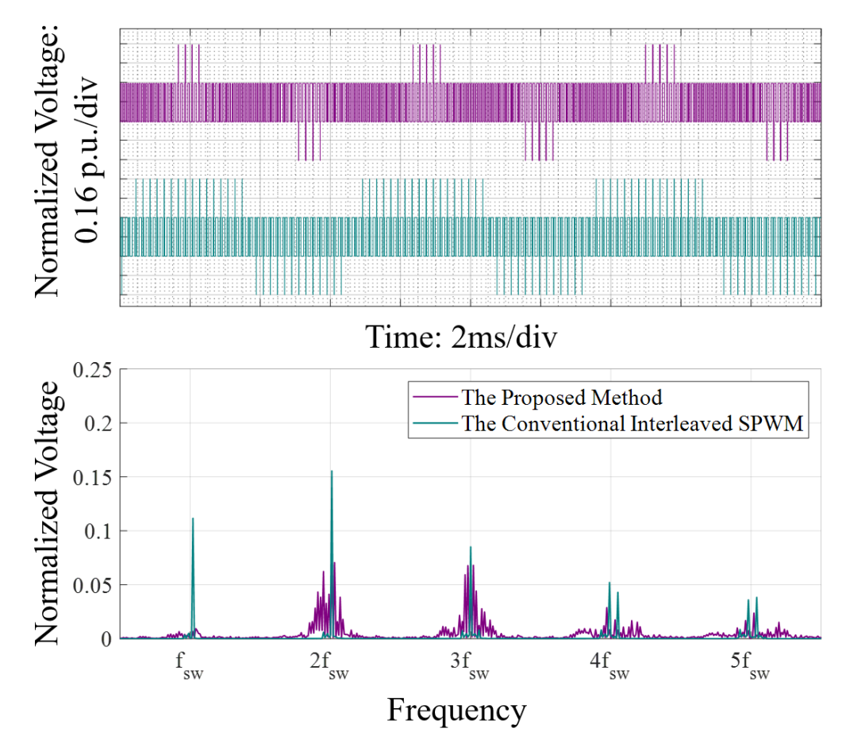
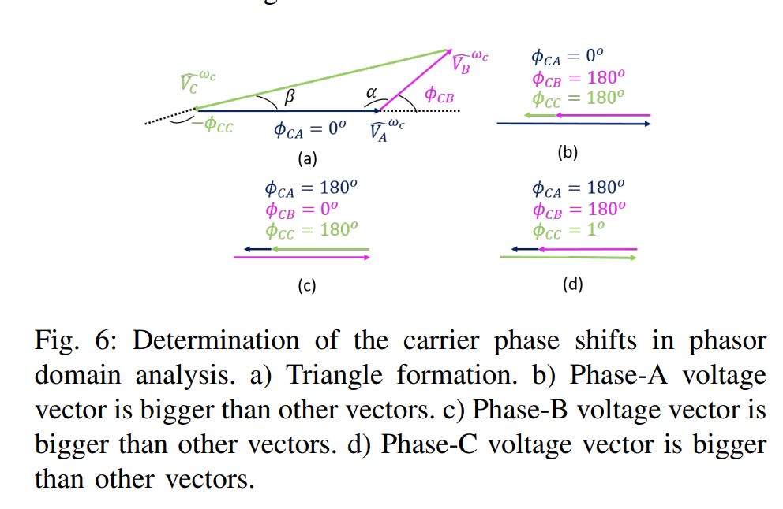
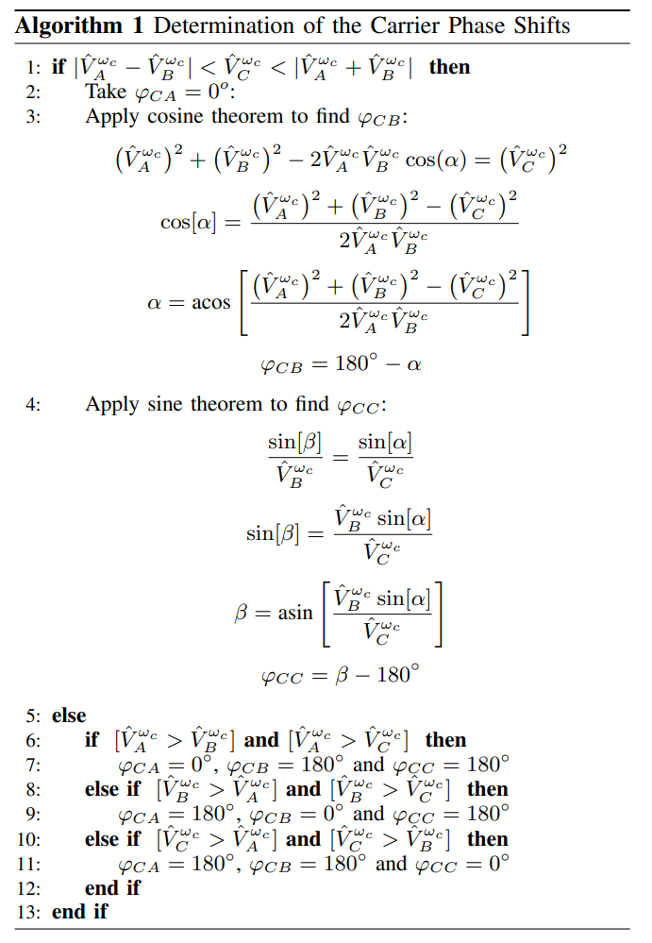
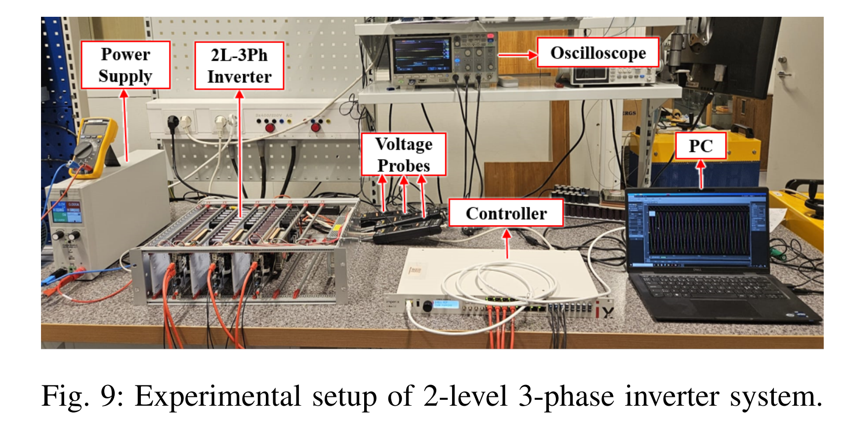
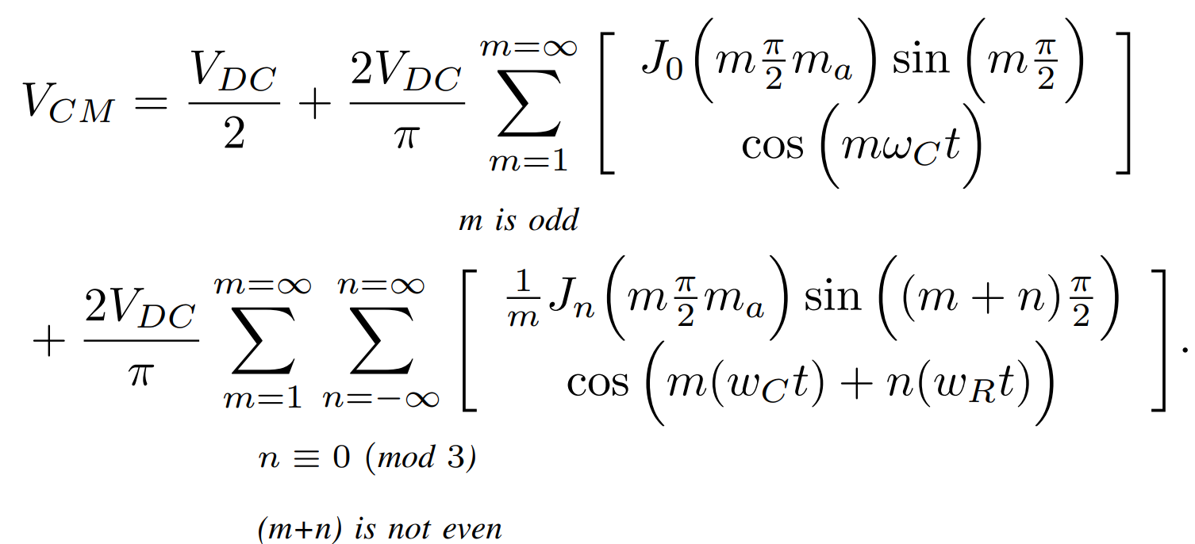
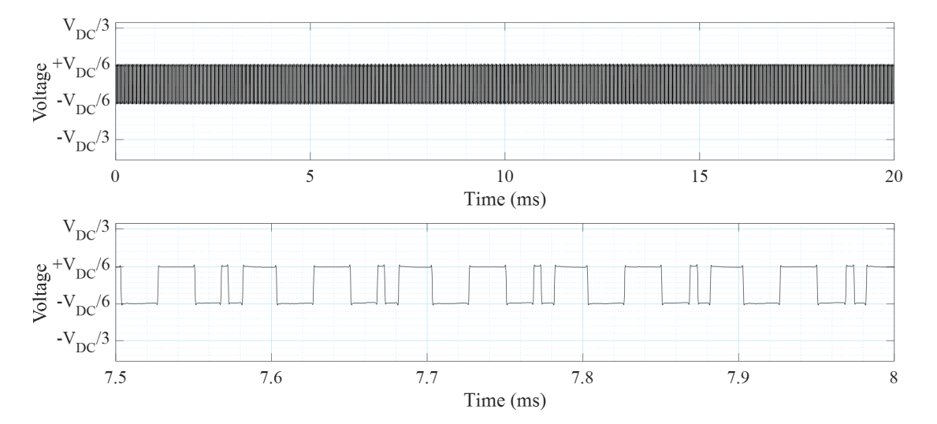
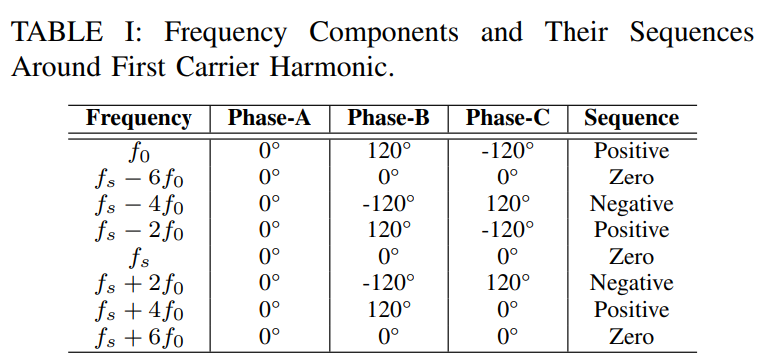
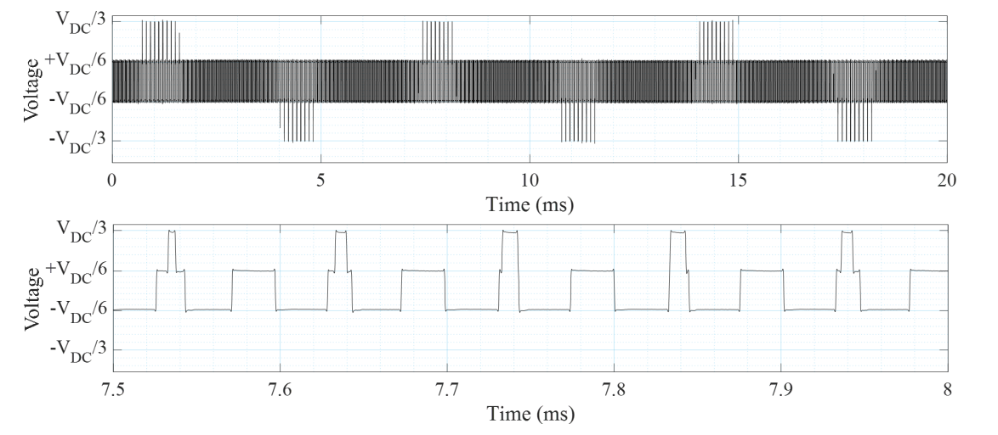
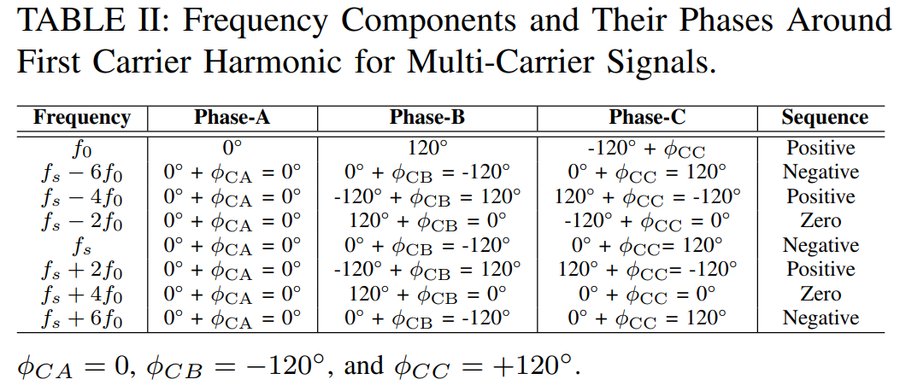
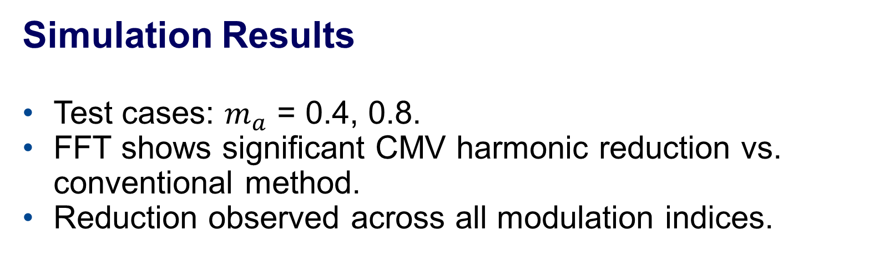
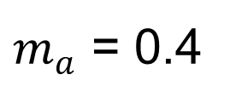
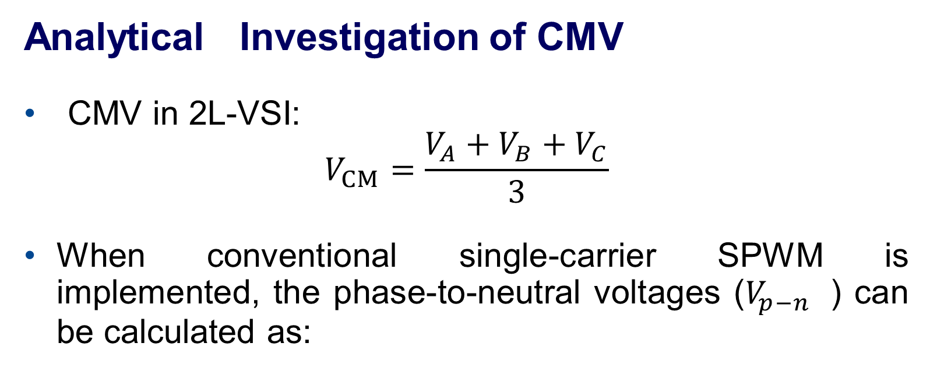
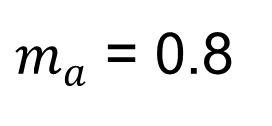
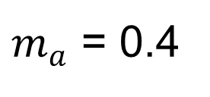
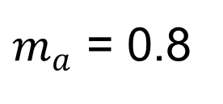
Common-Mode Voltage Reduction in Two-Level Inverters Using an Adaptive Carrier-Phase-Shift Method
Funded by EU CHIPS JU (PowerizeD) & Swedish Energy Agency (HEMIZERO)
Enes Ayaz, Shahriar Sarmast Ghahfarokhi, Staffan Norrga, Hans-Peter Nee – KTH Royal Institute of Technology
Introduction & Motivation
Two-Level Voltage Source Inverters dominate industrial motor drives due to simplicity, low cost, and reliability.
Proposed Method
Represent 1st carrier harmonics of each phase in phasor domain.
Simulation Results
Test cases: $m_{a}$ = 0.4, 0.8.
FFT shows significant CMV harmonic reduction vs. conventional method.
Reduction observed across all modulation indices.
Adjust phase shifts to either:
  Form a triangle → cancel CMV completely
  Align small vectors opposite to the largest vector (triangle inequality not met)
$m_{a}$ = 0.4
Problem: PWM outputs → Common-Mode Voltage → leads to:
Electromagnetic Interference (EMI)
Bearing currents → insulation damage → reduced lifespan
Existing Mitigation Approaches:
New inverter topologies / CM filters → ↑ cost & complexity
Constant carrier-phase-shift PWM → partial CMV reduction only
Key Idea:
Dynamically adjusts carrier phase shifts every switching interval
Minimizes CMV harmonics at the instantaneous level.
No hardware changes → scalable & low-cost.
$m_{a}$ = 0.8
Analytical Investigation of CMV
CMV in 2L-VSI:
$$V_{CM}=\frac{{V_{A}+V_{B}+V}_{C}}{3}$$
When conventional single-carrier SPWM is implemented, the phase-to-neutral voltages ($V_{p−n}$ ) can be calculated as:
Algorithm
Experimental Results
$m_{a}$ = 0.4
Harmonic decomposition → Zero-sequence components create CM currents.
$m_{a}$ = 0.8
Conventional Interleaving
Shifts carriers by 0°, 120°, 240° → redistributes harmonics.
Discussion
  Bearing current mechanisms: capacitive, electric discharge machining (EDM), and circulating bearing currents.
  Capacitive bearing currents: strongly influenced by high-frequency CMV components; higher dv/dt → larger currents.
  EDM currents: triggered when CMV exceeds lubricant breakdown voltage → electrical discharge across bearings.
  Switching pattern impact: less critical for capacitive currents but important for EDM current suppression.
Conclusion
Adaptive Carrier-Phase-Shift SPWM:
Reduces instantaneous CMV more effectively than fixed-carrier phase-shift PWMs.
Maintains simplicity of 2L-VSIs .
No additional hardware required.
Future Work:
Extend to multi-phase & multi-level inverters.

