Slide 1
Busbar Design
KTH

Slide 2

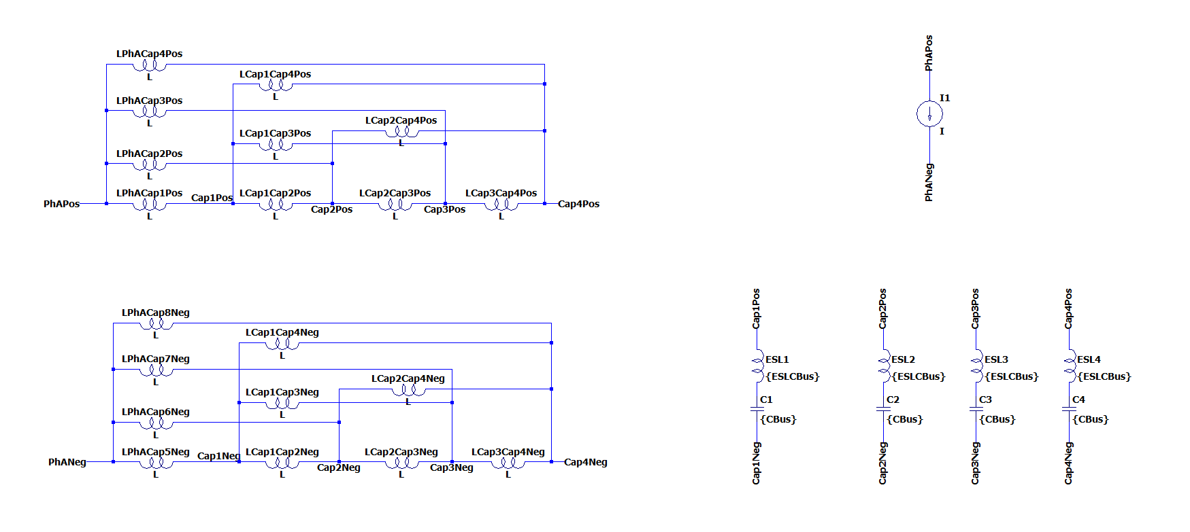
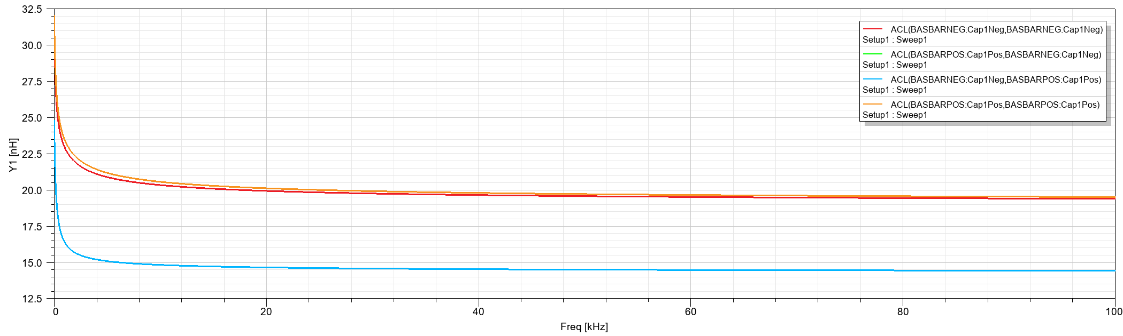
Busbar Geometry 62mm Power Module
C3
C4
C2
C1
Lumped Circuit Representation for one phase
20 inductance values (and mutual inductances between them).
Q3D Extractor can give the equivalent impedance between one sink and multiple sources.
Stray inductance inside the modules is considerably high.
Capacitor
DC- Nodes
Power Modules
DC+ Nodes

Slide 3
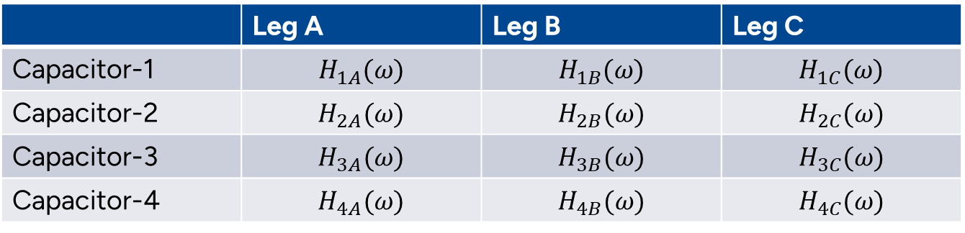
Impedance Model
Step response of capacitors to each leg
 | Leg A | Leg B | Leg C
Capacitor-1 | $$H_{1A}(ω)$$ | $$H_{1B}(ω)$$ | $$H_{1C}(ω)$$
Capacitor-2 | $$H_{2A}(ω)$$ | $$H_{2B}(ω)$$ | $$H_{2C}(ω)$$
Capacitor-3 | $$H_{3A}(ω)$$ | $$H_{3B}(ω)$$ | $$H_{3C}(ω)$$
Capacitor-4 | $$H_{4A}(ω)$$ | $$H_{4B}(ω)$$ | $$H_{4C}(ω)$$
The response of capacitor A for each leg should be calculated as:
$I_{capA}= {(S_{A}∗I_{A} )H}_{1A}\left(ω\right)+{(S_{B}∗I_{B} )H}_{1B}\left(ω\right)$+${(S_{C}∗I_{C} )H}_{1C}\left(ω\right)$
Capacitor Responses to Phase-A
Capacitor-1 Response to all phases

Slide 4
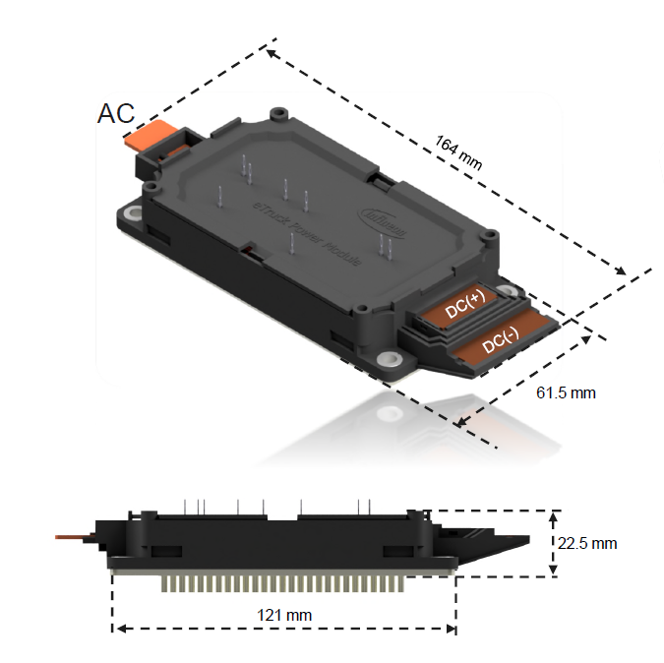
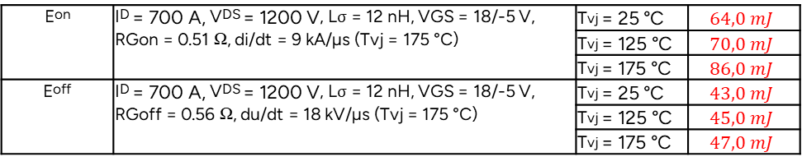
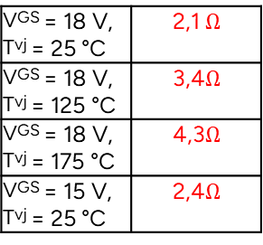
What do we need for further investigation?
Packaging Stray Inductance, Gate Loop, and Power Loop Interaction
Switching Energy Dependency on Current Levels
Eon | ID = 700 A, VDS = 1200 V, Lσ = 12 nH, VGS = 18/-5 V, RGon = 0.51 Ω, di/dt = 9 kA/µs (Tvj = 175 °C) | Tvj = 25 °C | $$64,0 mJ$$
 |  | Tvj = 125 °C | $$70,0 mJ$$
 |  | Tvj = 175 °C | $$86,0 mJ$$
Eoff | ID = 700 A, VDS = 1200 V, Lσ = 12 nH, VGS = 18/-5 V, RGoff = 0.56 Ω, du/dt = 18 kV/µs (Tvj = 175 °C) | Tvj = 25 °C | $$43,0 mJ$$
 |  | Tvj = 125 °C | $$45,0 mJ$$
 |  | Tvj = 175 °C | $$47,0 mJ$$
VGS = 18 V, Tvj = 25 °C | 2,1 $Ω$
VGS = 18 V, Tvj = 125 °C | 3,4$Ω$
VGS = 18 V, Tvj = 175 °C | 4,3$Ω$
VGS = 15 V, Tvj = 25 °C | 2,4$Ω$

Slide 7
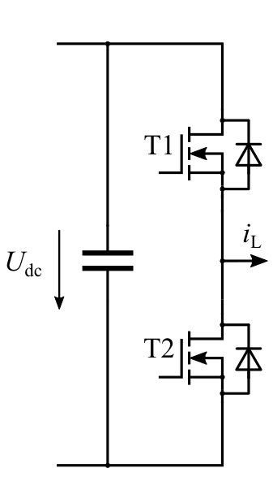
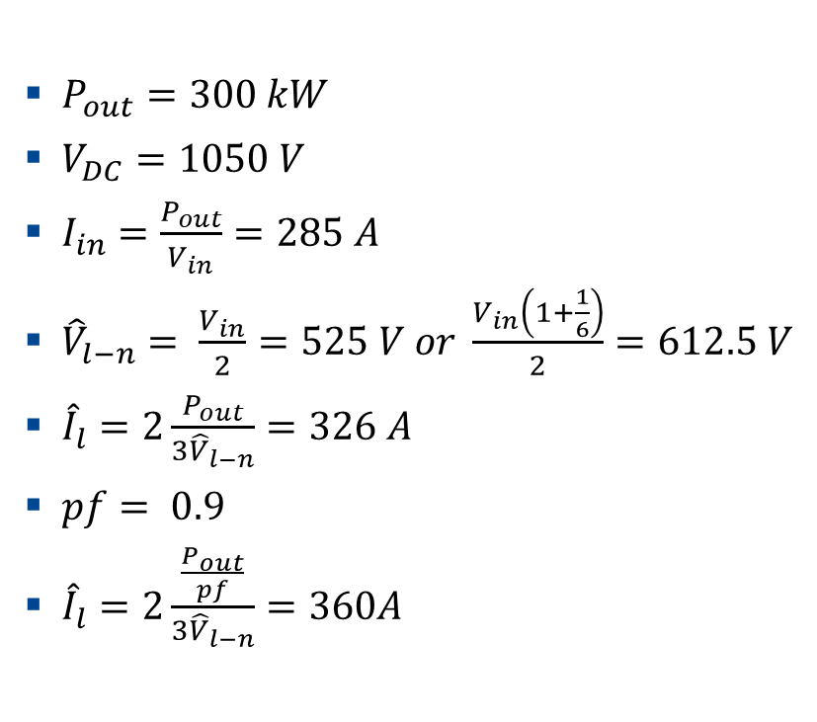
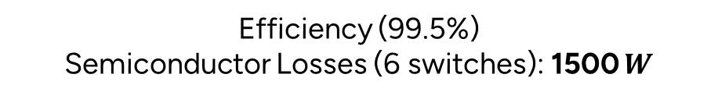
2-Level Inverter Power Ratings
$P_{out}=300 kW$
$V_{DC}=1050 V$
$I_{in}=\frac{P_{out}}{V_{in}}=285 A$
${\hat{V}}_{l−n}= \frac{V_{in}}{2}=525 V or \frac{V_{in}\left(1+\frac{1}{6}\right)}{2}=612.5 V$
${\hat{I}}_{l}=2\frac{P_{out}}{{3\hat{V}}_{l−n}}=326 A$
$pf= 0.9$
${\hat{I}}_{l}=2\frac{\frac{P_{out}}{pf}}{{3\hat{V}}_{l−n}}=360A$
Efficiency (99.5%)
Semiconductor Losses (6 switches): 1500 $W$

Slide 8
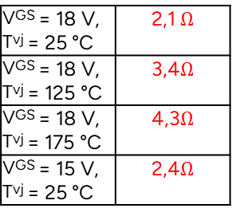

Given Parameters from Infineon
A. Basic Parameters:
Current rating @25°C (in Amperes) $700 A$
On-state resistance @25°C (in Ohms)
Internal gate resistance (in Ohms) ~ $2,1 Ω$
Die Size (mm) $20mm^{2}$ (12 chips)
Thermal resistance (Junction to Fluid) $56\text{°}\text{C}\text{/}\text{kW}$
VGS = 18 V, Tvj = 25 °C | 2,1 $Ω$
VGS = 18 V, Tvj = 125 °C | 3,4$Ω$
VGS = 18 V, Tvj = 175 °C | 4,3$Ω$
VGS = 15 V, Tvj = 25 °C | 2,4$Ω$
per MOSFET, Tf = 60 °C, ΔV/Δt = 10 dm³/min,
50% water / 50% ethylenglycol 56

Slide 9
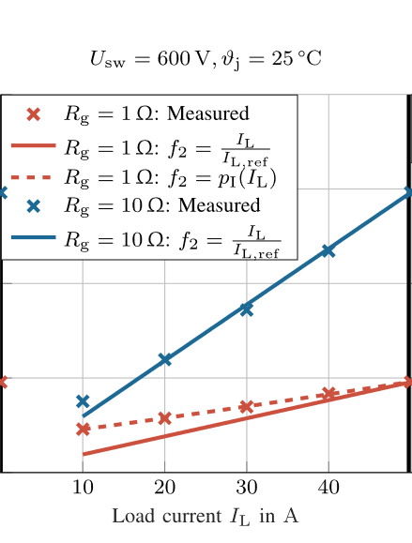

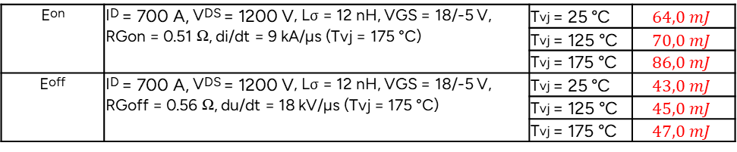
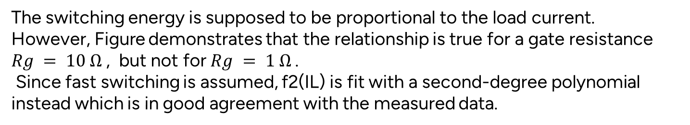
Datasheet-driven Loss Calculation
Voltage rating: 1700V
Current rating: 700A
Eon | ID = 700 A, VDS = 1200 V, Lσ = 12 nH, VGS = 18/-5 V, RGon = 0.51 Ω, di/dt = 9 kA/µs (Tvj = 175 °C) | Tvj = 25 °C | $$64,0 mJ$$
 |  | Tvj = 125 °C | $$70,0 mJ$$
 |  | Tvj = 175 °C | $$86,0 mJ$$
Eoff | ID = 700 A, VDS = 1200 V, Lσ = 12 nH, VGS = 18/-5 V, RGoff = 0.56 Ω, du/dt = 18 kV/µs (Tvj = 175 °C) | Tvj = 25 °C | $$43,0 mJ$$
 |  | Tvj = 125 °C | $$45,0 mJ$$
 |  | Tvj = 175 °C | $$47,0 mJ$$
Fast Switching
The switching energy is supposed to be proportional to the load current.
However, Figure demonstrates that the relationship is true for a gate resistance $Rg = 10 Ω$, but not for $Rg = 1 Ω$.
Since fast switching is assumed, f2(IL) is fit with a second-degree polynomial instead which is in good agreement with the measured data.
Retrieved from Potentials and Comparison of Inverter Topologies for Future All-Electric Aircraft Propulsion

Slide 10
Datasheet-driven Loss Calculation
Linear assumption
Polynomial assumption 1
Polynomial assumption 2
Eon ➔ p1,1=0.007 p1,2=0.5 p1,3=0
Eon ➔ p1,1=0.0107 p1,2=0.25 p1,3=0
Eoff ➔ p1,1=0.011 p1,2=0.5 p1,3=0
Eoff ➔ p1,1=0.0165 p1,2=0.25 p1,3=0
Linear assumption might be the worst-case scenario.

Slide 11
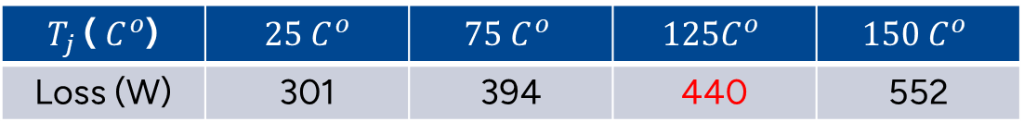
Datasheet-driven Loss Calculation (Conduction)
$T_{j}$ ( $C^{o}$) | $$25 C^{o}$$ | $$75 C^{o}$$ | $$125C^{o}$$ | $$150 C^{o}$$
Loss (W) | 301 | 394 | 440 | 552
Switching energies should be lower than 1060 W.

Slide 12


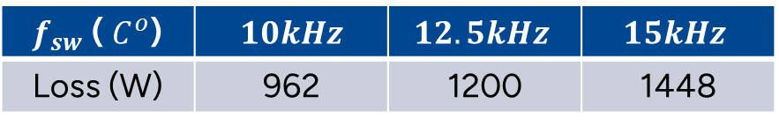
Datasheet-driven Loss Calculation (Switching)
$$10kHz$$
$$10kHz$$
$f_{sw}$ ( $C^{o}$) | $$10kHz$$ | $$12.5kHz$$ | $$15kHz$$
Loss (W) | 962 | 1200 | 1448

Slide 13

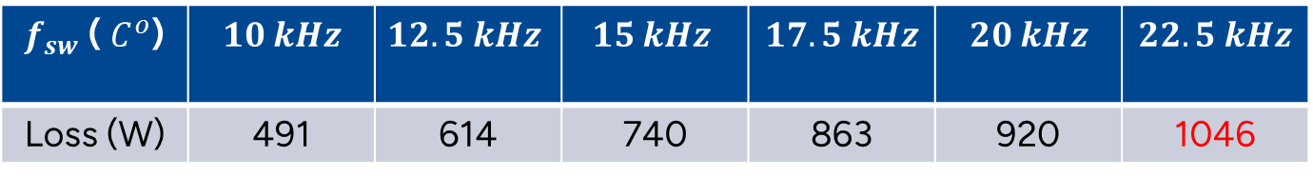

Datasheet-driven Loss Calculation (Switching)
$$10 kHz$$
$$10 kHz$$
Polynomial assumption 2
$f_{sw}$ ( $C^{o}$) | $$10 kHz$$ | $$12.5 kHz$$ | $$15 kHz$$ | $$17.5 kHz$$ | $$20 kHz$$ | $$22.5 kHz$$
Loss (W) | 491 | 614 | 740 | 863 | 920 | 1046

