Slide 1
Literature : Powertrains
Enes Ayaz

Slide 2
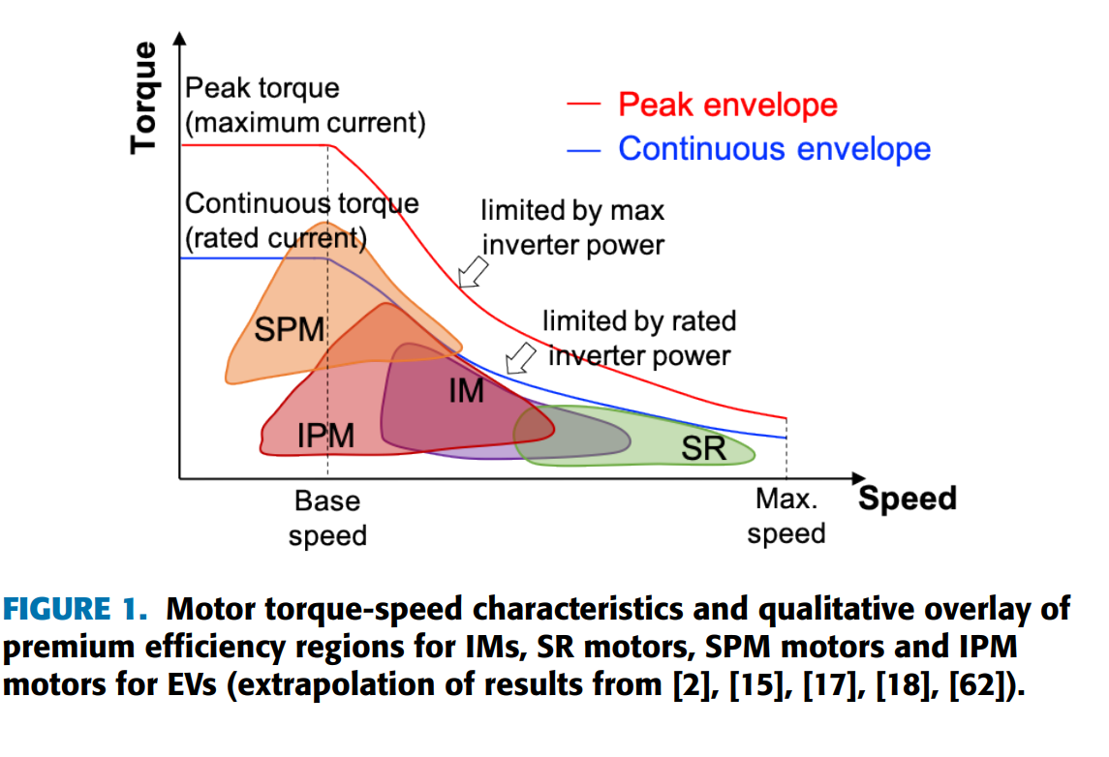
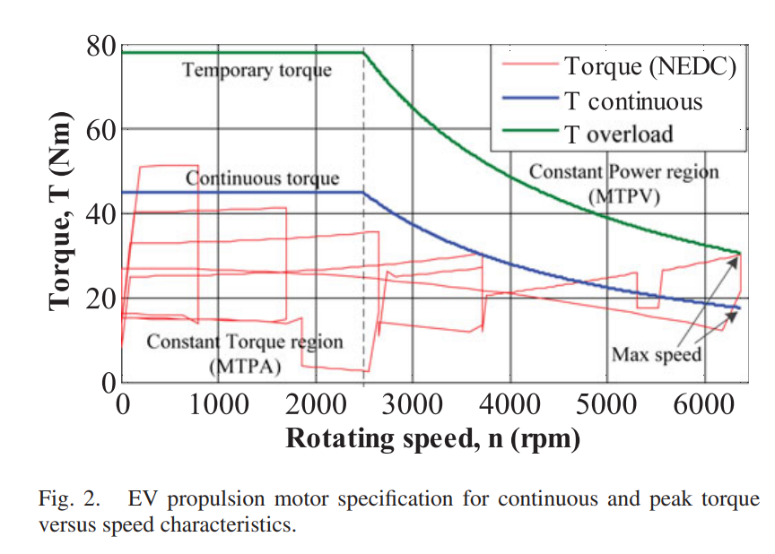
Torque-Speed Characteristics in Electric Trucks
Motoring Mode:
Starting/Initial Acceleration (High Torque, Lower Speed):
  Initiate motion from a standstill.
  Requires effective acceleration and overcoming inertia.
Normal Operation (Moderate Torque, Variable Speed):
  It delivers enough torque to maintain speed and handle typical loads efficiently.
Hill Climbing/Heavy Load Conditions (High Torque, Low Speed):
  Requires higher torque to counteract gravity or the added weight.
  Speed might decrease as torque increases to maintain power.
Cruising/Constant Speed (Balanced Torque and Speed):
  During steady-state driving on flat roads or at a constant speed,
  Optimizing energy efficiency.
Max Speed Capability (Lower Torque, High Speed):
  Reduced torque to achieve and sustain higher velocities.
Regenerative Braking/Deaceleration?
*[1]
*[2]

Slide 3
Torque Calculation via Vehicle Dynamics
Vehicle Dynamics Coefficients and Parameters
Radius of wheels ($r_{w}$ in $m$) | 0.25 – 0.40 (0.3?)
Vehicle front area ($A$ in $m^{2}$) | This value might range from 8 to 12 square meters, based on the vehicle's size and design.
Aerodynamic drag coefficient ($C_{d}$) | Depending on the truck's design, this could vary between 0.5 and 0.7.
Rolling resistance coefficient ($C_{rr}$) | Depends on tire type and road conditions, but this coefficient might range between 0.01 and 0.015.
Vehicle mass ($M$ in $kg$) | Encompasses the weight of the vehicle, payload, and occupants. Tens of thousands of kilograms.
Coefficient of inertia ($I$) | Includes the inertia of the wheels, drivetrain, and other rotating parts.
Coefficient of friction ($μ$) | Represents the friction between the tires and the road surface. This might be around 0.7 to 1.0
Coefficient of suspension stiffness ($μ$) | This coefficient varies based on the suspension design
Maximum vehicle speed ($v$ in $km. h^{−1}$ ) | 120 ?
Maximum NEDC acceleration ($\overline{a}$ in m$. s^{−2}$) | 1.043 ?
Differential gear ratio ($u$) | Typically > 4:1
*[2]

Slide 4
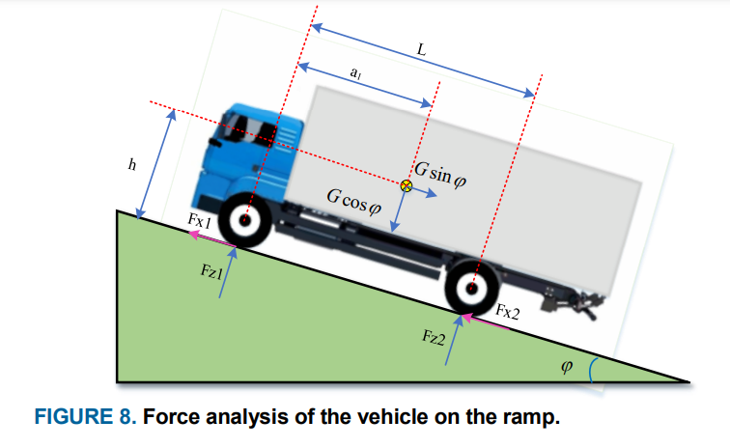
Total Tractive Force= Rolling Resistance + Aerodynamic Drag + Gradient Force + Acceleration Force
$$F_{TTF}=F_{RR}+F_{AD}+F_{G}+F_{A}$$
$$F_{RR}=C_{rr} . M .g cos⁡(θ)$$
$$F_{AD}=\frac{1}{2} . C_{d} . ρ . A .v^{2}$$
$ρ$ = density of air
$$F_{G}=M . g . sin⁡(θ)$$
$θ$= uphill or downhill slopes angle
$$F_{A}=M .\overline{a}$$
*[3]
$$T_{EM}=F_{TTF} .\frac{r}{u}$$

Slide 5
Motor Specifications
Motor Specifications
Active length (in $mm$) | 275
Outer diameter (in $mm$) | 350
Base/maximum speed (in $RPM$) | 2000-3000/7000
Continuous/peak (10s) power (in $kW$) | 600/720
Continuous/peak (10s) torque (in $N.m$) | 2500 / 3000
We did not apply the vehicle dynamics to find them, Scania just gave them !!!
Here we do not know the gear ratio, therefore can we change the torque and speed requirements?
Considerations for Heavy Trucks
High Torque at Low Speeds: Heavy-duty trucks often require high torque for initial acceleration and while climbing steep gradients with heavy loads.
Durability and Reliability: Motors should be designed to withstand continuous heavy usage, varied terrains, and adverse environmental conditions.
Efficiency and Energy Recovery: Motors capable of regenerative braking can help recover energy during braking, enhancing overall efficiency.
Maintenance and Serviceability: Motors should be designed for ease of maintenance and servicing to minimize downtime.

Slide 6
Current Types of EMs
1. Permanent Magnet Synchronous Motor (PMSM):
Providing high-speed capabilities, especially beneficial for cruising, maintaining higher speeds on highways, and offering good efficiency during constant-speed operations.
  Advantages: Offering excellent controllability, and efficiency at higher speeds.
  Considerations: Facing demagnetization issues due to high currents at low speeds or during high torque demands.
2. Induction Motor:
Having strong torque output at lower speeds complements the requirements.
  Advantages: Induction motors have robust torque capabilities at low speeds, making them well-suited for heavy-load scenarios.
  Considerations: They might lack the high-speed capabilities of PMSM motors. Fixed-speed nature might limit their widespread adoption without additional control systems.
3. Permanent Magnet Assisted Synchronous Reluctance Motors:
Can be designed to provide high torque even at low speeds, making them suitable for heavy-load applications at lower speeds.
  Advantages: With their combined reluctance and permanent magnet design, might mitigate some risks of demagnetization at high currents or low speeds.
  Considerations: Cost, availability, system complexity, and integration challenges.
4. Wound Rotor Synchronous Motors (WRSMs), or Electrically Excited Synchronous Motor (EESMs) :
Allowing for external control of the rotor winding, enabling variable speed and torque control and high torque output, particularly during starting and low-speed operations.
  Advantages: Robustness and ability to handle harsh operating conditions
  Considerations: Needing brushless exciter (with WPT?) and reduced efficiency due to rotor winding (also cooling?).

Slide 7
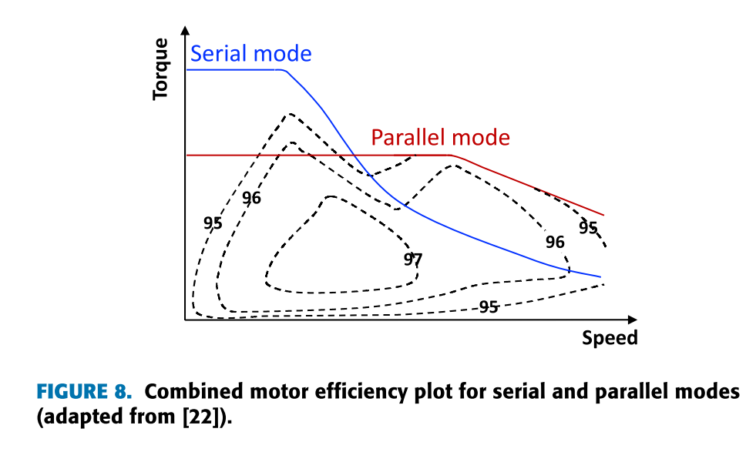
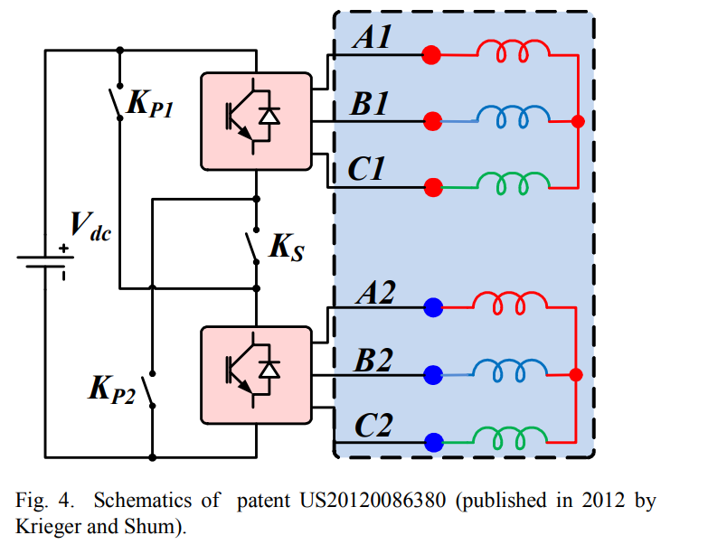
New Types of EMs
STATOR PM MACHINES
FLUX MEMORY MACHINES AND HYBRID EXCITATION MACHINES
MULTIPHASE MACHINES
MAGNETIC GEARED MACHINES
RECONFIGURABLE WINDING MACHINES
*[4]
*[5]

Slide 8
Different Configurations
Single motor
  Coupled with front or rear axle via a differential.
  Constant gear ratio, quite high, is used to reduce motor torque, resulting in lower motor size.
  The electrical motor needs a wide operating speed range.
  The motor should be capable of producing a higher torque, for a short time, in case of an overtaking or a starting from a high ground slope angle.
  We have motor specifications for continuous (rated) and temporary (peak) torque.
To achieve a wide range of speeds, PMSM or EESM is suitable.
PMSM has higher efficiency and is less complex, but demagnetization risk at the starting torque.
EESM has high torque at starting, but rotor cooling is problematic and efficiency is lower.
*[2]

Slide 9
Different Configurations
Dual motor *[6]
  It is practically impossible to optimize based on the whole torque-speed profile and especially when partial loads and overload conditions are considered in the problem formulation. (with inclusion of drive cycle)
  Two propulsion machines, with complimentary torque-speed characteristics, can be coupled to the same shaft via a torque/speed coupler that could be deployed in the EV powertrain.
  A potential merit of using two propulsion machines is the improved powertrain efficiency and effective load power split.
  Another advantage of using two complementary propulsion machines, instead of a single large machine, is that the space under the hood can be effectively utilized.
Permanent Magnet Synchronous Motor (PMSM) for High-Speed Performance:
  Considerations: These motors might face demagnetization issues due to high currents at low speeds or during high torque demands. Therefore, using them for high-speed operations where torque requirements are lower can mitigate this issue.
Induction Motor for High Torque at Low Speeds:
  Considerations: While they might lack the high-speed capabilities of PMSM motors, their strong torque output at lower speeds complements the requirements for heavy-duty trucks during start-up, inclines, and low-speed maneuvers.
Electrically Excited Synchronous Motor (EESMs) :
  Considerations: These motors can provide high torque output, particularly during starting and low-speed operations, making them suitable for heavy-duty applications that demand strong torque at lower speeds.

Slide 10
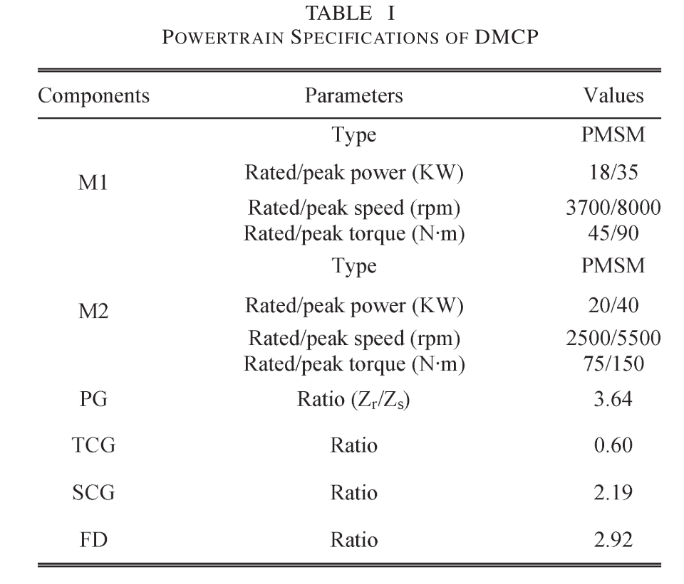
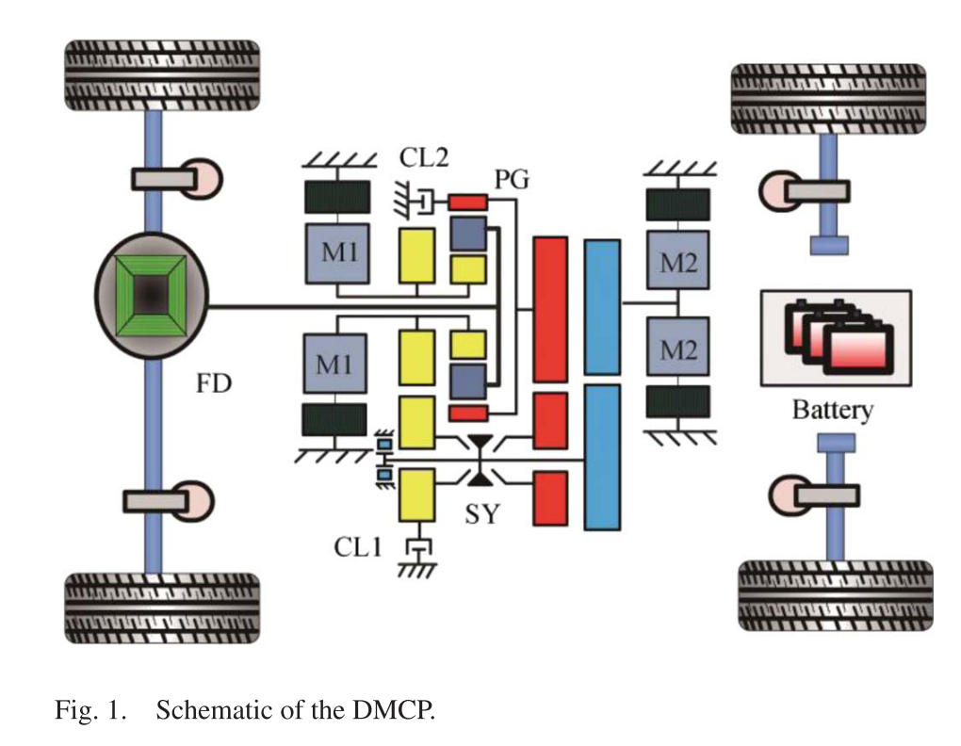
Efficiency Study of a Dual-Motor Coupling EV Powertrain
*[7]
Planetary gear unit couples the speed of two motors
Shaft-fixed gear unit couples the torque of two motors
By the engaging and disengaging of the clutches and setting, can operate in four modes to satisfy the demands of different running conditions, thereby improving the energy utilization efficiency

Slide 11
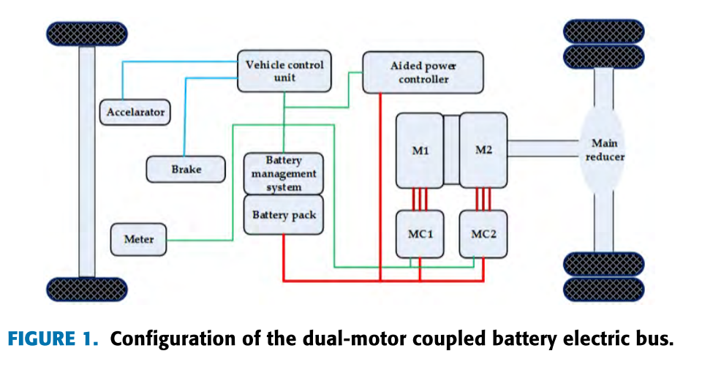
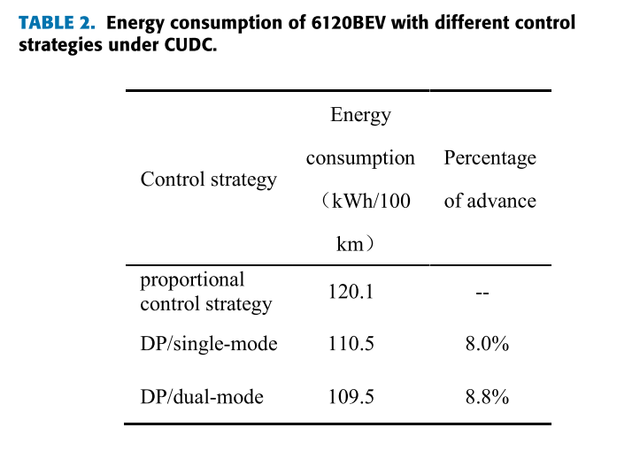
Optimization of a Dual-Motor Coupled Powertrain Energy Management Strategy for a Battery Electric Bus Based on Dynamic Programming Method
*[8]
The torques of the main motor (M1) and the auxiliary motor (M2) are coupled on a common axis.
M1= T= 2100N.m, base speed = 600RPM
M2= T= 900N.m, base speed = 1200RPM

Slide 12
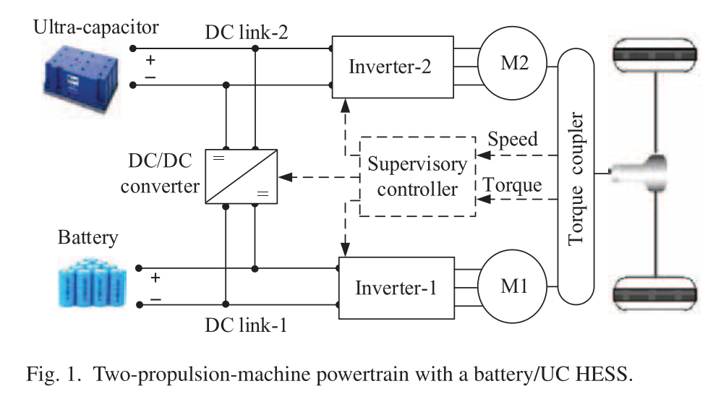
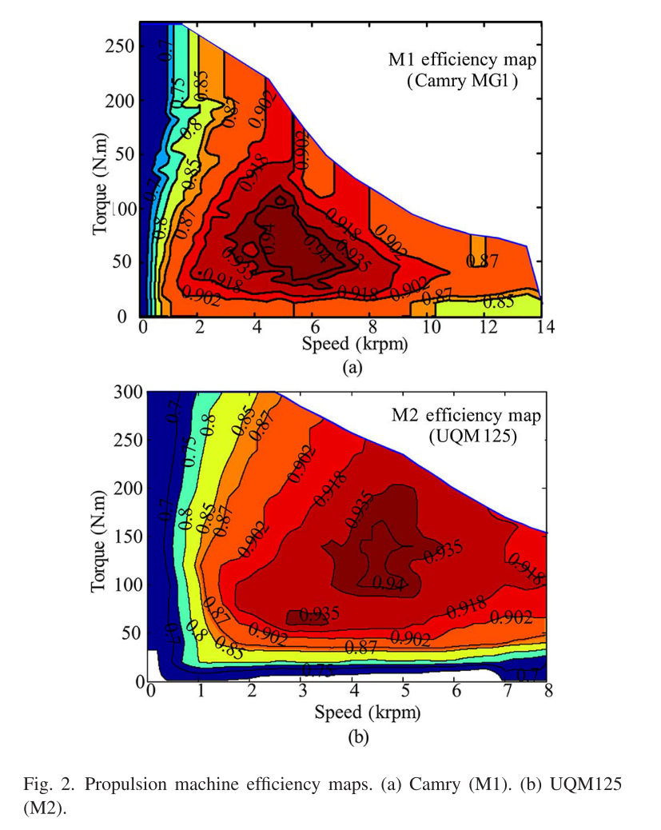
Power Split Control Strategy for an EV Powertrain With Two Propulsion Machines
*[6]
Batteries have relatively high energy density. Ultra-capacitors (UCs), on the other hand, have high power density and excellent instantaneous charging and discharging capabilities.
The M1 can operate at high efficiency under low torques, while M2 operates with high efficiency at high torques, implying the complementary operation features of these two propulsion machines.

Slide 13
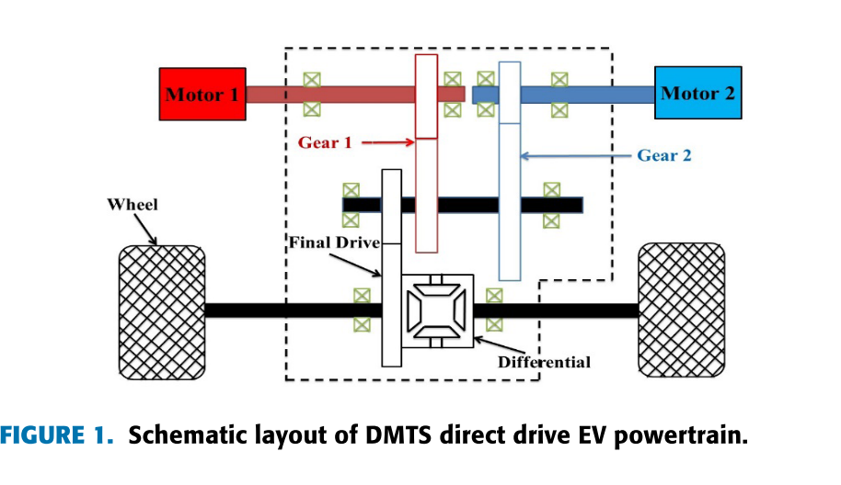
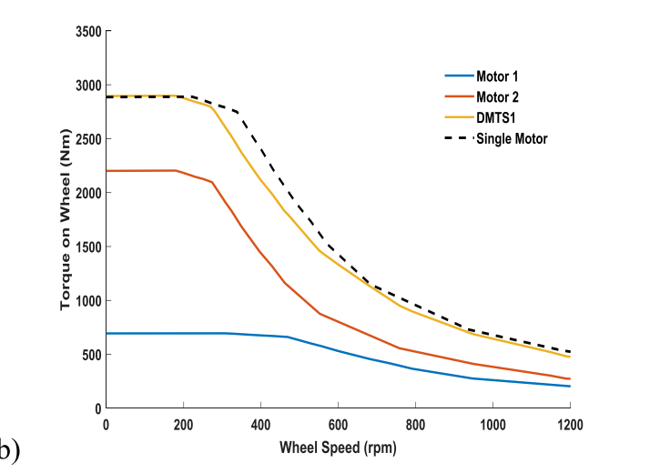
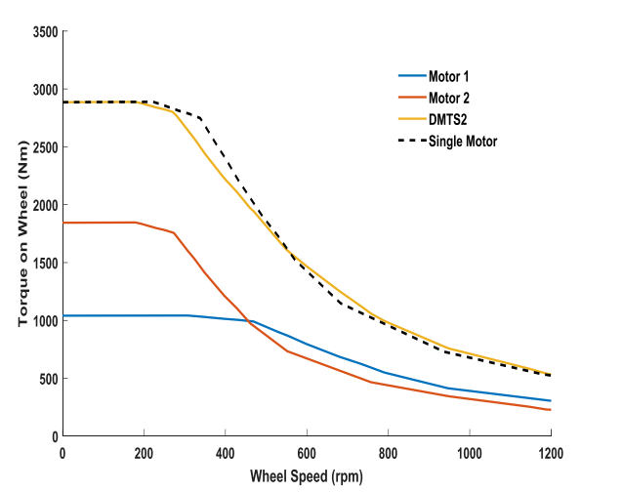
A Novel Dual-Motor Two-Speed Direct Drive Battery Electric Vehicle Drivetrain
*[9]
Two smaller motors with approximate same total output power in this paper to improve overall motor efficiency.
Permanently engaged gear pairs, rather than implicating mechanical shifting actuator, i.e. clutch or synchronizer.

Slide 14
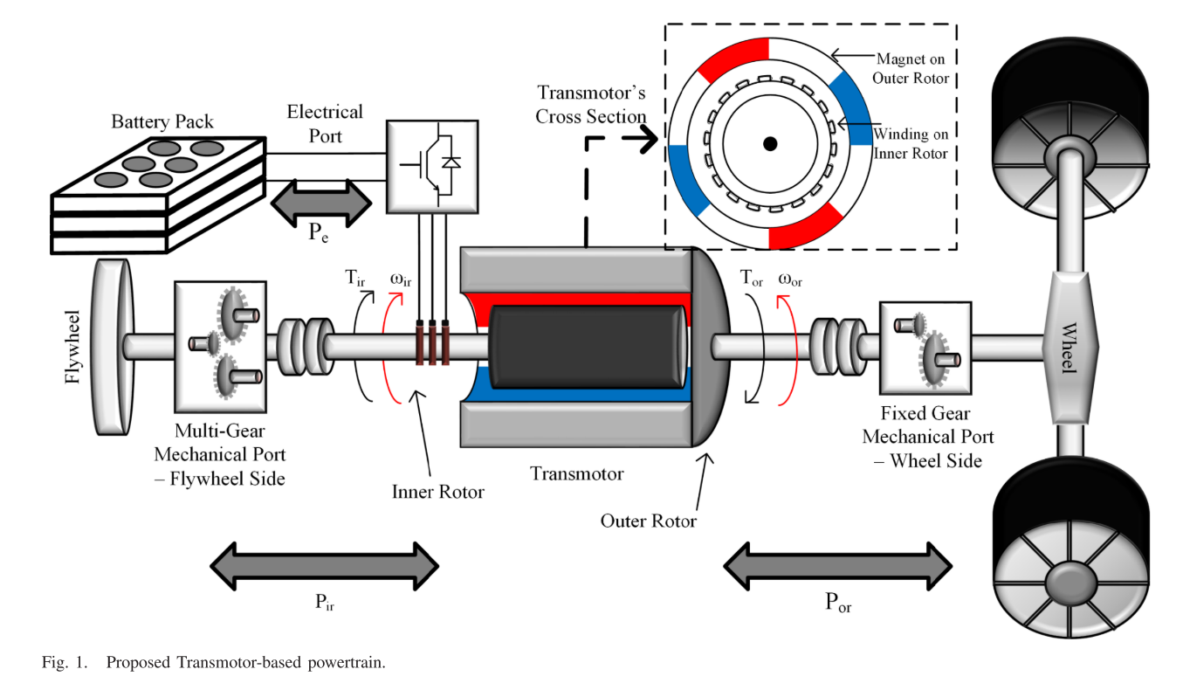
Transmotor-Based Powertrain for High-Performance Electric Vehicle
*[10]
The output torque is determined by the current in the electrical port (located on the inner rotor).
The produced torque on the two shafts is equal but opposite (action and reaction torque).
The speed of the mechanical ports can be different, so the input and output mechanical powers are not necessarily equal.
The maximum torque can be available at a larger speed range?? Hill Climbing???

Slide 15
References
[1] Design Approaches and Control Strategies for Energy-Efficient Electric Machines for Electric Vehicles—A Review
[2] Fast Adaptive Evolutionary PM Traction Motor Optimization Based on Electric Vehicle Drive Cycle
[3] Hill-start of Distributed Drive Electric Vehicle Based on Pneumatic Electronic Parking Brake System
[4] Design Approaches and Control Strategies for Energy-Efficient Electric Machines for Electric Vehicles—A Review
[5] A Reconfigurable-Winding System for Electric Vehicle Drive Applications
[6] Power Split Control Strategy for an EV Powertrain With Two Propulsion Machines
[7] Efficiency Study of a Dual-Motor Coupling EV Powertrain
[8] Optimization of a Dual-Motor Coupled Powertrain Energy Management Strategy for a Battery Electric Bus Based on Dynamic Programming Method
[9] A Novel Dual-Motor Two-Speed Direct Drive Battery Electric Vehicle Drivetrain
[10] Transmotor-Based Powertrain for High-Performance Electric Vehicle

Slide 16
Optimization : GearBox-EM
Enes Ayaz

Slide 17
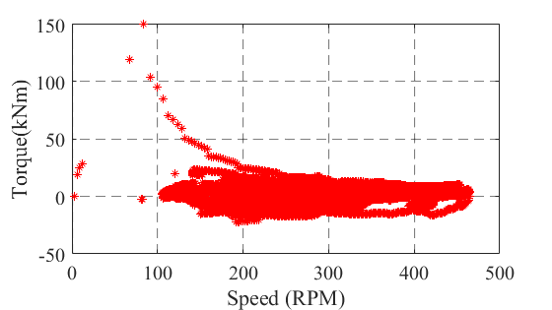
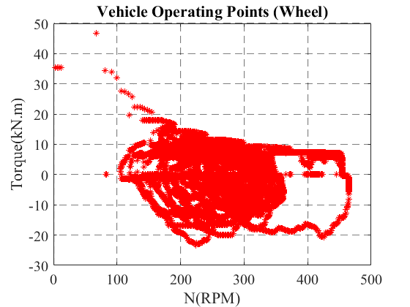
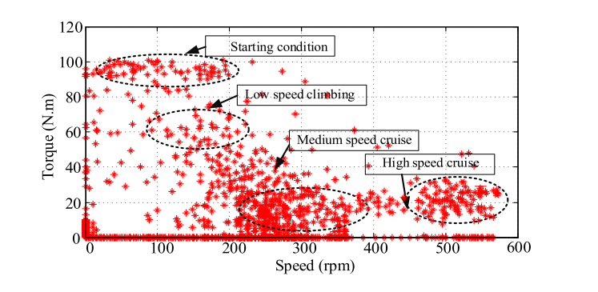
Batteries
$$V$$
Inverter
$$V$$
E-motor
$$T$$
Gearbox
$$T$$
Vehicle
$$T$$
Drive Cycle
$$I$$
$$I$$
$$ω$$
$$ω$$
$$ω$$
Losses
Drive Cycle
Speed and Torque (Output of Gearbox)
Example Ideal Drive Cycle
Wheel power
We do not have altitude information, so we cannot achieve low-speed climbing torque ??
Notes:
`

Slide 18
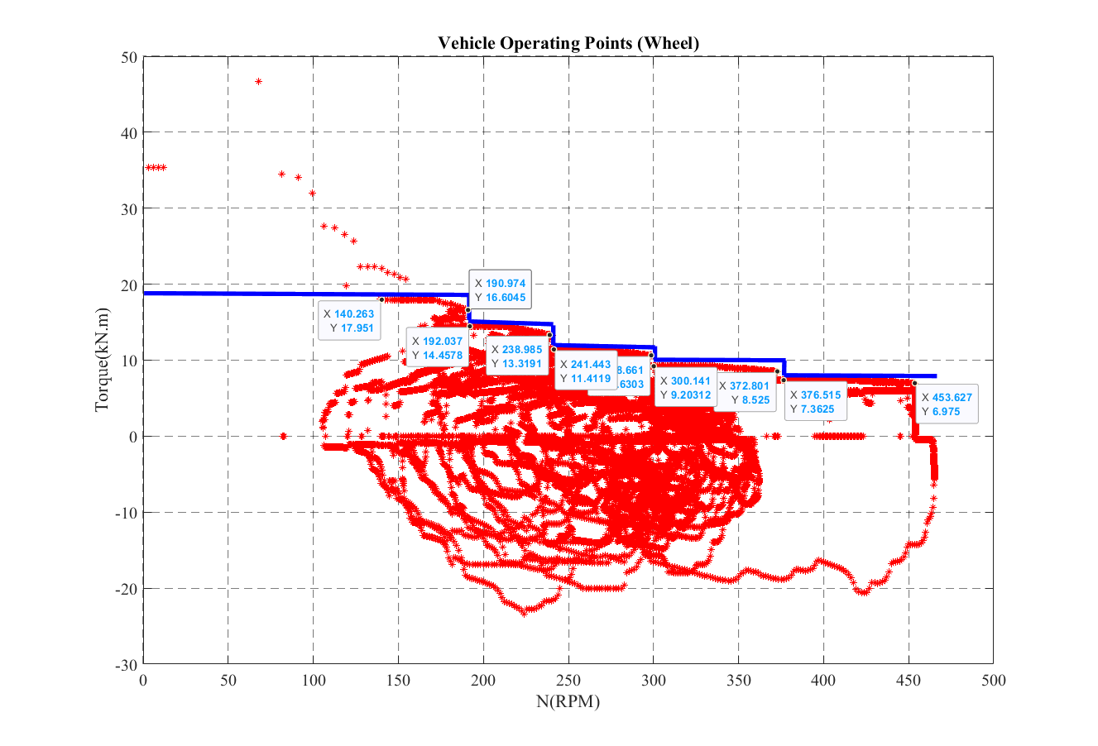
Notes:
`

Slide 19
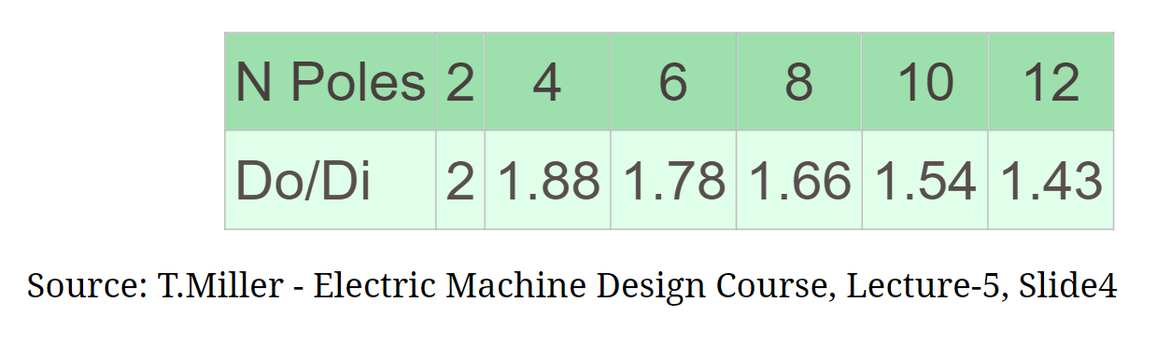
Motor Size Estimation
We can use specific electric loading ($\hat{A}$) and magnetic loading ($\hat{B}$)
If we select a lower synchronous speed, we might increase the number of poles (that means using the same electrical frequency every time), enabling a shorter outer diameter (stator diameter).
$$S=\frac{π^{2}}{2} k_{w1}\hat{A}\hat{B} D^{2}l n_{sys}$$
$$k_{w1}=0.959$$
$$\hat{A}=60\frac{kA}{m}$$
If an induction machine is utilized, the specific magnetic and specific loadings would be decreased and S should be raised for the same output power due to its bad power factor
$$\hat{B} =1.05 T$$
$$S=330 kVA$$
$$V=D_{i}^{2}l ( in m^{3})$$
$$n_{sys}=(in \frac{1}{s})$$
Inner diameter (rotor diameter)

Slide 20
2 pole pair
Variable pole pairs

Slide 21
Motor Loss Estimation
The EM power losses are modelled by a second-order polynomial in the mechanical power
We do not include the switching harmonics losses here
$$P_{EM−loss}=c_{1} T_{EM}^{2}+c_{2}{ T}_{EM}+c_{3}N^{2}$$
$$c_{1}=\frac{0.04}{\frac{{T_{maxi}}^{2}}{{477}^{2}}}$$
$$c_{2}=\frac{5}{\frac{T_{maxi}}{477}}$$
$$c_{3}=\frac{{10}^{−5} }{\frac{N_{base}^{2}}{{6000}^{2}}}$$

Slide 22
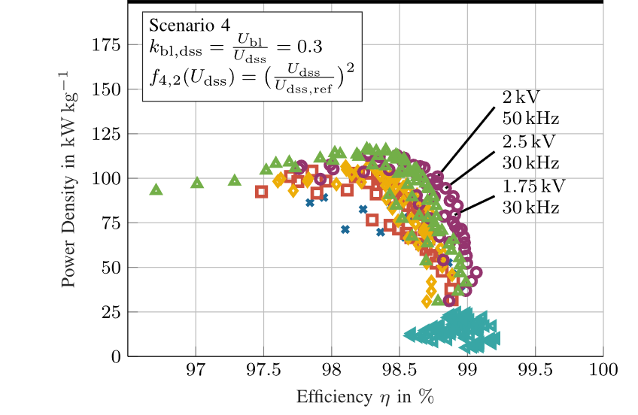
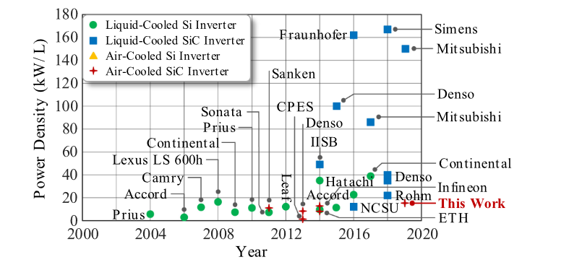
Inverter Size and Loss Estimation
The inverter is not affected by gear ratio if the DC-link voltage and power are the same.
$${f_{electrical}=n}_{sync} x pole−pair$$
We can keep $m_{f}$ constant, so the minumum switching frequency requirement changes.
$${f_{sw}=m}_{f} x f_{electrical}$$

Slide 23
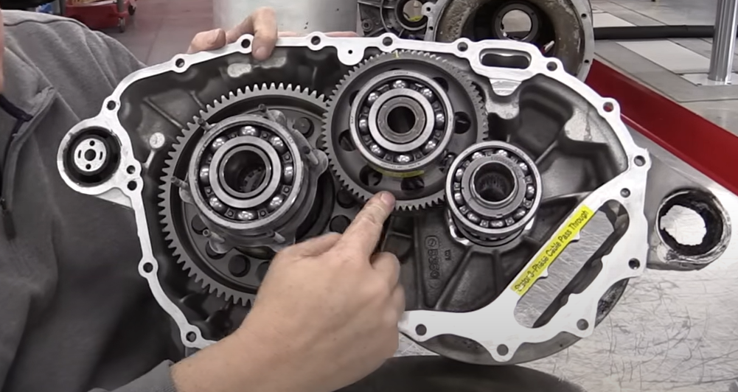
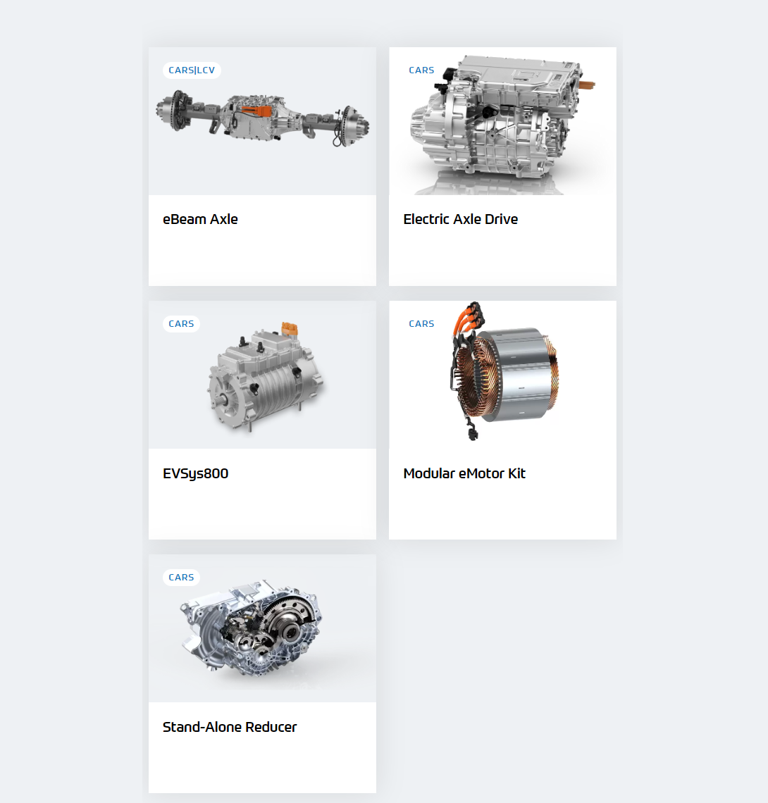
Gearbox Size Estimation
Tesla
78/25
78/25

Slide 24
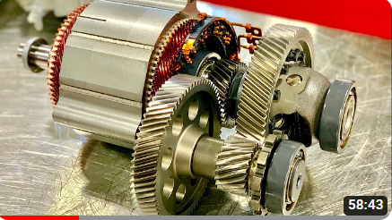
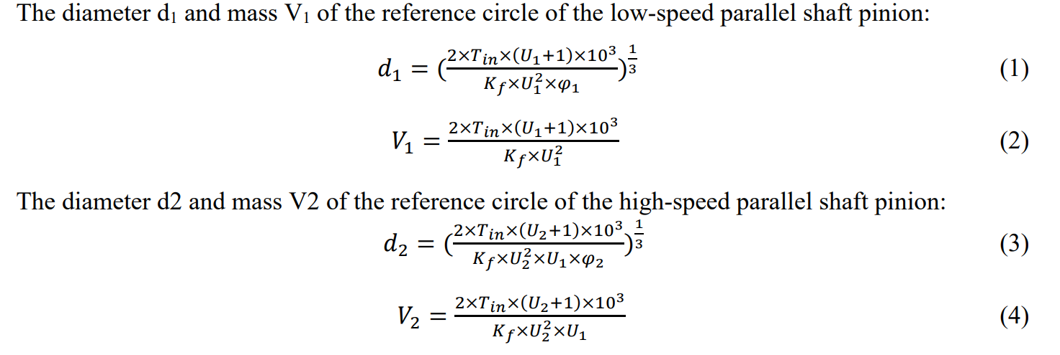
Gearbox Size Estimation
Gear Ratio Distribution of Electric Vehicle Reducer
Torque
Gear ratio
Material
Usage duty
Spur gear
Helical gear
Ring gear
Chevrolet Bolt EV

Slide 25
Not realistic values, since I have randomly selected the material !!!
Single Stage Gear
The volume will be increased quadratically if we have a constant aspect ratio and material.

Slide 26
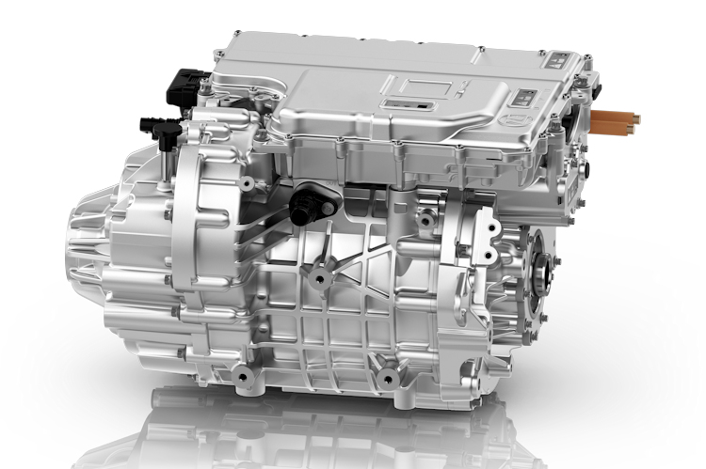
E-axle ???
If gear diameters are shorter than the summation of motor diameters and the height of the inverter in the e-axle system, we can increase the gear ratio. Therefore, the motor diameter is decreased, and there might be a sweet point that they are overlapped.
However, consider that the width of the gearbox is also increased with the diameter if we use the same material and so the aspect ratio.

Slide 27
Losses and Energy Flow between Drivetrain Components *[1]
Batteries
$$V$$
Inverter
$$V$$
E-motor
$$T$$
Gearbox
$$T$$
Vehicle
$$T$$
Drive Cycle
$$I$$
$$I$$
$$ω$$
$$ω$$
$$ω$$
Losses
Inverter-1
$$V$$
E-motor-1
$$T$$
Gearbox-1
$$I$$
$$ω$$
Batteries
$$V$$
$$T$$
$$T$$
$$I$$
$$ω$$
Vehicle
$$ω$$
Drive Cycle
Inverter-2
$$V$$
E-motor-2
$$T$$
Gearbox-2
$$I$$
$$ω$$
Losses
[1] A Simulation Platform for Optimization of Electric Vehicles With Modular Drivetrain Topologies

Slide 28
Drive Cycles
Enes Ayaz

Slide 29
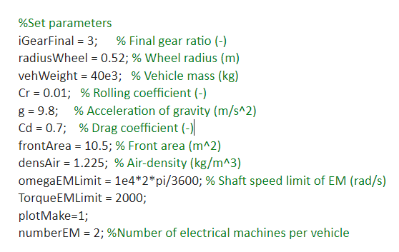
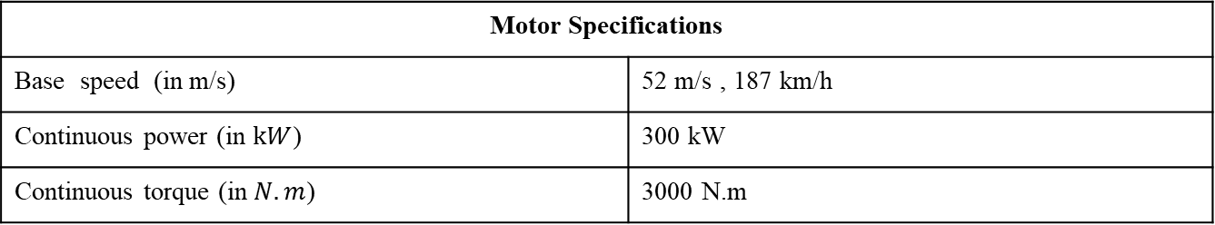
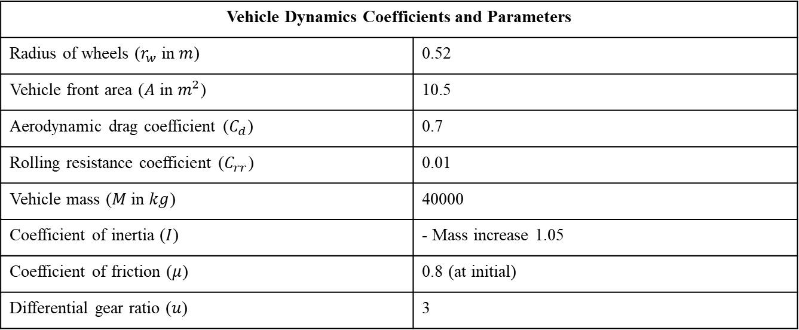
Vehicle Dynamics Coefficients and Parameters
Radius of wheels ($r_{w}$ in $m$) | 0.52
Vehicle front area ($A$ in $m^{2}$) | 10.5
Aerodynamic drag coefficient ($C_{d}$) | 0.7
Rolling resistance coefficient ($C_{rr}$) | 0.01
Vehicle mass ($M$ in $kg$) | 40000
Coefficient of inertia ($I$) | - Mass increase 1.05
Coefficient of friction ($μ$) | 0.8 (at initial)
Differential gear ratio ($u$) | 3
From the data that Luca has sent before
Motor Specifications
Base speed (in m/s) | 52 m/s , 187 km/h
Continuous power (in $kW$) | 300 kW
Continuous torque (in $N.m$) | 3000 N.m

Slide 30
90 km/h
Cruise-high way
Hill climbing
Need altitude information?

Slide 31






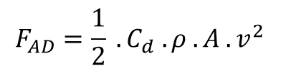

Total Tractive Force= Rolling Resistance + Aerodynamic Drag + Gradient Force + Acceleration Force
$$F_{TTF}=F_{RR}+F_{AD}+F_{G}+F_{A}$$
$$F_{RR}=C_{rr} . M .g.cos⁡(θ)$$
$$F_{AD}=\frac{1}{2} . C_{d} . ρ . A .v^{2}$$
$ρ$ = density of air
$$F_{G}=M . g . sin⁡(θ)$$
$θ$= uphill or downhill slopes angle
$$F_{A}=M .\overline{a}$$
*[3]
$$T_{EM}=F_{TTF} .\frac{r}{u}$$

Slide 32
Powerized KPI
1.Reduce the nominal power losses of
the traction inverter from 1% to 0.6%.
2. Reduce losses over the VECTO long-
haul drive cycle from 1.2% to 0.7%
3. Increase the input voltage of the
designed converter from 800V to 1250V
4. Increase the power density of the
traction inverter from 30 kW/l to 50 kW/l
Regenerative brake efficiency?

Slide 33
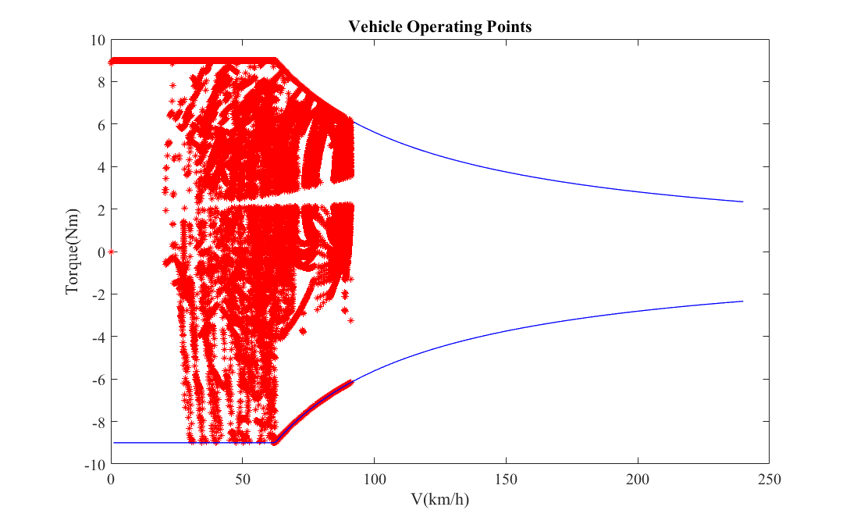

Slide 34
High torque requires acceleration from 0-100km/h

