Slide 1
Harmonic Modelling of the Inverter

Slide 2
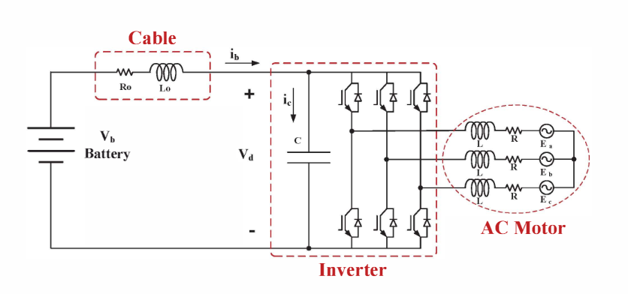
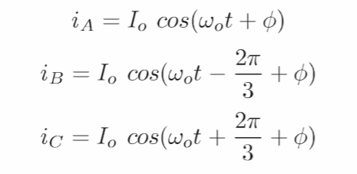
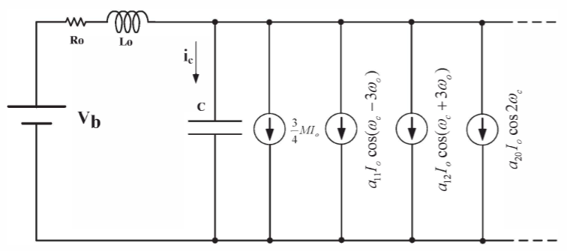

Simplified Inverter Model
Do not consider output harmonics for the phase currents
Combined Inverter and battery model
The inverter can be modeled as current sources of harmonic components.

Slide 3
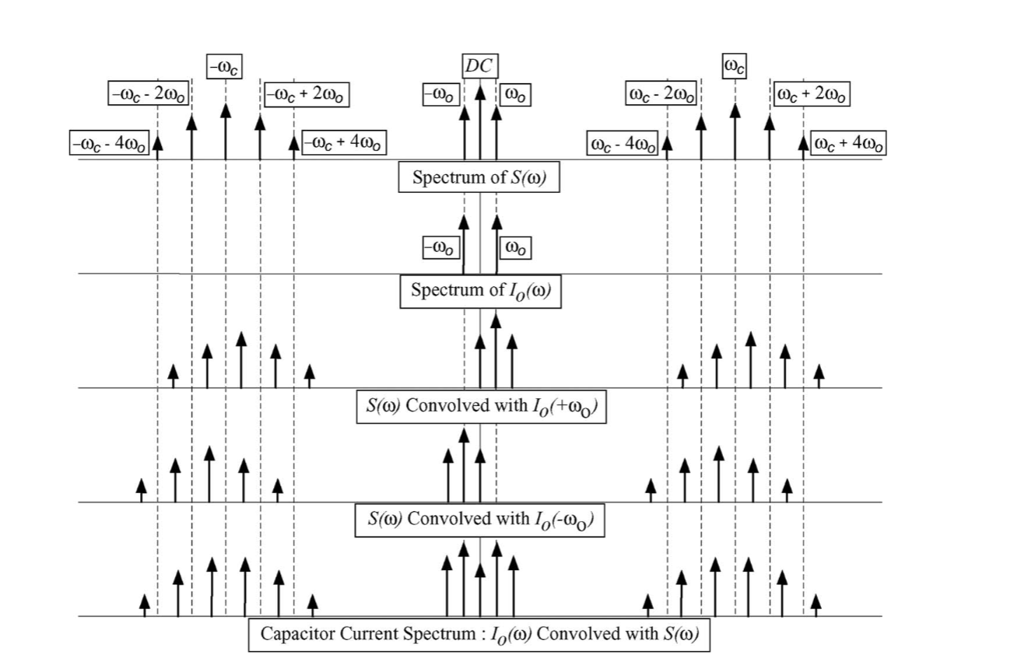


Current Sources of Harmonics
Leg current in the time domain is the multiplication of the phase current and switching function
Leg current in the frequency domain is the convolution of the phase current and switching function
$S_{A}(t)I_{A}(t)$➔
$S_{A}(ω){∗ I}_{A}(ω)$➔

Slide 4
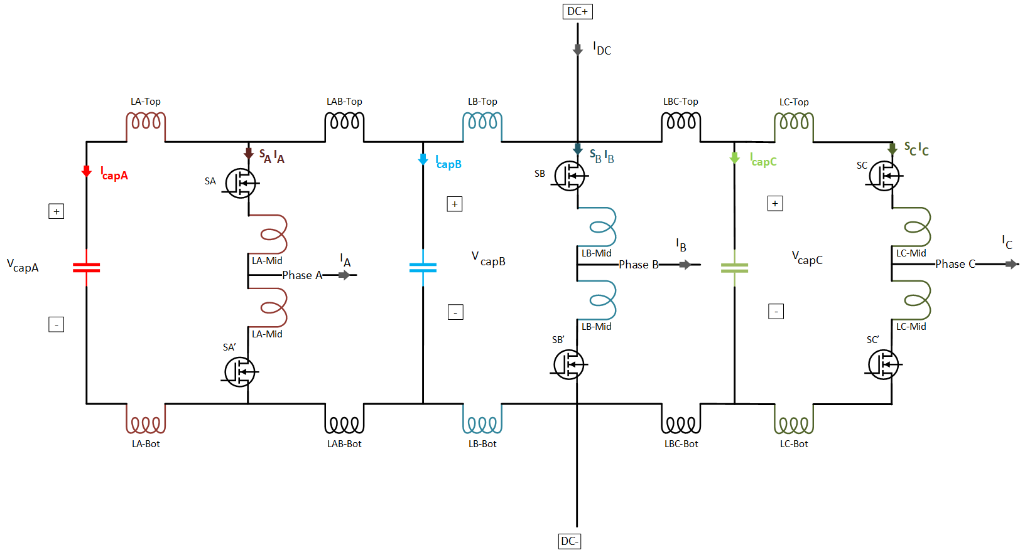
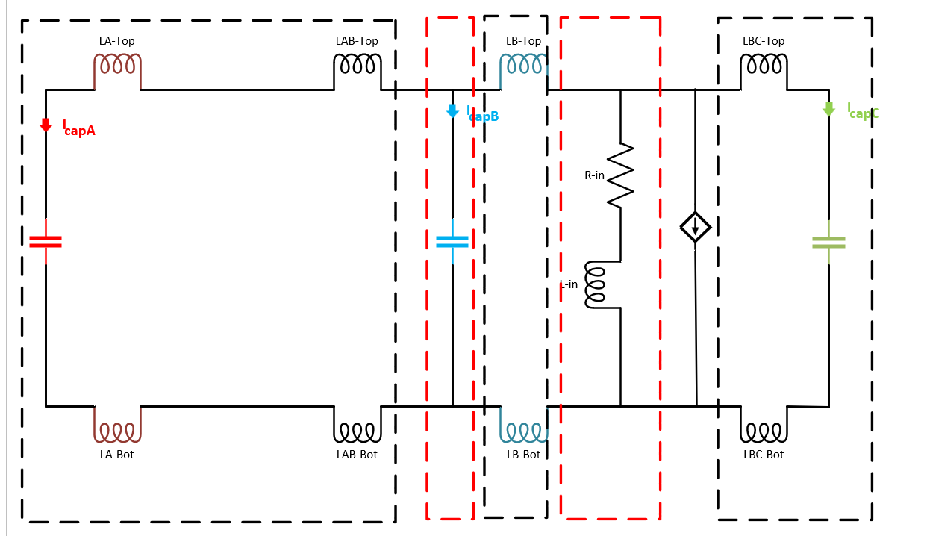
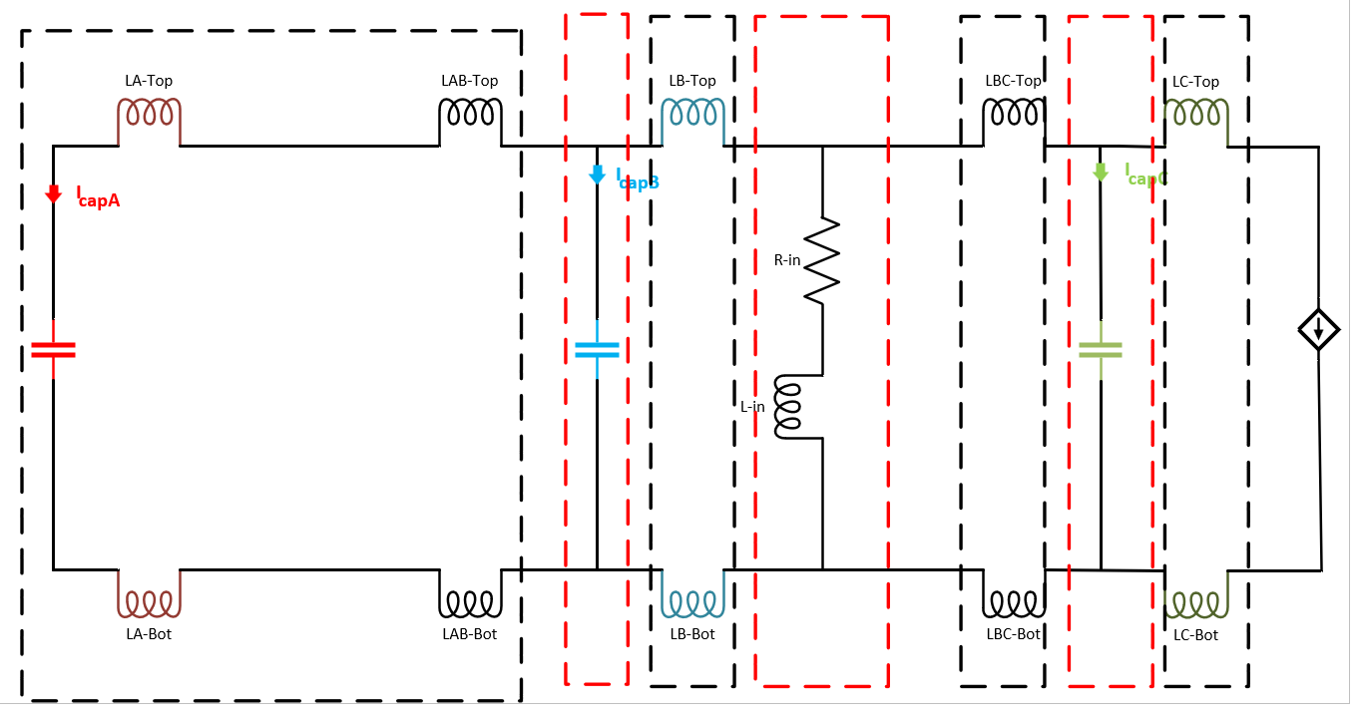
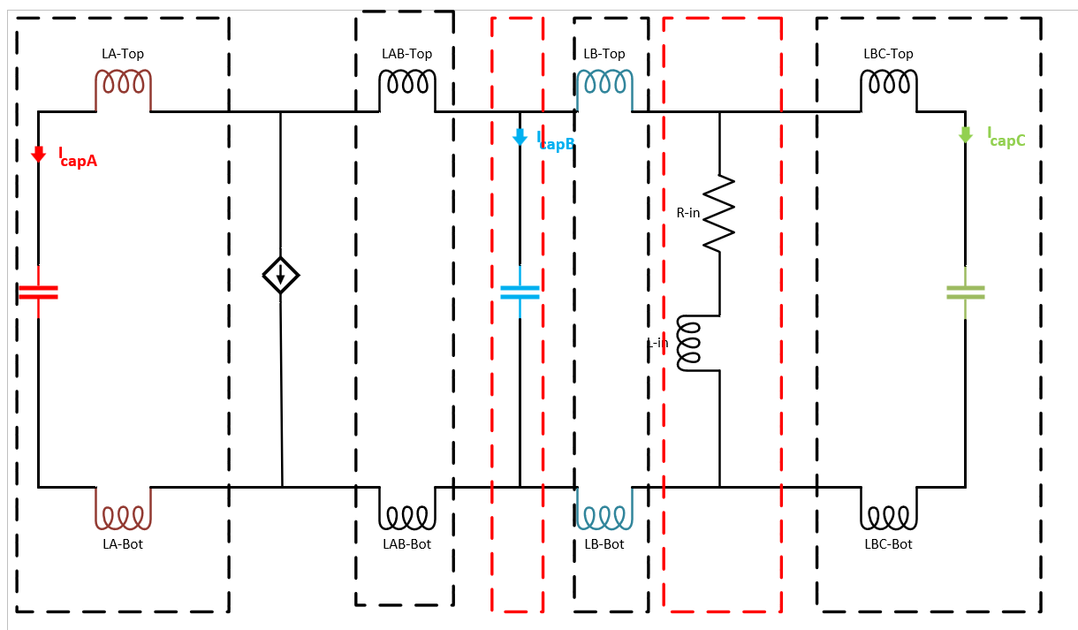
Impedance Model of an Inverter - Example
Simplified 3 capacitors and 3 phase Parasitic Model
Only Phase A
Only Phase B
Only Phase C

Slide 5
The Aim of Using Impedance Model
High impedance points
A simplified model does not provide the effective capacitance values for each phase.
A simplified model does not provide the current distribution of the capacitors.
The uneven current distribution leads to thermal unbalance, which affects the lifetime of the capacitors.
The individual capacitance values of the capacitors, but the total capacitance value kept the same, can be re-selected to balance the losses and thermal stress.
Additionally, a resonant structure is created because of the capacitors and stray inductances, which create high impedance for some frequencies.

Slide 6

Busbar Geometry 62mm Power Module
C3
C4
Capacitor
Power Modules
C2
C1
DC- Nodes
DC+ Nodes

Slide 7
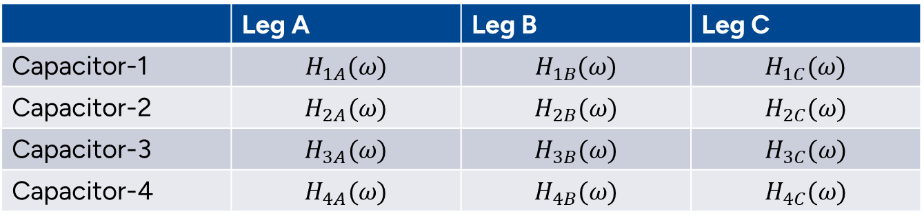
Impedance Model
Step response of capacitors to each leg
 | Leg A | Leg B | Leg C
Capacitor-1 | $$H_{1A}(ω)$$ | $$H_{1B}(ω)$$ | $$H_{1C}(ω)$$
Capacitor-2 | $$H_{2A}(ω)$$ | $$H_{2B}(ω)$$ | $$H_{2C}(ω)$$
Capacitor-3 | $$H_{3A}(ω)$$ | $$H_{3B}(ω)$$ | $$H_{3C}(ω)$$
Capacitor-4 | $$H_{4A}(ω)$$ | $$H_{4B}(ω)$$ | $$H_{4C}(ω)$$
The response of capacitor A for each leg should be calculated as:
$I_{capA}= {(S_{A}∗I_{A} )H}_{1A}\left(ω\right)+{(S_{B}∗I_{B} )H}_{1B}\left(ω\right)$+${(S_{C}∗I_{C} )H}_{1C}\left(ω\right)$

Slide 8
DC Link Current (Positive/Negative/Zero Sequences)
6th 12th

Slide 9
Without Battery Model
Capacitor Responses to Phase-A
Capacitor-1 Response to all phases

Slide 10
The Effect of the Battery Connection and Parasitics
Capacitor-1 Response to all phases
High frequency
resonance
Low frequency resonance

Slide 11
The Effect of the Battery Connection and Parasitics
Capacitor Responses to Phase-A
High frequency
resonance
Low frequency resonance

Slide 12
High Frequency Resonance
14 kHz Switching
24kHz Switching
Harmonic number
Harmonic number

Slide 13
Low Frequency Resonance
700 Hz Fundamental
200 Hz Fundamental

Slide 14
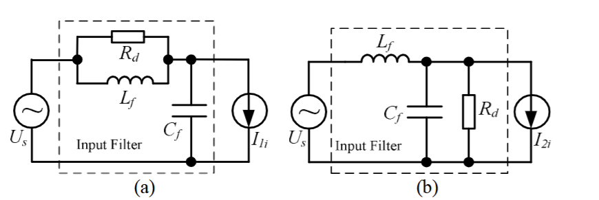
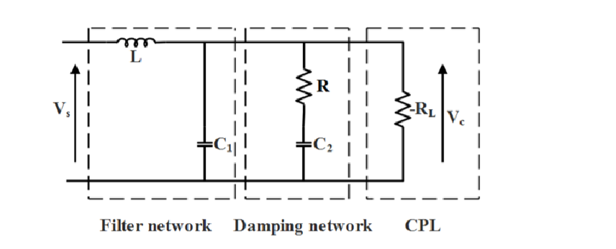
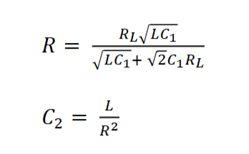
Possible Solutions : 1- Passive Dampings
We need additional passive elements like resistance/capacitance/inductance
In the design, the damping capacitor C2 was assumed to be much larger than filter capacitor C1, C2>>C1, and that makes the impedance of C2 very small at higher frequencies.
[1] Damping of Input LC Filter Resonance Based on Virtual Resistor for Matrix Converter
[2] DC bus stabilization using passive damping network indistributed power system with constant power load

Slide 15
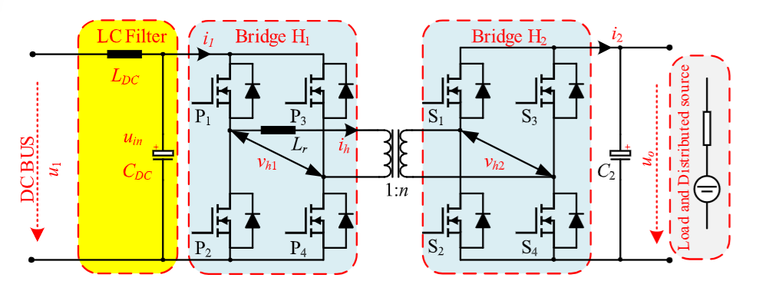
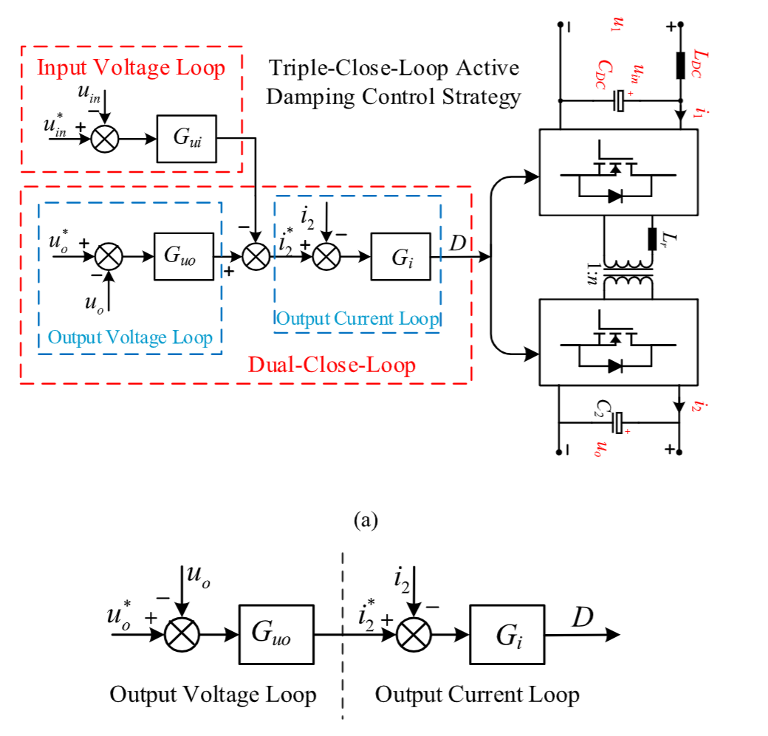
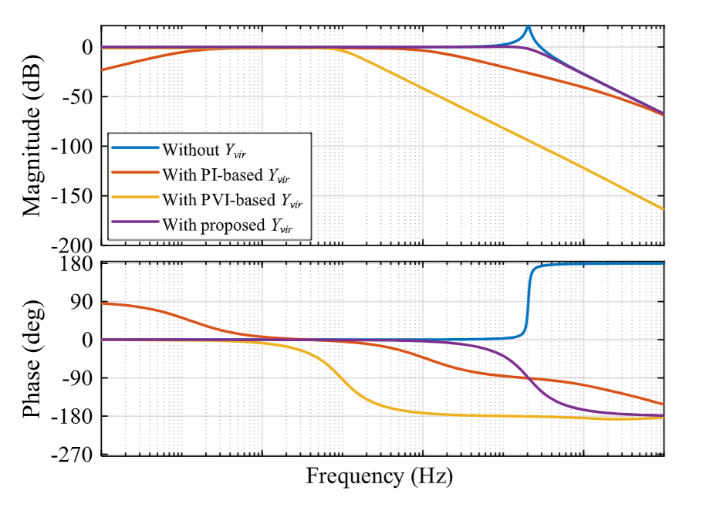
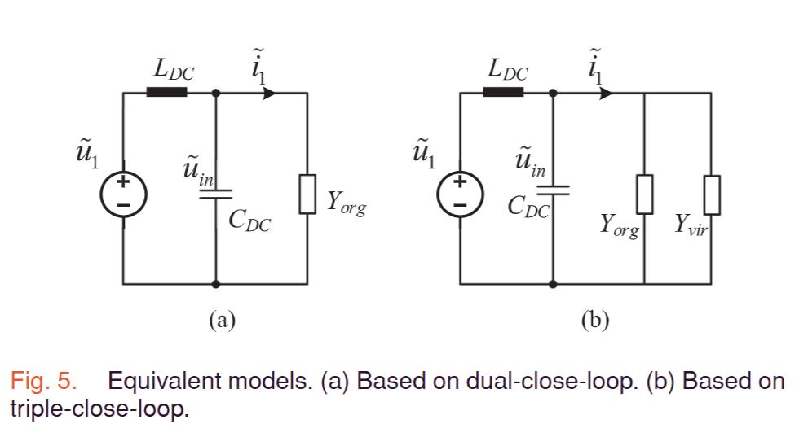
Possible Solutions : 2- Active Dampings
[1] An Active Damping Strategy for InputImpedance of Bidirectional Dual Active BridgeDC–DC Converter: Modeling, Shaping,Design, and Experiment

Slide 16
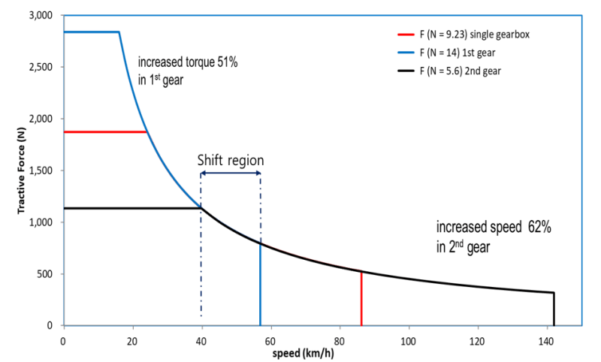
Possible Solutions: 3- Two-speed Transmission (Gearbox )
The gear ratios can be selected as the low-frequency resonant frequency is aligned with the shift-region frequency to avoid the resonant frequency injection.

