Slide 1
DC-Link Voltage Scaling to 1.2 kV for Heavy-DutyEVs
Enes Ayaz

Slide 2


Introduction
The shift towards electrifying heavy-duty vehicles is driven by the increasing need for sustainable transportation solutions to address environmental challenges and reduce emissions.
Limitations of 400–800 V architectures:
Power Ratings: Electric trucks require high power ratings.
Megawatt charging systems (MCS) are essential to support rapid charging, aligning with the operational demands of electric trucks.
European Union's regulation on driving times
  Drivers may drive for a maximum of 4.5 hours continuously.
  After 4.5 hours, a driver must take a minimum 45-minute rest.
.

Slide 3
Research Motivation & Problem Statement
Research gap
Literature mostly:
  Subsystem-level
  Focused on passenger EVs (≤ 800 V)
Lack of:
  Unified HDV-scale analysis (> 1 kV)
The research objective
Quantify the system-level impact of increasing DC-link voltage from 800 V to 1200 V in heavy-duty electric vehicles.
Key questions
What are performance improvements enabled by increasing the DC-link voltage from 800 V to 1200 V at the system level?
What new penalties and constraints (losses, stresses, sizing) are introduced by high-voltage operation?
Under which design conditions does a 1200 V architecture become preferable to an 800 V system?

Slide 4
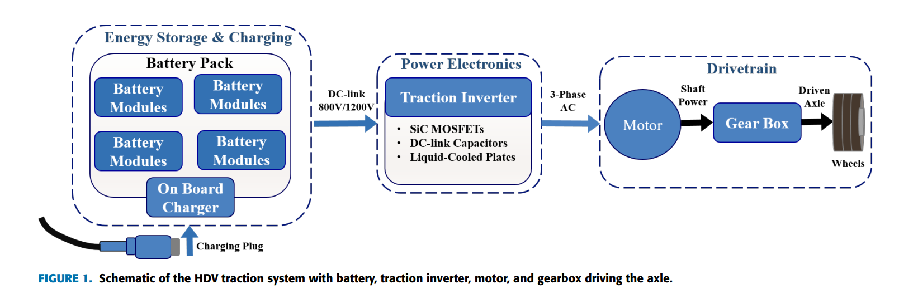
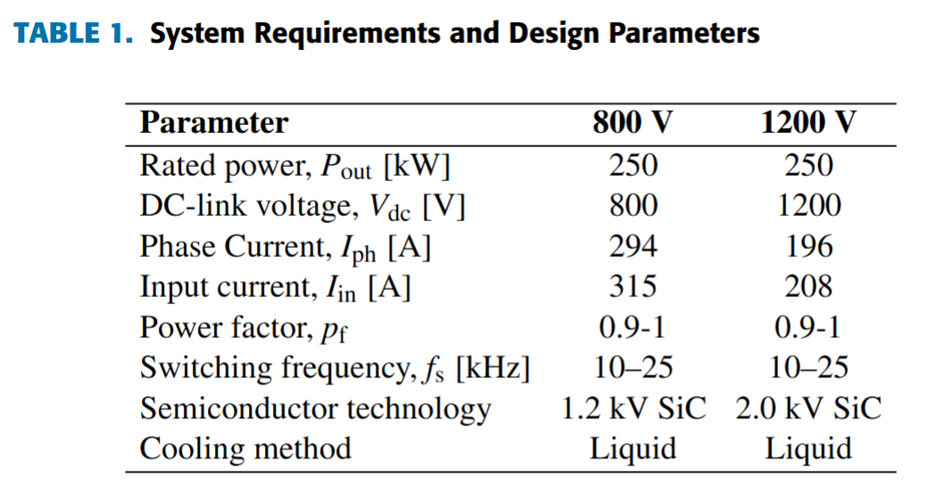
System Overview & Methodology
Studied system
  Battery + charging
  Traction inverter
  Traction motor
Methodology
  Unified virtual-prototyping framework
  Equal-power & equal-loss benchmarking
  Analytical & experimental approach

Slide 5




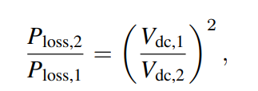
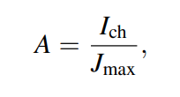

Battery & Fast-Charging Analysis
Total energy storaged:
Higher voltage → lower current:
(Preserving the same total energy.)
The instantenous charging current:
The corresponding cable conduction loss :
Conduction loss is scaled by:
(while keeping the same conductor area.)
Cable cross section can be reduced :
Power is scaled by:
(if cable current is fixed.)

Slide 6
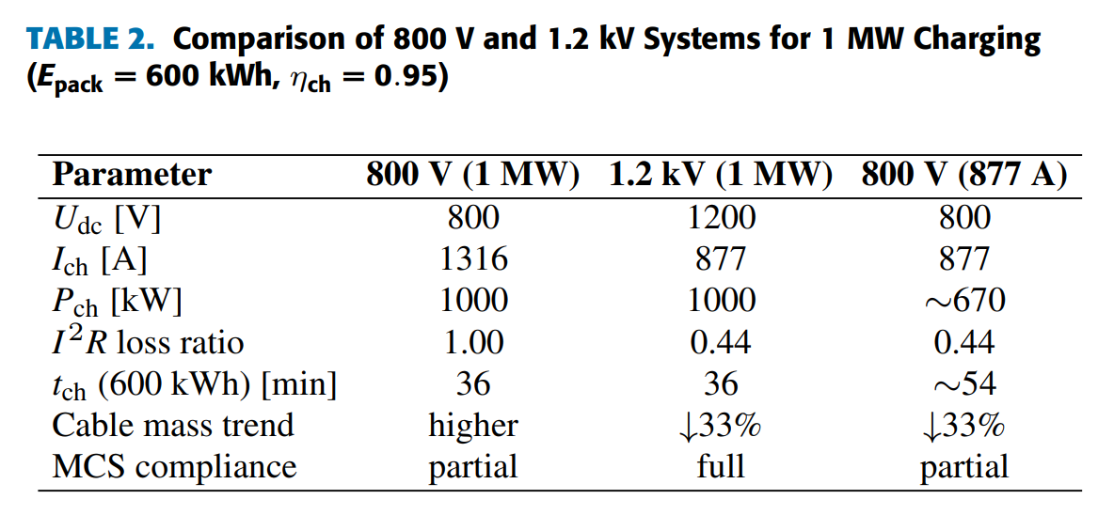
Battery & Fast-Charging Analysis
Main findings:
Same energy : higher voltage → lower current
~33% current reduction at 1200 V
~56% reduction in I²R cable losses
~40–45% cable mass reduction
Full compatibility with MCS standards(> 1 MW)

Slide 7
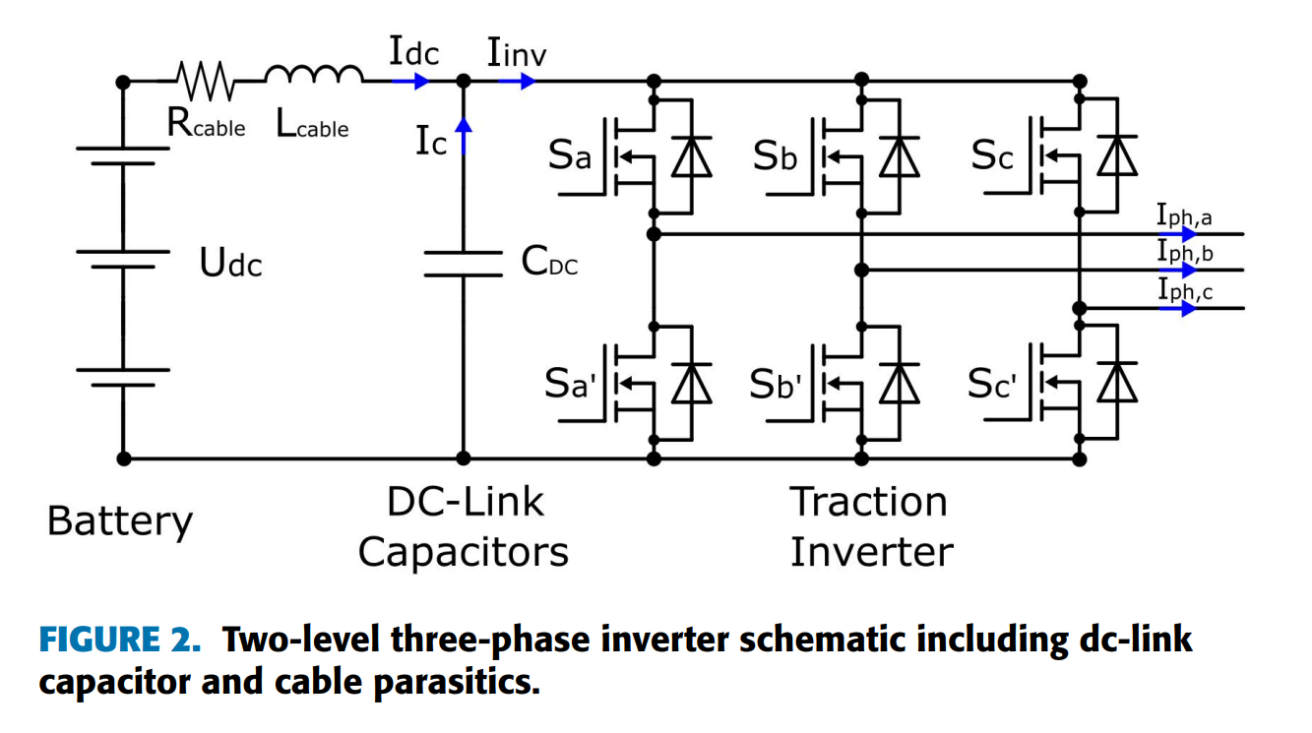
Traction Inverter Benchmark
Benchmark setup
800 V (1.2 kV SiC) vs 1200 V (2 kV SiC)
Same power, same thermal limits
Loss modeling
  Conduction vs switching
Device Rating
  Die-area optimization
Cooling System
  Cooling-system performance index
DC-Link Capacitance
  Capacitance value and volume
Design Selection
  Efficiency map
.

Slide 8
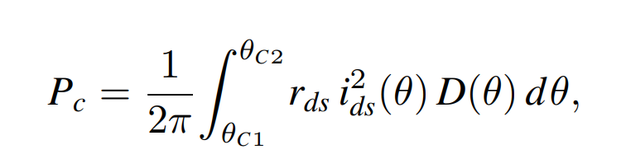
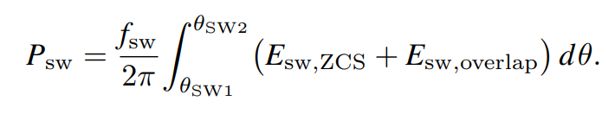

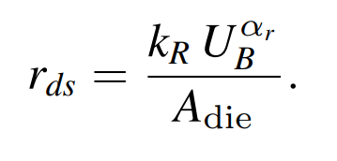
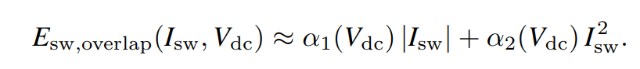
Traction Inverter Loss Calculation
Conduction Loss
Switching Losses
where duty cycles (D(θ)), switch current (ids(θ)), conduction angles (θC1 to θC2), and on-state resistance (rds) are required.
Where θSW1 and θSW2 are switching angles, Esw,zcs and Esw,overlap are zero current switching energy and overlapping energy.
The on-state resistance depends on the voltage rating (UB) and die area (Adie) that can be roughly calculated:
The zero current switching energy is reliant on the output capacitance (Coss,Q) and switching voltage (Udc).
The overlapping energy aligns with a second order polynomial:
where kr and αr are technology-dependent coefficients.

Slide 9
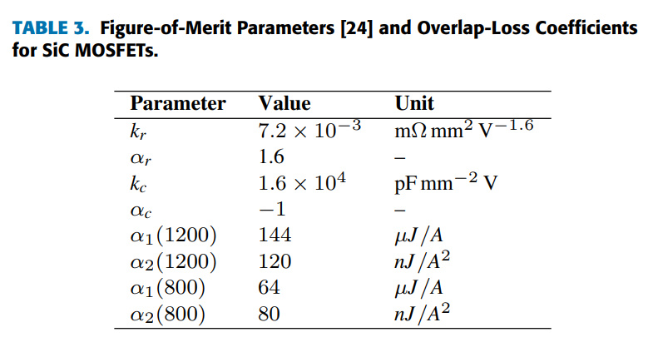
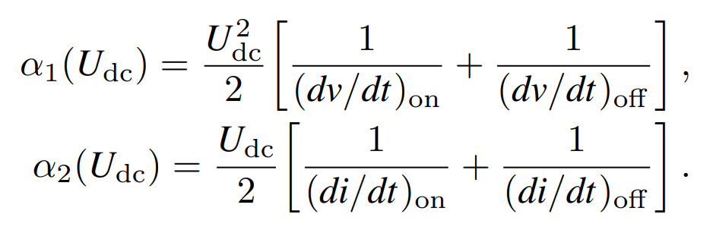
Traction Inverter Loss Calculation
The voltage and current slew rates determine coefficients α1 and α2s during the switching transitions.
While faster transitions reduce α1 and α2 but aggravate electromagnetic interference (EMI) and common-mode voltage stress.

Slide 10
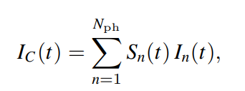
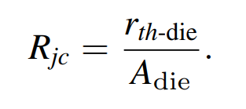
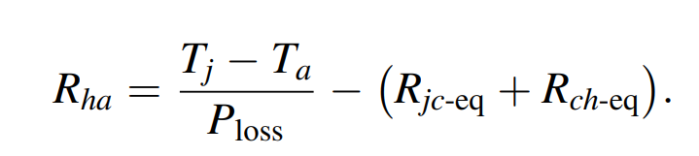
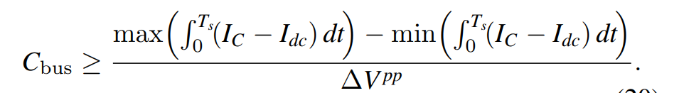
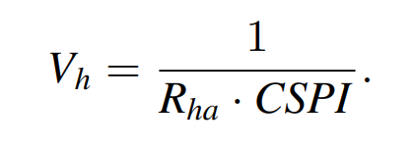
Cooling System & DC-Link Capacitance
The junction-to-case thermal resistance decreases with die area
The instantaneous dc-link capacitor current is expressed as
The required heatsink-to-ambient thermal resistance to limit junction temperature:
The minimum required dclink capacitance for a specified voltage ripple ∆V pp is calculated a
The heatsink volume is then estimated from the cooling system performance index (CSPI):
At constant power, a higher dc-link voltage proportionally reduces the capacitor ripple current, thereby decreasing the required capacitance and volume

Slide 11
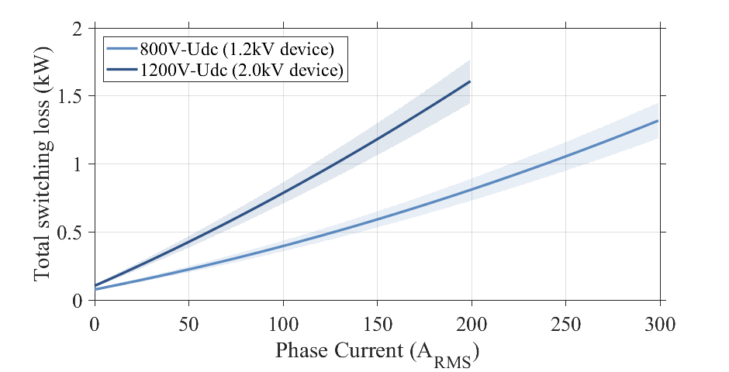
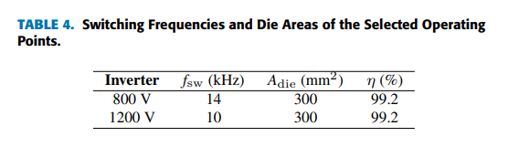
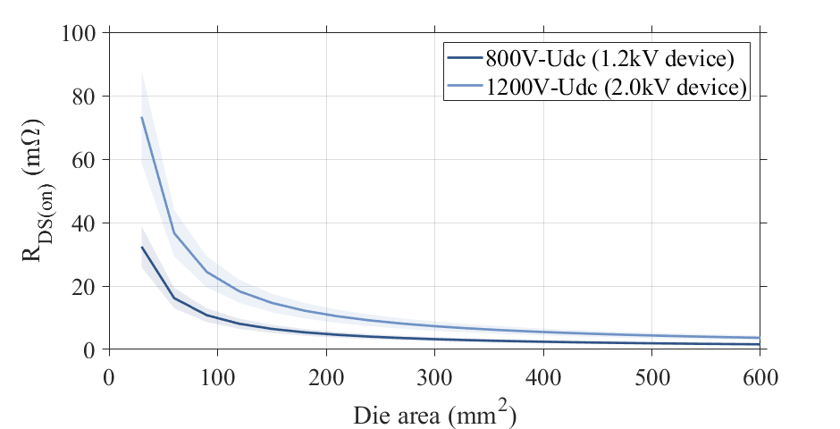
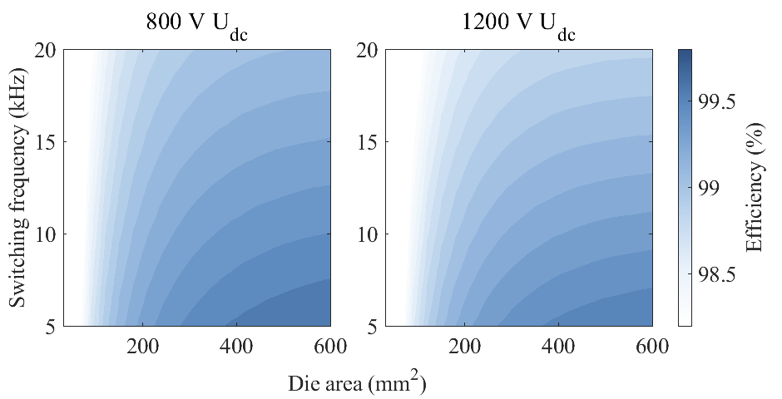


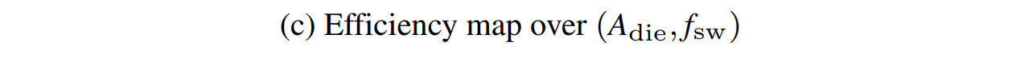
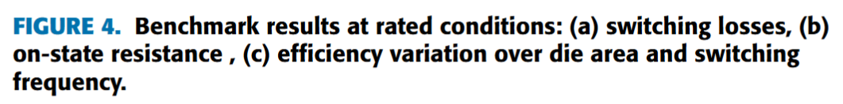
Loss Analyses: Switching Frequency & Die Area
.

Slide 12
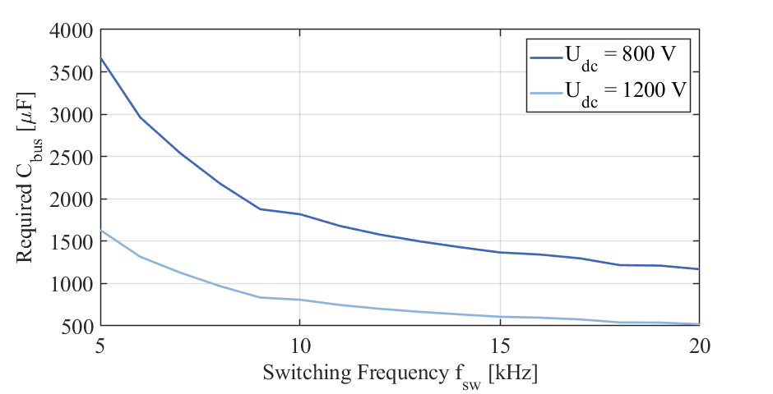
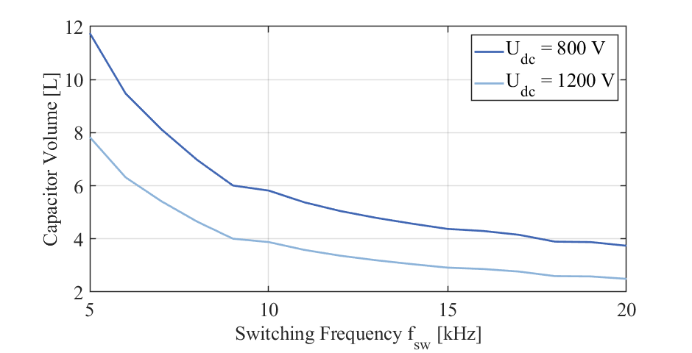
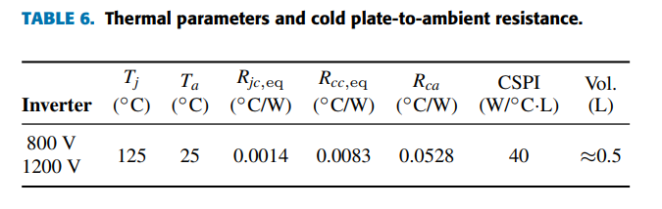
Results: Cooling System & DC-Link Capacitance
.

Slide 13
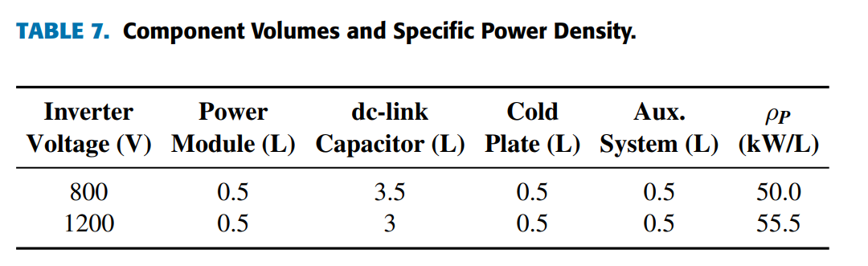
Traction Inverter: Loss & Power Density Trade-Offs
Key results
Similar efficiency (~99.2%)
Lower current ≠ automatically lower losses
1200 V → smaller DC-link capacitor
Power density increased by 11%
.

Slide 14
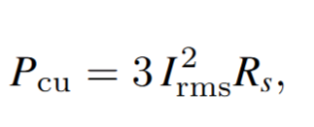
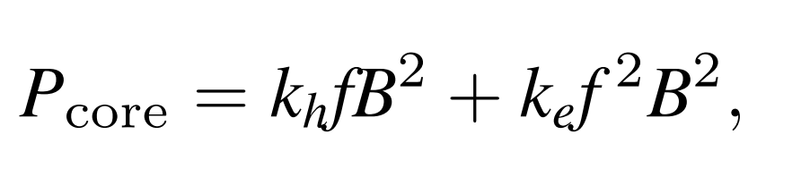
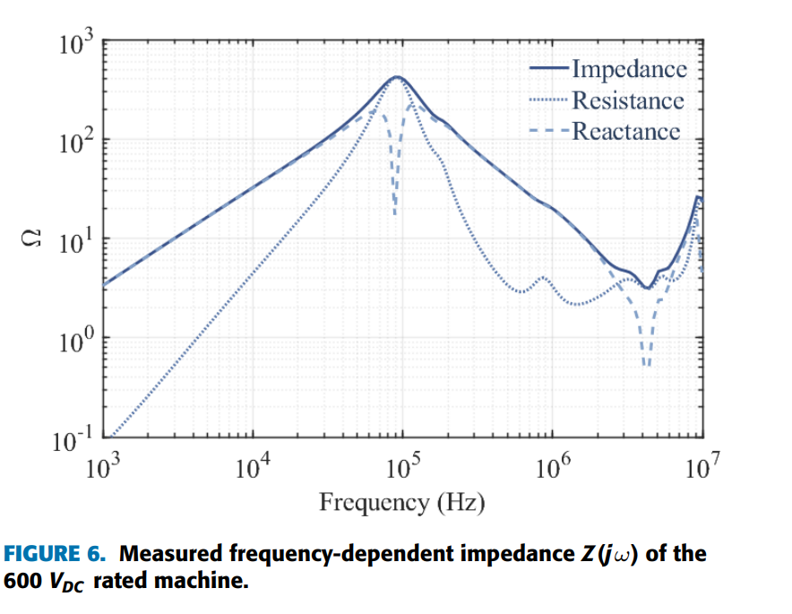
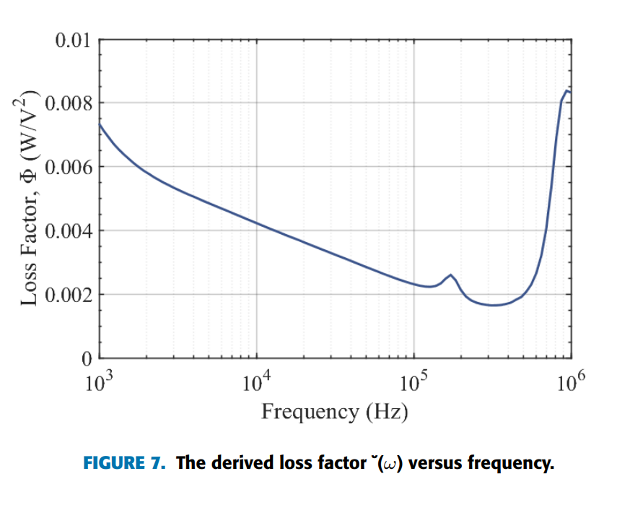
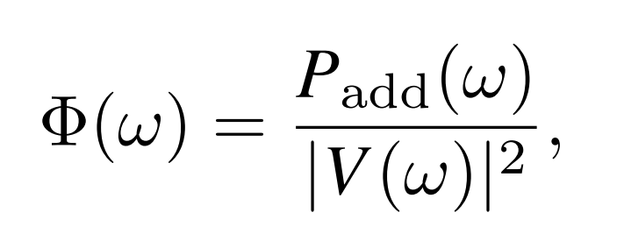
Traction Motor Loss Analyses
The same motor geometry and electromagnetic design are maintained.
A higher dc-link voltage is accommodated by reconnecting the existing parallel winding paths in series.
Stator copper loss:
Core losses:
Higher insulation requirements at 1.2 kV typically mandate thicker groundwall and turn insulation, which reduces the slot fill factor and slightly increases Rs, leading to a marginal rise in stator copper losses.
Impedance-based loss factor Φ(ω)
From the measured impedance response, a voltage-based loss factor is extracted as
.

Slide 15
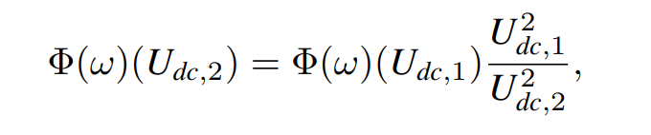
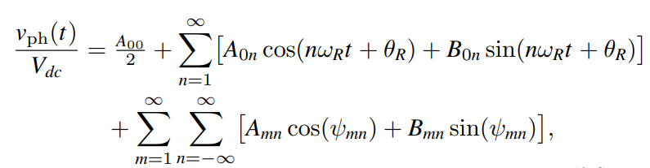
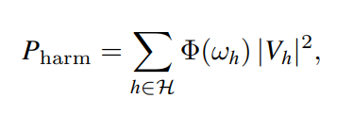
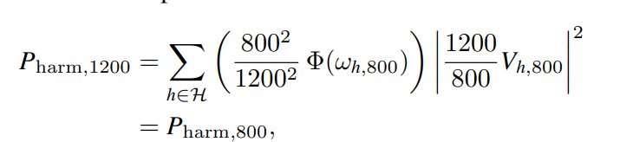
Traction Motor Loss Analyses
LOSS FACTOR SCALING WITH SERIES/PARALLEL RECONNECTION
Reconnecting parallel winding paths in series increases the effective phase inductance, altering the winding’s high-frequency impedance behavior.
SYNTHESIS OF PWM HARMONIC LOSS
  Same harmonic losses: scaled loss factor and voltage levels.
.

Slide 16
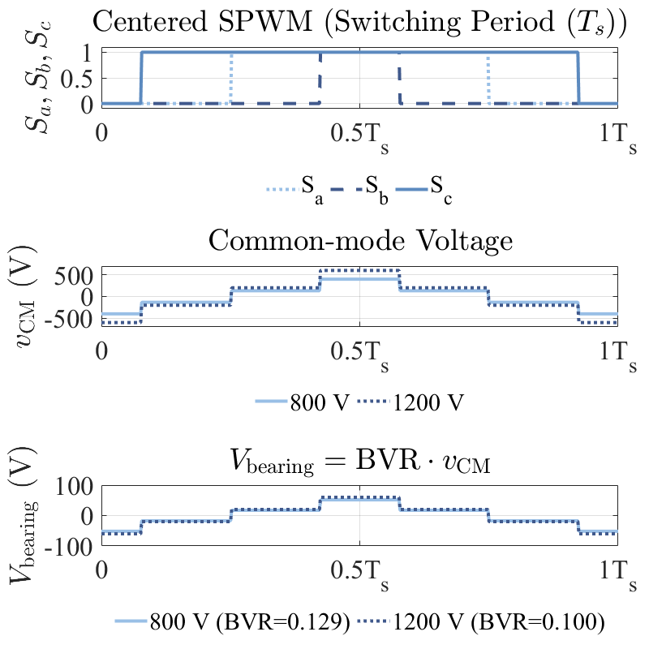
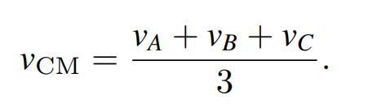
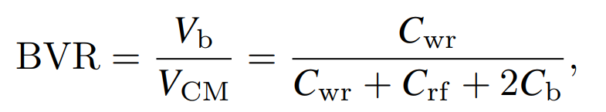
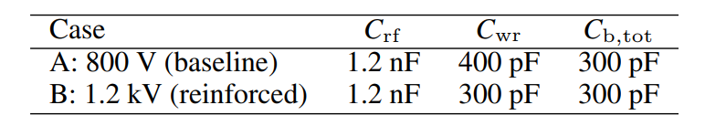
Common-Mode Voltage & Bearing Stress
Concern : Higher Vdc → higher CMV amplitude
Bearing Voltage Ratio (BVR) quantifies the coupling of CMV to the rotor shaft:
In higher-voltage machines, shielding materials can be employed to further reduce the bearing voltage ratio (BVR), while reinforced insulation decreases the winding-to-rotor capacitance (Cwr).
.

Slide 17
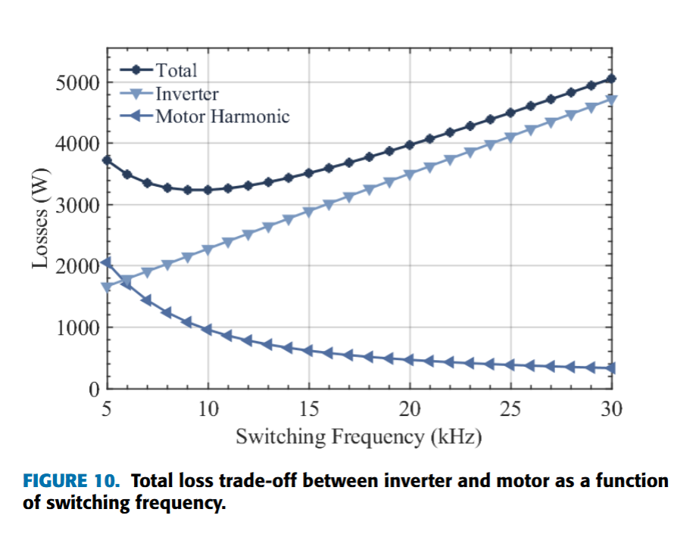
Holistic Optimization: Switching Frequency
Why holistic?
Inverter losses ↑ with fsw
Motor harmonic losses ↓ with fsw
.

Slide 18



Experimental Validation: B2B Setup
.

Slide 19
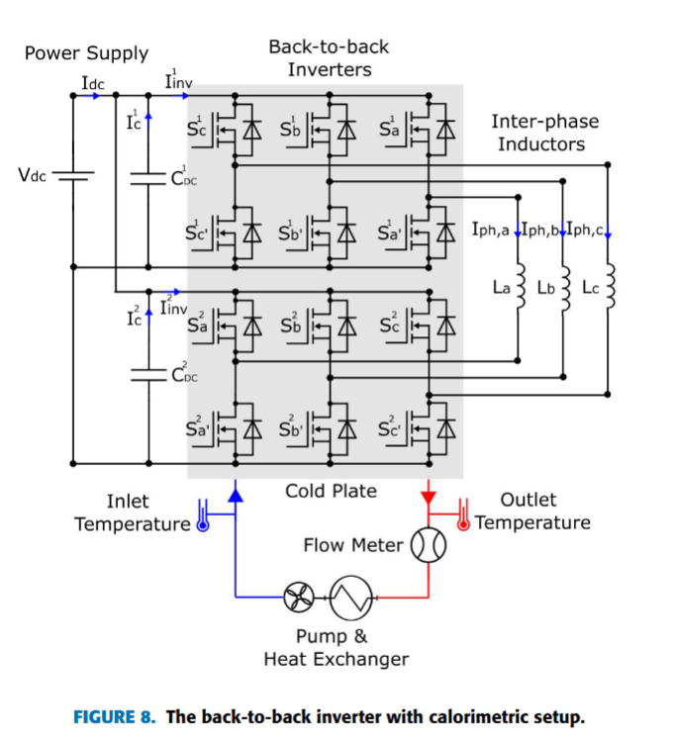
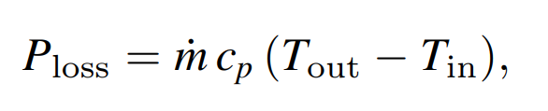
Experimental Validation : Loss Seperation
Measuring individual loss components independently requires high-precision instrumentation, therefore, a calorimetric measurement is employed.
The total power loss was determined from the coolant temperature rise and the measured flow rate using
This measurement does not distinguish between individual loss mechanisms.

Slide 20

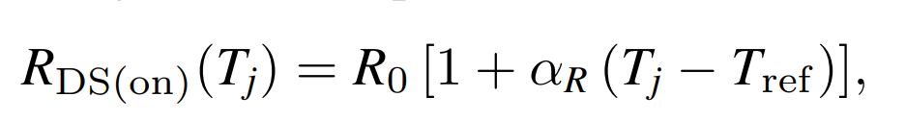
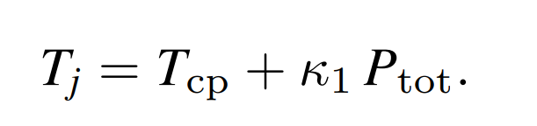
Loss Seperation: Conduction Loss
Assuming a constant junction temperature in steady-state, the average conduction loss per leg is
The on-state resistance can be modeled as a linear function of the junction temperature:
The junction temperature cannot be directly measured in typical calorimetric setups. It is therefore inferred from the total measured losses
The factor κ1 accounts for the effective thermal resistance network between the junction and the coolant, comprising spreading effects and sensor placement.

Slide 21
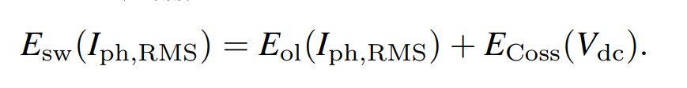
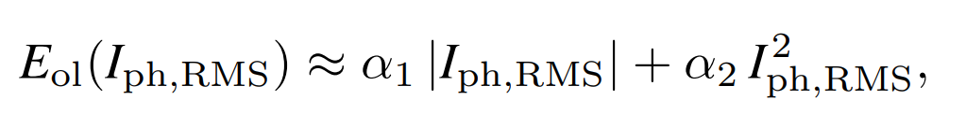

Loss Seperation : Switching Loss
The total switching energy per device is expressed as the sum of the overlap energy and the capacitive energy of the output capacitance
The overlap energy is represented by a low-order polynomial in the RMS current:
where α1 and α2 are empirical coefficients that account for the gate-drive network, device charge dynamics, and resulting dv/dt and di/dt characteristics.
The capacitive energy contribution of Coss during hard-switching transitions is modeled as
The average switching power loss per leg is then given by

Slide 22
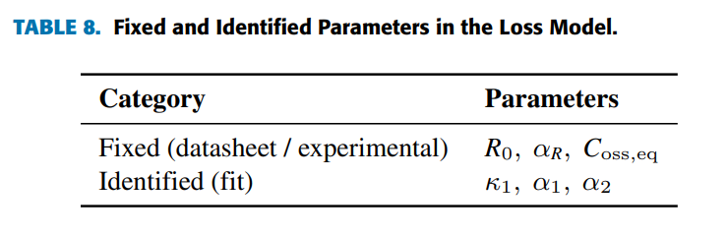
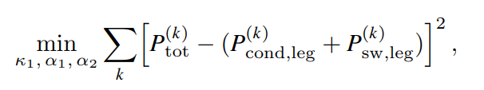
Loss Seperation : Calibration
Model calibration is carried out using calorimetric measurements over a grid of operating points (Iph,RMS, fsw) at constant Vdc and flow rate.

Slide 23
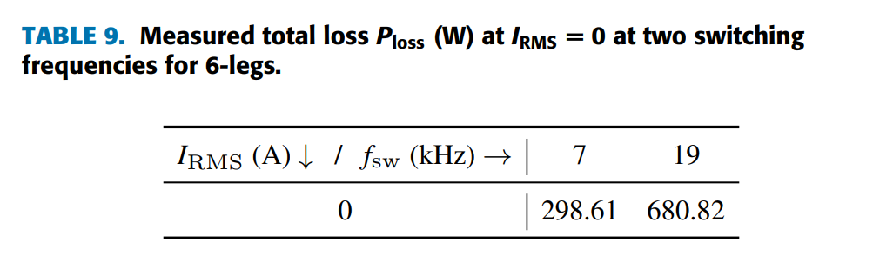


Experimental Validation : Loss Seperation

Slide 24



Experimental Validation : Loss Seperation

Slide 25




Experimental Validation: Effiency and Paremeters
Equivalent output capacitance matches datasheet-based output energy
Switching-loss parameters show good agreement with the analytical model (8%–20% deviation)
Total loss estimation agrees with experiments (error < 10%)

Slide 26
Conclusion
1200 V is not merely a voltage increase; it fundamentally reshapes the entire powertrain architecture, rather than optimizing individual subsystems.
At the charging level, higher DC-link voltage enables megawatt-class fast charging with substantially reduced current, lower cable losses, and significant reductions in cable mass, making compliance with MCS and long-haul operational constraints feasible.
At the inverter level, higher voltage operation reduces current stress and DC-link capacitor requirements. When semiconductor die area and switching frequency are properly optimized, comparable efficiencies to 800 V systems are achieved, while enabling higher power density.
At the system level, a holistic optimization, jointly considering inverter losses, motor harmonic losses, and switching frequency, reveals optimal operating regions that cannot be identified using inverter-only or motor-only design approaches.
This work provides experimentally validated design guidance for next-generation heavy-duty electric vehicles, bridging analytical modeling and high-power laboratory validation, and establishing a practical framework for future high-voltage powertrain development.

Slide 27
Limitations & Future Work
Limitations
Single topology (2-level)
Only rated operating point , no drive-cycle weighting
No lifetime/aging modeling
Limited CMV/motor harmonic loss experimental validation
Future work can be
3-level topologies (NPC / T-type)
Drive-cycle-based optimization
Reliability & lifetime (SiC + capacitors)
CO₂ & life-cycle cost optimization
EMI / CMV experimental campaigns
.

Slide 28
Thank you !!!
Research leading to these results has received funding from the EU CHIPSJoint Undertaking under grant agreement no 101007326 (project PowerizeD) and from the (Swedish) partner national funding authority Vinnova. Funding for this research has also been received from the Swedish Energy Agency through the HEMIZERO project.

