Slide 1
Stacked Poly-Phase Bridge
Enes Ayaz

Slide 2
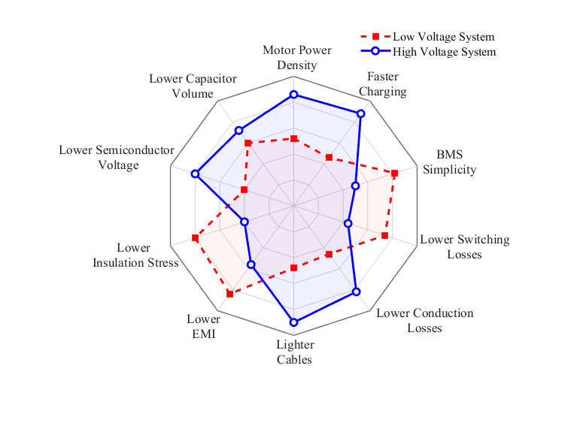
Why raise the traction DC-link voltage?
Lower current
for the same transmitted power
Smaller conductors
and lower cable losses
Faster charging
with lower current at megawatt power
Challenge
A conventional two-level inverter exposes every switch to the full DC-link voltage.

Slide 3
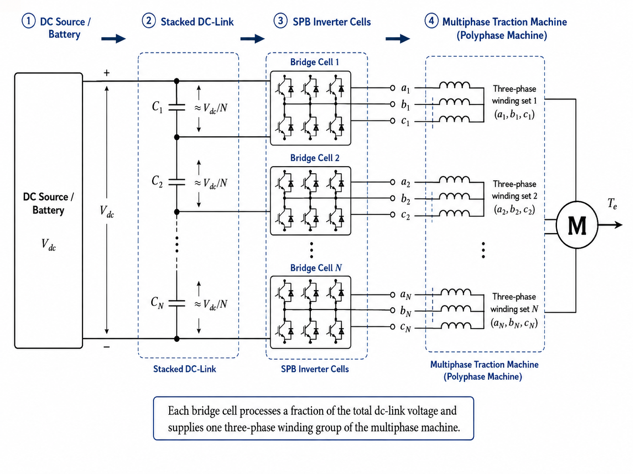
SPB portions one high-voltage DC link across N cells
Vcell ≈ Vdc / N
nominal voltage per cell
Series on the DC side
The cells share the total blocking voltage.
Separate winding groups
Each cell controls a three-phase section of the same machine.
The machine and converter become one modular architecture.

Slide 4
Voltage portioning opens lower device-voltage classes
3 cells
5 cells
8 cells
15 cells
400 V
240 V
150 V
80 V
nominal cell voltage
nominal cell voltage
nominal cell voltage
nominal cell voltage
650 V class
350 V class
200 V class
100 V class
6N = 18
active switches
6N = 30
active switches
6N = 48
active switches
6N = 90
active switches

Slide 5
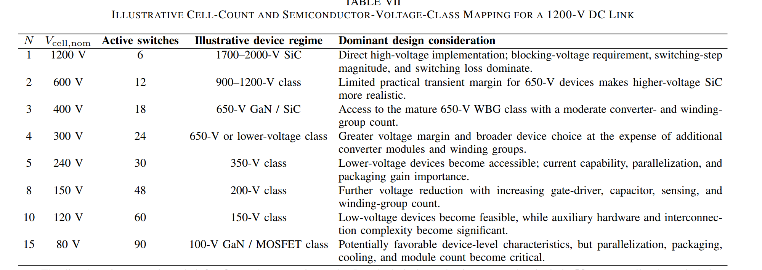
Voltage portioning opens lower device-voltage classes

Slide 6
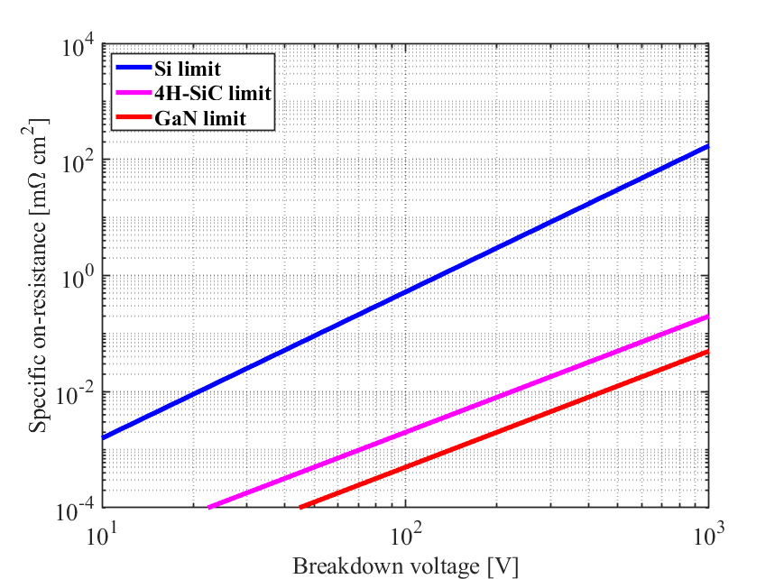
Lower-voltage GaN can improve device-level performance
Why it matters
Lower RDS(on)
can reduce conduction loss and chip area
Lower charge
can support faster switching and smaller passives
Commercial reality
Current rating, Coss, package parasitics, dynamic RDS(on), and thermal limits can reverse a simple FOM ranking.

Slide 7
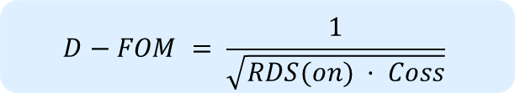
Figure-of-merit of Off-the-shelf GaN Devices
$$D−FOM = \frac{1}{\sqrt{RDS(on) · Coss}}$$

Slide 8
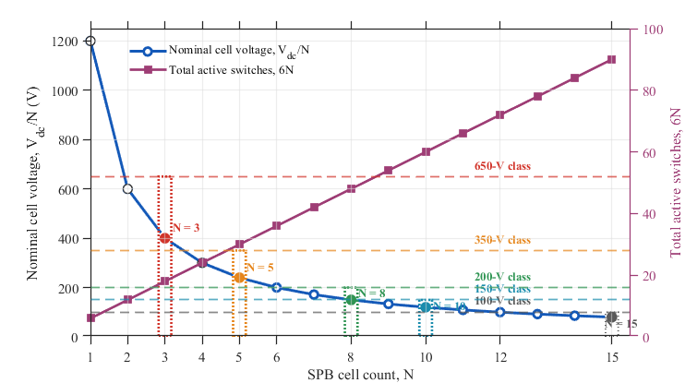
The optimum cell count balances efficiency against complexity
Voltage benefit
Vcell falls approximately with 1/N
Hardware penalty
Switch count grows linearly as 6N
Core question:
How many stacked two-level cells are worth adding before device count and control overload dominate?
More cells
lower Vcell
more switches

Slide 9
SPB optimization spans the converter and the machine
Semiconductors
DC-link
Conduction, Coss/Eoss, overlap loss, current capability
Capacitance, ripple, balancing stability, overshoot
Machine
Integration
Winding-group count, voltage demand, coupling, harmonics
Gate drives, isolation, cooling, interconnects, packaging
One common objective: minimum system loss, mass, volume, and implementation risk

Slide 10
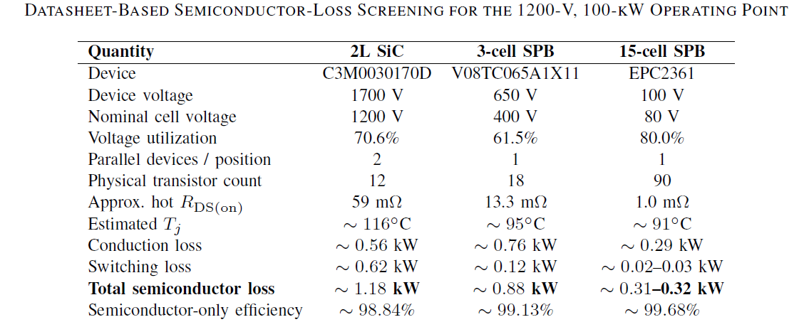
Preliminary results - comparison

Slide 11
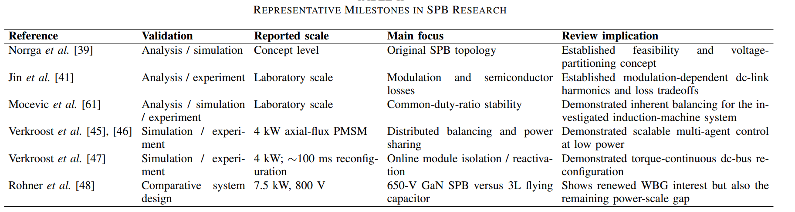
SPB research - milestones

