Slide 1
WP4: Progress Update
Enes Ayaz, Shahriar Sermest Ghahfarokhi

Slide 2
WP4: Progress Update
Objective: Main development inverter for high voltage system.
 | 2023 |  |  |  | 2024 |  |  |  | 2025 |  |  |  | 2026
4.1 Inverter topology and construction |  |  | x | x | x | x | x | x | x
4.2 Intelligent gate driver |  |  |  |  |  |  | x | x | x | x | x | x | x
4.3 Cooling of DC link capacitors |  |  |  |  |  |  |  | x | x | x | x
4.4 High bandwidth current meas. |  |  |  |  |  |  |  |  |  |  | x | x | x | x
4.1: The high-voltage inverter can be designed as a two-level, three-level, or multi-level inverter, requiring theoretical evaluation and comparison of various topologies and modular configurations to optimize efficiency, compactness, and cost.
4.2: The gate driver controls the inverter’s semiconductor components and can optimize motor stresses and perform state estimation by monitoring parameters like gate threshold voltage and leakage current, requiring comparison of different designs for performance and reliability.
4.3: DC link capacitors’ size and reliability depend heavily on temperature, making it essential to evaluate various cooling methods, both theoretically and experimentally.
4.4: Current measurement methods need evaluation, as higher bandwidth offers advantages like improved state estimation of the motor's stator winding.

Slide 3
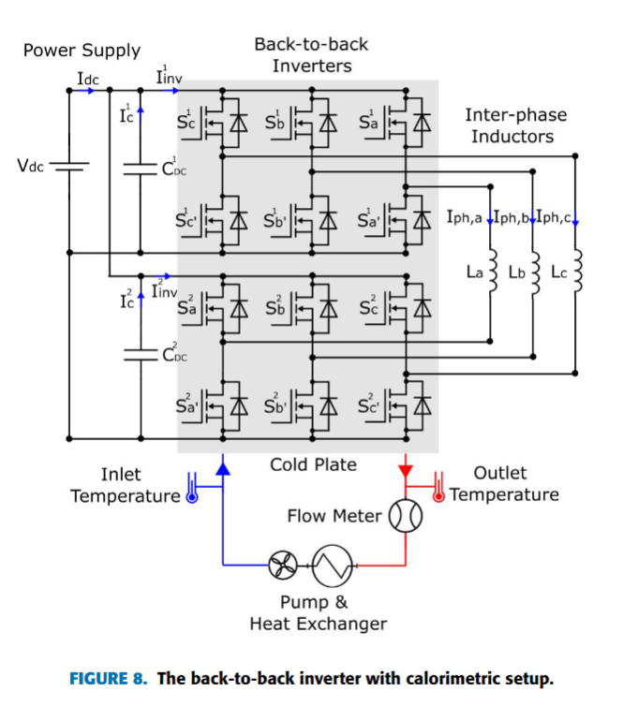
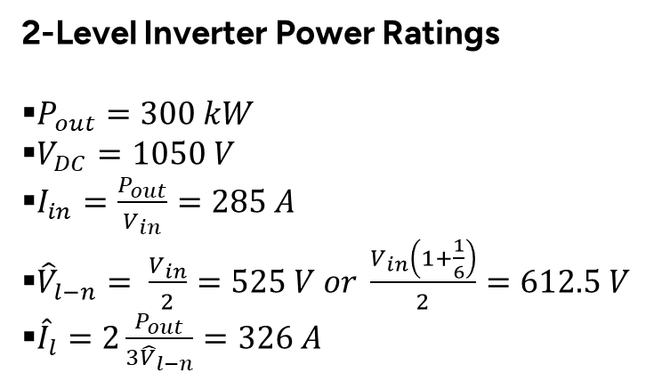
System Requirements & Testbed
2-Level Inverter Power Ratings
$P_{out}=300 kW$
$V_{DC}=1050 V$
$I_{in}=\frac{P_{out}}{V_{in}}=285 A$
${\hat{V}}_{l−n}= \frac{V_{in}}{2}=525 V or \frac{V_{in}\left(1+\frac{1}{6}\right)}{2}=612.5 V$
${\hat{I}}_{l}=2\frac{P_{out}}{{3\hat{V}}_{l−n}}=326 A$

Slide 4



First Prototype with 62mm Power Modules
.

Slide 5

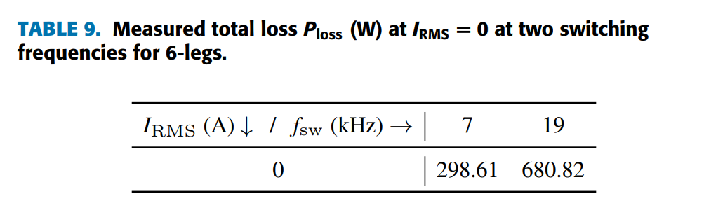
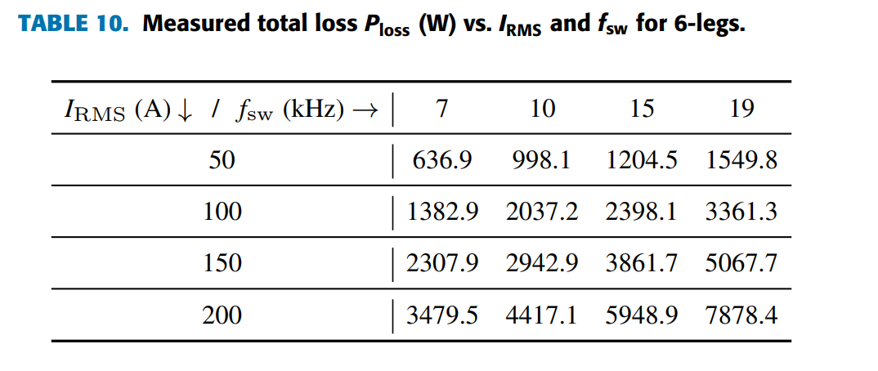


Effiency and Power Density Results

Slide 6
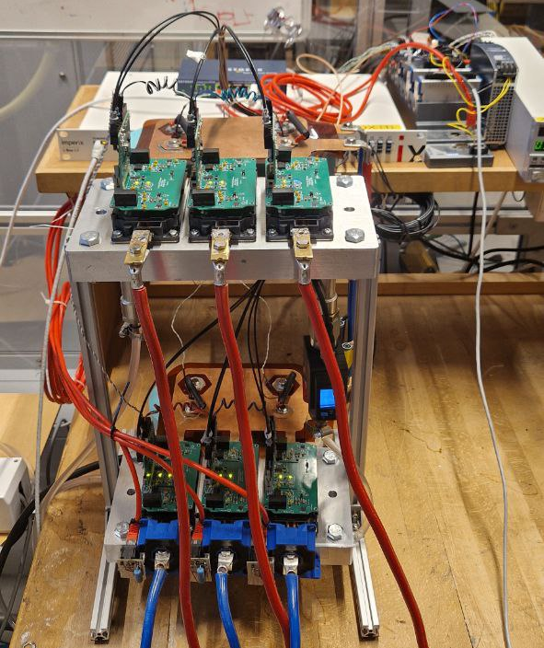
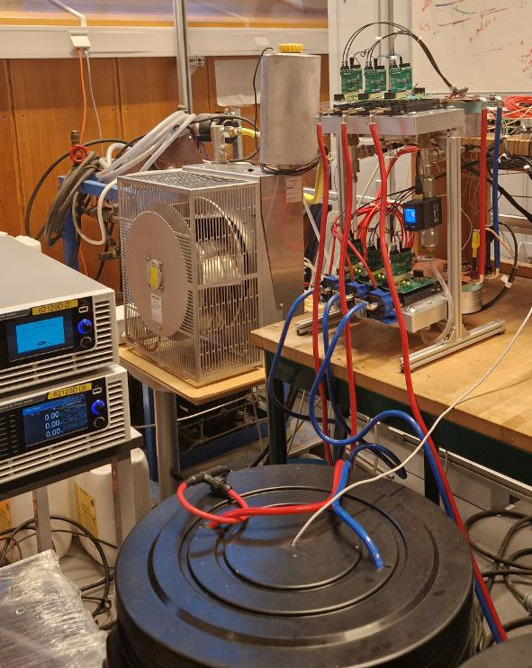
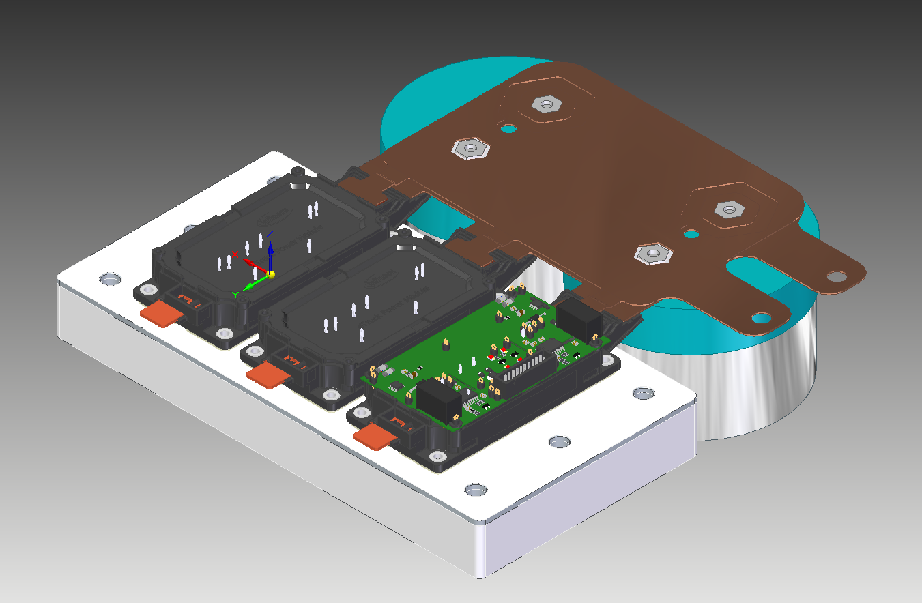
Second Prototype with eTruck Power Modules
Parameters | Value
Total volume | 4.14 L
Power Density | ~72 kW/L
Box Power Density | ~50kW/L

Slide 7
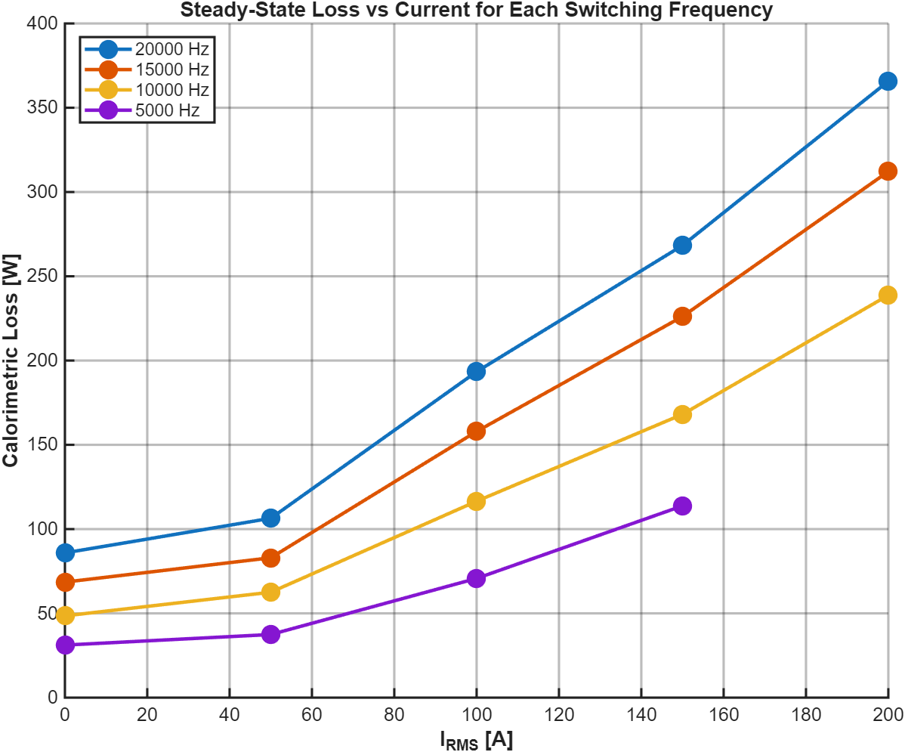
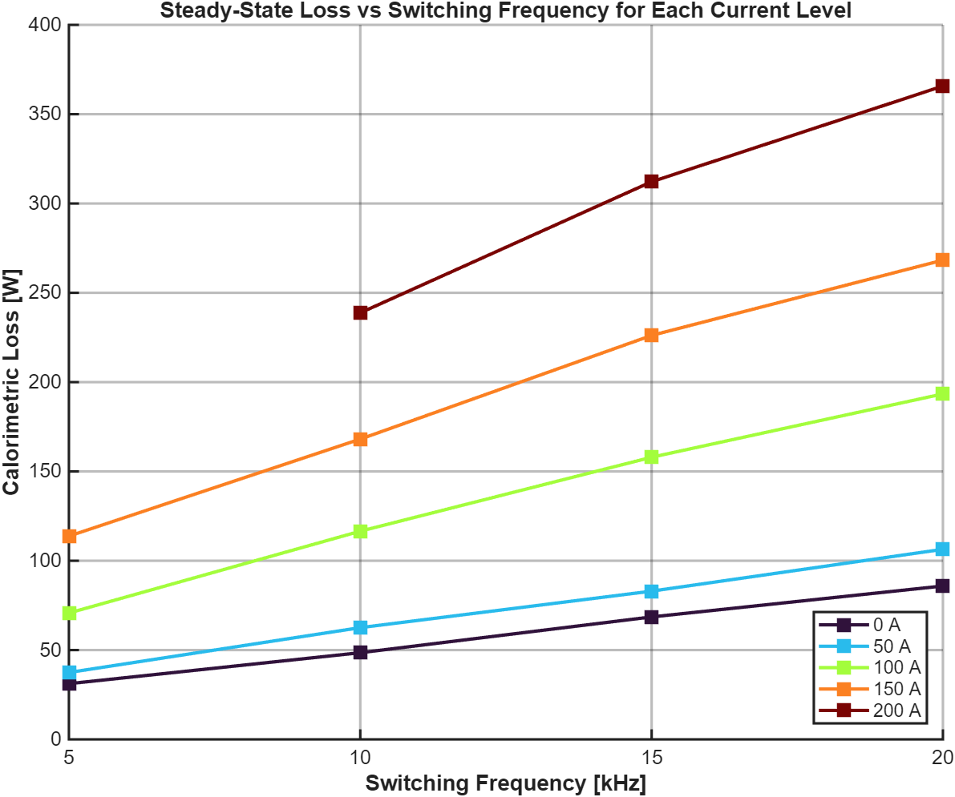
Loss Analysis
.

Slide 8
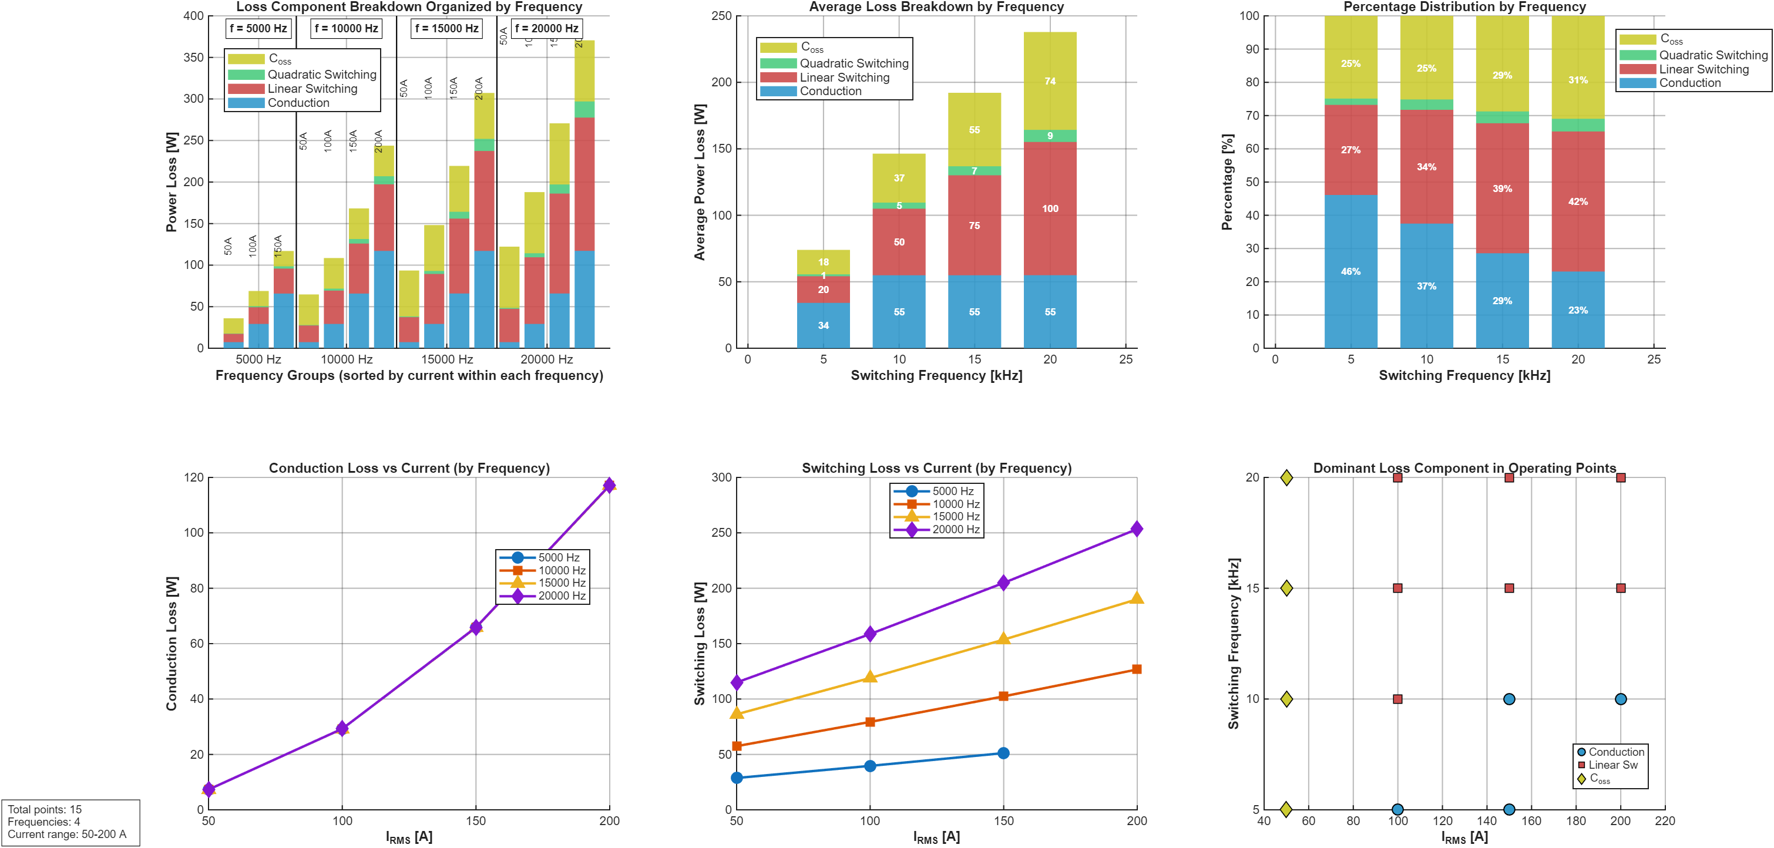
Loss Analysis
.

Slide 9
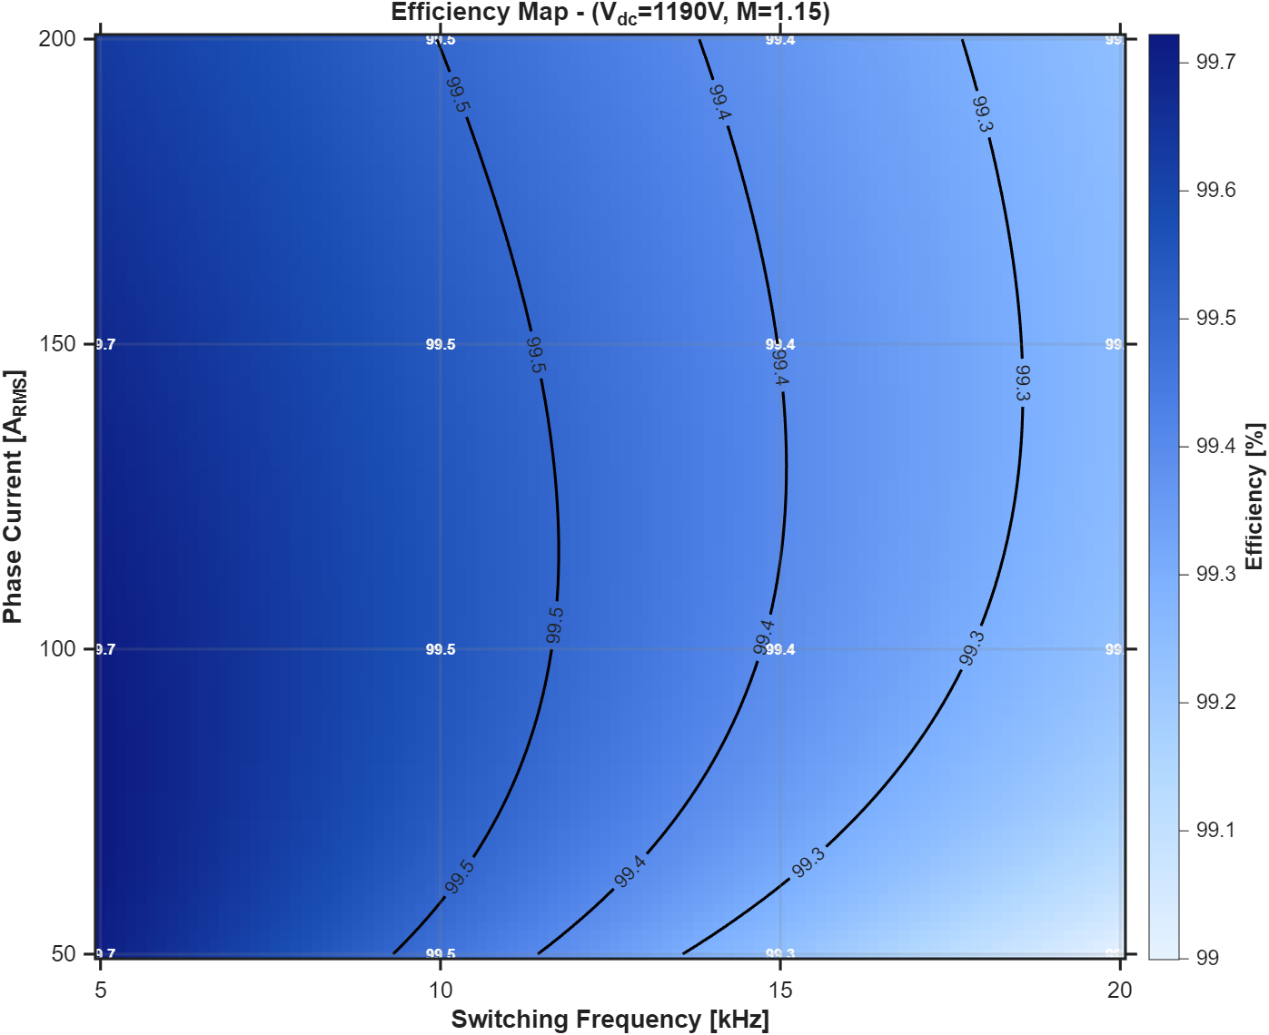
Efficiency Maps

