Slide 1
WP4: Progress Update
KTH

Slide 2
WP4: Progress Update
Objective: Main development inverter for high voltage system.
 | 2023 |  |  |  | 2024 |  |  |  | 2025 |  |  |  | 2026
4.1 Inverter topology and construction |  |  | x | x | x | x | x | x | x
4.2 Intelligent gate driver |  |  |  |  |  |  | x | x | x | x | x | x | x
4.3 Cooling of DC link capacitors |  |  |  |  |  |  |  | x | x | x | x
4.4 High bandwidth current meas. |  |  |  |  |  |  |  |  |  |  | x | x | x | x
4.1: The high-voltage inverter can be designed as a two-level, three-level, or multi-level inverter, requiring theoretical evaluation and comparison of various topologies and modular configurations to optimize efficiency, compactness, and cost.
4.2: The gate driver controls the inverter’s semiconductor components and can optimize motor stresses and perform state estimation by monitoring parameters like gate threshold voltage and leakage current, requiring comparison of different designs for performance and reliability.
4.3: DC link capacitors’ size and reliability depend heavily on temperature, making it essential to evaluate various cooling methods, both theoretically and experimentally.
4.4: Current measurement methods need evaluation, as higher bandwidth offers advantages like improved state estimation of the motor's stator winding.

Slide 3
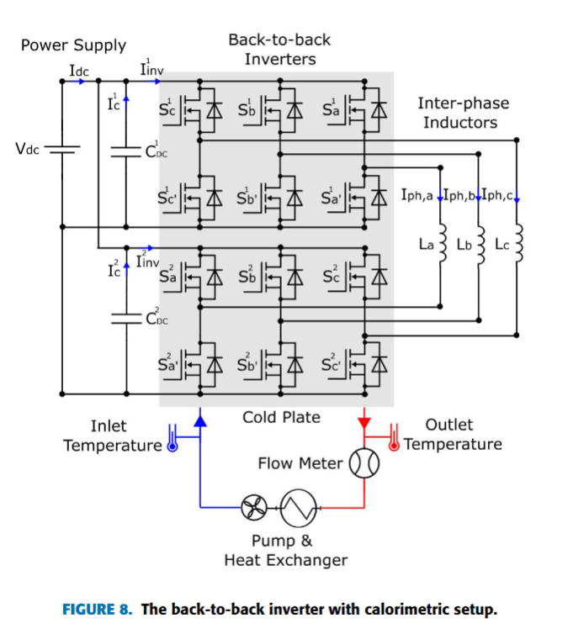
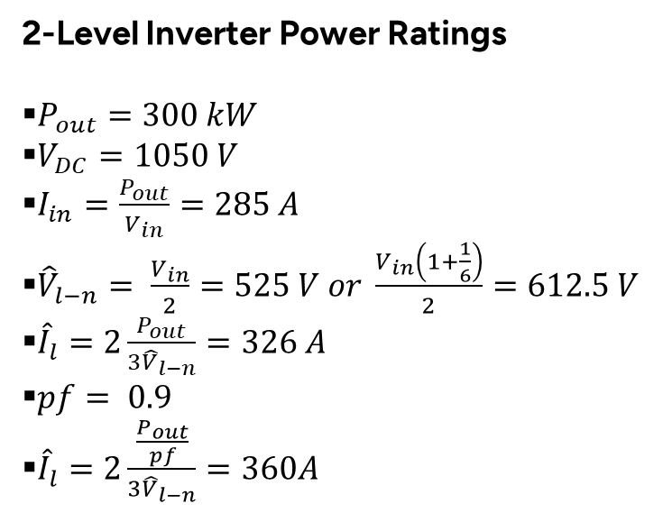
System Requirements & Test Bed
2-Level Inverter Power Ratings
$P_{out}=300 kW$
$V_{DC}=1050 V$
$I_{in}=\frac{P_{out}}{V_{in}}=285 A$
${\hat{V}}_{l−n}= \frac{V_{in}}{2}=525 V or \frac{V_{in}\left(1+\frac{1}{6}\right)}{2}=612.5 V$
${\hat{I}}_{l}=2\frac{P_{out}}{{3\hat{V}}_{l−n}}=326 A$
$pf= 0.9$
${\hat{I}}_{l}=2\frac{\frac{P_{out}}{pf}}{{3\hat{V}}_{l−n}}=360A$

Slide 4



First Prototype with 62mm Power Modules
.

Slide 5

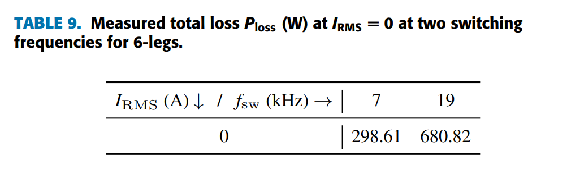
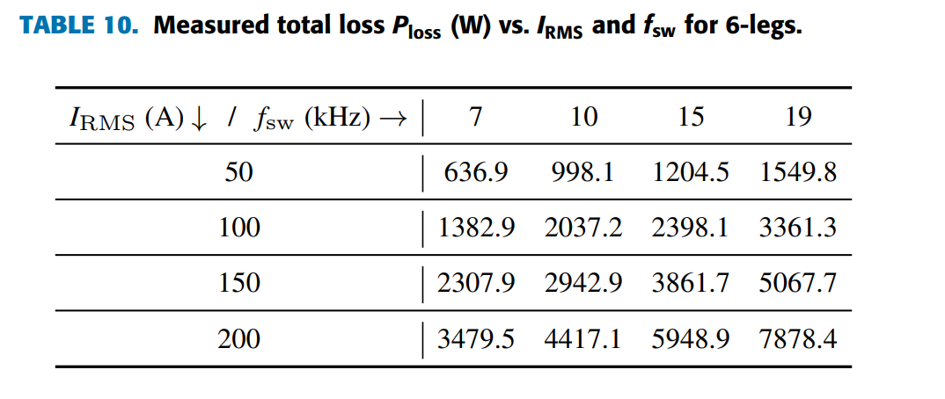


Effiency and Power Density Results

Slide 6
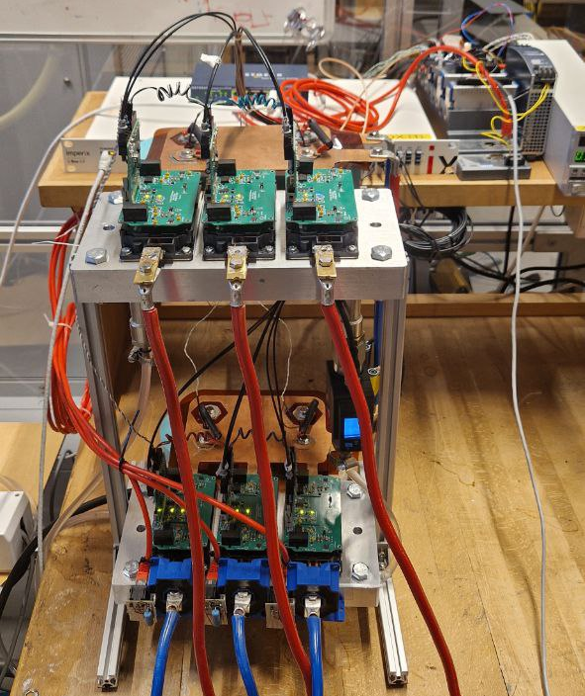
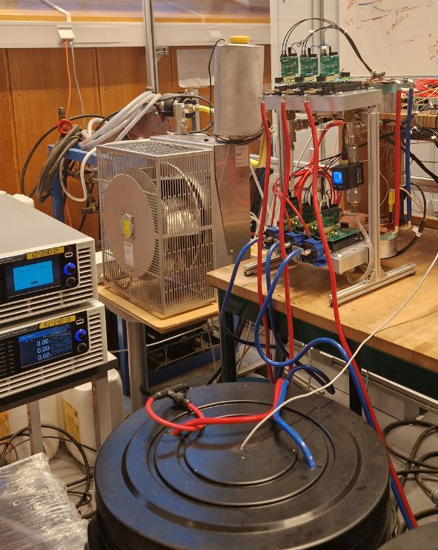
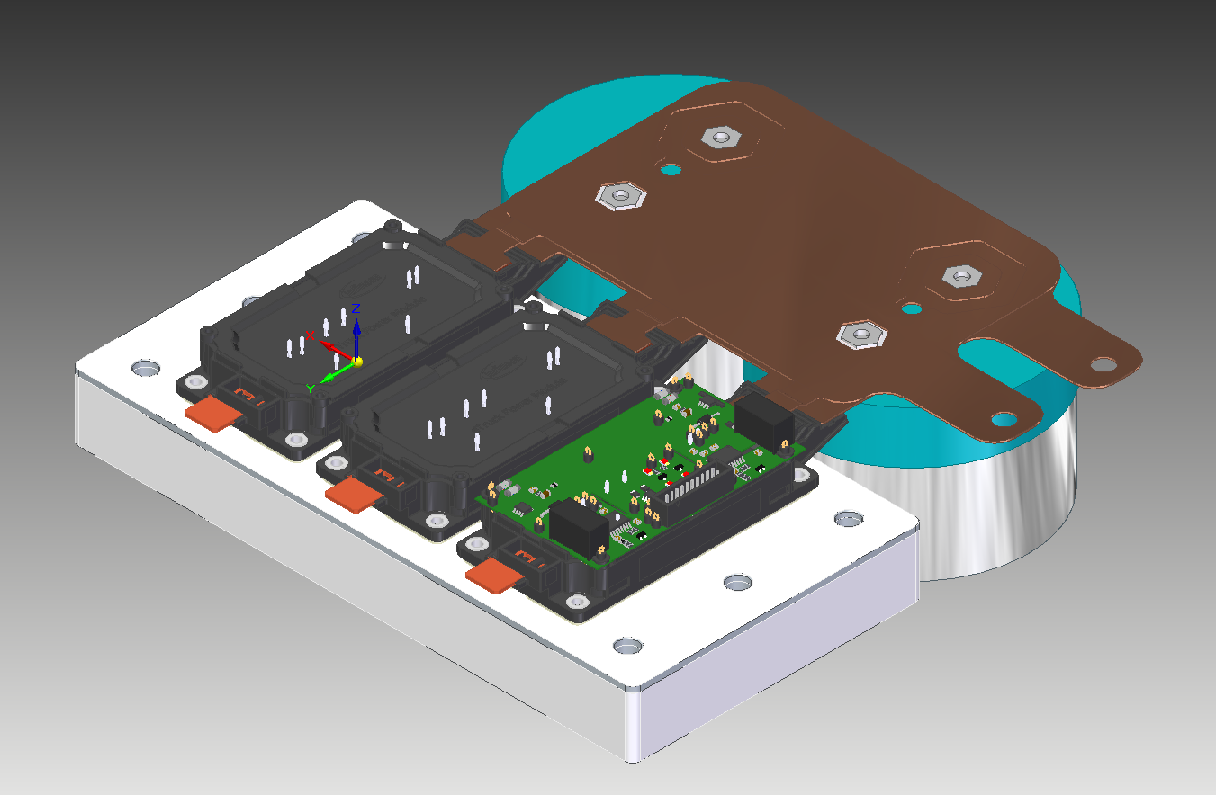
Second Prototype with eTruck Power Modules
Parameters | Value
Total volume | 4.14 L
Power Density | ~72 kW/L
Box Power Density | ~50kW/L

Slide 7
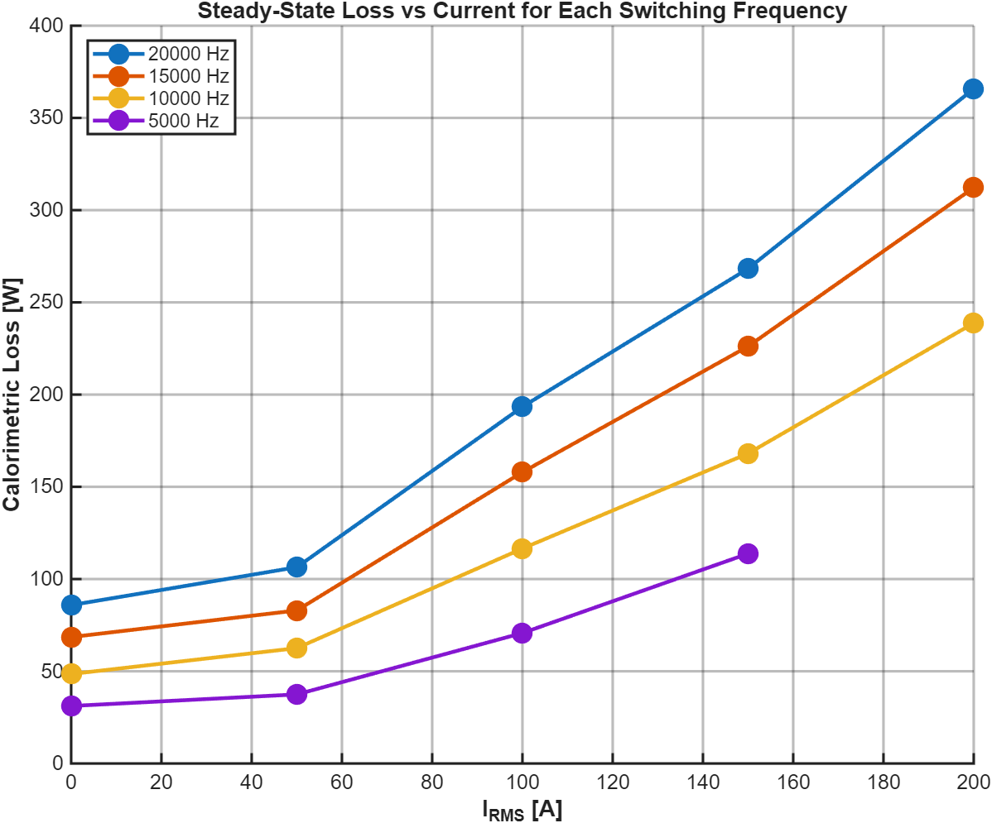
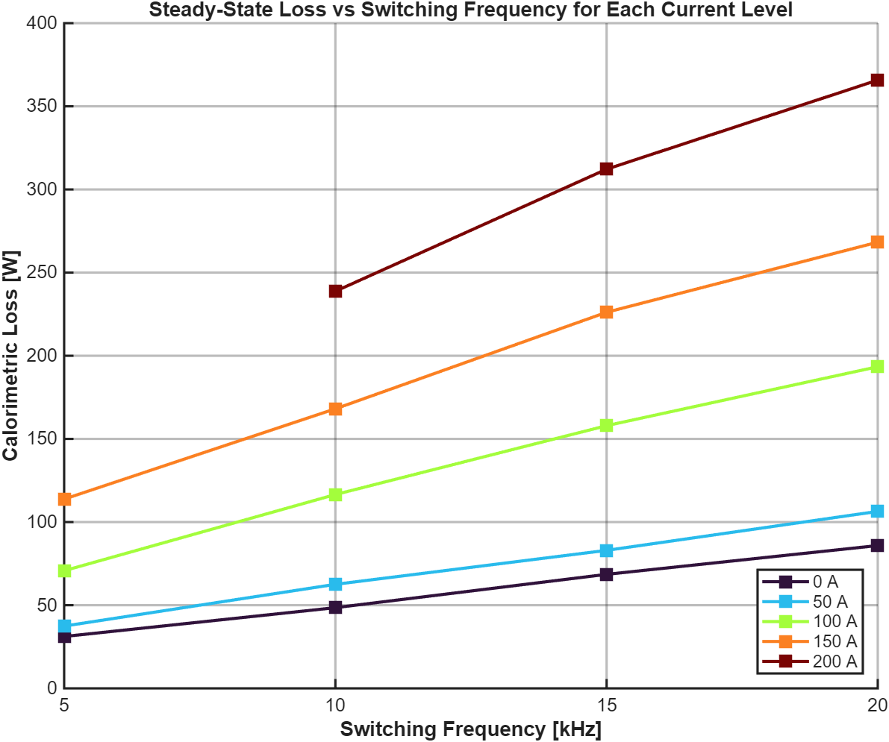
Loss Analysis
.

Slide 8
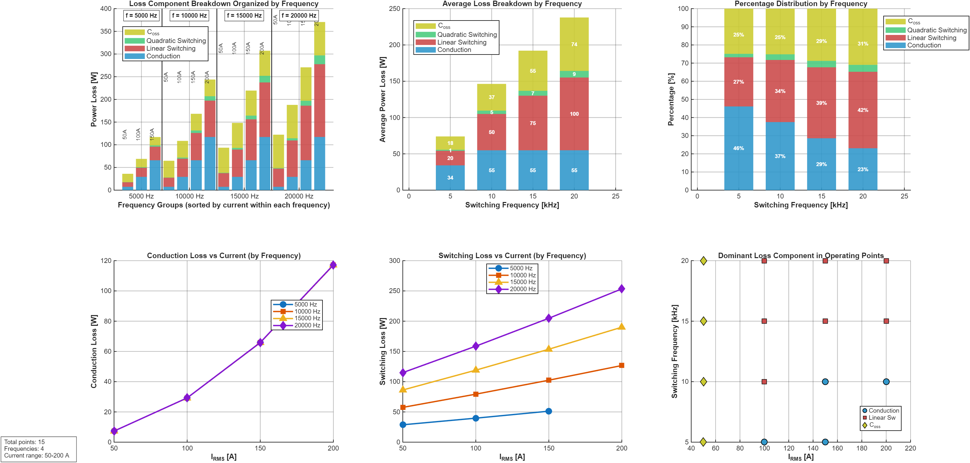
Loss Analysis
.

Slide 9
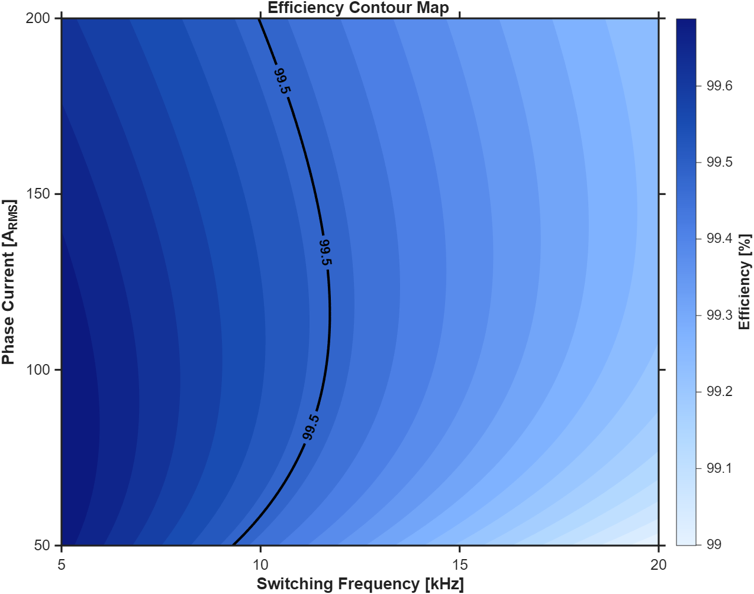
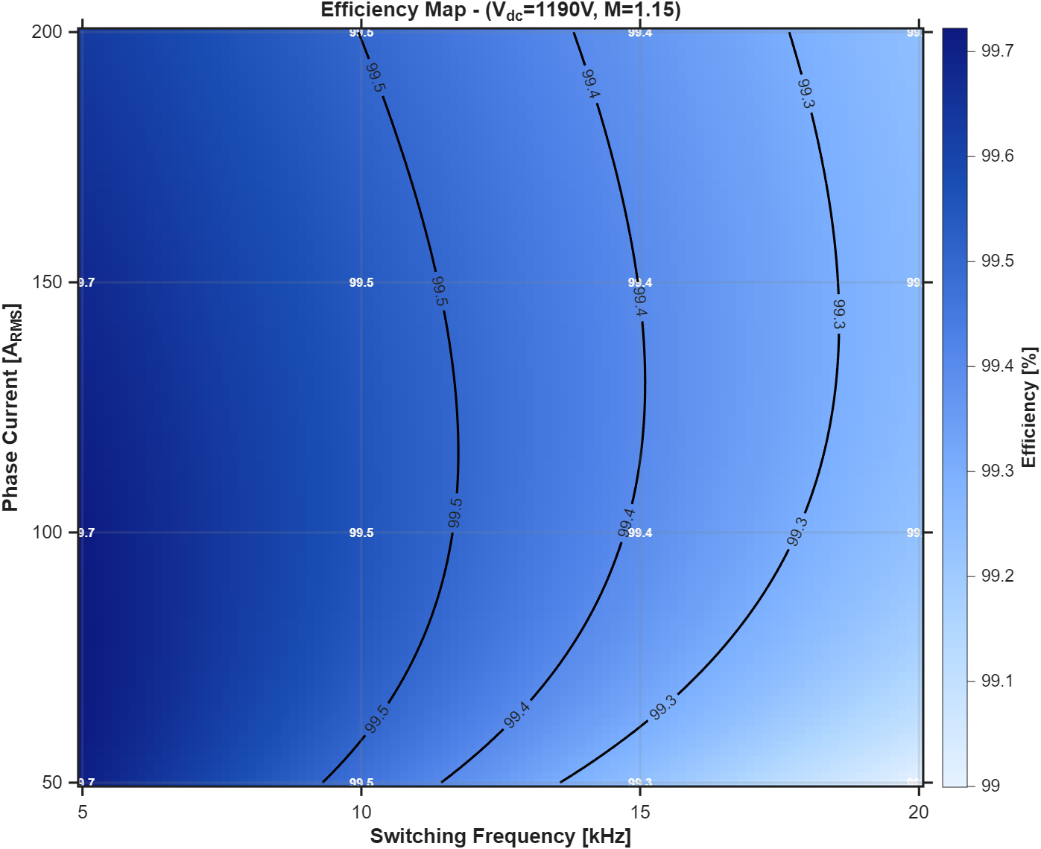
Efficiency Maps

Slide 10
Research Updates

Slide 11
Papers Published in 2026
ECCE-Asia (IPEC-2026) Paper Digest
ECCE-Asia (IPEC-2026) Paper Digest
ECCE-Asia (IPEC-2026) Paper Digest

Slide 12
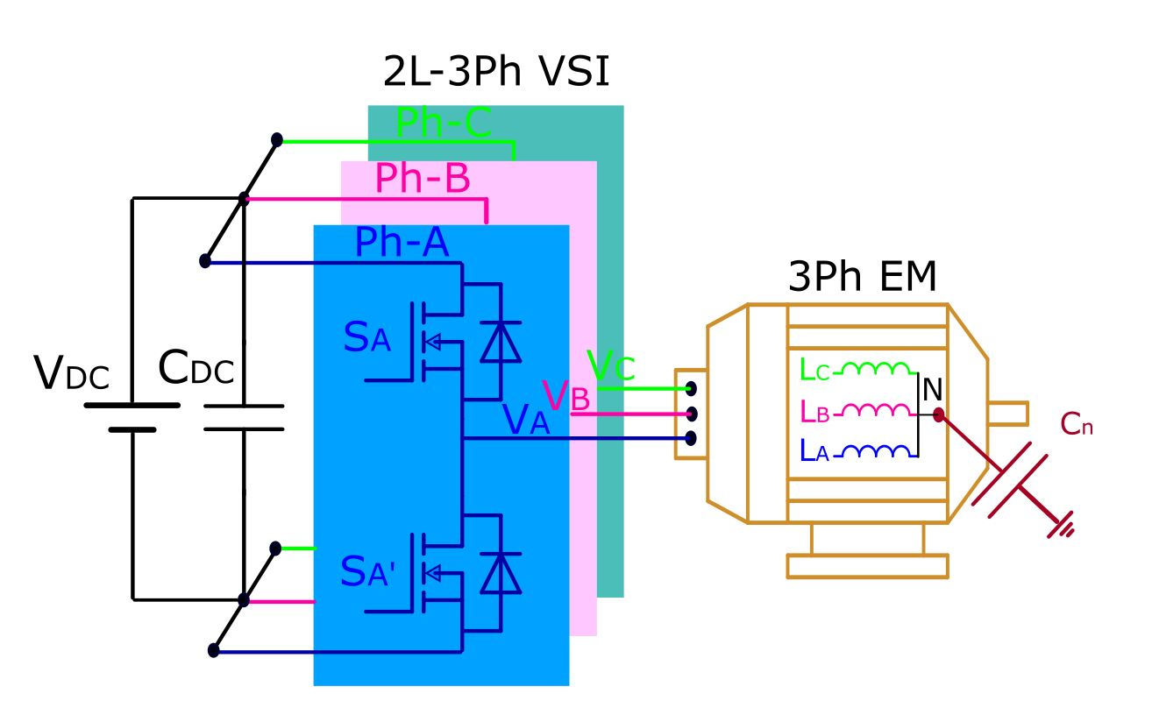
Overview of Three-Phase Two-Level VSIs
Still dominant in industrial motor drives, traction systems, and renewable energy applications owing to:
  Structural simplicity
  Minimal component requirements
  Simple to control
  Minimal cost
Reliability remains a critical concern for sustainable power conversion systems.
Extending the lifespan of the system is crucial at this point.

Slide 13
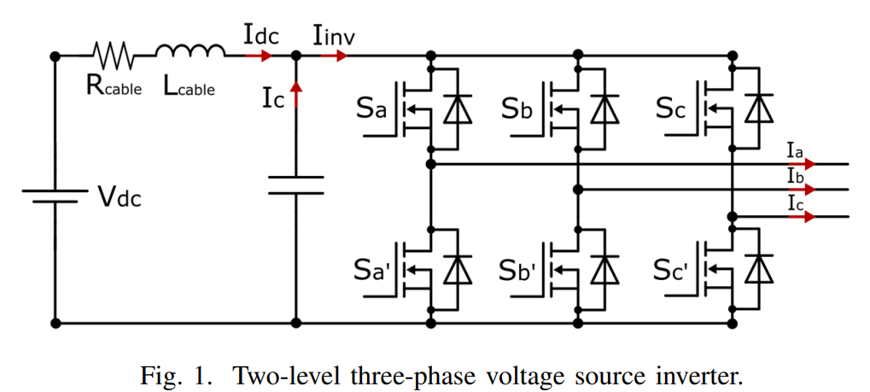
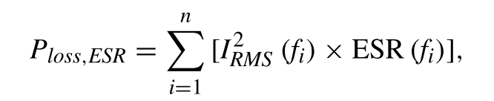

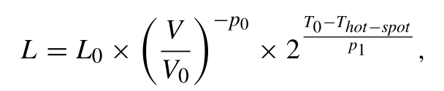
DC-Link Capacitor: Reliability Bottleneck
Functions:
  Stabilizes DC bus voltage
  Suppresses switching-induced fluctuations and parasitic oscillations
Accounts for ~20% of all VSI failures.
Degradation impacts system longevity.
DC-link current harmonics influence thermal stress, affecting capacitor lifespan.
Capacitor lifetime improves with lower hot-spot temperatures.
Hot-spot temperature depends on power losses, which decrease when the RMS value of the capacitor current is reduced.
Therefore, minimizing the capacitor's ripple current helps extend its lifespan.

Slide 14
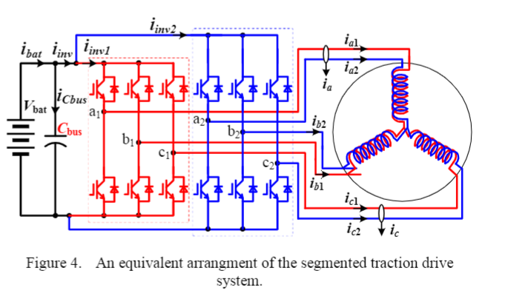
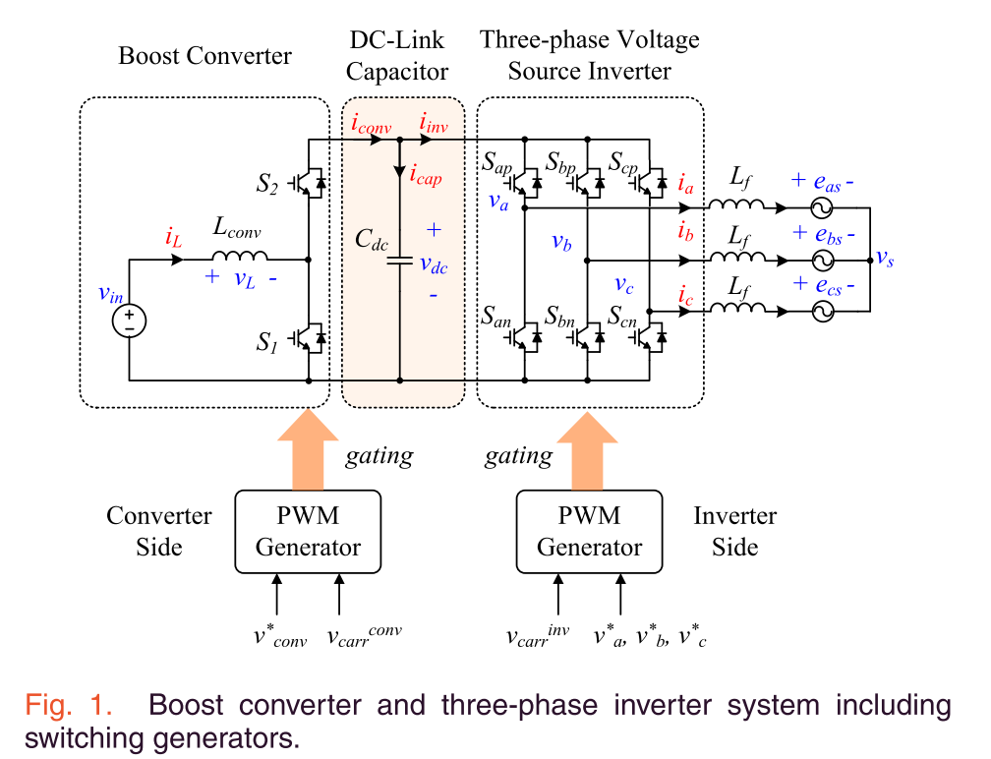
Reducing Current Ripple & Stress
Advanced modulation techniques aim to:
  Minimize inverter-induced current ripple
  Reduce DC-link current stress
  Maintain system performance & durability
Interleaving techniques modify carrier phase-shift relationships to reduce stress.
Primarily applied in multi-converter systems, such as:
  Dual-inverter architectures (e.g. Segmented motor drives)
  Systems with integrated front-end converters for DC-link regulation

Slide 15
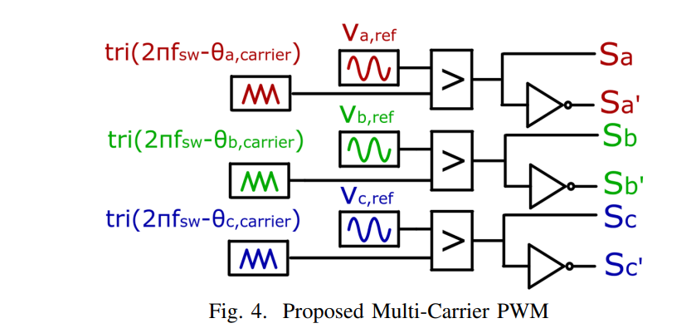
Interleaving for Single 2L-VSI
Existing Interleaving Approaches & Limitations
  Require additional switches (pre-converters, parallel inverters)
  Not applicable for several applications that aim to achieve a cost-effective solution.
We propose a novel interleaving between the phase legs of a single two-level VSI.
Challenges:
  Time-varying leg currents complicate implementation.
  Unlike parallel systems, it requires dynamic phase adjustment.

Slide 16
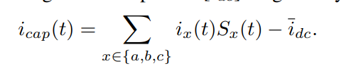

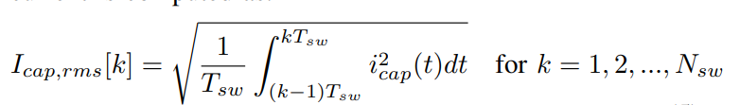
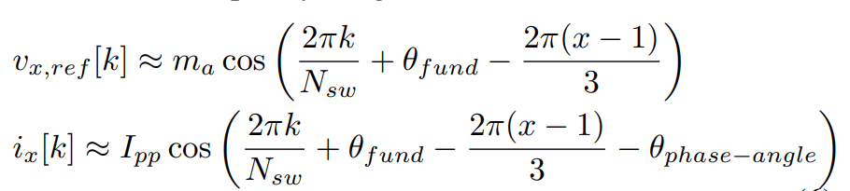
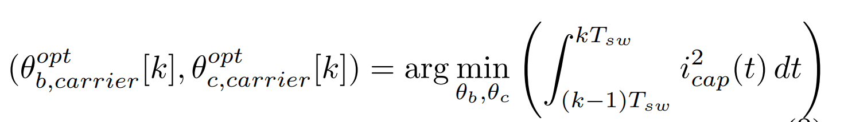







Dynamic Variable Carrier Phase-Shift Modulation
  Adaptively adjusts carrier phase shifts in real-time.
  Optimizes current stress reduction while maintaining performance
$OC_{1}$
$OC_{Nsw}$
Operating condition
…
$N_{sw}$ is the frequency ratio: $\frac{f_{sw}}{f_{fund}}$
Fundamental Phase
$0$
…
$2π$
Carrier phase shift
$[φ_{B−OC1},φ_{C−OC1},]$
…
$[φ_{B−OC_{mf}},φ_{C−OC_{mf}},]$

Slide 17
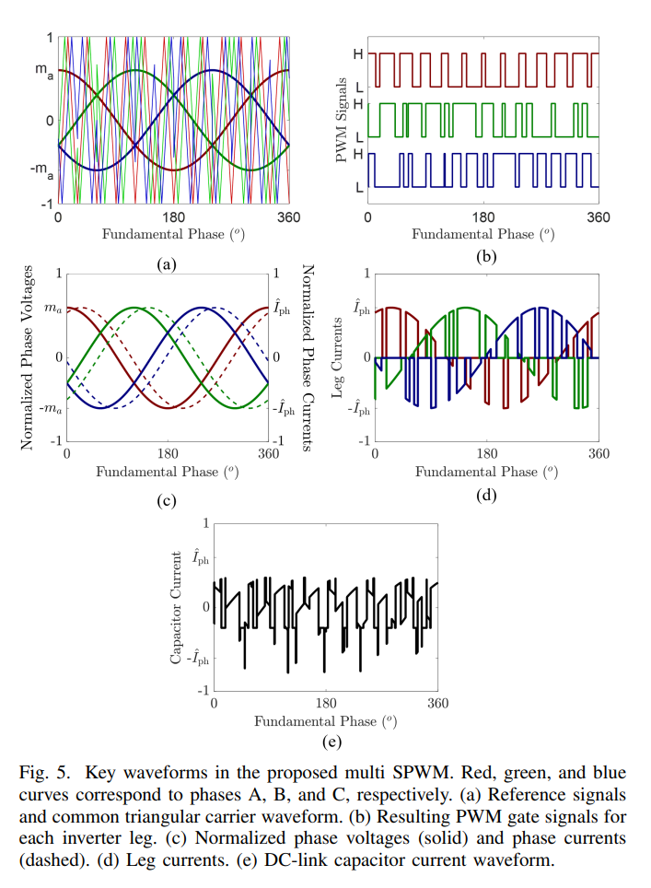
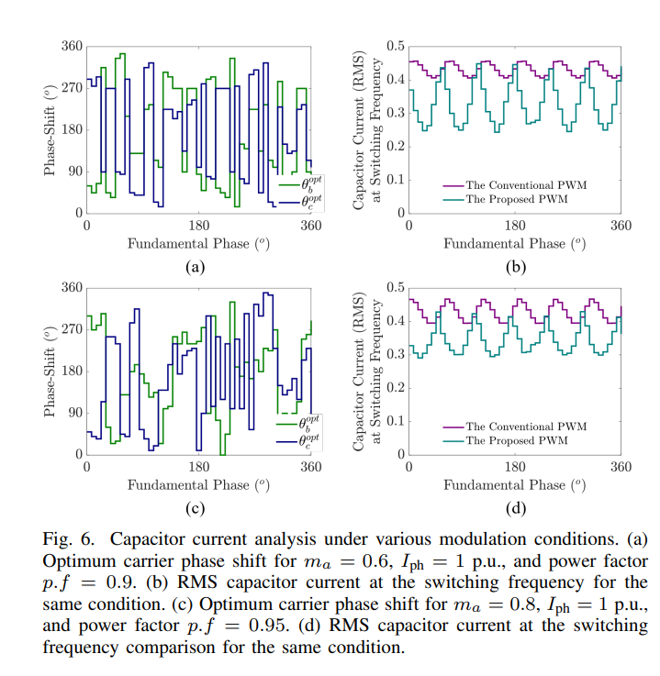
Dynamic Variable Carrier Phase-Shift Modulation

Slide 18
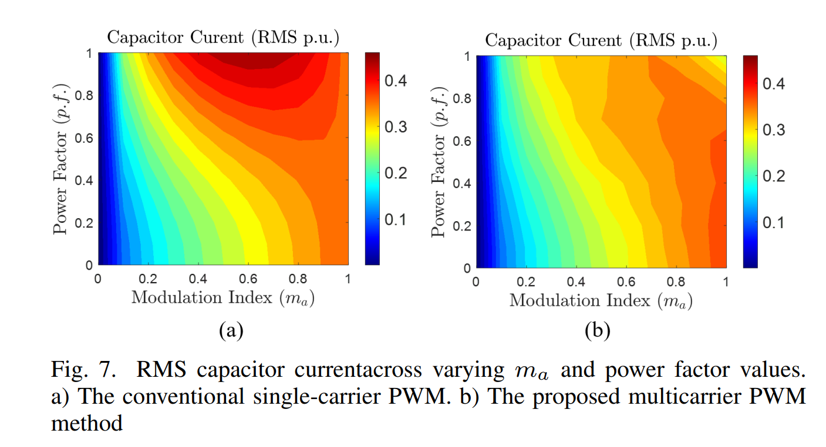
Dynamic Variable Carrier Phase-Shift Modulation

Slide 19
Outline
ECCE-Asia (IPEC-2026) Paper Digest
Initial Experimental Results of The Patent

Slide 20
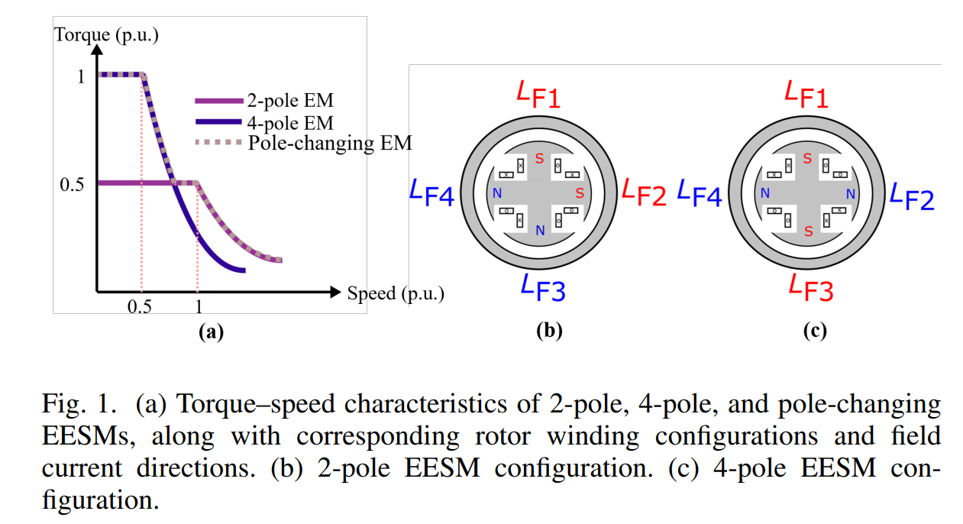
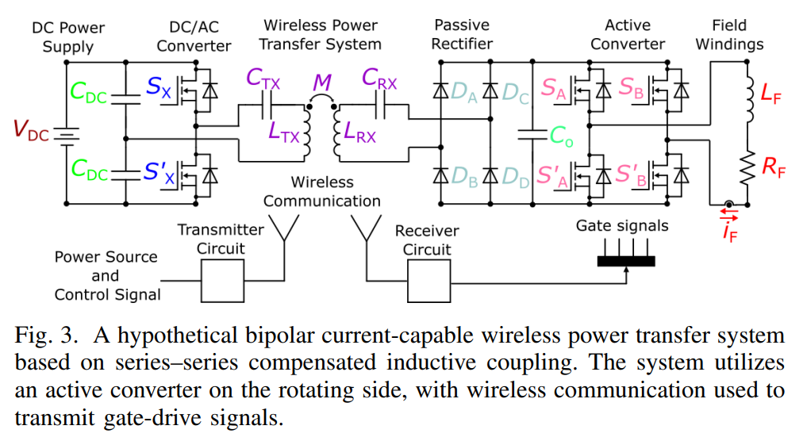
Variable Phase-Pole Machine
Hypothetically, if such a solution were to exist, it might involve utilizing rotating semiconductor components that necessitate active gate signals for control.
However, this approach introduces complexities, including the need for a wireless converter system to receive commands from the stationary side. This This would add layers of intricacy to the system, posing challenges to reliability and overall system robustness.
To achieve a variable pole (synchronous) machine, the rotor windings should be re-configurable, which means a controllable bi-directional current on the rotor side.
A 4-pole rotor structure can be transformed into a 2-pole structure by employing identical field windings and strategically altering the current direction in only two windings.

Slide 21
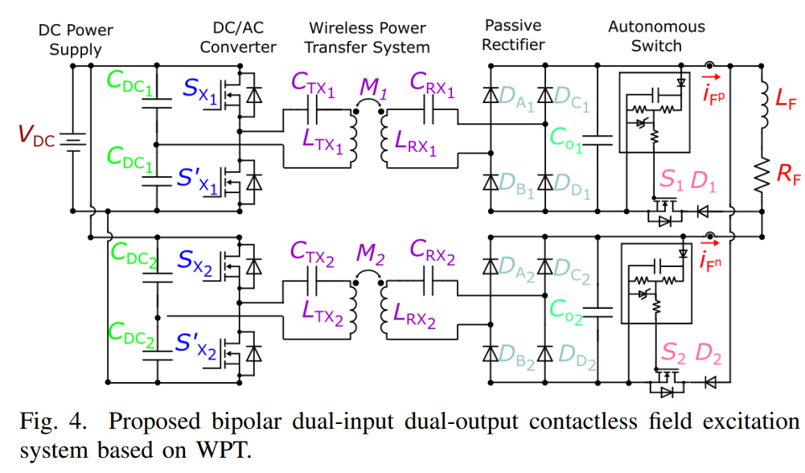
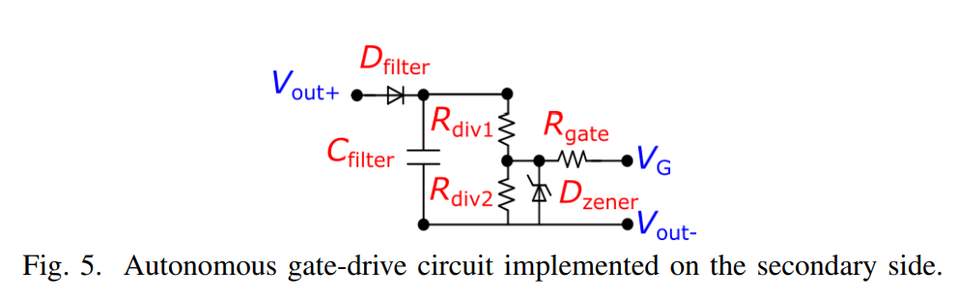
Self-Driven Field Excitation
The proposed dual-input, dual-output WPT system employs two resonant coil sets, each feeding a diode rectifier to supply unidirectional current.
The anti-parallel connection of the rectifier outputs enables bipolar excitation of the field winding.
To avoid reverse biasing of the rectifiers, bidirectional power switches—implemented using a MOSFET in anti-series with a diode—are placed between the rectifier ground and one terminal of the field winding.
These switches are self-driven using passive feedback network from their respective rectifier outputs, eliminating the need for external control signals.
Field-current reversal is achieved by altering excitation between the two coil sets: one set drives the positive direction, while the other drives the negative

Slide 22
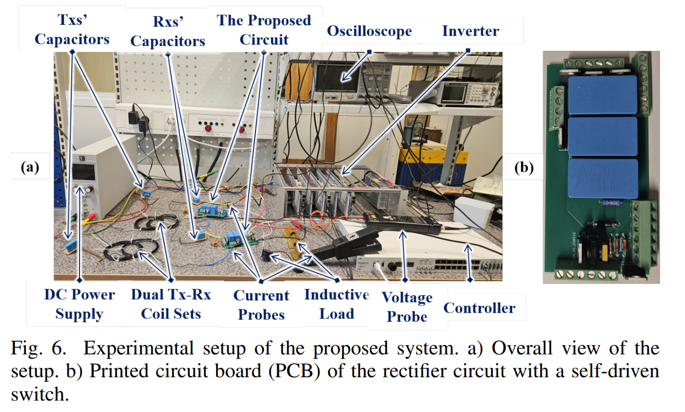
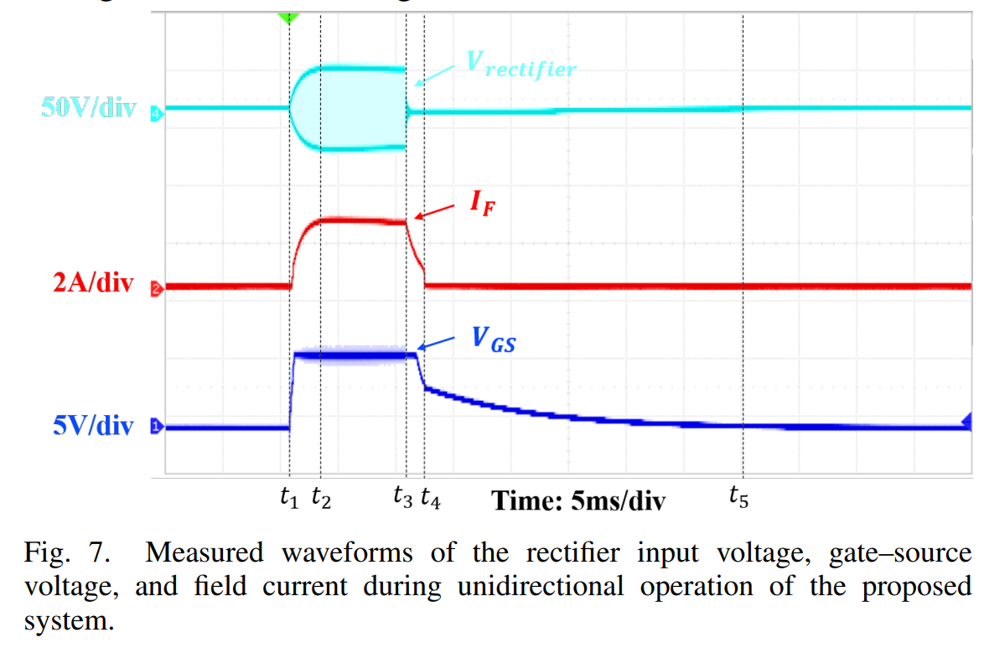
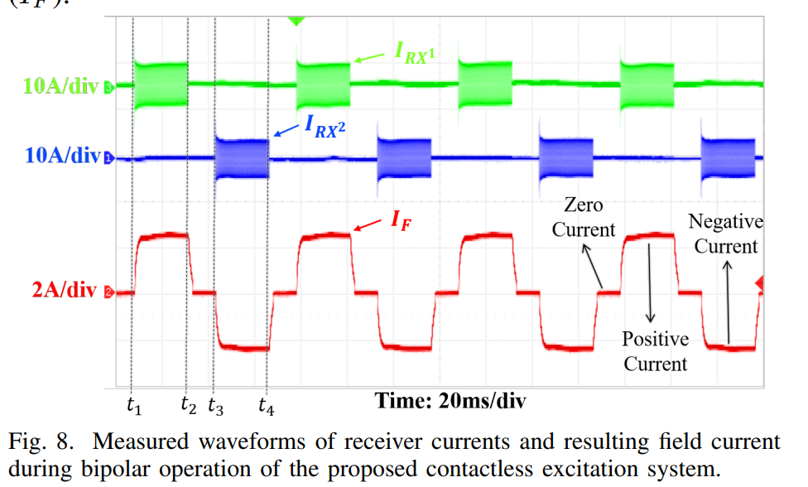
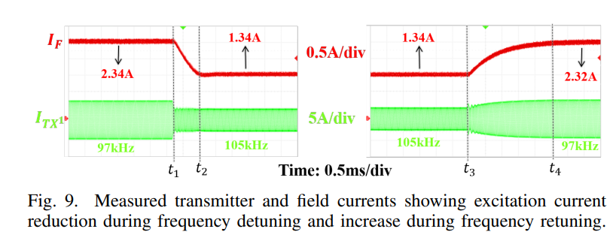
Experimental Validation

