Slide 1
What has been done?
Enes Ayaz

Slide 2
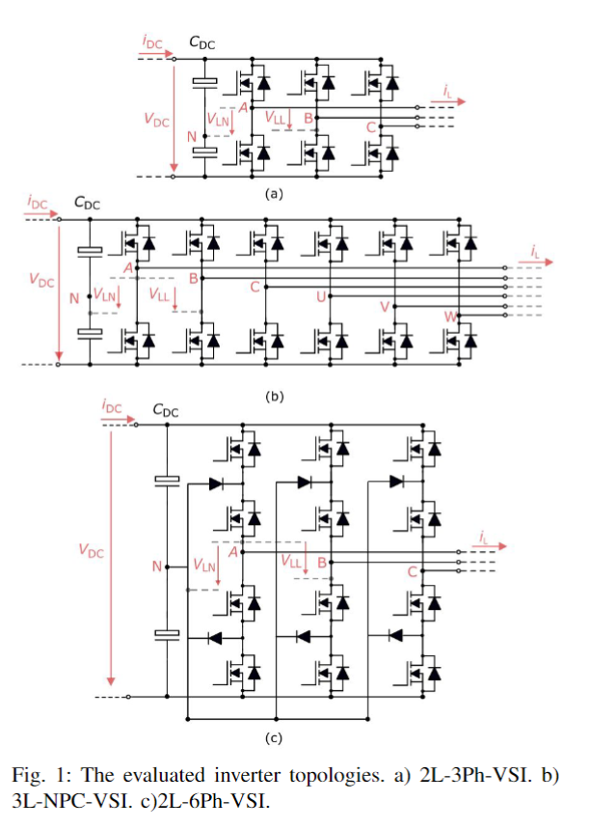
Papers
Evaluation of Possible Traction Inverter Topologies for Heavy-Duty Electric Vehicles, SPEC 2024 (Submitted)
The study evaluates traction inverters for heavy-duty electric vehicles, focusing on efficiency, and power density.
3-Level NPC (3L-NPC) and 2-Level 6-phase (2L-6Ph) inverters are compared to the conventional 2-Level 3-phase (2L-3Ph) VSI.
The comparisons are based on parameters like efficiency, power density, output harmonic quality, and reliability, and the system is modeled by virtual prototyping.
Efficiency maps are used to identify optimal operating points to minimize inverter losses.
Results show that the 3L-NPC inverter achieves a higher switching frequency, reducing the size of passive components and the cooling system, despite requiring more power switches and gate drivers.
The study concludes that multi-level inverter topologies are promising for high-voltage, high-power traction drives, offering better performance despite increased complexity and cost.

Slide 3
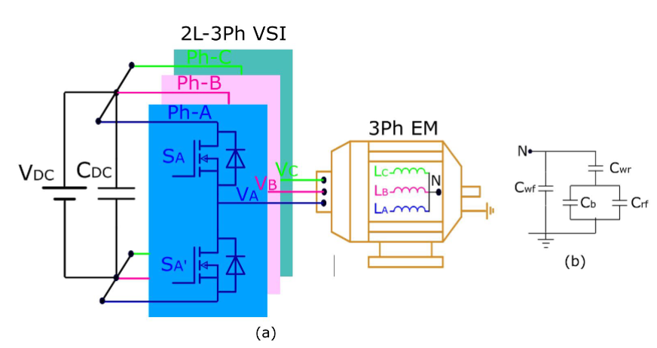
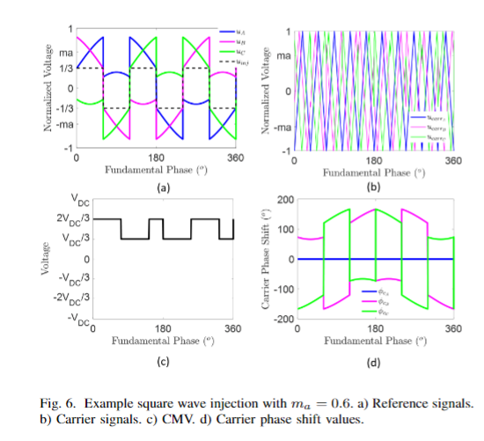
Papers
Mitigation of Common Mode Voltage in 2-Level 3-Phase Voltage Source Inverters (First Draft is written)
Issue Addressed: The paper proposes a novel method to mitigate the common mode voltage (CMV) issue in 2-level 3-phase voltage-source inverters (2L-3Ph VSI).
Existing Solutions: Previous methods to mitigate CMV include passive/active filters, additional switches, and specially designed pulse-width modulation (PWM), with PWM being a promising, cost-effective solution.
Novel Contribution: The study introduces a novel PWM method to eliminate CMV owing to dv/dt by synchronizing the PWMs of the VSI’s legs.
Implementation: A third-harmonic square-wave injection and adaptive carrier phase shift method are used to enable the synchronization.
Validation: The method will be validated through analytical and simulation analysis, with an experimental setup using SiC devices, showing the feasibility and effectiveness of the approach, though some small dv/dt impact might still be observed due to switch and gate driver non-idealities.

Slide 4
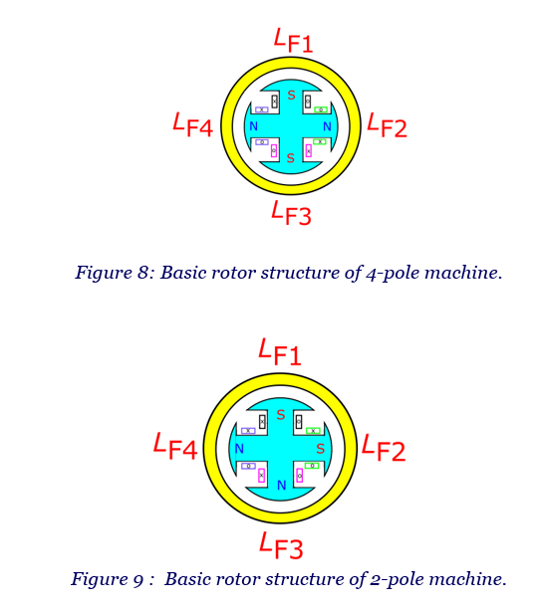
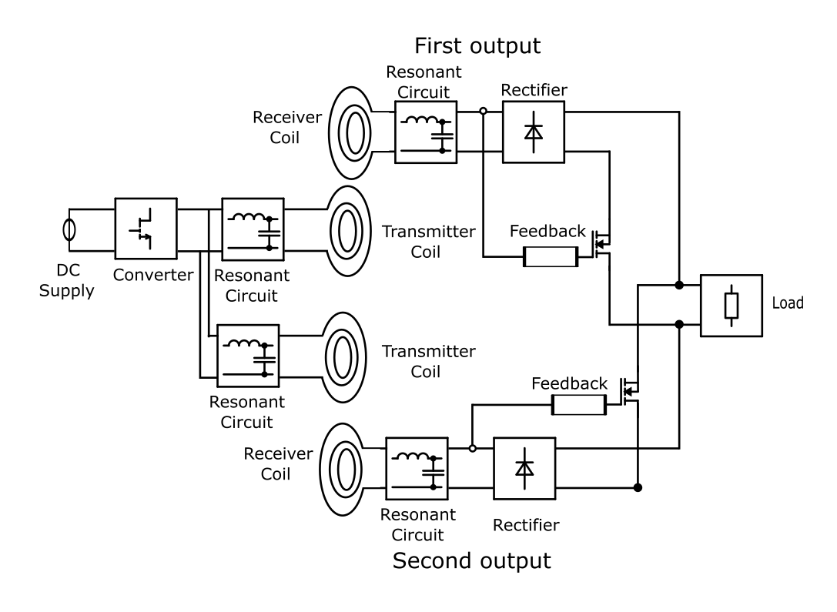
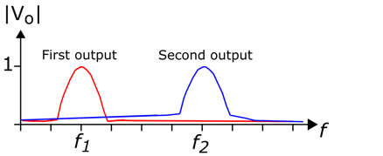
Patent Application
(About to be transferred to Scania)
4-pole to 2-pole
To achieve a variable pole (synchronous) machine, the rotor windings should be reconfigurable, which means a controllable bidirectional current on the rotor side is needed.
Current Flow Mechanism:
Diode rectifiers allowing just each output for one-way current flow.
Anti-parallel connection for two-way current capability.
Bi-directional Power Switches:
Placed between rectifier ground and unconnected side of the field winding to complete the current loop for each direction.
Output Activation:
The operating converter at a frequency near the resonant frequency of the corresponding set activates the corresponding output, exciting the field winding in a specific direction.

Slide 5

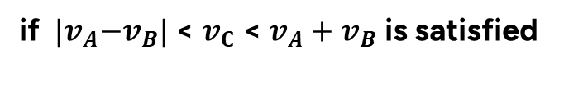
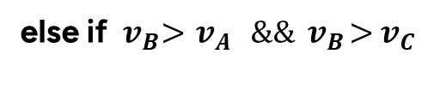



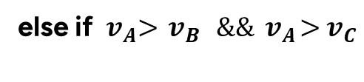


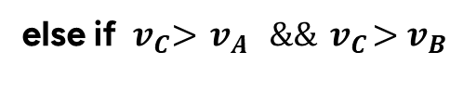
Other Studies and Plans
Second CMV paper: Reducing the switching component of the common mode voltage (also decreasing the occurrence of the dV/dt ) by adjusting the phase shifts to reach the vectorial sum of the first switching component as zero. In the literature, giving 0-120-240 carrier phase shifts to reduce the CMV is common, but our proposal surpasses it.
$$v_{B}$$
We have tree vectors with magnitude of ${|S}_{A}{\left(t\right)}^{f_{s}}\left|, {|S}_{B}{\left(t\right)}^{f_{s}}\right|,and{|S}_{C}{\left(t\right)}^{f_{s}}|$.
We can anymore call them by $v_{A}$ , $v_{B}$ , and $v_{C}$for ease of representation.
If these vectors create a triangle, the sum could be zero.
It is easily determined whether these three vectors create a triangle by using triangle inequalityy.
$$v_{A}$$
$$v_{C}$$
if ${ |v}_{A}−v_{B}|$ < $v_{C}$ < $v_{A}+v_{B}$ is satisfied
else if ${ v}_{A}>{ v}_{B} \&\&{ v}_{A}>{ v}_{C}$
$φ_{CB}={180}^{o}$ and $φ_{CC}={180}^{o}$
else if ${ v}_{B}>{ v}_{A} \&\&{ v}_{B}>{ v}_{C}$
$φ_{CB}$
$φ_{CB}={180}^{o}$ and $φ_{CC}=0^{o}$
$φ_{CC}$
else if ${ v}_{C}>{ v}_{A} \&\&{ v}_{C}>{ v}_{B}$
Apply cosine and sine theorems to find $φ_{CB}$ and $φ_{CC}.$
$φ_{CB}=0^{o}$ and $φ_{CC}={180}^{o}$

Slide 6
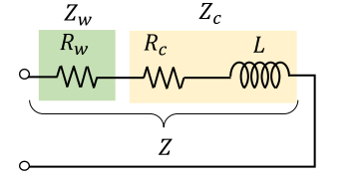




Other Studies and Plans
Motor Harmonic Losses:
Creating a model for harmonic loss calculation on the motor side, including the Ld-Lq differences and positive-negative sequences, that generates negative power for some frequency components.
The Ld-Lq difference causes negative power on the stator side.
$P_{h}=P_{h−stator}+P_{h−rotor}$
$$P_{n}=V_{n}^{2}. K_{h}(n)$$
$$P_{n}=V_{n}^{2}. K_{h}(n±1)$$
We can apply superposition here.
Rotor sees a frequency different from the excitation frequency, which depends on the sequence of the excited harmonic and fundamental frequency.
The fundamental component is stationary regarding the Rotor.
$K_{h}$ = harmonic loss factor

Slide 7
Multi-Objective Optimization of Traction Inverters for Electric Trucks Considering Environmental Impacts
A Life-Cycle-Based Approach for Minimizing Environmental Footprint
Enes Ayaz

Slide 8
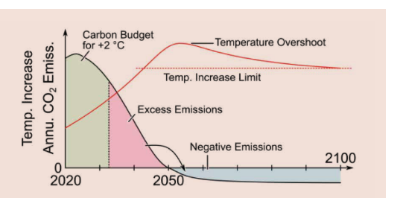
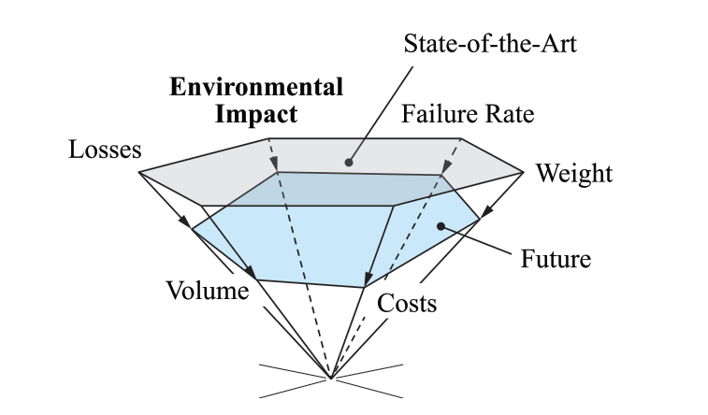
Introduction & Motivation
Introduction:
Climate targets (e.g., Paris Agreement) emphasize the need for net-zero emissions by 2050.
Electric trucks are critical for reducing CO2 emissions in the transportation sector.
Motivation:
Traditional power converter optimization focuses on efficiency and power density.
Environmental impacts across the inverter's lifecycle and reliability are often overlooked but crucial for sustainability.

Slide 9
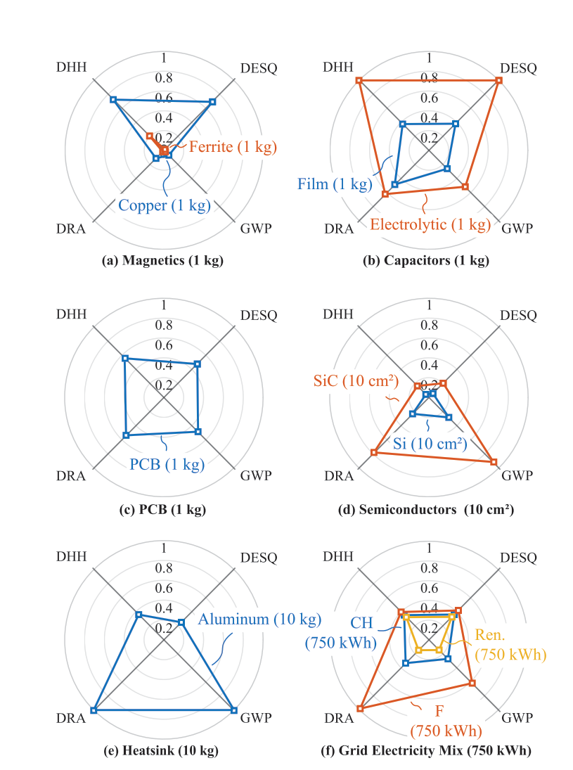
Challenges
Energy Efficiency and Beyond:
The environmental impact of power electronics goes beyond energy efficiency.
Future electrification (e.g., trucks) needs sustainable solutions for power conversion systems.
Research Challenges:
How can we integrate life-cycle environmental impacts with traditional performance metrics (efficiency, power density, reliability)?
The need for multi-objective optimization frameworks that include:
  Global Warming Potential (GWP)
  Damage to Eco-System Quality (DESQ)
  Damage to Resource Availability (DRA),
  Damage to Human Health (DHH)

Slide 10
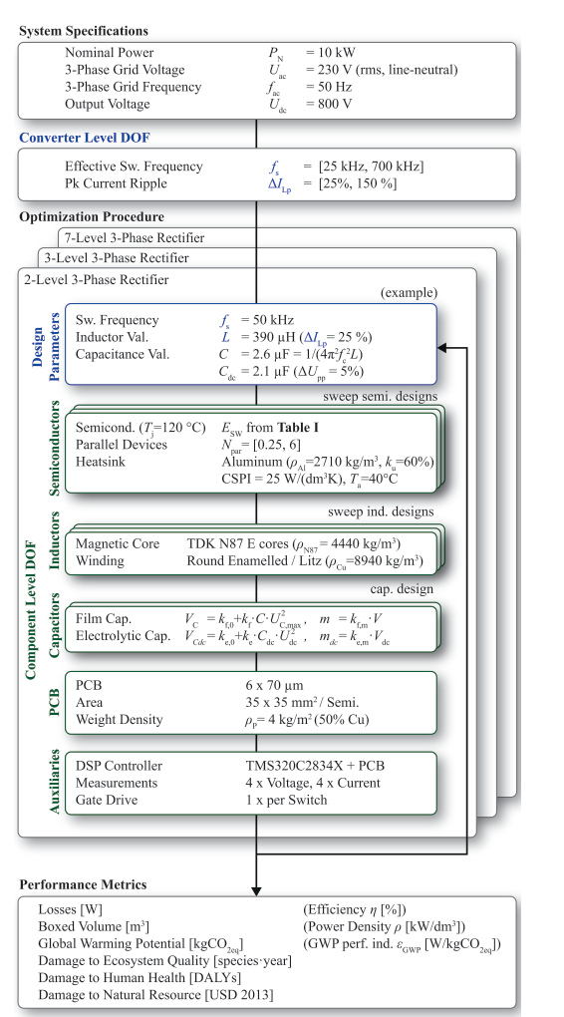
Research Problem & Objectives
Research Problem:
How to design traction inverters for electric trucks that not only maximize energy efficiency but also minimize environmental impacts.
Objectives:
Extend multi-objective optimization of traction inverters to include:
  Carbon footprint (GWP, DESQ, DRA, DHH)
  Material efficiency (circular economy)
  Recycling potential at the end of life
Evaluate design trade-offs between efficiency, environmental impact, and power density.
Evaluate different inverter topologies (e.g., 2-level vs. SPB vs. multilevel) using Pareto-front analysis.
Include life-cycle assessment (LCA) metrics in the design phase, considering the use phase of the inverter in electric trucks.

Slide 11
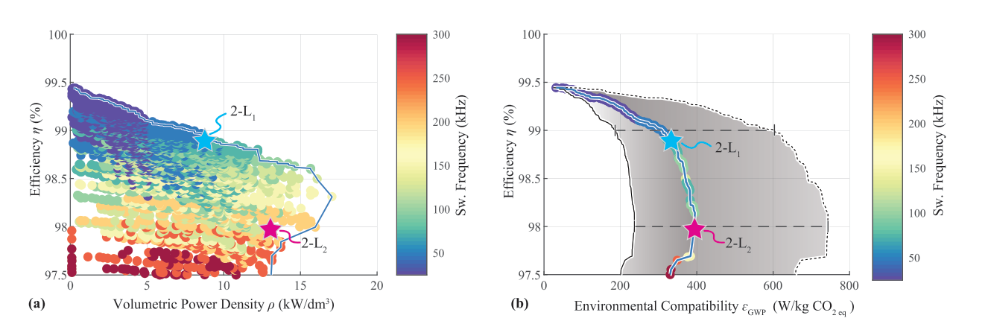
Adopted Methodology
Life-Cycle Assessment (LCA):
  Assess all stages of the traction inverter lifecycle: manufacturing, use-phase, and end-of-life.
  Incorporate environmental metrics such as GWP, resource depletion, and recyclability.
Multi-Objective Optimization:
  Extend traditional optimization (efficiency, cost, power density) to include LCA results.
  Use Pareto-front analysis to balance conflicting objectives (e.g., higher efficiency vs. higher material footprint).
Tools: Optimization algorithm (e.g., MATLAB), modeling of SiC and Si components, and switching frequency evaluation.
Case Study: A comparative study of different traction inverter topologies (e.g., Si vs. SiC, 2L vs. 3L).

Slide 12
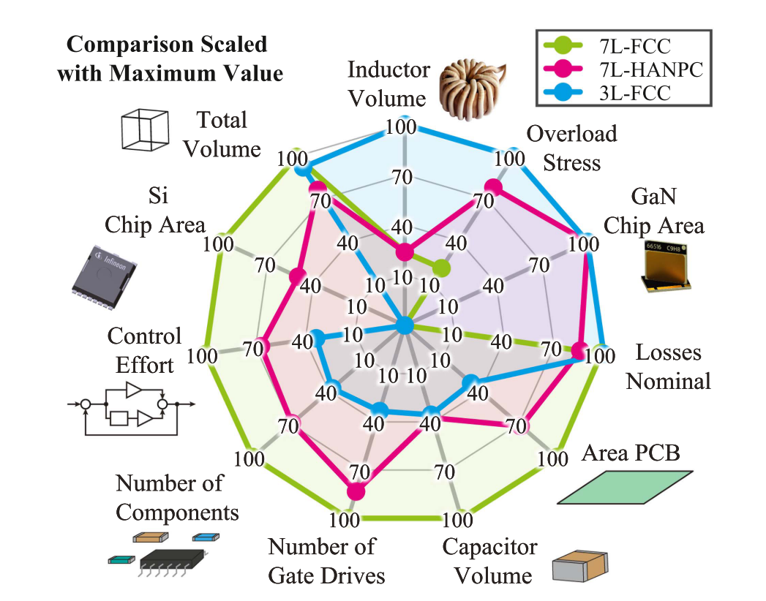
Application to Traction Inverters
Optimization Process:
Compare 2-level vs. SPB (series-parallel) vs. Multilevel (e.g., 3-level, 5-level) inverter topologies.
Evaluate key parameters:
  Switching frequency vs. losses and efficiency.
  Component-level impacts (semiconductors, capacitors, PCBs, etc.).
Use of mission profiles to optimize the use-phase emissions (e.g., hours of operation per day for electric trucks).

Slide 13
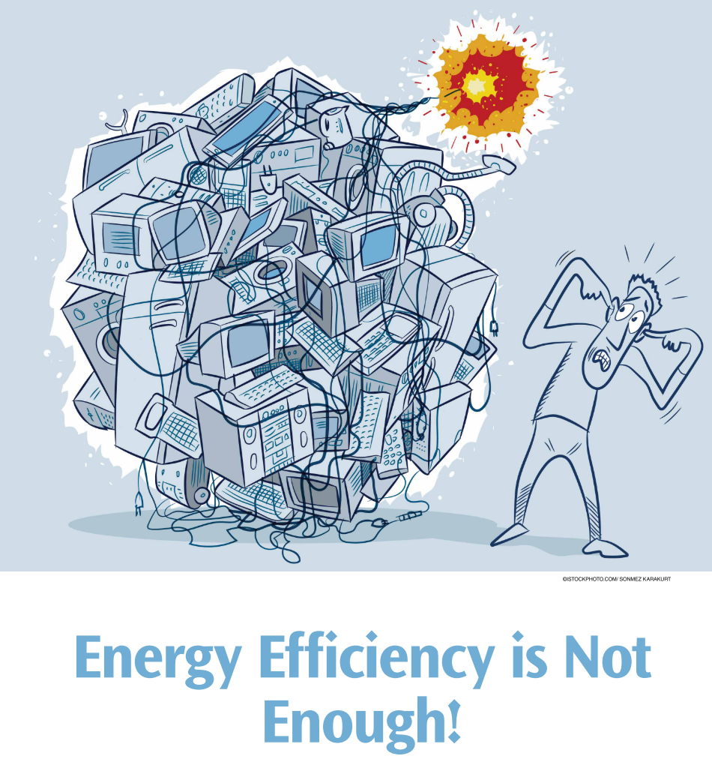
Expected Scientific Contributions
Novelty: Introduce environmental impact as a key dimension in traction inverter design optimization.
Framework: Develop a comprehensive framework for integrating environmental factors in the early design stages.
Case Study: Provide real-world data (e.g., drive cycles) and insights on the environmental trade-offs of different inverter topologies.

Slide 14
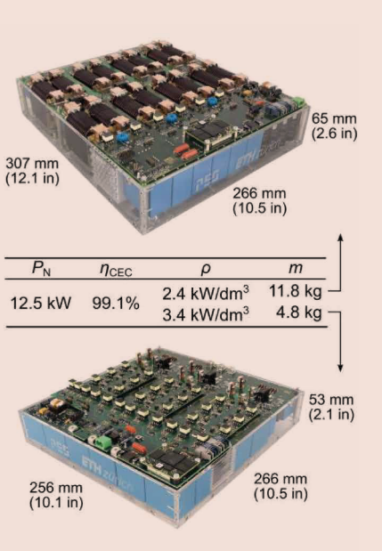
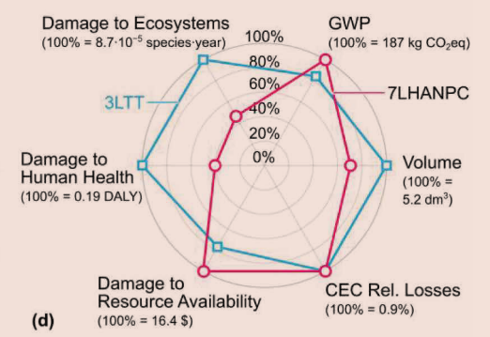
Expected Results
3LTT
Expected Outcomes:
Achieve optimized designs with higher efficiency and lower environmental footprint (e.g., lower GWP).
Design Trade-offs:
Higher switching frequencies reduce passive component size but increase semiconductor losses.
Inverter design with an initially higher environmental impact (e.g., larger components) might yield lower lifecycle emissions due to superior efficiency.
7LHANPC

Slide 15
Impact
Industry: Support the design of more sustainable electric truck power systems.
Regulation: Align inverter designs with upcoming environmental policies (e.g., EU Circular Economy Action Plan).
Real-World Impact: Support regulatory alignment with circular economy principles and CO2 tax incentives for the trucking industry.

Slide 16
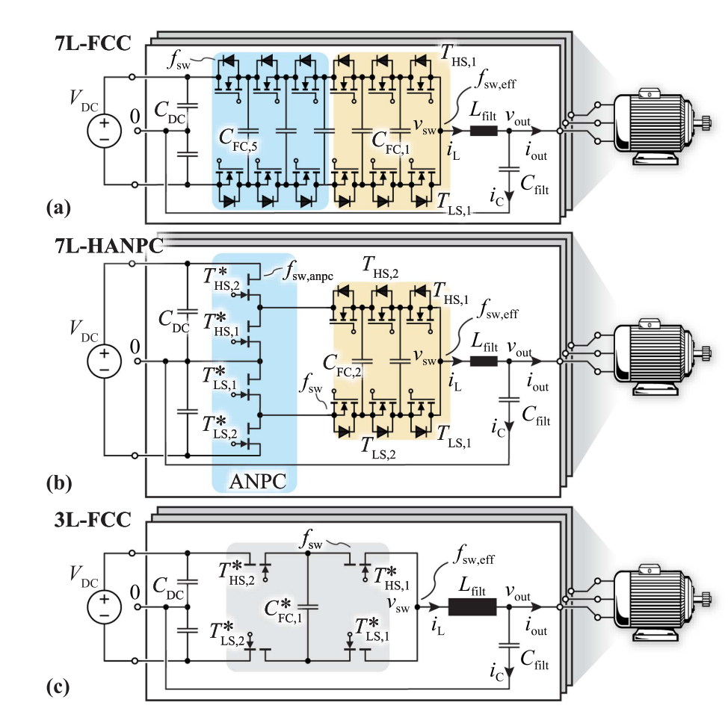
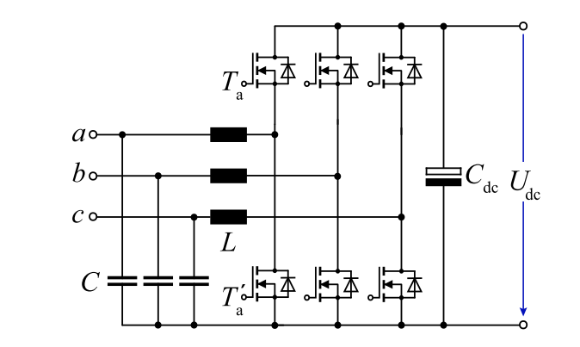
Topologies– 2 Level or Multilevel VSIs
Possible Semiconductor Technology
2L- SiC
3L- SiC
5L- GaN
7L- Si

Slide 17
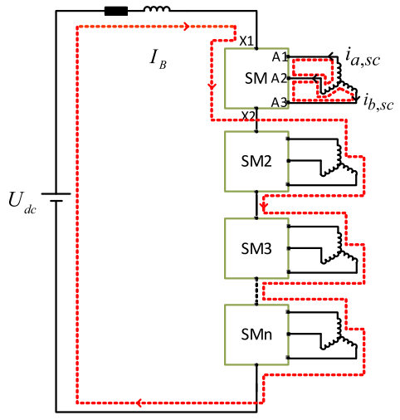
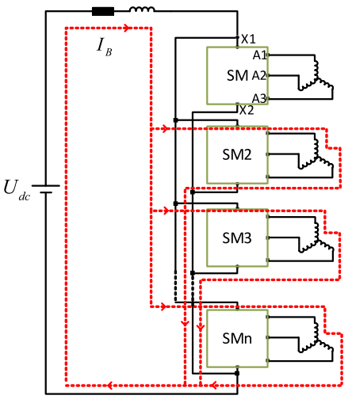
Topologies– SPB or PPB to Introduce Modularity
Fault Tolerance:
  Modular Architecture: SPB modules can operate independently, enabling continued operation during faults.
  Redundancy: Enables partial load operation even when a module fails, minimizing system downtime.
Modularity:
  Scalability: SPB's modular structure supports different power levels, adapting to the specific needs of electric trucks (urban vs. long-haul).
  Easier Maintenance: Modular components simplify repair and replacement, reducing operational disruptions.
Multi-Phase Operation:
  Improved Efficiency: SPB supports 3-, 6-, 9-, or 12-phase configurations, optimizing power delivery and motor performance for different applications.
  Variable Phase-Pole: SPB supports variable phase-pole configuration on the stator side, which can increase the overall efficiency along with the drive cycle.
  Ripple Reduction: Multi-phase operation reduces current ripple, improving the overall efficiency and torque smoothness.
Interleaving:
  Current Ripple Reduction: Interleaving SPB modules minimizes current ripple, reducing the need for bulky filters and enhancing power quality.
  Thermal Management: Distributes heat generation more evenly across modules, improving thermal performance and extending the lifespan of components.
Stacked polyphase bridges (SPB)
Parallel-connected polyphase bridges (PPB)

Slide 18
References
Rohner, G., Kolar, J. W., Bortis, D., & Schweizer, M. (2022). Optimal Level Number and Performance Evaluation of Si/GaN Multi-Level Flying Capacitor Inverter for Variable Speed Drive Systems. 2022 International Conference on Electrical Machines and Systems, ICEMS 2022, 1–6. https://doi.org/10.1109/ICEMS56177.2022.9982999
Rohner, G., Gfrorer, T., Niklaus, P. S., Huber, J., Bortis, D., Schweizer, M., & Kolar, J. W. (2023). Hardware-Based Comparative Analysis of Multilevel Inverter Topologies for Integrated Motor Drives Considering Overload Operation. IEEE Open Journal of Power Electronics, 4(August), 934–944. https://doi.org/10.1109/OJPEL.2023.3327423
Rohner, G., Huber, J., Mirić, S., & Kolar, J. W. (2024). Comparative Evaluation of Three-Phase Three-Level Flying Capacitor and Stacked Polyphase Bridge GaN Inverter Systems for Integrated Motor Drives. Electronics (Switzerland), 13(7). https://doi.org/10.3390/electronics13071259
Rohner, G., Huber, J., Mirić, S., & Kolar, J. W. (2024). Comparative Evaluation of Three-Phase Three-Level Flying Capacitor and Stacked Polyphase Bridge GaN Inverter Systems for Integrated Motor Drives. Electronics (Switzerland), 13(7). https://doi.org/10.3390/electronics13071259
Imperiali, L., Menzi, D., Kolar, J. W., & Huber, J. (2024). Multi-Objective Minimization of Life-Cycle Environmental Impacts of Three-Phase AC-DC Converter Building Blocks. Conference Proceedings - IEEE Applied Power Electronics Conference and Exposition - APEC, 2994–3004. https://doi.org/10.1109/APEC48139.2024.10509190
Huber, J., Imperiali, L., Menzi, D., Musil, F., & Kolar, J. W. (2024). Life-Cycle Carbon Footprints of Low-Voltage Motor Drives with 600-V GaN or 650-V SiC Power Transistors. Proceedings of the 13th International E-Conference on Integrated Power Electronics Systems .
Huber, J., Imperiali, L., Menzi, D., Musil, F., & Kolar, J. W. (2024). Energy Efficiency is Not Enough! IEEE Power Electronics Magazine, 11(1), 18–31. https://doi.org/10.1109/MPEL.2024.3354013

Slide 19
References
J. Wang, Y. Li and Y. Han, "Evaluation and design for an integrated modular motor drive (IMMD) with GaN devices," 2013 IEEE Energy Conversion Congress and Exposition, Denver, CO, USA, 2013, pp. 4318-4325, doi: 10.1109/ECCE.2013.6647278.
J. Wang and Y. Han, "A new concept of multilevel converter motor drive with modular design and split winding machine," 2014 Power and Energy Conference at Illinois (PECI), Champaign, IL, USA, 2014, pp. 1-6, doi: 10.1109/PECI.2014.6804550. J. Wang and Y. Han, "A class of modular multilevel motor drives with design flexibility and reduced components number," 2015 IEEE Applied Power Electronics Conference and Exposition (APEC), Charlotte, NC, USA, 2015, pp. 2387-2393, doi: 10.1109/APEC.2015.7104682. Design of Multilevel Integrated Modular Motor Drive withGallium Nitride Power Devices, Jiyao Wang
H. Zhang, O. Wallmark, M. Leksell, S. Norrga, M. N. Harnefors and L. Jin, "Machine design considerations for an MHF/SPB-converter based electric drive," IECON 2014 - 40th Annual Conference of the IEEE Industrial Electronics Society, Dallas, TX, USA, 2014, pp. 3849-3854, doi: 10.1109/IECON.2014.7049074.
L. Jin, S. Norrga, H. Zhang and O. Wallmark, "Evaluation of a multiphase drive system in EV and HEV applications," 2015 IEEE International Electric Machines & Drives Conference (IEMDC), Coeur d'Alene, ID, USA, 2015, pp. 941-945, doi: 10.1109/IEMDC.2015.7409174.
H. Zhang and O. Wallmark, "Evaluation of winding arrangements in electric machinery for modular electric drives," 2016 IEEE 8th International Power Electronics and Motion Control Conference (IPEMC-ECCE Asia), Hefei, China, 2016, pp. 2820-2825, doi: 10.1109/IPEMC.2016.7512744.

