Slide 1
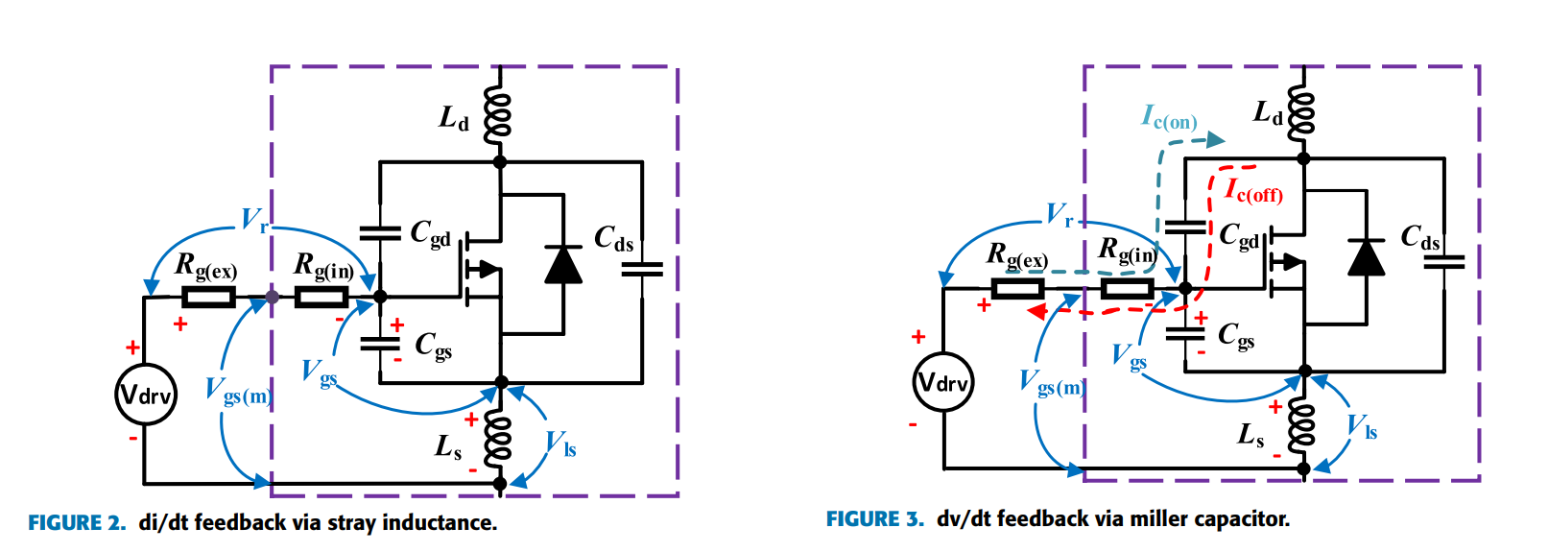
Package dependent
Single Bare Die
Double Dies
Triple Dies
To investigate the conduction and switching losses vs die area
To investigate the distortive effect of the package on the losses
Hefner Saber medici

Slide 2
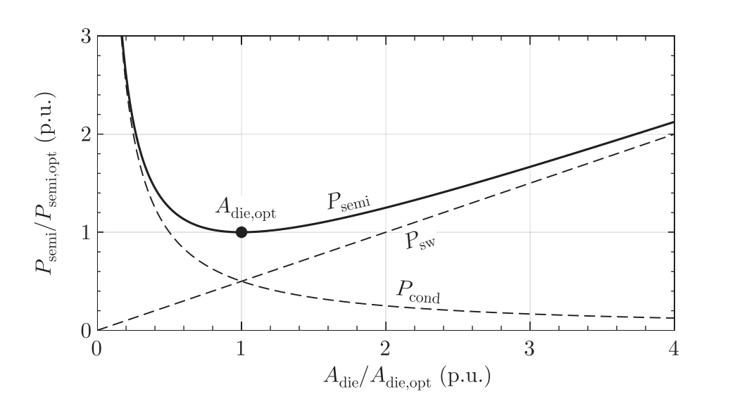
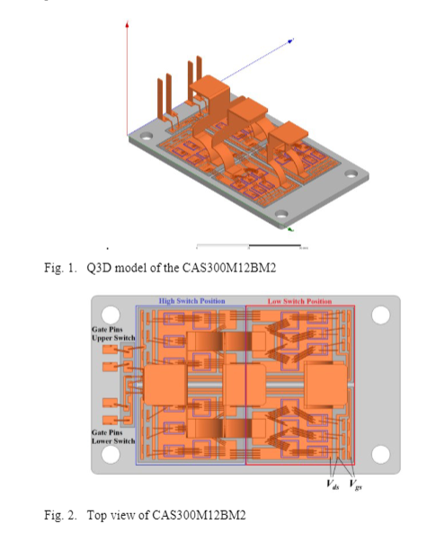
Check this linearity.
Since the input capacitance increases, we might change the outer gate resistance ?
Estimate package inductances and resistances.

Slide 3
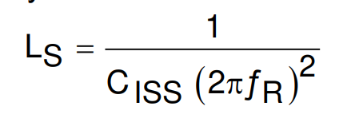
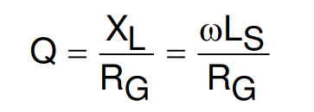
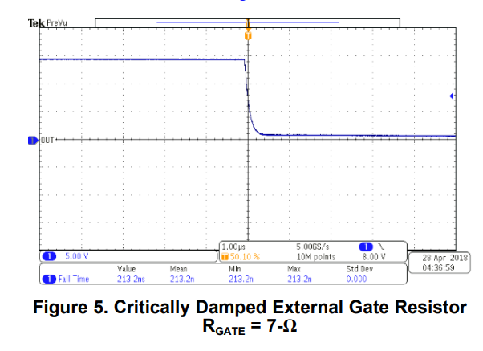
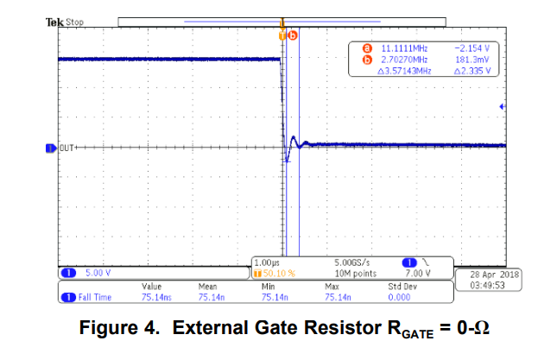
Update the possible dv/dt by considering gate oscillation due to the resonance between input capacitance and stray inductance.
* External Gate Resistor Design Guide for Gate Drivers

Slide 4
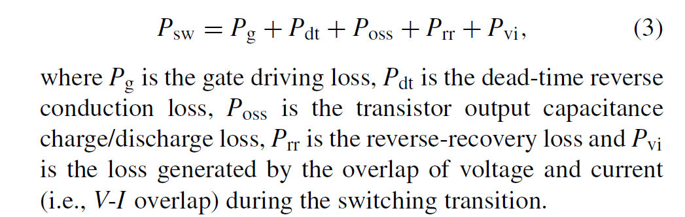




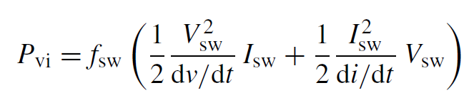
Linearly increasing by the number of dies in parallel
The same by the number of dies in parallel?
The same by the number of dies in parallel?
Depends on dv/dt and di/dt

Slide 5
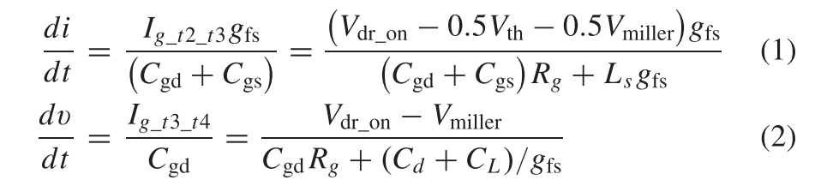
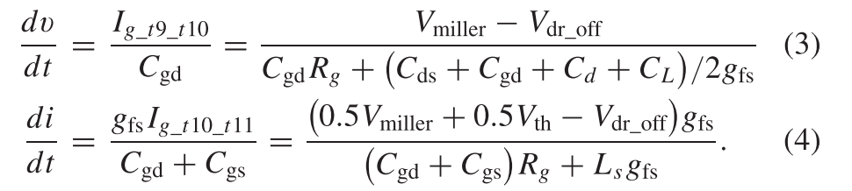
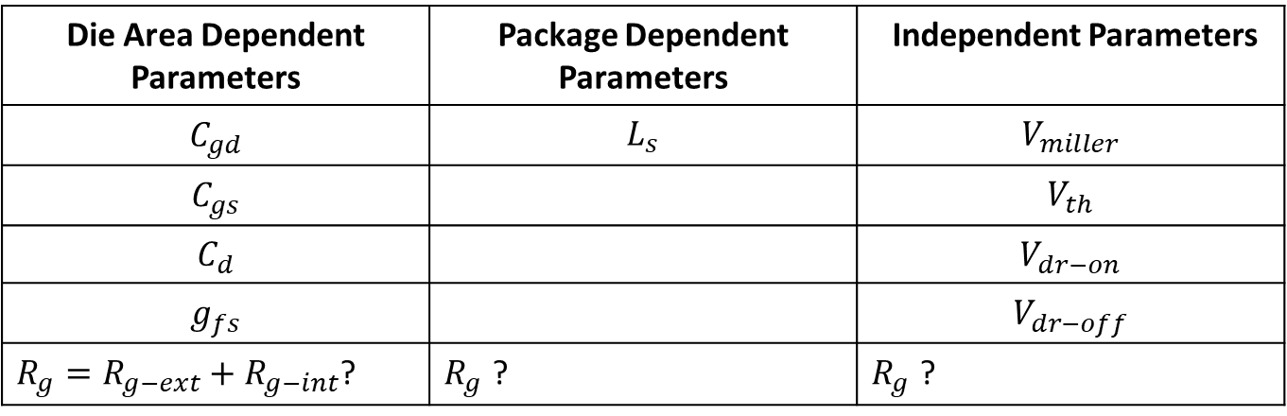
Die Area Dependent Parameters | Package Dependent Parameters | Independent Parameters
$$C_{gd}$$ | $$L_{s}$$ | $$V_{miller}$$
$$C_{gs}$$ |  | $$V_{th}$$
$$C_{d}$$ |  | $$V_{dr−on}$$
$$g_{fs}$$ |  | $$V_{dr−off}$$
$R_{g}=R_{g−ext}+R_{g−int}$? | $R_{g}$ ? | $R_{g}$ ?

Slide 6
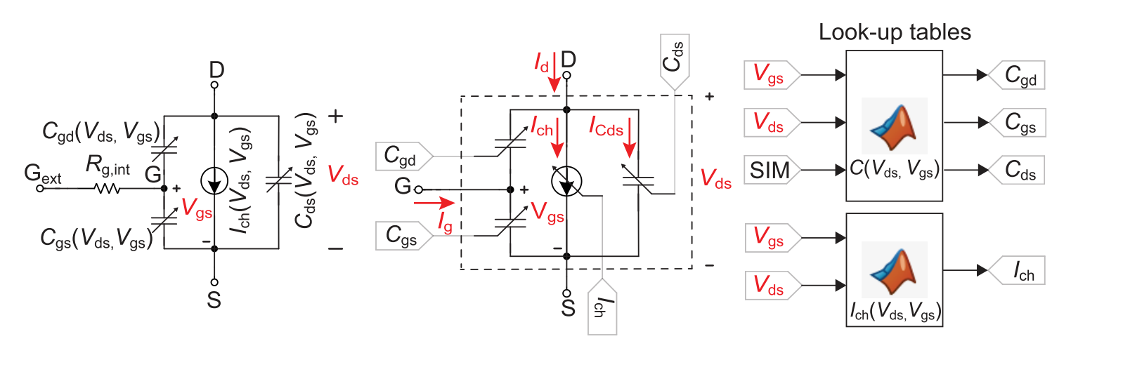

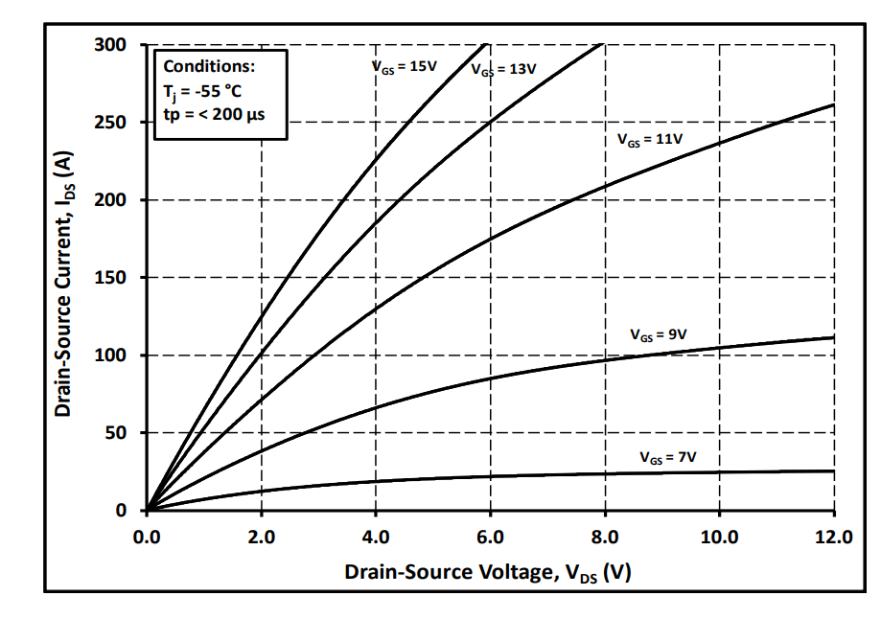
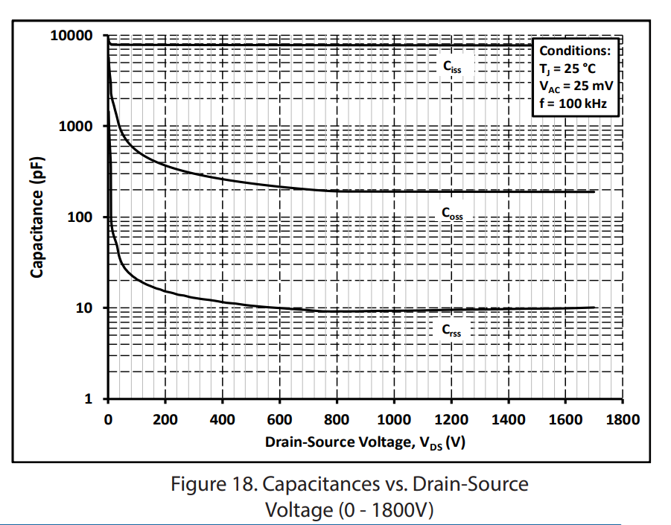
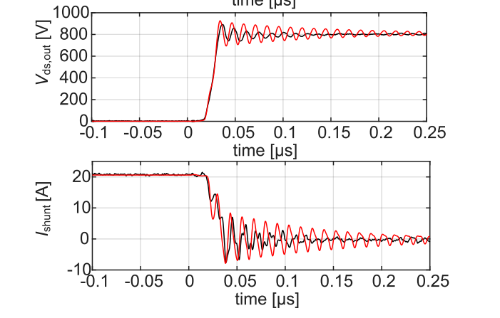
Just we need static parameters without DPT.

Slide 7
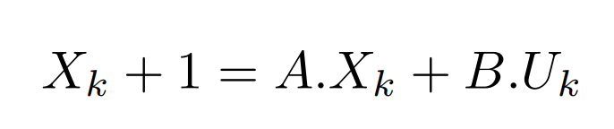
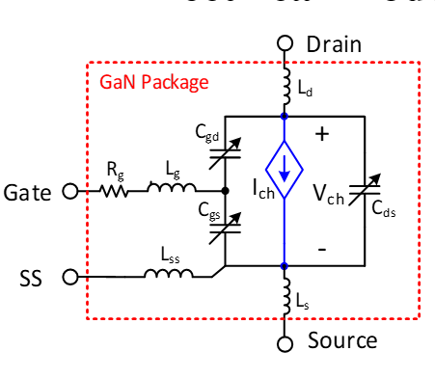
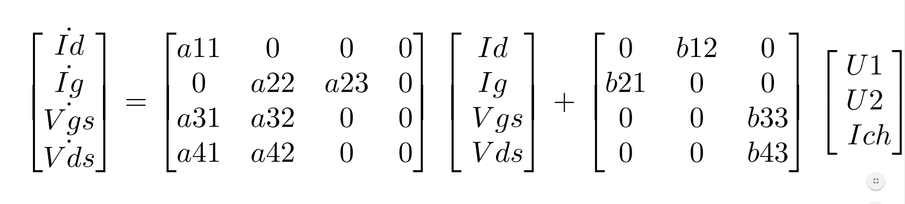
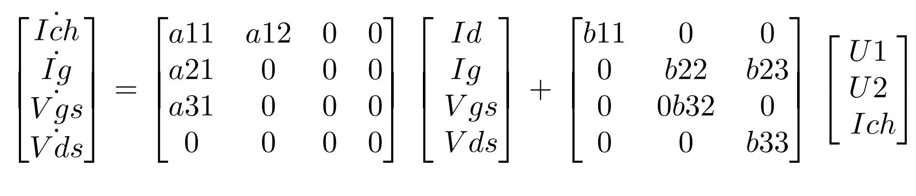
State Space Model
Voltage Excitation Model
Current Excitation Model

Slide 8
