Slide 1
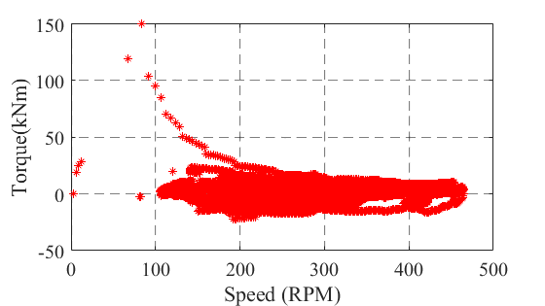
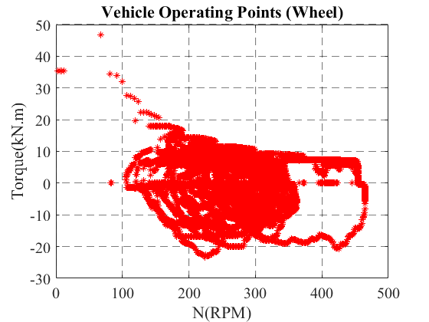
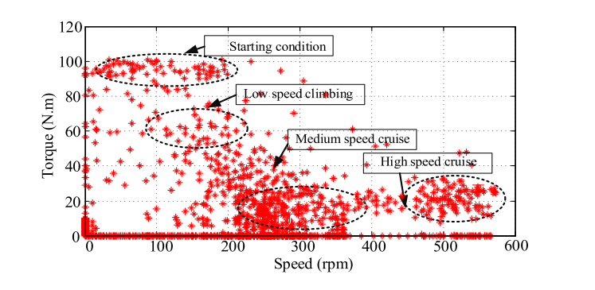







Batteries
$$V$$
Inverter
$$V$$
E-motor
$$T$$
Gearbox
$$T$$
Vehicle
$$T$$
Drive Cycle
$$I$$
$$I$$
$$ω$$
$$ω$$
$$ω$$
Losses
Drive Cycle
Speed and Torque (Output of Gearbox)
Example Ideal Drive Cycle
Wheel power
We do not have altitude information, so we cannot achieve low-speed climbing torque ??
Notes:
`

Slide 2
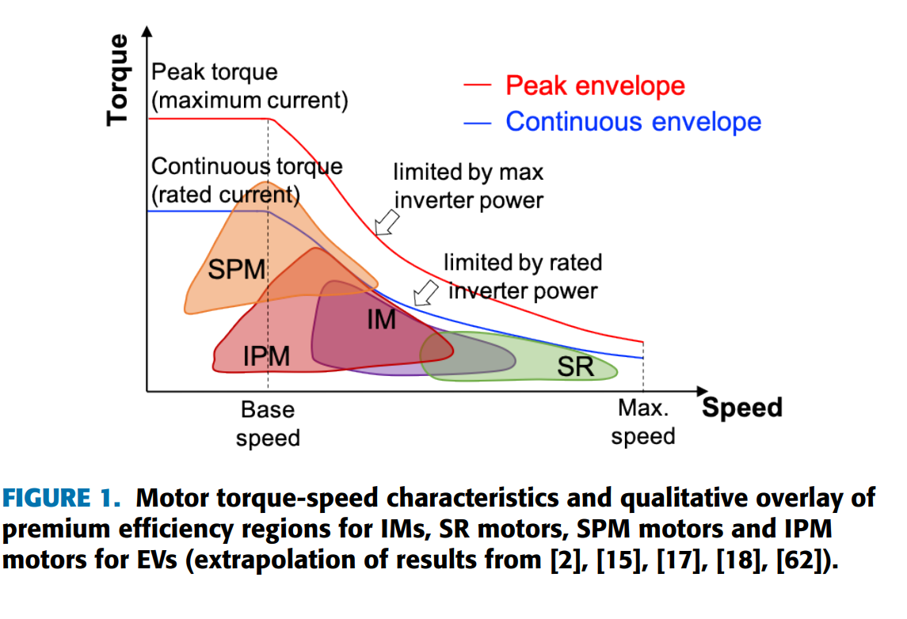
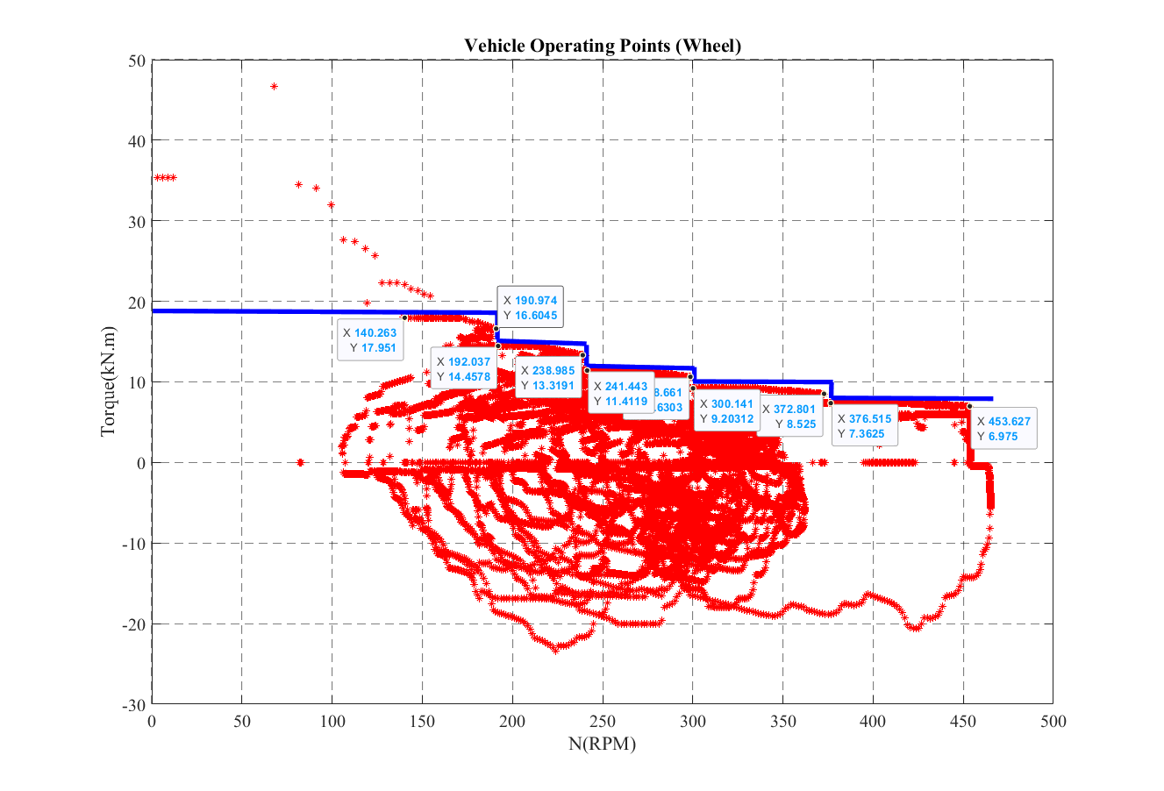
Notes:
`

Slide 3
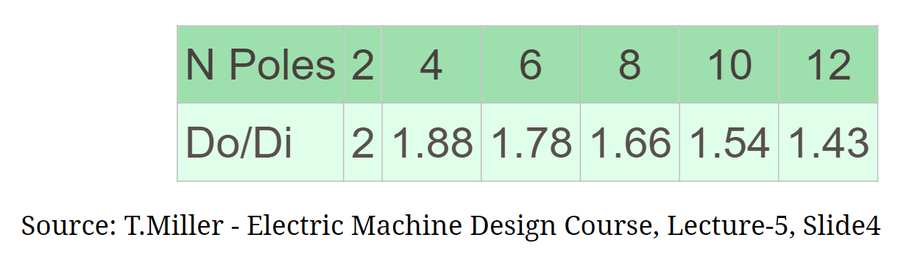

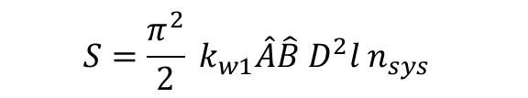


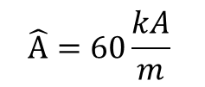


Motor Size Estimation
We can use specific electric loading ($\hat{A}$) and magnetic loading ($\hat{B}$)
If we select a lower synchronous speed, we might increase the number of poles (that means using the same electrical frequency every time), enabling a shorter outer diameter (stator diameter).
$$S=\frac{π^{2}}{2} k_{w1}\hat{A}\hat{B} D^{2}l n_{sys}$$
$$k_{w1}=0.959$$
$$\hat{A}=60\frac{kA}{m}$$
If an induction machine is utilized, the specific magnetic and specific loadings would be decreased and S should be raised for the same output power due to its bad power factor
$$\hat{B} =1.05 T$$
$$S=330 kVA$$
$$V=D_{i}^{2}l ( in m^{3})$$
$$n_{sys}=(in \frac{1}{s})$$
Inner diameter (rotor diameter)

Slide 4
2 pole pair
Variable pole pairs

Slide 5
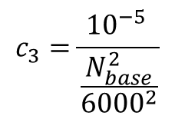
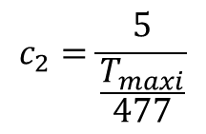
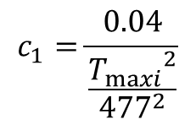
Motor Loss Estimation
The EM power losses are modelled by a second-order polynomial in the mechanical power
We do not include the switching harmonics losses here
$$P_{EM−loss}=c_{1} T_{EM}^{2}+c_{2}{ T}_{EM}+c_{3}N^{2}$$
$$c_{1}=\frac{0.04}{\frac{{T_{maxi}}^{2}}{{477}^{2}}}$$
$$c_{2}=\frac{5}{\frac{T_{maxi}}{477}}$$
$$c_{3}=\frac{{10}^{−5} }{\frac{N_{base}^{2}}{{6000}^{2}}}$$

Slide 6
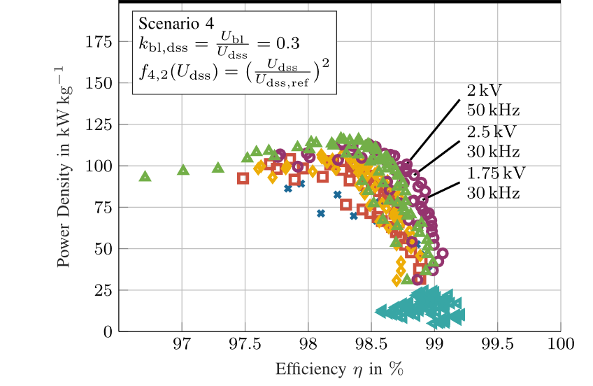
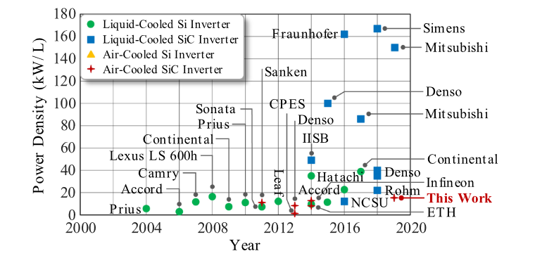


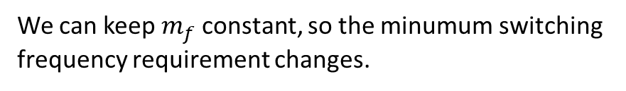
Inverter Size and Loss Estimation
The inverter is not affected by gear ratio if the DC-link voltage and power are the same.
$${f_{electrical}=n}_{sync} x pole−pair$$
We can keep $m_{f}$ constant, so the minumum switching frequency requirement changes.
$${f_{sw}=m}_{f} x f_{electrical}$$

Slide 7
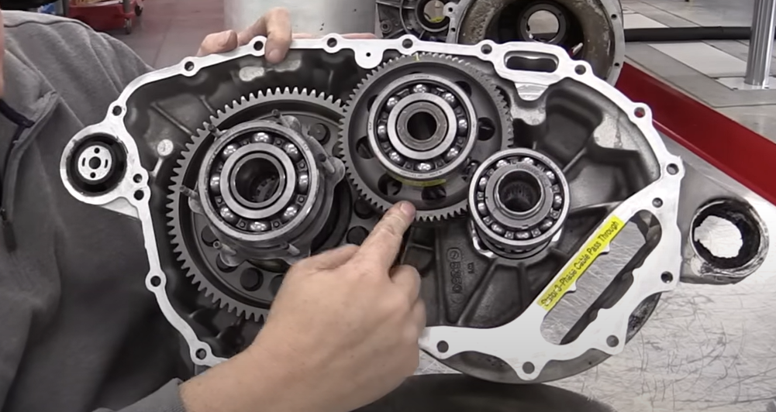
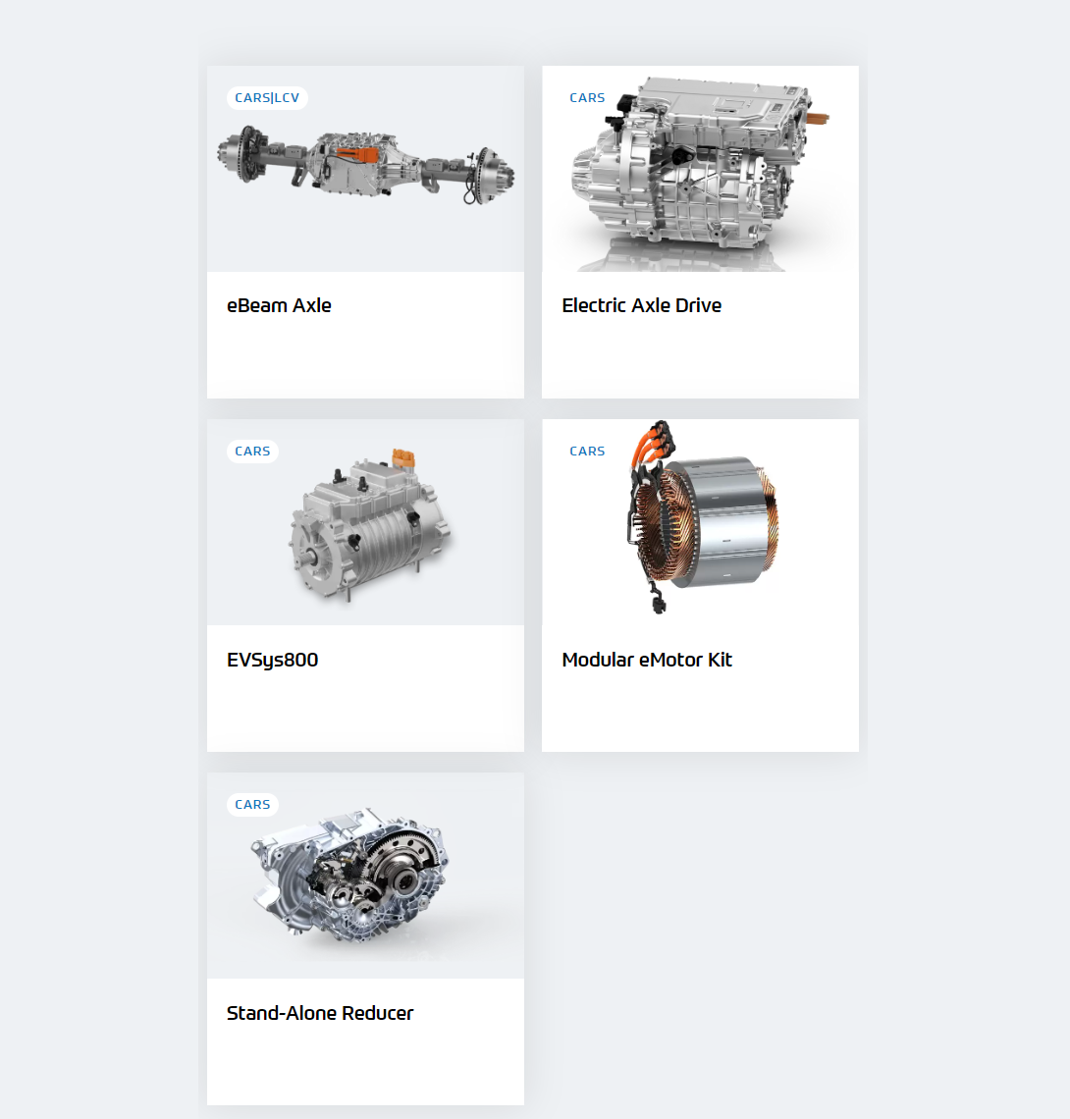
Gearbox Size Estimation
Tesla
78/25
78/25

Slide 8
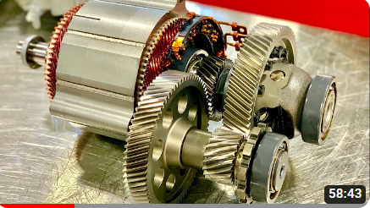
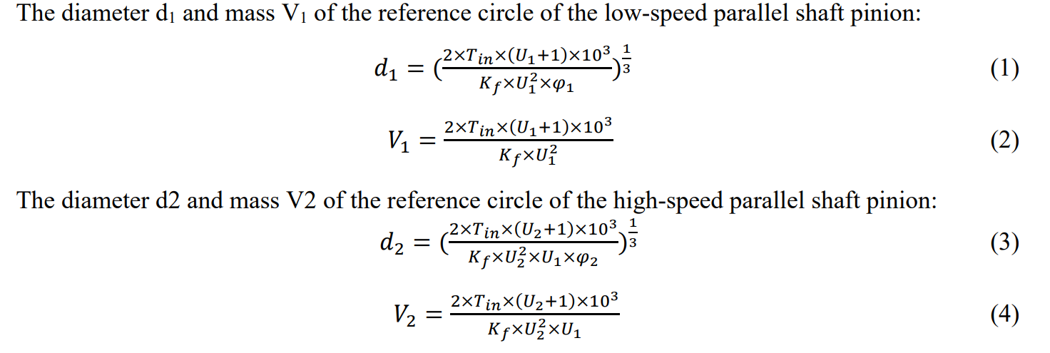
Gearbox Size Estimation
Gear Ratio Distribution of Electric Vehicle Reducer
Torque
Gear ratio
Material
Usage duty
Spur gear
Helical gear
Ring gear
Chevrolet Bolt EV

Slide 9
Not realistic values, since I have randomly selected the material !!!
Single Stage Gear
The volume will be increased quadratically if we have a constant aspect ratio and material.

Slide 10
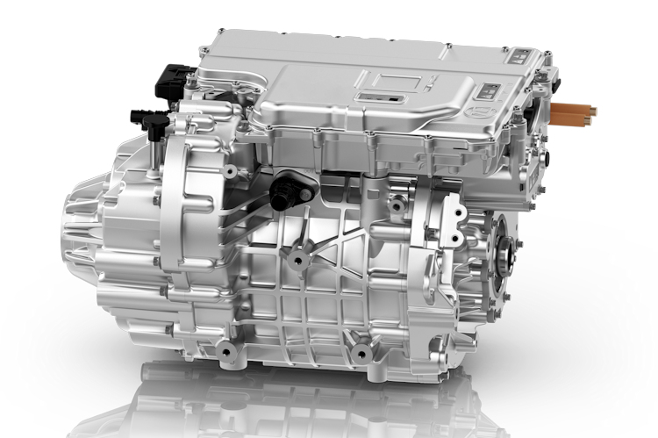
E-axle ???
If gear diameters are shorter than the summation of motor diameters and the height of the inverter in the e-axle system, we can increase the gear ratio. Therefore, the motor diameter is decreased, and there might be a sweet point that they are overlapped.
However, consider that the width of the gearbox is also increased with the diameter if we use the same material and so the aspect ratio.

Slide 14
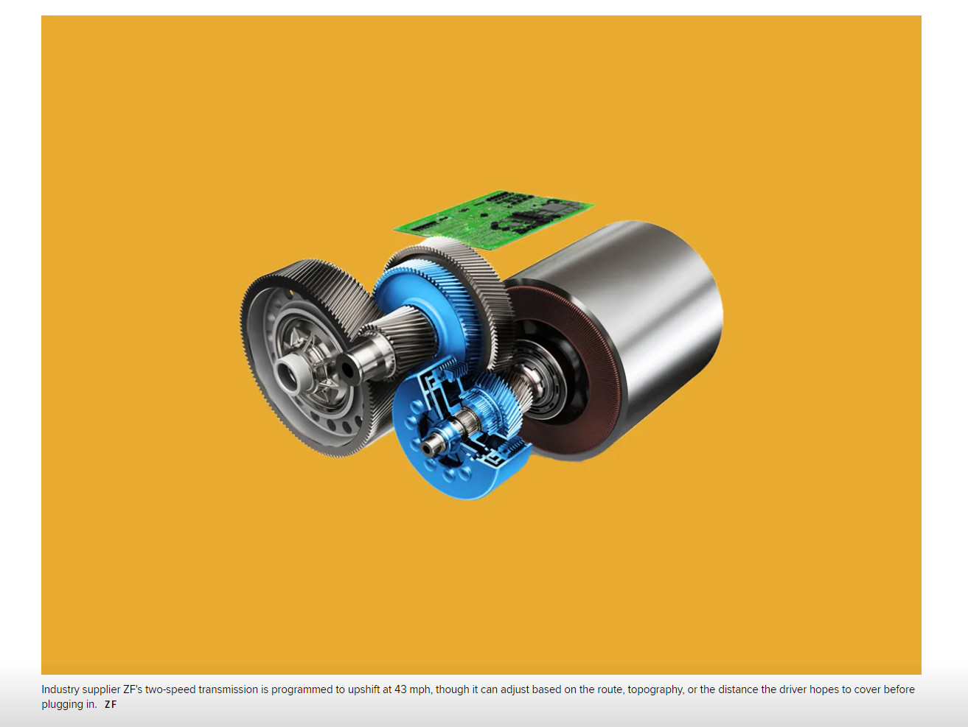
https://www.wired.com/story/electric-car-two-speed-transmission-gearbox/
https://www.zf.com/products/en/cars/products_66244.html
https://www.zf.com/products/en/cars/products_64270.html

Slide 16





Losses and Energy Flow between Drivetrain Components *[1]
Batteries
$$V$$
Inverter
$$V$$
E-motor
$$T$$
Gearbox
$$T$$
Vehicle
$$T$$
Drive Cycle
$$I$$
$$I$$
$$ω$$
$$ω$$
$$ω$$
Losses
Inverter-1
$$V$$
E-motor-1
$$T$$
Gearbox-1
$$I$$
$$ω$$
Batteries
$$V$$
$$T$$
$$T$$
$$I$$
$$ω$$
Vehicle
$$ω$$
Drive Cycle
Inverter-2
$$V$$
E-motor-2
$$T$$
Gearbox-2
$$I$$
$$ω$$
Losses
[1] A Simulation Platform for Optimization of Electric Vehicles With Modular Drivetrain Topologies

Slide 17
Tesla
78/25
78/25

Slide 18
https://iopscience.iop.org/article/10.1088/1742-6596/1654/1/012011/pdf
Gear Ratio Distribution of Electric Vehicle Reducer
https://www.sciencedirect.com/science/article/pii/S030626191931877X

Slide 19
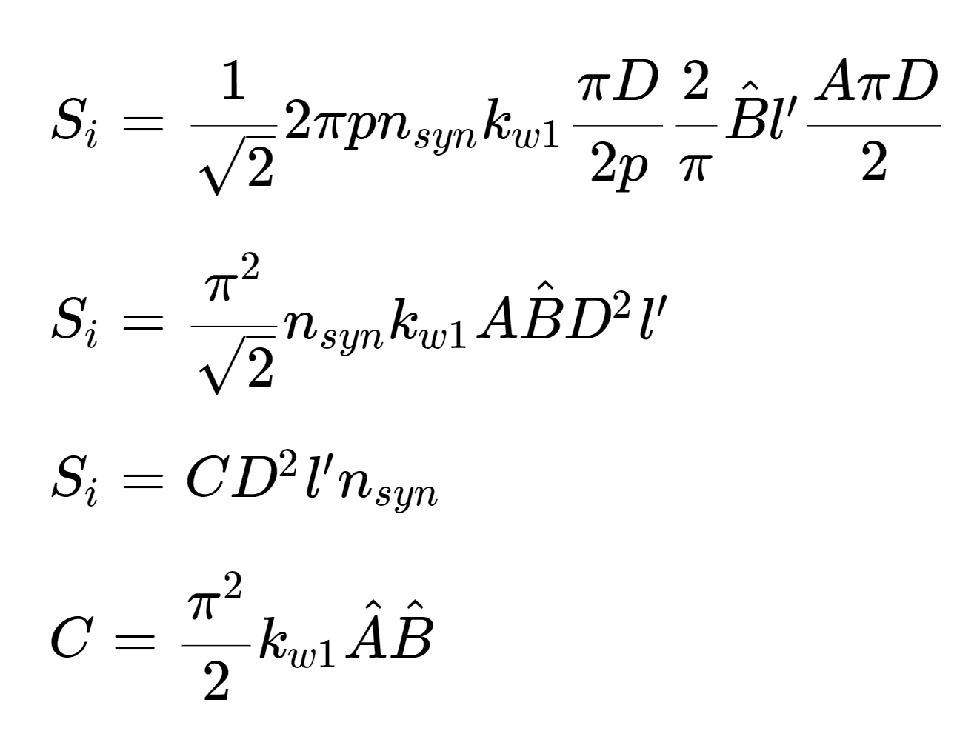
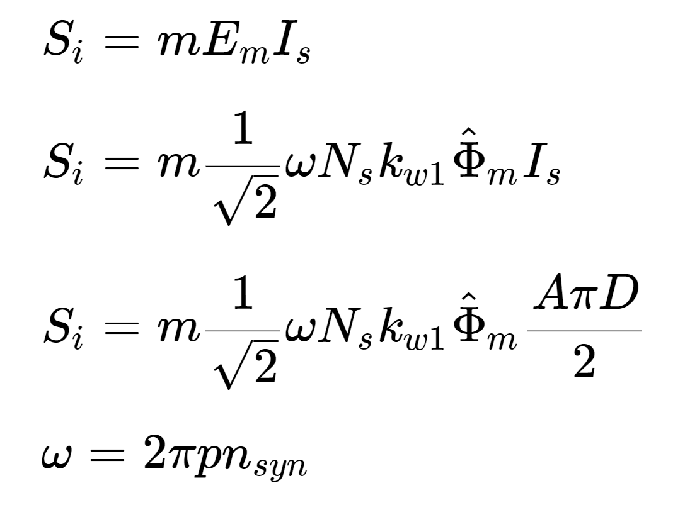
Motor Volume Estimation
Specific Machine Constant (C)
Define
  magnetic loading
  electric loading
Define
  diameter
  axial length
Define
  airgap
  winding Type
  number of coils
http://keysan.me/presentations/ee564_basic_machine_design.html#38

Slide 20
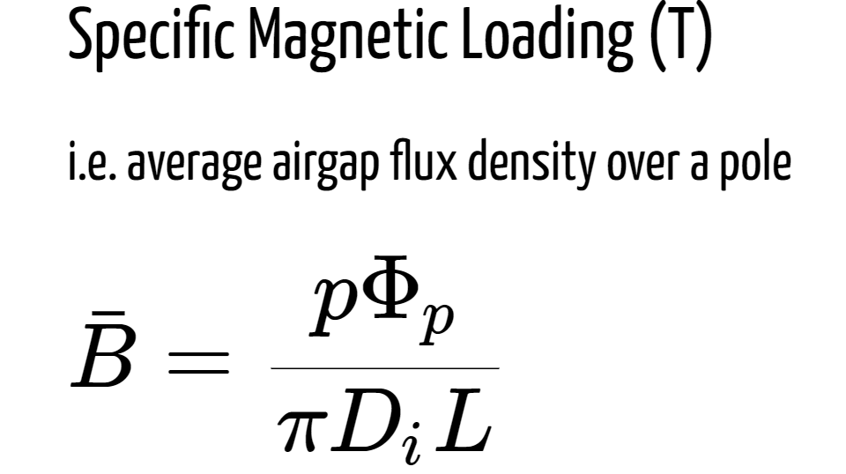
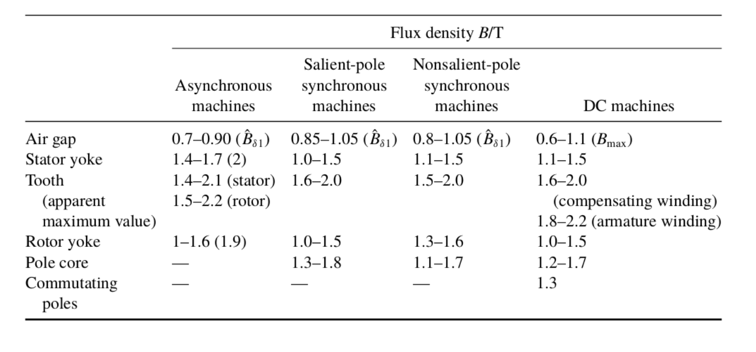

Slide 21
