Slide 1


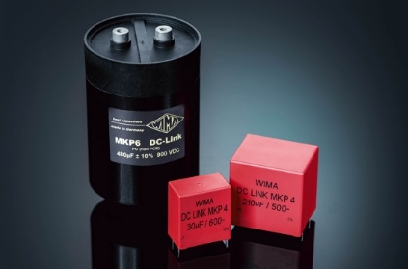
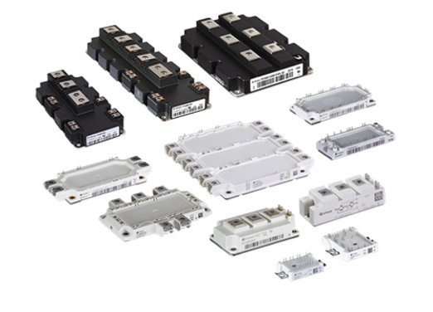
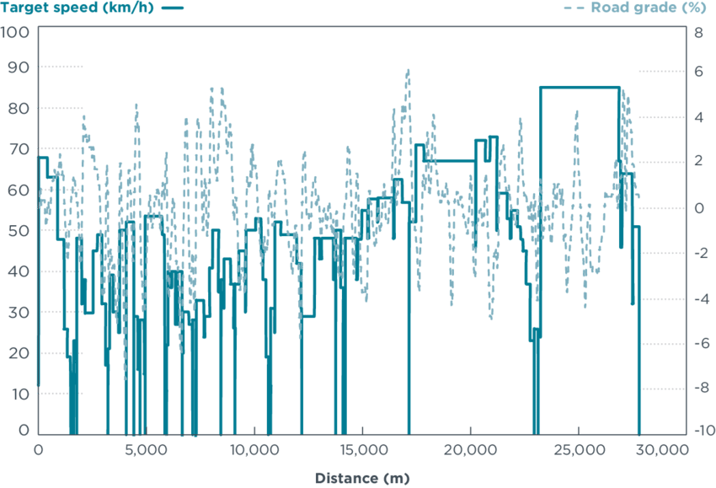
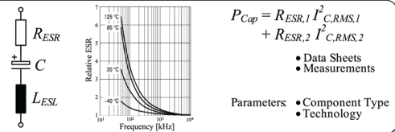
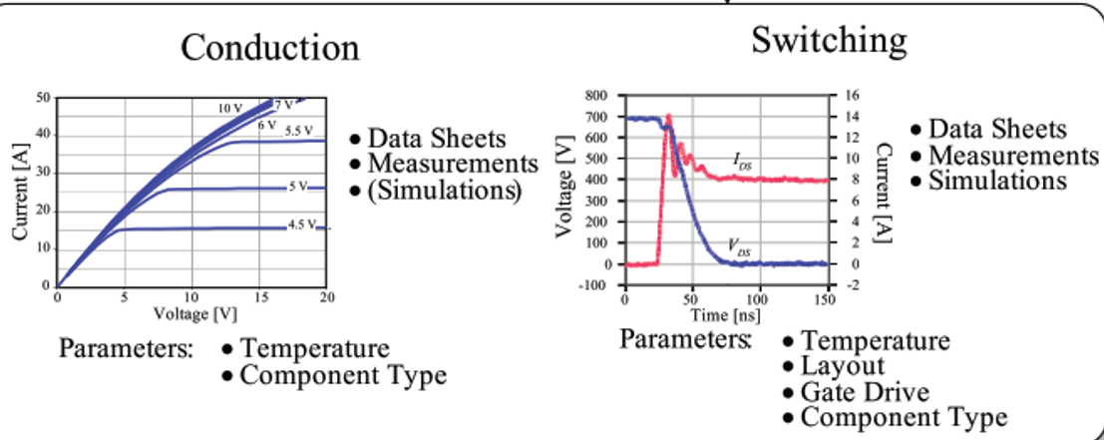

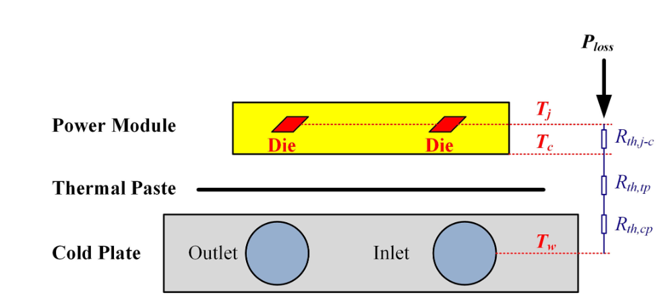
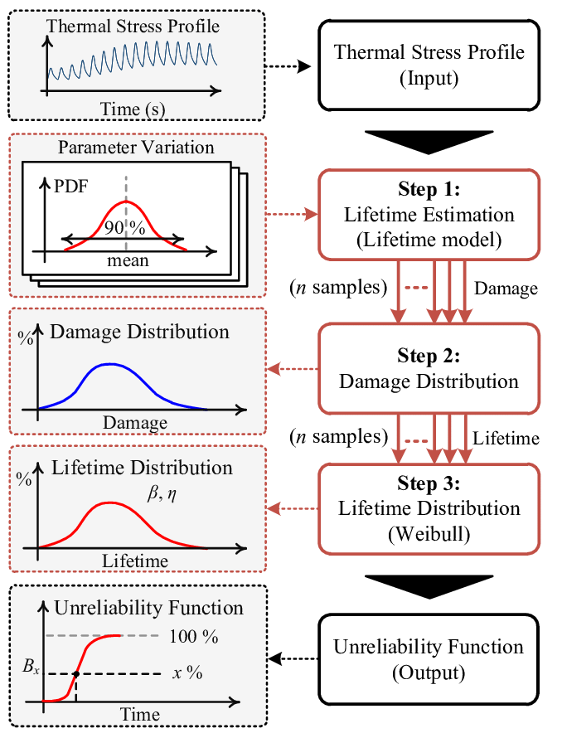
OVERALL ELECTRO-THERMAL MODELLING OF TRACTION INVERTER
Topology Selection
V/I Ratings
Semiconductor and Capacitor Selection
Drive Cycle
Operating Points
V/I (t)
Capacitor Loss Calulation
Tc
Tj
Semiconductor Loss Calculation
W
W
Thermal Model
Thermal Model
Tc
Tj
|Tc (k)-Tc(k-1)|< ϵ
No
No
|Tj (k)-Tj(k-1)|< ϵ
Yes
Yes
Tc (t)
Tj (t)
Reliability Algorithm

Slide 2
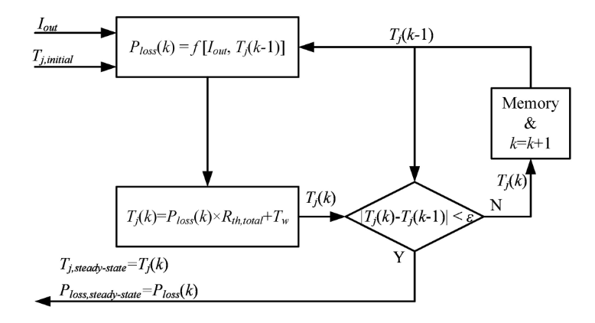
LOSS MODELLING OF SEMICONDUCTOR DEVICES
Modulation and Topology
Conduction and Switching Events
Selection of Input Parameters
Voltage and current Waveforms
Topology and Modulation Selection
Finding the conduction and commutation times
Creating voltage and current waveforms
Loss Calculations
Iterative Solution
The conduction and commutation times
Conduction Loss Calculation
Switching Loss Calculation

Slide 3
Topology Selection
V/I Ratings
Semiconductor and Capacitor Selection
Drive Cycle
Operating Points
V/I (t)
Capacitor Loss Calulation
Tc
Tj
Semiconductor Loss Calculation
W
W
Thermal Model
Thermal Model
Tc
Tj
|Tc (k)-Tc(k-1)|< ϵ
No
No
|Tj (k)-Tj(k-1)|< ϵ
Yes
Yes
Tc (t)
Tj (t)

Slide 4
Topology Selection
Semiconductor and Capacitor Selection
Operating Points
Tj
Semiconductor Loss Calculation
W
Thermal Model
Tj
No
|Tj (k)-Tj(k-1)|< ϵ
Tj (t)
Yes

