Slide 1
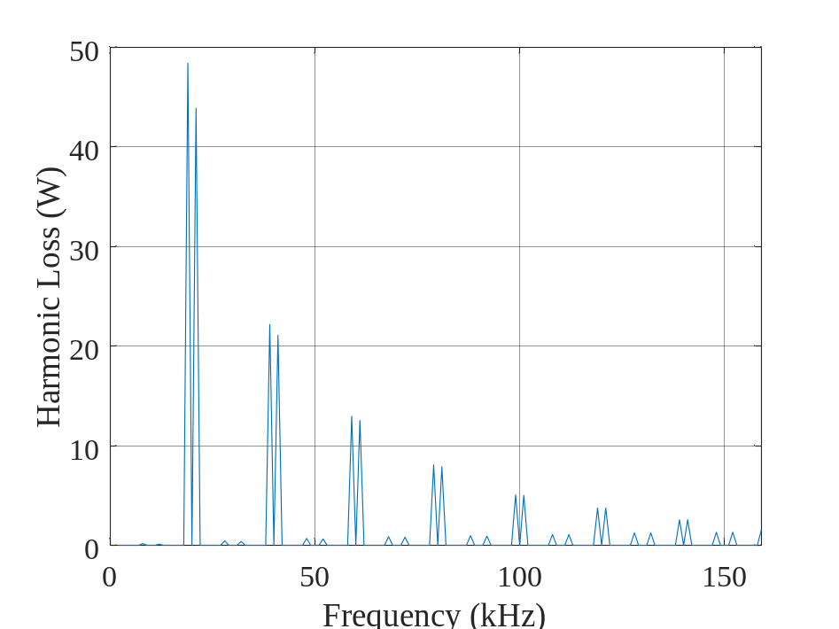
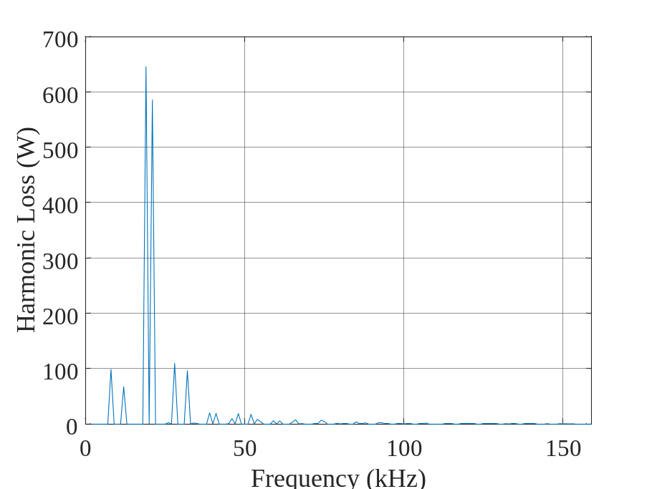
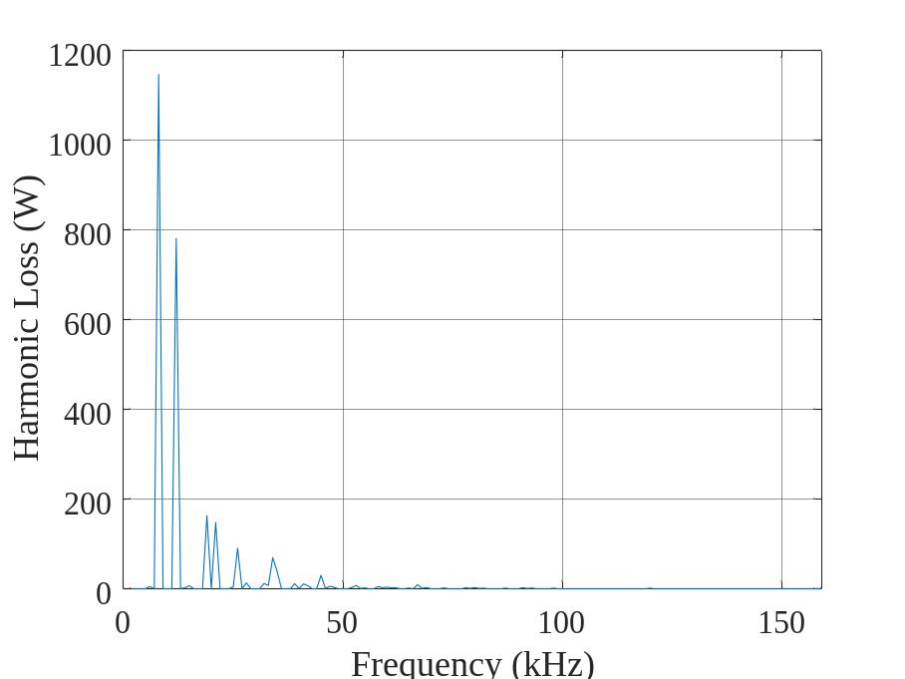
M=0.1
fsw=10kHz
Total Harmonic Loss=214 W
M=0.5
fsw=10kHz
Total Harmonic Loss=1750 W
M=1
fsw=10kHz
Total Harmonic Loss=2600 W

Slide 2
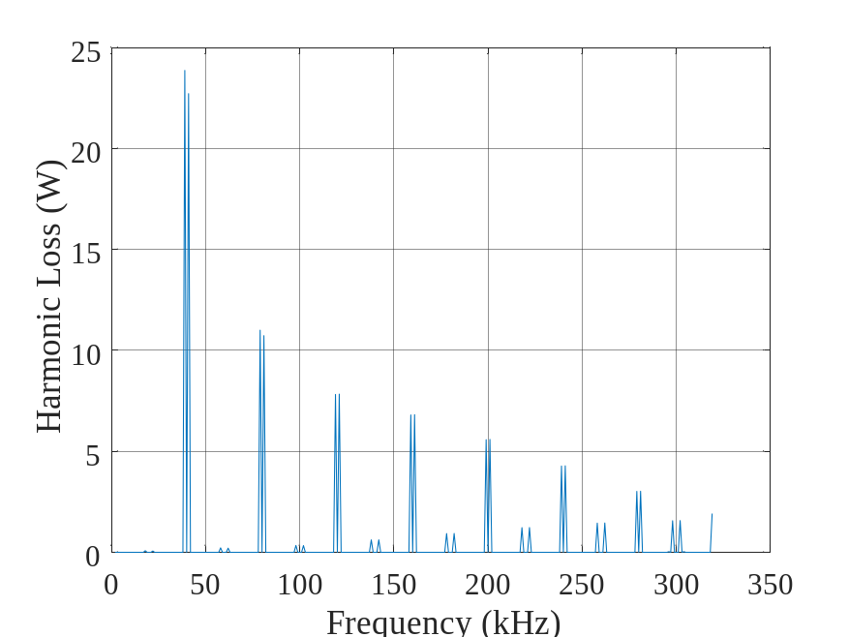
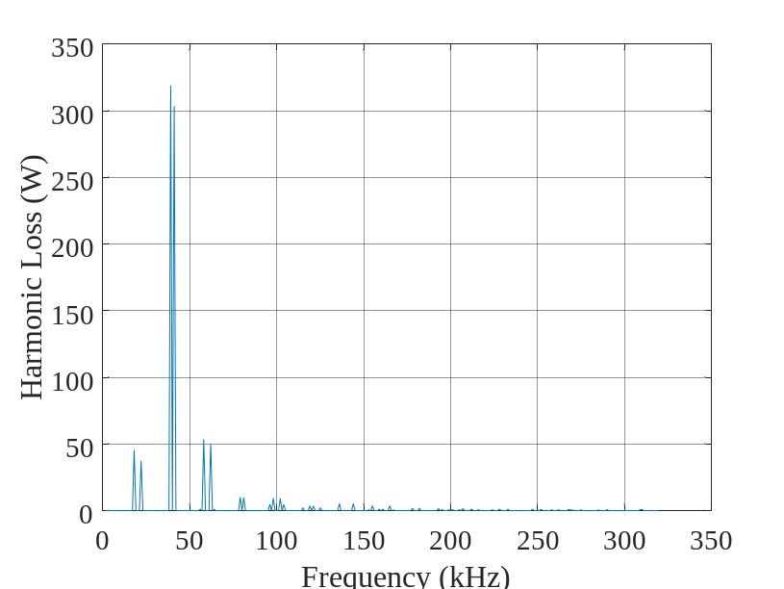
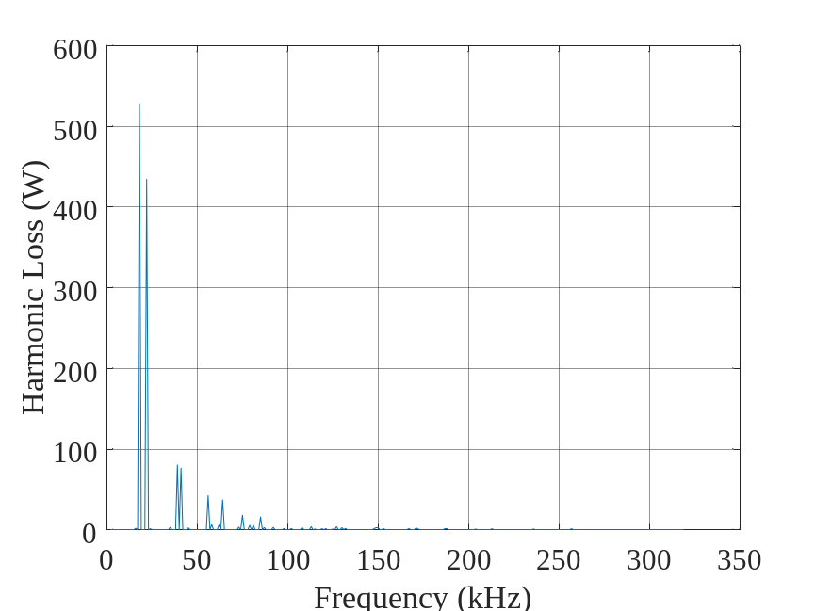
M=0.1
fsw=20kHz
Total Harmonic Loss=140 W
M=0.5
fsw=20kHz
Total Harmonic Loss=925 W
M=1
fsw=20kHz
Total Harmonic Loss=1350 W

Slide 3
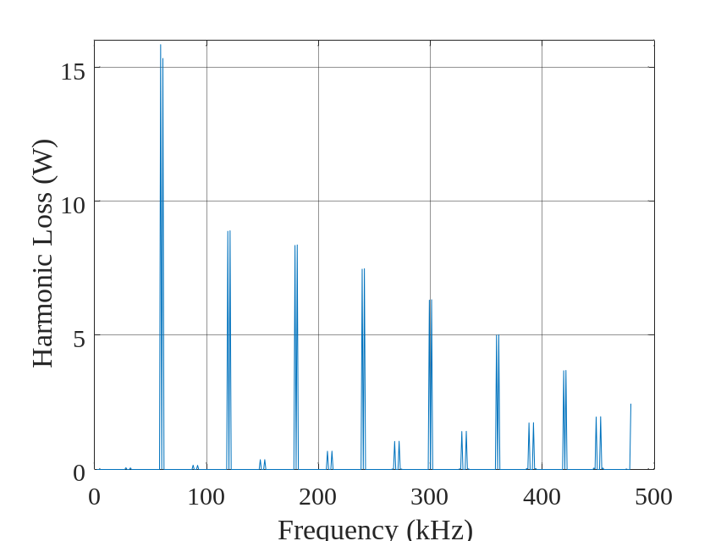
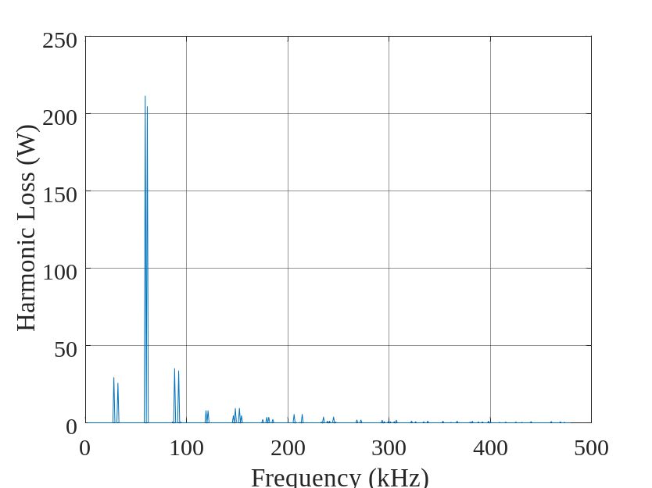
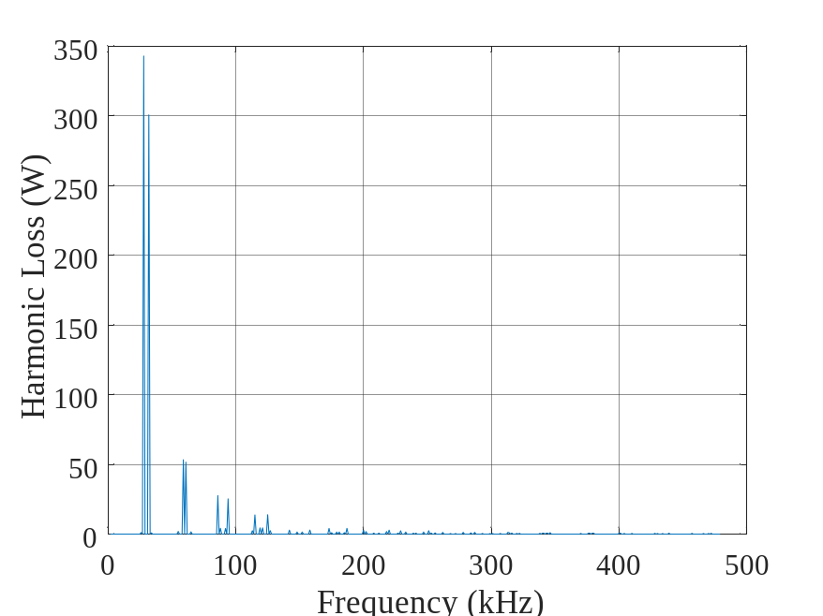
M=0.1
fsw=30kHz
Total Harmonic Loss=120 W
M=0.5
fsw=30kHz
Total Harmonic Loss=660 W
M=1
fsw=30kHz
Total Harmonic Loss=930 W

