Slide 1
Impedance Model of the Motor

Slide 2
m= 1
Fsw= 10kHz
Fsw (kHz) | 10 | 20 | 30 | 40
Loss (W) | 960 | 468 | 333 | 270
Decrease factor | 2.06 (2)
 |  | 1.40 (1.5)
 |  |  | 1.23 (1.33)

Slide 3
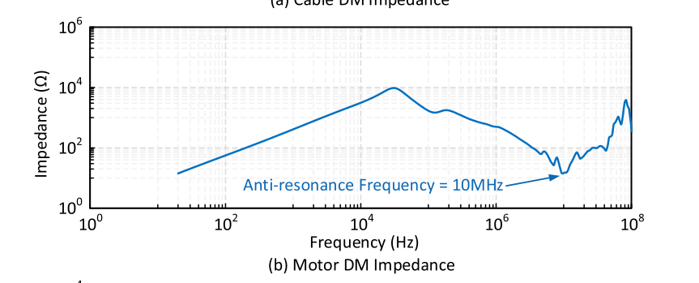
Anti-resonance
Impact of High Switching Speed and High Switching Frequency of Wide-Bandgap Motor Drives on Electric Machines

Slide 4
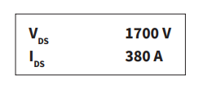
CAS380M17HM3-3ph
Fsw (kHz) | 10 | 15 | 20 | 25
Harmonic Loss (W) | 960 | 618 | 468 | 385
Inverter Loss (W) | 967 | 1131 | 1301 | 1471
Total Loss (W) | 1927 | 1749 | 1769 | 1856

Slide 5
CAS380M17HM3-3ph

