Slide 1










3-phase SPWM Waveforms
A
C
B
$$\frac{D_{C}T_{s }}{2}$$
CMV
$$D_{A}T_{s}$$
$$\frac{D_{C}T_{s }}{2}$$
$$\frac{{(D}_{A}−D_{C})T_{s }}{2}$$
$$D_{B}T_{s}$$
$$\frac{{(D}_{A}−D_{C})T_{s }}{2}$$
$$\frac{{(D}_{B}−D_{A})T_{s }}{2}$$
$$\frac{{(D}_{B}−D_{A})T_{s }}{2}$$
$$D_{C}T_{s}$$
$$\frac{{(1−D}_{B})T_{s }}{2}$$

Slide 2




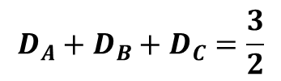

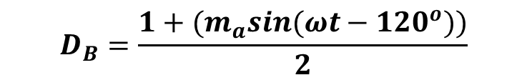

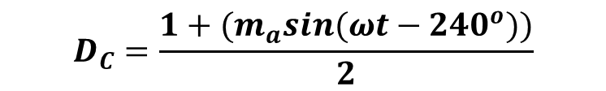
3-phase CMV elimination
Turn-off
Turn-on
$$D_{A}T_{s}$$
Case 1
Turn-on
Turn-off
$$D_{A}+D_{B}+D_{C}=1$$
$$D_{B}T_{s}$$
Turn-on
Turn-off
$$D_{C}T_{s}$$
$$D_{A}=\frac{1+{(m}_{a}sin\left(ωt\right))}{2}$$
Case 2
$$D_{A}+D_{B}+D_{C}=2$$
$$D_{B}=\frac{1+{(m}_{a}sin(ωt−120^{o}))}{2}$$
$$D_{C}=\frac{1+{(m}_{a}sin(ωt−240^{o}))}{2}$$
$$D_{A}+D_{B}+D_{C}=\frac{3}{2}$$

Slide 3
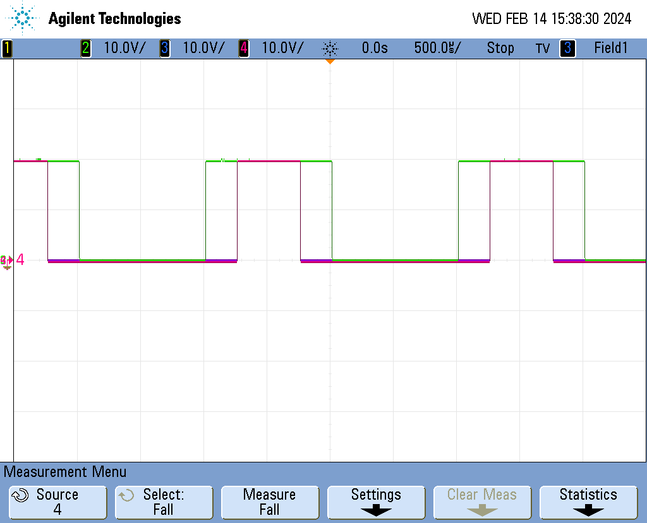
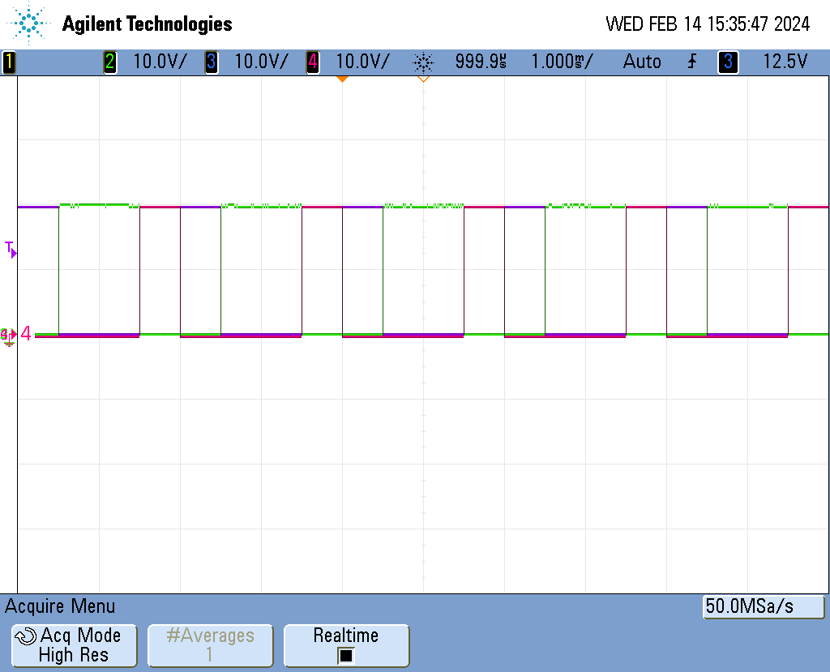

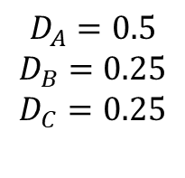
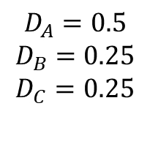
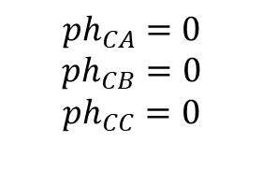

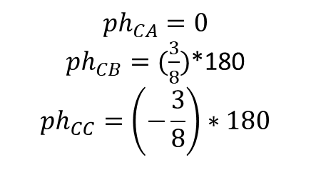
Case 1
$$D_{A}=0.5$$
$$D_{B}=0.25$$
$$D_{C}=0.25$$
$${ph}_{CA}=0$$
$${ph}_{CB}=0$$
$${ph}_{CC}=0$$
$D_{A}$+$D_{B}$+$D_{C}$= 1
$${ph}_{CA}=0$$
${ph}_{CB}=(\frac{3}{8})$*180
$${ph}_{CC}=\left(−\frac{3}{8}\right)∗180$$
$$D_{A}=0.5$$
$$D_{B}=0.25$$
$$D_{C}=0.25$$
$D_{A}$+$D_{B}$+$D_{C}$= 1

Slide 4
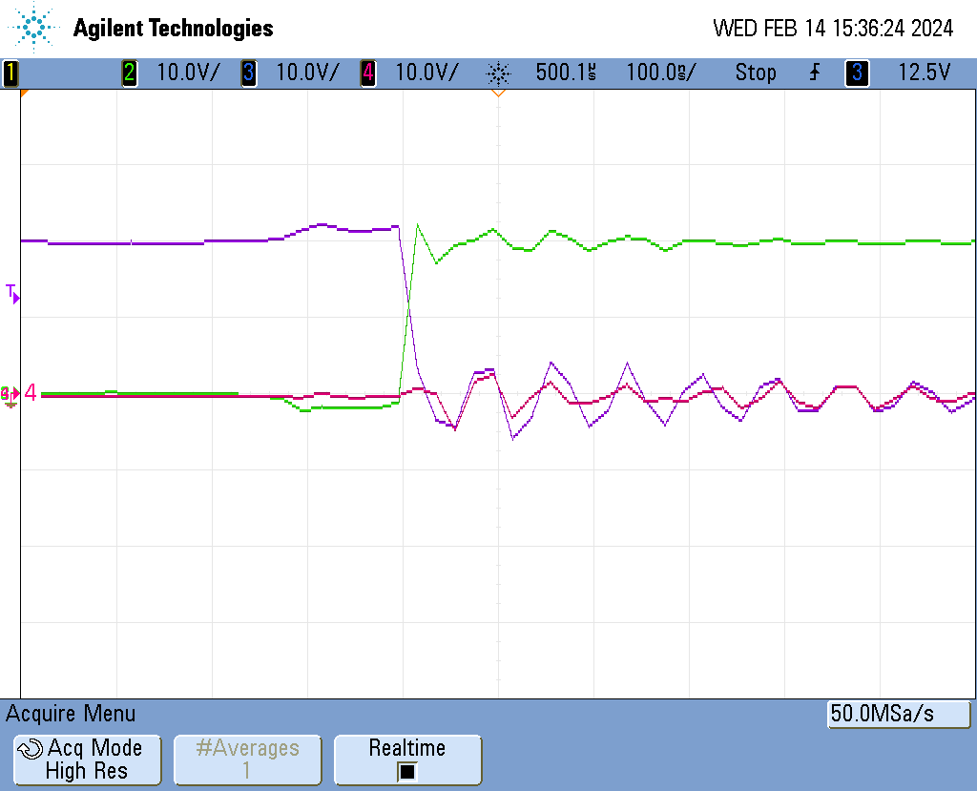
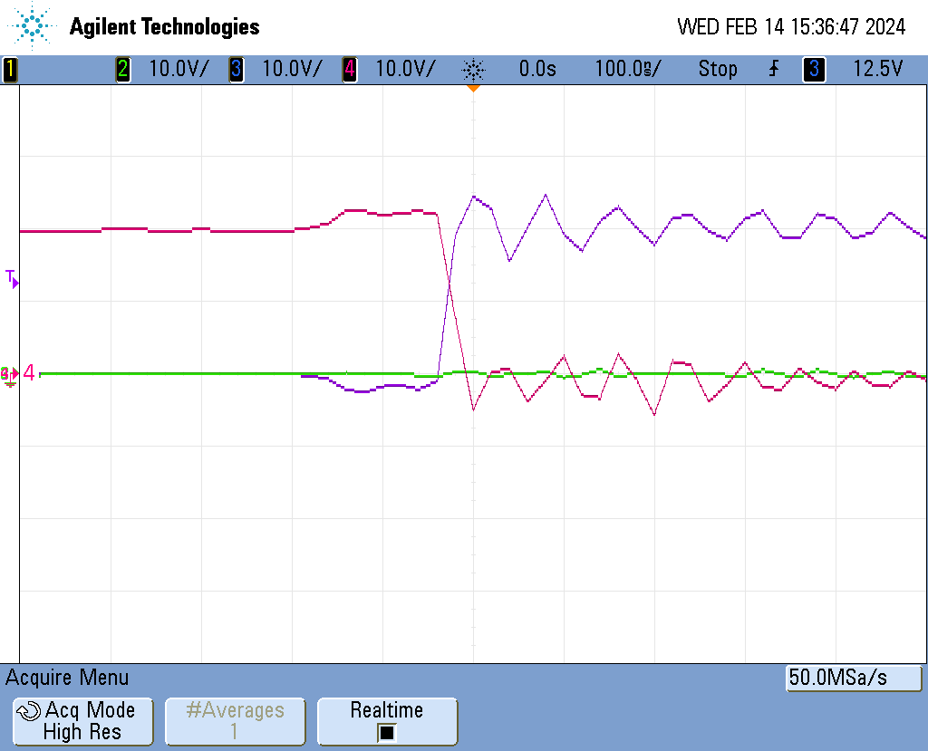
Case 1
Aligned signals

Slide 5
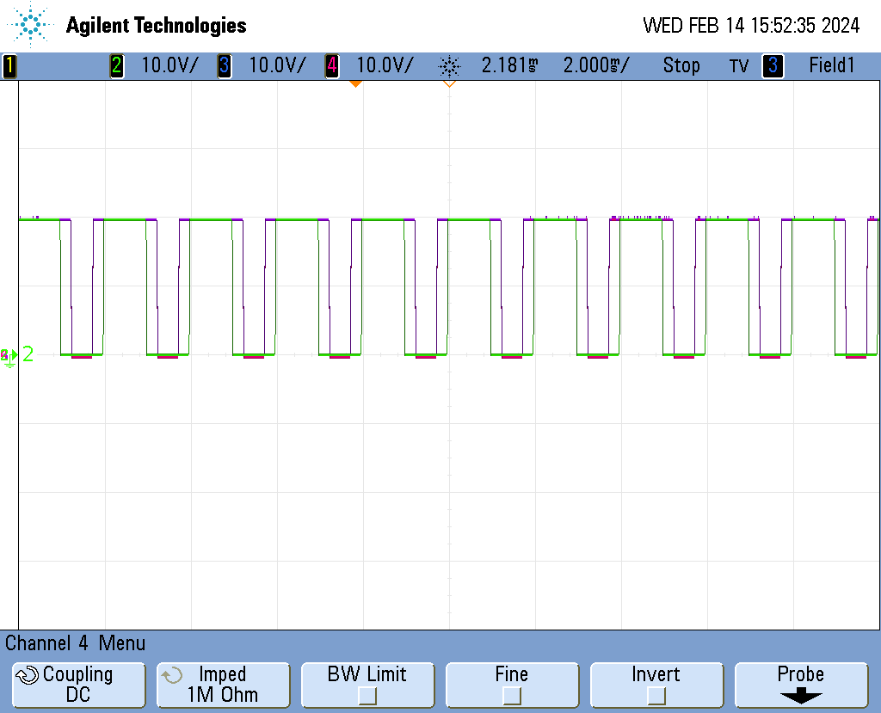
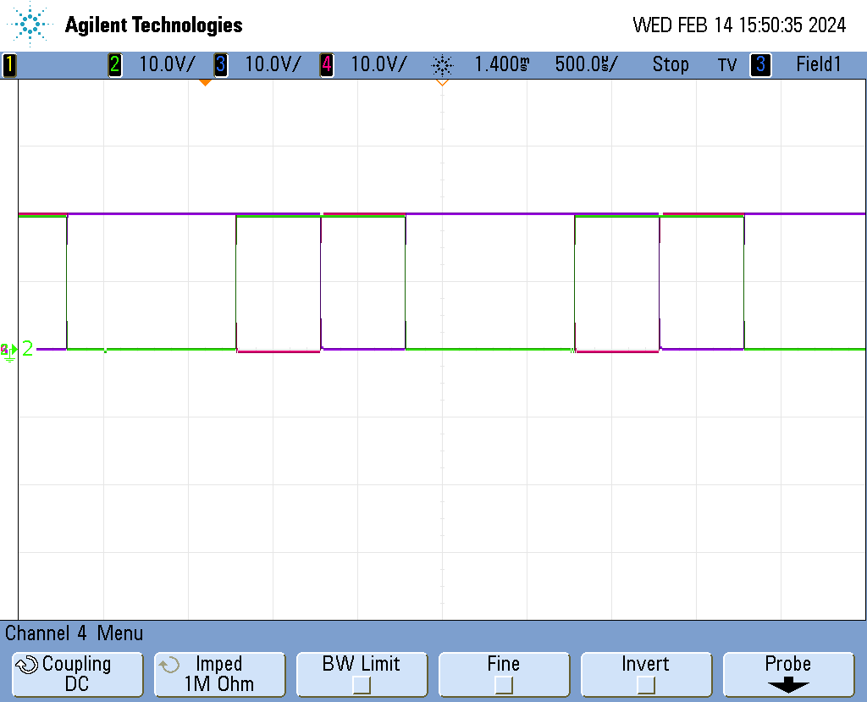

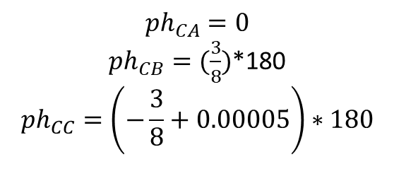
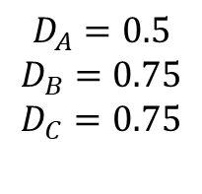

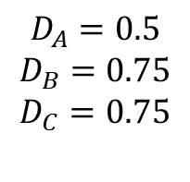
Case 2
$$D_{A}=0.5$$
$$D_{B}=0.75$$
$$D_{C}=0.75$$
$${ph}_{CA}=0$$
$${ph}_{CB}=0$$
$${ph}_{CC}=0$$
$D_{A}$+$D_{B}$+$D_{C}$= 2
$${ph}_{CA}=0$$
${ph}_{CB}=(\frac{3}{8})$*180
$${ph}_{CC}=\left(−\frac{3}{8}+0.00005\right)∗180$$
$$D_{A}=0.5$$
$$D_{B}=0.75$$
$$D_{C}=0.75$$
$D_{A}$+$D_{B}$+$D_{C}$= 2

Slide 6
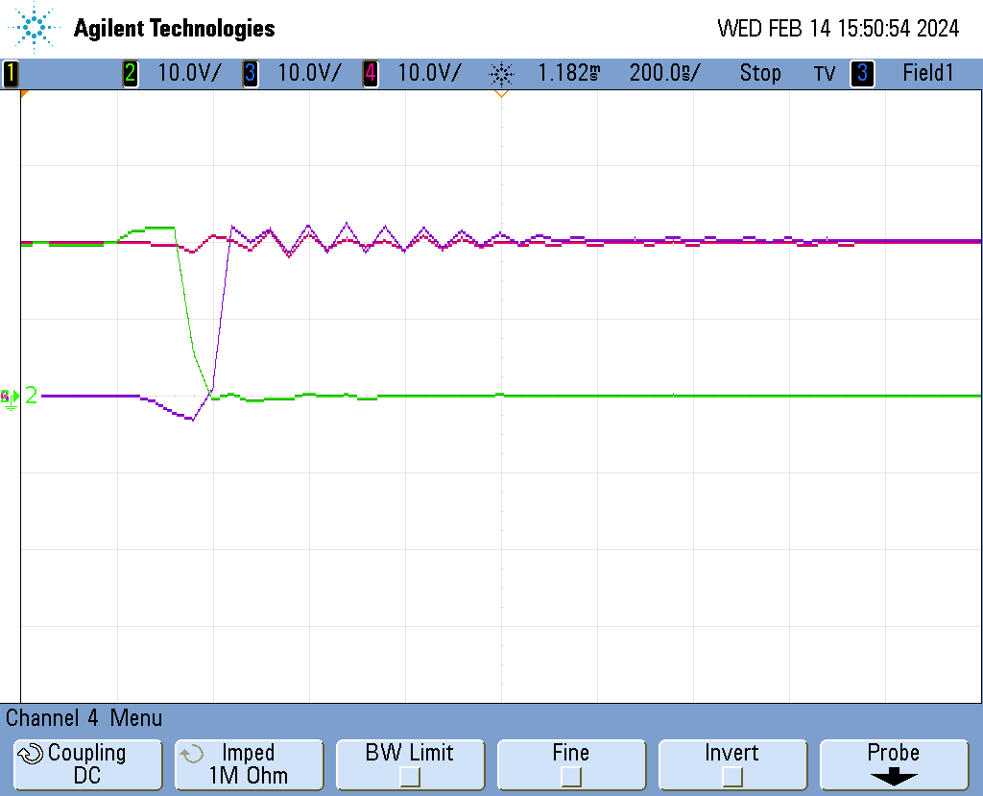
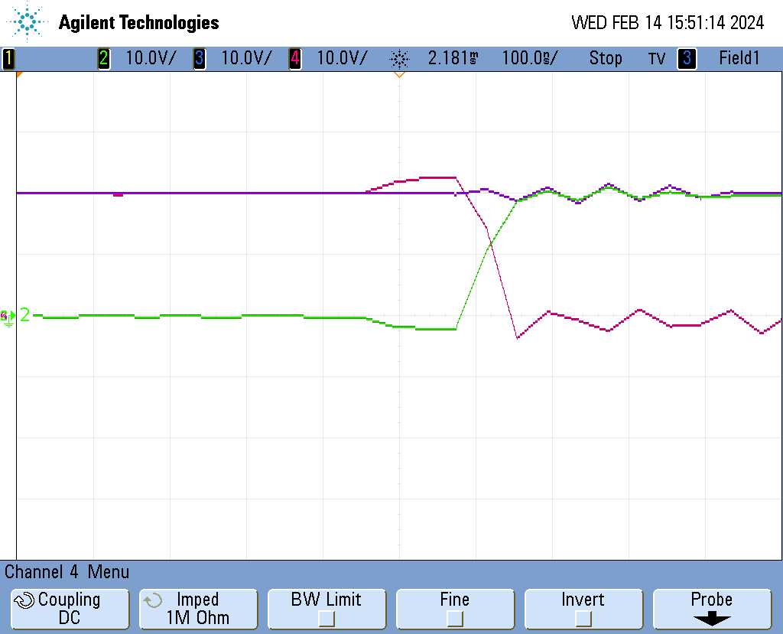
Case 2
Aligned signals

