Slide 1
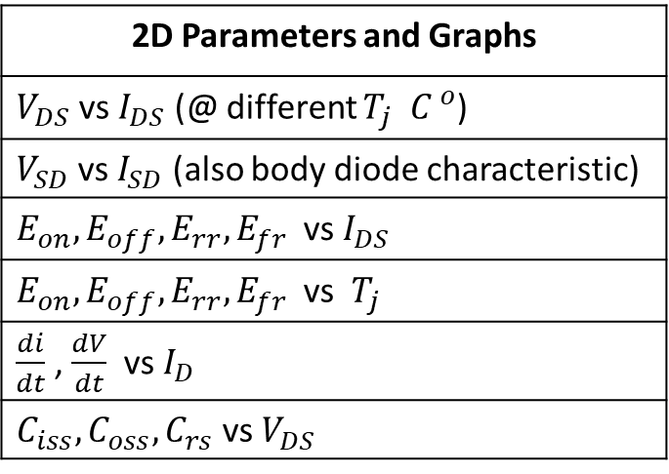
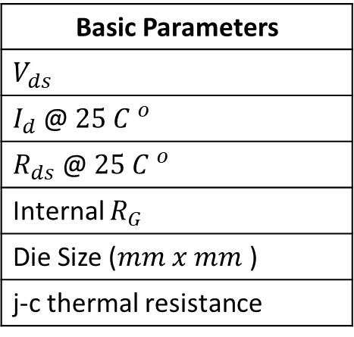
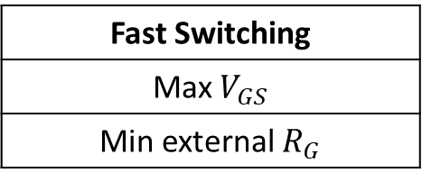
Single Bare Die Parameters with 62mm power module and TO-247PLUS-4-HCC package
Basic Parameters
$V_{ds}$
$I_{d}$@ $25 {C }^{o}$
$R_{ds}$ @ $25 {C }^{o}$
Internal $R_{G}$
Die Size ($mm x mm$)
j-c thermal resistance
2D Parameters and Graphs
$V_{DS}$ vs $I_{DS}$ (@ different $T_{j} {C }^{o}$)
$V_{SD}$ vs $I_{SD}$ (also body diode characteristic)
$E_{on}, E_{off}, E_{rr}, E_{fr}$vs $I_{DS}$
$E_{on}, E_{off}, E_{rr}, E_{fr}$vs $T_{j}$
$\frac{di}{dt}$ , $\frac{dV}{dt}$ vs $I_{D}$
$C_{iss}, C_{oss}, C_{rs}$ vs $V_{DS}$
Fast Switching
Max $V_{GS}$
Min external $R_{G}$

Slide 2
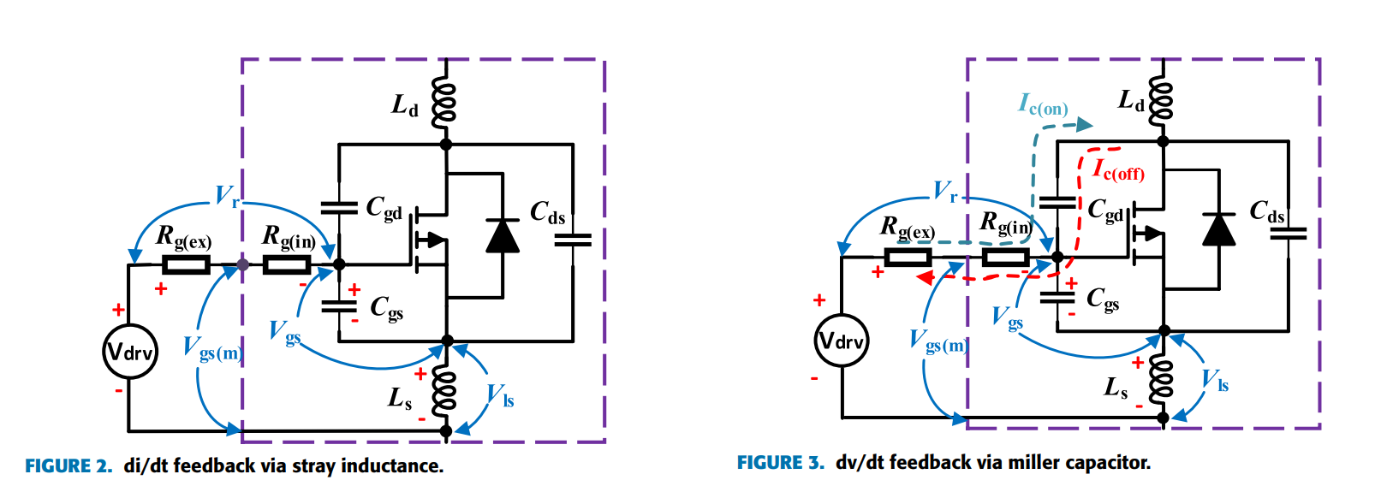
Package dependent
Single Bare Die
Double Dies
Triple Dies
To investigate the conduction and switching losses vs die area
To investigate the distortive effect of the package on the losses
400 A (290 A 3-phase)
200 A (145 A 6-phase)
With fast switching

Slide 3
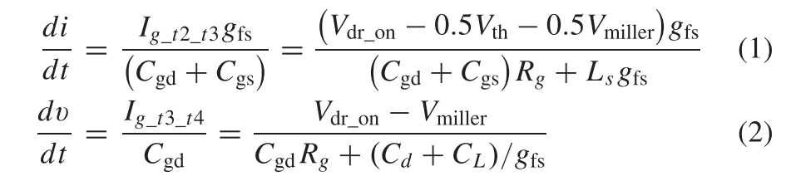
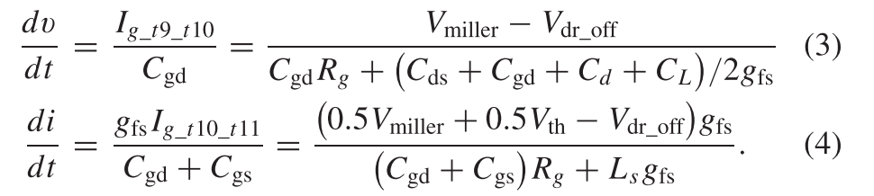
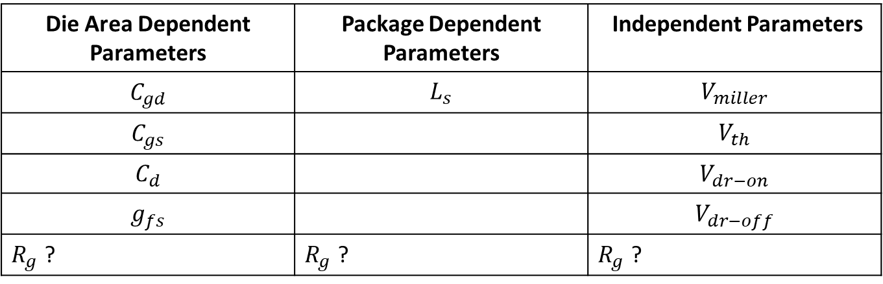
Die Area Dependent Parameters | Package Dependent Parameters | Independent Parameters
$$C_{gd}$$ | $$L_{s}$$ | $$V_{miller}$$
$$C_{gs}$$ |  | $$V_{th}$$
$$C_{d}$$ |  | $$V_{dr−on}$$
$$g_{fs}$$ |  | $$V_{dr−off}$$
$R_{g}$ ? | $R_{g}$ ? | $R_{g}$ ?

Slide 4
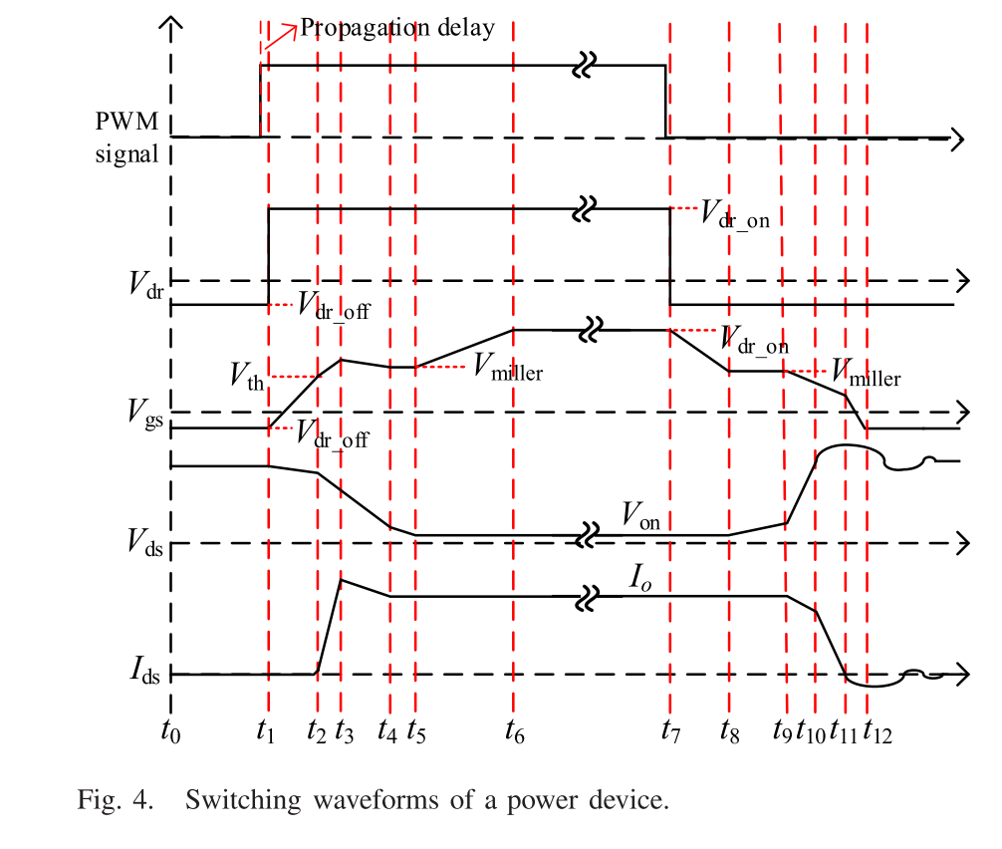

Slide 5
Turn -on
Turn -off
-100 ns deskewing
11 ns deskewing
11 ns deskewing
-100 ns deskewing
Current
Voltage

Slide 6
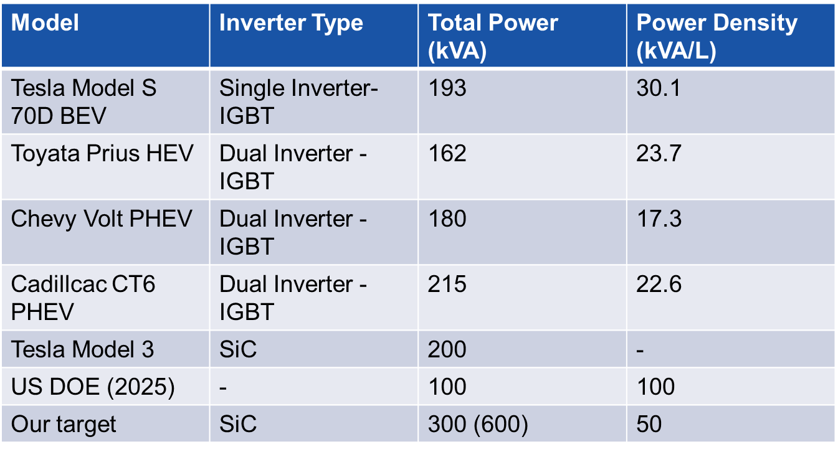
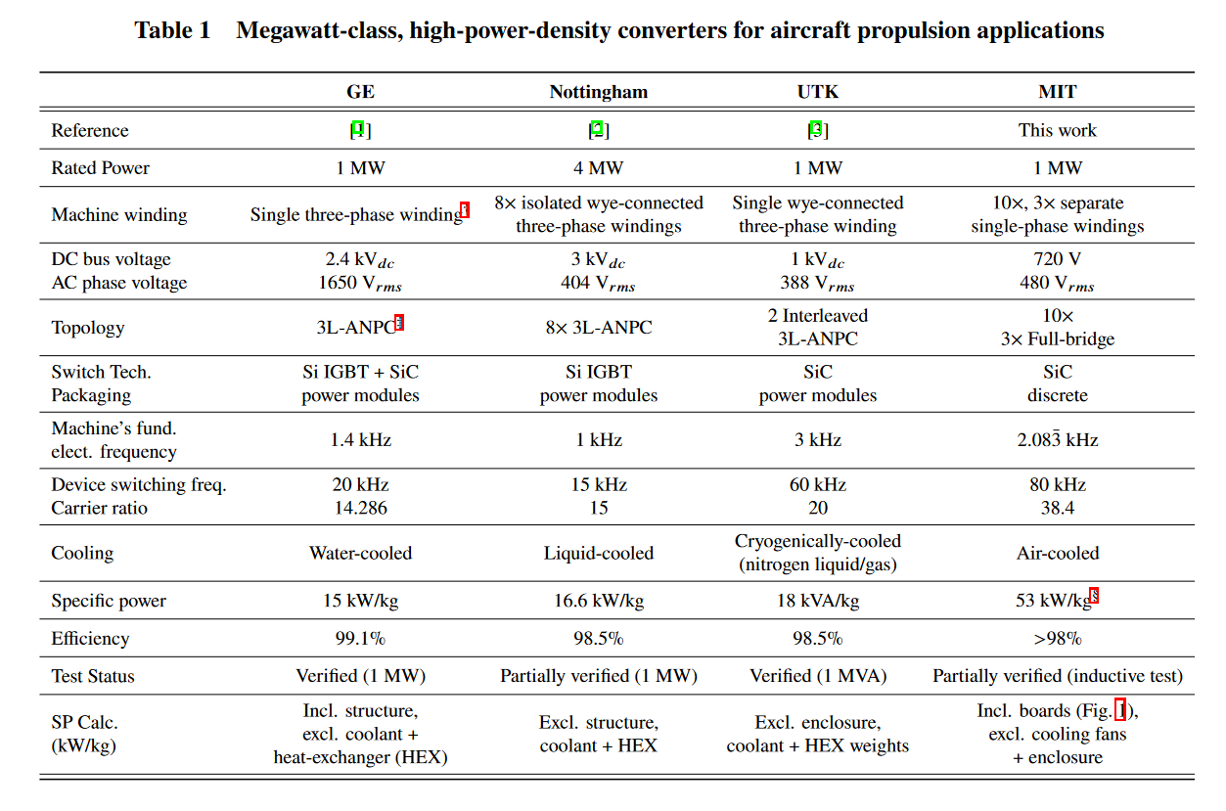
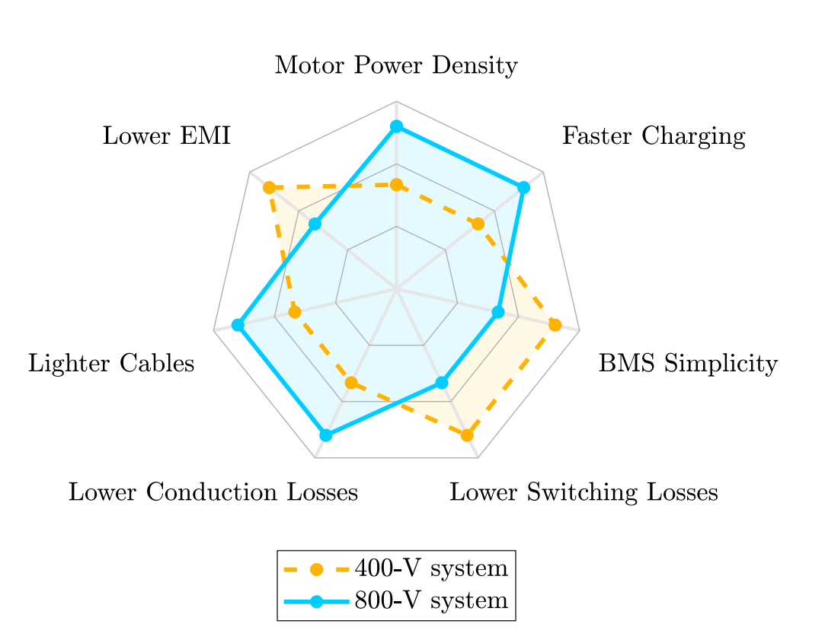

Outline: Evaluation of Traction Inverter Topologies for High-Duty Electric Truck
Literature Review:
  Traction Inverters:
      Automotive,
      Aerospace because of ratings
  Key Requirements for High-Duty Electric Trucks:
      Power requirements
      High voltage, fast charge
  Existing Traction Inverter Topologies

Slide 7
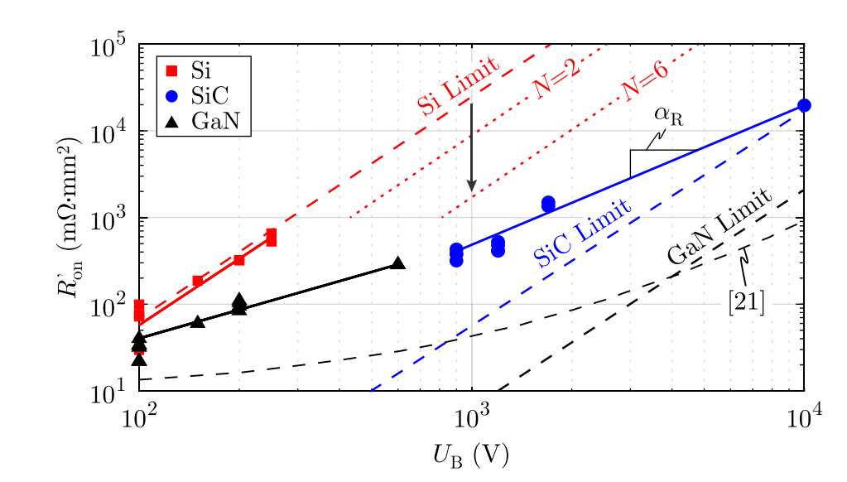
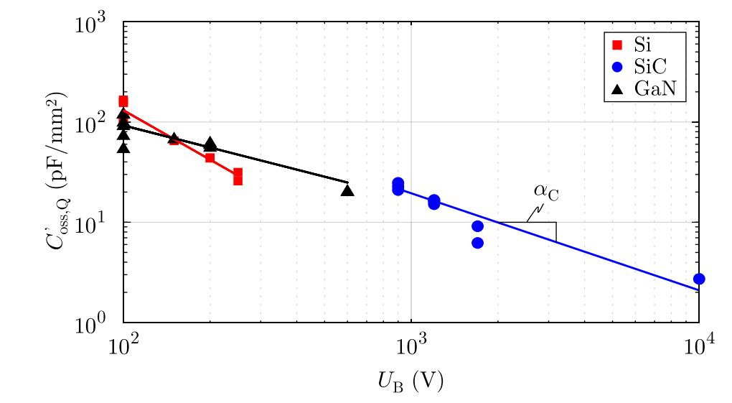
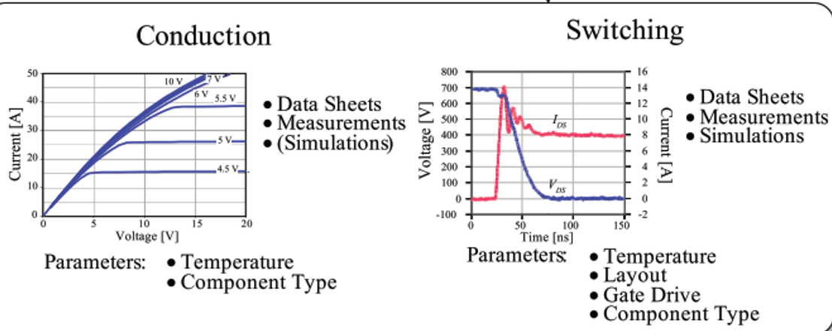
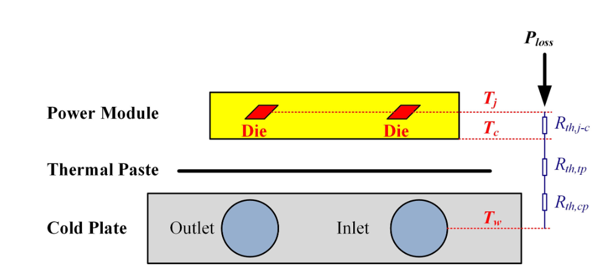
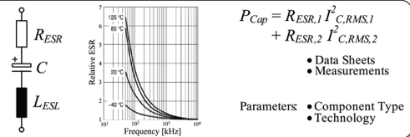

Virtual Prototyping and Modelling:
Figure-of-Merit SiC devices:
      rds
      switching loss
Probable Topology Selection and Current-Voltage Waveforms:
      2-level 3-phase
      3-level 3-phase
      2-level 6-phase
Loss Modelling
      Semiconductor Loss
      Thermal Model
      Capacitor Modelling

Slide 8
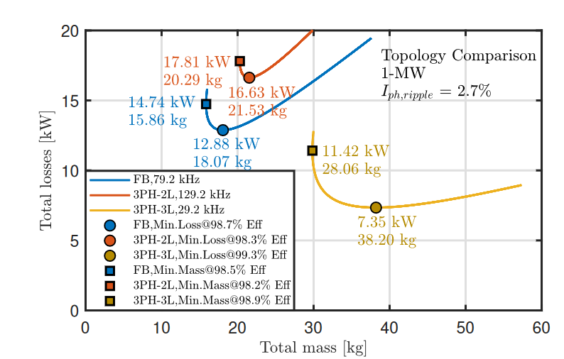
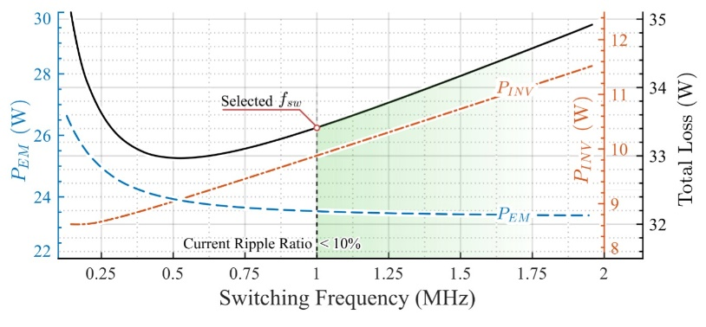
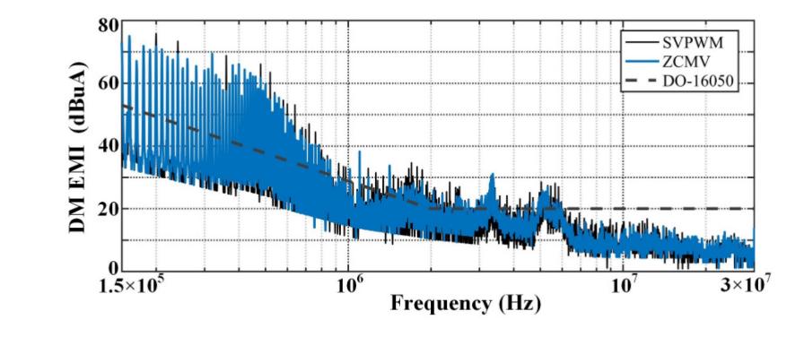
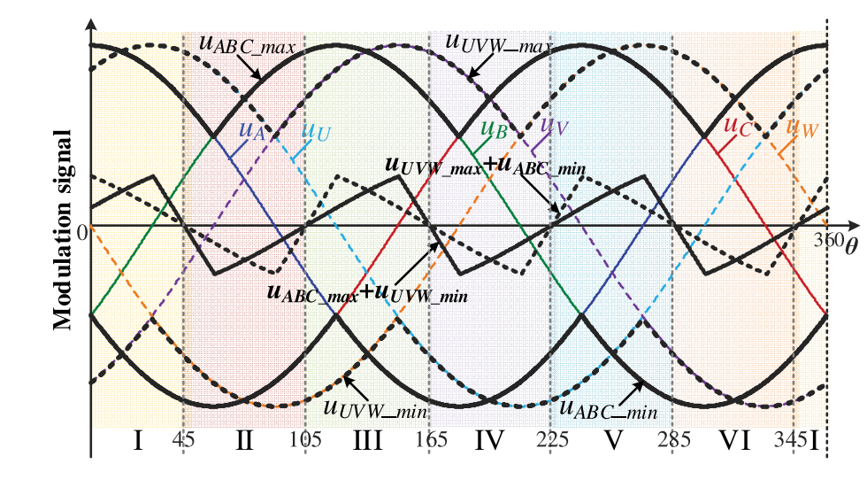
Performance Evaluation:
Loss and Size Comparison
Output Harmonics and Possible Motor Losses
Common Mode Voltage and Bearing Current
  PWM methodologies

Slide 9
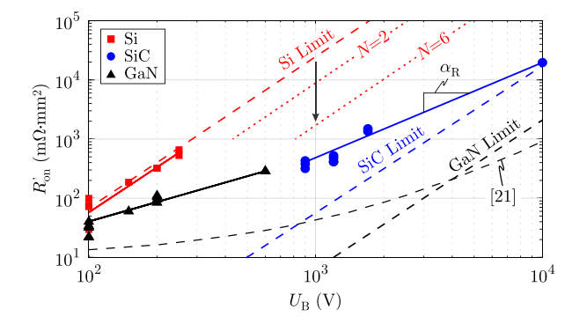

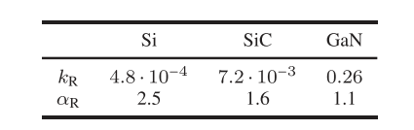
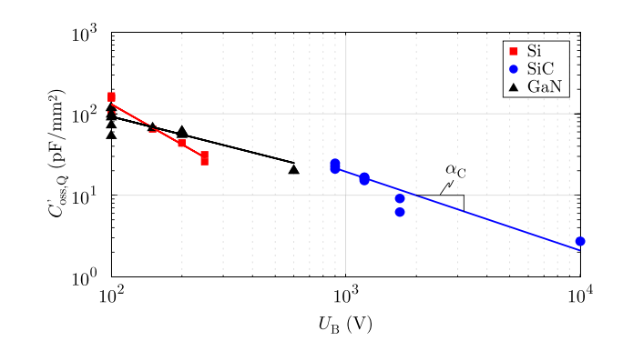

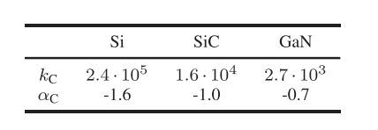
Virtual Prototyping
Conduction Loss
Zero Current Switching Loss

Slide 10
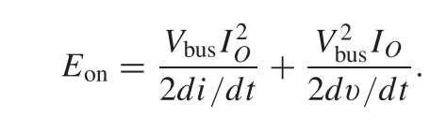
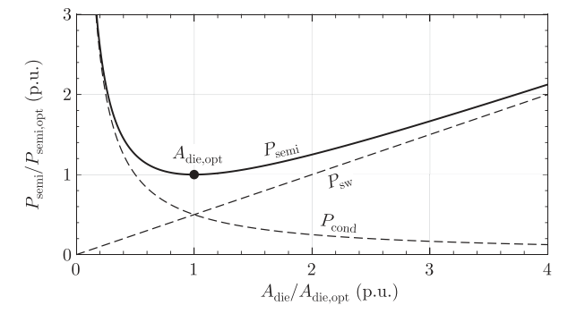
Virtual Prototyping
Switching Loss – dv/dt and di/dt
2-level loss-minimized
optimal semiconductor die area

