Slide 1
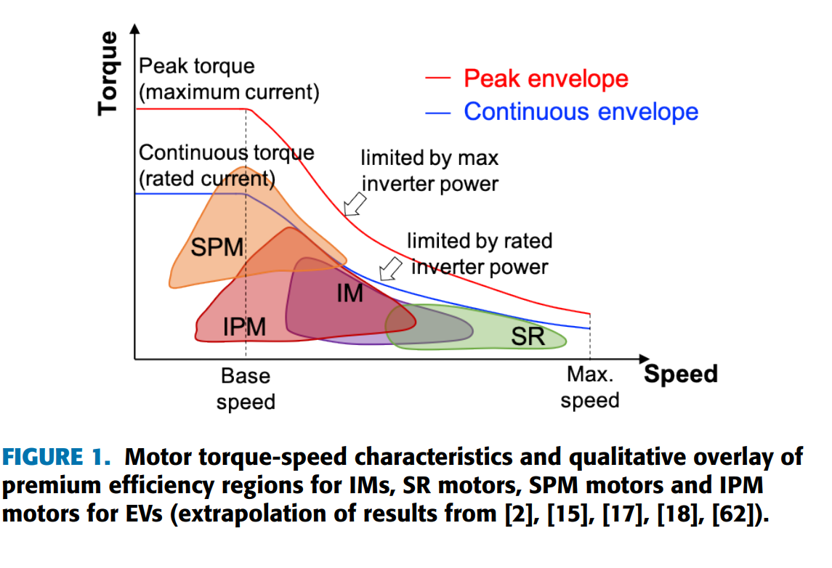
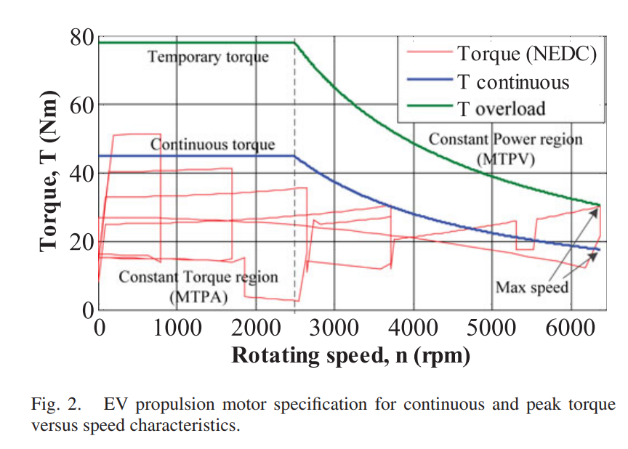
Torque-Speed Characteristics in Electric Trucks
Motoring Mode:
Starting/Initial Acceleration (High Torque, Lower Speed):
  Initiate motion from a standstill.
  Requires effective acceleration and overcoming inertia.
Normal Operation (Moderate Torque, Variable Speed):
  It delivers enough torque to maintain speed and handle typical loads efficiently.
Hill Climbing/Heavy Load Conditions (High Torque, Low Speed):
  Requires higher torque to counteract gravity or the added weight.
  Speed might decrease as torque increases to maintain power.
Cruising/Constant Speed (Balanced Torque and Speed):
  During steady-state driving on flat roads or at a constant speed,
  Optimizing energy efficiency.
Max Speed Capability (Lower Torque, High Speed):
  Reduced torque to achieve and sustain higher velocities.
Regenerative Braking/Deaceleration?
*[1]
*[2]

Slide 2
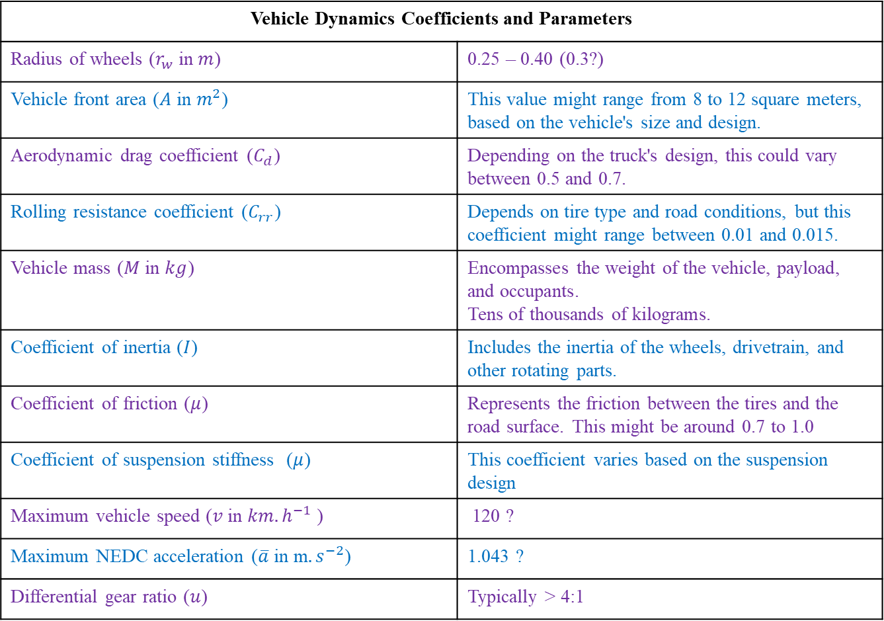
Torque Calculation via Vehicle Dynamics
Vehicle Dynamics Coefficients and Parameters
Radius of wheels ($r_{w}$ in $m$) | 0.25 – 0.40 (0.3?)
Vehicle front area ($A$ in $m^{2}$) | This value might range from 8 to 12 square meters, based on the vehicle's size and design.
Aerodynamic drag coefficient ($C_{d}$) | Depending on the truck's design, this could vary between 0.5 and 0.7.
Rolling resistance coefficient ($C_{rr}$) | Depends on tire type and road conditions, but this coefficient might range between 0.01 and 0.015.
Vehicle mass ($M$ in $kg$) | Encompasses the weight of the vehicle, payload, and occupants. Tens of thousands of kilograms.
Coefficient of inertia ($I$) | Includes the inertia of the wheels, drivetrain, and other rotating parts.
Coefficient of friction ($μ$) | Represents the friction between the tires and the road surface. This might be around 0.7 to 1.0
Coefficient of suspension stiffness ($μ$) | This coefficient varies based on the suspension design
Maximum vehicle speed ($v$ in $km. h^{−1}$ ) | 120 ?
Maximum NEDC acceleration ($\overline{a}$ in m$. s^{−2}$) | 1.043 ?
Differential gear ratio ($u$) | Typically > 4:1
*[2]

Slide 3
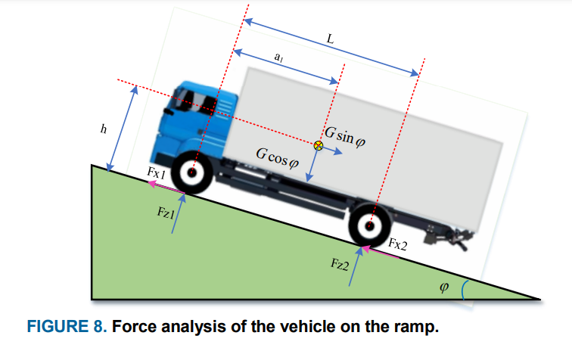






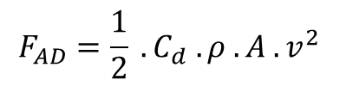

Total Tractive Force= Rolling Resistance + Aerodynamic Drag + Gradient Force + Acceleration Force
$$F_{TTF}=F_{RR}+F_{AD}+F_{G}+F_{A}$$
$$F_{RR}=C_{rr} . M .g cos⁡(θ)$$
$$F_{AD}=\frac{1}{2} . C_{d} . ρ . A .v^{2}$$
$ρ$ = density of air
$$F_{G}=M . g . sin⁡(θ)$$
$θ$= uphill or downhill slopes angle
$$F_{A}=M .\overline{a}$$
*[3]
$$T_{EM}=F_{TTF} .\frac{r}{u}$$

Slide 4
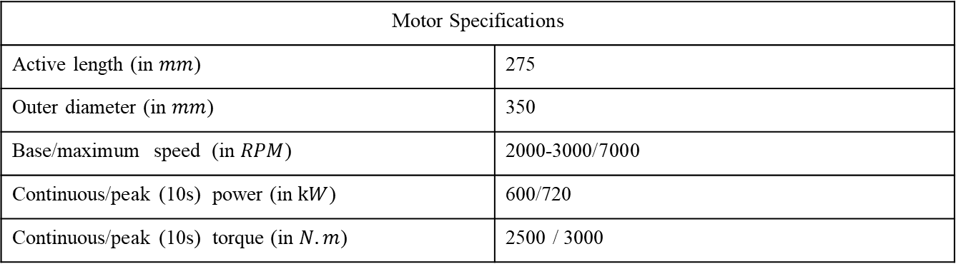
Motor Specifications
Motor Specifications
Active length (in $mm$) | 275
Outer diameter (in $mm$) | 350
Base/maximum speed (in $RPM$) | 2000-3000/7000
Continuous/peak (10s) power (in $kW$) | 600/720
Continuous/peak (10s) torque (in $N.m$) | 2500 / 3000
We did not apply the vehicle dynamics to find them, Scania just gave them !!!
Here we do not know the gear ratio, therefore can we change the torque and speed requirements?
Considerations for Heavy Trucks
High Torque at Low Speeds: Heavy-duty trucks often require high torque for initial acceleration and while climbing steep gradients with heavy loads.
Durability and Reliability: Motors should be designed to withstand continuous heavy usage, varied terrains, and adverse environmental conditions.
Efficiency and Energy Recovery: Motors capable of regenerative braking can help recover energy during braking, enhancing overall efficiency.
Maintenance and Serviceability: Motors should be designed for ease of maintenance and servicing to minimize downtime.

Slide 5
Current Types of EMs
1. Permanent Magnet Synchronous Motor (PMSM):
Providing high-speed capabilities, especially beneficial for cruising, maintaining higher speeds on highways, and offering good efficiency during constant-speed operations.
  Advantages: Offering excellent controllability, and efficiency at higher speeds.
  Considerations: Facing demagnetization issues due to high currents at low speeds or during high torque demands.
2. Induction Motor:
Having strong torque output at lower speeds complements the requirements.
  Advantages: Induction motors have robust torque capabilities at low speeds, making them well-suited for heavy-load scenarios.
  Considerations: They might lack the high-speed capabilities of PMSM motors. Fixed-speed nature might limit their widespread adoption without additional control systems.
3. Permanent Magnet Assisted Synchronous Reluctance Motors:
Can be designed to provide high torque even at low speeds, making them suitable for heavy-load applications at lower speeds.
  Advantages: With their combined reluctance and permanent magnet design, might mitigate some risks of demagnetization at high currents or low speeds.
  Considerations: Cost, availability, system complexity, and integration challenges.
4. Wound Rotor Synchronous Motors (WRSMs), or Electrically Excited Synchronous Motor (EESMs) :
Allowing for external control of the rotor winding, enabling variable speed and torque control and high torque output, particularly during starting and low-speed operations.
  Advantages: Robustness and ability to handle harsh operating conditions
  Considerations: Needing brushless exciter (with WPT?) and reduced efficiency due to rotor winding (also cooling?).

Slide 6
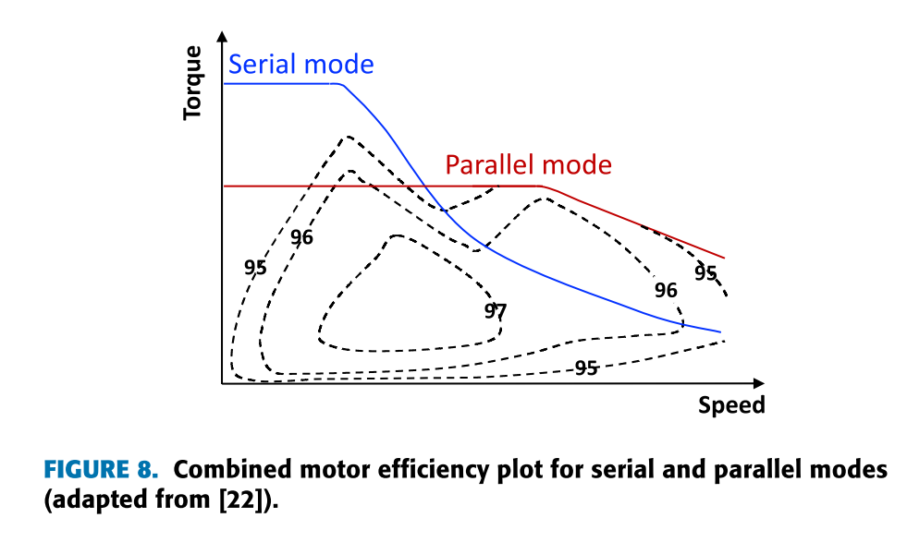
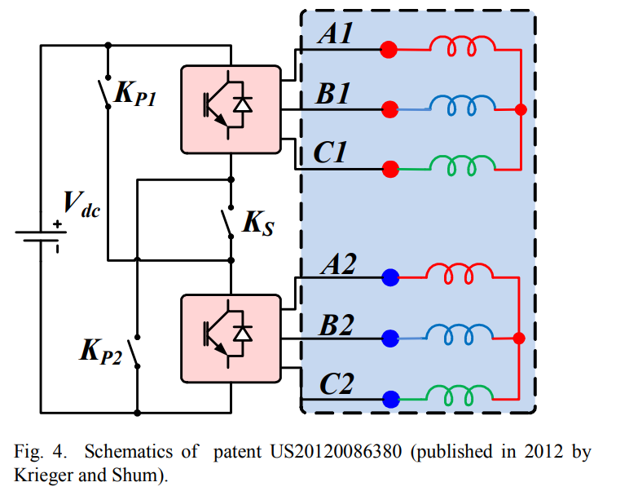
New Types of EMs
STATOR PM MACHINES
FLUX MEMORY MACHINES AND HYBRID EXCITATION MACHINES
MULTIPHASE MACHINES
MAGNETIC GEARED MACHINES
RECONFIGURABLE WINDING MACHINES
*[4]
*[5]

Slide 7
Different Configurations
Single motor
  Coupled with front or rear axle via a differential.
  Constant gear ratio, quite high, is used to reduce motor torque, resulting in lower motor size.
  The electrical motor needs a wide operating speed range.
  The motor should be capable of producing a higher torque, for a short time, in case of an overtaking or a starting from a high ground slope angle.
  We have motor specifications for continuous (rated) and temporary (peak) torque.
To achieve a wide range of speeds, PMSM or EESM is suitable.
PMSM has higher efficiency and is less complex, but demagnetization risk at the starting torque.
EESM has high torque at starting, but rotor cooling is problematic and efficiency is lower.
*[2]

Slide 8
Different Configurations
Dual motor *[6]
  It is practically impossible to optimize based on the whole torque-speed profile and especially when partial loads and overload conditions are considered in the problem formulation. (with inclusion of drive cycle)
  Two propulsion machines, with complimentary torque-speed characteristics, can be coupled to the same shaft via a torque/speed coupler that could be deployed in the EV powertrain.
  A potential merit of using two propulsion machines is the improved powertrain efficiency and effective load power split.
  Another advantage of using two complementary propulsion machines, instead of a single large machine, is that the space under the hood can be effectively utilized.
Permanent Magnet Synchronous Motor (PMSM) for High-Speed Performance:
  Considerations: These motors might face demagnetization issues due to high currents at low speeds or during high torque demands. Therefore, using them for high-speed operations where torque requirements are lower can mitigate this issue.
Induction Motor for High Torque at Low Speeds:
  Considerations: While they might lack the high-speed capabilities of PMSM motors, their strong torque output at lower speeds complements the requirements for heavy-duty trucks during start-up, inclines, and low-speed maneuvers.
Electrically Excited Synchronous Motor (EESMs) :
  Considerations: These motors can provide high torque output, particularly during starting and low-speed operations, making them suitable for heavy-duty applications that demand strong torque at lower speeds.

Slide 9
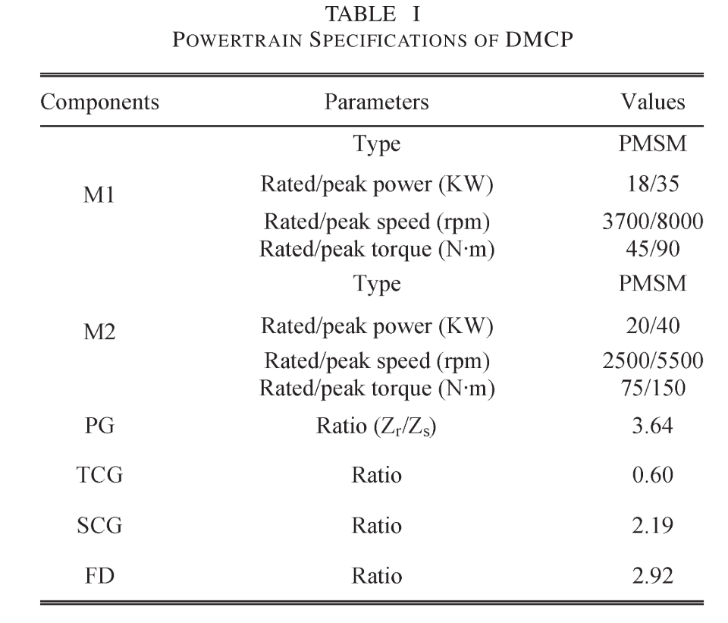
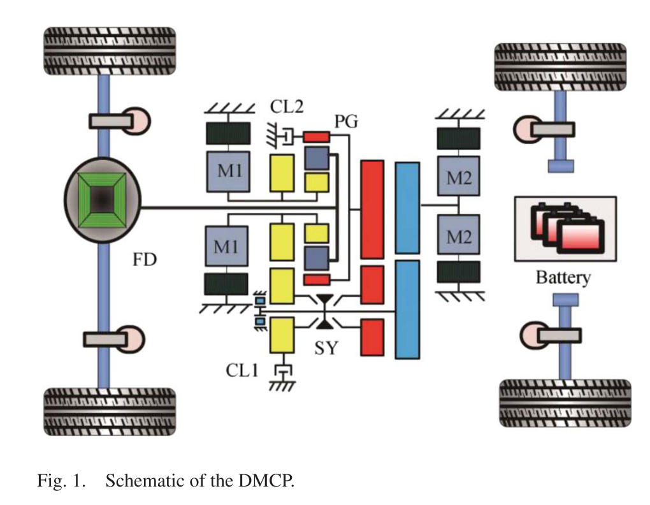
Efficiency Study of a Dual-Motor Coupling EV Powertrain
*[7]
Planetary gear unit couples the speed of two motors
Shaft-fixed gear unit couples the torque of two motors
By the engaging and disengaging of the clutches and setting, can operate in four modes to satisfy the demands of different running conditions, thereby improving the energy utilization efficiency

Slide 10
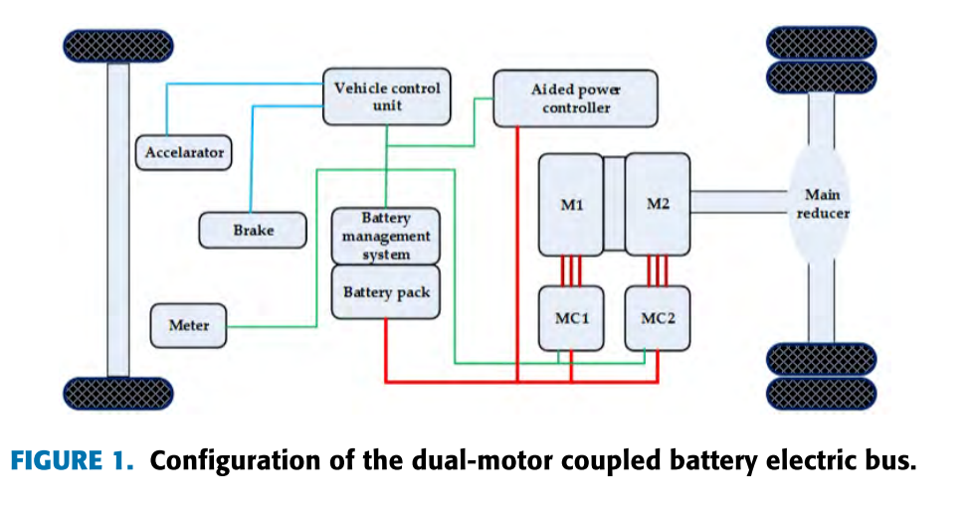
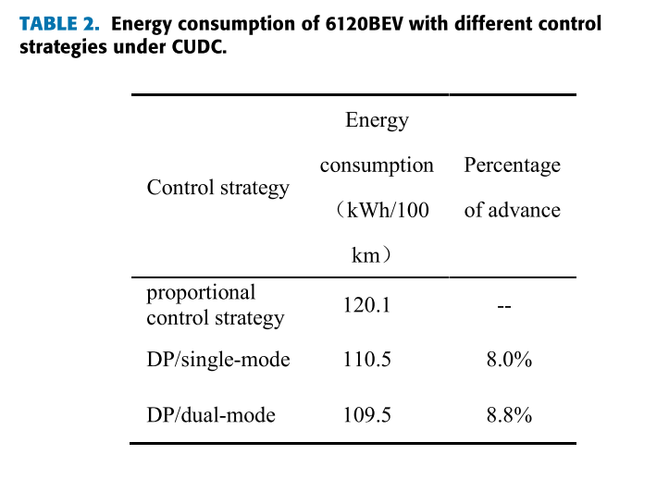
Optimization of a Dual-Motor Coupled Powertrain Energy Management Strategy for a Battery Electric Bus Based on Dynamic Programming Method
*[8]
The torques of the main motor (M1) and the auxiliary motor (M2) are coupled on a common axis.
M1= T= 2100N.m, base speed = 600RPM
M2= T= 900N.m, base speed = 1200RPM

Slide 11
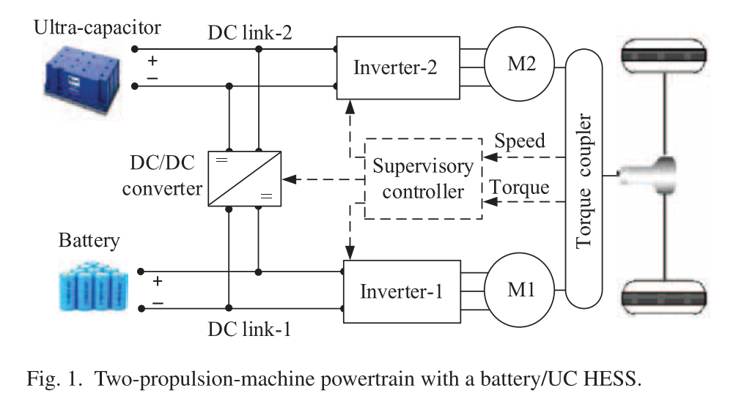
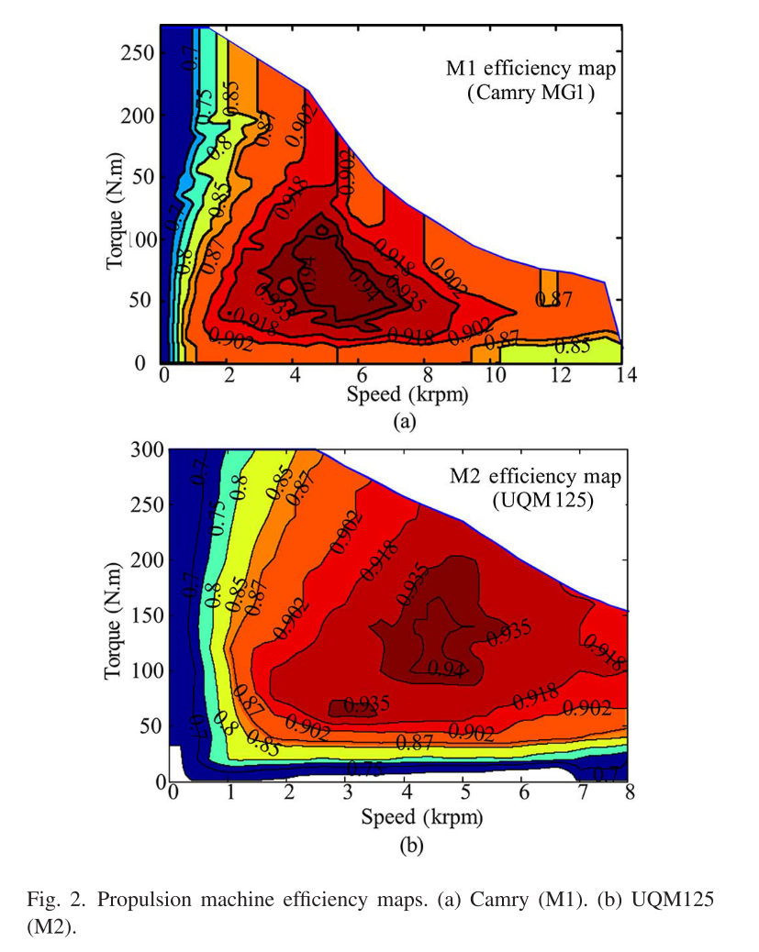
Power Split Control Strategy for an EV Powertrain With Two Propulsion Machines
*[6]
Batteries have relatively high energy density. Ultra-capacitors (UCs), on the other hand, have high power density and excellent instantaneous charging and discharging capabilities.
The M1 can operate at high efficiency under low torques, while M2 operates with high efficiency at high torques, implying the complementary operation features of these two propulsion machines.

Slide 12
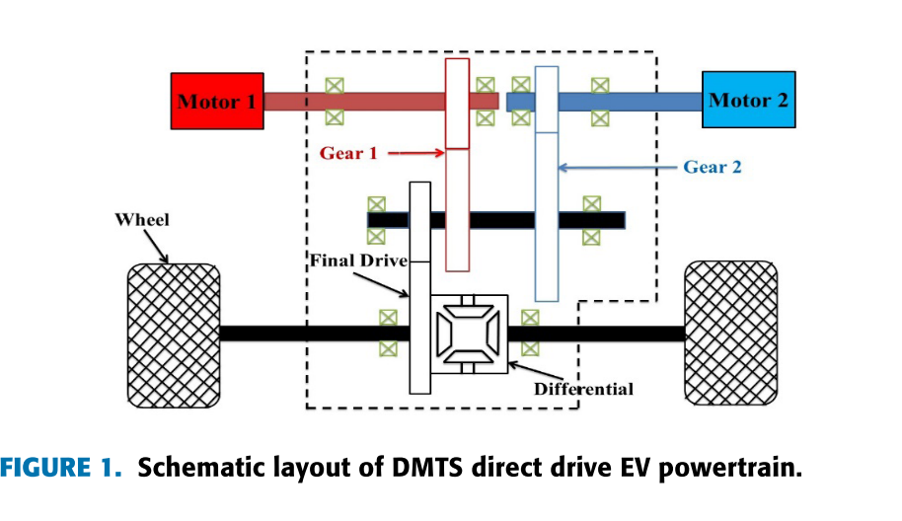
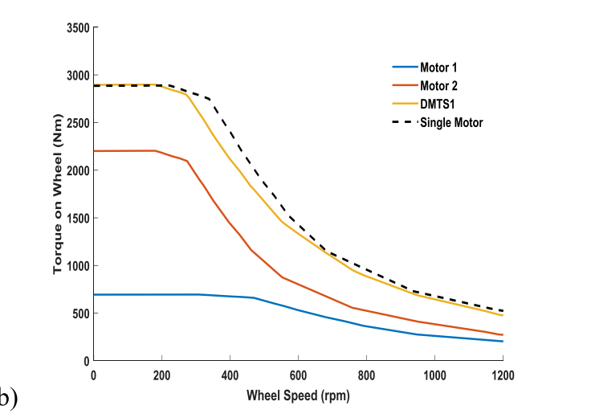
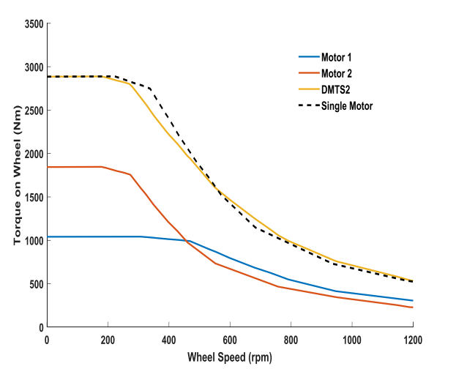
A Novel Dual-Motor Two-Speed Direct Drive Battery Electric Vehicle Drivetrain
*[9]
Two smaller motors with approximate same total output power in this paper to improve overall motor efficiency.
Permanently engaged gear pairs, rather than implicating mechanical shifting actuator, i.e. clutch or synchronizer.

Slide 13
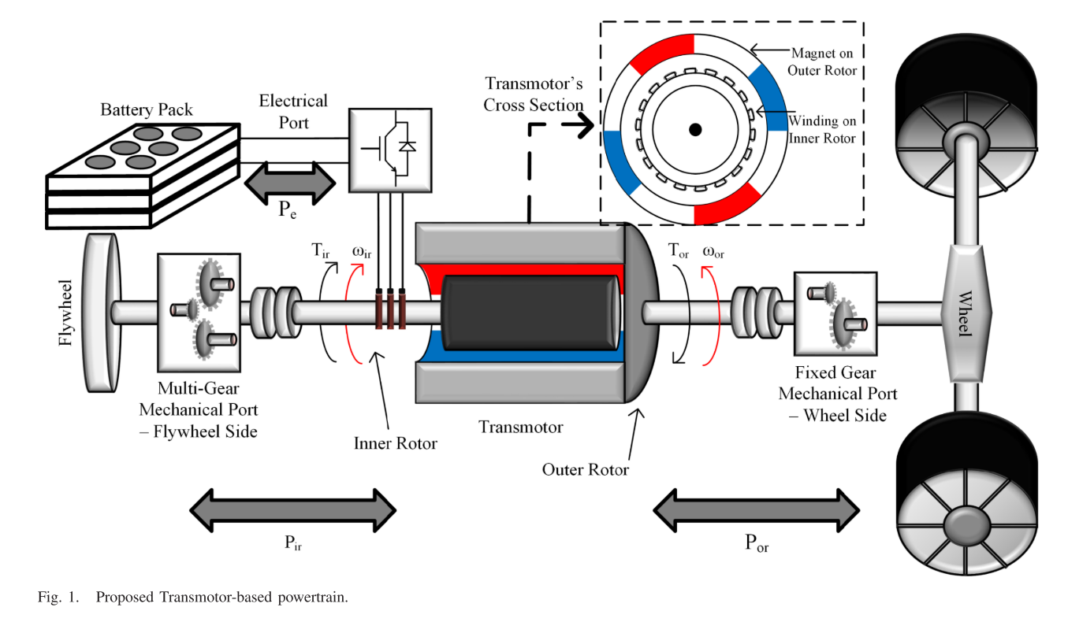
Transmotor-Based Powertrain for High-Performance Electric Vehicle
*[10]
The output torque is determined by the current in the electrical port (located on the inner rotor).
The produced torque on the two shafts is equal but opposite (action and reaction torque).
The speed of the mechanical ports can be different, so the input and output mechanical powers are not necessarily equal.
The maximum torque can be available at a larger speed range?? Hill Climbing???

Slide 14
References
[1] Design Approaches and Control Strategies for Energy-Efficient Electric Machines for Electric Vehicles—A Review
[2] Fast Adaptive Evolutionary PM Traction Motor Optimization Based on Electric Vehicle Drive Cycle
[3] Hill-start of Distributed Drive Electric Vehicle Based on Pneumatic Electronic Parking Brake System
[4] Design Approaches and Control Strategies for Energy-Efficient Electric Machines for Electric Vehicles—A Review
[5] A Reconfigurable-Winding System for Electric Vehicle Drive Applications
[6] Power Split Control Strategy for an EV Powertrain With Two Propulsion Machines
[7] Efficiency Study of a Dual-Motor Coupling EV Powertrain
[8] Optimization of a Dual-Motor Coupled Powertrain Energy Management Strategy for a Battery Electric Bus Based on Dynamic Programming Method
[9] A Novel Dual-Motor Two-Speed Direct Drive Battery Electric Vehicle Drivetrain
[10] Transmotor-Based Powertrain for High-Performance Electric Vehicle

