Slide 1
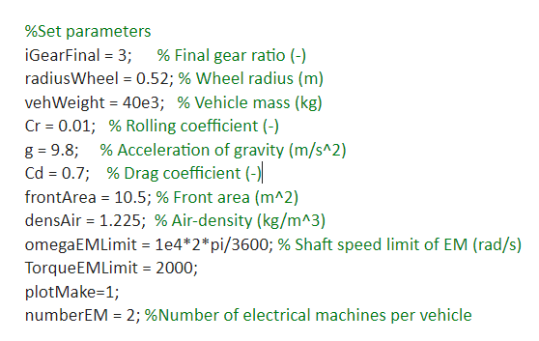
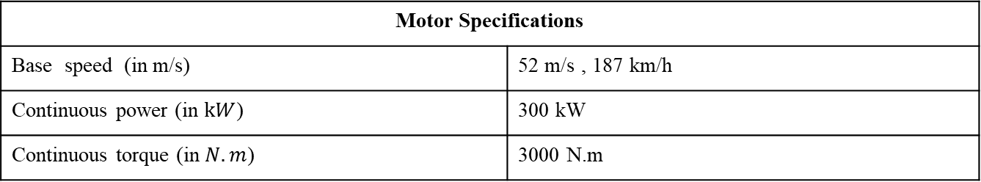
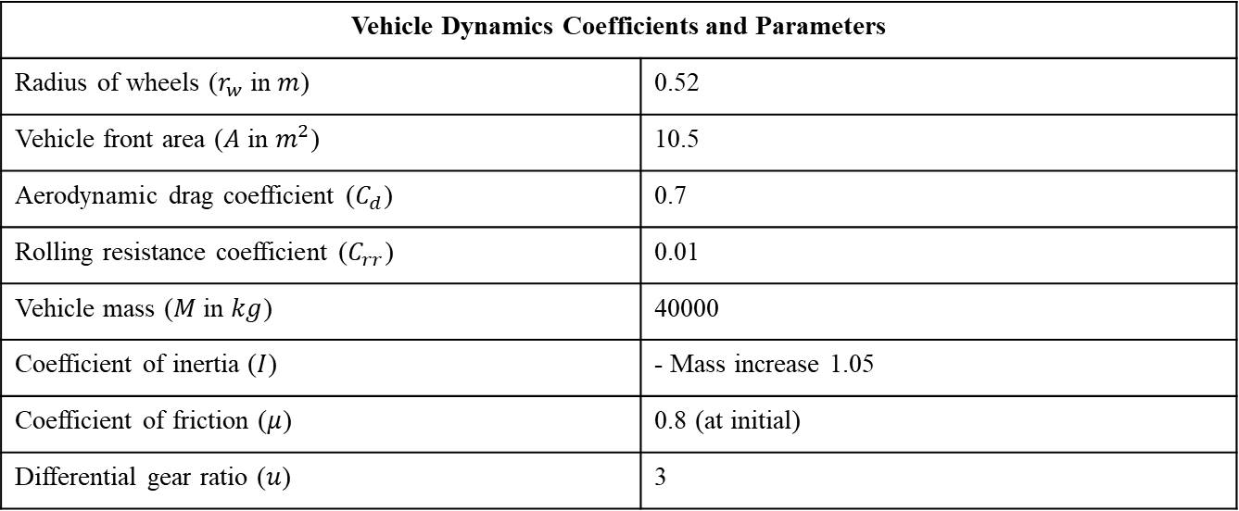
Vehicle Dynamics Coefficients and Parameters
Radius of wheels ($r_{w}$ in $m$) | 0.52
Vehicle front area ($A$ in $m^{2}$) | 10.5
Aerodynamic drag coefficient ($C_{d}$) | 0.7
Rolling resistance coefficient ($C_{rr}$) | 0.01
Vehicle mass ($M$ in $kg$) | 40000
Coefficient of inertia ($I$) | - Mass increase 1.05
Coefficient of friction ($μ$) | 0.8 (at initial)
Differential gear ratio ($u$) | 3
From the data that Luca has sent before
Motor Specifications
Base speed (in m/s) | 52 m/s , 187 km/h
Continuous power (in $kW$) | 300 kW
Continuous torque (in $N.m$) | 3000 N.m

Slide 2
90 km/h
Cruise-high way
Hill climbing
Need altitude information?

Slide 3
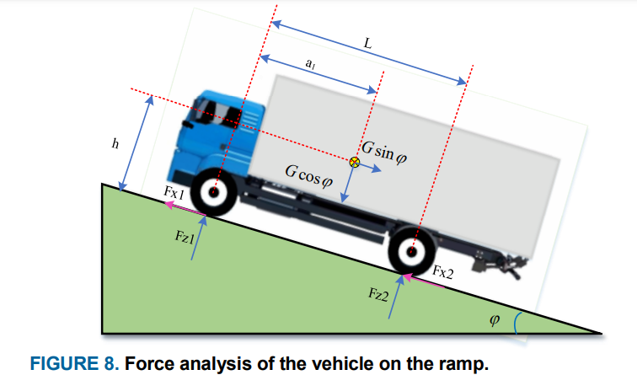






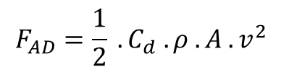

Total Tractive Force= Rolling Resistance + Aerodynamic Drag + Gradient Force + Acceleration Force
$$F_{TTF}=F_{RR}+F_{AD}+F_{G}+F_{A}$$
$$F_{RR}=C_{rr} . M .g.cos⁡(θ)$$
$$F_{AD}=\frac{1}{2} . C_{d} . ρ . A .v^{2}$$
$ρ$ = density of air
$$F_{G}=M . g . sin⁡(θ)$$
$θ$= uphill or downhill slopes angle
$$F_{A}=M .\overline{a}$$
*[3]
$$T_{EM}=F_{TTF} .\frac{r}{u}$$

Slide 4
Powerized KPI
1.Reduce the nominal power losses of
the traction inverter from 1% to 0.6%.
2. Reduce losses over the VECTO long-
haul drive cycle from 1.2% to 0.7%
3. Increase the input voltage of the
designed converter from 800V to 1250V
4. Increase the power density of the
traction inverter from 30 kW/l to 50 kW/l
Regenerative brake efficiency?

Slide 5
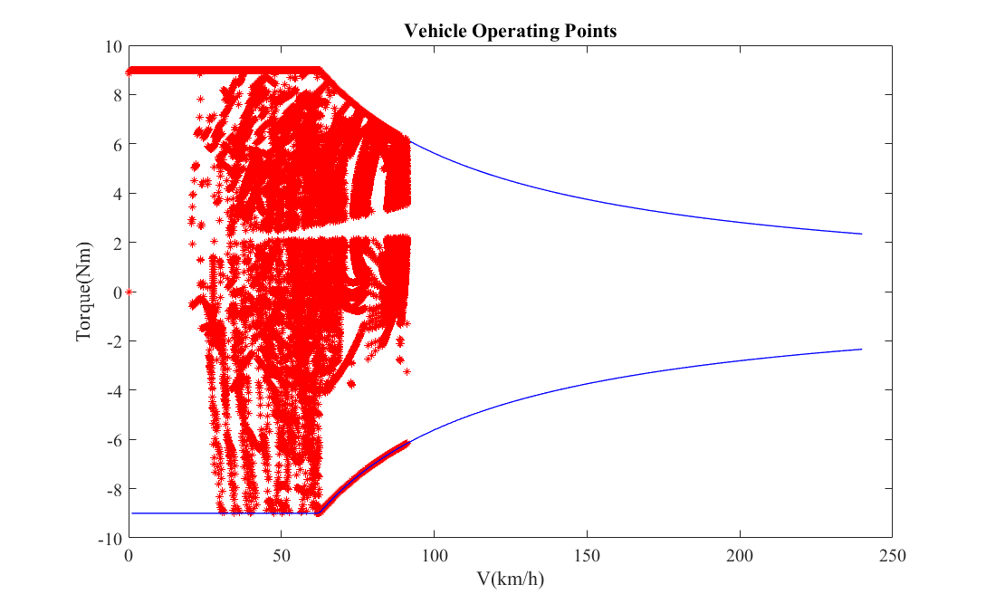

Slide 6
High torque requires acceleration from 0-100km/h

