Slide 1
Power Loop Inductance Modelling
To Draft an Idea for ECCE-Europe

Slide 2
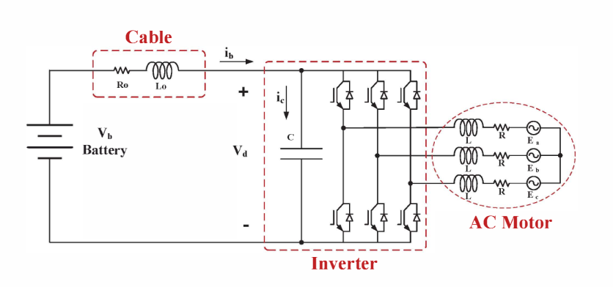
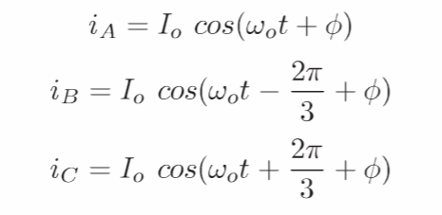
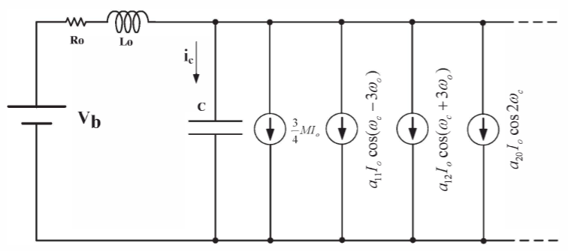

Simplified Inverter Model
Do not consider output harmonics for the phase currents
Combined Inverter and battery model
The inverter can be modeled as current sources of harmonic components.

Slide 3
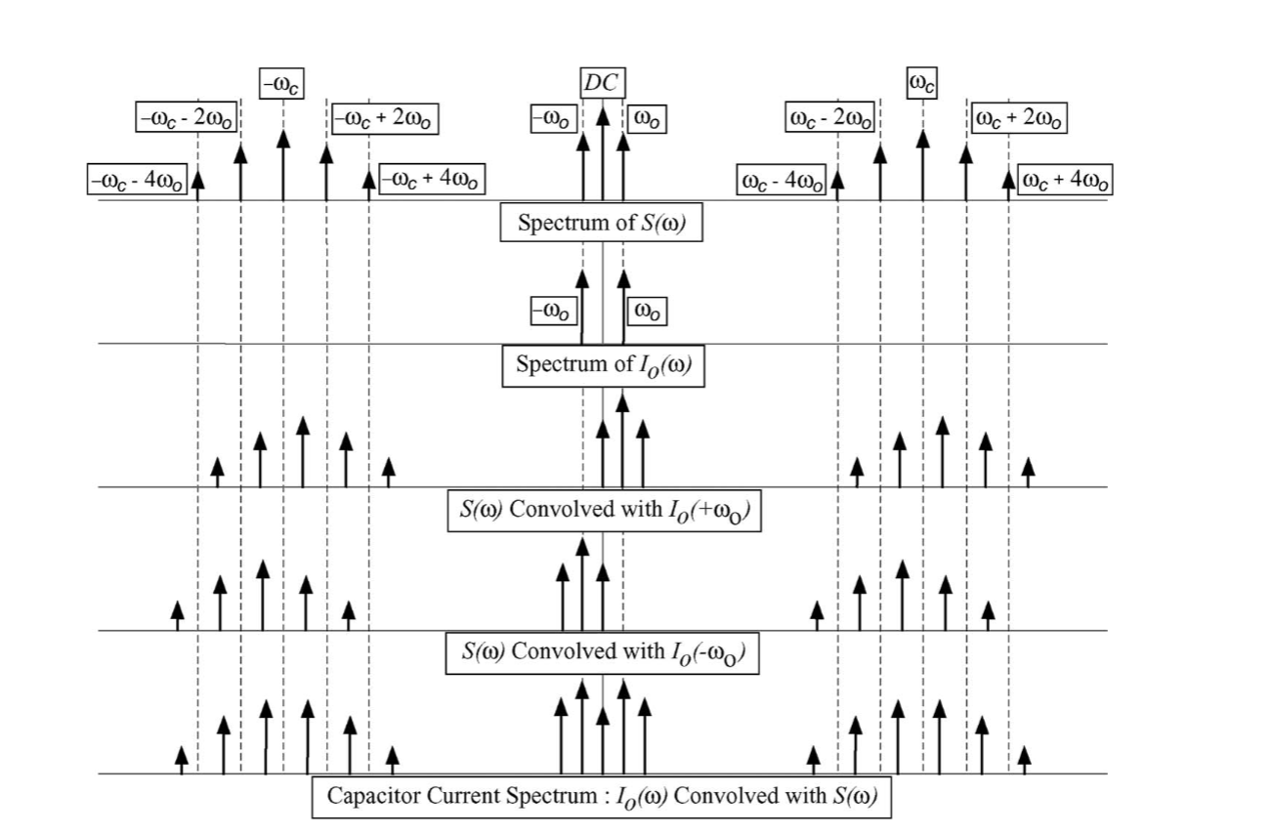


Current Sources of Harmonics
Leg current in the time domain is the multiplication of the phase current and switching function
Leg current in the frequency domain is the convolution of the phase current and switching function
$S_{A}(t)I_{A}(t)$➔
$S_{A}(ω){∗ I}_{A}(ω)$➔

Slide 4
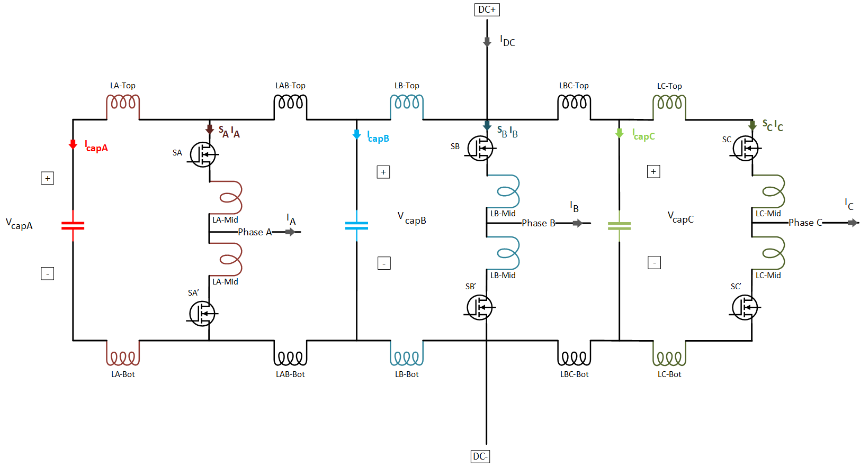
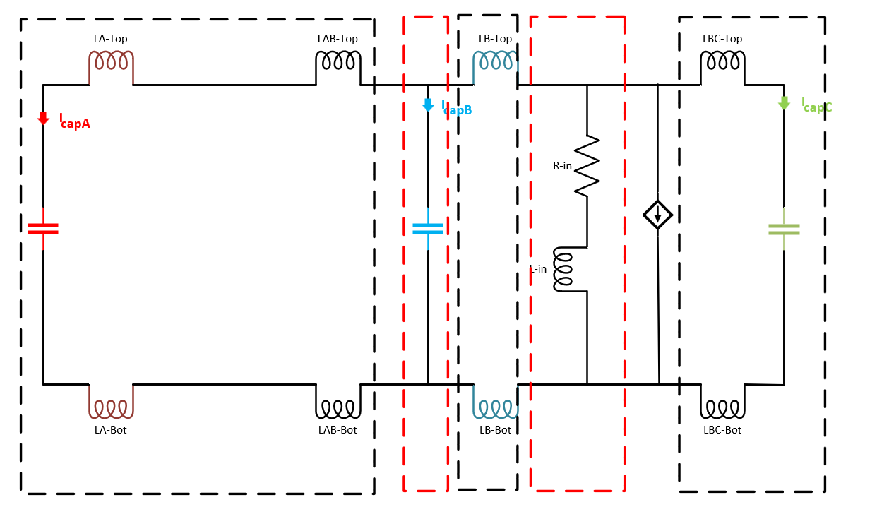
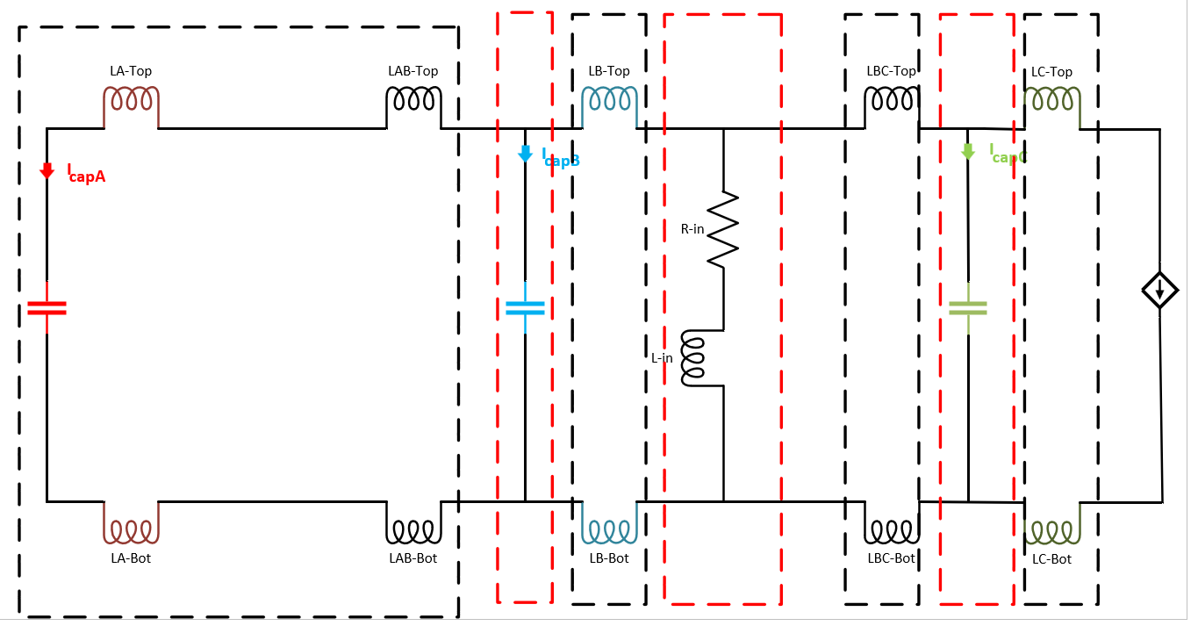
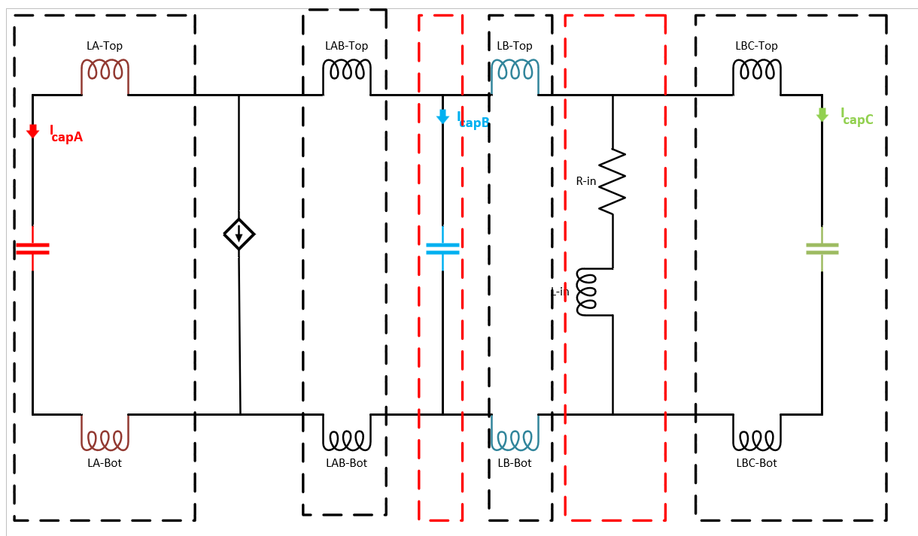
Impedance Model of an Inverter
Simplified 3 capacitors and 3 phase Parasitic Model
Only Phase A
Only Phase B
Only Phase C

Slide 5
The Aim of Using Impedance Model
High impedance points
A simplified model does not provide the effective capacitance values for each phase.
A simplified model does not provide the current distribution of the capacitors.
The uneven current distribution leads to thermal unbalance, which affects the lifetime of the capacitors.
The individual capacitance values of the capacitors, but the total capacitance value kept the same, can be re-selected to balance the losses and thermal stress.
Additionally, a resonant structure is created because of the capacitors and stray inductances, which create high impedance for some frequencies.

Slide 6
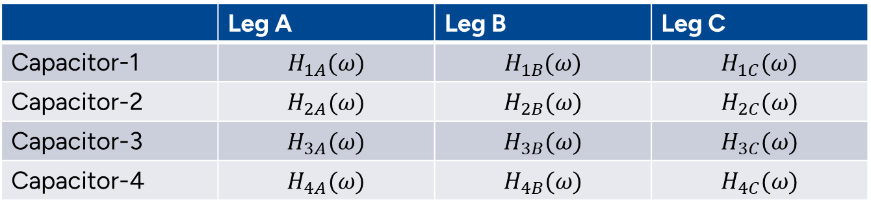
Impedance Model
Step response of capacitors to each leg
 | Leg A | Leg B | Leg C
Capacitor-1 | $$H_{1A}(ω)$$ | $$H_{1B}(ω)$$ | $$H_{1C}(ω)$$
Capacitor-2 | $$H_{2A}(ω)$$ | $$H_{2B}(ω)$$ | $$H_{2C}(ω)$$
Capacitor-3 | $$H_{3A}(ω)$$ | $$H_{3B}(ω)$$ | $$H_{3C}(ω)$$
Capacitor-4 | $$H_{4A}(ω)$$ | $$H_{4B}(ω)$$ | $$H_{4C}(ω)$$
The response of capacitor A for each leg should be calculated as:
$I_{capA}= {(S_{A}∗I_{A} )H}_{1A}\left(ω\right)+{(S_{B}∗I_{B} )H}_{1B}\left(ω\right)$+${(S_{C}∗I_{C} )H}_{1C}\left(ω\right)$

Slide 7

Busbar Geometry from Shahriar
Capacitor
Power Modules
DC- Nodes
DC+ Nodes

Slide 8
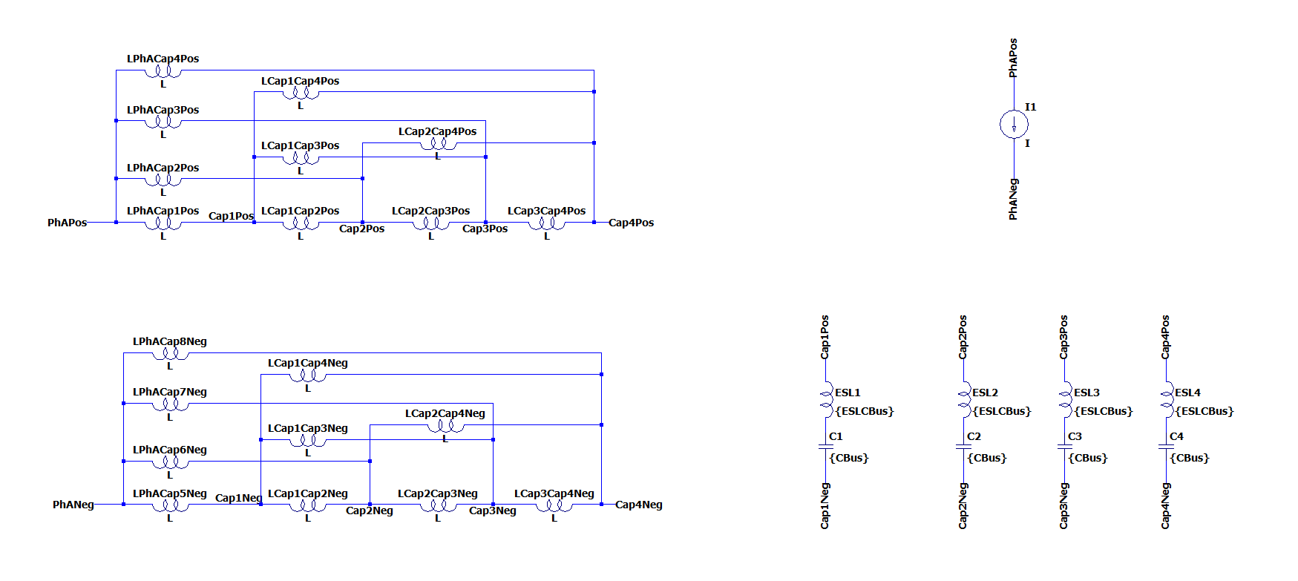
Lumped Circuit Representation
20 inductance values (and mutual inductances between them) are required to model.
Q3D Extractor can give the equivalent impedance between nodes, but a post-process to achieve individual inductances is required.
A simplified model is required.

Slide 9
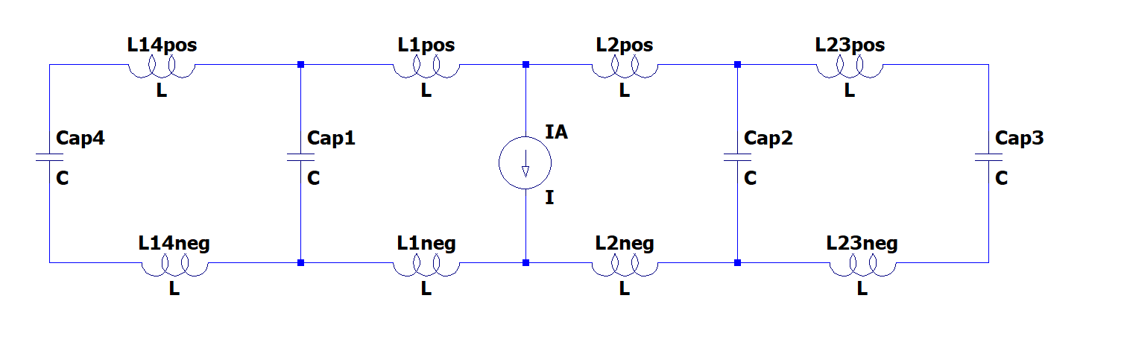
Simplified Lumped Circuit Representation
C3
C4
C2
C1
Capacitor3 and Capacitor4 are considered isolated thanks to the geometry.
Mutual Inductances:
L14pos-L14neg
L1pos-L1neg
L2pos-L2neg
L23pos-L23neg
Mutual Inductances:
L1pos-L2pos
L1neg-L2neg
Mutual Inductances:
L1pos-L2neg
L1neg-L2pos

Slide 10
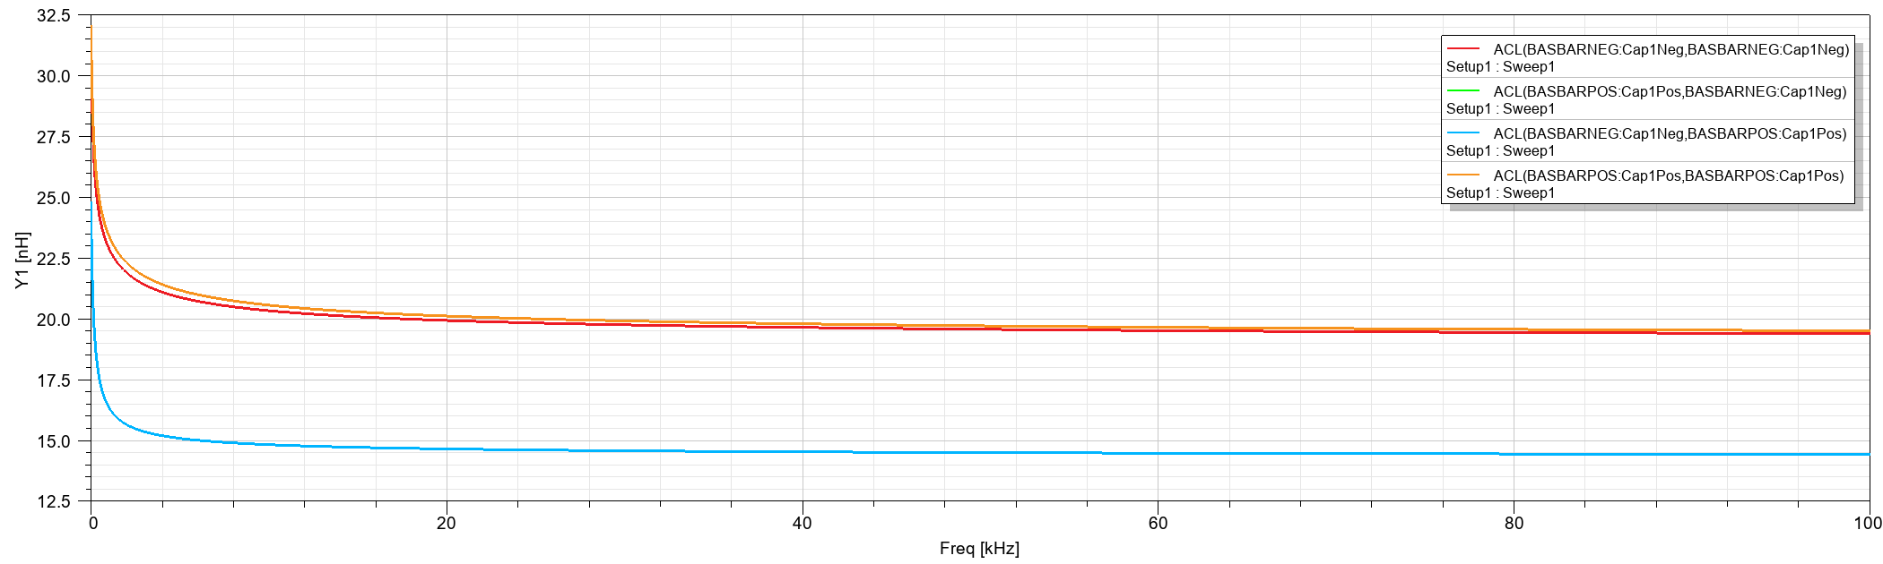
Initial Results (L14pos-L14neg)
Skin depth effect ?
Can we select single frequency?

