Slide 1
Inverter Protoyping: 62mm Power Module
KTH

Slide 2
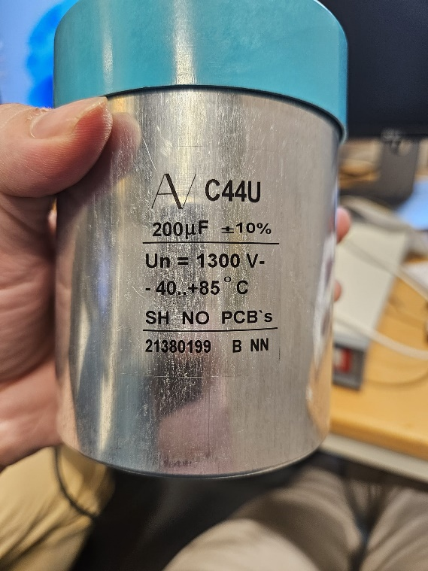

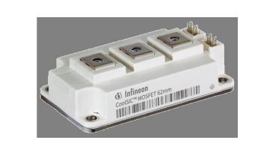
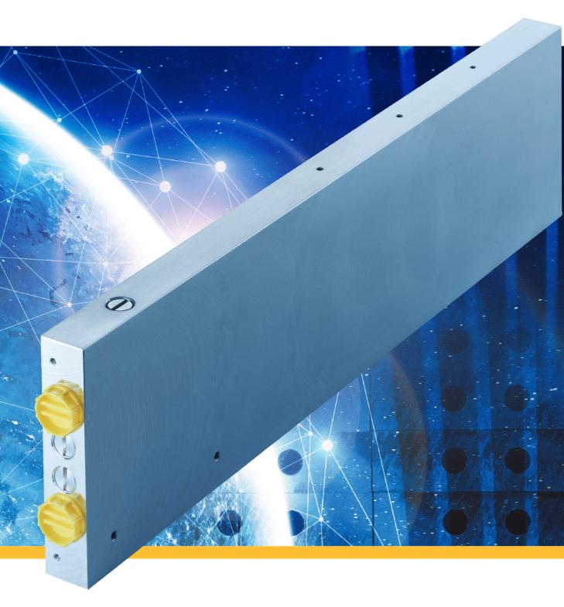
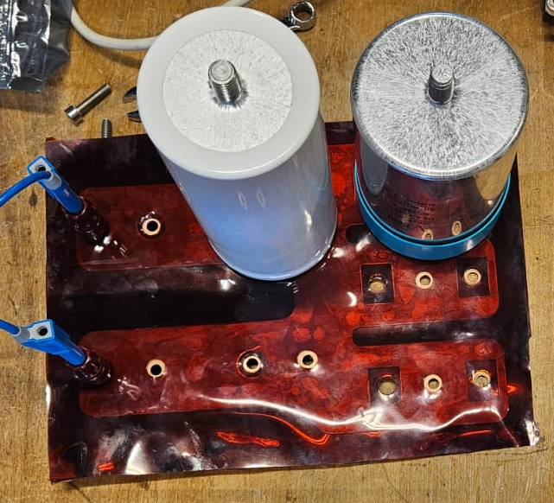
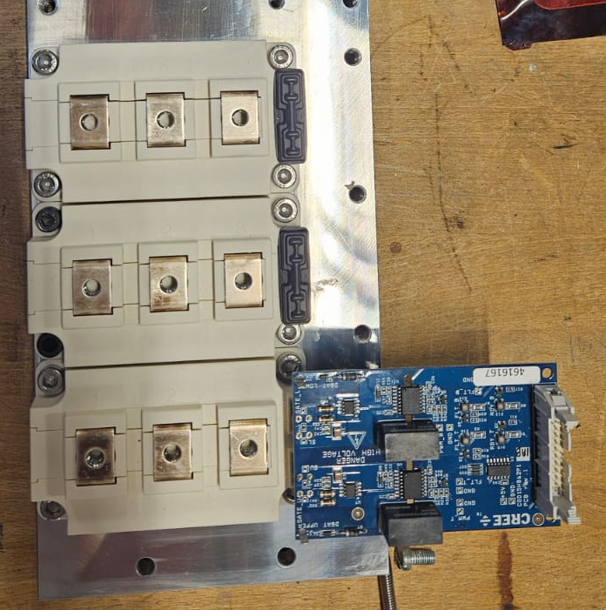
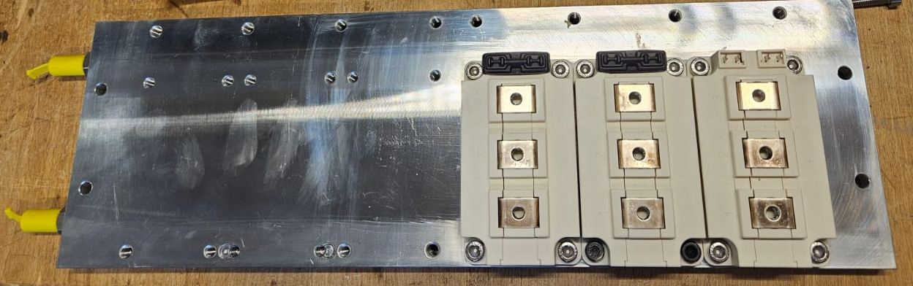
Busbar Desing
Capacitor : KEMET C44U 1300V 200uH
DC- Nodes
Power Modules : Infineon 2kV CoolSic 62mm
DC+ Nodes
Coldplate
Coldplate
Power Modules
Laminated
Busbar
Capacitor
Gate Driver

Slide 3
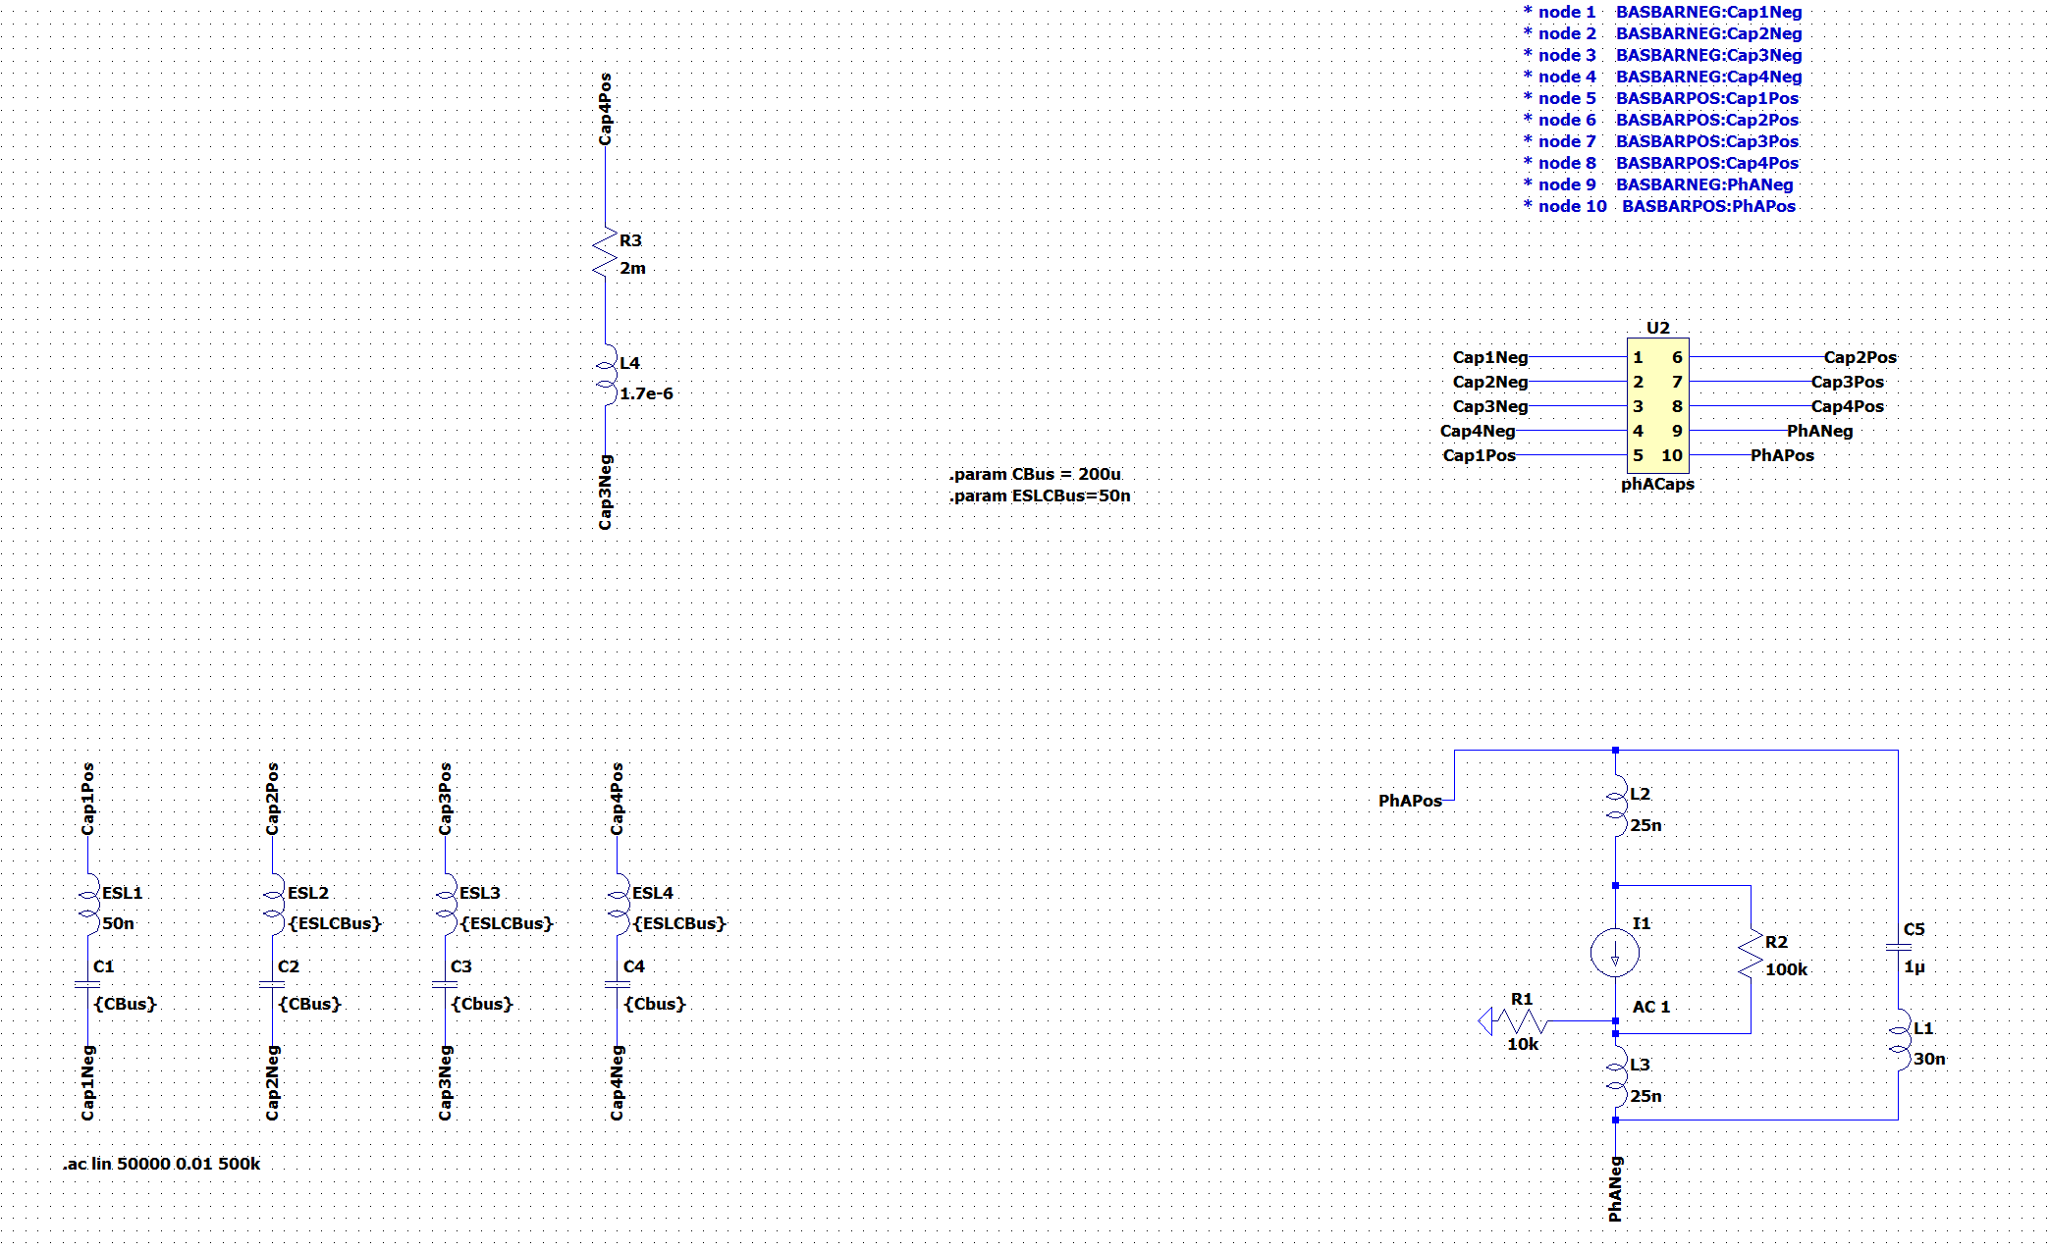
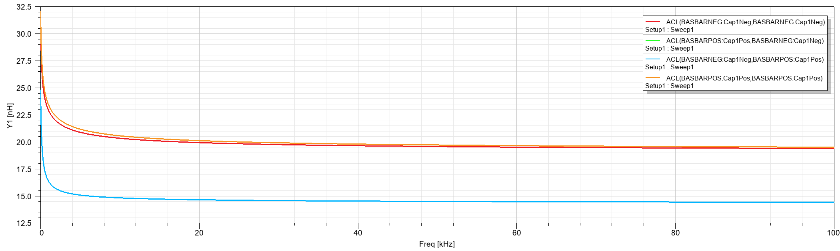
Busbar Geometry 62mm Power Module
C3
C4
C2
C1
Lumped Circuit Representation for one phase
20 inductance values (and mutual inductances between them).
Q3D Extractor can give the equivalent impedance between one sink and multiple sources.
Stray inductance inside the modules is considerably high.
Capacitor
DC- Nodes
Power Modules
DC+ Nodes

Slide 4
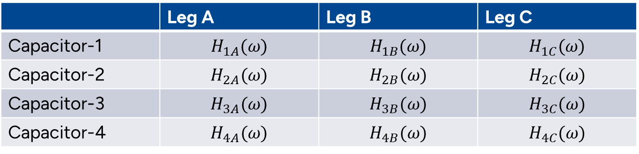
Impedance Model
Step response of capacitors to each leg
 | Leg A | Leg B | Leg C
Capacitor-1 | $$H_{1A}(ω)$$ | $$H_{1B}(ω)$$ | $$H_{1C}(ω)$$
Capacitor-2 | $$H_{2A}(ω)$$ | $$H_{2B}(ω)$$ | $$H_{2C}(ω)$$
Capacitor-3 | $$H_{3A}(ω)$$ | $$H_{3B}(ω)$$ | $$H_{3C}(ω)$$
Capacitor-4 | $$H_{4A}(ω)$$ | $$H_{4B}(ω)$$ | $$H_{4C}(ω)$$
The response of capacitor A for each leg should be calculated as:
$I_{capA}= {(S_{A}∗I_{A} )H}_{1A}\left(ω\right)+{(S_{B}∗I_{B} )H}_{1B}\left(ω\right)$+${(S_{C}∗I_{C} )H}_{1C}\left(ω\right)$
Capacitor Responses to Phase-A
Capacitor-1 Response to all phases

Slide 5
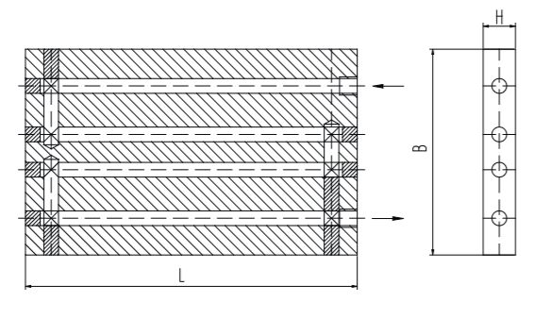
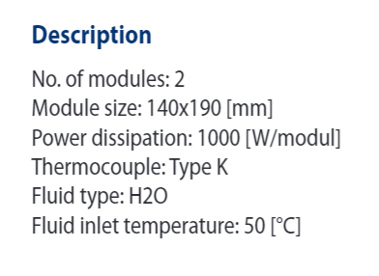
Cooling : Six 62mm Power Modules (in a row)
LIQUID COOLING
Series KS

Slide 6
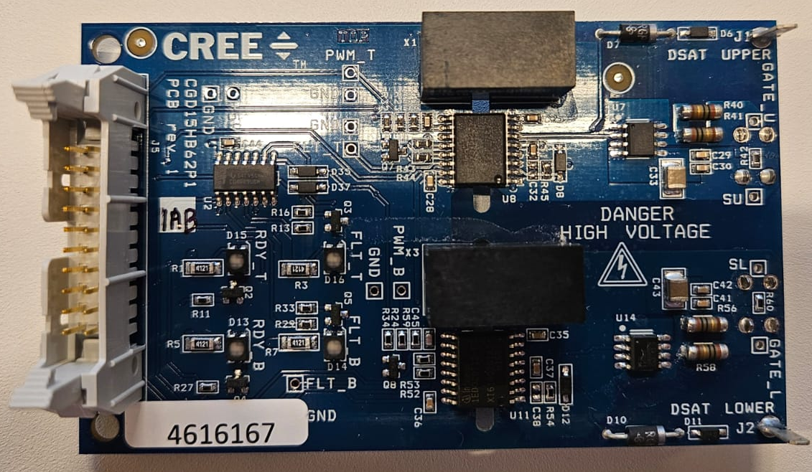
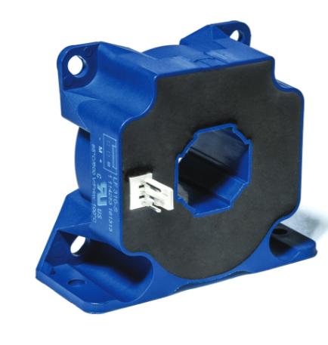
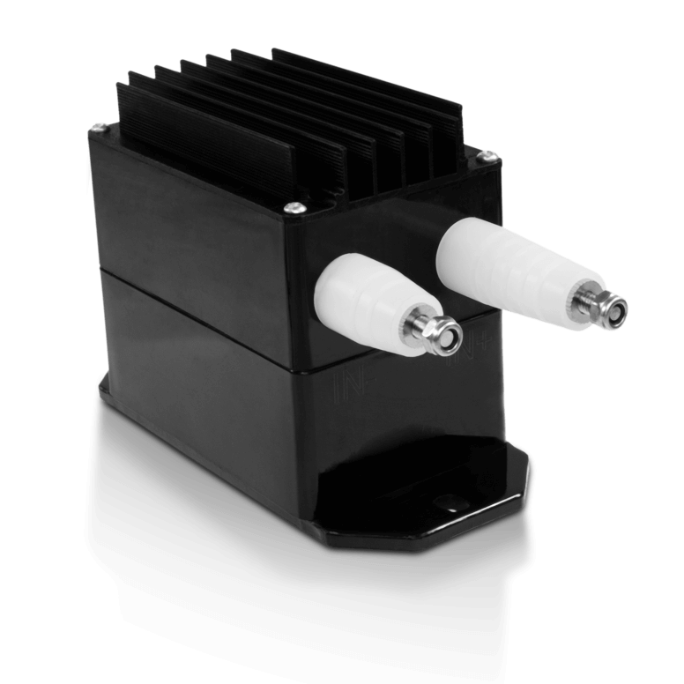
Gate Driver and Sensors (that we consider to use)
Gate Driver: Evaluation Board Cree
CGD1200HB2P
20V -5V
Current Transducer LF 310-S
300A (RMS)
100kHz Bandwith
Accuenergy HV2-1500
1500V
DC

