Slide 1
DC-Link Capacitor
RMS Current Minimization
Adaptive Multi-Carrier PWM via Triple Overlap Principle

Slide 2
PROBLEM Uncontrolled switching → excessive capacitor stress
~30%
of inverter failures
linked to DC-link
capacitor
↑ RMS
causes thermal
stress & lifetime
reduction

Slide 3












Analytical Foundation RMS² budget decompositions
$$i_{inv }\left(t\right)=i_{a}S_{a}\left(t\right)+i_{b}S_{b}\left(t\right)+i_{c}S_{C}\left(t\right)$$
Assume that
$$i_{a}= + , i_{b}=−, i_{c}= +$$
Fraction of time only Sa, Sb, or Sc is on
Fraction of time only same-sign pair is on
Fraction of time only opposite-sign pairs are on
Fraction of time triple overlap, Sa, Sb, Sc are on
$$I_{inv,rms}^{2}=$$
$$+$$
$$+$$
$$+$$
$$i_{a}^{2}{·λ}_{a}+i_{b}^{2}{·λ}_{b}+ i_{c}^{2}{·λ}_{c}$$
$${{(i}_{b}+i_{c})}^{2}{·λ}_{bc}$$
Minimize to zero
$${{(i}_{a}+i_{b})}^{2}{·λ}_{ab}+{{(i}_{a}+i_{c})}^{2}{·λ}_{ac}$$
Maximize
$${{(i_{a}+i}_{b}+i_{c})}^{2}{·λ}_{abc}$$
Minimize Lone
Maximize
$i_{a}+i_{b}+i_{c}=0$
Since
${ i}_{a}+i_{b}<i_{a}$
$i_{a}+i_{b}<i_{a}$

Slide 4
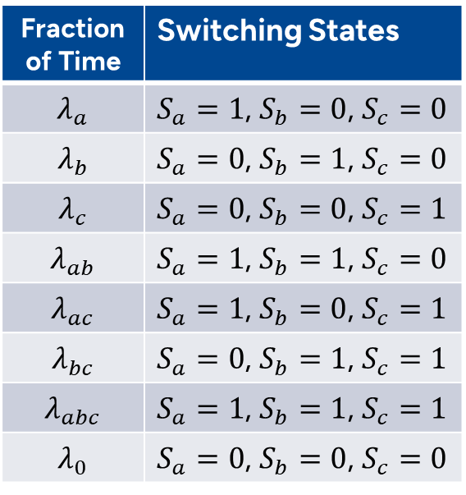
Fraction of Times
Fraction of Time | Switching States
$$λ_{a}$$ | $S_{a}=1$, $S_{b}=0$, $S_{c}=0$
$$λ_{b}$$ | $S_{a}=0$, $S_{b}=1$, $S_{c}=0$
$$λ_{c}$$ | $S_{a}=0$, $S_{b}=0$, $S_{c}=1$
$$λ_{ab}$$ | $S_{a}=1$, $S_{b}=1$, $S_{c}=0$
$$λ_{ac}$$ | $S_{a}=1$, $S_{b}=0$, $S_{c}=1$
$$λ_{bc}$$ | $S_{a}=0$, $S_{b}=1$, $S_{c}=1$
$$λ_{abc}$$ | $S_{a}=1$, $S_{b}=1$, $S_{c}=1$
$$λ_{0}$$ | $S_{a}=0$, $S_{b}=0$, $S_{c}=0$

Slide 5
Algorithm
Measure ia, ib,ic
Compute da,db,dc
Detect lone-sign leg
Sign(ia), sign(ib), sign(ic)
Lone =A
Lone =B
Lone =C
Introduce Phase Shift

Slide 6


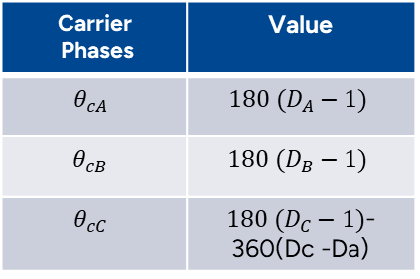


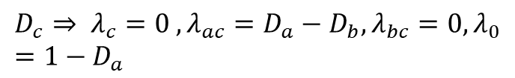

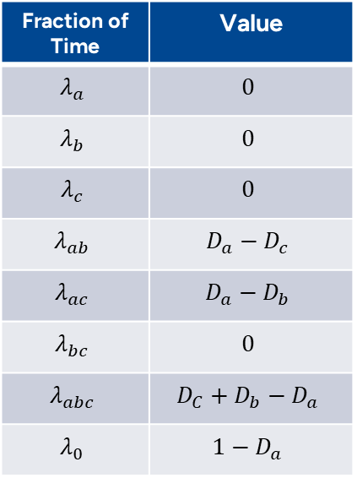
Lone = A
Fraction of Time | Value
$$λ_{a}$$ | $$0$$
$$λ_{b}$$ | $$0$$
$$λ_{c}$$ | $$0$$
$$λ_{ab}$$ | $$D_{a}−D_{c}$$
$$λ_{ac}$$ | $$D_{a}−D_{b}$$
$$λ_{bc}$$ | $$0$$
$$λ_{abc}$$ | $$D_{C}+D_{b}−D_{a}$$
$$λ_{0}$$ | $$1−D_{a}$$
$$D_{a}+D_{b}+D_{c}=\frac{3}{2}$$
Case 1
DA<(DB +DC) AND DA>DB DA>DC
$$D_{a}=λ_{a}+λ_{ab}+λ_{ac}+λ_{abc}+λ_{0}$$
$$D_{b}=λ_{b}+λ_{ab}+λ_{bc}+λ_{abc}+λ_{0}$$
$$λ_{abc}=D_{c}+D_{b}−D_{a}$$
$$D_{c}=λ_{c}+λ_{ac}+λ_{bc}+λ_{abc}+λ_{0}$$
$$D_{c}⇒ λ_{c}=0 ,λ_{ac}=D_{a}−D_{b},λ_{bc}=0, λ_{0}=1−D_{a}$$
$$D_{a}⇒λ_{a }=0, λ_{ab}=D_{a}−D_{c}$$
$$D_{b}⇒ λ_{b}=0$$
Maximizing triple-overlap
Carrier Phases | Value
$$θ_{cA}$$ | $${180 (D}_{A}−1)$$
$$θ_{cB}$$ | $${180 (D}_{B}−1)$$
$$θ_{cC}$$ | ${180 (D}_{C}−1)$- 360(Dc -Da)
$λ_{abc}$, $λ_{ab}$ and $λ_{ac}$
Minimizing opposite pair overlap
$$λ_{bc}$$
Minimizing lone
$$λ_{a}$$

Slide 7
Lone =A - Case 1

Slide 8
Lone =A - Case 1

Slide 10
Algorithm
⊻⊻
⊻
Measure ia, ib,ic
Compute da,db,dc
Detect lone-sign leg
Sign(ia), sign(ib), sign(ic)
Lone =A
Lone =B
Lone =C
DA > DB AND
DA> DC
DA < DC XOR
DA < DB
DA < DB AND
DA< DC
DB > DA AND
DB> DC
DB < DA XOR
DB < DC
DB < DA AND
DB< DC
DC > DA AND
DC> DB
DC < DA XOR
DC < DB
DC < DA AND
DC< DB
Introduce Phase Shift

Slide 11
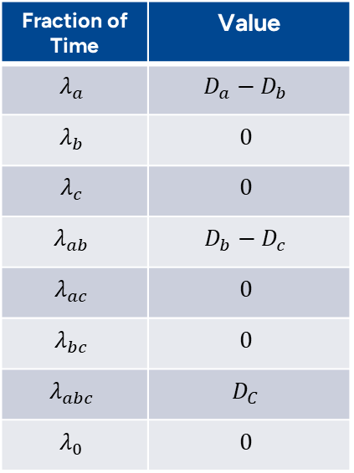



Lone =A
Fraction of Time | Value
$$λ_{a}$$ | $$D_{a}−D_{b}$$
$$λ_{b}$$ | $$0$$
$$λ_{c}$$ | $$0$$
$$λ_{ab}$$ | $$D_{b}−D_{c}$$
$$λ_{ac}$$ | $$0$$
$$λ_{bc}$$ | $$0$$
$$λ_{abc}$$ | $$D_{C}$$
$$λ_{0}$$ | $$0$$
$$D_{a}+D_{b}+D_{c}=\frac{3}{2}$$
Case 1
DA>DB >DC
$$D_{a}=λ_{a}+λ_{ab}+λ_{ac}+λ_{abc}+λ_{0}$$
$$D_{b}=λ_{b}+λ_{ab}+λ_{bc}+λ_{abc}+λ_{0}$$
$$λ_{abc}=\min\left(D_{a}, D_{b}, D_{c}\right)=D_{c}$$
$$D_{c}=λ_{c}+λ_{ac}+λ_{bc}+λ_{abc}+λ_{0}$$
$$D_{c}⇒ λ_{c}=0 ,λ_{ac}=0,λ_{bc}=0, λ_{0}=0$$
$$D_{a}⇒ λ_{a}+λ_{ab}=D_{a}−D_{c}$$
$$D_{b}⇒ λ_{b}+λ_{ab}=D_{b}−D_{c}$$
Maximizing triple-overlap
$$if λ_{b}=0⇒ λ_{ab}=D_{b}−D_{c}$$
Carrier Phases | Value
$$θ_{cA}$$ | $${180 (D}_{A}−1)$$
$$θ_{cB}$$ | $${180 (D}_{B}−1)$$
$$θ_{cC}$$ | ${180 (D}_{C}−1)$- 360(Dc -Da)
$$λ_{abc}=min⁡(D_{a}, D_{b}, D_{c})$$
$$λ_{a}=D_{a}−D_{b}$$
Minimizing opposite pair overlap
$$λ_{bc}$$
Minimizing lone
$$λ_{a}$$

