Slide 1
The Traditional EV Architecture
Modern electric vehicles rely on a high-power traction inverter—often hundreds of kilowatts—to drive the electric machine.
Alongside this inverter, however, a separate auxiliary power supply is almost always present:
  HV → LV DC/DC converters (for 12 V / 24 V buses)
  Dedicated auxiliary inverters or converters
  Extra semiconductors, magnetics, cooling, isolation, and protection
Although the auxiliary power demand is tiny (typically several kilowatts), it is served by a fully independent power module, designed, qualified, and cooled as if it were a major energy path.
This creates a structural inefficiency:

Slide 2
The Overlooked Resource: Harmonic Energy in the Traction Inverter
The traction inverter already:
  Switches at high frequency
  Generates rich spectral content around the switching frequency
  Handles voltages and currents far beyond auxiliary needs
Traditionally, harmonics are treated as a problem:
  Filtered
  Suppressed
  Minimized
But fundamentally, these harmonics are real electrical energy, generated continuously during normal operation.

Slide 3
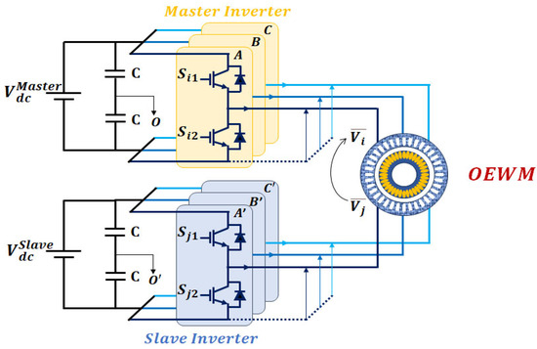
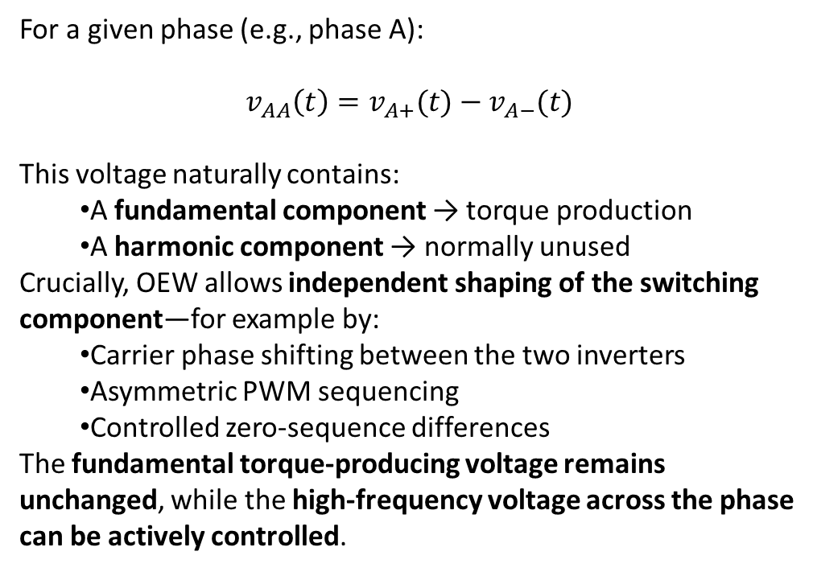
Open-End Winding: Enabling Control
The open-end winding (OEW) machine topology introduces two independent inverter terminals per phase.
This does not just double hardware—it introduces modulation redundancy.
For a given phase (e.g., phase A):
$$v_{AA}\left(t\right)=v_{A+}(t)−v_{A−}(t)$$
This voltage naturally contains:
  A fundamental component → torque production
  A harmonic component → normally unused
Crucially, OEW allows independent shaping of the switching component—for example by:
  Carrier phase shifting between the two inverters
  Asymmetric PWM sequencing
  Controlled zero-sequence differences
The fundamental torque-producing voltage remains unchanged, while the high-frequency voltage across the phase can be actively controlled.

Slide 4
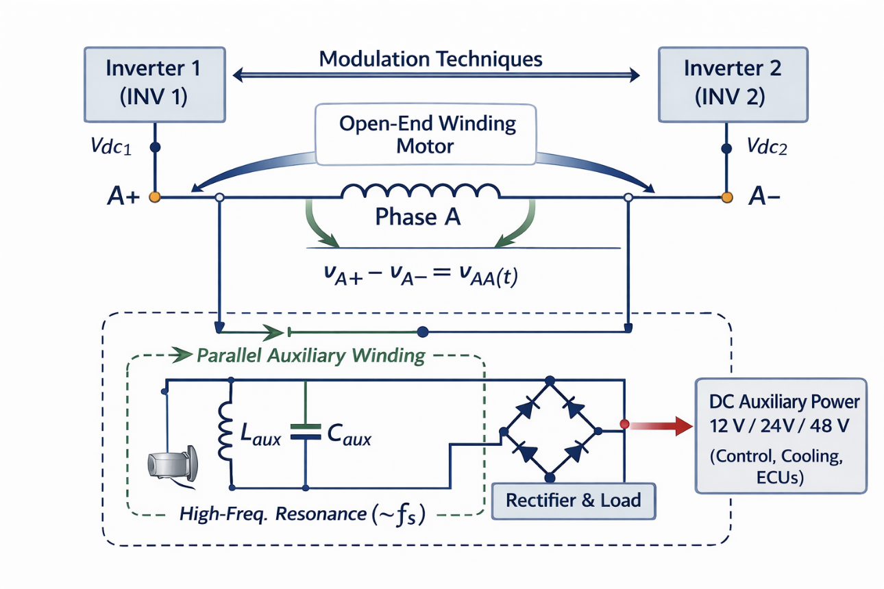
Parallel Resonant Extraction: Using What Is Already There
By connecting a high-frequency resonant branch (e.g., LC or LCL) in parallel with the phase terminals, tuned near the switching frequency:
  The resonant branch presents high impedance at fundamental frequency
  And low impedance at switching frequency
As a result:
  The motor current and torque are essentially unaffected
  Only the switching-frequency voltage excites the resonant branch
  Auxiliary power is extracted without disturbing main operation
The auxiliary power level is then modulated electrically, not structurally—by adjusting:
  Carrier phase shift
  PWM timing
  Switching alignment
Back-up power supply.

Slide 5
Why the Main Inverter Barely Notices
This is the most important system-level conclusion:
  Auxiliary power demand: several kilowatts
  Traction inverter rating: hundreds of kilowatts
Even if the auxiliary system draws power through switching harmonics:
  The additional current is small
  The extra switching loss is marginal
  Thermal impact is negligible compared to traction load

Slide 6
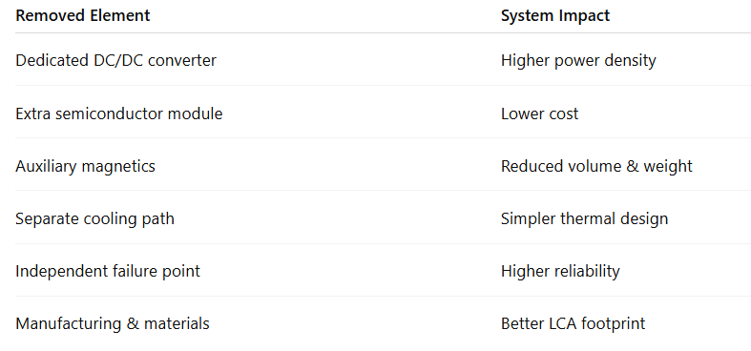
What Is Eliminated (and Why It Matters)

Slide 7
A Shift in Design Philosophy
The classical EV approach separates:
  Main power conversion
  Auxiliary power conversion
The OEW + modulation-controlled resonant extraction approach unifies them.
This aligns naturally with:
  High-voltage EV platforms (800–1200 V)
  Power-density-driven designs
  Life-cycle and sustainability optimization
  Advanced modulation tecniques

Slide 8
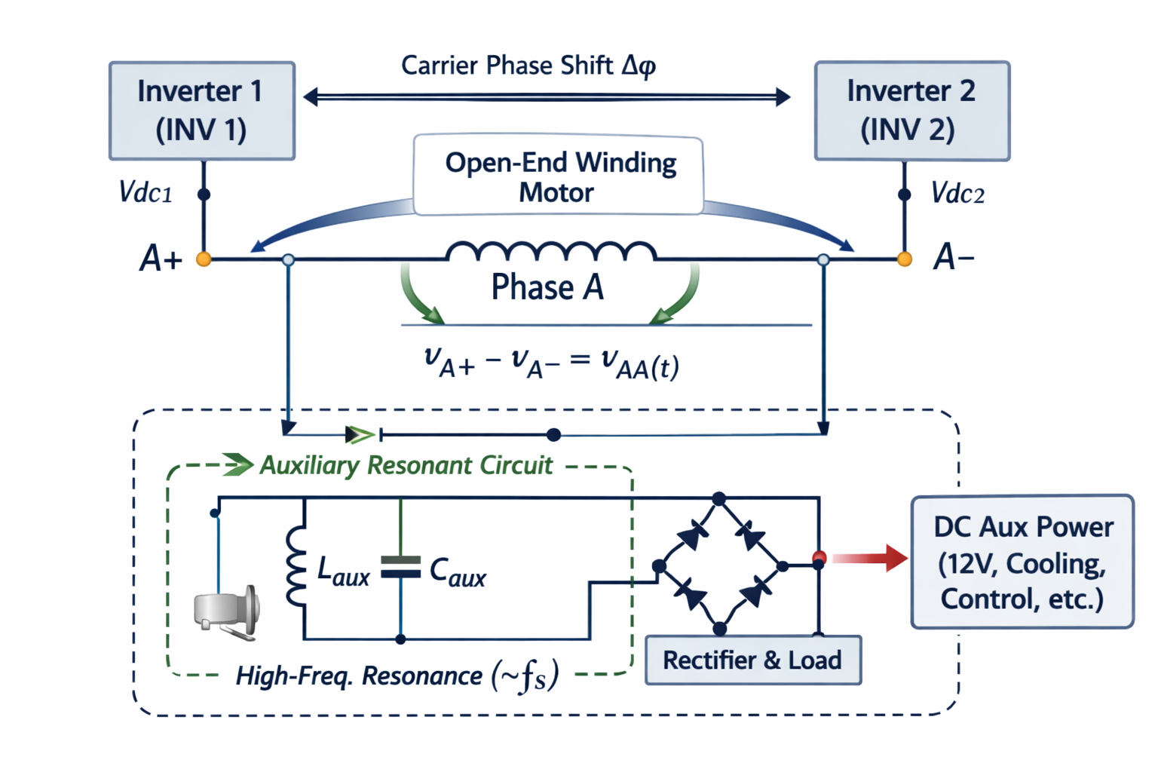

Slide 10
