Slide 1
POWER ELECTRONICS · PWM TECHNIQUE
Minimizing DC-Link
Capacitor RMS Current
Adaptive Multi-Carrier PWM via Triple Overlap Principle
Two-level three-phase VSI · Analytical closed-form optimum · No LUT, no sweep
KTH Royal Institute of Technology

Slide 2
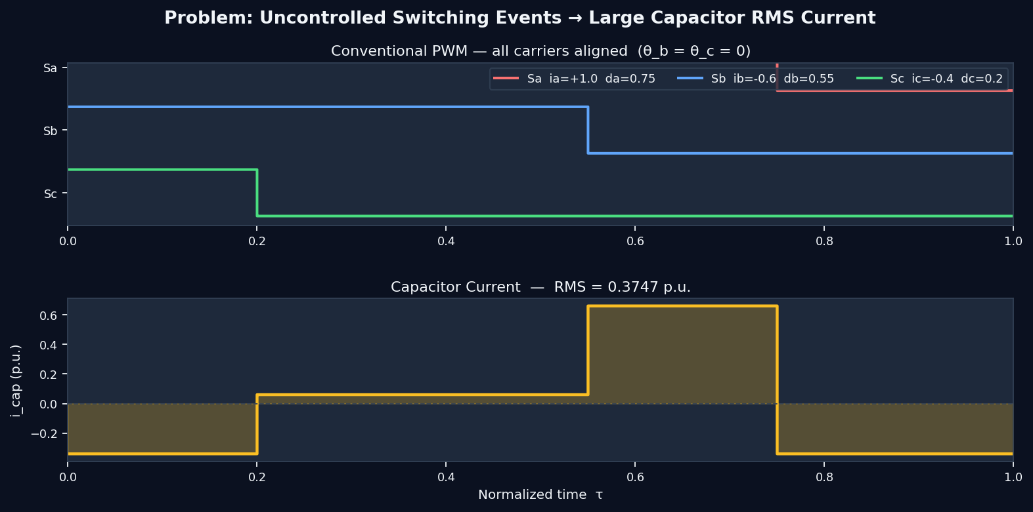
THE PROBLEM
Uncontrolled switching → excessive capacitor stress
~30%
of inverter failures
from capacitor
↑ RMS
causes thermal
stress & aging
0 hw
extra hardware
required
Goal: dynamically choose carrier phase shifts θ_b, θ_c each switching cycle to minimise I²_cap,rms

Slide 3
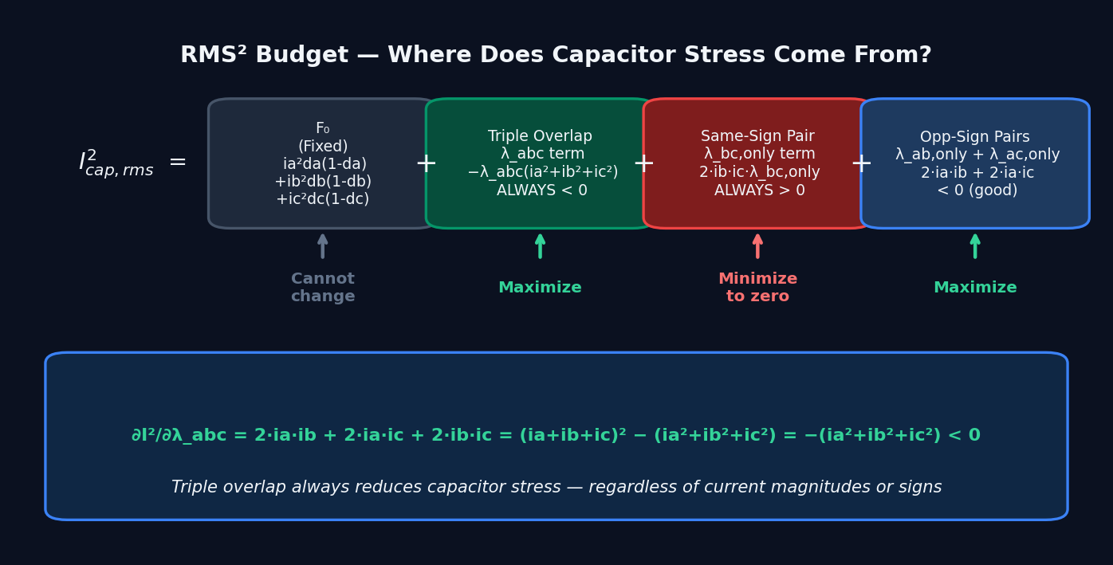
ANALYTICAL FOUNDATION
RMS² budget decomposition

Slide 4
THE KEY INSIGHT
Triple overlap principle
Maximize λ_abc (Triple Overlap)
Minimize λ_bc,only (Same-Sign Pair)
∂I² / ∂λ_abc = −(ia²+ib²+ic²) < 0
∂I² / ∂λ_bc,only = 2·ib·ic > 0
When all three switches are ON simultaneously,
i_a + i_b + i_c = 0 → only −ī_dc flows.
Triple overlap ALWAYS reduces RMS² —
regardless of current magnitude or sign.
When the two same-sign legs switch together
without the lone leg, i_b + i_c = −i_a
flows as ripple current.
Same-sign exclusive overlap ALWAYS bad.
Optimal rule: nest both bank pulses INSIDE the lone pulse → λ_bc,only = 0 AND λ_abc = max(0, db+dc−da)

Slide 5
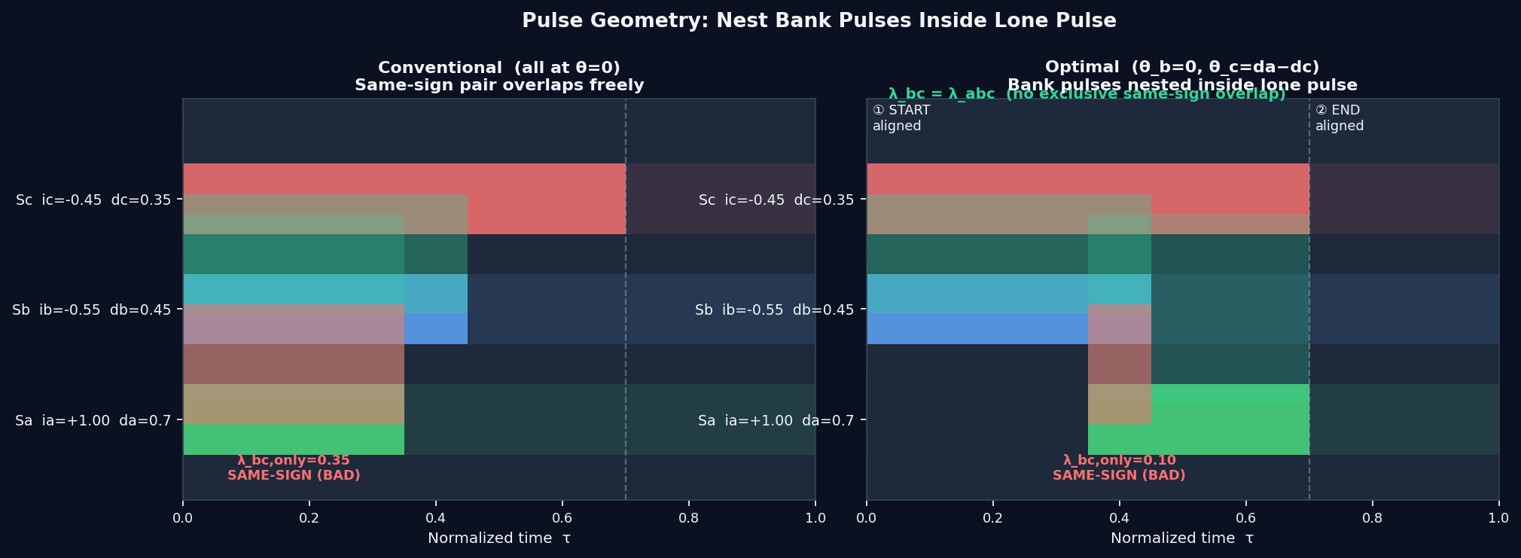
PULSE GEOMETRY
Before & after: nesting the bank pulses

Slide 6
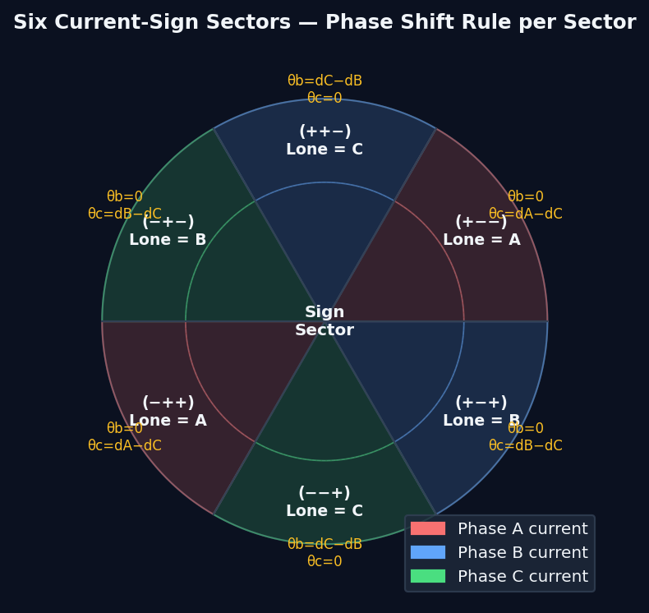
SECTOR LOGIC
Three if-else cases cover all six sign combinations
% 3 comparisons, 1 subtraction
sa = sign(ia); sb = sign(ib); sc = sign(ic);
if sa≠sb && sa≠sc % lone=A
θ_a=0; θ_b=0;
θ_c=
da−dc;
elseif sb≠sa && sb≠sc % lone=B
θ_a=0; θ_b=0;
θ_c=
db−dc;
else % lone=C
θ_a=0;
θ_b=
dc−db;
θ_c=0;
end

Slide 7
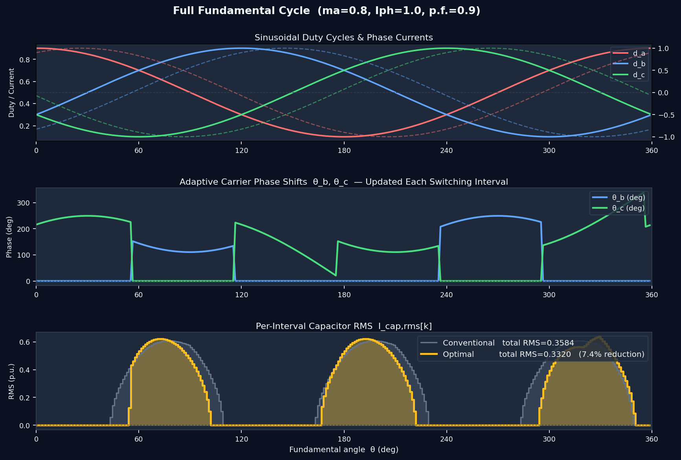
FULL CYCLE RESULTS
Sinusoidal references, adaptive phase shifts

Slide 8
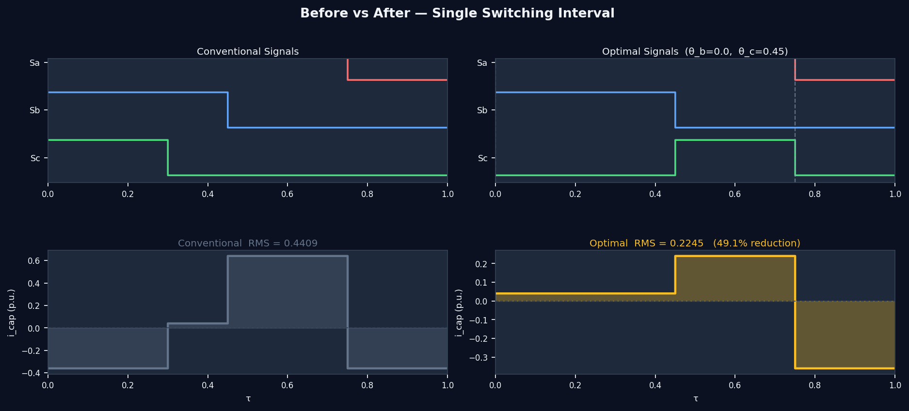
PERFORMANCE
Single switching interval — before vs after

Slide 9
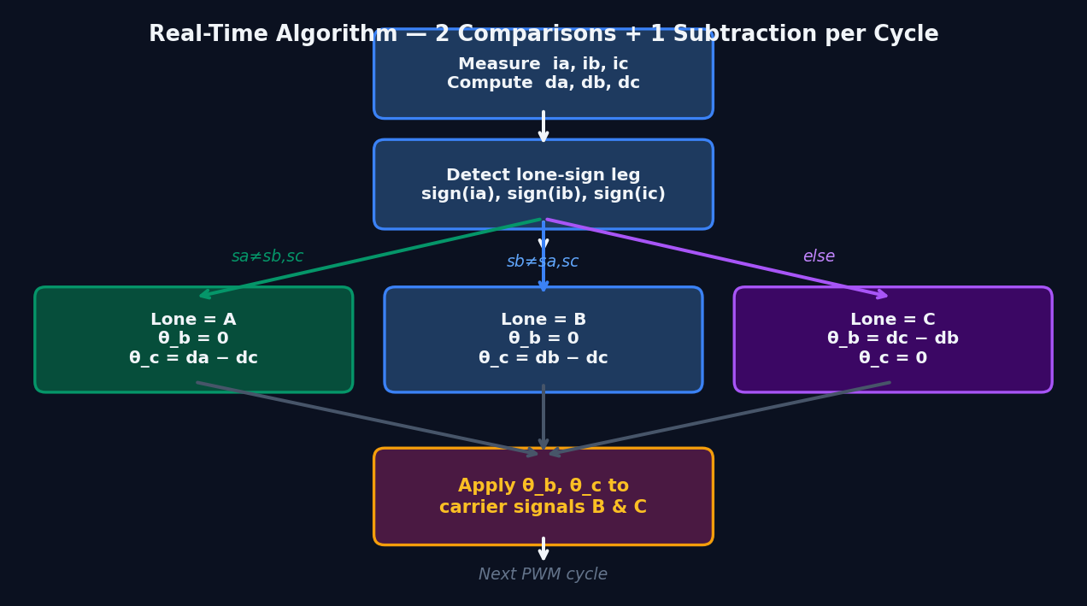
IMPLEMENTATION
Real-time algorithm: 2 comparisons + 1 subtraction
✓ No offline LUT required
✓ No iterative solver or sweep
✓ Analytically optimal — provably
✓ 2 sign checks + 1 subtraction
✓ Updates every switching cycle
✓ No extra hardware needed

Slide 10
CONCLUSION
Key Takeaways
01
Analytical Closed-Form RMS
03
Simple Two-Rule Implementation
I²_rms decomposes into fixed F₀ plus pairwise overlap cross-terms.
All overlaps are piecewise-linear in phase shifts — exact, no approximation.
Align START of one bank pulse with lone pulse.
Align END of other bank pulse with lone pulse.
→ θ_b = 0, θ_c = d_lone − d_bank2
02
Triple Overlap Always Beneficial
04
Three If-Else Cases Cover Full Cycle
∂I²/∂λ_abc = −(ia²+ib²+ic²) < 0 unconditionally.
Maximizing triple overlap is equivalent to maximizing sum-to-zero intervals.
Sign detection → 3 sectors → one subtraction per case.
No sweep, no LUT, no offline computation needed.
Proven analytically and verified numerically against brute-force sweep across all operating points

