Slide 1
KTH
Minimizing
DC-Link
Capacitor
RMS Current
POWER ELECTRONICS
Adaptive Multi-Carrier PWM via Triple Overlap Principle
Two-level three-phase VSI · Analytical closed-form optimum · No LUT, no sweep
KTH Royal Institute of Technology

Slide 2
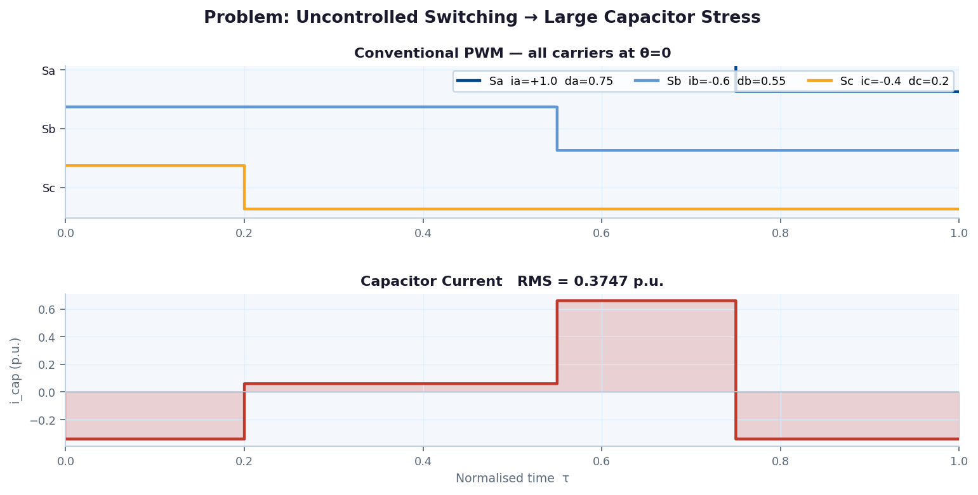
THE PROBLEM
KTH
Uncontrolled switching → excessive capacitor stress
~30%
of inverter failures
linked to DC-link
capacitor
↑ RMS
causes thermal
stress & lifetime
reduction
0 hw
extra hardware
needed for this
optimisation
KTH Royal Institute of Technology | Electrical Engineering | 2 / 10

Slide 3
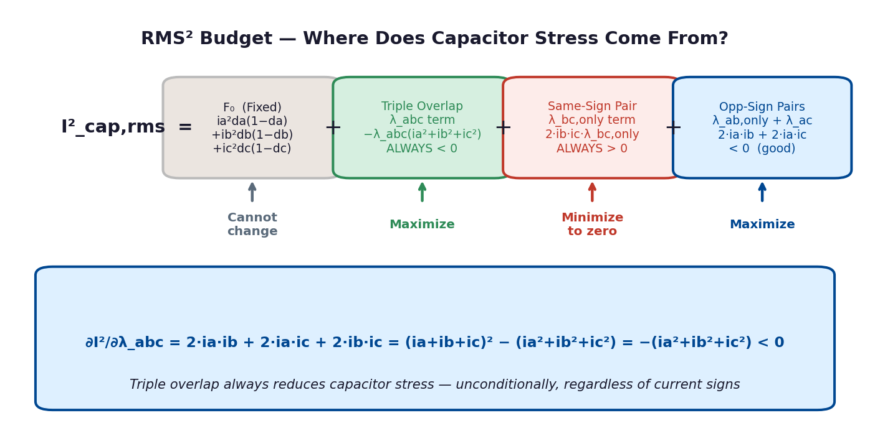
ANALYTICAL FOUNDATION
KTH
RMS² budget decomposition
KTH Royal Institute of Technology | Electrical Engineering | 3 / 10

Slide 4
KEY INSIGHT
KTH
Triple overlap principle
Maximize λ_abc (Triple Overlap)
Minimize λ_bc,only (Same-Sign Pair)
∂I² / ∂λ_abc = −(ia²+ib²+ic²) < 0
∂I² / ∂λ_bc,only = 2·ib·ic > 0
When all three switches are ON simultaneously,
ia + ib + ic = 0 → only −ī_dc remains.
Triple overlap ALWAYS reduces RMS² —
unconditionally, regardless of signs.
When the two same-sign legs switch together
without the lone leg:
ib + ic = −ia flows as ripple current.
Same-sign exclusive overlap ALWAYS bad.
Optimal rule: nest both bank pulses INSIDE the lone pulse → λ_bc,only = 0 AND λ_abc = max(0, db+dc−da)
KTH Royal Institute of Technology | Electrical Engineering | 4 / 10

Slide 5
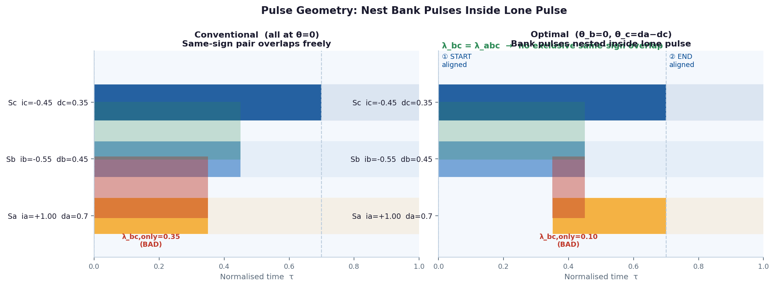
PULSE GEOMETRY
KTH
Before & after: nesting the bank pulses
KTH Royal Institute of Technology | Electrical Engineering | 5 / 10

Slide 6
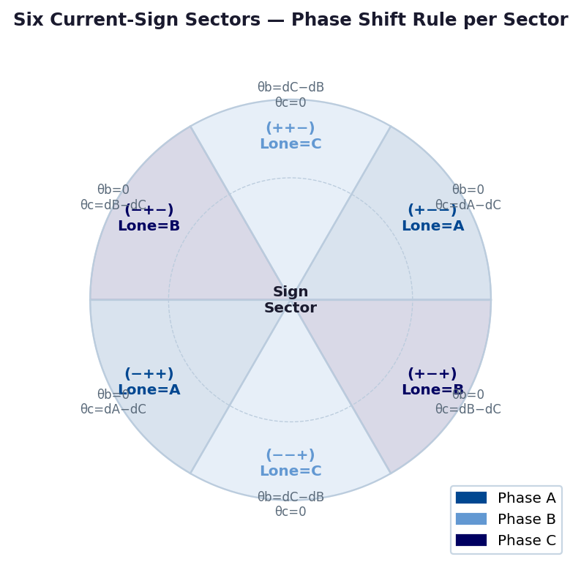
SECTOR LOGIC
KTH
Three if-else cases cover all six sign combinations
% 3 comparisons, 1 subtraction
sa = sign(ia); sb = sign(ib);
sc = sign(ic);
if sa≠sb && sa≠sc % lone=A
θ_a=0; θ_b=0;
θ_c=
da−dc;
elseif sb≠sa && sb≠sc % lone=B
θ_a=0; θ_b=0;
θ_c=
db−dc;
else % lone=C
θ_a=0;
θ_b=
dc−db;
θ_c=0;
end
KTH Royal Institute of Technology | Electrical Engineering | 6 / 10

Slide 7
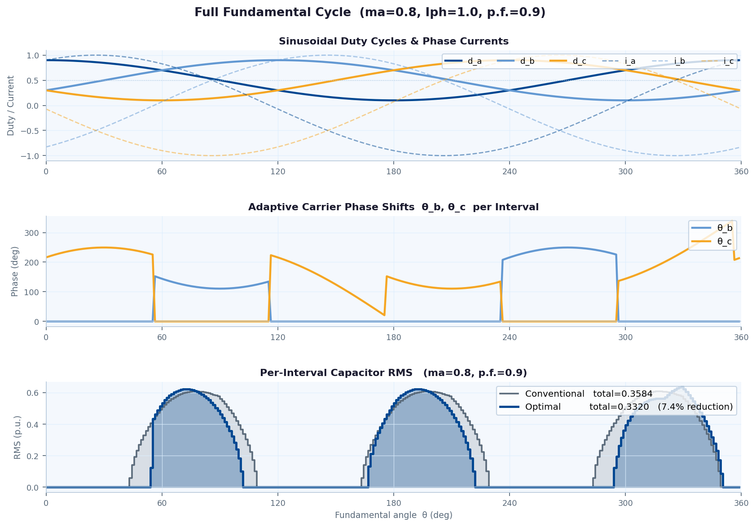
RESULTS
KTH
Full fundamental cycle — sinusoidal references
KTH Royal Institute of Technology | Electrical Engineering | 7 / 10

Slide 8
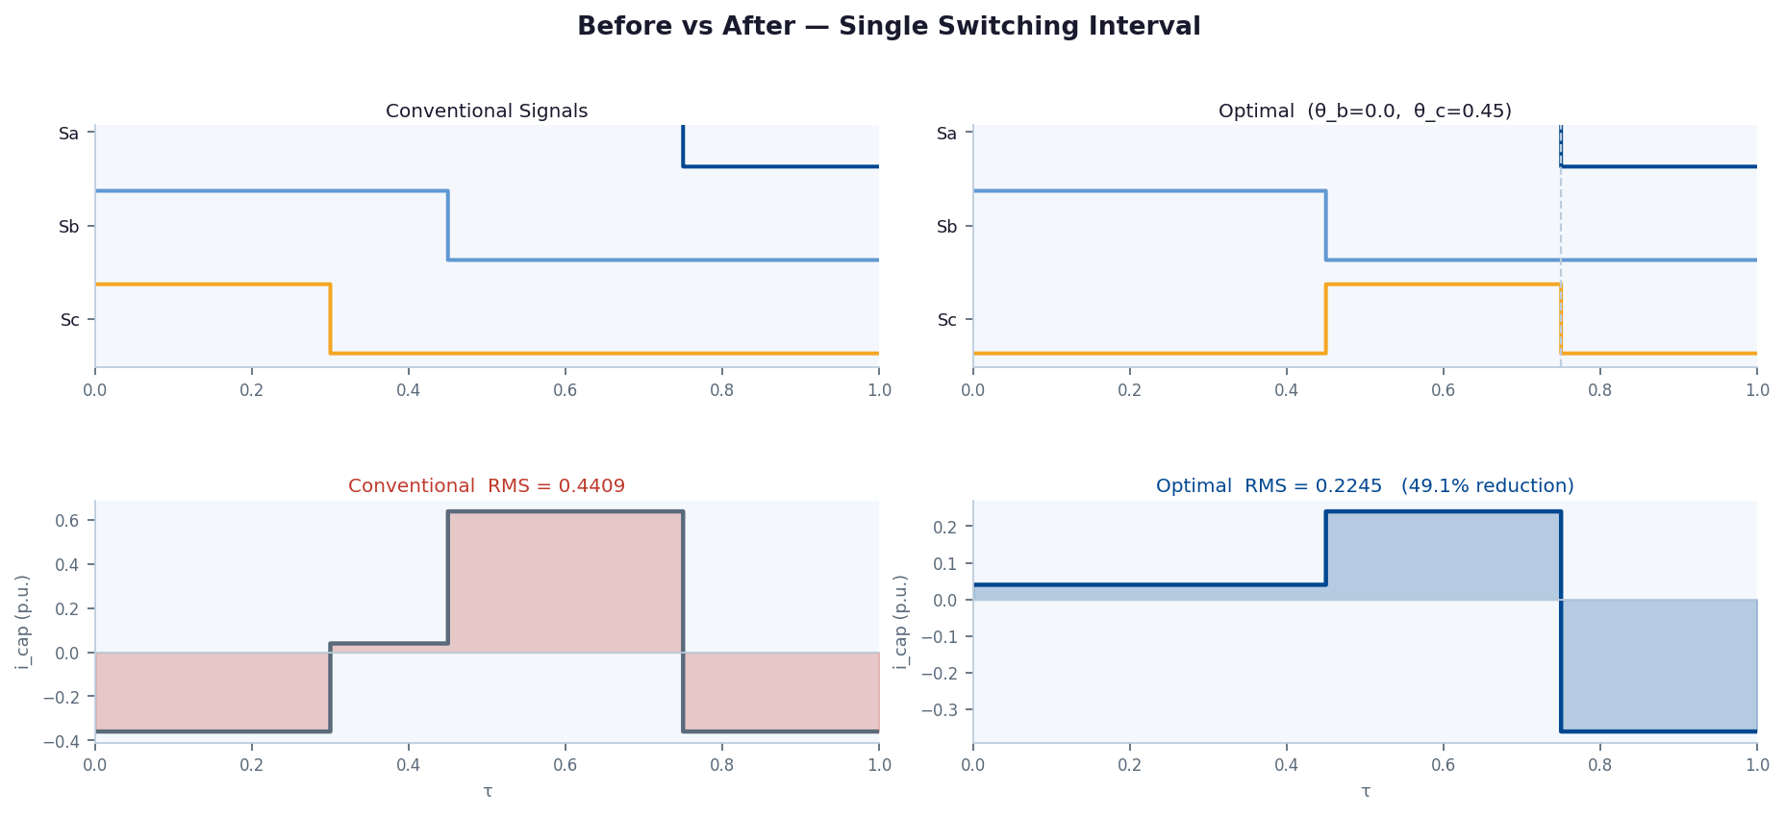
PERFORMANCE
KTH
Single switching interval — before vs after
KTH Royal Institute of Technology | Electrical Engineering | 8 / 10

Slide 9
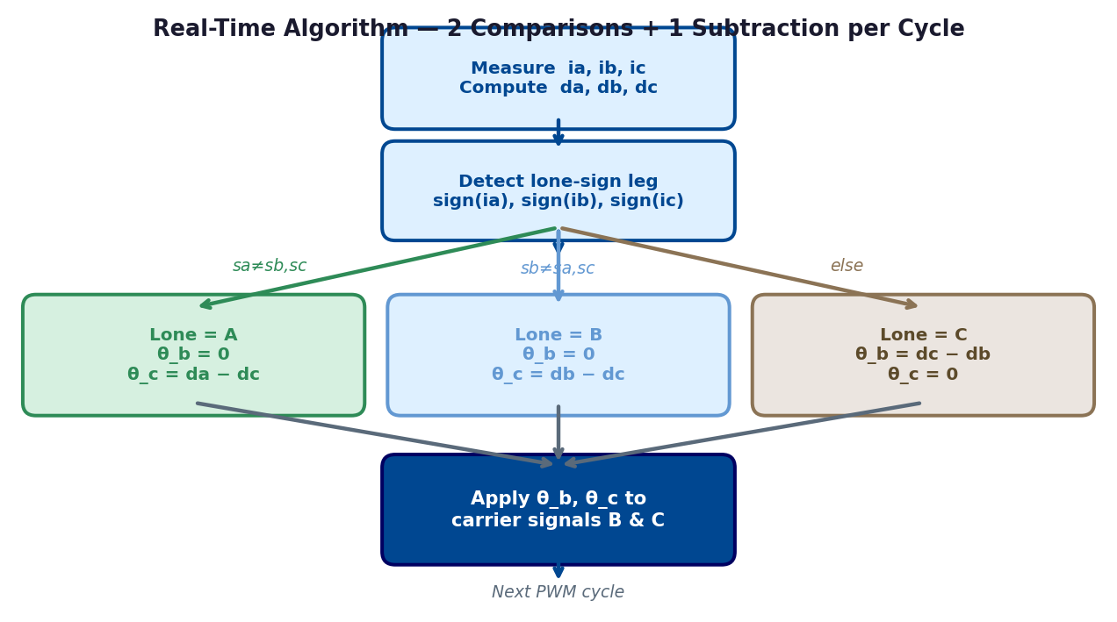
IMPLEMENTATION
KTH
Real-time algorithm: 2 comparisons + 1 subtraction
✓ No offline LUT required
✓ No iterative solver or sweep
✓ Analytically optimal — proved
✓ 2 sign checks + 1 subtraction
✓ Updates every switching cycle
✓ No extra hardware needed
KTH Royal Institute of Technology | Electrical Engineering | 9 / 10

Slide 10
KTH
Key Takeaways
Analytical Closed-Form RMS
Simple Two-Rule Implementation
01
03
I²_rms decomposes into fixed F₀ plus pairwise overlap cross-terms.
All overlaps are piecewise-linear in θ_b, θ_c — exact, no approximation.
Align START of one bank pulse with lone pulse.
Align END of other bank pulse with lone pulse.
→ θ_b = 0, θ_c = d_lone − d_bank2
Triple Overlap Always Beneficial
Three If-Else Cases Cover Full Cycle
02
04
∂I²/∂λ_abc = −(ia²+ib²+ic²) < 0 unconditionally.
Maximising λ_abc = maximising sum-to-zero intervals.
Sign detection → 3 sectors → one subtraction per case.
No sweep, no LUT, no offline computation needed.
Verified analytically and against brute-force sweep across all operating points
KTH Royal Institute of Technology | Electrical Engineering | 10 / 10

