Slide 1
DC-link Capacitance Estimation

Slide 2
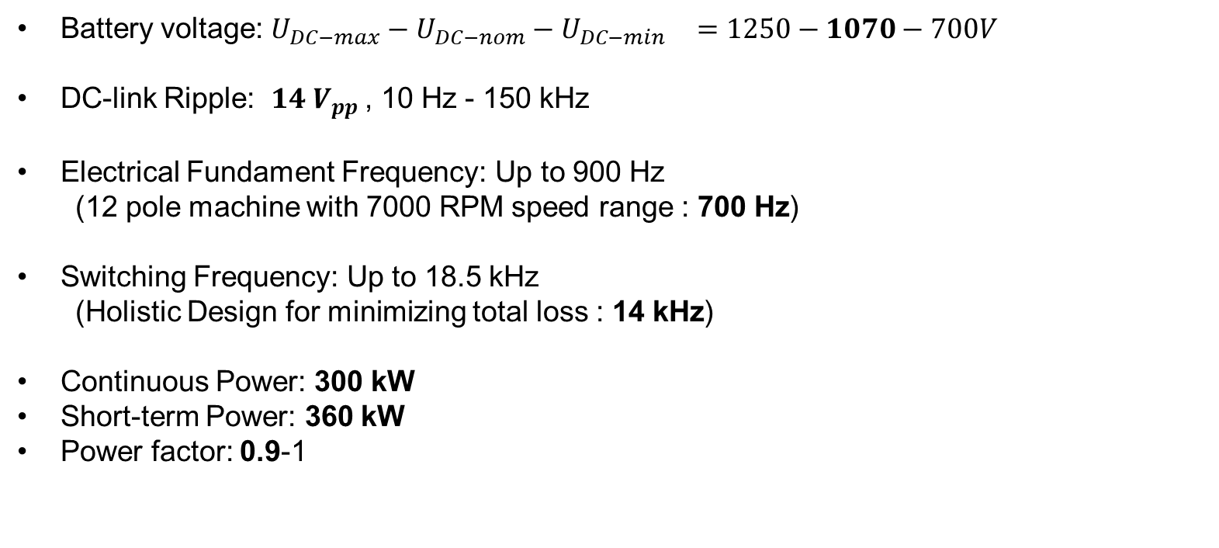
System Specifications-Ratings
Battery voltage: $U_{DC−max}−U_{DC−nom}−U_{DC−min}{ }=1250−1070−700V$
DC-link Ripple: $14 V_{pp}$, 10 Hz - 150 kHz
Electrical Fundament Frequency: Up to 900 Hz
  (12 pole machine with 7000 RPM speed range : 700 Hz)
Switching Frequency: Up to 18.5 kHz
  (Holistic Design for minimizing total loss : 14 kHz)
Continuous Power: 300 kW
Short-term Power: 360 kW
Power factor: 0.9-1

Slide 3
Voltage - Current Waveforms

Slide 4


Minimum Capacitance Requirement
1070 V 415 A
1250 V 355 A
$$>375 μF$$
$$>320 μF$$

Slide 5


Short Term Power Requirement
1070 V 415 A
1250 V 355 A
$$>400 μF$$
$$>350 μF$$

Slide 6
Current Ripple Requirements (RMS)
1070 V 415 A
1250 V 355 A

Slide 7

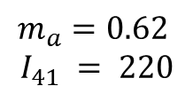
Current Ripple For Different Cases (ffund=700Hz)
pf=0.9
$$m_{a}=0.62$$
$$I_{41} = 220$$
${41}^{th}=28700 Hz$
m=0.25
m=0.5
m=0.75
m=1

Slide 8
Current Ripple For Different Cases (ffund=700Hz)
pf=1
m=0.25
m=0.5
m=0.75
m=1

Slide 9
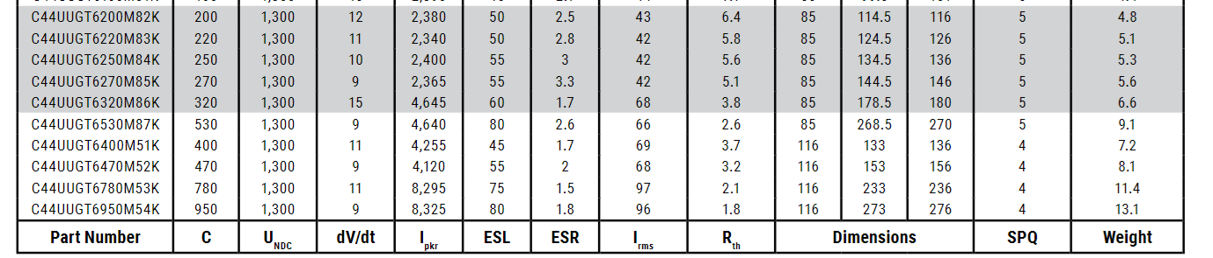
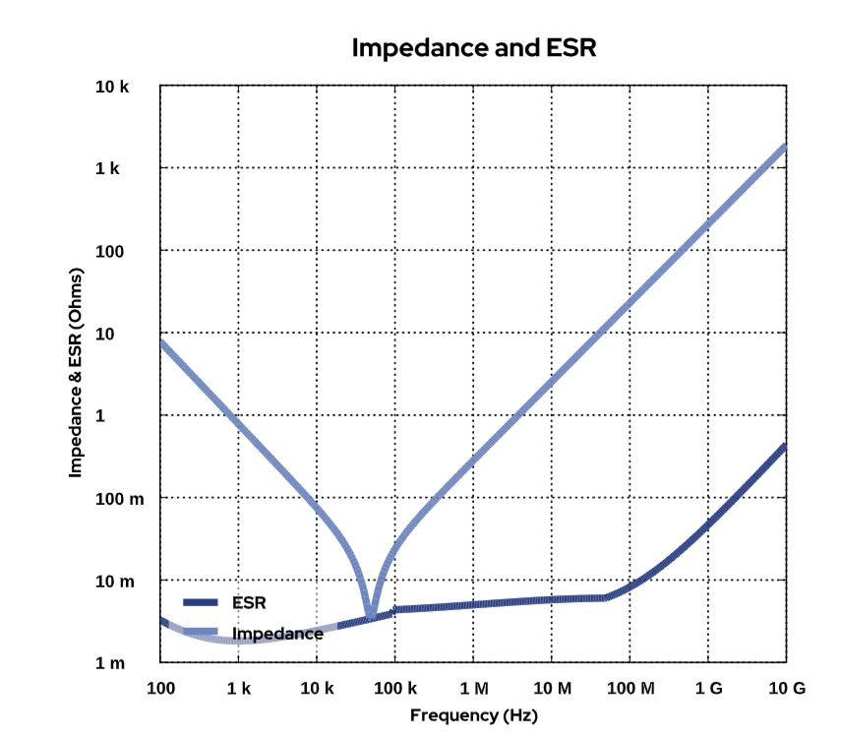
Capacitance Selection
at 10kHz
C44U-M, Film, Metallized Polypropylene, DC Link, 200 uF, 10%, 1300 VDC

Slide 10







Capacitance Selection
ESR = 2.5 $mΩ$ at 10kHz
3 $mΩ$ at aroud 30 khz
28700 Hz 180 $A_{RMS}$
4$3 A_{RMS}$ ripple at 10kHz
35 $A_{RMS}$ at aroud 30 khz
Required parallel capacitors = $\frac{180}{35 } \sim 5$
Capacitance = $1000 μF$
3.3 L
4.8 kg
https://search.kemet.com/component-documentation/download/specsheet/C44UUGT6200M82K

