Slide 1
Multi-Objective Optimization of Traction Inverters for Electric Trucks Considering Environmental Impacts
A Life-Cycle-Based Approach for Minimizing Environmental Footprint
Enes Ayaz, KTH

Slide 2
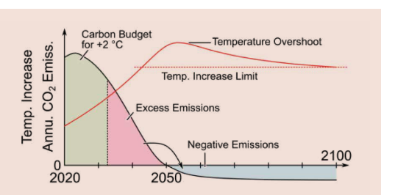
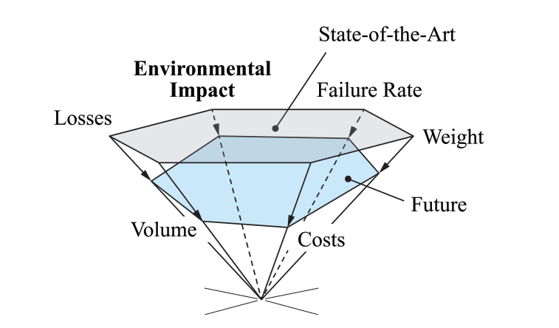
Introduction & Motivation
Introduction:
Climate targets (e.g., Paris Agreement) emphasize the need for net-zero emissions by 2050.
Electric trucks are critical for reducing CO2 emissions in the transportation sector.
Motivation:
Traditional power converter optimization focuses on efficiency and power density.
Environmental impacts across the inverter's lifecycle and reliability are often overlooked but crucial for sustainability.

Slide 3
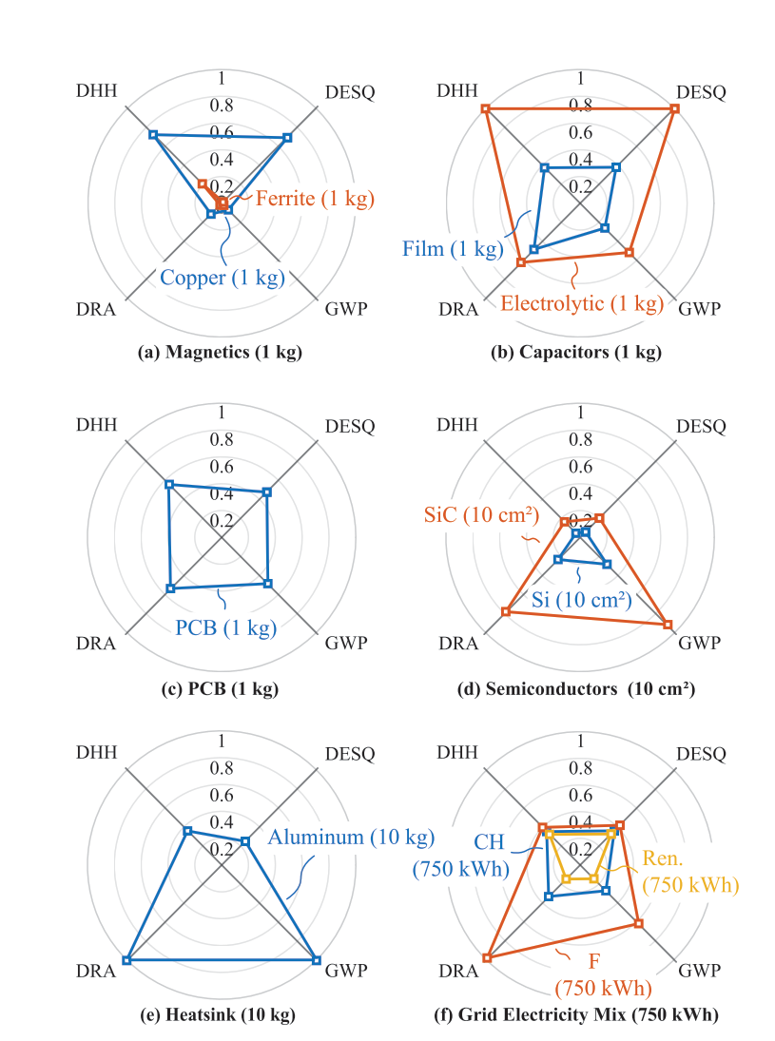
Challenges
Energy Efficiency and Beyond:
The environmental impact of power electronics goes beyond energy efficiency.
Future electrification (e.g., trucks) needs sustainable solutions for power conversion systems.
Research Challenges:
How can we integrate life-cycle environmental impacts with traditional performance metrics (efficiency, power density, reliability)?
The need for multi-objective optimization frameworks that include:
  Global Warming Potential (GWP)
  Damage to Eco-System Quality (DESQ)
  Damage to Resource Availability (DRA),
  Damage to Human Health (DHH)

Slide 4
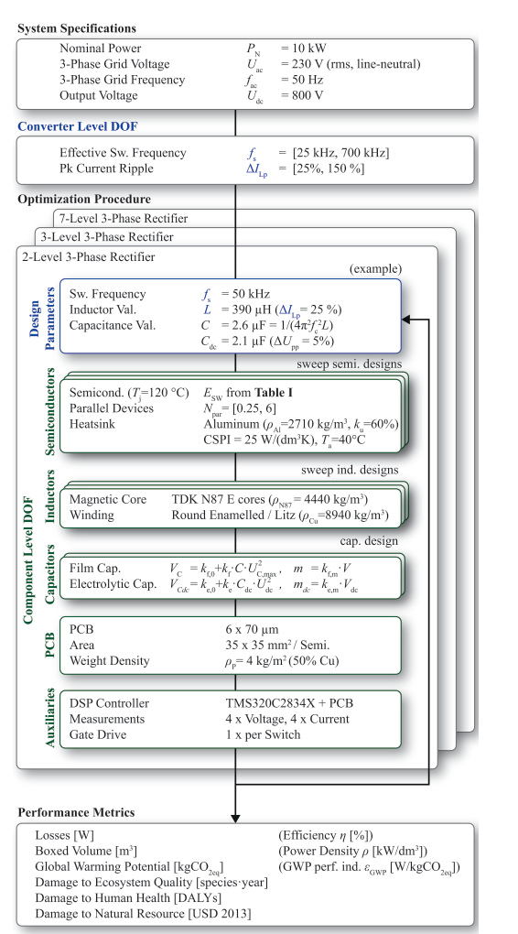
Research Problem & Objectives
Research Problem:
How to design traction inverters for electric trucks that not only maximize energy efficiency but also minimize environmental impacts.
Objectives:
Extend multi-objective optimization of traction inverters to include:
  Carbon footprint (GWP, DESQ, DRA, DHH)
  Material efficiency (circular economy)
  Recycling potential at the end of life
Evaluate design trade-offs between efficiency, environmental impact, and power density.
Evaluate different inverter topologies (e.g., 2-level vs. SPB vs. multilevel) using Pareto-front analysis.
Include life-cycle assessment (LCA) metrics in the design phase, considering the use phase of the inverter in electric trucks.

Slide 5
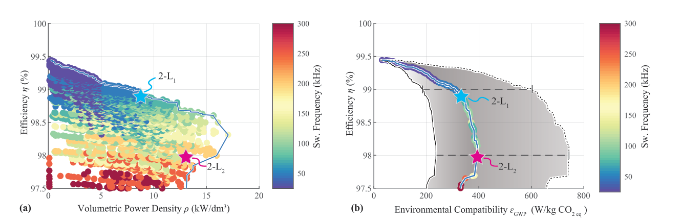
Adopted Methodology
Life-Cycle Assessment (LCA):
  Assess all stages of the traction inverter lifecycle: manufacturing, use-phase, and end-of-life.
  Incorporate environmental metrics such as GWP, resource depletion, and recyclability.
Multi-Objective Optimization:
  Extend traditional optimization (efficiency, cost, power density) to include LCA results.
  Use Pareto-front analysis to balance conflicting objectives (e.g., higher efficiency vs. higher material footprint).
Tools: Optimization algorithm (e.g., MATLAB), modeling of SiC and Si components, and switching frequency evaluation.
Case Study: A comparative study of different traction inverter topologies (e.g., Si vs. SiC, 2L vs. 3L).

Slide 6
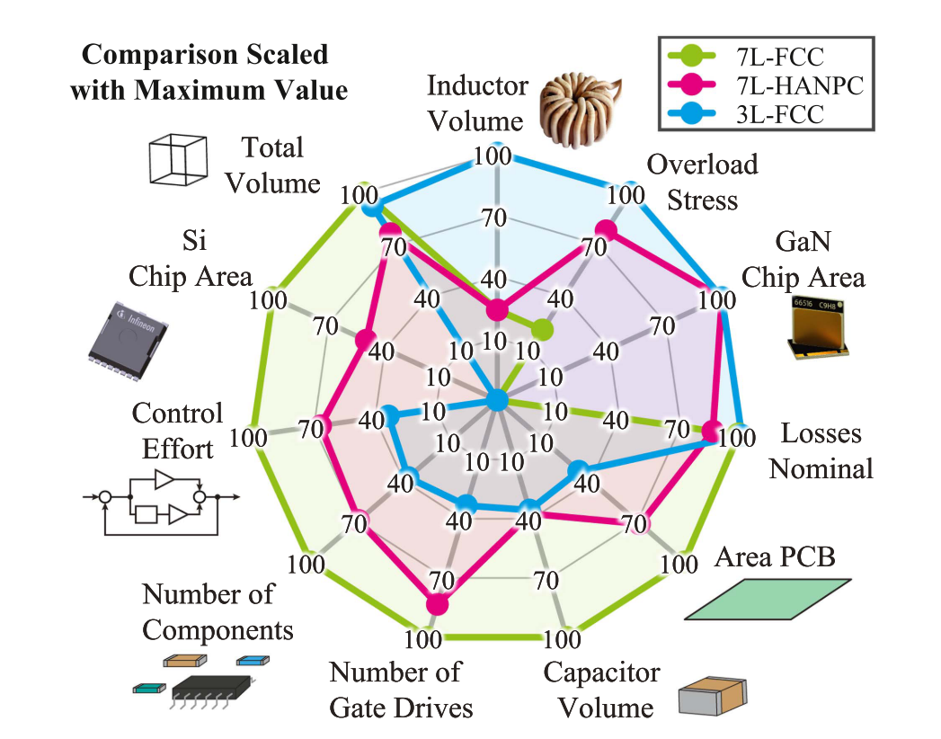
Application of Traction Inverters
Optimization Process:
Compare 2-level vs. SPB (series-parallel) vs. Multilevel (e.g., 3-level, 5-level) inverter topologies.
Evaluate key parameters:
  Switching frequency vs. losses and efficiency.
  Component-level impacts (semiconductors, capacitors, PCBs, etc.).
Use of mission profiles to optimize the use-phase emissions (e.g., hours of operation per day for electric trucks).

Slide 7
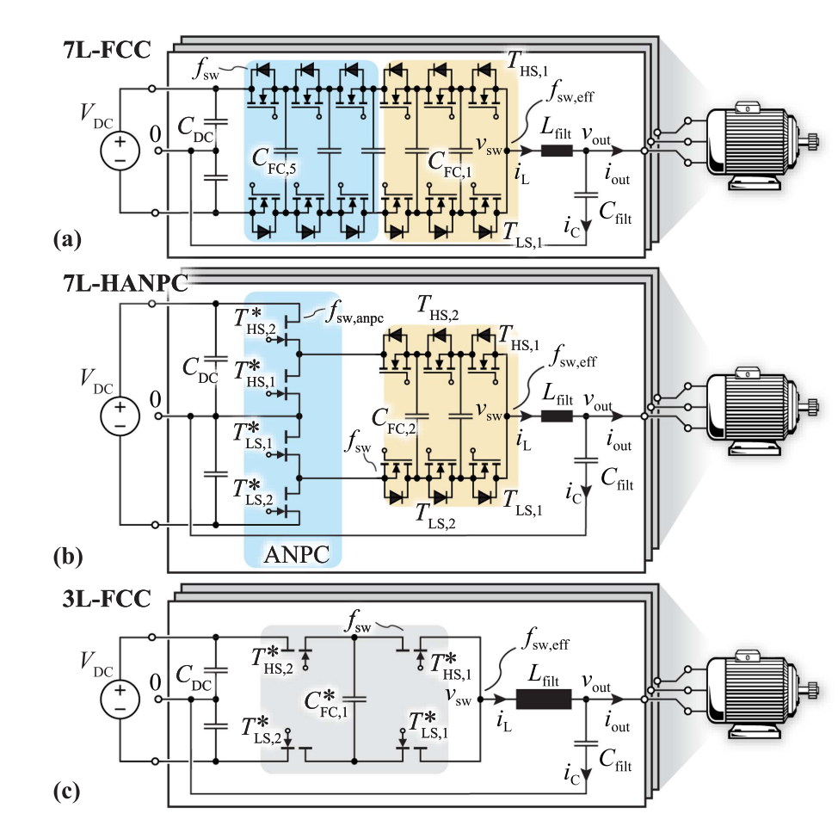
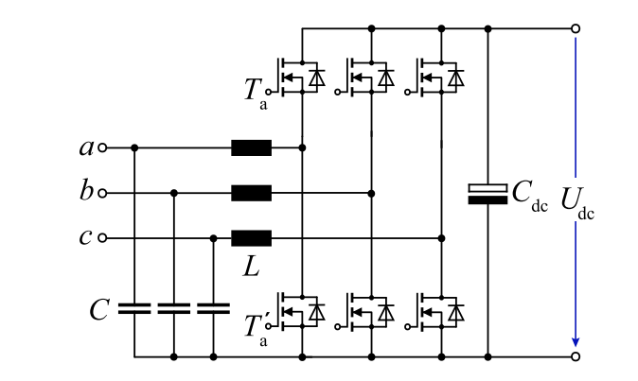
Topologies– 2 Level or Multilevel VSIs
Possible Semiconductor Technology
2L- SiC
3L- SiC
5L- GaN
7L- Si

Slide 8
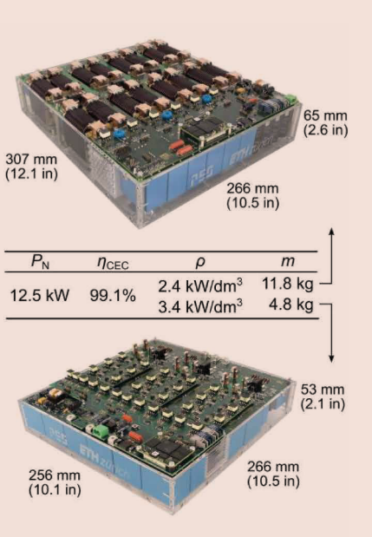
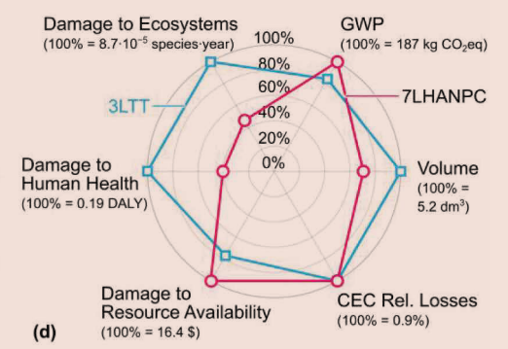
Expected Results
3LTT
Expected Outcomes:
Achieve optimized designs with higher efficiency and lower environmental footprint (e.g., lower GWP).
Design Trade-offs:
Higher switching frequencies reduce passive component size but increase semiconductor losses.
Inverter design with an initially higher environmental impact (e.g., larger components) might yield lower lifecycle emissions due to superior efficiency.
7LHANPC

Slide 9
References
Rohner, G., Kolar, J. W., Bortis, D., & Schweizer, M. (2022). Optimal Level Number and Performance Evaluation of Si/GaN Multi-Level Flying Capacitor Inverter for Variable Speed Drive Systems. 2022 International Conference on Electrical Machines and Systems, ICEMS 2022, 1–6. https://doi.org/10.1109/ICEMS56177.2022.9982999
Rohner, G., Gfrorer, T., Niklaus, P. S., Huber, J., Bortis, D., Schweizer, M., & Kolar, J. W. (2023). Hardware-Based Comparative Analysis of Multilevel Inverter Topologies for Integrated Motor Drives Considering Overload Operation. IEEE Open Journal of Power Electronics, 4(August), 934–944. https://doi.org/10.1109/OJPEL.2023.3327423
Rohner, G., Huber, J., Mirić, S., & Kolar, J. W. (2024). Comparative Evaluation of Three-Phase Three-Level Flying Capacitor and Stacked Polyphase Bridge GaN Inverter Systems for Integrated Motor Drives. Electronics (Switzerland), 13(7). https://doi.org/10.3390/electronics13071259
Rohner, G., Huber, J., Mirić, S., & Kolar, J. W. (2024). Comparative Evaluation of Three-Phase Three-Level Flying Capacitor and Stacked Polyphase Bridge GaN Inverter Systems for Integrated Motor Drives. Electronics (Switzerland), 13(7). https://doi.org/10.3390/electronics13071259
Imperiali, L., Menzi, D., Kolar, J. W., & Huber, J. (2024). Multi-Objective Minimization of Life-Cycle Environmental Impacts of Three-Phase AC-DC Converter Building Blocks. Conference Proceedings - IEEE Applied Power Electronics Conference and Exposition - APEC, 2994–3004. https://doi.org/10.1109/APEC48139.2024.10509190
Huber, J., Imperiali, L., Menzi, D., Musil, F., & Kolar, J. W. (2024). Life-Cycle Carbon Footprints of Low-Voltage Motor Drives with 600-V GaN or 650-V SiC Power Transistors. Proceedings of the 13th International E-Conference on Integrated Power Electronics Systems .
Huber, J., Imperiali, L., Menzi, D., Musil, F., & Kolar, J. W. (2024). Energy Efficiency is Not Enough! IEEE Power Electronics Magazine, 11(1), 18–31. https://doi.org/10.1109/MPEL.2024.3354013

Slide 10
References
J. Wang, Y. Li and Y. Han, "Evaluation and design for an integrated modular motor drive (IMMD) with GaN devices," 2013 IEEE Energy Conversion Congress and Exposition, Denver, CO, USA, 2013, pp. 4318-4325, doi: 10.1109/ECCE.2013.6647278.
J. Wang and Y. Han, "A new concept of multilevel converter motor drive with modular design and split winding machine," 2014 Power and Energy Conference at Illinois (PECI), Champaign, IL, USA, 2014, pp. 1-6, doi: 10.1109/PECI.2014.6804550. J. Wang and Y. Han, "A class of modular multilevel motor drives with design flexibility and reduced components number," 2015 IEEE Applied Power Electronics Conference and Exposition (APEC), Charlotte, NC, USA, 2015, pp. 2387-2393, doi: 10.1109/APEC.2015.7104682. Design of Multilevel Integrated Modular Motor Drive withGallium Nitride Power Devices, Jiyao Wang
H. Zhang, O. Wallmark, M. Leksell, S. Norrga, M. N. Harnefors and L. Jin, "Machine design considerations for an MHF/SPB-converter based electric drive," IECON 2014 - 40th Annual Conference of the IEEE Industrial Electronics Society, Dallas, TX, USA, 2014, pp. 3849-3854, doi: 10.1109/IECON.2014.7049074.
L. Jin, S. Norrga, H. Zhang and O. Wallmark, "Evaluation of a multiphase drive system in EV and HEV applications," 2015 IEEE International Electric Machines & Drives Conference (IEMDC), Coeur d'Alene, ID, USA, 2015, pp. 941-945, doi: 10.1109/IEMDC.2015.7409174.
H. Zhang and O. Wallmark, "Evaluation of winding arrangements in electric machinery for modular electric drives," 2016 IEEE 8th International Power Electronics and Motion Control Conference (IPEMC-ECCE Asia), Hefei, China, 2016, pp. 2820-2825, doi: 10.1109/IPEMC.2016.7512744.

