Slide 1
A Neural Network Aided Modulation Strategy for DC-Link Capacitor Lifetime Extension in Three-Phase Two-Level VSIs
Enes Ayaz, KTH

Slide 2
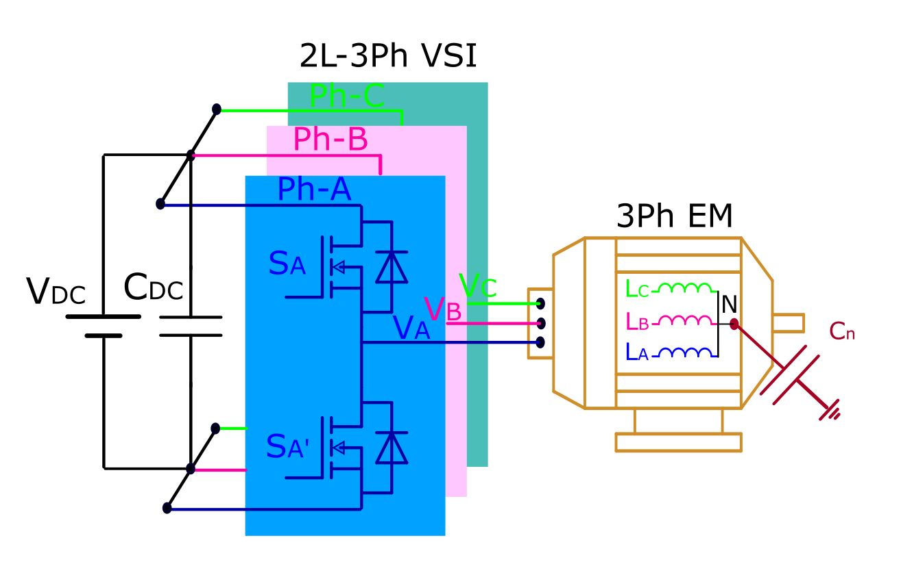
Overview of Three-Phase Two-Level VSIs
Still dominant in industrial motor drives, traction systems, and renewable energy applications owing to:
  Structural simplicity
  Minimal component requirements
  Simple to control
  Minimal cost
Reliability remains a critical concern for sustainable power conversion systems.
Extending the lifespan of the system is crucial at this point.

Slide 3
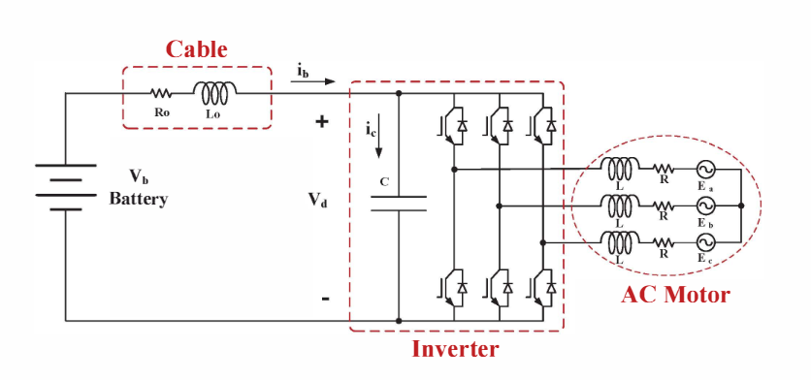
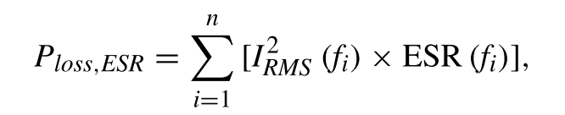

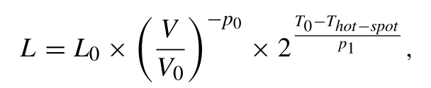
DC-Link Capacitor: A Key Reliability Bottleneck
Functions:
  Stabilizes DC bus voltage
  Suppresses switching-induced fluctuations and parasitic oscillations
Accounts for ~20% of all VSI failures.
Degradation impacts system longevity.
DC-link current harmonics influence thermal stress, affecting capacitor lifespan.
Capacitor lifetime improves with lower hot-spot temperatures.
Hot-spot temperature depends on power losses, which decrease when the RMS value of the capacitor current is reduced.
Therefore, minimizing the capacitor's ripple current helps extend its lifespan.

Slide 4
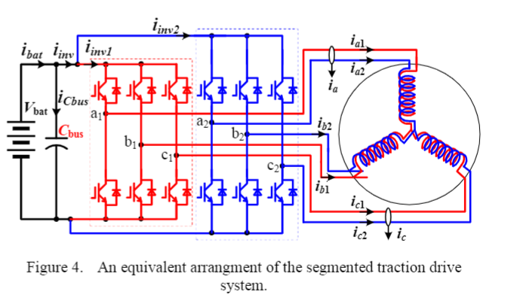
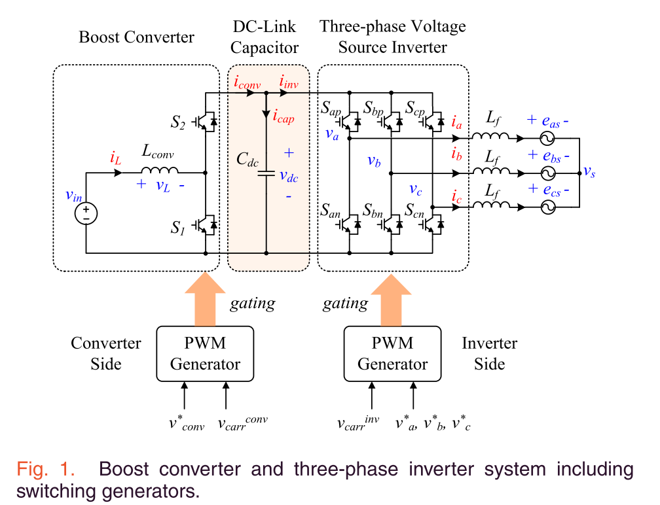
Reducing Current Ripple & Stress
Advanced modulation techniques aim to:
  Minimize inverter-induced current ripple
  Reduce DC-link current stress
  Maintain system performance & durability
Interleaving techniques modify carrier phase-shift relationships to reduce stress.
Primarily applied in multi-converter systems, such as:
  Dual-inverter architectures (e.g. Segmented motor drives)
  Systems with integrated front-end converters for DC-link regulation

Slide 5



Interleaving for Single 2L-VSI
Existing Interleaving Approaches & Limitations
  Require additional switches (pre-converters, parallel inverters)
  Not applicable for several applications that aim to achieve a cost-effective solution.
PWM-phA
PhA
Voltage
>
x
We propose a novel interleaving between the phase legs of a single two-level VSI.
Challenges:
  Time-varying leg currents complicate implementation.
  Unlike parallel systems, it requires dynamic phase adjustment.
PhA
Current
$$φ_{A}$$
PWM-phB
Inverter current
PhB
Voltage
>
x
+
PhB
Current
$$φ_{B}$$
PWM-phC
PhC
Voltage
>
x
PhC
Current
$$φ_{C}$$

Slide 6
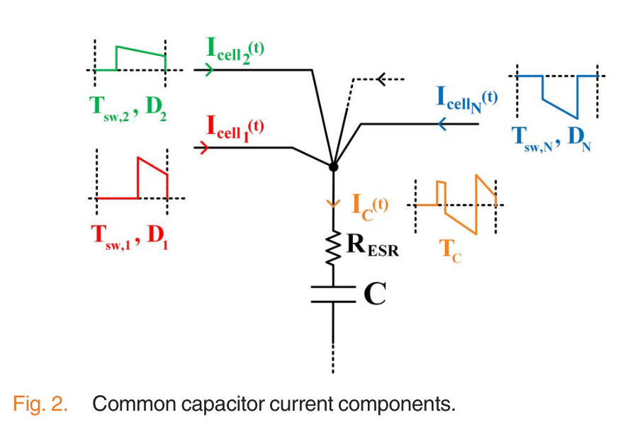







Dynamic Variable Carrier Phase-Shift Modulation
  Adaptively adjusts carrier phase shifts in real-time.
  Optimizes current stress reduction while maintaining performance
Paralel DC/DC Converters
$OC_{1}$
$OC_{mf}$
Operating condition
…
Fundamental Phase
$0$
…
$2π$
Carrier phase shift
$[φ_{B−OC1},φ_{C−OC1},]$
…
$[φ_{B−OC_{mf}},φ_{C−OC_{mf}},]$
$m_{f}$ is the frequency ratio: $\frac{f_{sw}}{f_{fund}}$
Each operating point (switching period )
duty cycles and phase currents are changing

Slide 7
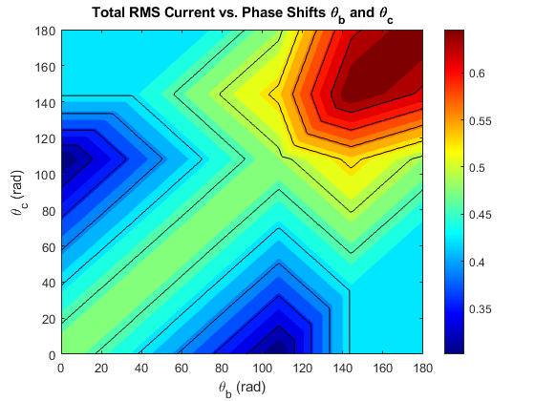
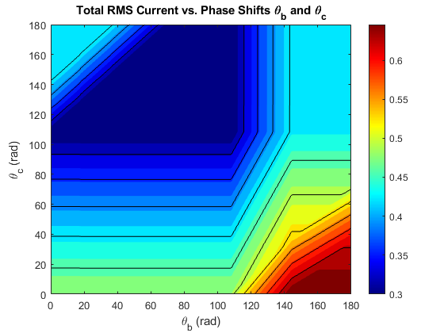
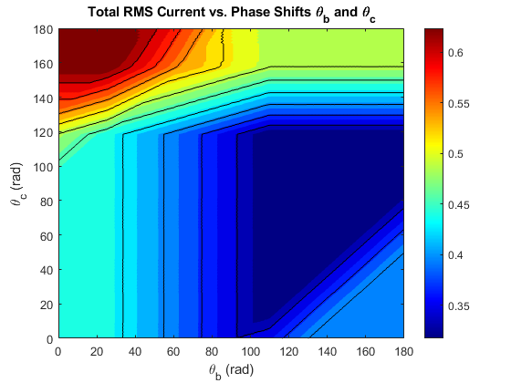

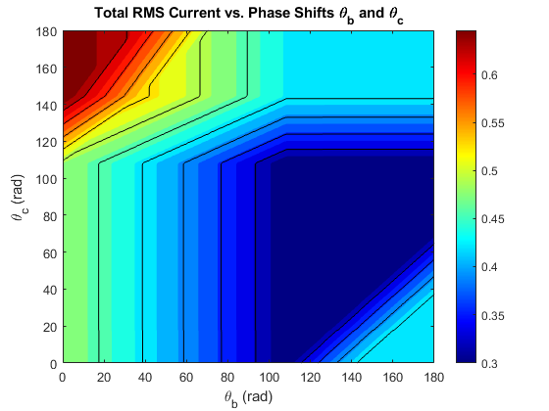

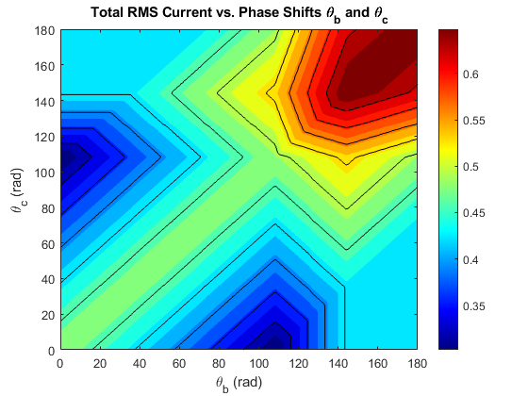







Example of Finding Carrier Phase Shifts
Power factor =1
Modulation index=0.8
$$φ_{fund}=0$$
$$φ_{fund}={60}^{o}$$
$$φ_{fund}={120}^{o}$$
$$φ_{fund}=240$$
$$φ_{fund}={300}^{o}$$
$$φ_{fund}={360}^{o}$$
$$φ_{fund}={180}^{o}$$

Slide 8
Example of Finding Carrier Phase Shifts

Slide 9
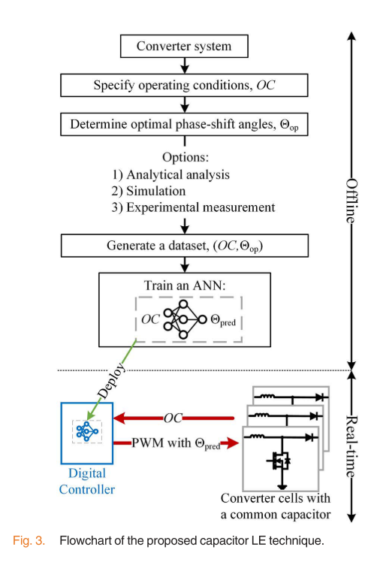
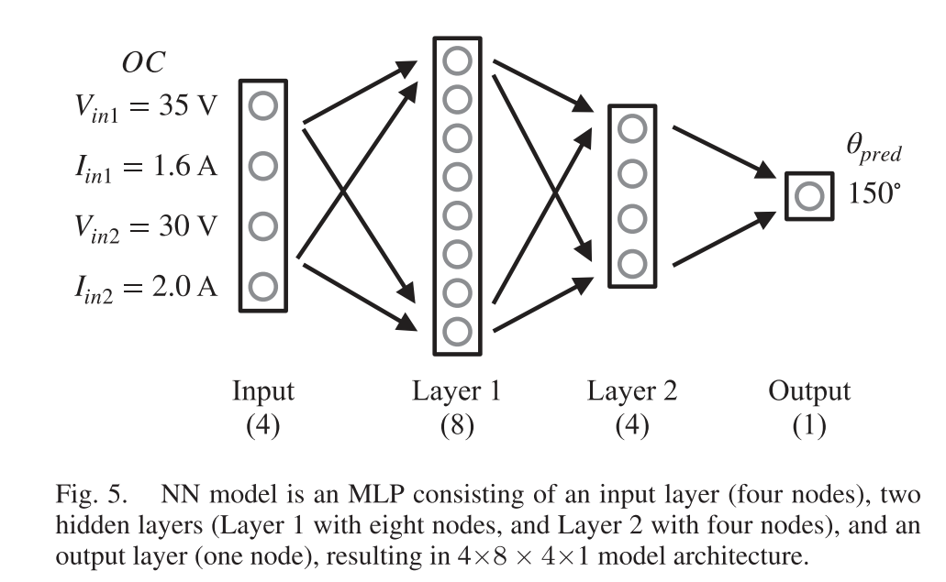
Convolutional Neural Network for CPS
Parallel DC/DC Converters
6 inputs in our case: DA, DB, DC, IphA, IphB, IphC
2 outputs in our case: PhiB and PhiC
SPWM: We can make reduction for inputs: DB, DC, and IphB, IphC since the sum of duty cycle is 3/2 and the sum of the currents is zero.
SVM or other methods: We can reduce inputs: DA, DB, DC, and IphB, IphC since the sum of duty cycle depends on the common mode as well and the sum of the currents is zero.

Slide 10
Possible Contributions
A new interleaving technique for single two-level VSIs, eliminating the need for additional converter/inverter.
An AI-based adaptive modulation strategy that dynamically adjusts phase shifts to minimize DC-link current ripple.
The proposed system is independent of the modulation technique, which can be applied to SPWM, THIPWM, SVM.
Experimental validation demonstrating significant ripple reduction compared to conventional PWM methods to show life time extention.

Slide 11
DC-link Current Ripple- Calculations

