Slide 1
WP4: Progress Updates
Modelling:
  SiC MOSFET module switching and conduction loss modeling.
  Inverter topologies evaluation and virtual prototyping.
  Gate-Drive unit modeling and classification.
Tasks Done:
  FEM simulation of thermal management of system a 2-level prototype inverter.
  Two papers have been presented at ECCE Europe-2024 one about precise switching loss calculation method for SiC modules, and a device identification method to be implemented on Date-Drive unit .
Ongoing Tasks :
  The prototype of a back-to-back 2-level inverter is under development.
  Model the electrothermal behavior and

Slide 2
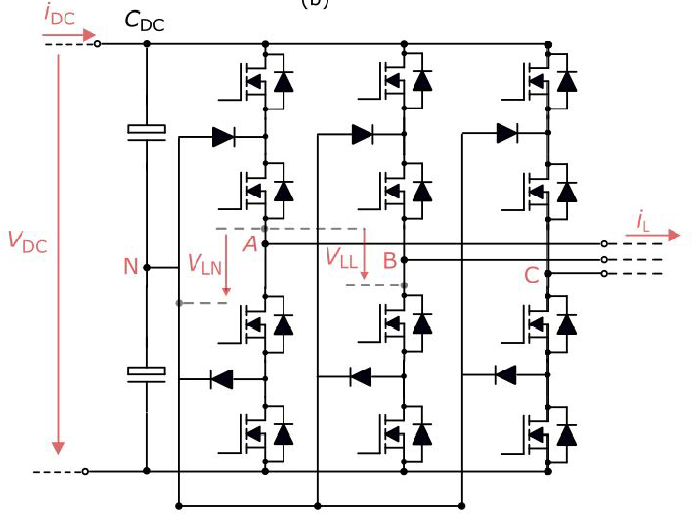
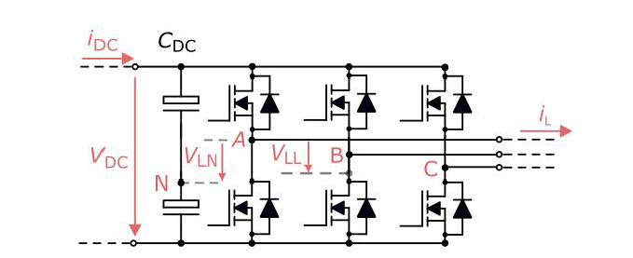
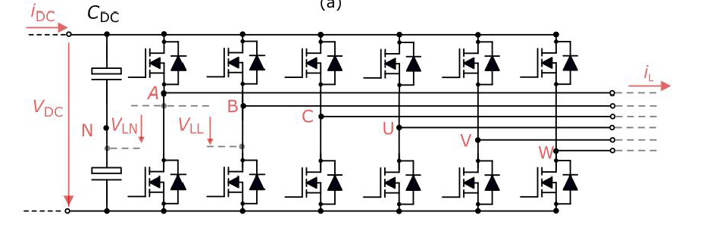
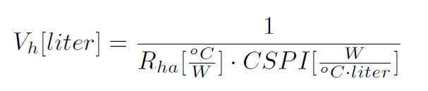
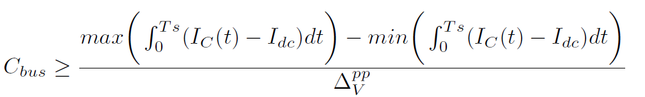
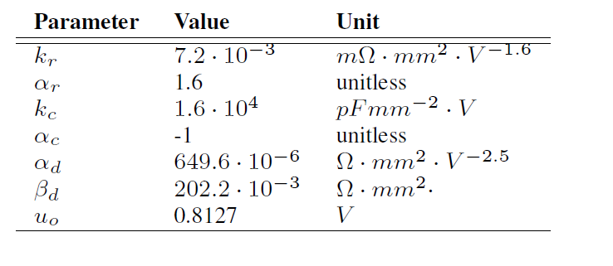
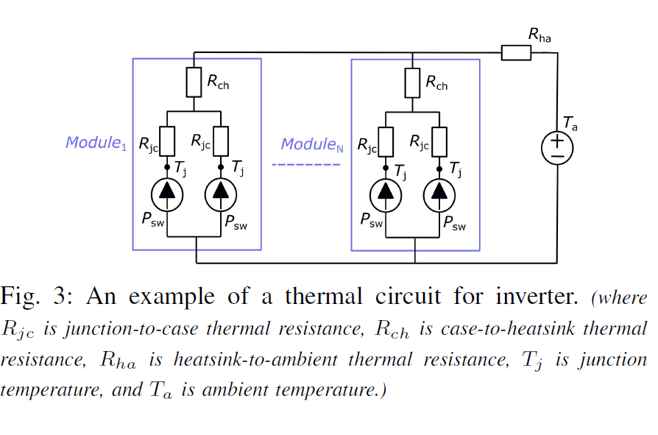
WP4 : Evaluation of Topologies
Topologies:
2L-3Ph-VSI
2L-6Ph-VSI
3L-NPC-VSI
Virtual Prototyping Method to evaluate topologies:
1. Semiconductor Loss Modelling by using figure-of-merit parameters for each topology:
  Conduction Loss
  Switching Loss
2. Cooling System Size Estimation using CSPI
3. DC-link Capacitance Requirements

Slide 3
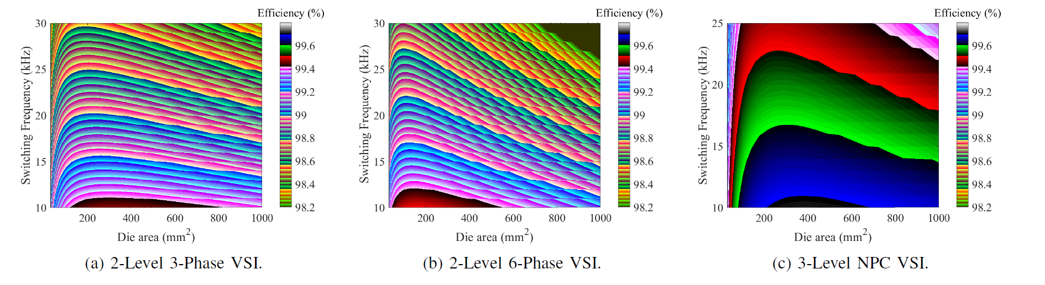
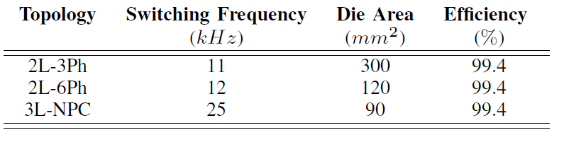
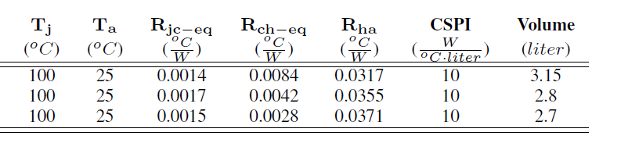
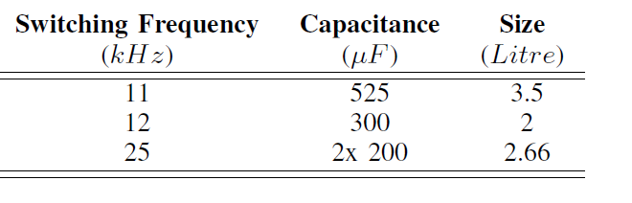
WP4 : Evaluation of Topologies
Results:
The efficiency over varying die area and switching frequency
The adoption of 3L-NPC VSIs, which use lower voltage-rated MOSFETs, has resulted in
a reduction of switching losses,
an increase in switching frequency,
an improvement of the output harmonic quality,
a reduction in the need for passive elements,
a smaller volume

Slide 4
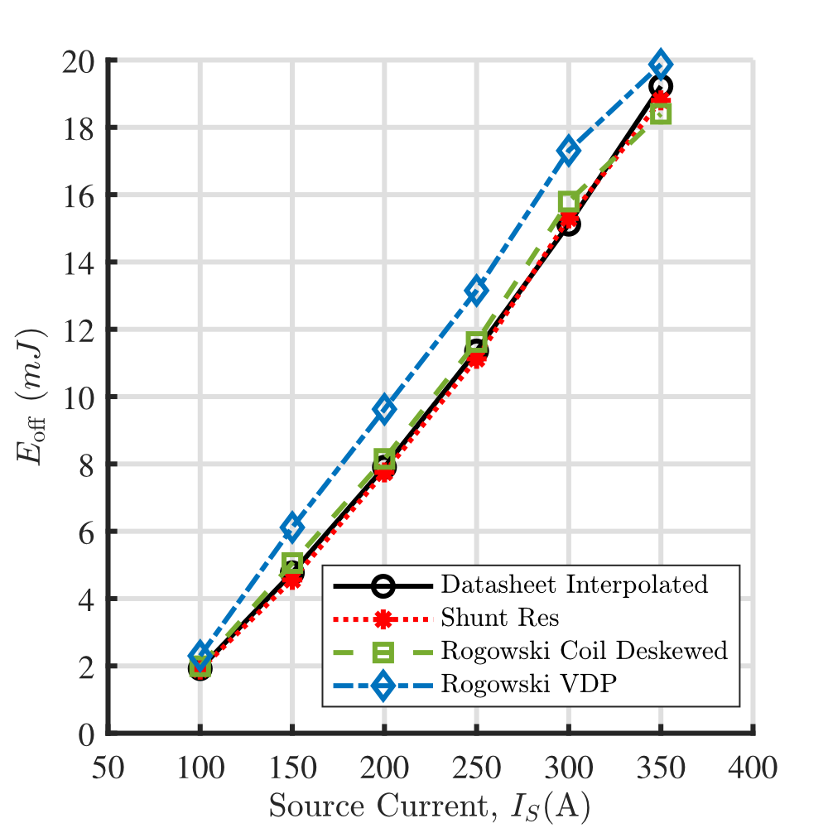
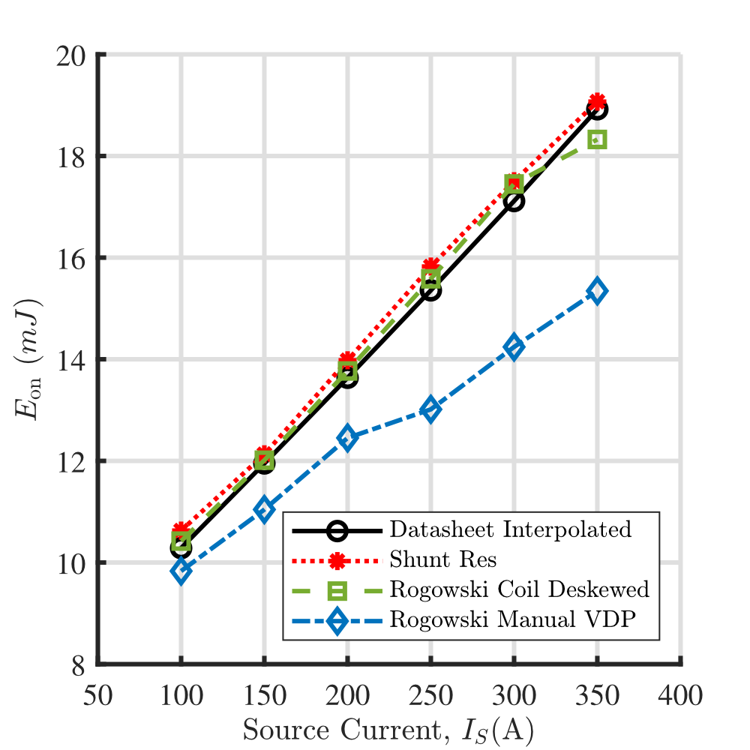
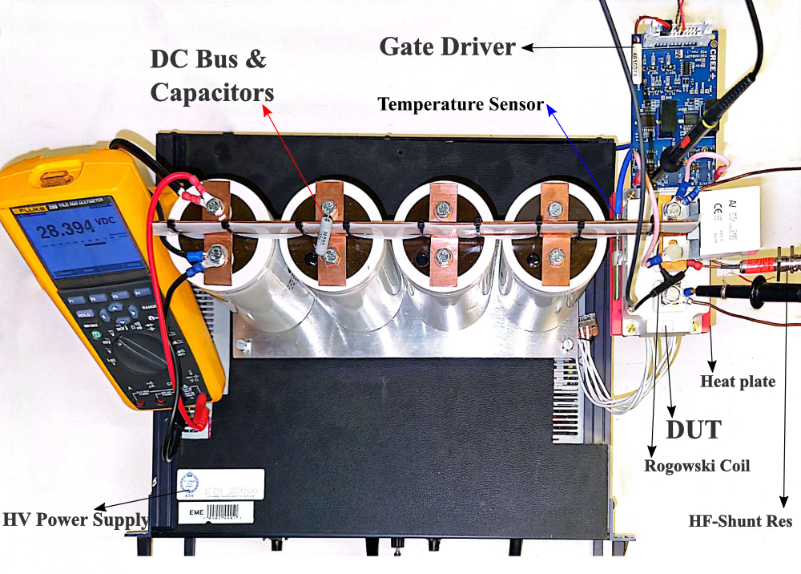
WP4: Progress Updates
DPT setup utilized to measure the SiC MOSFET switching losses
Applying the deskewing method on current waveform to improve switching loss measurement

Slide 5
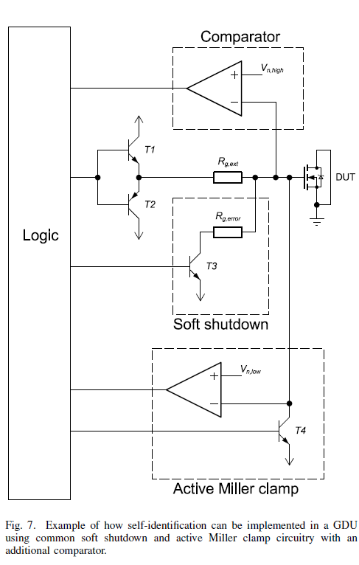
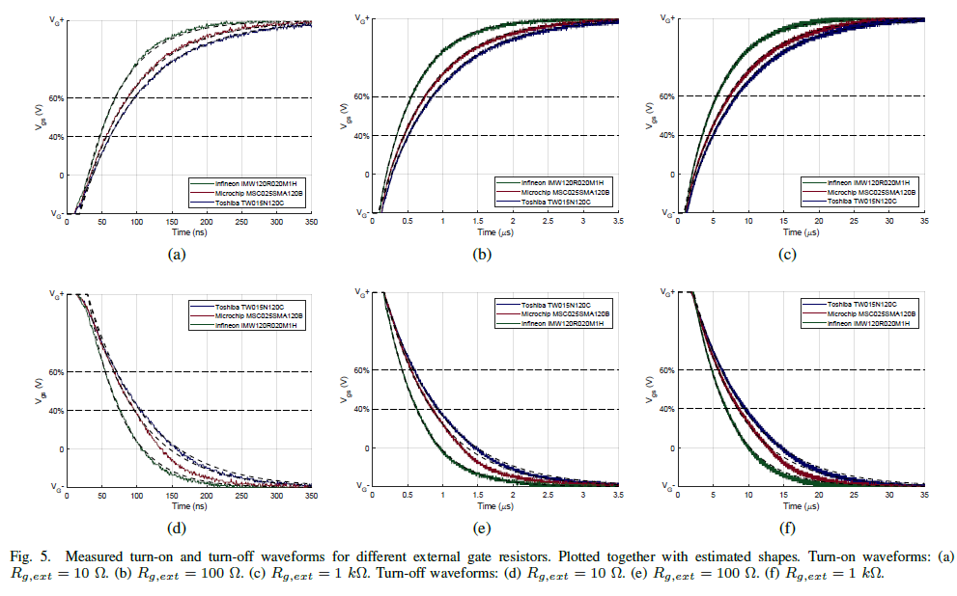
WP4: Progress Updates
Device classification by the gate response behavior
Proposed circuitry for device identification Method

Slide 6
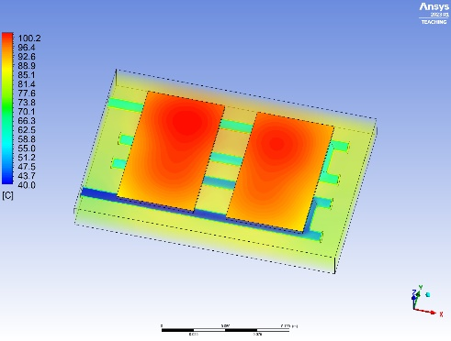
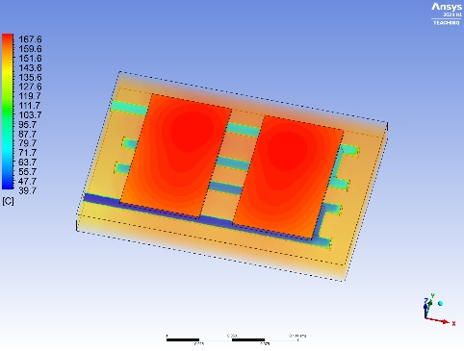
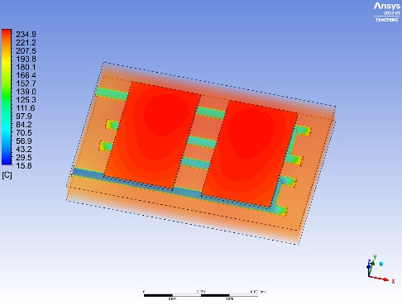
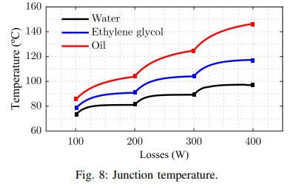
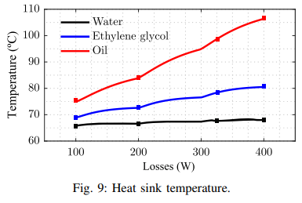
WP4: Progress Updates
(a)
(b)
(c)
Thermal management system FEM simulation

Slide 7
WP6: Progress Updates
Objective: Focusing on total system efficiency, including harmonic losses on the motor and inverter, helps identify the true energy-wise optimal design.
Modelling:
  Inverter losses: Optimization of die area regarding switching frequency and efficiency.
  Motor harmonic losses: Switching frequency optimization to reduce total losses.
Tasks Done:
  Loss models to analyze loss contributors have been created.
  A paper has been submitted to SPEC-2024 (accepted) about the evaluation of possible traction inverter topologies for heavy-duty electric vehicles.
Ongoing Tasks :
  The prototype of the 2-level inverter is under development.
  The comparison matrix with other inverter topologies (3L-Ttype and 3L-NPC) is under analysis.

Slide 8
WP6 : Holistic Design for 2L Inverter
Parameters of Infineon 2kV Power Module
(FF3MR20KM1H)
Inverter Losses with varying number of parallel dies and switching frequency

Slide 9


WP6 : Holistic Design for 2L Inverter
$$f_{sw}= 10 kHz$$
$$m= 1$$
Motor Harmonic Losses
for varying modulation index
Motor Harmonic Losses
for varying switching frequency
Optimization of overall losses
and the number of die area

