Slide 1
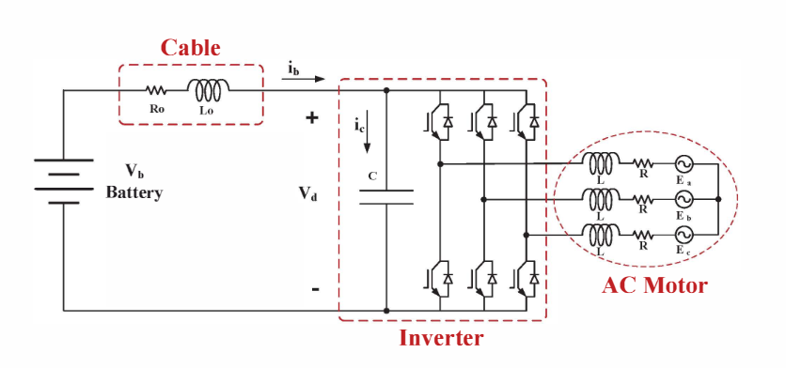
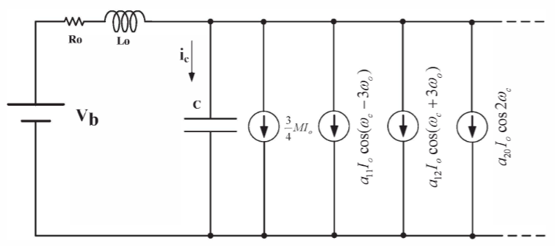
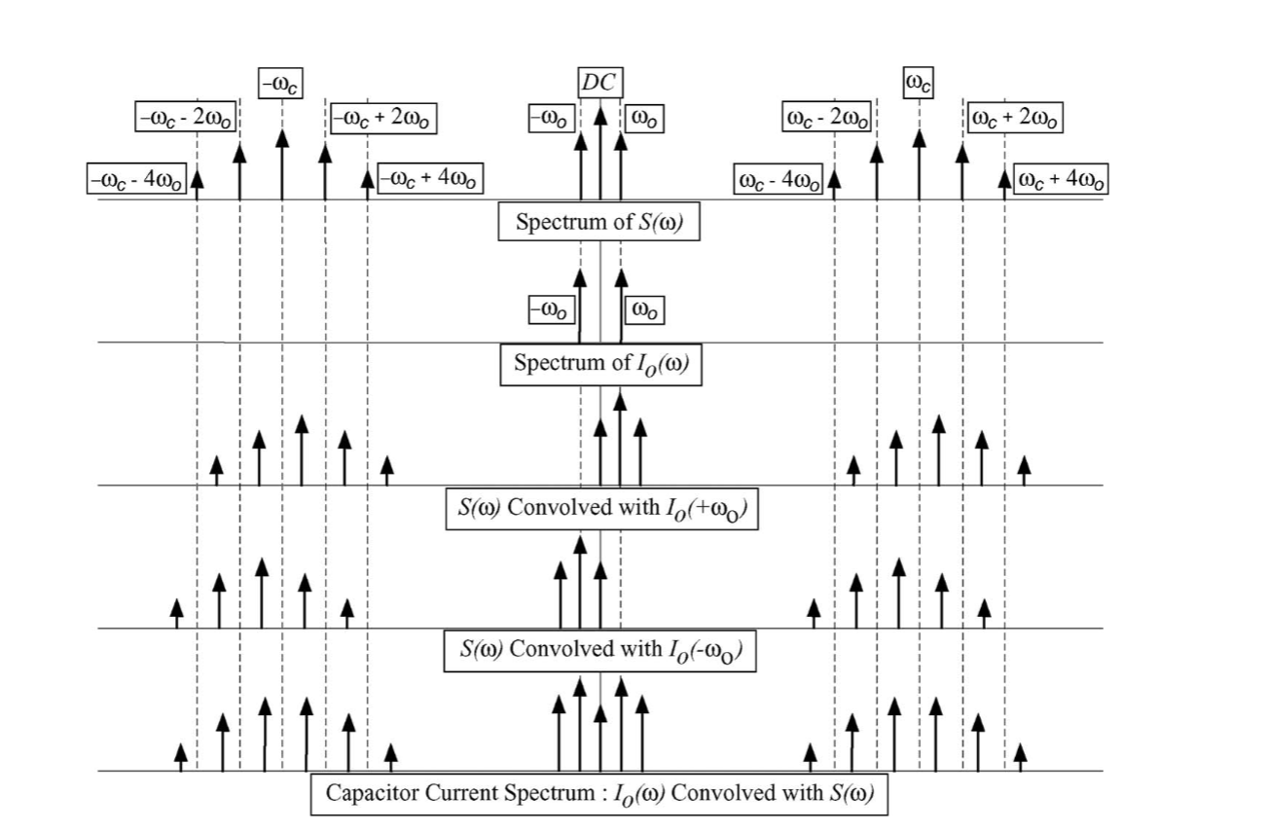
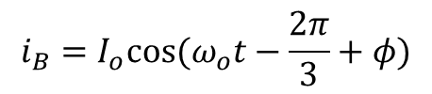



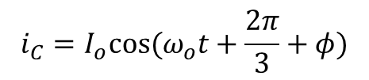
Simplified Inverter Model
We do not consider output harmonics for the phase currents
$$i_{A}=I_{o}cos⁡(ω_{o}t+φ)$$
$$i_{B}=I_{o}cos⁡(ω_{o}t−\frac{2π}{3}+φ)$$
$$i_{inv}=S_{A}i_{A}+S_{B}i_{B}+S_{C}i_{c}$$
$$i_{C}=I_{o}cos⁡(ω_{o}t+\frac{2π}{3}+φ)$$
Combined Inverter and battery model
Leg current in the frequency domain is the convolution of the phase current and switching function.
$S_{A}(t)i_{A}(t)$➔$S_{A}(ω){∗ I}_{A}(ω)$
The inverter can be modeled as current sources of harmonic components.

Slide 2

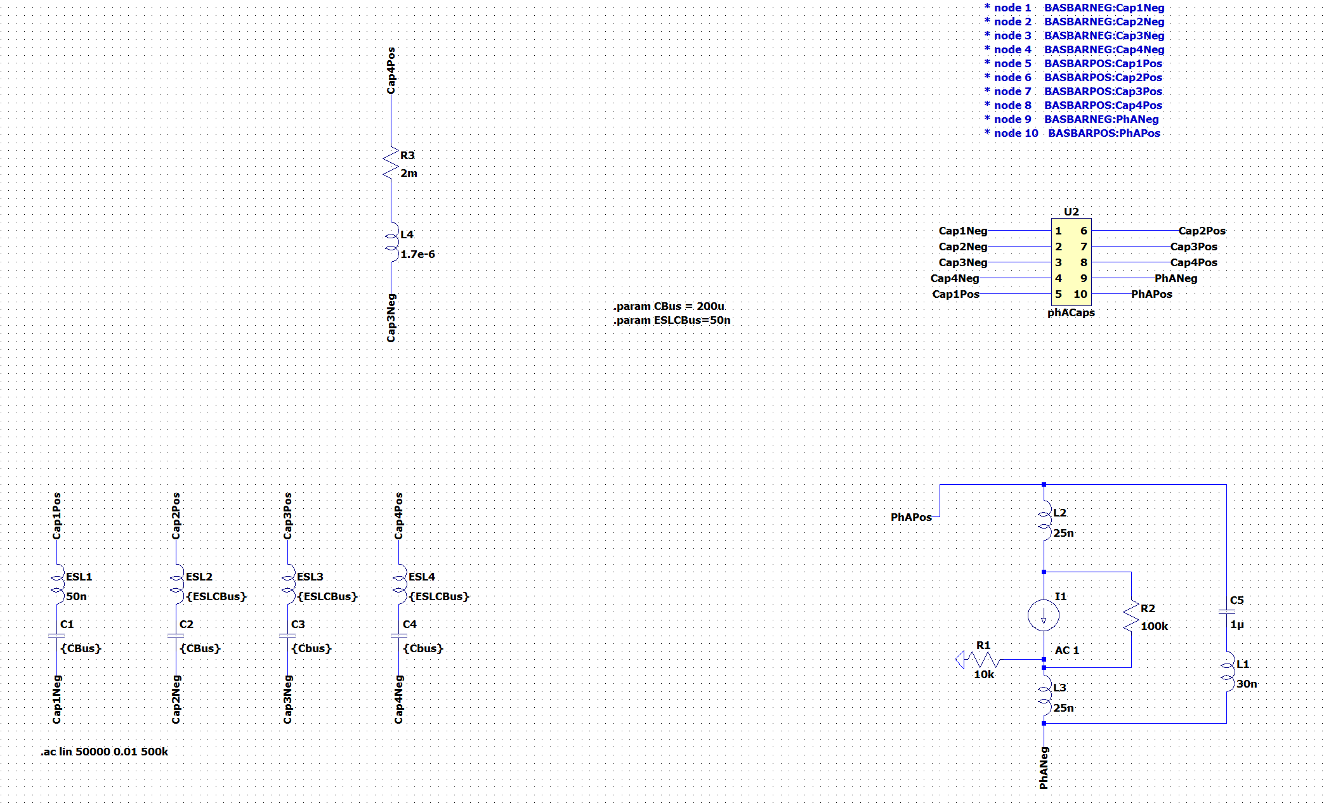
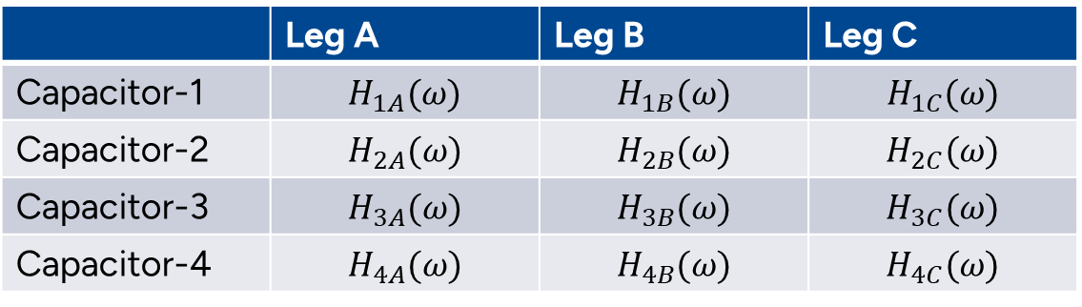
Busbar Geometry 62mm Power Module
Step response of capacitors to each leg
 | Leg A | Leg B | Leg C
Capacitor-1 | $$H_{1A}(ω)$$ | $$H_{1B}(ω)$$ | $$H_{1C}(ω)$$
Capacitor-2 | $$H_{2A}(ω)$$ | $$H_{2B}(ω)$$ | $$H_{2C}(ω)$$
Capacitor-3 | $$H_{3A}(ω)$$ | $$H_{3B}(ω)$$ | $$H_{3C}(ω)$$
Capacitor-4 | $$H_{4A}(ω)$$ | $$H_{4B}(ω)$$ | $$H_{4C}(ω)$$
C3
C4
C2
C1
The response of capacitor A for each leg should be calculated as:
$I_{capA}= {(S_{A}∗I_{A} )H}_{1A}\left(ω\right)+{(S_{B}∗I_{B} )H}_{1B}\left(ω\right)$+${(S_{C}∗I_{C} )H}_{1C}\left(ω\right)$
Capacitor
Power Modules
DC- Nodes
DC+ Nodes

Slide 3
DC Link Current (Positive/Negative/Zero Sequences)
6th 12th

Slide 4
The Effect of the Busbar Inductance and Battery Connection
Capacitor-1 Response to All-phases
Capacitor Responses to Phase-A
High frequency
resonance
High frequency
resonance
Low frequency resonance
Low frequency resonance

Slide 5
High Frequency Resonance
14 kHz Switching
24kHz Switching
Harmonic number
Harmonic number
P.S: The high-frequency resonance might be considerable if we have a dual-3-phase-inverter (6-phase) structure and we desire to interleave them to reduce capacitance requirements. (We should look at phase-response (not magnitude response) at such a scenario)

Slide 6
Low Frequency Resonance
700 Hz Fundamental
200 Hz Fundamental

Slide 7
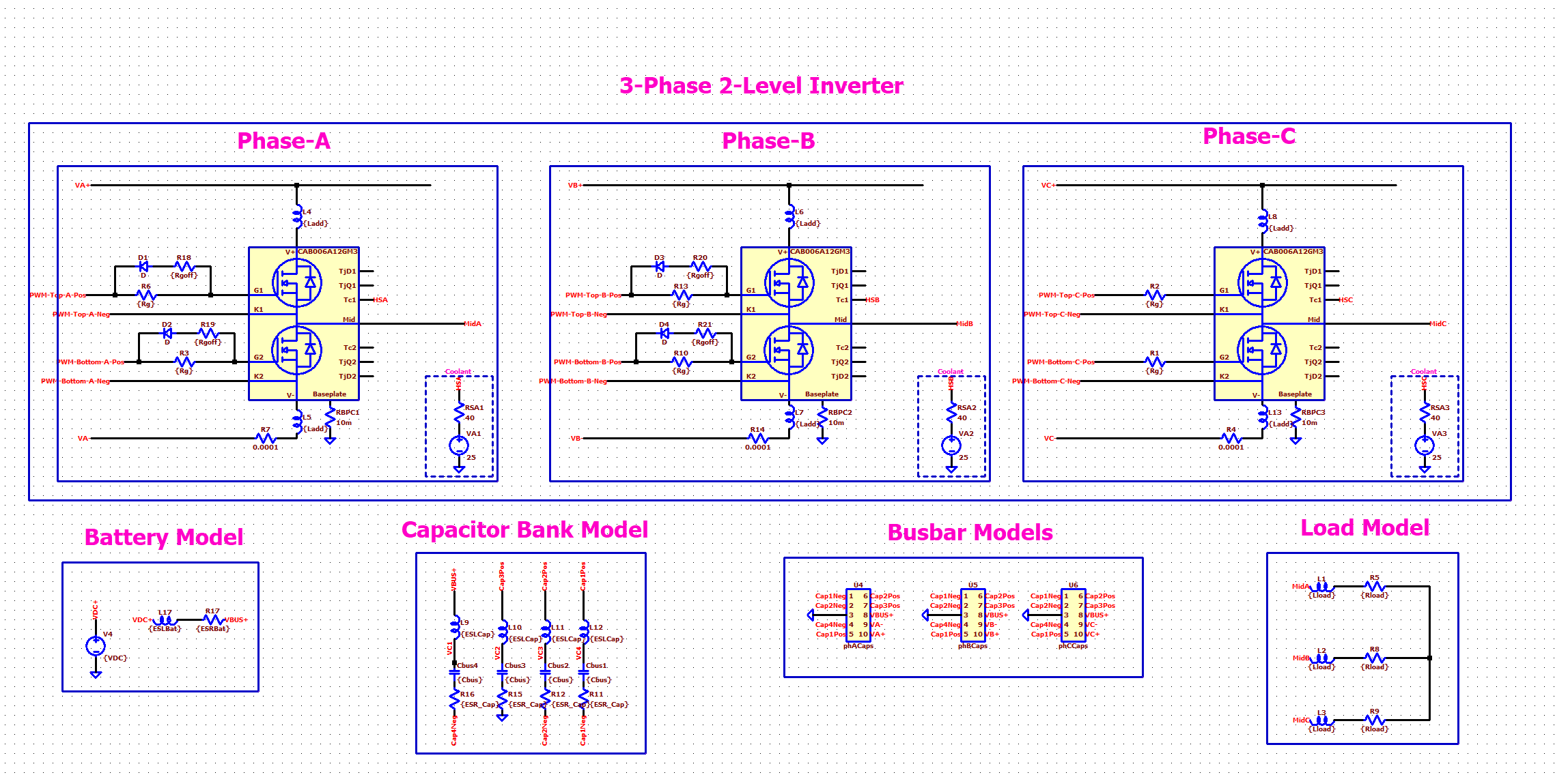
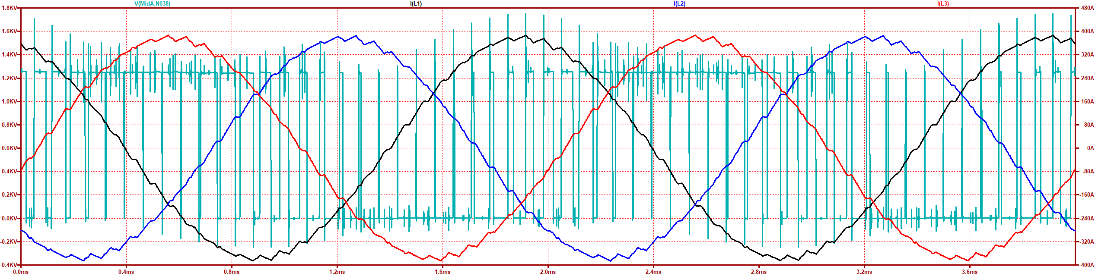
Parasitic Inductances (Switching Speed Limitation)
Parasitic Sources | Inductance
Power module | 50 nH
Capacitor ESL | 50nH
Busbar | Overall <20nH
Maximum Current (MaxA) (inA) | dv/dt (in V/nS) @ MaxA | Overshoot (in %) @ MaxA
380 A | 35 V/ns | 40 %

Slide 8
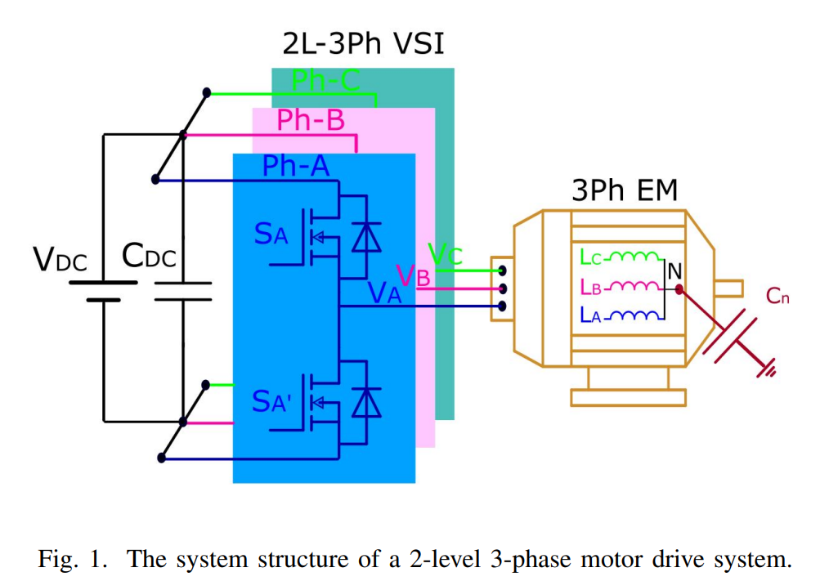
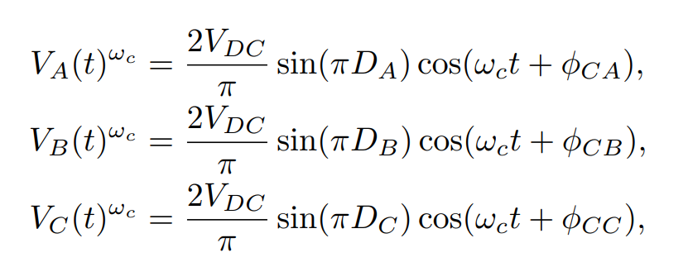
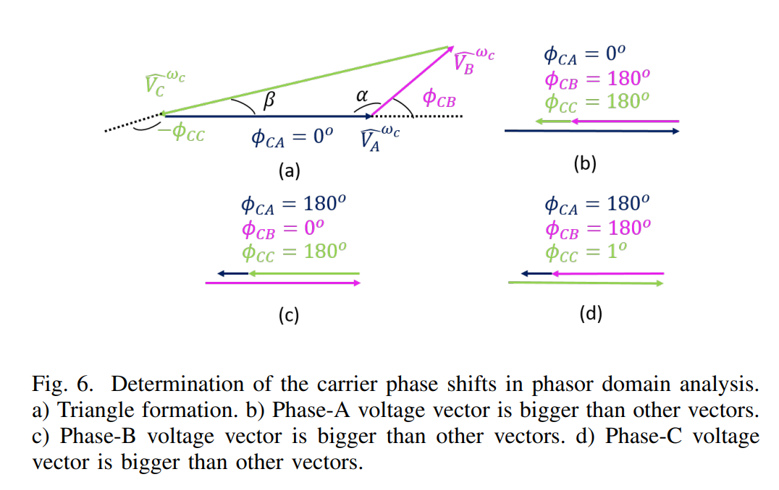
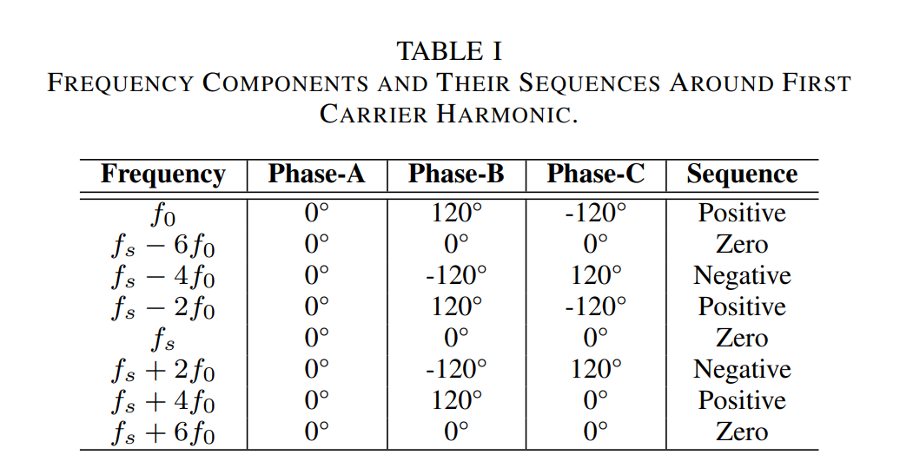
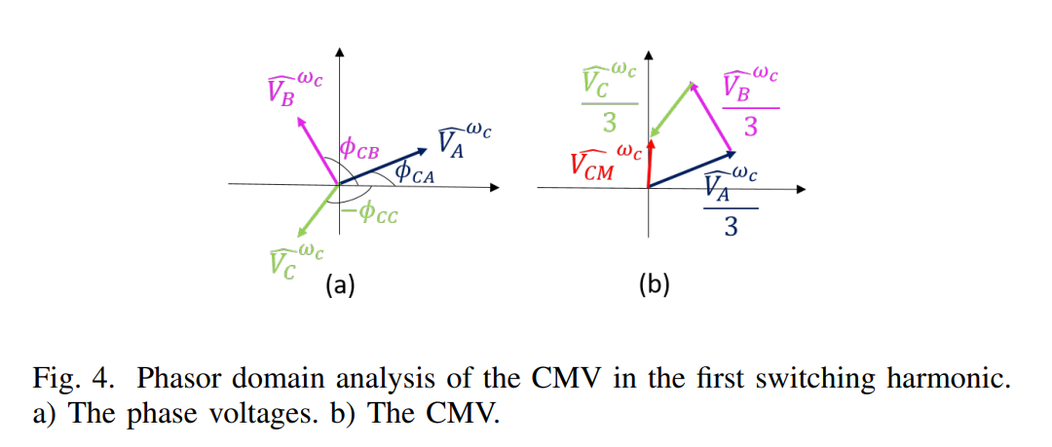
Common-Mode Voltage Reduction in Two-Level Inverters by Introducing Adaptive Carrier-Phase-Shift Method (ECCE-Europe)

Slide 9
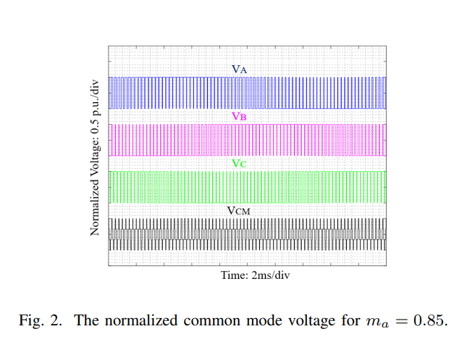
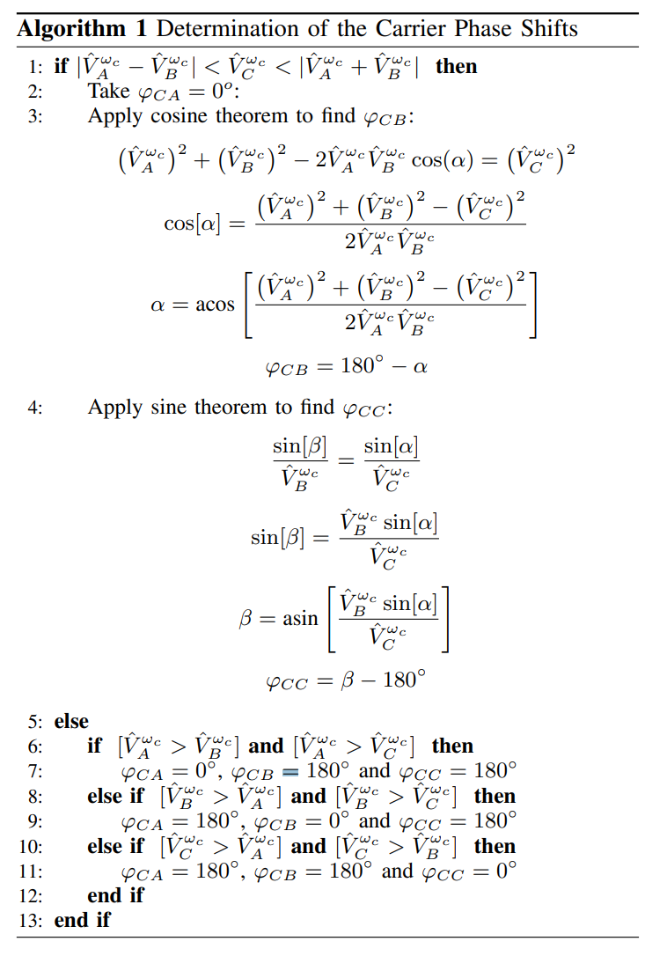
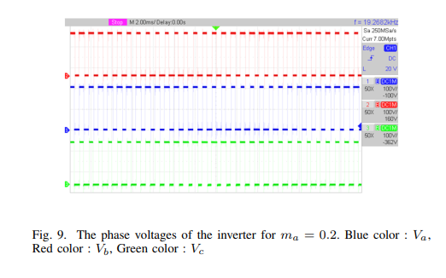
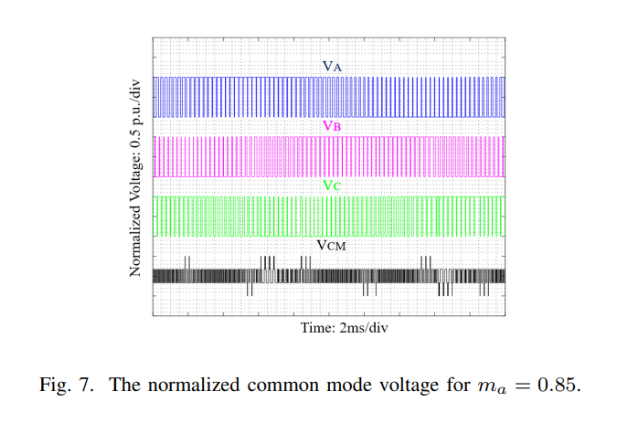
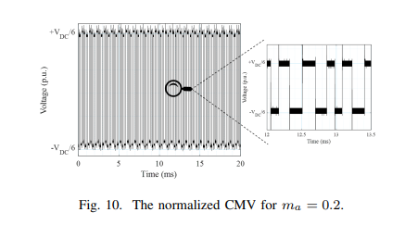
Common-Mode Voltage Reduction in Two-Level Inverters by Introducing Adaptive Carrier-Phase-Shift Method (ECCE-Europe)

