Slide 1
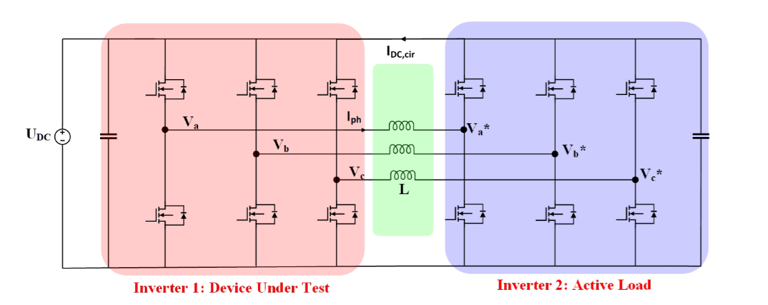
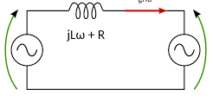
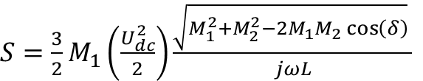



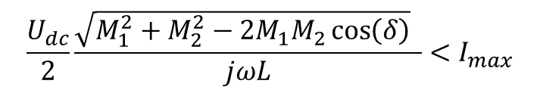

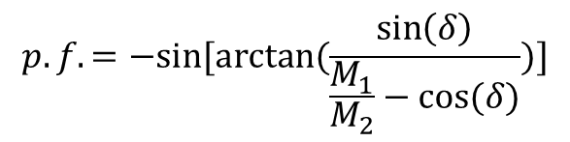
Back-to-Back Inverter
$$P=\frac{V_{ph1}V_{ph2}\sin\left(δ\right)}{jωL}$$
Q$=\frac{V_{ph1}^{2} − V_{ph1}V_{ph2}\cos\left(δ\right)}{jωL}$
$V_{ph1}=\frac{1}{\sqrt{2}}U_{dc}\frac{{ M}_{1}}{2}$
$V_{ph2}=\frac{1}{\sqrt{2}}U_{dc}\frac{{ M}_{2}}{2}$
$S=\frac{3}{2}M_{1}\left(\frac{U_{dc}^{2}}{2}\right)\frac{\sqrt{M_{1}^{2}+M_{2}^{2}−2M_{1}M_{2}\cos\left(δ\right)} }{jωL}$
Iph
$$p.f.=−sin⁡[arctan⁡(\frac{\sin\left(δ\right)}{\frac{M_{1}}{M_{2}}−cos⁡(δ)})]$$
Vph1
Vph2
When two AC voltage sources are connected through an inductance, the power flow between them depends on the phase difference between the voltages of the two sources and the reactance of the connecting inductance.
$$\frac{U_{dc}}{2}\frac{\sqrt{M_{1}^{2}+M_{2}^{2}−2M_{1}M_{2}\cos\left(δ\right)} }{jωL}<I_{max}$$
Y. Luo, "A Variable Power Factor High Power Testbed for Traction Inverter Using Back-to-Back Connection,"

Slide 2
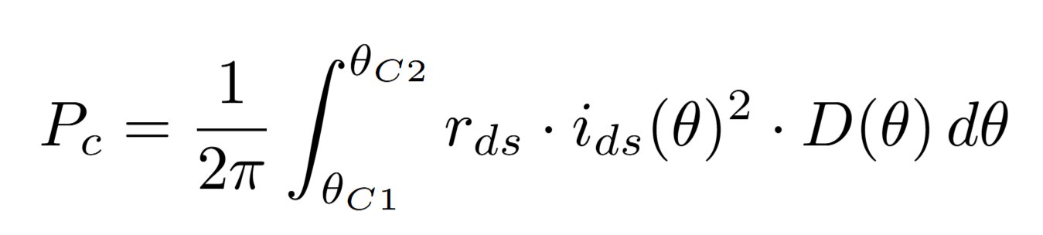
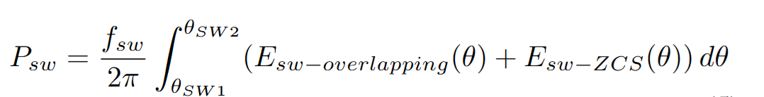
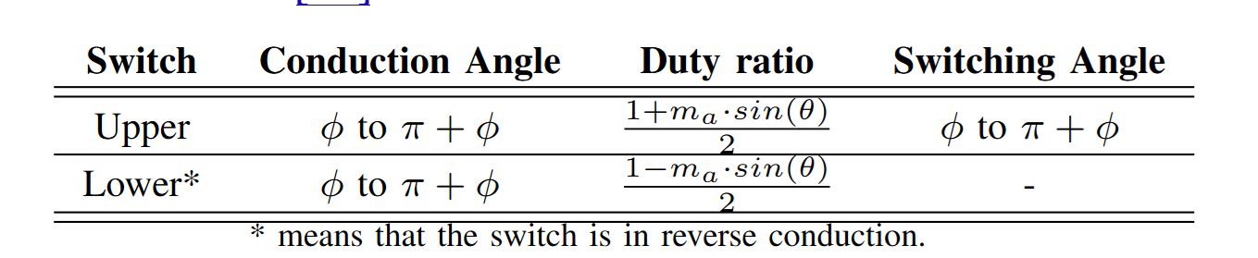
Inverter Losses
2500
Dp1
100% of power
600
Dp2
Torque [Nm]
Power [kW]
Dp5
100% of power
Dp3
50% of power
In a two-level inverter, we can assume the losses do not depend on the power factor.
We can control the modulation index and the current, then we can estimate the power loss for the desired operating points.
The efficiency can be estimated then using the power loss and operating point power.
Dp6
50% of power
Dp4
25% of power
0
2000
4500
6000
speed [rpm]

Slide 3
Third Harmonic Injection or SVM
Worst case scenario

Slide 4
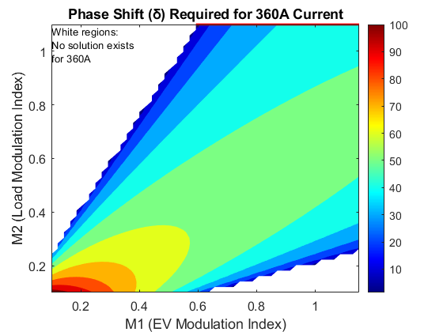
Limitations-500uH

Slide 5
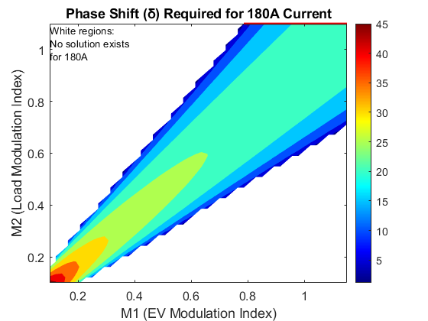
Limitations: 500u

Slide 6
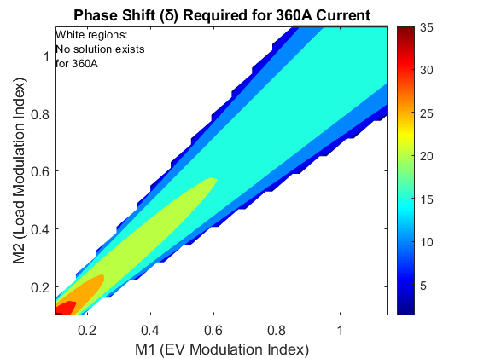
Limitations: 200u

Slide 7
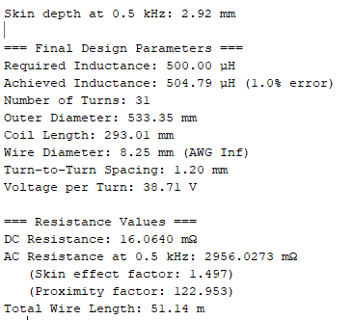
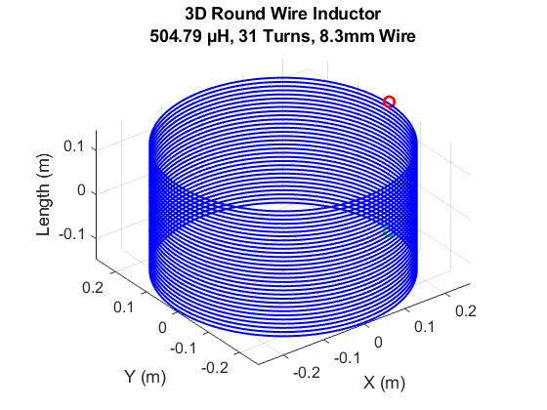

Air Core Inductance Calculation
Design Specifications
Required inductance: 500 µH
Peak voltage: 1200 V
Peak current: 350 A
Fundamental frequency: 500 Hz
Wheelers’s Formula
$$L \left(µH\right) = (d² ∗ n²) / (18d + 40l)$$
It needs to be confirmed by FEA.

