Slide 1
Online Carrier Phase Shift Calculation to Reduce Common Mode Voltage
Enes Ayaz
!!!
The presentation aims carrier phase shift of SPWM for 2L conventional inverter.
However, it should be noted that the proposed method could be expanded for other topology and modulations. It is actually necessity since 2L topology with SPWM could not be suitable for 300kW 1200 V EV drives regarding other concerns.

Slide 2
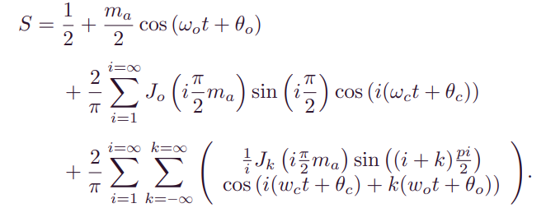
Analytical Analysis of carrier-based PWM (CBPWM) (i.e. SPWM)
SPWM is (or other CBPWMs can be) established by comparing a high-frequency triangular carrier signal and a fundamental (modulating) signal.
The analytical model of SPWM (also can be called switching function) can be obtained as given in below by using Double Fourier analysis.
DC component
Fundamental components
Switching frequency and its harmonics
Side band harmonics

Slide 3
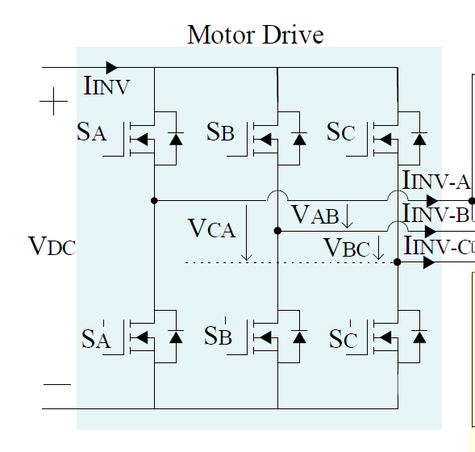
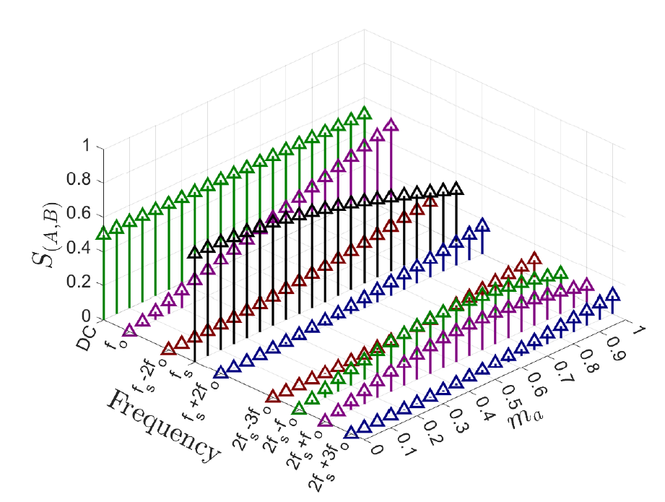


Analytical Analysis of PWM (i.e. SPWM)
We can calculate the voltage harmonics by using the switching functions.
$$V_{A}= S_{A} V_{DC}$$
$$V_{AB}= S_{A} V_{DC}−S_{B} V_{DC}$$
The magnitudes of switching harmonics and their sidebands cannot be adjusted independently, and they change along with the modulation index.
The dominant components are :
1) dc; 2) fundamental; 3) the first switching harmonic; 4) sidebands of the first switching harmonic.

Slide 4
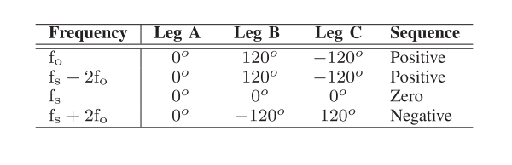






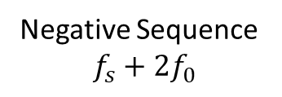

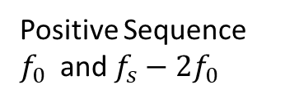
Analytical Analysis of PWM (i.e. SPWM)
For the conventional SPWM with single carrier signal, the phases of these dominant components vary for each leg of the inverter, and they create positive, negative, or zero sequence voltage harmonics.
While the positive and negative sequence voltage harmonics create differential-mode current harmonics, zero sequence voltage harmonics create common-mode current harmonics.
B
$${120}^{o}$$
C
$${120}^{o}$$
A
A
A
C
B
$${120}^{o}$$
$${120}^{o}$$
$${120}^{o}$$
$${120}^{o}$$
C
B
Positive Sequence
$f_{0}$ and $f_{s}−2f_{0}$
Negative Sequence
$$f_{s}+2f_{0}$$
Zero Sequence
$$f_{s}$$

Slide 5
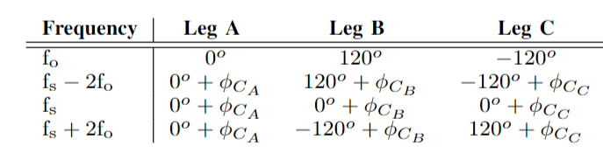



The initial idea
The magnitude of the zero sequence component (so the first switching frequency) is higher than the positive and negative sequences (sidebands). Although It is actually good considering differential-mode current, it is bad regarding common-mode current.
Using multi-carriers instead of single carrier, we can change the sequences by adjusting the phases of the carrier signals.
$$φ_{CA}=0$$
References
A
$T_{s}(\frac{φ_{CB}}{2π}\text{)}$
B
C
Carrier
A
$T_{s}(\frac{φ_{CC}}{2π}\text{)}$
B
C

Slide 6
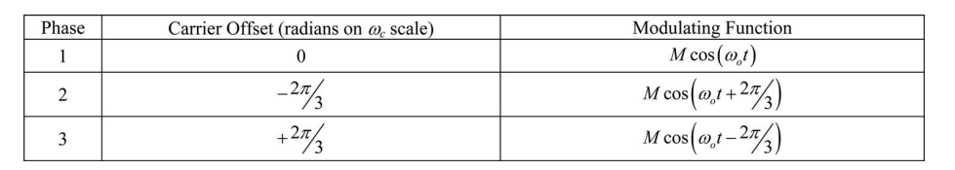
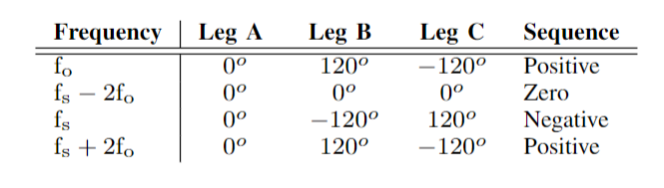
Literature (for ones that are related carrier phase shift !!)
Reducing Common-Mode Voltage in Three-Phase Sine-Triangle PWM With Interleaved Carriers, IEEE TRANSACTIONS ON POWER ELECTRONICS 2011
It basically propose that the carriers are offset as given below.
Now, we have the harmonics below
Our zero sequence is replaced.
The magnitude of sideband is smaller, so we reduce CMV.

Slide 7
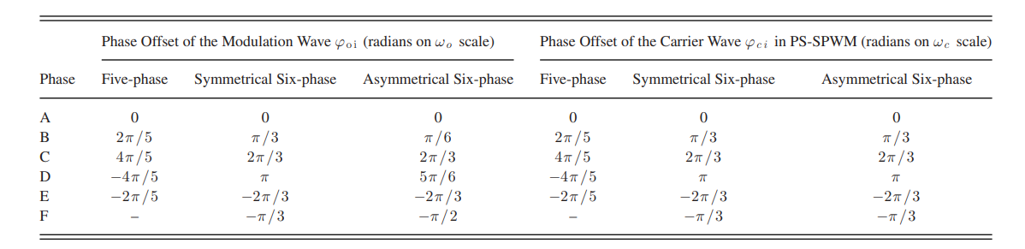
Literature (for ones that are related carrier phase shift !!)
Carrier Phase Shifted SPWM for CMV reduction In a three-level inverter using Open-end winding
induction motor drive, IEEE Region 10 International Conference TENCON.
The same method is applied for open-end winding induction machine.
Reduction of Common-Mode Voltage in Multiphase Two-Level Inverters Using SPWM With Phase-Shifted Carriers, IEEE TRANSACTIONS ON POWER ELECTRONICS, 2016.

Slide 8
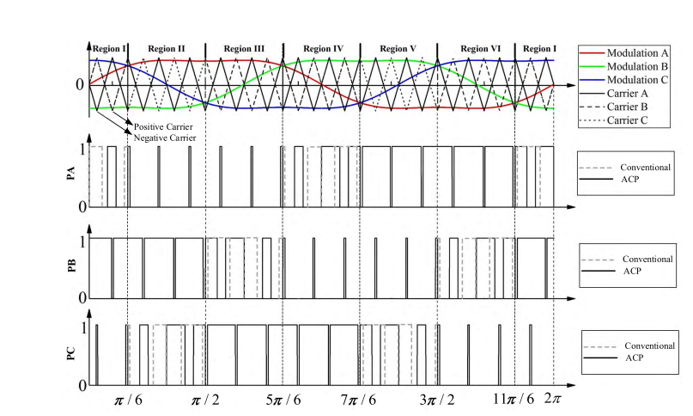
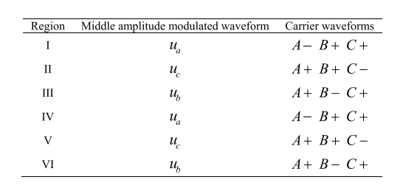
Literature (for ones that are related carrier phase shift !!)
Third Harmonic Injection SPWM Method Based on Alternating Carrier Polarity to Suppress the Common Mode Voltage, IEEE ACCESS, 2018.
An alternating carrier polarity method is proposed to eliminate the zero switch states.
According to the characteristic of the three-phase modulated voltages, it is divided into six regions.

Slide 9
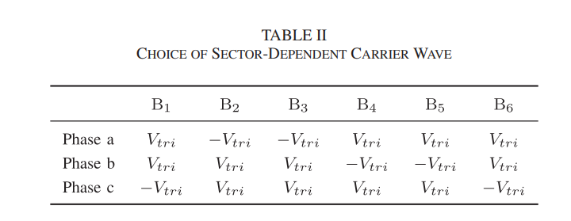
Literature (for ones that are related carrier phase shift !!)
High-Frequency SiC Three-Phase VSIs With Common-Mode Voltage Reduction and Improved Performance Using Novel Tri-State PWM Method, IEEE TRANSACTIONS ON POWER ELECTRONICS, 2019.
The polarity of triangular carrier to be compared with the modulation signals is sector dependent to obtain CMV suppression, as given in Table II.

Slide 10
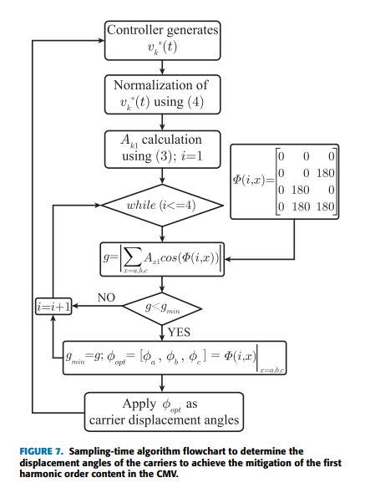
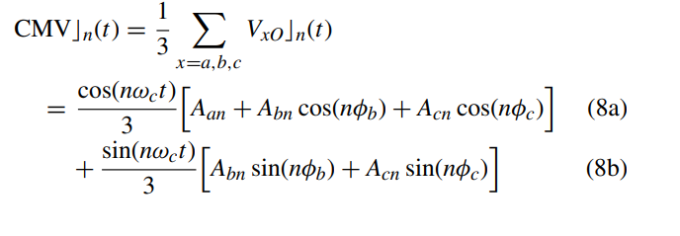
Literature (for ones that are related carrier phase shift !!)
Common-Mode Voltage Mitigation Technique in Motor Drive Applications by Applying a Sampling-Time Adaptive Multi-Carrier PWM Method, IEEE ACCESS, 2021.
CMV is highly dependent on the values of the displacement angles of the carriers φb and φc.
The proposed adaptive multi-carrier PWM method considers the carrier phase displacement φa = 0 ◦ , while the angles φb and φc, for the sake of simplicity, only take values equal to 0◦ or 180◦ . Under this assumption, (8b) remains always zero. In this way, the final values of φb and φc (0◦ or 180◦ ) in order to minimize CMVcn(t) are those that will minimize (in absolute value) the mathematical term introduced in (8a).

Slide 11
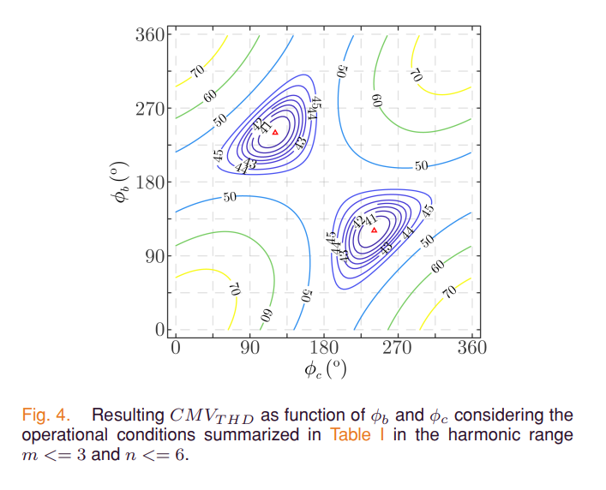
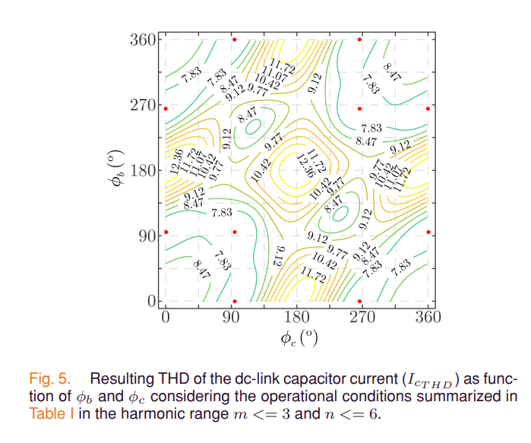
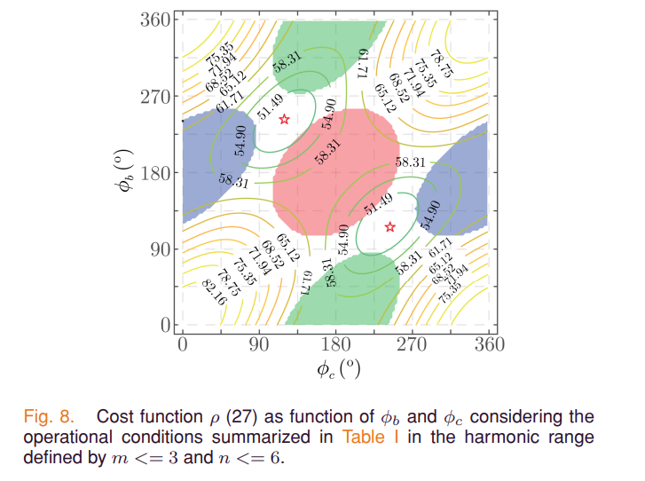
Literature (for ones that are related carrier phase shift !!)
Generalized Multicarrier PWM Technique for Two-Level Voltage Source Inverters, IEEE TRANSACTIONS ON INDUSTRIAL ELECTRONICS,2023.
The carrier phase displacement angles are evaluated in order to reduce the common-mode voltage (CMV) total harmonic distortion (THD), the dc-link capacitor current THD, and the phase currents THD.
These targets are difficult to be met at the same time and a cost function is deployed in order to look for a suitable solution that develops a tradeoff between all the targets

Slide 12
The Proposed Technique
For all studies aforementioned, Either phase shift is kept at constant value during a fundamental period ; Or only polarity is altered regarding the voltage sector required to achieve voltage reference.
Therefore, the methods reduces the average CMV along a fundamental period, but the CMV for each switching interval can be decreased more if adaptive carrier phase shift is applied.
Accordingly, a variable carrier phase shift method, which aims to achieve lower common mode voltage during each switching interval, is proposed.

Slide 13
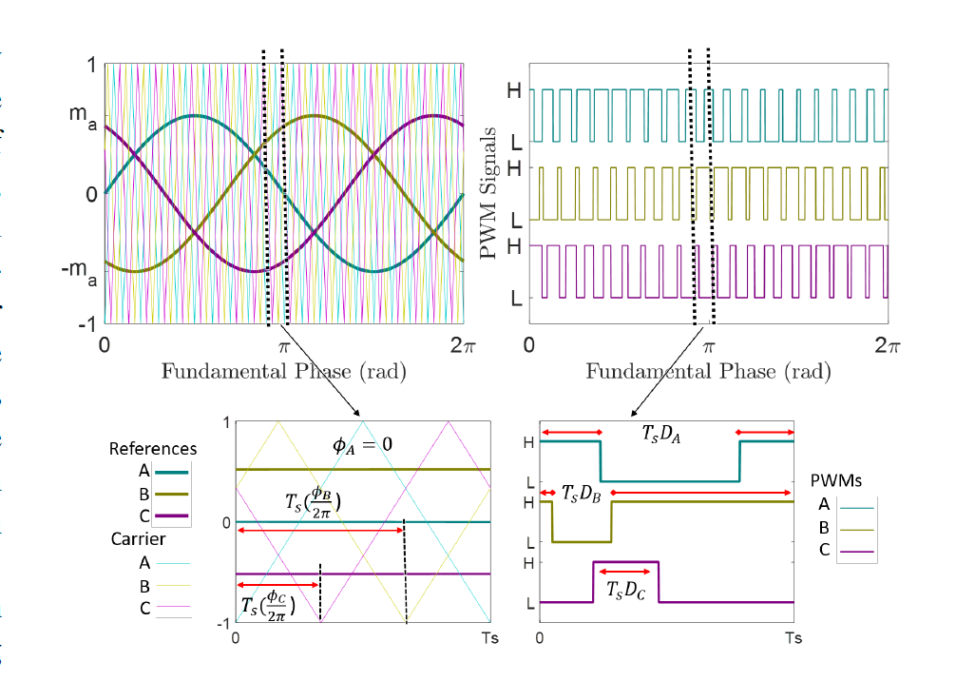
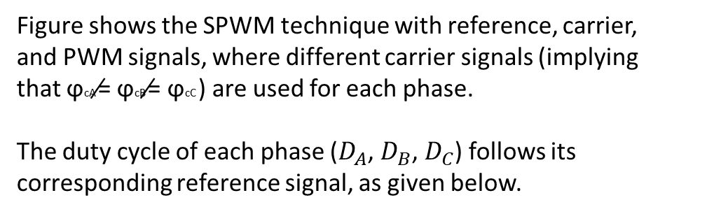
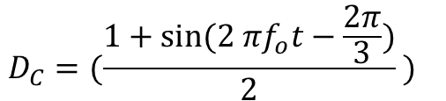
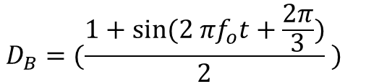

Mathematical Modelling
Figure shows the SPWM technique with reference, carrier,
and PWM signals, where different carrier signals (implying
that ϕcA ̸= ϕcB ̸= ϕcC ) are used for each phase.
The duty cycle of each phase ($D_{A}$, $D_{B}$, $D_{C}$) follows its corresponding reference signal, as given below.
$$D_{A}=(\frac{1+sin⁡(2 πf_{o}t)}{2}{) }$$
$$D_{B}=(\frac{1+sin⁡(2 πf_{o}t+\frac{2π}{3})}{2}{) }$$
$$D_{C}=(\frac{1+sin⁡(2 πf_{o}t−\frac{2π}{3})}{2}{) }$$

Slide 14
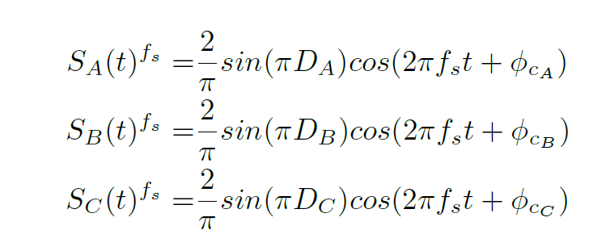
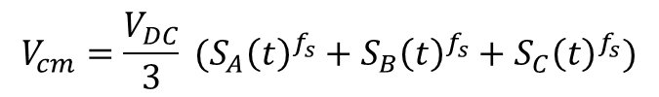
Mathematical Modelling
Square waves with varying duty cycles are generated within a switching interval.
The duty cycles depend on the reference signals.
Therefore, the first switching harmonic components for these square waves can be calculated using the Fourier series.
Then, common mode voltage is calculated for a switching interval as follows
$$V_{cm}=\frac{V_{DC}}{3} (S_{A}{\left(t\right)}^{f_{s}}+S_{B}{\left(t\right)}^{f_{s}}+S_{C}{\left(t\right)}^{f_{s}})$$
Therefore, we have three signals ($S_{A}{\left(t\right)}^{f_{s}}$ , $S_{B}{\left(t\right)}^{f_{s}},$ $S_{C}{\left(t\right)}^{f_{s}}$) with the same frequency with different magnitudes and phases. Accordingly, we can pass phasor domain analysis !!!

Slide 15







Mathematical Modelling
$$m=0$$
The magnitude of the switching frequency are plotted over a fundamental period for different modulation index.
It is observed that the magnitude changes for each leg.
Also, we know that the phases of the components depends on the carrier phase shift.
Our aim is to minimize the sum of these components.
$$m=0.25$$
$$m=0.5$$
B
$$φ_{CB}$$
A
$${−φ}_{CC}$$
C
$$m=0.75$$
$$m=1$$

Slide 16

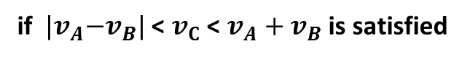
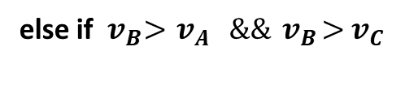
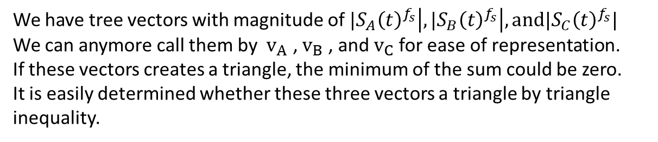


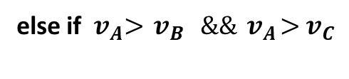


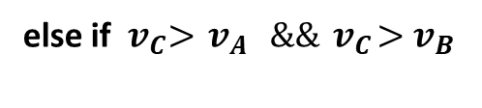
Mathematical Modelling
$$v_{B}$$
We have tree vectors with magnitude of ${|S}_{A}{\left(t\right)}^{f_{s}}\left|, {|S}_{B}{\left(t\right)}^{f_{s}}\right|,and{|S}_{C}{\left(t\right)}^{f_{s}}|$
We can anymore call them by $v_{A}$ , $v_{B}$ , and $v_{C}$for ease of representation.
If these vectors creates a triangle, the minimum of the sum could be zero.
It is easily determined whether these three vectors a triangle by triangle
inequality.
$$v_{A}$$
$$v_{C}$$
if ${ |v}_{A}−v_{B}|$ < $v_{C}$ < $v_{A}+v_{B}$ is satisfied
$φ_{CB}$
$φ_{CC}$
Apply cosine and sine theorems to find $φ_{CB}$ and $φ_{CC}.$
else if ${ v}_{A}>{ v}_{B} \&\&{ v}_{A}>{ v}_{C}$
$φ_{CB}={180}^{o}$ and $φ_{CC}={180}^{o}$
else if ${ v}_{B}>{ v}_{A} \&\&{ v}_{B}>{ v}_{C}$
$φ_{CB}={180}^{o}$ and $φ_{CC}=0^{o}$
else if ${ v}_{C}>{ v}_{A} \&\&{ v}_{C}>{ v}_{B}$
$φ_{CB}=0^{o}$ and $φ_{CC}={180}^{o}$

Slide 17












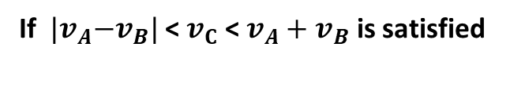


Mathematical Modelling
If ${ |v}_{A}−v_{B}|$ < $v_{C}$ < $v_{A}+v_{B}$ is satisfied
$$β$$
$$α$$
$φ_{CB}$
$−φ_{CC}$
1. Apply cosine theorem to find $φ_{CB}$
2. Apply sine theorem to find $φ_{CC}$
${ v}_{A}^{2}+{ v}_{B}^{2}$-2 $v_{A}$ $v_{B} cos(α)$ = ${ v}_{C}^{2}$
$\frac{sın\left(β\right)}{v_{B}}$ = $\frac{sın\left(a\right)}{v_{C}}$
$cos(α)$ = $\frac{{{ v}_{A}^{2}+{ v}_{B}^{2} −v}_{C}^{2}}{\text{2 }v_{A} v_{B}}$
$sin⁡(β)$ = $\frac{v_{B} sın\left(a\right)}{v_{C}}$
$α$ =acos( $\frac{{{ v}_{A}^{2}+{ v}_{B}^{2} −v}_{C}^{2}}{\text{2 }v_{A} v_{B}})$
$β$ = asın ($\frac{v_{B} sın\left(a\right)}{v_{C}}$)
$$φ_{CB}=180−α$$
$φ_{CB}=β−180$

Slide 18
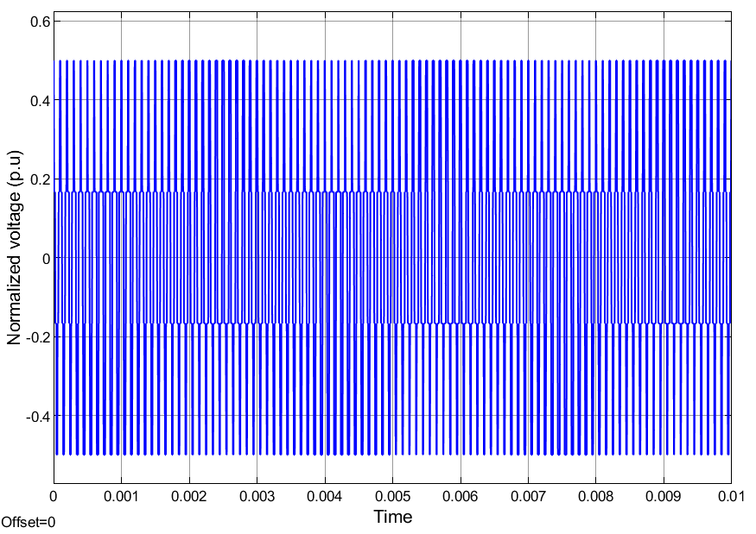
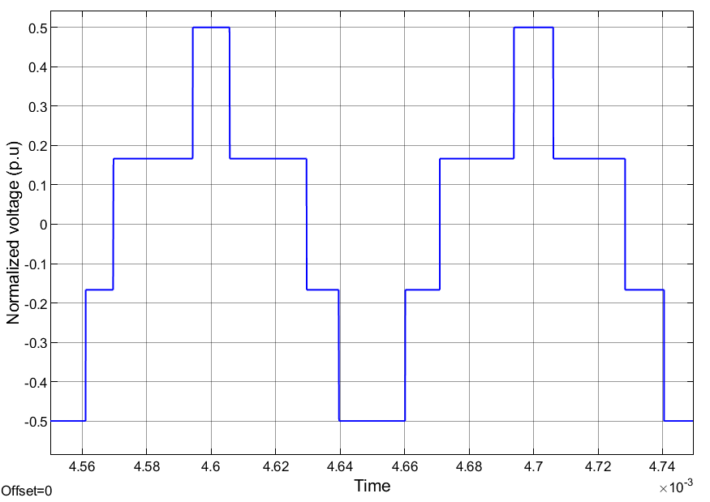
CMV Comparisons- Equal Carrier Phases

Slide 19
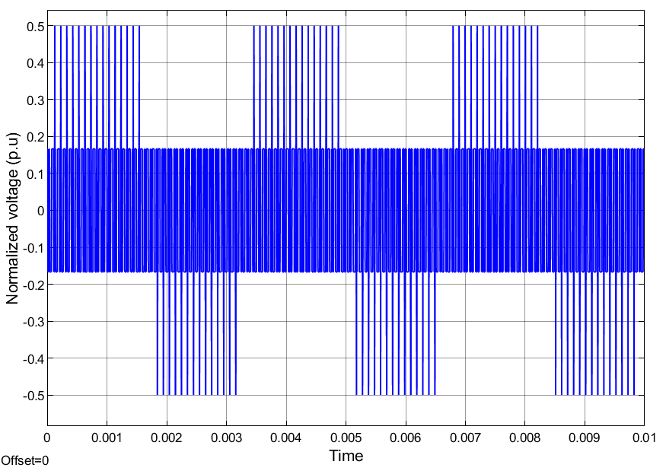
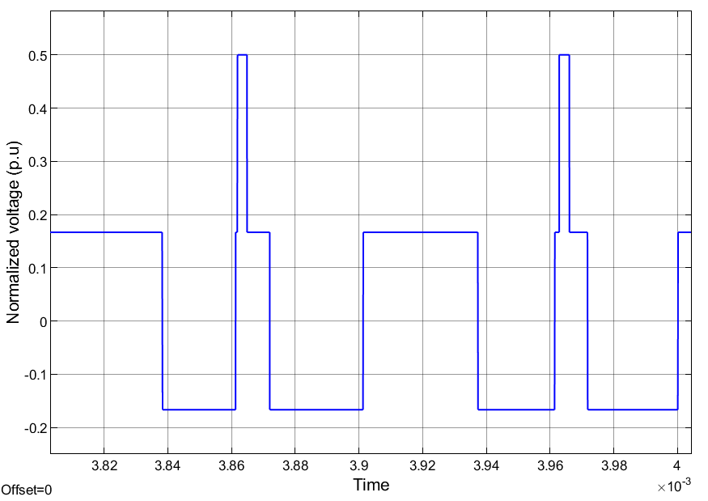
CMV Comparisons- 0-120-240 carrier phases

Slide 20
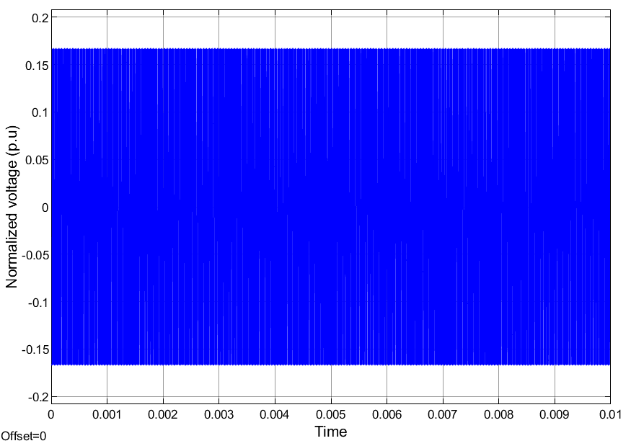
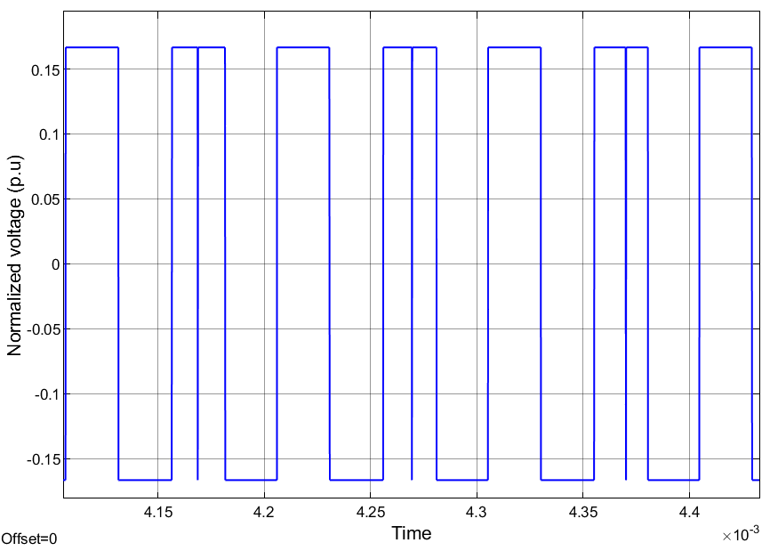
CMV Comparisons- Variable

Slide 21



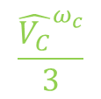


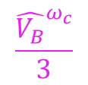

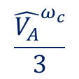


B
$${\hat{V_{B}}}^{ω_{c}}$$
$$\frac{{\hat{V_{C}}}^{ω_{c}}}{3}$$
$$\frac{{\hat{V_{B}}}^{ω_{c}}}{3}$$
$$φ_{CB}$$
$$φ_{CB}$$
$${\hat{V_{A}}}^{ω_{c}}$$
A
$$φ_{CA}$$
$${\hat{V_{CM}}}^{ω_{c}}$$
$$\frac{{\hat{V_{A}}}^{ω_{c}}}{3}$$
$${−φ}_{CC}$$
$$−φ_{CC}$$
C
$${\hat{V_{C}}}^{ω_{c}}$$
(a)
(b)

Slide 22
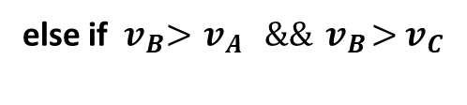







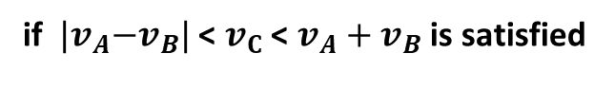


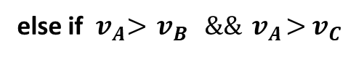





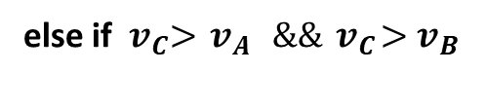





if ${ |v}_{A}−v_{B}|$ < $v_{C}$ < $v_{A}+v_{B}$ is satisfied
$φ_{CB}$
$φ_{CA}=0^{o}$
$${\hat{V_{B}}}^{ω_{c}}$$
$φ_{CC}$
$${\hat{V_{C}}}^{ω_{c}}$$
$$φ_{CB}={180}^{o}$$
$$β$$
$$α$$
$φ_{CB}$
$$φ_{CC}={180}^{o}$$
Apply cosine and sine theorems to find $φ_{CB}$ and $φ_{CC}.$
$−φ_{CC}$
else if ${ v}_{A}>{ v}_{B} \&\&{ v}_{A}>{ v}_{C}$
$φ_{CA}=0^{o}$
$${\hat{V_{A}}}^{ω_{c}}$$
$φ_{CB}={180}^{o}$ and $φ_{CC}={180}^{o}$
(a)
(b)
else if ${ v}_{B}>{ v}_{A} \&\&{ v}_{B}>{ v}_{C}$
$φ_{CA}={180}^{o}$
$φ_{CA}={180}^{o}$
$φ_{CB}={180}^{o}$ and $φ_{CC}=0^{o}$
$$φ_{CB}=0^{o}$$
$$φ_{CB}={180}^{o}$$
$$φ_{CC}={180}^{o}$$
$$φ_{CC}=1^{o}$$
else if ${ v}_{C}>{ v}_{A} \&\&{ v}_{C}>{ v}_{B}$
$φ_{CB}=0^{o}$ and $φ_{CC}={180}^{o}$
(c)
(d)

