Slide 1
3-Level Modulation Techniques
Enes Ayaz, KTH

Slide 2
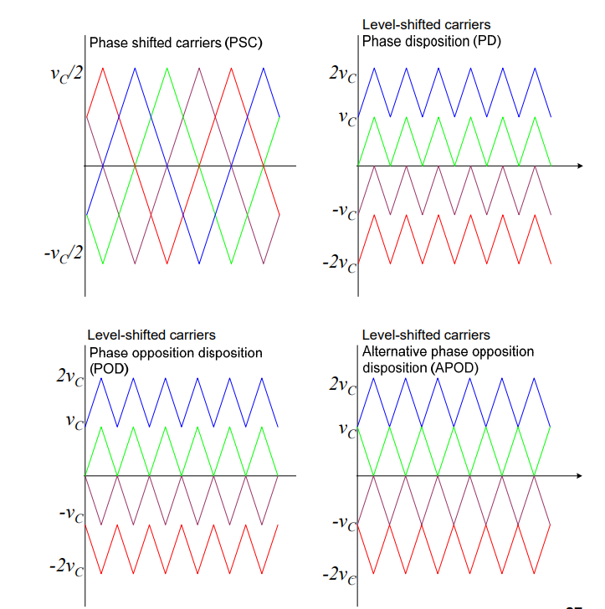

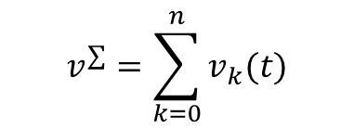
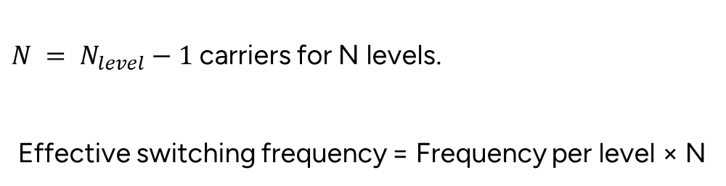
Multilevel Carrier-Based Modulation Methods
The multilevel waveform is the sum of N two-level waveforms $v_{k}( t)$ each with its own carrier.
$$v^{∑}=\sum_{k=0}^{n}{v_{k}(t)}$$
$N = N_{level}−1$carriers for N levels.
Effective switching frequency = Frequency per level × N

Slide 3
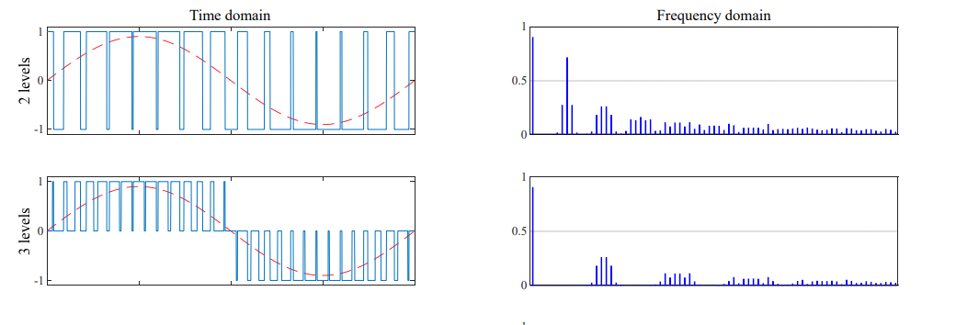
Multilevel carrier based methods
All harmonics canceled out expect those around $f = p f_{c} N$where $p$ is an integer, $f_{c}$ is the switching frequency, $N$ is the level number.

Slide 4
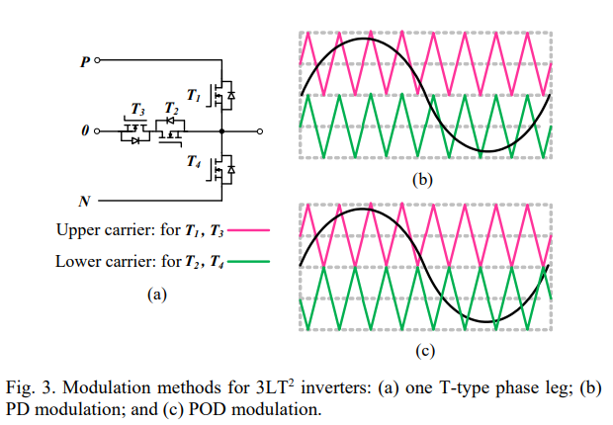
Multilevel carrier based methods
T1 T3 switching
T2 T4 switching

Slide 5
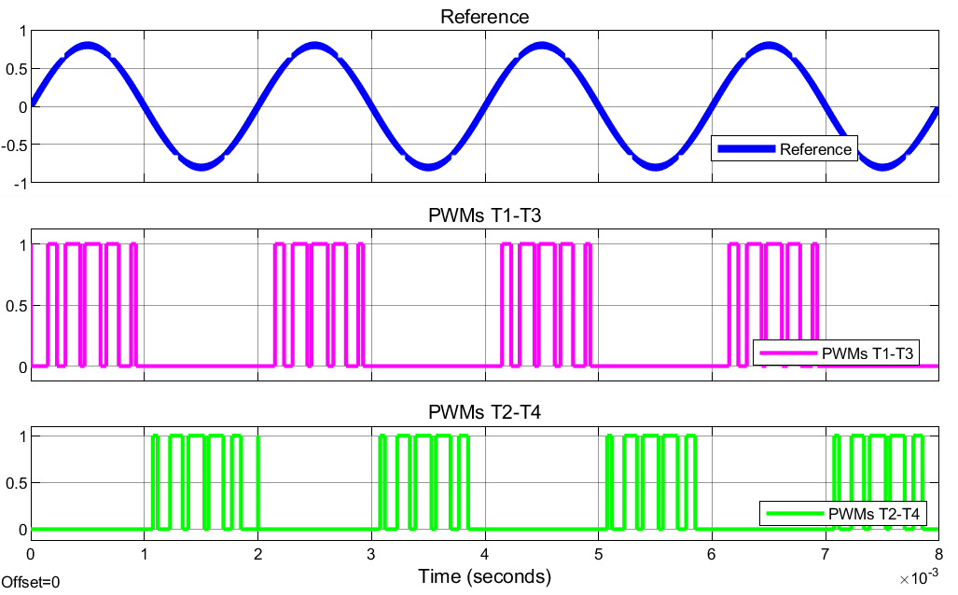
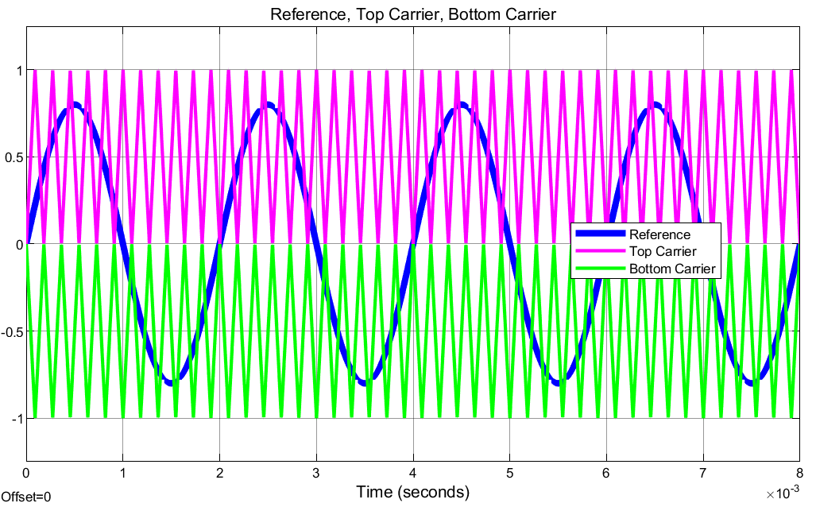
Multilevel carrier based methods
Therefore, the average switcing frequency would be the half of the carrier frequency.
The carrier frequency should be double the desired switching frequency.

Slide 6
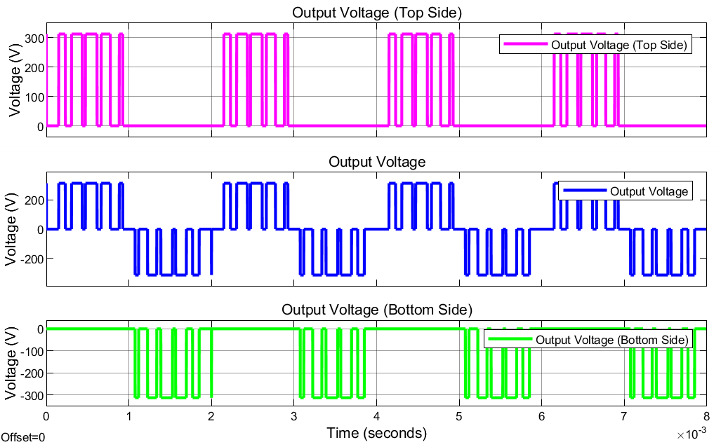
Multilevel carrier based methods

Slide 7
Multilevel carrier based methods

Slide 8
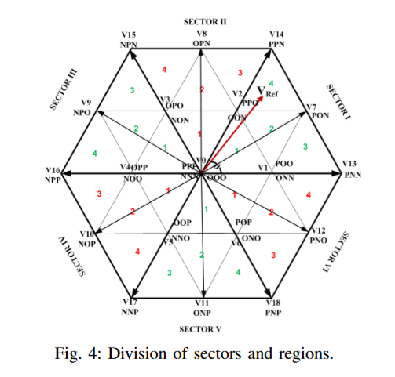
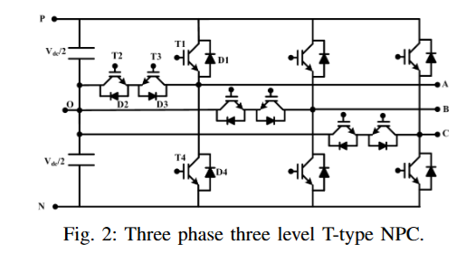
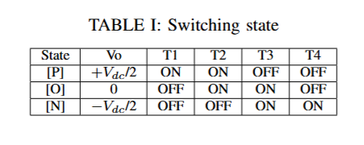
Multilevel SVM
https://ieeexplore.ieee.org/stamp/stamp.jsp?tp=&arnumber=8993215

Slide 9
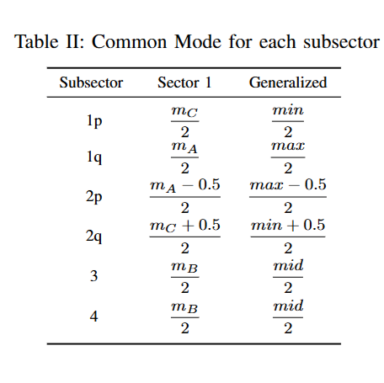
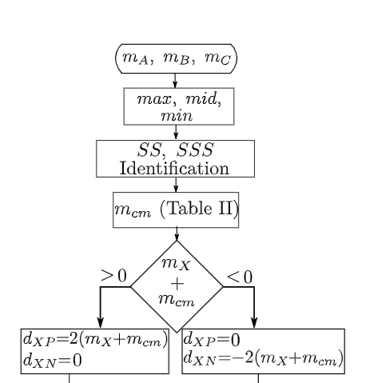
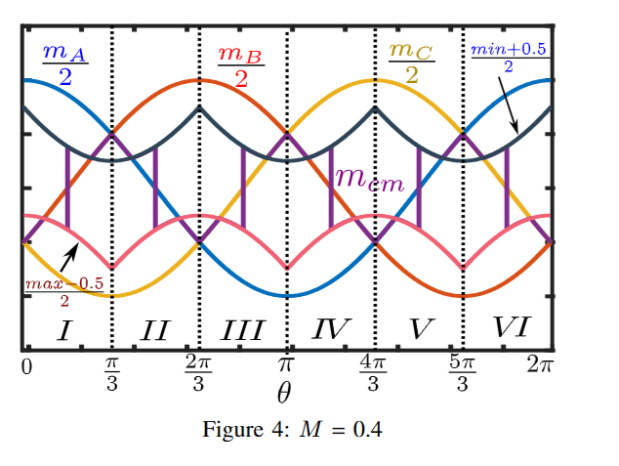
https://ieeexplore.ieee.org/stamp/stamp.jsp?tp=&arnumber=9236106

