Slide 1
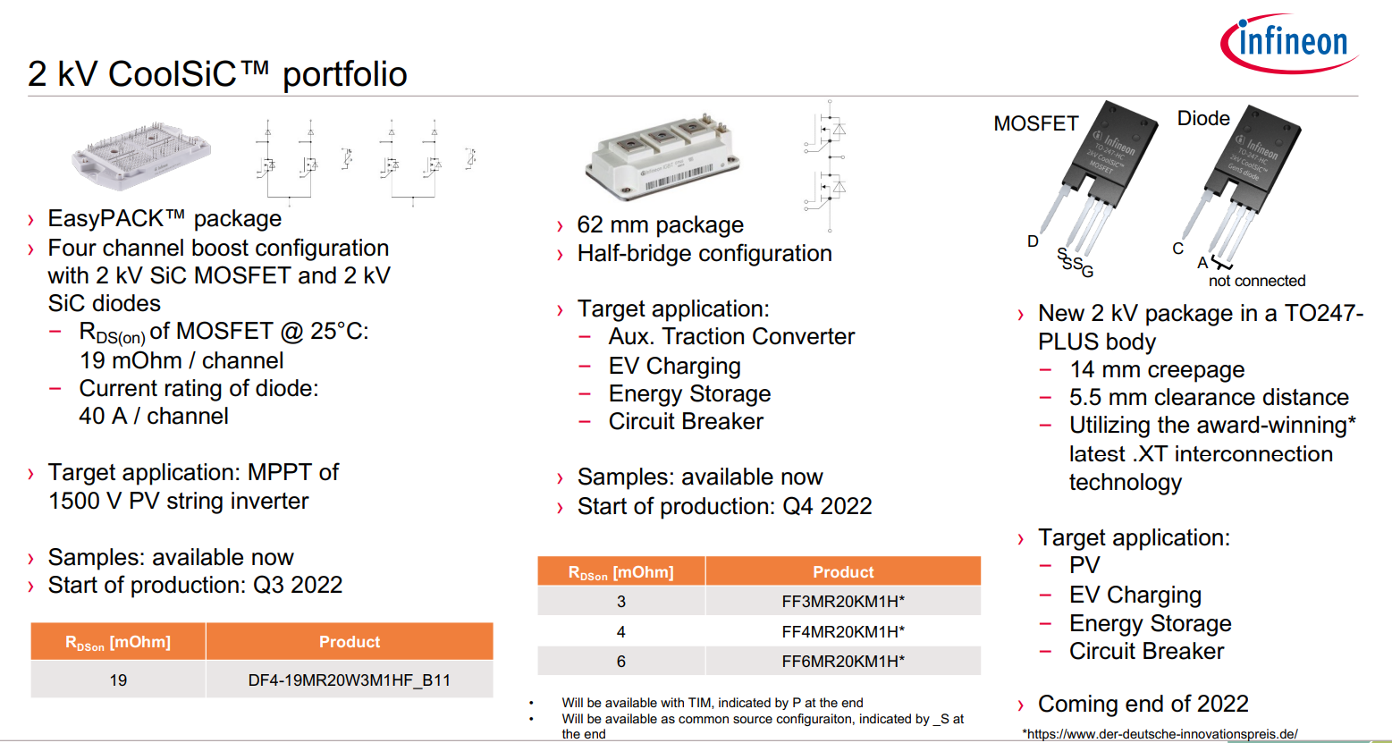

Slide 2
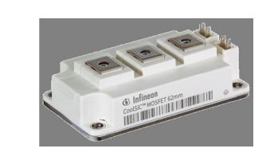

Voltage rating: 2kV
Current rating: 400A
Interpolation
$$V_{test}=1200 V$$
$$T_{j}=150 C^{o}$$

Slide 4
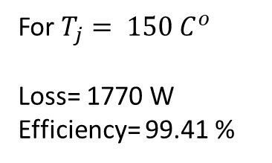
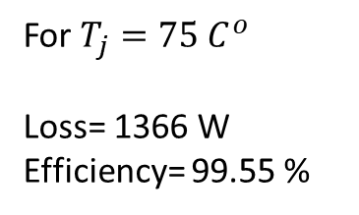
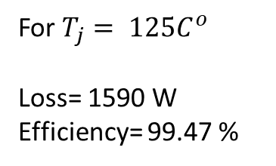
Switching frequency = 5kHz, ma=1.15, pf=0.9 2-level 3 phase, P=300kW
For $T_{j}=75 C^{o}$
Loss= 1366 W
Efficiency= 99.55 %
For $T_{j}= 125C^{o}$
Loss= 1590 W
Efficiency= 99.47 %
For $T_{j}= 150 C^{o}$
Loss= 1770 W
Efficiency= 99.41 %

Slide 5
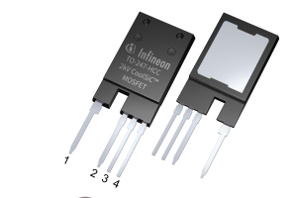
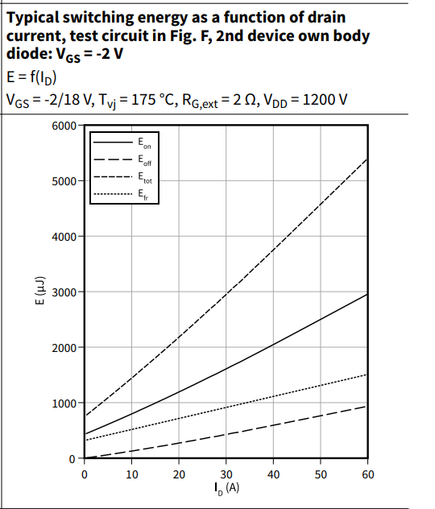
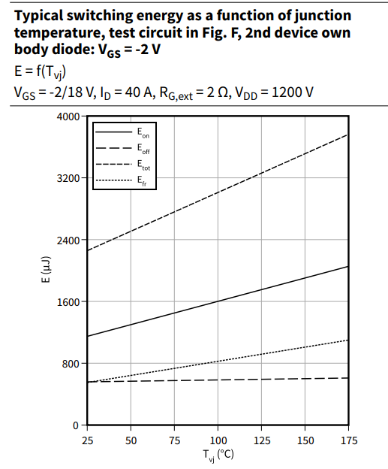

Slide 6
