Slide 1
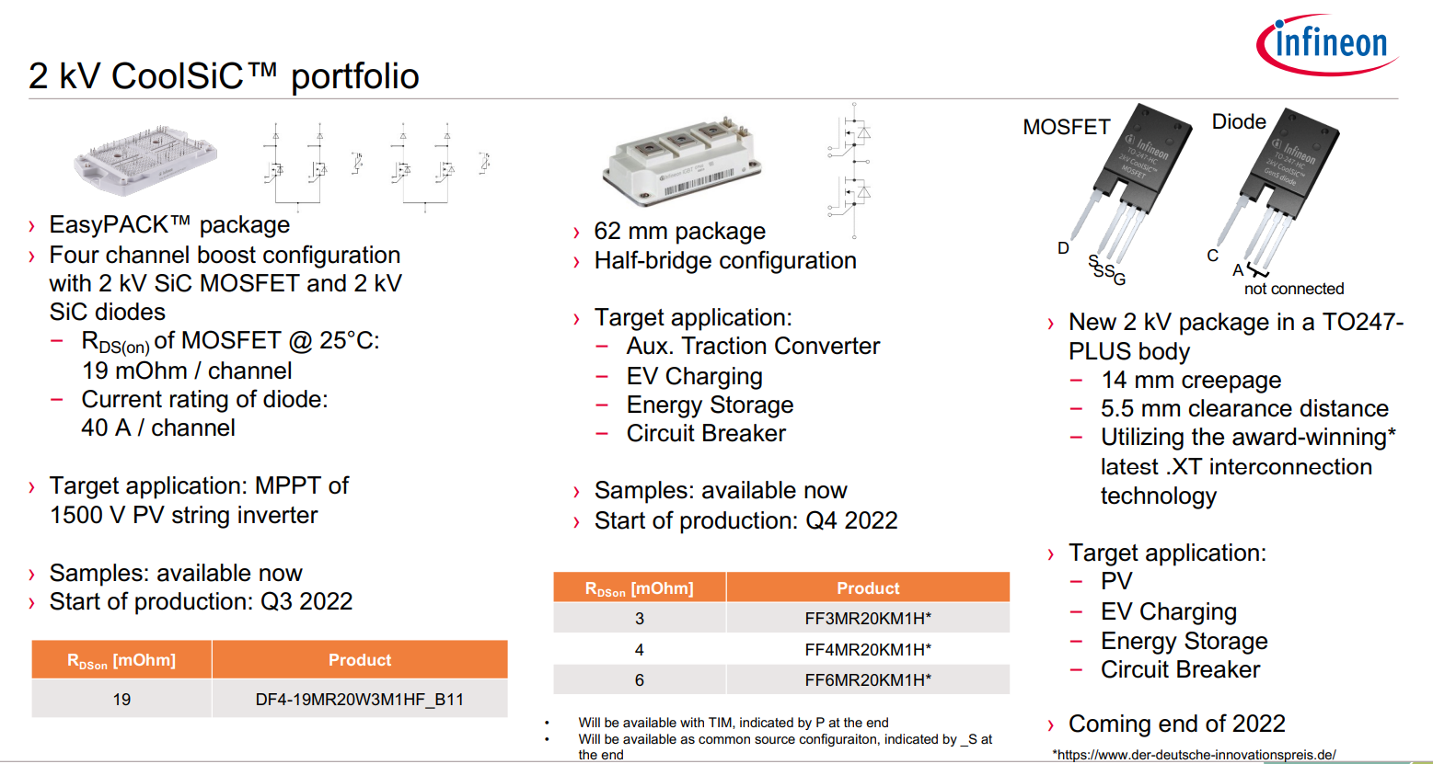
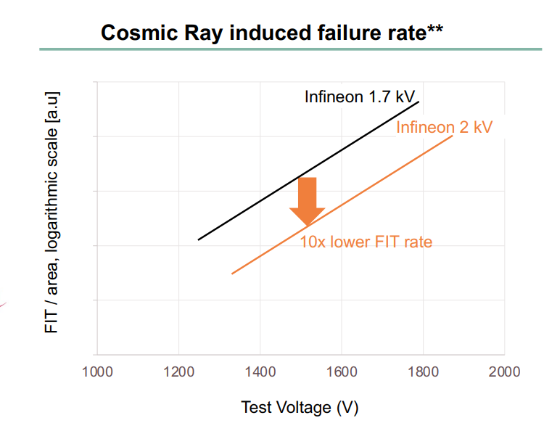
2kV SiC probably might have a higher on-state resistance and switching energies than 1.7 kV SiC competitors.
Effect the reliability of trucks on a high altitude

Slide 2
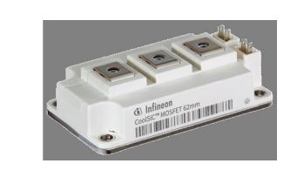
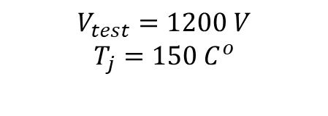
Voltage rating: 2kV
Current rating: 400A
Interpolation
$$V_{test}=1200 V$$
$$T_{j}=150 C^{o}$$

Slide 4
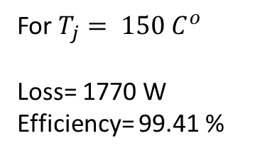
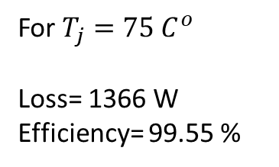
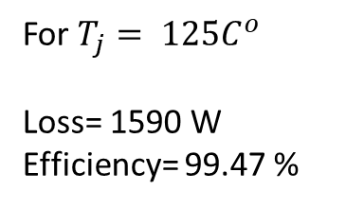
Switching frequency = 5kHz, ma=1.15, pf=0.9 2-level 3 phase, P=300kW
For $T_{j}=75 C^{o}$
Loss= 1366 W
Efficiency= 99.55 %
For $T_{j}= 125C^{o}$
Loss= 1590 W
Efficiency= 99.47 %
For $T_{j}= 150 C^{o}$
Loss= 1770 W
Efficiency= 99.41 %

Slide 5
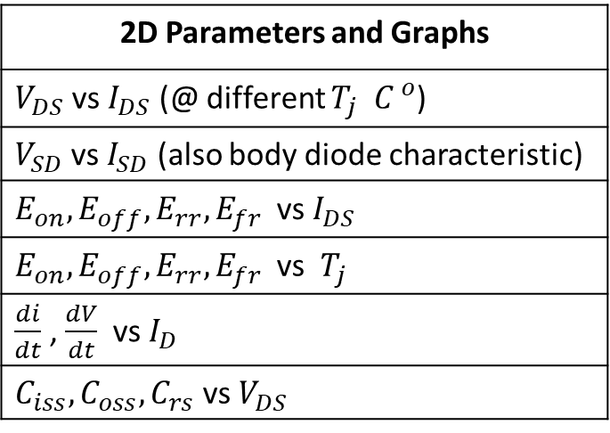
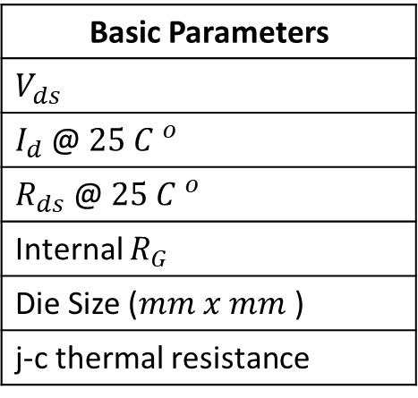
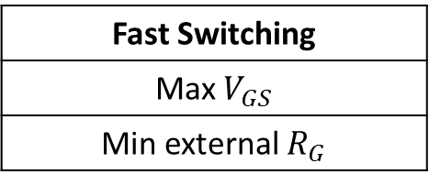
Single Bare Die Parameters with 62mm power module and TO-247PLUS-4-HCC package
Basic Parameters
$V_{ds}$
$I_{d}$@ $25 {C }^{o}$
$R_{ds}$ @ $25 {C }^{o}$
Internal $R_{G}$
Die Size ($mm x mm$)
j-c thermal resistance
2D Parameters and Graphs
$V_{DS}$ vs $I_{DS}$ (@ different $T_{j} {C }^{o}$)
$V_{SD}$ vs $I_{SD}$ (also body diode characteristic)
$E_{on}, E_{off}, E_{rr}, E_{fr}$vs $I_{DS}$
$E_{on}, E_{off}, E_{rr}, E_{fr}$vs $T_{j}$
$\frac{di}{dt}$ , $\frac{dV}{dt}$ vs $I_{D}$
$C_{iss}, C_{oss}, C_{rs}$ vs $V_{DS}$
Fast Switching
Max $V_{GS}$
Min external $R_{G}$

Slide 6
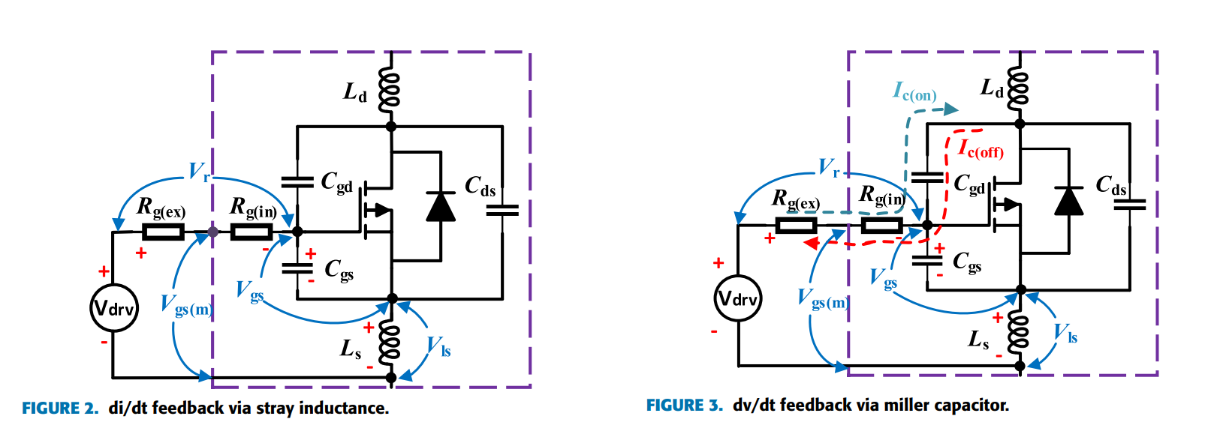
Package dependent
Single Bare Die
Double Dies
Triple Dies
To investigate the conduction and switching losses vs die area
To investigate the distortive effect of the package on the losses
400 A (290 A 3-phase)
200 A (145 A 6-phase)
With fast switching

Slide 7
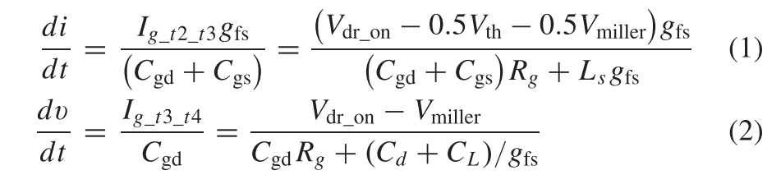
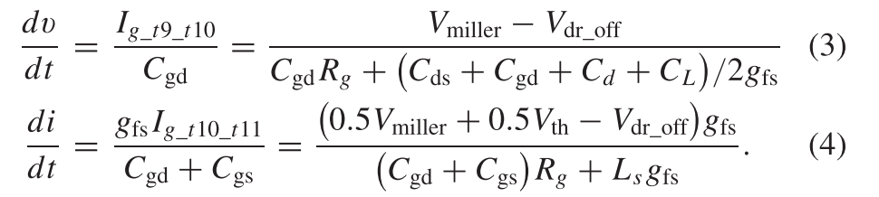
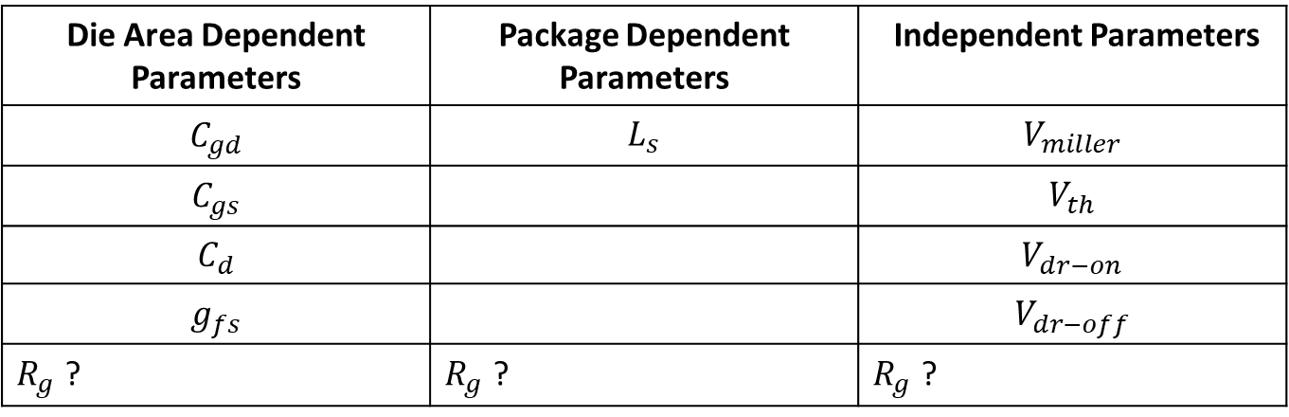
Die Area Dependent Parameters | Package Dependent Parameters | Independent Parameters
$$C_{gd}$$ | $$L_{s}$$ | $$V_{miller}$$
$$C_{gs}$$ |  | $$V_{th}$$
$$C_{d}$$ |  | $$V_{dr−on}$$
$$g_{fs}$$ |  | $$V_{dr−off}$$
$R_{g}$ ? | $R_{g}$ ? | $R_{g}$ ?

